Slide 1
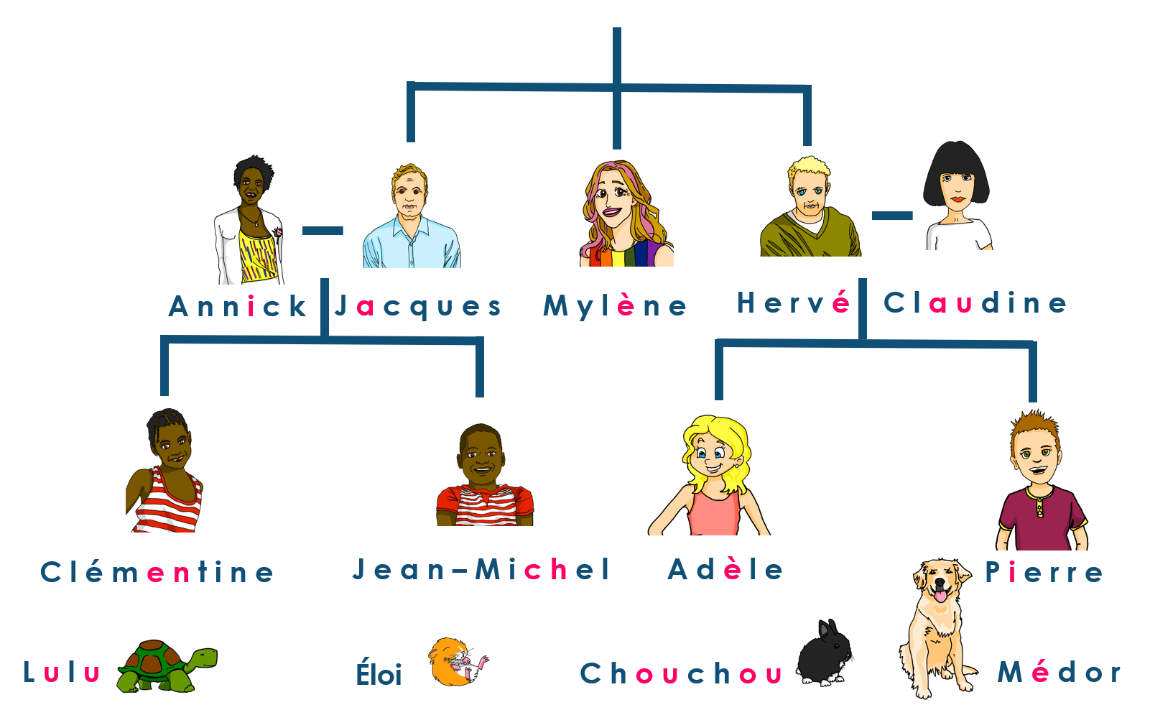
Saying what I and others do
Hervé est professeur de musique
jaune
Definite articles: le, la singular words for ‘the’
SSC open and closed [eu]
Notes:
Artwork by Steve Clarke. Pronoun pictures from NCELP (www.ncelp.org). All additional pictures selected from Pixabay and are
available under a Creative Commons license, no attribution required.
The AUDIO version of the lesson material includes additional audio for the new language presented (phonics, vocabulary) and audio for the instructions
on the slide.
In addition, it includes VIDEO clips of the phonics and the phonics’ source words. Pupils can be encouraged to look at the shape of the mouth/lips on
slides where these appear, and try to copy it/them.
Phonics: SSC Revisit: closed [eu(t,x,s)] un peu [91]
Introduce: open [eu(r,l,f,ne,ve)] peur [755] jeune [152] neuf [787] acteur [1552] seul [102]
Vocabulary (new words in bold): enseigner [2134] poser [218] anglais1 [784] français2 [251] grand-mère [3883] grand-père [3748] musique [1139] le [1] la [1]
Revisit 1: --
Revisit 2: affiche [2886] bureau [273] chaise [3419] chambre [633] idée [239] lit [1837] un [3] une [3] (revisit moto, cheval)
Londsale, D., & Le Bras, Y. (2009). A Frequency Dictionary of French: Core vocabulary for learners London: Routledge.
The frequency rankings for words that occur in this PowerPoint which have been previously introduced in these resources are given in the SOW and in the resources that first introduced and formally re-visited those words. For any other words that occur incidentally in this PowerPoint, frequency rankings will be provided in the notes field wherever possible.
1

Slide 2
closed [eu]
open [eu]
prononcer
un peu
peur
It sounds like the ‘ur’ in ‘hurt’.
[a bit]
[fear]
This is a closed vowel. When you say this sound, your tongue is near the top of your mouth.
This is an open vowel. When you say this sound, your tongue is near the bottom of your mouth.
Notes:
Timing: 2 minutes
Aim: to recap closed and open [eu].
Procedure:
Click to bring up the closed [eu]. Repeat the SSC [eu] with the class.
Click to bring up the phrase ‘un peu’ (with gesture, if using).
Click to bring up the English translation and picture.
Pupils to practise saying the phrase several times.
Click to bring up the callout about closed vowel tongue position.
Click to bring up the open [eu]. Repeat the SSC with the class.
Click to bring up the word ‘peur’ (with gesture, if using).
Click to bring up the English translation and picture, and the callout hint about ‘hurt’.
Say this SSC several times with the class.
Click to bring up the call out about open SSC [eu].
Practise alternating between ‘peu’ and ‘peur’ several times.

Slide 3
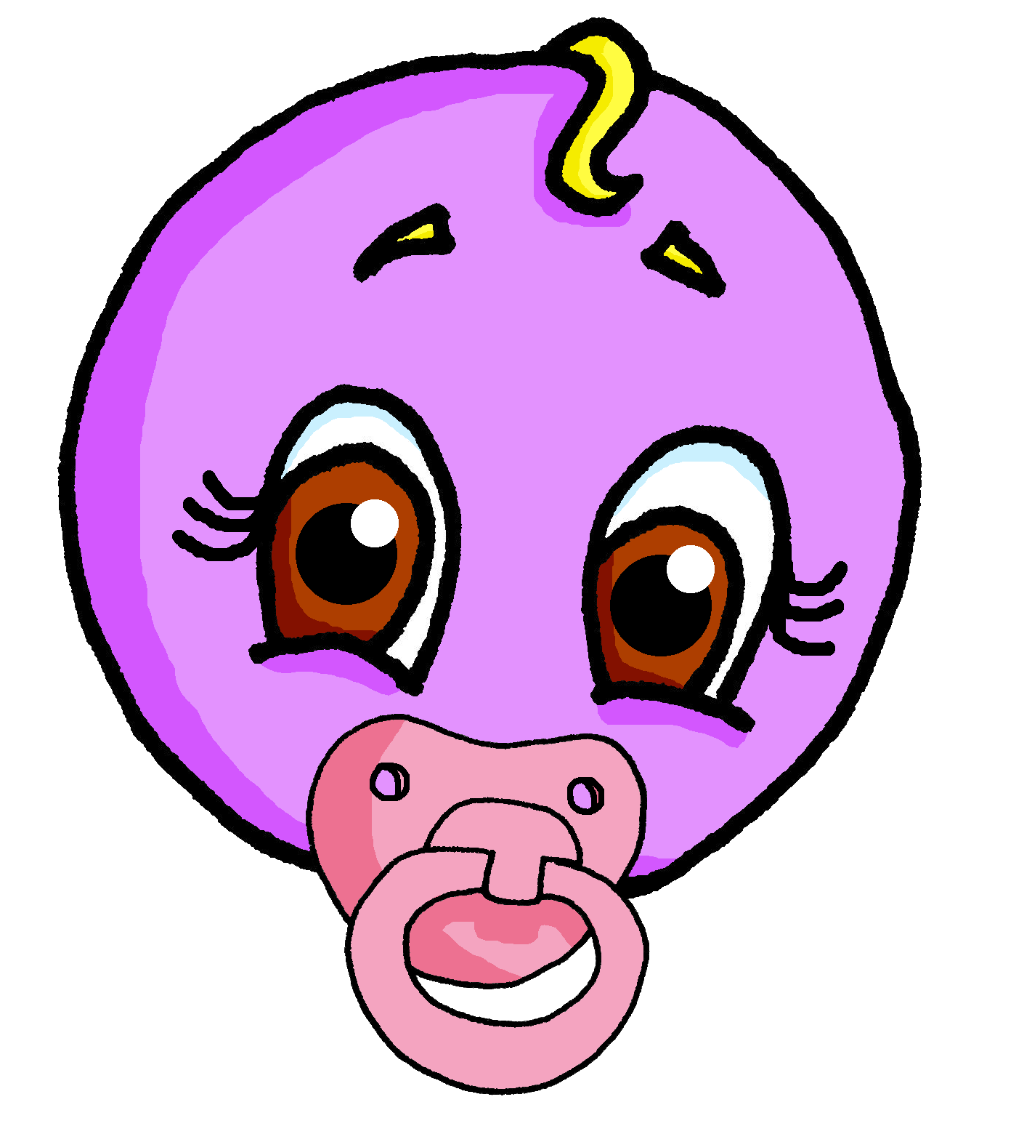
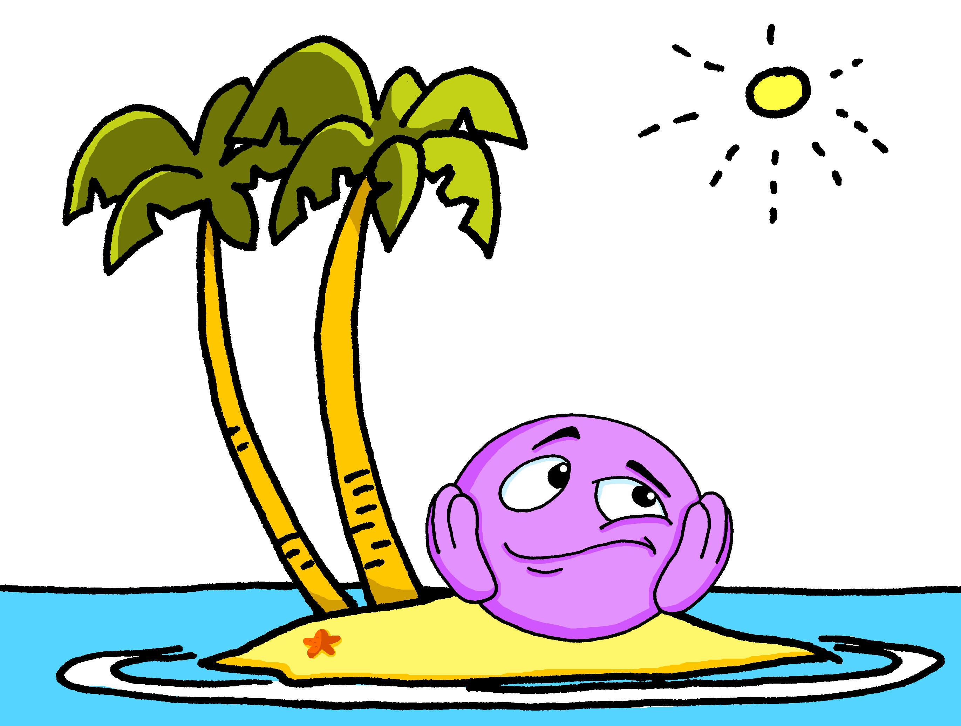
open [eu]
prononcer
jeune
seul
Notes:
Timing: 2 minutes (two slides)
Aim: to practise open SSC [eu] in words where [eu] is followed by –l, -f, -r, -n(e).
Procedure:
Elicit the pronunciation of the individual SSC [eu].
Click to bring on the first picture and word and elicit the pronunciation from pupils. Note: jeune and seul are already known.
Move to next slide.

Slide 4
open [eu]
prononcer
neuf
acteur
[eu] is open when followed by r, f, l, but closed before x, s.
Notes:
Timing: 2 minutes (two slides)
Aim: to practise open SSC [eu] in words where [eu] is followed by –l, -f, -r, -n(e).
Procedure:
Click to present neuf and acteur and practise these with pupils, e.g. by prompting with the English and eliciting choral responses.
Finally, click to bring up the callout. This provides a link to the vocabulary for this week, which are adjectives ending in –eux, with closed [eu].

Slide 5
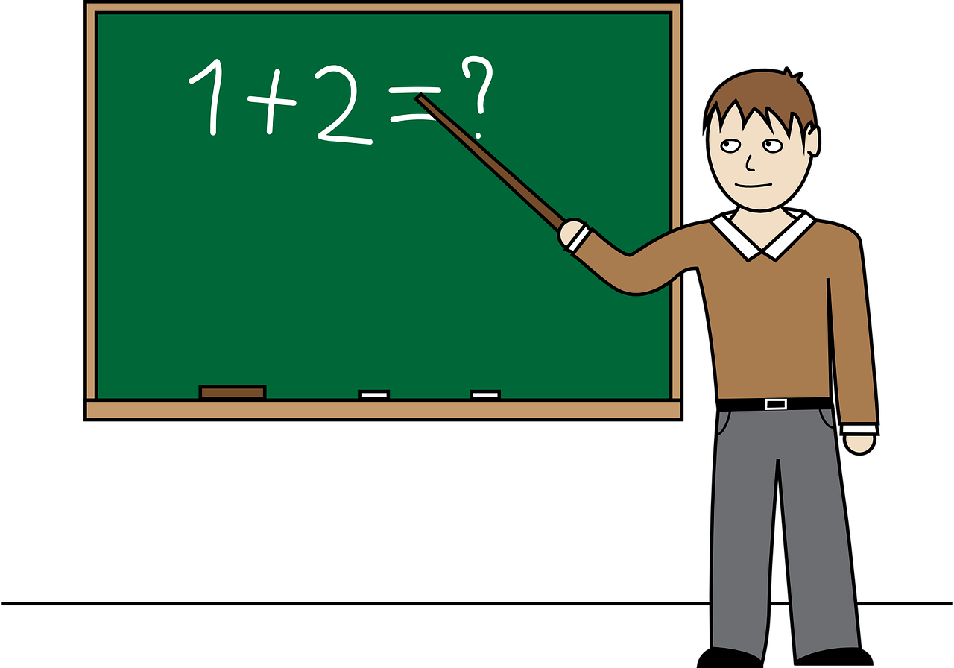
Closed or open [eu]?
. Écoute les noms des animaux. C’est [ien] ou [(a)in]?
Écris 1-8 et ‘open’ ou ‘closed’.
prononcer
 |  | open [eu] | closed [eu]
 | feu
 | neuf
 | lieu
 | vieux
 |  | open [eu] | closed [eu]
 | professeur
 | œuf
 | seul
 | boxeur
9
Remember: [eu] is open when followed by r, f but closed before x, s.
Notes:
Timing: 5 minutes
Aim: to apply written recognition of the open/closed [eu] rule; to practise aural recognition of open and closed [eu/œu] when checking answers.
Procedure:
Click to bring up the reminder about the rule.
2. Pupils read the words and decide, based on spelling, if the [eu/œu] is open or closed.
3. Click to listen and check (allow pupils a moment to adjust their answers, as needed).
4. Click again to reveal ticks.
Transcript:
feu
neuf
lieu
vieux
professeur
œuf
seul
boxeur

Slide 6
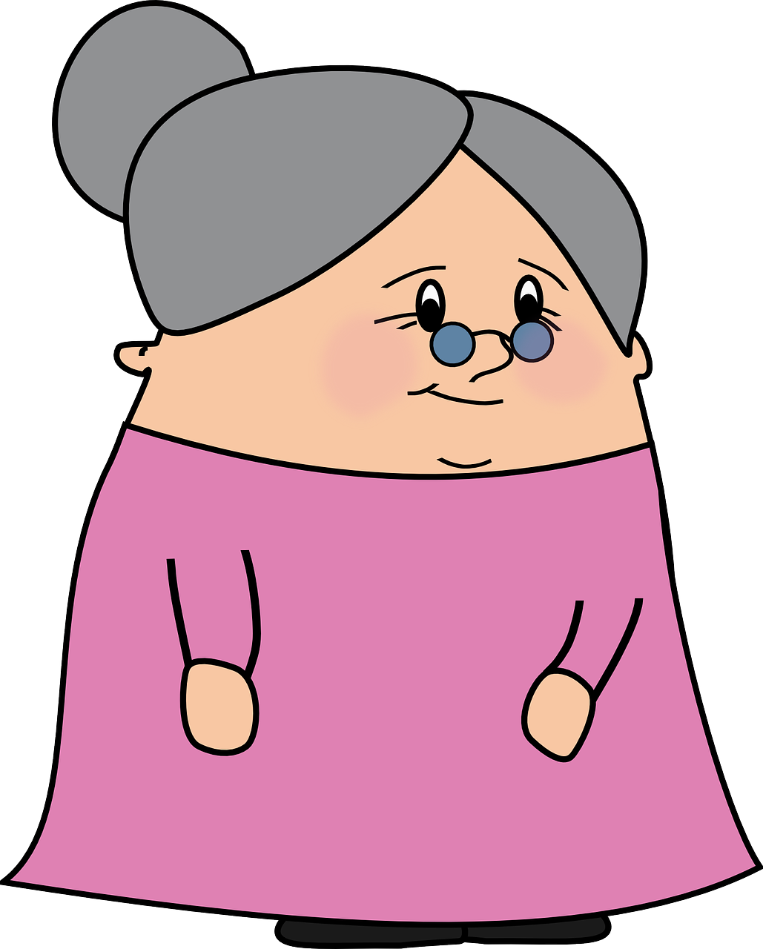
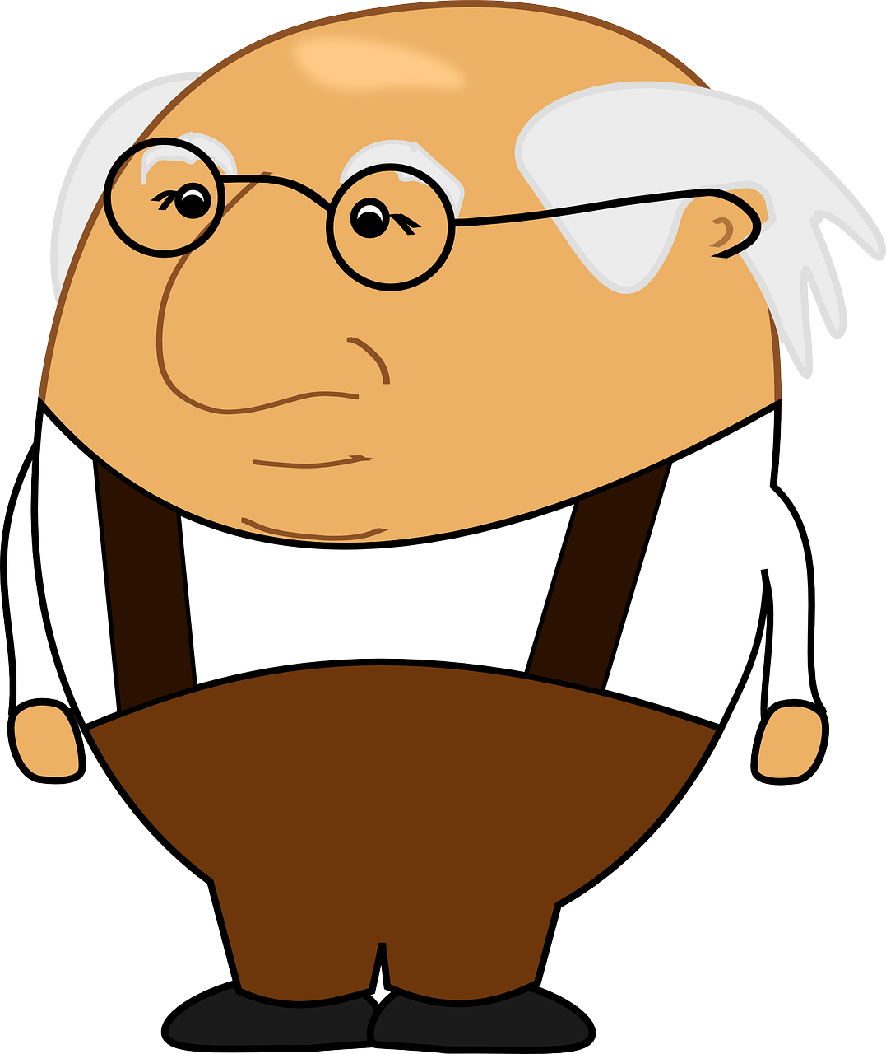
vocabulaire
Écoute et répète.
[1/2]
les noms des animaux. C’est [ien] ou [(a)in]?
mots
enseigner
poser
[to put (down), ask (a question)]
[to teach, teaching]
le français
l’anglais
la musique
le grand-père
la grand-mère
[the grandad]
[the grandmother]
Notes:
Timing: 6 minutes (two slides)
Aim: to introduce key vocabulary for the context of family.
Procedure: 1. Teacher clicks to present the French words one by one. Pupils can repeat.
2. Pupils either work individually or in pairs, reading the French words out loud and looking at the English meanings (1 minute). 3. Then the teacher removes the English words or pictures (one by one) and pupils try to recall the English orally (chorally), looking at the French (1 minute).
4. When teacher clicks, the French words re-appear (with audio in the audio version). 5. Then the French meanings are removed (one by one) and pupils try to recall them orally (again, chorally), looking at the English (1 minute) 6. Further rounds of learning can be facilitated by one pupil turning away from the board, and his/her partner asking him/her the meanings (‘Comment dit-on XXX en anglais/français ?’). This activity can work from L2 → L1 or L1 → L2.

Slide 7
écouter
Vocabulaire [2/2]
. Écoute les noms des animaux. C’est [ien] ou [(a)in]?
Écoute. Écris en anglais.
 | en anglais ?
Ex
1
2
3
4
5
6
Notes:
Timing: 1 minute
Aim: to practise aural comprehension of the new vocabulary for this week.
Procedure:
1. Click to listen.
2. Pupils write or say the English meaning.
3. Click to correct.
Transcript:
Exemple: la musique
la grand-mère
enseigner
le français
le grand-père
poser
l’anglais

Slide 8
The definite article
Words for ‘the’
We know that all French nouns have gender, and are masculine or feminine.
To mean a or an in French before a noun, use un (masculine) or une (feminine).
When la is followed by a vowel it also becomes l’
When le is followed by a vowel it becomes l’
la
visite
a visit
un
une
the visit
le
a word
mot
the word
question
the question
la
a question
a desk
une
un
the desk
le
bureau
affiche
the poster
un
une
a poster
l’
univers
a universe
l’
the universe
To mean the in French before a noun, use le (masculine) or la (feminine).
Notes:
Timing: 2 minutes
Aim: to recap singular indefinite articles and to introduce singular definite articles.
Procedure: 1. Click to present the new information.
2. Elicit responses from pupils, following the animated question marks.

Slide 9
vocabulaire
C’est le ou la ?
les noms des animaux. C’est [ien] ou [(a)in]?
mots
pays
univers
affiche
mot
idée
message
chaise
question
anglais
visite
français
lit
chat
musique
chambre
dessin
le (l’)
la (l’)
Notes:
Timing: 3 minutes
Aim: to practise gender recognition and connection to the appropriate definite article with previously taught vocabulary.
Procedure:
Pupils nominate and word, saying it with its definite article.
Click on the word to make it ‘fly’ to the ‘le’ or ‘la’.
Note: pupils can nominate the words in any order, as they are triggered.

Slide 10
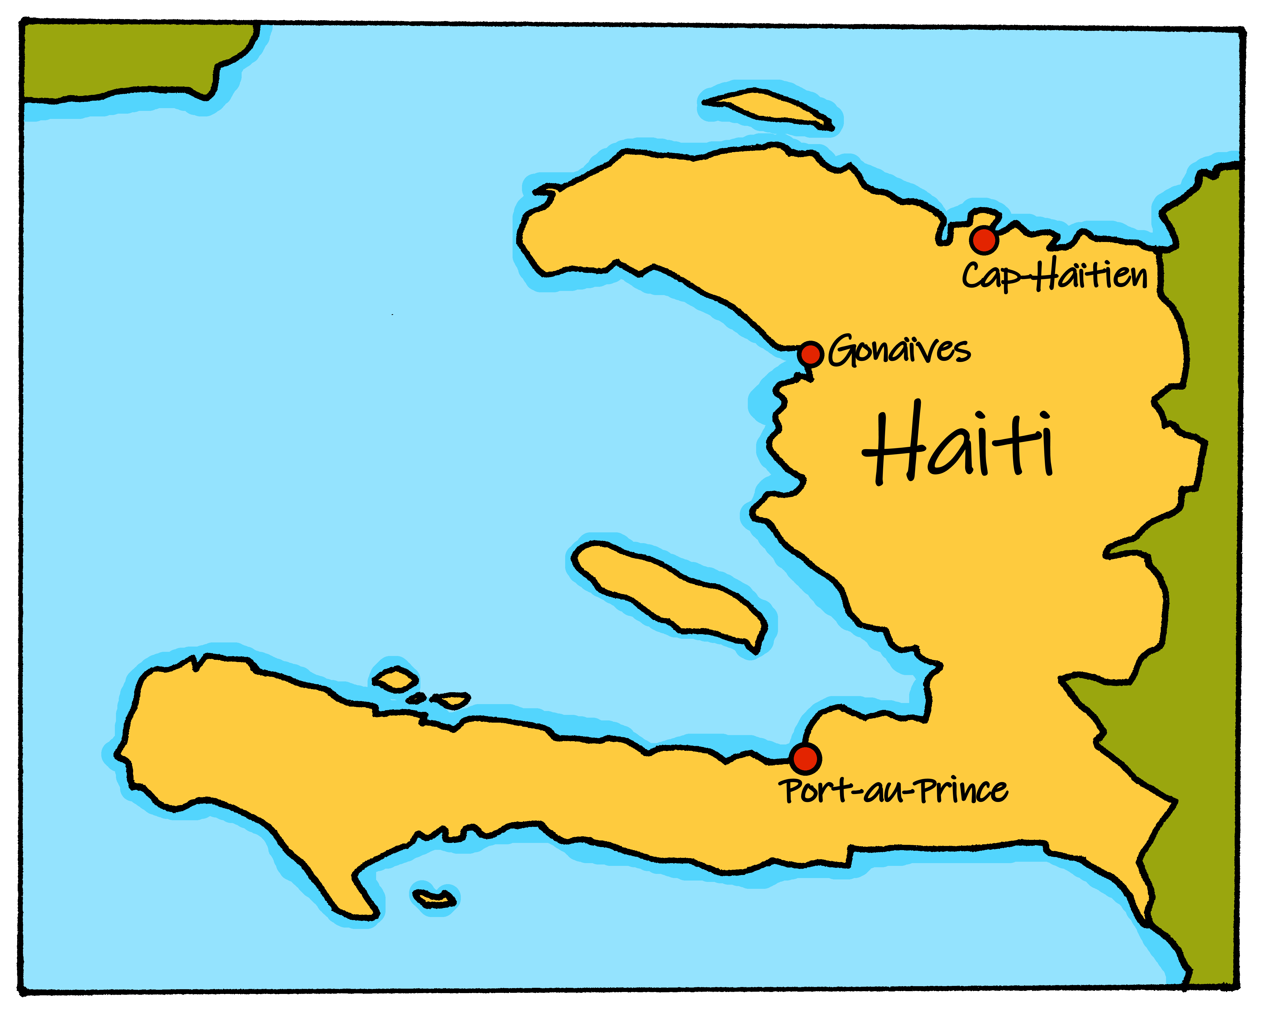
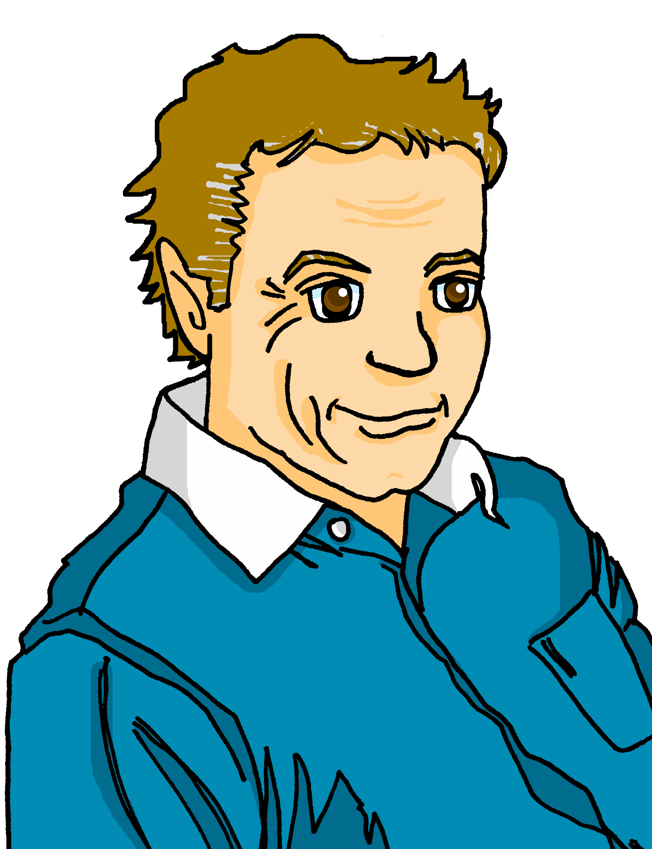
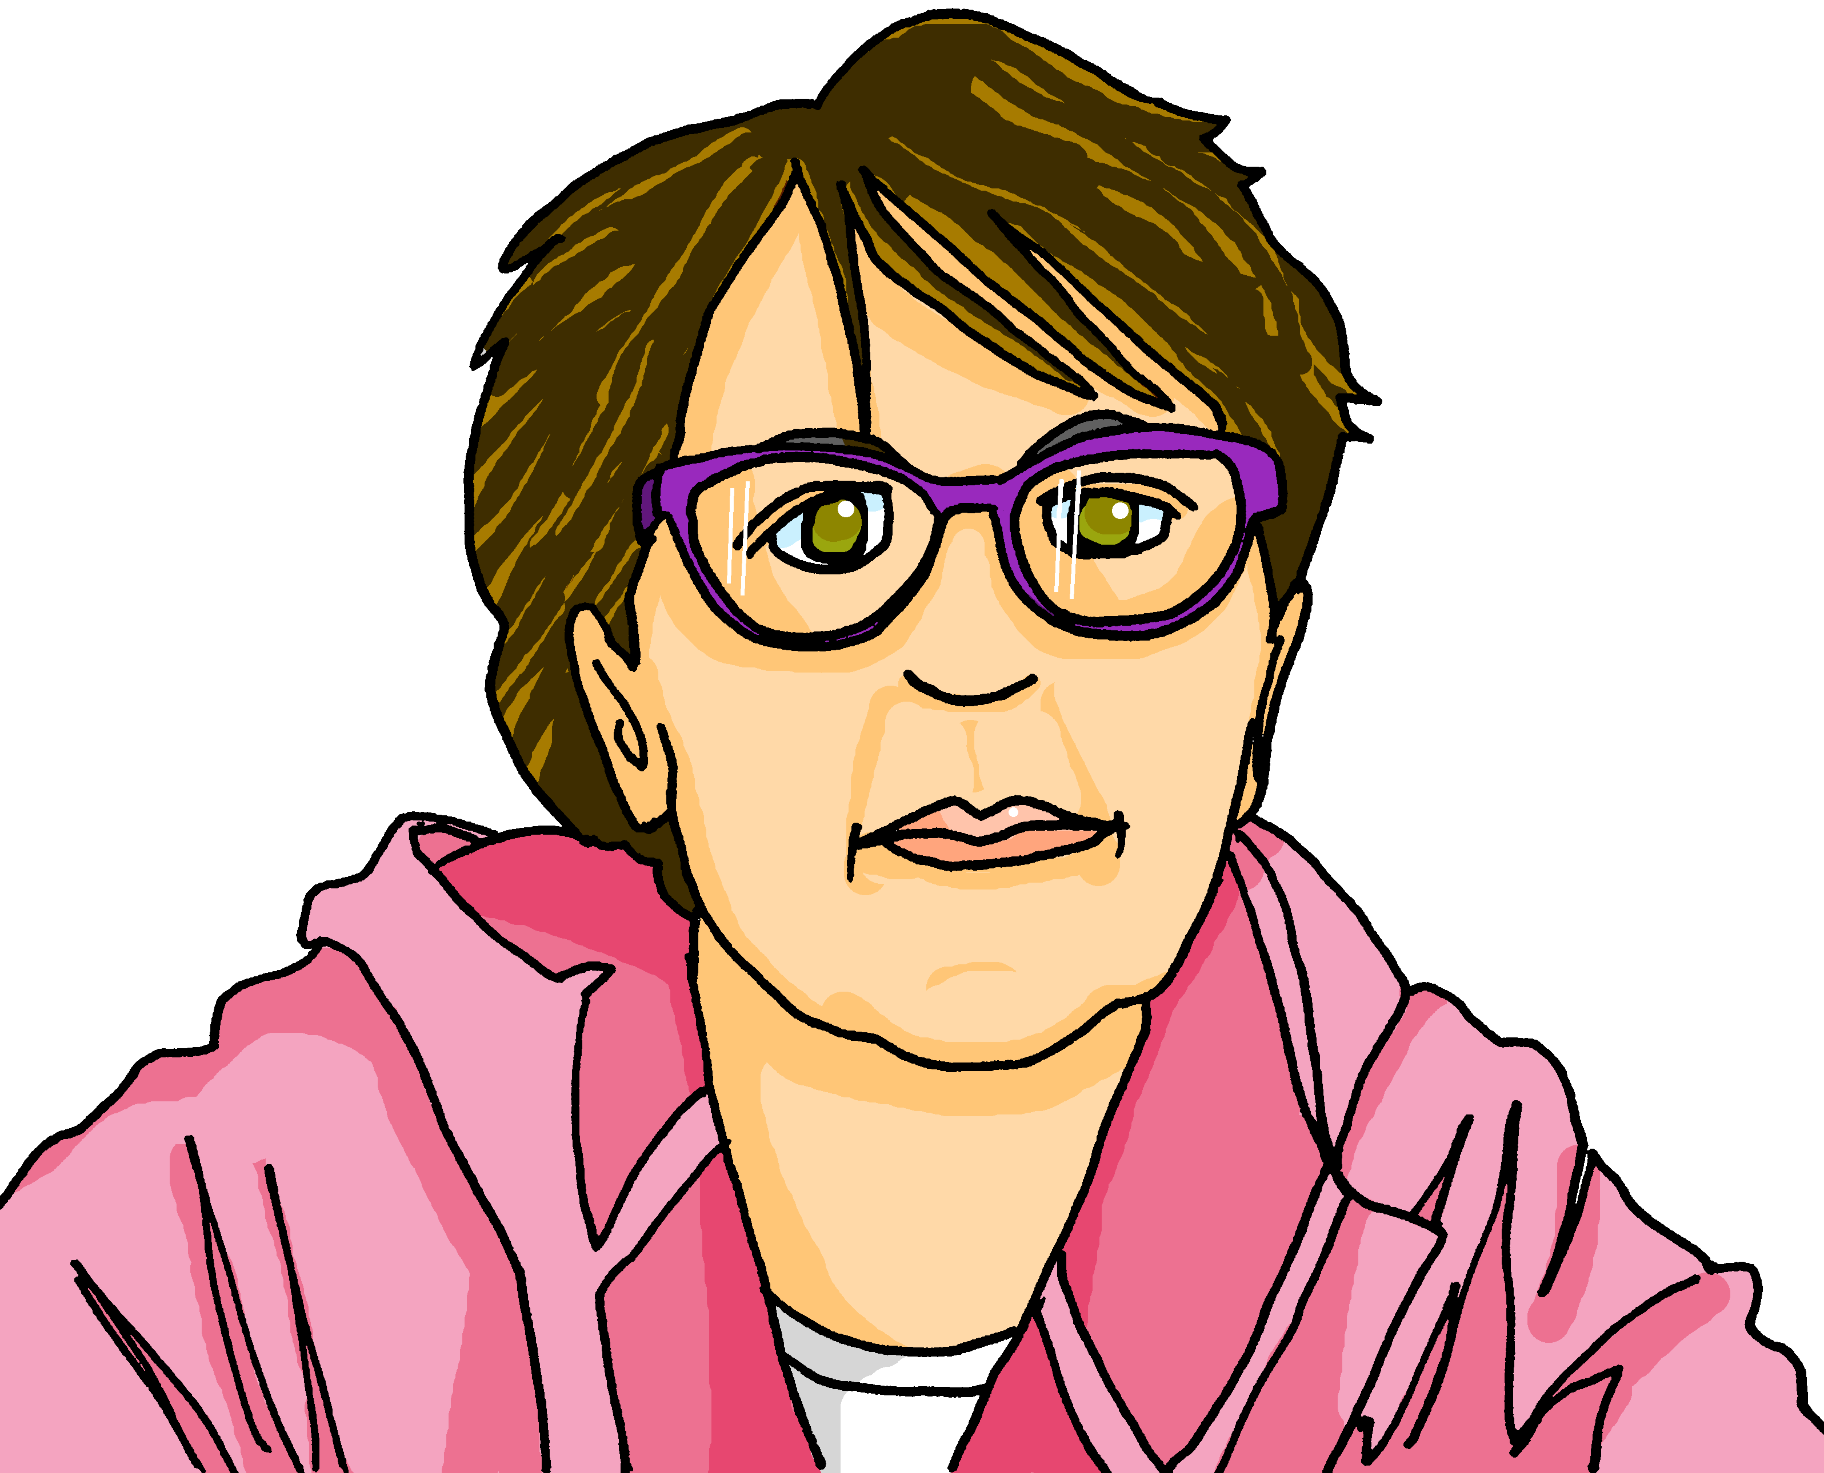
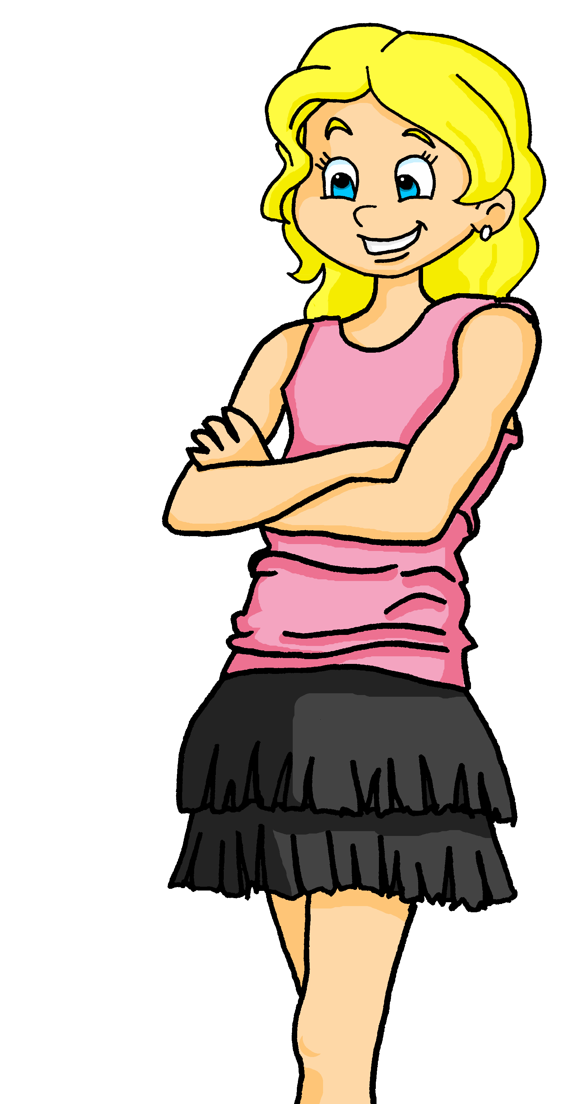
lire
La famille Kergosien
C’est qui ?
ien] ou [(a)in]?
C’est Guillaume, le grand-père
C’est Marie-Ange, la grand-mère
C’est Hervé, le père
C’est Claudine, la mère
C’est Macaron le chat
Notes:
Timing: 1 minute
Aim: to present the parents of Claudine, the grandparents of Adele and Pierre, introduce the surname Kergosien and practise two new items of vocabulary for this week.
Procedure: Click through the animations to present the family members and to re-encounter two key vocabulary items for this week.

Slide 11
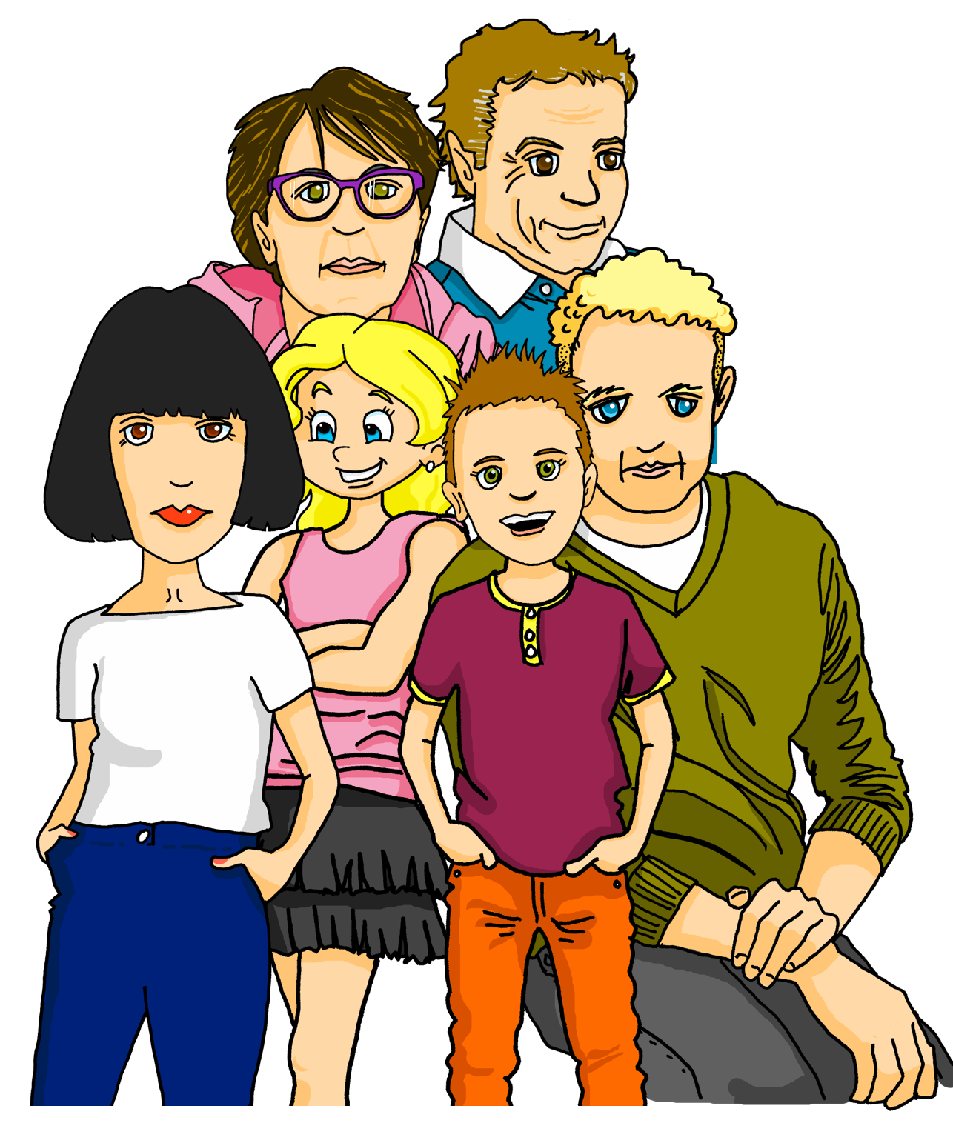
lire
Une visite en Angleterre
C’est qui ? C’est quoi ?
1 | Le | mère | père | enseigne la | français. | musique.
The father teaches music.
2 | La | professeure d’anglais| père | organise une | bureau. | visite.
The English teacher (f) is organising a visit.
3 | Elle prépare la | message | présentation | pour les parents.
She prepares the presentation for the parents.
4 | La | visite| échange | est en Angleterre.
Papa ! C’est possible de participer ?
The visit is in England.
5 | Adèle | adore l’ | message | idée.
Adèle loves the idea.
6 | Pierre | pose la | question ! | crayon !
Pierre asks the question!
Notes:
Timing: 7 minutes
Aim: to practise written recognition of definite articles and their connection with corresponding nouns; to practise comprehension of new and previously taught vocabulary.
Procedure:
Ensure that the context is clear. There is a parents’ evening to learn about a school trip to England.
Pupils read the sentence and select the appropriate noun based on the definite article.
They then translate the sentence (this can be done orally with the whole class or written, and then checked).
Click to reveal answers.

Slide 12
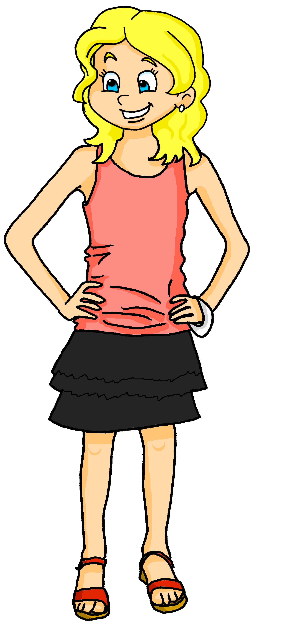
lire
Une visite en Angleterre
Oui, c’est génial !
Une visite en Angleterre ! C’est super !
Notes:
Timing: 1 minute
Aim: to reinforce the idea of the school trip to England and Adèle and Pierre’s reaction to it.

Slide 13
écouter
Une visite en Angleterre
C’est qui ? C’est quoi ?
 | C’est qui ? |  | Extra details
 | le | la | mère | père | listens to the presentation.
 | le | la | grand-père | grand-mère | is also there.
 | le | la | mère| père | asks a question in English.
 | le | la | grand-mère | grand-père | repeats the question in French.
 | le | la | professeure| père | has an idea.
 | le | la | famille | père | organises a concert for the visit.
1
v
1
2
v
2
3
v
3
4
v
4
5
v
5
6
v
6
Notes:
Timing: 5 minutes
Aim: to practise aural recognition of definite articles and connect written forms with meaning.
Procedure:
Click on a number to hear a sentence with the noun obscured.
Pupils write 1-6 and the word to which the article refers, along with any additional information they hear.
Click to reveal answers.
A further click brings up a set of audio buttons with full sentences for further reinforcement / practice.
Transcript
1) La [mère] écoute la présentation.
2) Le [grand-père] est aussi là.
3) Le [père] pose une question en anglais.
4) La [grand-mère] répète la question en français.
5) La [professeure] a une idée.
6) Le [père] organise un concert pour la visite.

Slide 14
Au revoir !
jaune
Notes:
14

