Slide 1
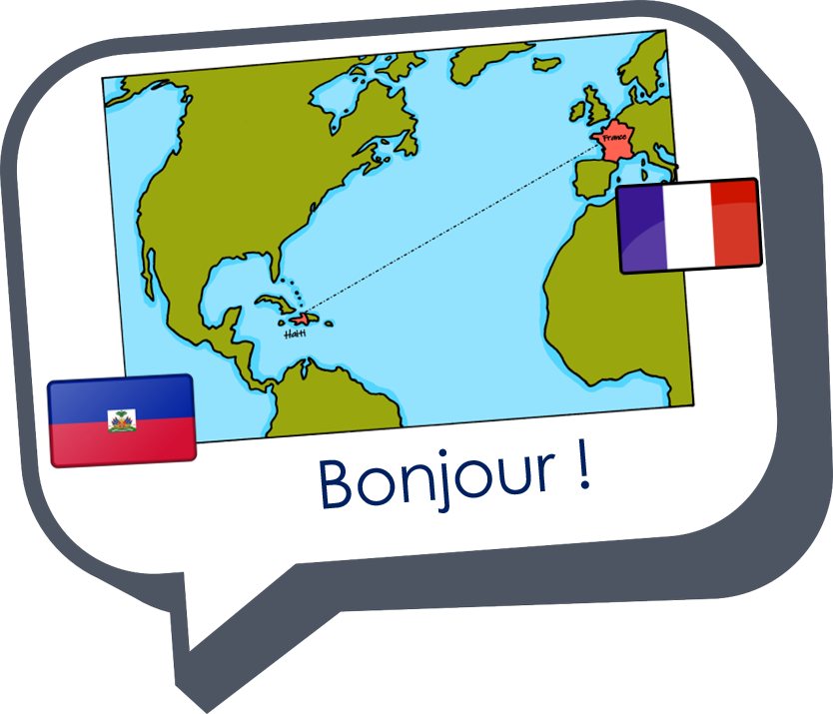
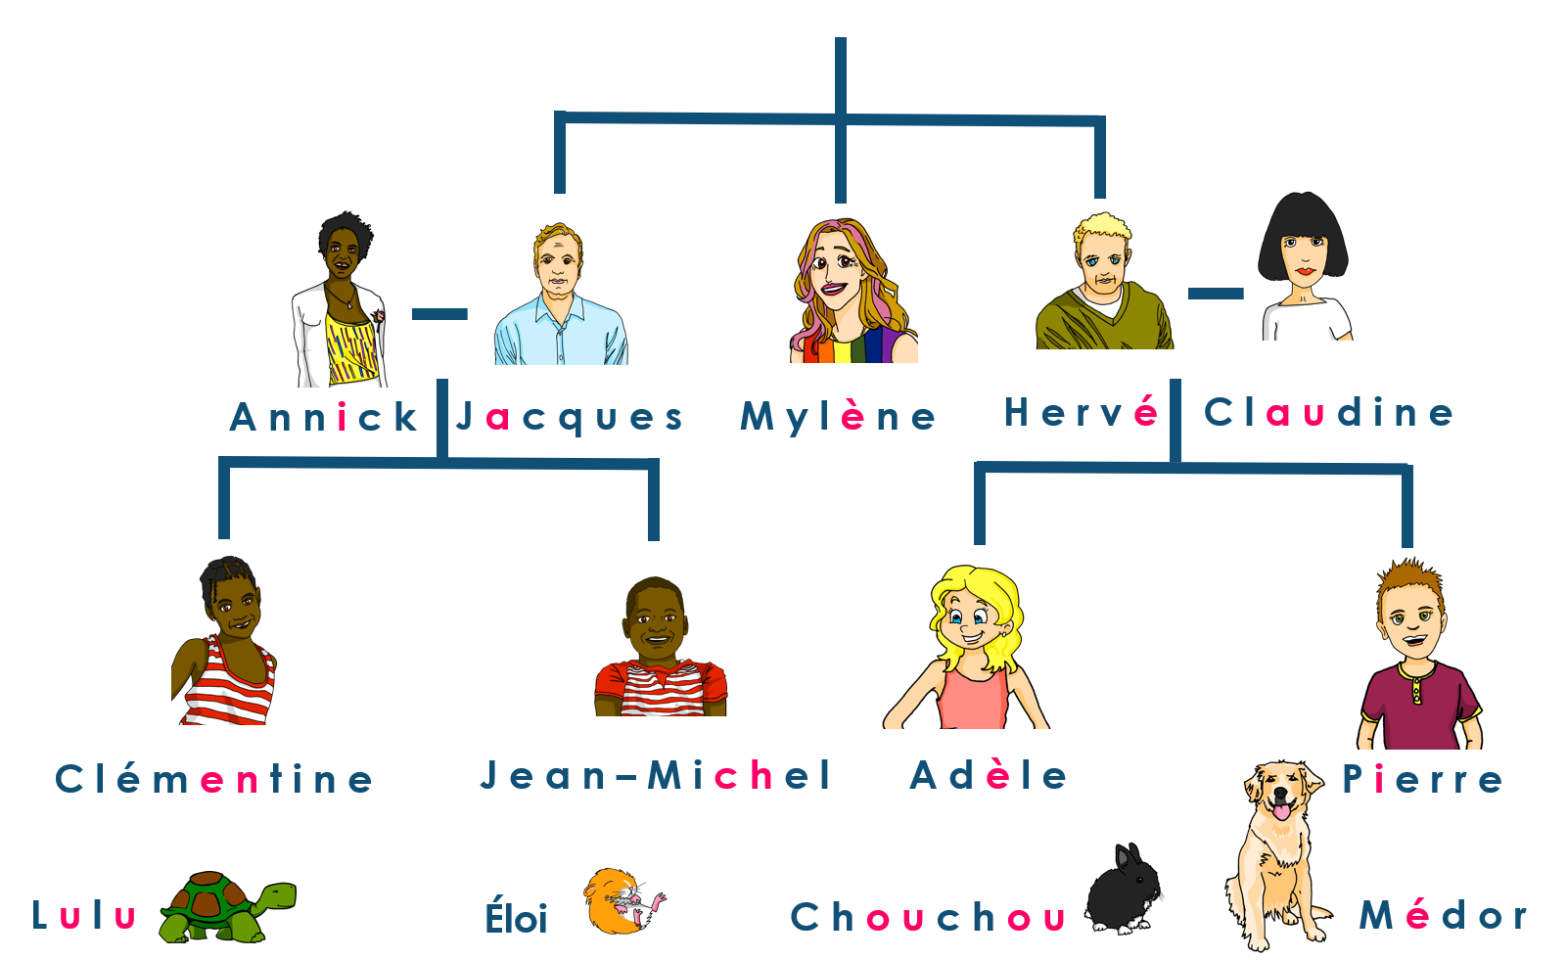
Saying what I and others do
Claudine est guide touristique
jaune
-ER verbs: je, tu, il, elle
intonation questions
SSC [et] [ez]
Notes:
Artwork by Steve Clarke. Pronoun pictures from NCELP (www.ncelp.org). All additional pictures selected from Pixabay and are
available under a Creative Commons license, no attribution required.
The AUDIO version of the lesson material includes additional audio for the new language presented (phonics, vocabulary) and audio for the instructions
on the slide.
In addition, it includes VIDEO clips of the phonics and the phonics’ source words. Pupils can be encouraged to look at the shape of the mouth/lips on
slides where these appear, and try to copy it/them.
Phonics: SSC [et] [ez] - et [6] nez [2661] Vocabulary (new words in bold): organiser [791] préparer [368] visiter [1378] parc [1240] université [1192] musée [2216] visite [1072] avec [23]
Revisit 1: --
Revisit 2: Revisit days of the week, sérieux [412] heureux [764] curieux [2424] courageux [2198 semaine [245]
Londsale, D., & Le Bras, Y. (2009). A Frequency Dictionary of French: Core vocabulary for learners London: Routledge.
The frequency rankings for words that occur in this PowerPoint which have been previously introduced in these resources are given in the SOW and in the resources that first introduced and formally re-visited those words. For any other words that occur incidentally in this PowerPoint, frequency rankings will be provided in the notes field wherever possible.
1

Slide 2
prononcer
[é]
[er]
[et]
[ez]
[et] and [ez] also sound the same as [é] and [er].
répéter
[and]
et
nez
Notes:
Timing: 2 minutes
Aim: to introduce SSC [et] and [ez], which are the same sound as [é] and [er], written differently.
Procedure:
Introduce and elicit the pronunciation of the individual SSC [et] and [ez] and remind them of the source word ‘répéter’, which has both other spellings of the same sound.
Click to bring on the picture and get students to repeat (with gesture, if using).
Present and practise the cluster words.
Gesture: gesture for répéter – hand with thumb and two fingers pointing forwards doing a three downwards motions, one for each syllable of the word.
https://www.signbsl.com/sign/repeat (the 2nd video marked again: repeat with the female signer) gesture for et – right hand with index finger extended does rapid looped pointing action from right to left. (the 1st video on the left) - https://www.signbsl.com/sign/and gesture for le nez – point to your own nose
2

Slide 3
prononcer
[é]
[er]
[et]
[ez]
[et] and [ez] also sound the same as [é] and [er].
Tally the times you hear [é] [er] [et] [ez] |  | Phrases
1
II
Le métier de Claudine est guide touristique.
Claudine’s profession is tourist guide.
2
III
Aujourd’hui elle organise un rendez-vous et une visite à une université.
Today she is organising a meet up and a visit to a university.
Les touristes adorent visiter les parcs et les musées. Quelle bonne idée !
3
IIII
The tourists love visiting the parks and the museums. What a good idea!
Notes:
Timing: 2 minutes
Aim: practising recognition of SSC [é] [er] [et] [ez]
Procedure:
1. Click the numbers to play the audio.
2. Students write 1-3 and tally how many times they hear the SSC [é] [er] [et] [ez].
Transcript:
Le métier de Claudine est guide touristique.
Aujourd’hui elle organise un rendez-vous et une visite à une université.
Les touristes adorent visiter les parcs et les musées. Quelle bonne idée !
3

Slide 4
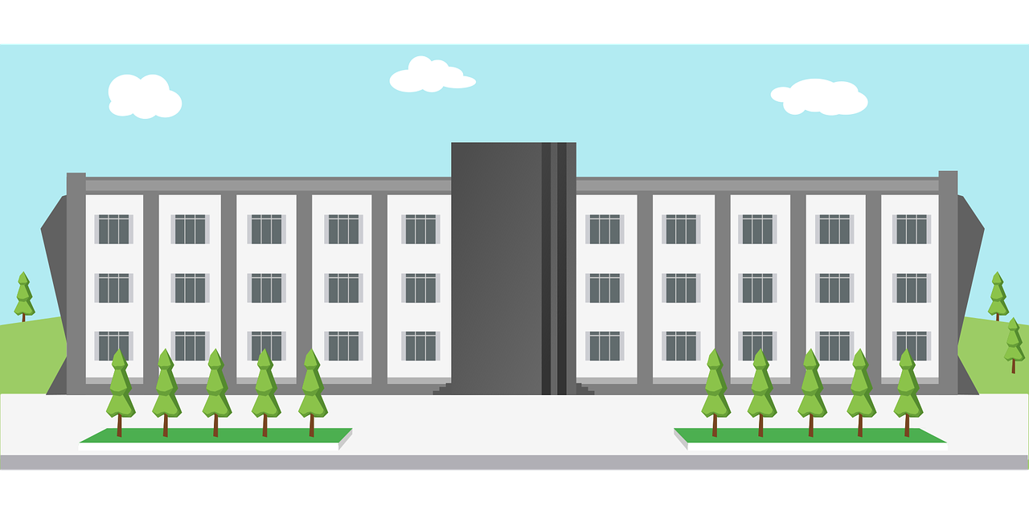
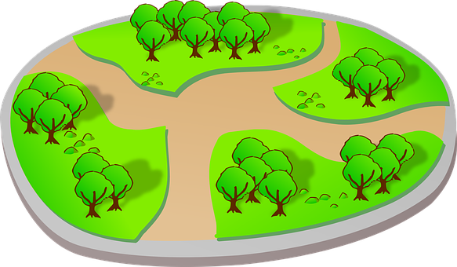
vocabulaire
Écoute et répète.
mots
visiter
organiser
préparer
[organise]
[prepare]
[visit]
une université
une visite
un parc
un musée
avec
Notes:
[1/2]
Timing: 8 minutes (two slides)
Aim: to present and practise new vocabulary
Procedure:
Click to present the French word. Listen and repeat the word.
Click to bring up the English meaning/picture. The words for this week are cognates and pupils should recognise their meaning fairly easily.
Click to disappear the English meaning/picture. Elicit these from pupils. Click for each to reappear each time.
Click to disappear the French meanings. Elicit these from pupils. Click for each to reappear.
4

Slide 5
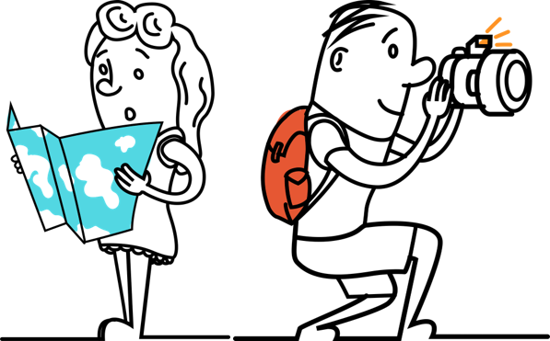
vocabulaire
Écoute et répète.
mots
un parc
visiter
une université
un musée
préparer
organiser
avec
une visite
1
2
3
4
5
6
7
8
Notes:
[2/2]
Procedure: 1. Pupils match the French nouns to the pictures in their heads.
2. The teacher gives the pupils a number and the pupils must say the correct word in French. The number prompts are the trigger (i.e. click on the number) for the lines to connect the correct word to the picture.
3. Click to make each French word disappear in turn. Can pupils recall the French words?
4. If desired, click on each picture to hear the word pronounced.
5

Slide 6
Knowing who does what
It is also the form of a verb you see in a dictionary.
[–er verbs: ‘I’ and ‘you’]
We know the infinitive verb tells us the general meaning.
C’est facile de visiter un musée.
It’s easy to visit a museum.
In English, this is often written ‘to + verb’.
In French, most infinitives end in –er.
To mean ‘I’ with a verb, change the ending to match the pronoun:
Je visite un musée.
I visite a museum.
Note that visite and visites sound the same because of the Silent Final Consonant.
To mean ‘you’ with a verb:
Tu visites un musée.
You visit a museum.
Notes:
Timing: 3 minutes
Aim: to introduce 1st and 2nd persons singular for –er verbs.
Procedure:
Click through the animations to present the new information.
Elicit English translations for the French examples provided.

Slide 7
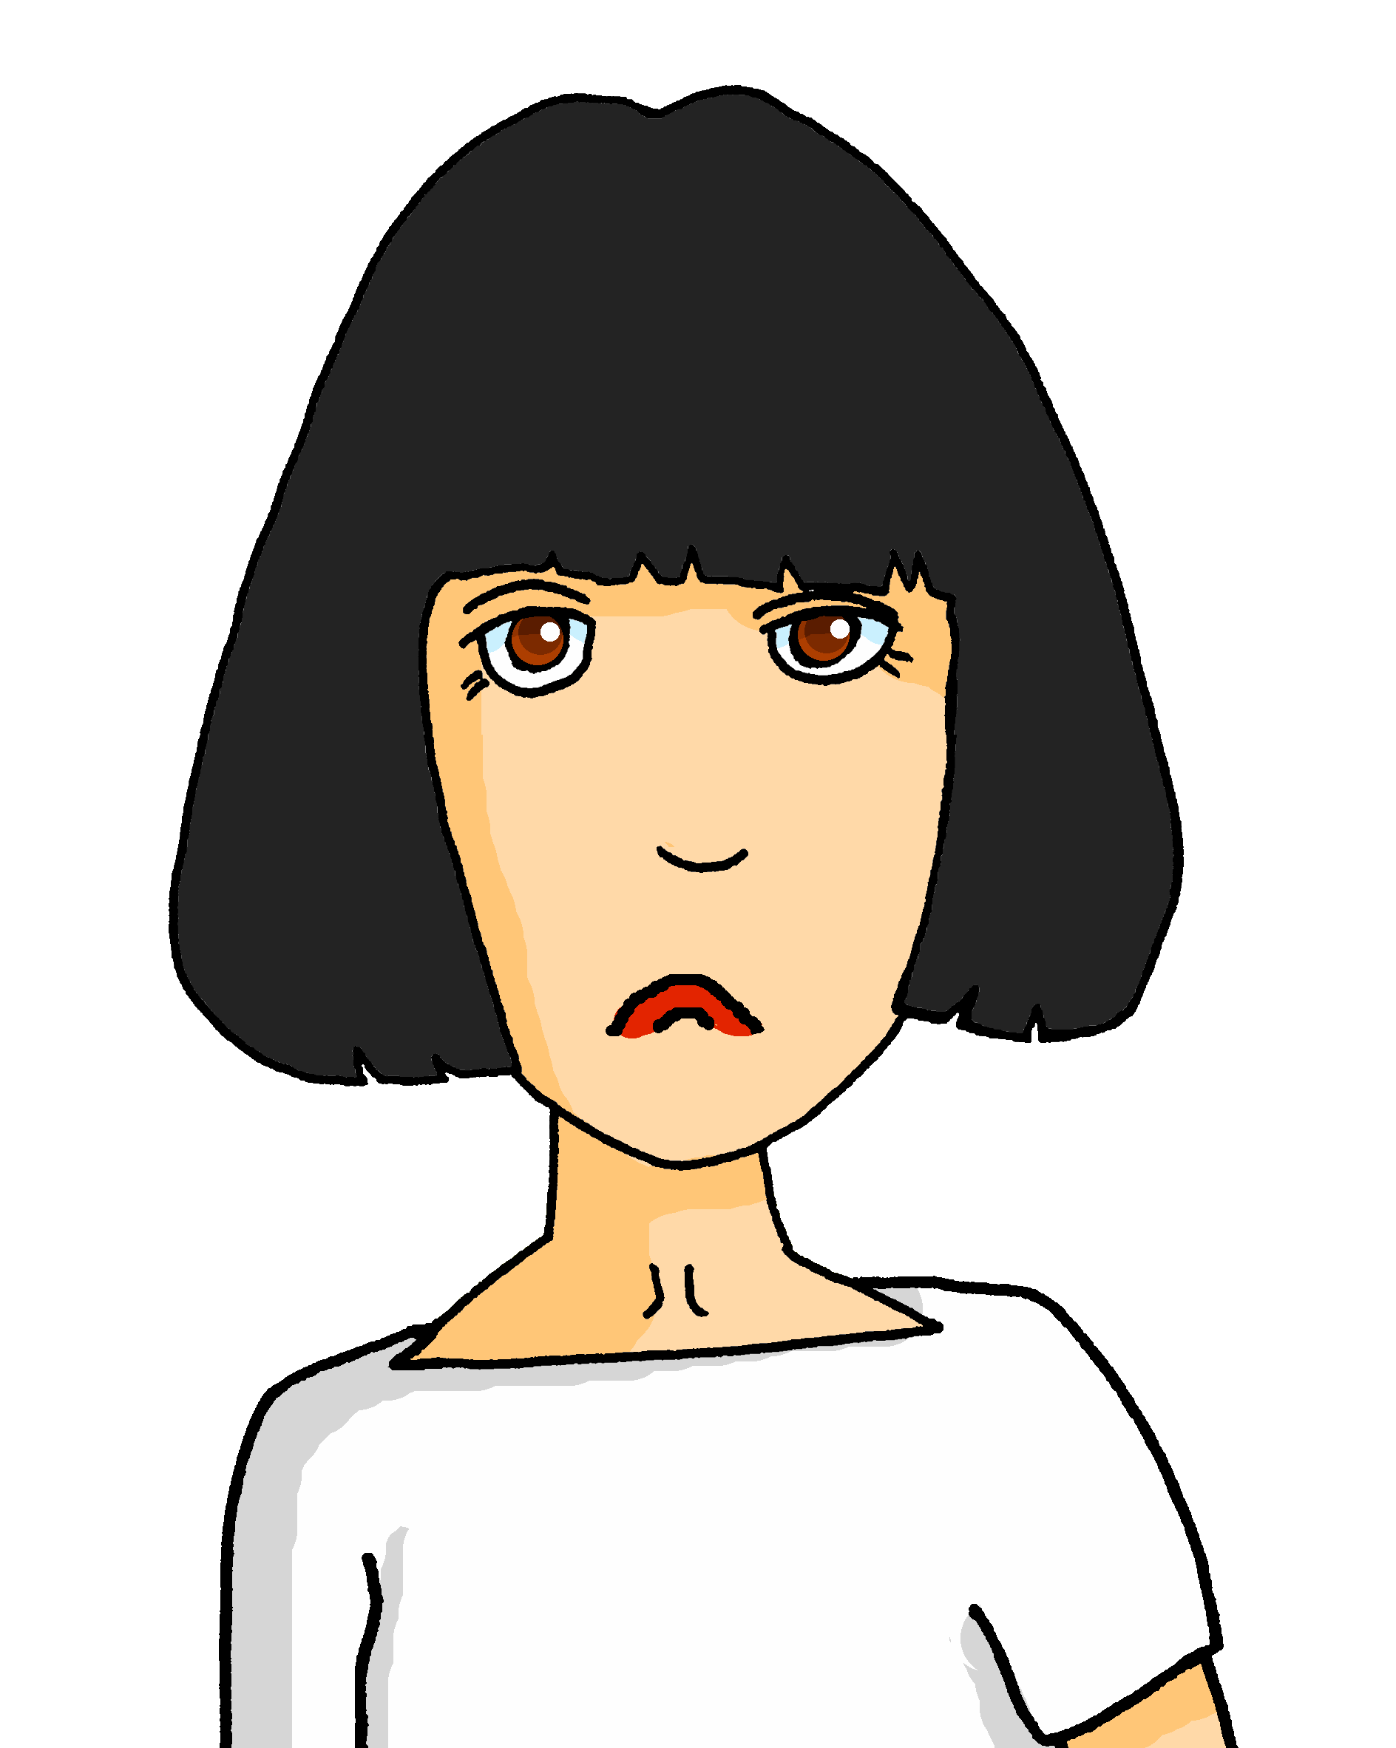
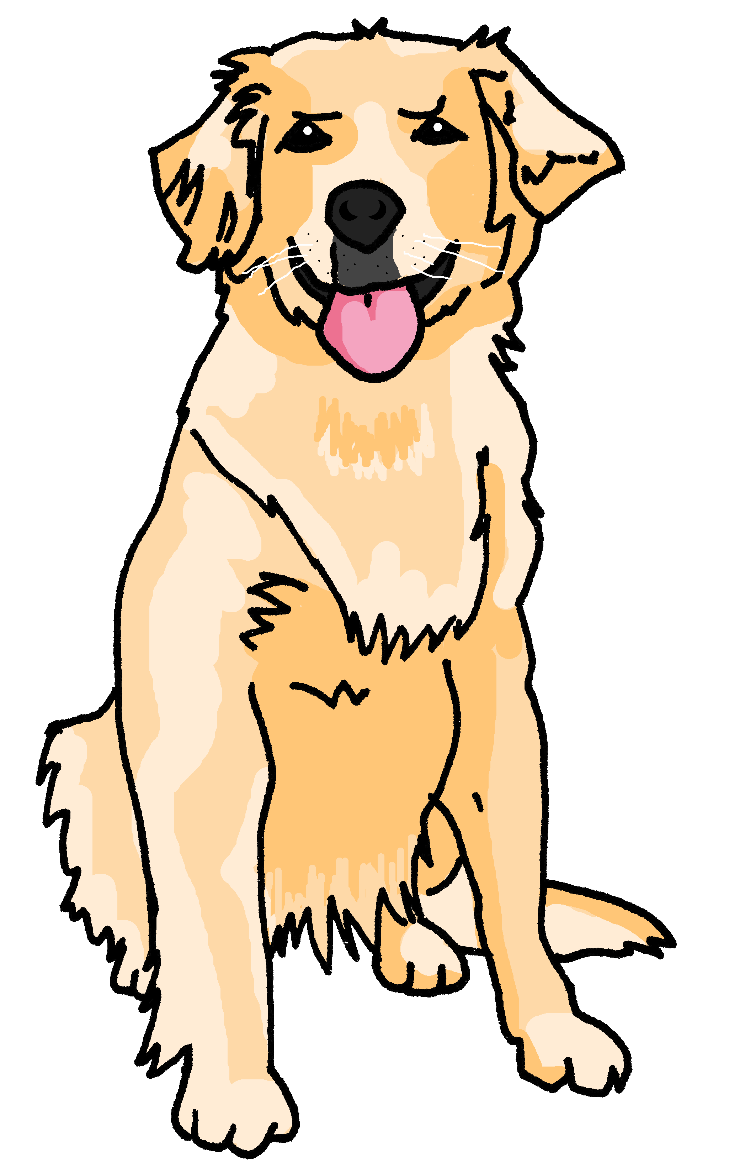
lire
Un accident ! 💧
Médor has spilled water on Claudine’s work plans.
Pardon !
Tu organises une visite à* un musée.
à = to
1
Médor !
You organise a visit to a museum.
 | I | you
1
2
3
4
5
6
Verbe
Je prépare un texte en anglais.
2
I prepare a text in English.
you organise
Je cherche une image.
3
I look for a picture.
I prepare
Tu cherches un parc.
4
I look for
You look for a park.
Tu présentes une idée.
you look for
5
You present an idea.
Je visite une université,
you present
6
I visit a university.
I visit
Notes:
Timing: 7 minutes
Aim: to practise written comprehension of 1st and 2nd person singular –ER verbs.
Procedure:
Read the title and explain the context of the task. Claudine is preparing tomorrow’s work for her and her colleague Céline.
Do [1] with them to model the task and draw their attention to the verb (organises). Is it ‘I’ or ‘you’?
Pupils complete 2-6.
Click through the animations to bring up answers.
If desired, click on the numbered buttons to hear audio for each sentence.
7

Slide 8
Knowing who does what
[–er verbs: ‘he’ and ‘she’]
To mean ‘he’ and ‘she’ with a verb, use ‘il’ and ‘elle’ and the ending –e:
Il prépare un texte en français.
He prepares a text in French.
Elle prépare un texte en anglais.
She prepares a text in English.
Notes:
Timing: 3 minutes
Aim: to introduce 3rd person singular for –er verbs.
Procedure:
Click through the animations to present the new information.
Elicit English translations for the French examples provided.

Slide 9
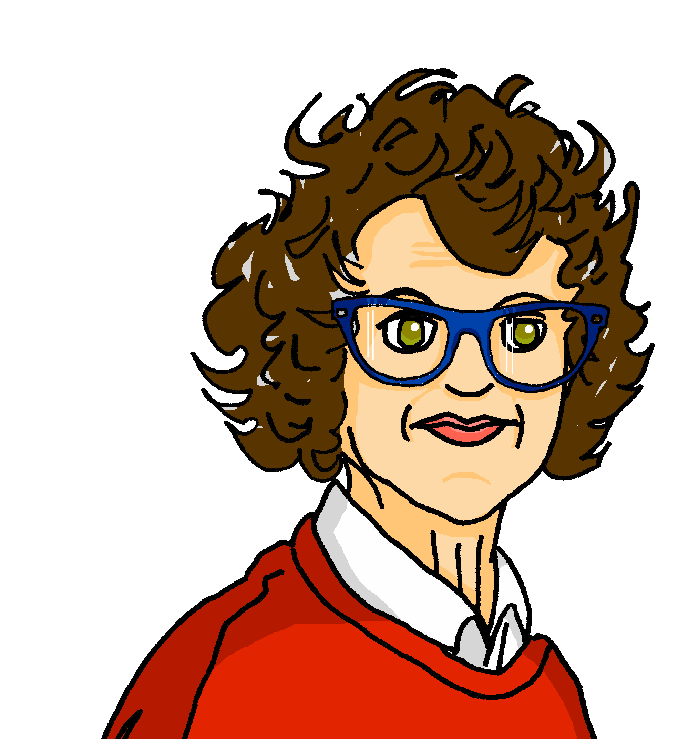
lire
Céline écrit des messages.
Is she asking Claudine (tu) or about Hervé (il)?
Claudine, tu… ?
Et Hervé? Il… ?
en ligne = online un/une volontaire = a volunteer
 |  | (tu) | (il) |  |  | (tu) | (il)
1 | … organise une visite le weekend ? |  |  | 5 | … présente une idée pour un concert en septembre ?
2 | … cherches une image de Rouen en ligne*? |  |  | 6 | … organises une activité pour un groupe le vendredi ?
3 | … prépares une brochure le jeudi ? |  |  | 7 | … prépares une liste d’activités ?
4 | Le weekend, … prépare un pique-nique ? |  |  | 8 | … cheche un ou une volontaire pour un match de football ?
1
5
2
6
3
7
4
8
Notes:
Timing: 7 minutes
Aim: to practise written comprehension of 2nd and 3rd person singular –ER verbs.
Procedure:
Read the title and explain the context of the task.
Do [1] with them to model the task and draw their attention to the verb (porte). Is it ‘you’ or ‘he’?
Pupils complete 2-8.
Click through the animations to bring up answers.
If desired, click on the numbered buttons to hear audio for each sentence.
Elicit English meanings of each question, orally.
Frequencies of unknown words and cognates: activité [452] brochure [>5000] concert [1697] (en) ligne [342] football [2602] groupe [187] liste [924] match [1906] pique-nique [>5000] septembre [944] volontaire [1675] weekend [2475]
Note: most of these words are taught later in the SOW.
9

Slide 10
Au revoir !
jaune
Notes:
10

