Slide 1
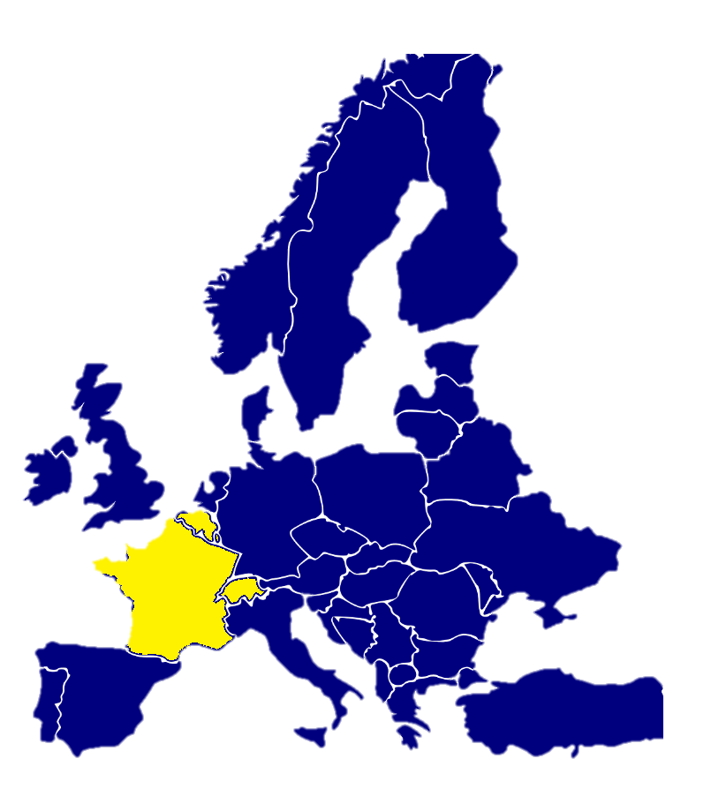
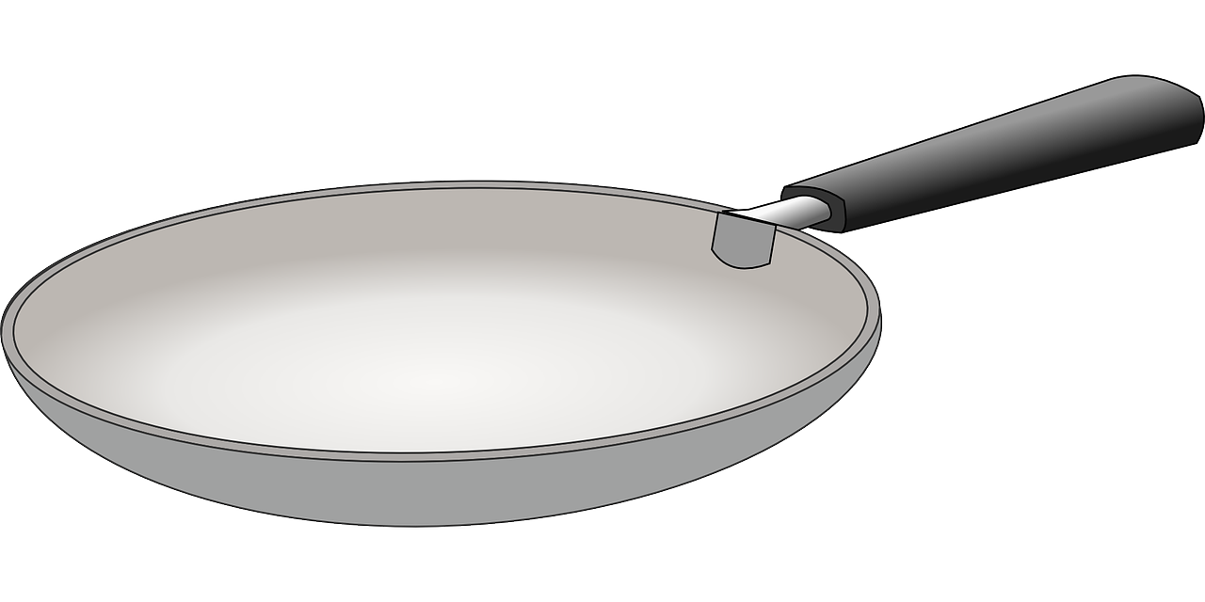
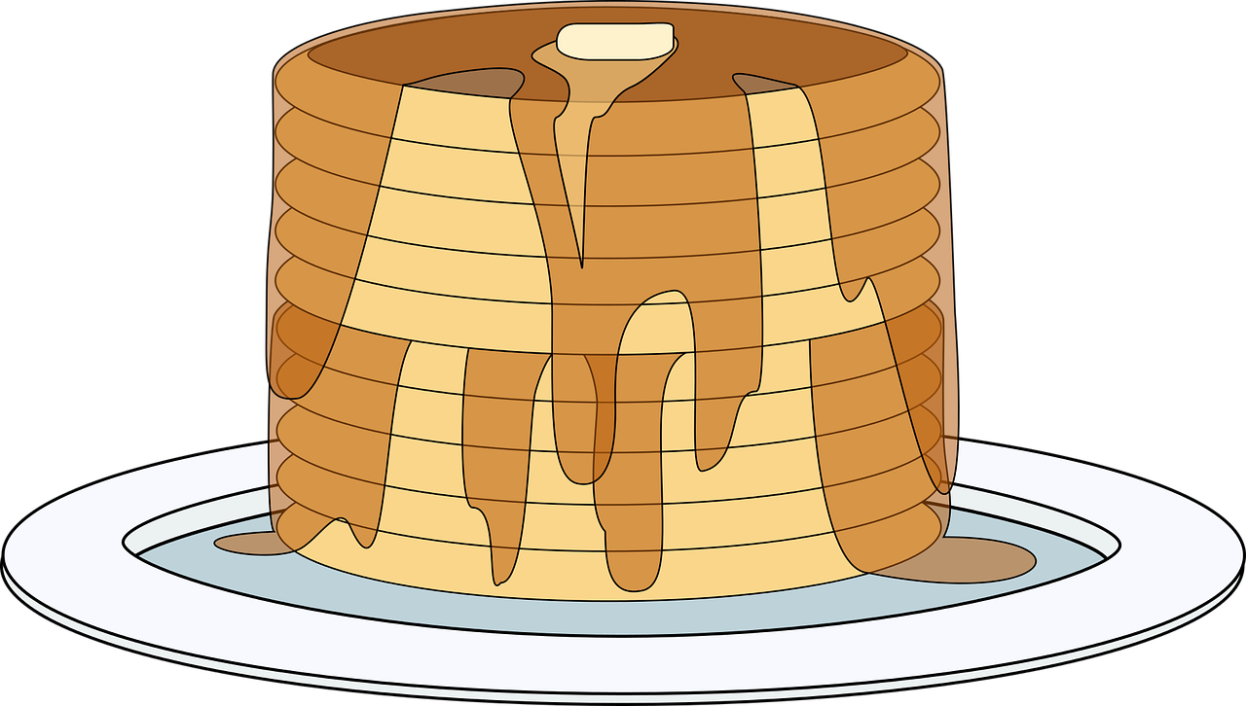
Saying what I and others do
Au club de français
jaune
-ER verbs: infinitives
SSC [é] [er]
Notes:
Artwork by Steve Clarke. Pronoun pictures from NCELP (www.ncelp.org). All additional pictures selected from Pixabay and are
available under a Creative Commons license, no attribution required.
The AUDIO version of the lesson material includes additional audio for the new language presented (phonics, vocabulary) and audio for the instructions
on the slide.
In addition, it includes VIDEO clips of the phonics and the phonics’ source words. Pupils can be encouraged to look at the shape of the mouth/lips on
slides where these appear, and try to copy it/them.
Phonics: [é] [er] répéter [630] écrire [382] bébé [2271] donner [46] parler [106]
Vocabulary (new words in bold): chercher [336] dessiner [2086] présenter [209] prononcer [706] image [659] mot [220] pays [114] texte [631] facile [822] intéressant [1244]
Revisit 1: jour [78] chaque [151] revisit days of the week
Revisit 2: lundi [1091] mardi [1044] mercredi [1168] jeudi [1112] vendredi [1086] samedi [1356] dimanche [1235] aujourd’hui [233] ce (c') [12]
Londsale, D., & Le Bras, Y. (2009). A Frequency Dictionary of French: Core vocabulary for learners London: Routledge.
The frequency rankings for words that occur in this PowerPoint which have been previously introduced in these resources are given in the SOW and in the resources that first introduced and formally re-visited those words. For any other words that occur incidentally in this PowerPoint, frequency rankings will be provided in the notes field wherever possible.
1

Slide 2
prononcer
[é]
[er]
répéter
[é] and [er] sound the same. They are two ways to write exactly the same sound.
Notes:
Timing: 2 minutes
Aim: to introduce SSC [é] and [er], which are the same sound written differently.
Note: there are two further letter combinations that are also pronounced the same. We will introduce those next week.
Procedure:
Introduce and elicit the pronunciation of the individual SSC [é] and [er] then the source word ‘répéter’, which has both spellings of the sound.
Click to bring on the picture and get students to repeat (with gesture, if using).
Gesture: gesture for répéter – hand with thumb and two fingers pointing forwards doing a three downwards motions, one for each syllable of the word.
https://www.signbsl.com/sign/repeat (the 2nd video marked again: repeat with the female signer)
2

Slide 3
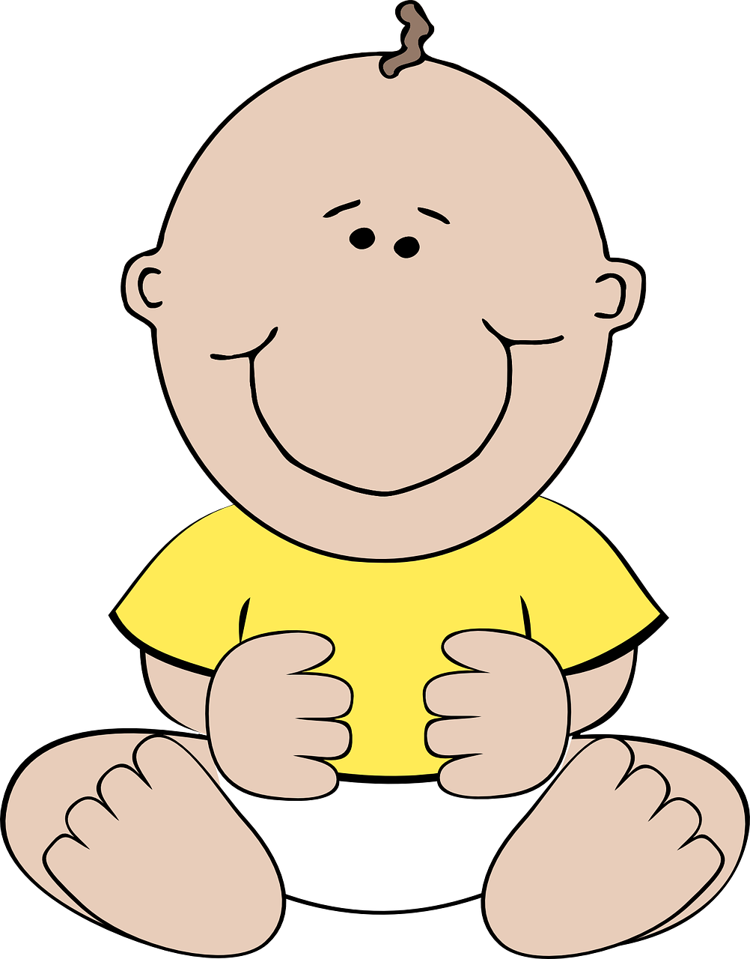
prononcer
[é]
[er]
répéter
écrire
parler
bébé
donner
[to give]
Notes:
Timing: 2 minutes
Aim: to introduce SSC [é] and [er], which are the same sound written differently.
Procedure:
Introduce and elicit the pronunciation of the individual SSC [é] and [er] then the source word ‘répéter’, which has both spellings of the sound.
Click to bring on the picture and get students to repeat (with gesture, if using).
Present and practise the cluster words. Note that pupils already know écrire and parler from term 1.
Gesture: gesture for répéter – hand with thumb and two fingers pointing forwards doing a three downwards motions, one for each syllable of the word.
https:/./www.signbsl.com/sign/repeat (the 2nd video marked again: repeat with the female signer).
Note that the cluster words are also suggestive of simple gestures that teachers may want to use to elicit the words from pupils in the practice phase.
3

Slide 4
vocabulaire
Écoute et répète.
mots
chercher
dessiner
[to draw, drawing]
[to look for, looking for]
présenter
prononcer
[to present, presenting]
[to pronounce, pronouncing]
Notes:
Timing: 3 minutes (one slide)
Aim: to introduce key vocabulary for the context of classroom activities (a range of infinitive verbs).
Procedure: 1. Pupils either work in pairs, reading the French words out loud and looking at the English meanings (1 minute). 2. Then the teacher removes the English words or pictures (one by one) and pupils try to recall the English orally (chorally), looking at the French (1 minute). 3. Then the French meanings are removed (one by one) and pupils try to recall them orally (again, chorally), looking at the English (1 minute) 4. Further rounds of learning can be facilitated by one pupil turning away from the board, and his/her partner asking him/her the meanings (‘Comment dit-on XXX en anglais/français ?’). This activity can work from L2 → L1 or L1 → L2.
4

Slide 5
vocabulaire
mots
intéressant
facile
un mot
une image
un texte
dessiner
prononcer
chercher
un pays
interesting
easy
a word
Notes:
Timing: 3 minutes
Aim: to practise new and revisited vocabulary for this week.
Procedure: 1. Elicit pronunciation from pupils for the French words.
2. Click for an English prompt.
3. Elicit the French word from pupils. 4. Continue until all 9 items have been seen and heard.
5

Slide 6
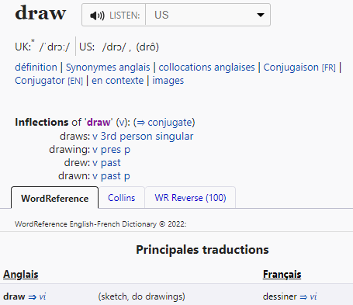
Infinitives: -er verbs
The infinitive form of a verb is the form you see in a dictionary.
[to ______]
The infinitive often describes the general meaning of the verb.
In English, this is often written ‘to + verb’:
It’s easy to draw a picture.
You add ‘de’ to link adjective and verb.
In French, many infinitives end in –er:
C’est facile de dessiner une image.
You can also begin a French sentence with the infinitive:
Dessiner une image, c’est facile !
In this case, we translate the French infinitive with the –ing form of the verb in English.
Drawing a picture is easy!
Notes:
Timing: 3 minutes
Aim: to introduce the notion of infinitive –ER verbs and their two positions and two English translations.
Procedure:
Click through the animations to present the new information.
Elicit English translations for the French examples provided.
6

Slide 7
écouter
Un club de français
Madame Nancy parle.
L’infinitif, c’est où ?
Écoute et écris.
 | beginning | in the middle
l’infinitif | en anglais
1
chercher
to look for
It’s interesting __ _________ a text.
dessiner
to draw
2
It’s fun __ ___________ a poster.
avoir
Having
3
________ a pencil is important.
4
présenter
to present
It’s interesting __ _________ a country.
to look for
5
chercher
It’s easy __ ____________ a word.
6
prononcer
Pronouncing
_____________ a text well is important!
Note: Most infinitives end in –er, but you know a few verbs already that end in –ir and –re.
Notes:
Timing: 7 minutes
Aim: to practise aural recognition of infinitive verbs, their position and corresponding meaning in English.
Procedure:
Read the title and click to bring up the instructions.
Clarify the task. Pupils listen out first for the infinitive and note its position in the sentence.
Click to bring up the answers.
Click to bring up the 2nd table and instruction.
Pupils listen again and write the infinitive.
They also write the English meaning, using the gapped English sentence for support.
Note: for additional challenge pupils could turn away and try to complete the task without the English sentence support.
7. Click to elicit and confirm the answers.
Transcript:
1. C’est intéressant de chercher un texte. 2. C‘est amusant de dessiner une affiche.
3. Avoir un crayon, c’est important ! 4. C’est intéressant de présenter un pays. 5. C’est facile de chercher un mot.
6. Prononcer un texte bien, c’est important !
7

Slide 8
lire
Max écrit.
Max writes his impressions of French club.
1
Dessiner un pays, c’est difficile !
Complète les phrases ✍.
2
C’est facile de chercher une image !
Drawing
[1] ___________ a country is hard!
[2] It’s easy ___ _____________ an image.
[3] It is important ____ __________ a ruler in class.
[4] It’s ideal ___ ____________ a text online.
[5] __________ a country ___ ___________ is interesting.
[6] It’s fun ___ ____________ in French.
to
look for
3
Écrire un texte, c’est difficile !
to
use
4
C’est idéal de chercher un texte en ligne.
to look for
Having
to
present
5
Avoir un pays pour présenter, c’est intéressant.
to
pronounce
6
C’est amusant de prononcer en français.
Notes:
Timing: 7 minutes
Aim: to practise written comprehension of –er verbs, including both possible translations into English (to __ / ing) and previously taught vocabulary.
Procedure:
Read the title and click to explain the context of the task (Max reflects on what he’s learned in French club so far this year).
Click to bring up a further instruction in French (complète les phrases).
Do [1] with them to model the task. Remind students about the English translation of the infinitive form of the verb in French.
Students complete 2-7.
Click through the animations to bring up answers.
Frequency of unknown words and cognates: completer [2034] difficile [296] texte [631]
8

Slide 9
lire
Une porte est ouverte : Médor est en danger !
Prononcer bien, c’est important !
parler
Read the sentence aloud with your partner before Médor gets to the door.
C’est important de [speak] français chaque jour.
C’est important de parler français chaque jour.
présenter
prononcer
parler
une porte = a door en danger = in danger
Notes:
Timing: 5 mins [5 slides in total] [1/5]
Aim: to practise read aloud of this week’s language and spoken production of infinitive verbs.
Procedure:
Teacher reads the title and elicits English translation from students.
Click to bring up the English instruction.
Pupils work in pairs to say the sentence aloud in French. Encourage most able to translate it too.
Once Médor disappears, the infinitive is removed from the board and three options are provided.
Elicit the full sentence again from students, with the correct infinitive.
Frequency of unknown words and cognates: danger [932]
9

Slide 10
lire
Une porte est ouverte : Médor est en danger !
Prononcer bien, c’est important !
parler
Read the sentence aloud with your partner before Médor gets to the door.
C’est facile de [look for] un mot en ligne.
C’est facile de chercher un mot en ligne.
chercher
chanter
dessiner
une porte = a door en danger = in danger
Notes:
[2/5]
Frequency of unknown words and cognates: danger [932]
10

Slide 11
lire
Une porte est ouverte : Médor est en danger !
Prononcer bien, c’est important !
parler
Read the sentence aloud with your partner before Médor gets to the door.
[Having] une question, c’est normal !
Avoir une question, c’est normal !
écrire
avoir
lire
une porte = a door en danger = in danger
Notes:
[3/5]
Frequency of unknown words and cognates: danger [932]
11

Slide 12
lire
Une porte est ouverte : Médor est en danger !
Prononcer bien, c’est important !
parler
Read the sentence aloud with your partner before Médor gets to the door.
[Presenting] un texte en classe, c’est super !
Présenter un texte en classe, c’est super !
écouter
prononcer
présenter
une porte = a door en danger = in danger
Notes:
[4/5]
Frequency of unknown words and cognates: danger [932]
12

Slide 13
lire
Une porte est ouverte : Médor est en danger !
Prononcer bien, c’est important !
parler
Read the sentence aloud with your partner before Médor gets to the door.
[Pronouncing] bien, c’est important !
Prononcer bien, c’est important !
parler
prononcer
présenter
une porte = a door en danger = in danger
Notes:
[5/5]
Frequency of unknown words and cognates: danger [932]
13

Slide 14
Au revoir !
jaune
Notes:
14

