Slide 1
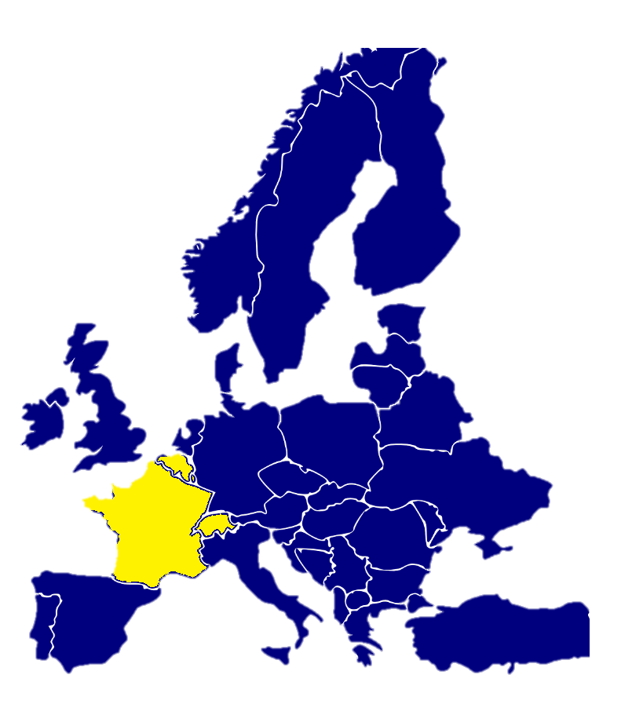
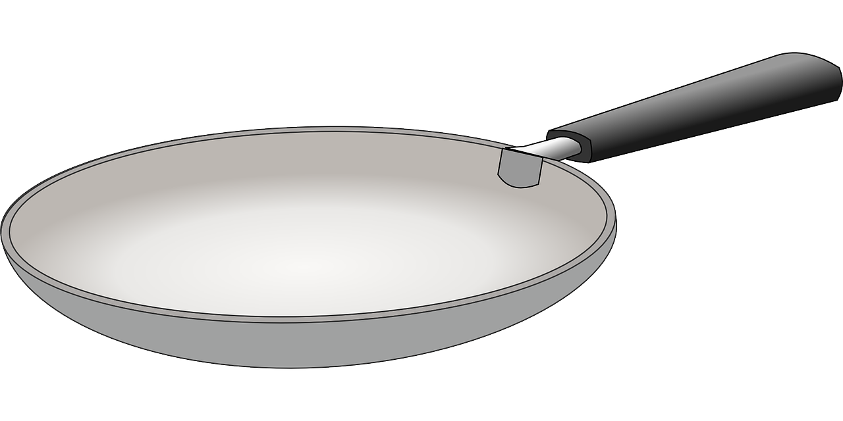
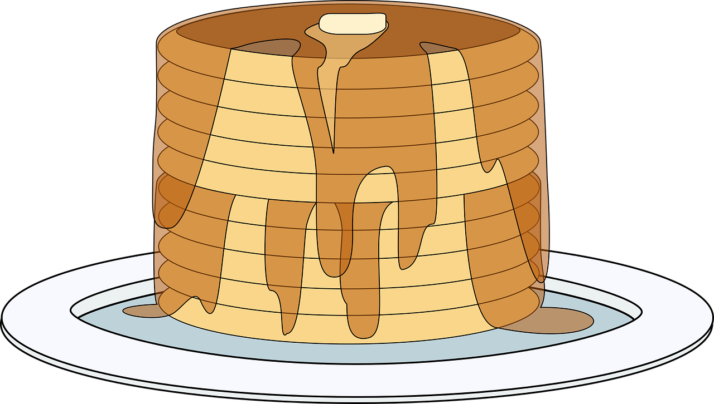
Saying what I and others do
Le club de français
jaune
Follow ups 1-5
Notes:
Artwork by Steve Clarke. Pronoun pictures from NCELP (www.ncelp.org). All additional pictures selected from Pixabay and are
available under a Creative Commons license, no attribution required.
The AUDIO version of the lesson material includes additional audio for the new language presented (phonics, vocabulary) and audio for the instructions
on the slide.
In addition, it includes VIDEO clips of the phonics and the phonics’ source words. Pupils can be encouraged to look at the shape of the mouth/lips on
slides where these appear, and try to copy it/them.
Phonics: [é] [er] répéter [630] écrire [382] bébé [2271] donner [46] parler [106]
Vocabulary (new words in bold): chercher [336] dessiner [2086] présenter [209] prononcer [706] image [659] mot [220] pays [114] texte [631] facile [822] intéressant [1244]
Revisit 1: jour [78] chaque [151] revisit days of the week
Revisit 2: lundi [1091] mardi [1044] mercredi [1168] jeudi [1112] vendredi [1086] samedi [1356] dimanche [1235] aujourd’hui [233] ce (c') [12]
Londsale, D., & Le Bras, Y. (2009). A Frequency Dictionary of French: Core vocabulary for learners London: Routledge.
The frequency rankings for words that occur in this PowerPoint which have been previously introduced in these resources are given in the SOW and in the resources that first introduced and formally re-visited those words. For any other words that occur incidentally in this PowerPoint, frequency rankings will be provided in the notes field wherever possible.

Slide 2
prononcer
[é]
[er]
This slide is for the ‘audio’ version. The following slide is for the non-audio version. If you delete the one you don’t need when you create the two versions.
répéter
écrire
parler
bébé
donner
[to give]
Notes:
Timing: 2 minutes
Aim: to introduce SSC [é] and [er], which are the same sound written differently.
Procedure:
Introduce and elicit the pronunciation of the individual SSC [é] and [er] then the source word ‘répéter’, which has both spellings of the sound.
Click to bring on the picture and get students to repeat (with gesture, if using).
Present and practise the cluster words. Note that pupils already know écrire and parler from term 1.
Gesture: gesture for répéter – hand with thumb and two fingers pointing forwards doing a three downwards motions, one for each syllable of the word.
https:/./www.signbsl.com/sign/repeat (the 2nd video marked again: repeat with the female signer).
Note that the cluster words are also suggestive of simple gestures that teachers may want to use to elicit the words from pupils in the practice phase.
2

Slide 3
prononcer
[é]
[er]
répéter
écrire
parler
bébé
donner
[to give]
Notes:
Timing: 2 minutes
Aim: to recap SSC [é] and [er], which are the same sound written differently.
Procedure:
Introduce and elicit the pronunciation of the individual SSC [é] and [er] then the source word ‘répéter’, which has both spellings of the sound.
Click to bring on the picture and get students to repeat (with gesture, if using).
Present and practise the cluster words. Note that pupils already know écrire and parler from term 1.
Gesture: gesture for répéter – hand with thumb and two fingers pointing forwards doing a three downwards motions, one for each syllable of the word.
https:/./www.signbsl.com/sign/repeat (the 2nd video marked again: repeat with the female signer).
Note that the cluster words are also suggestive of simple gestures that teachers may want to use to elicit the words from pupils in the practice phase.
3

Slide 4
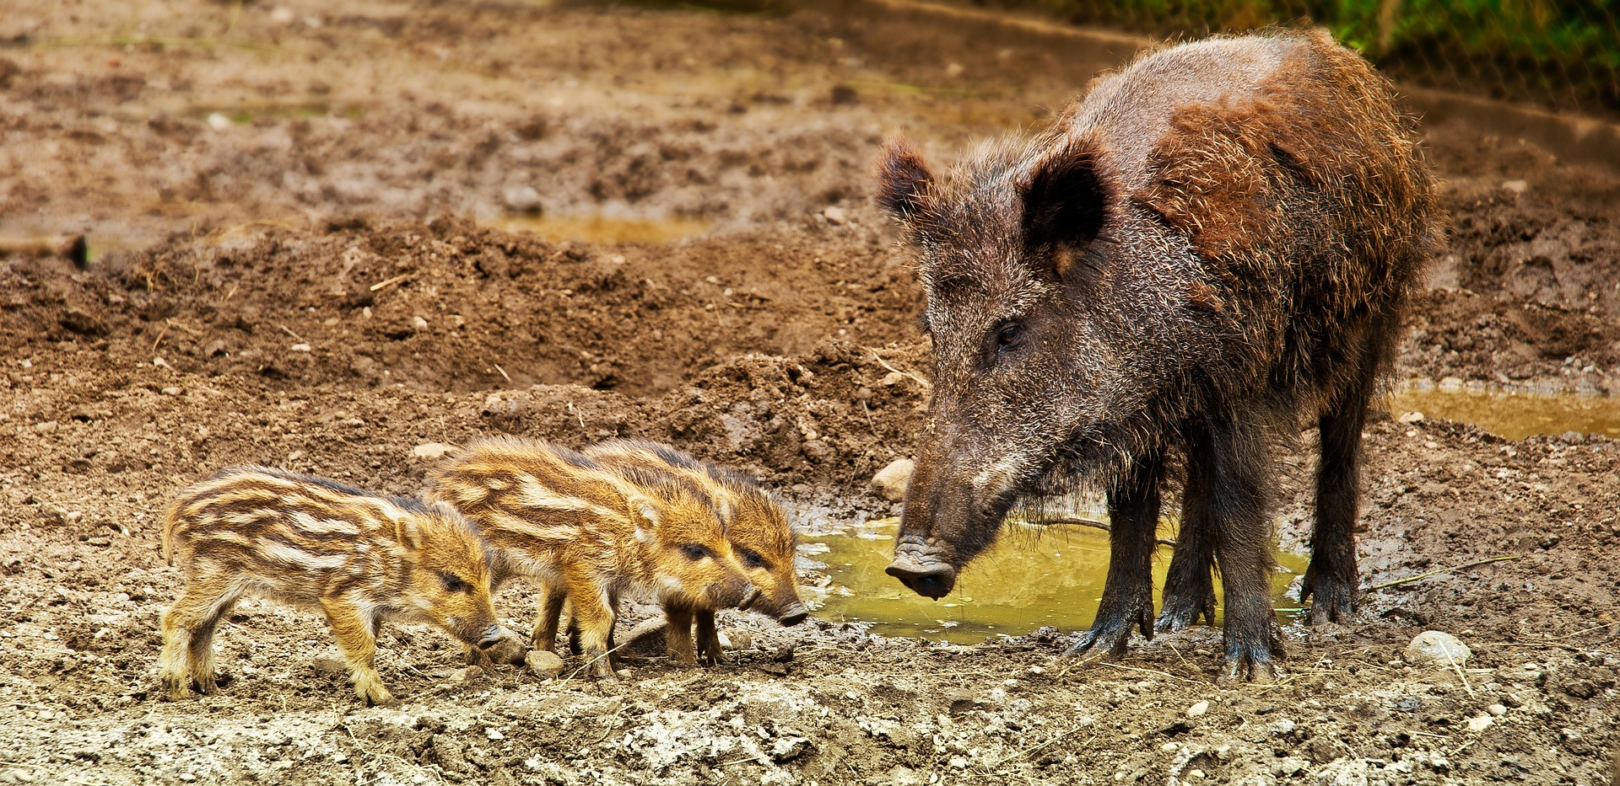
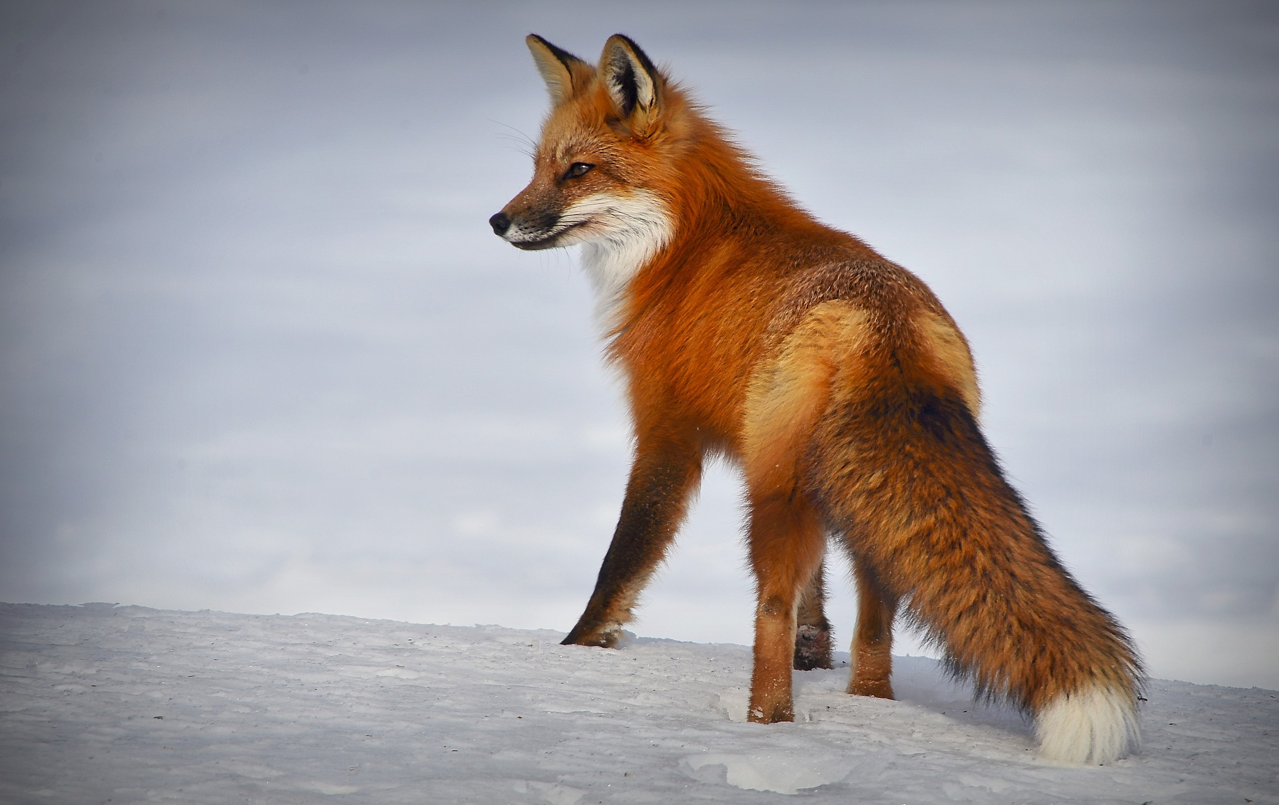
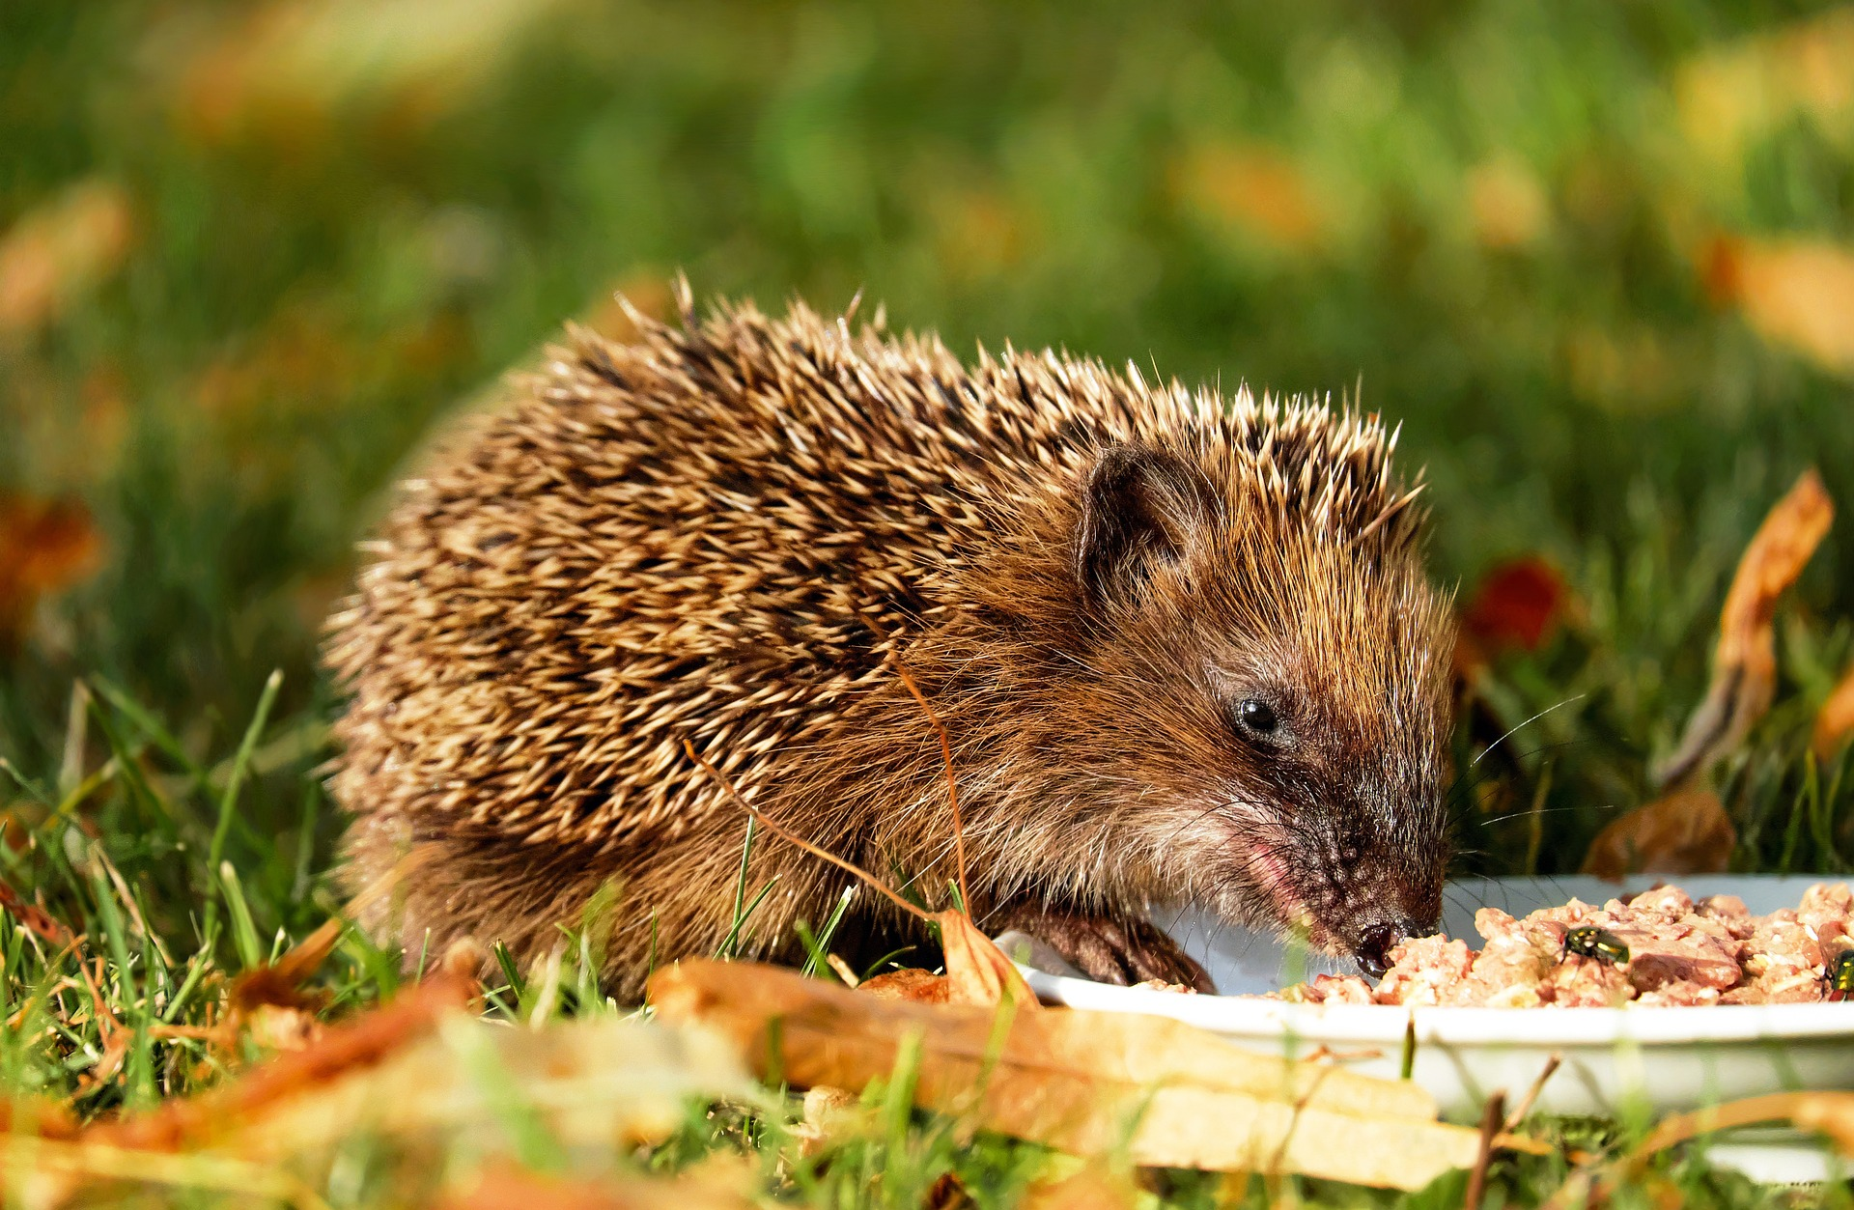
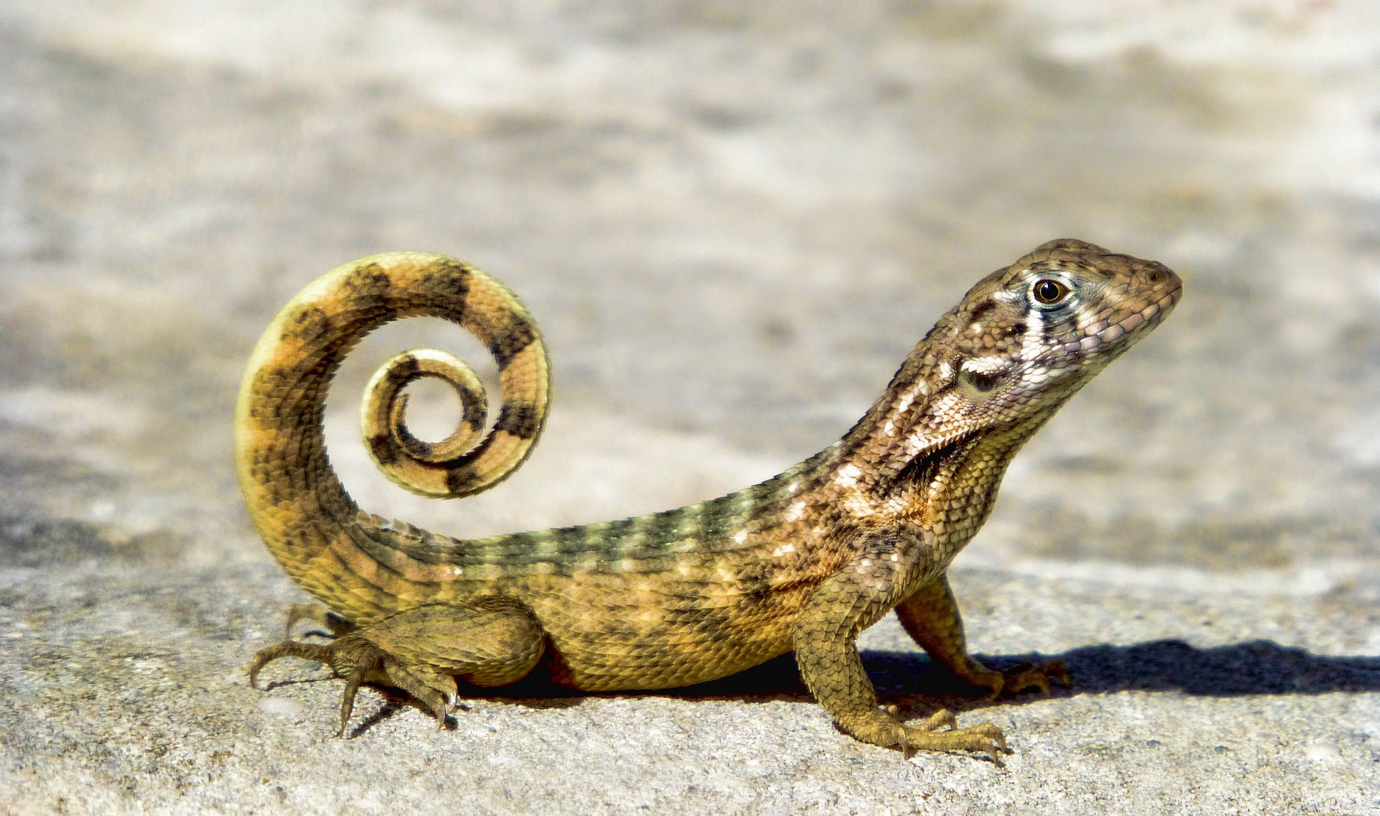
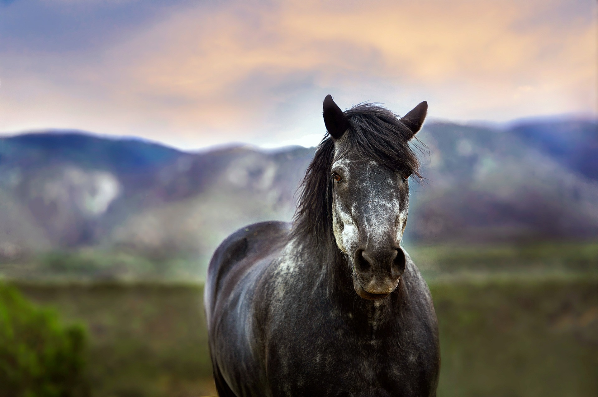
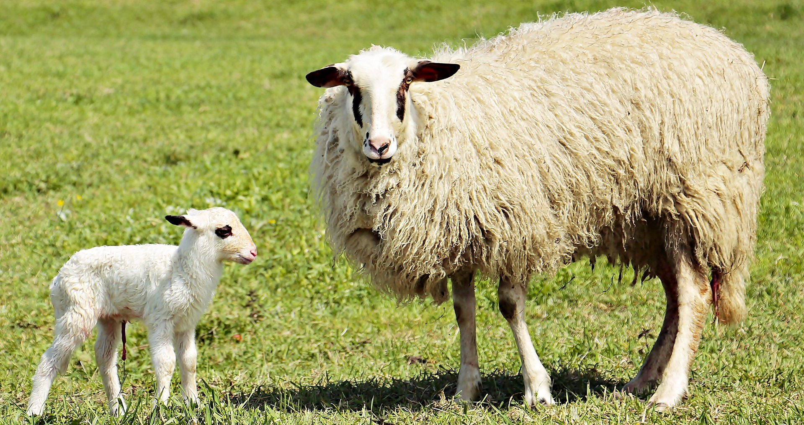
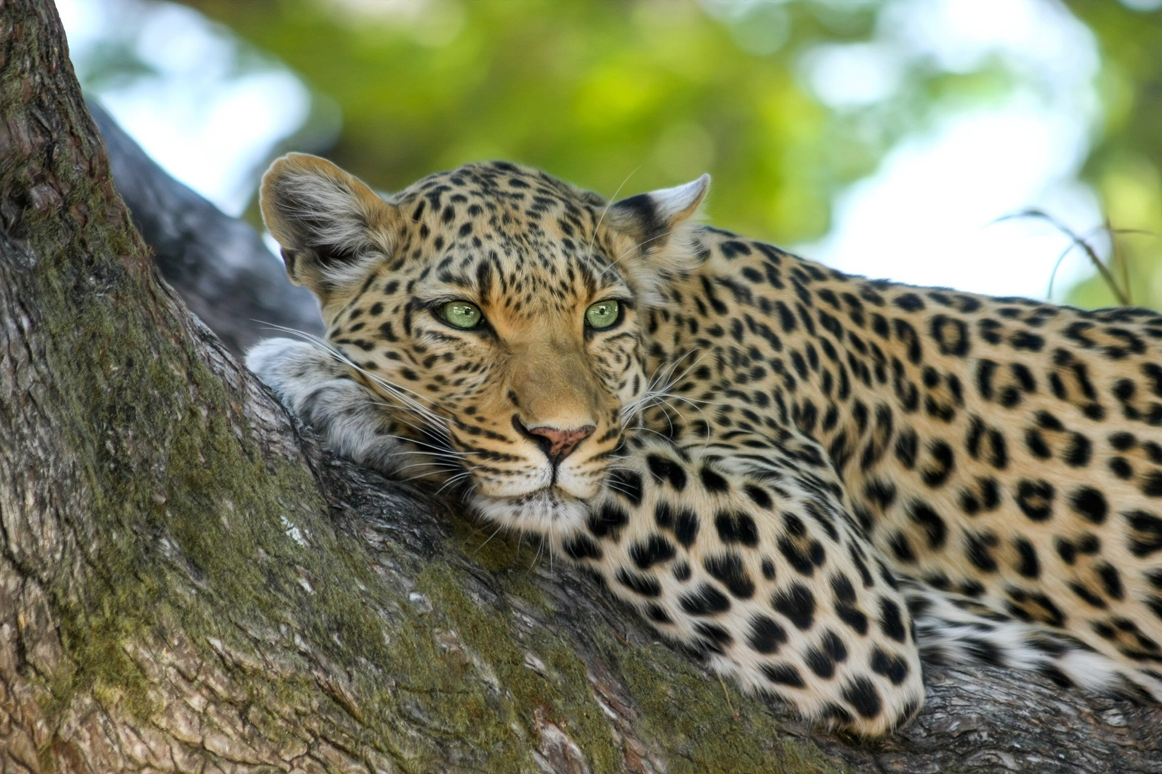
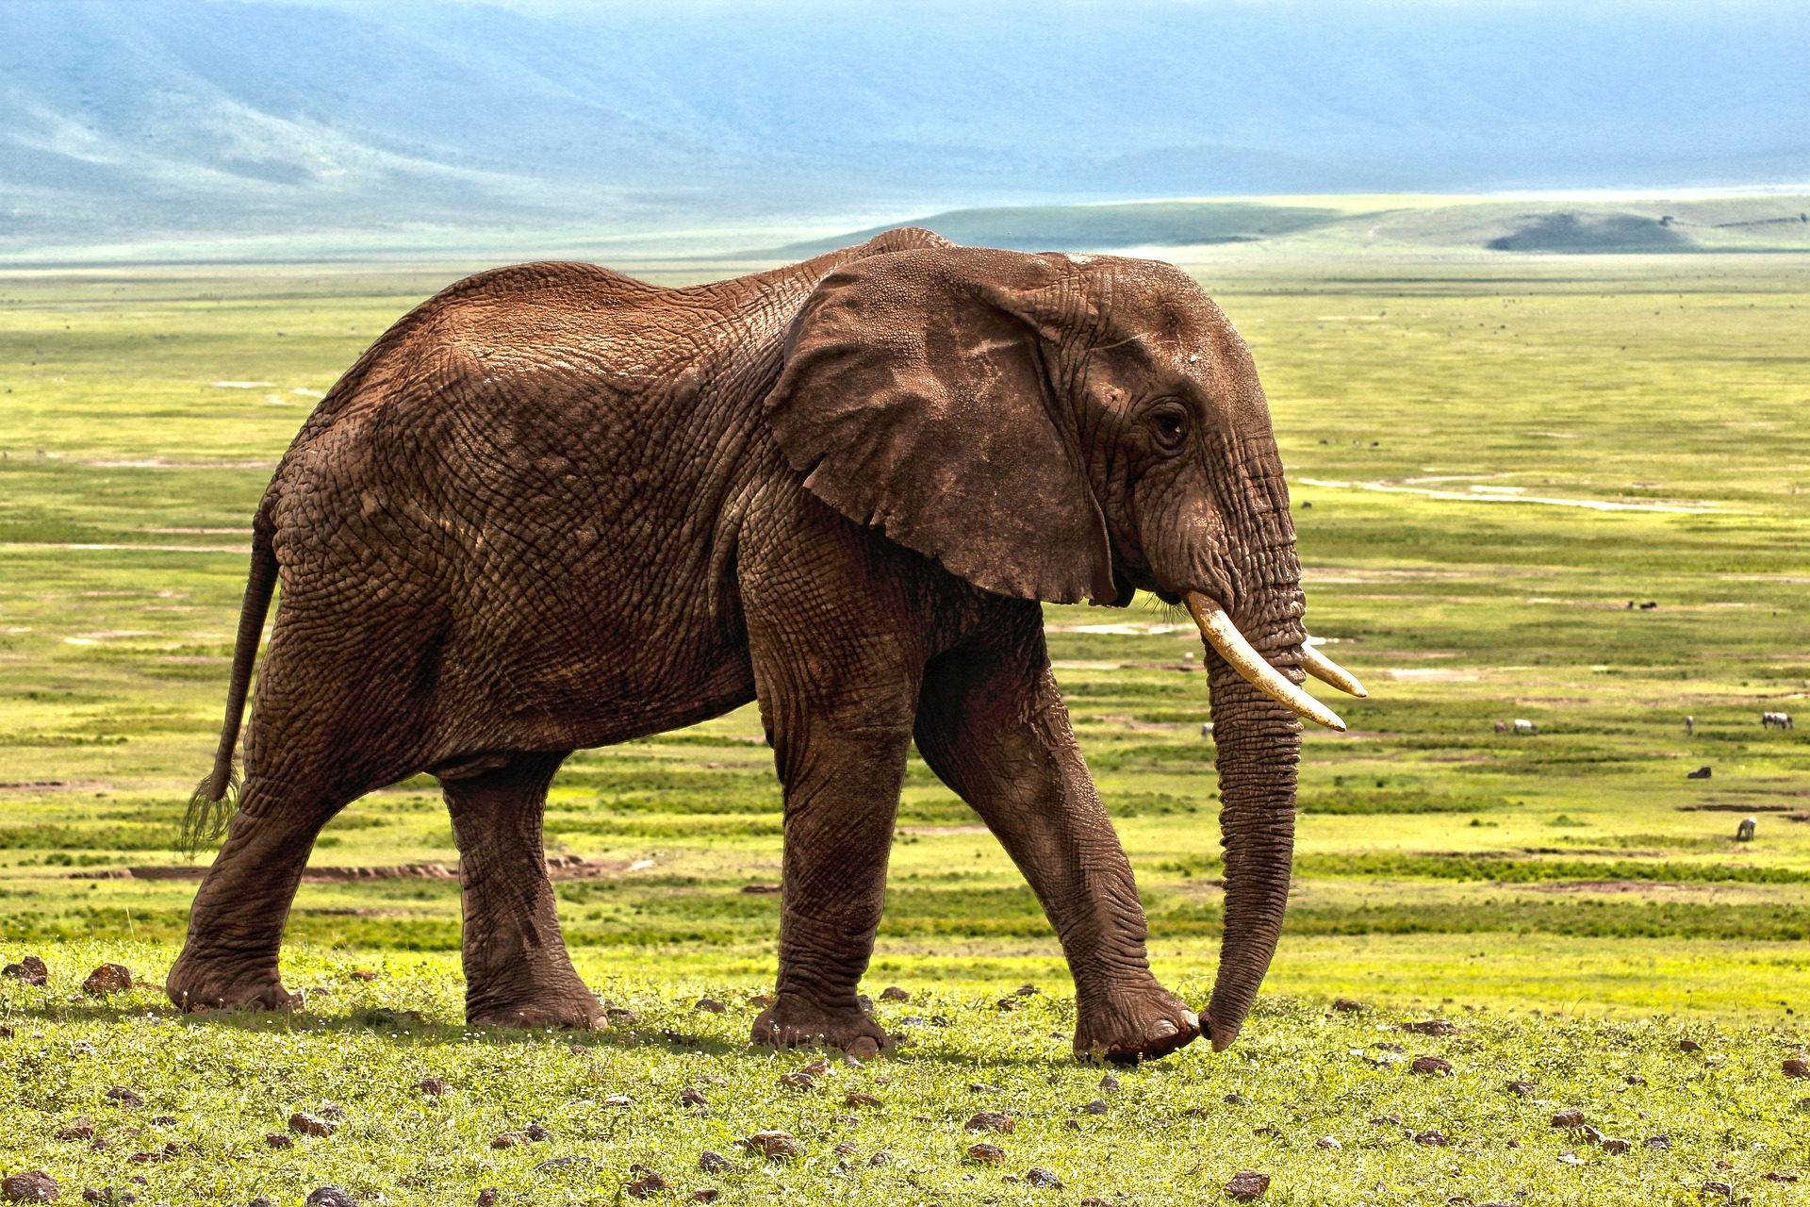
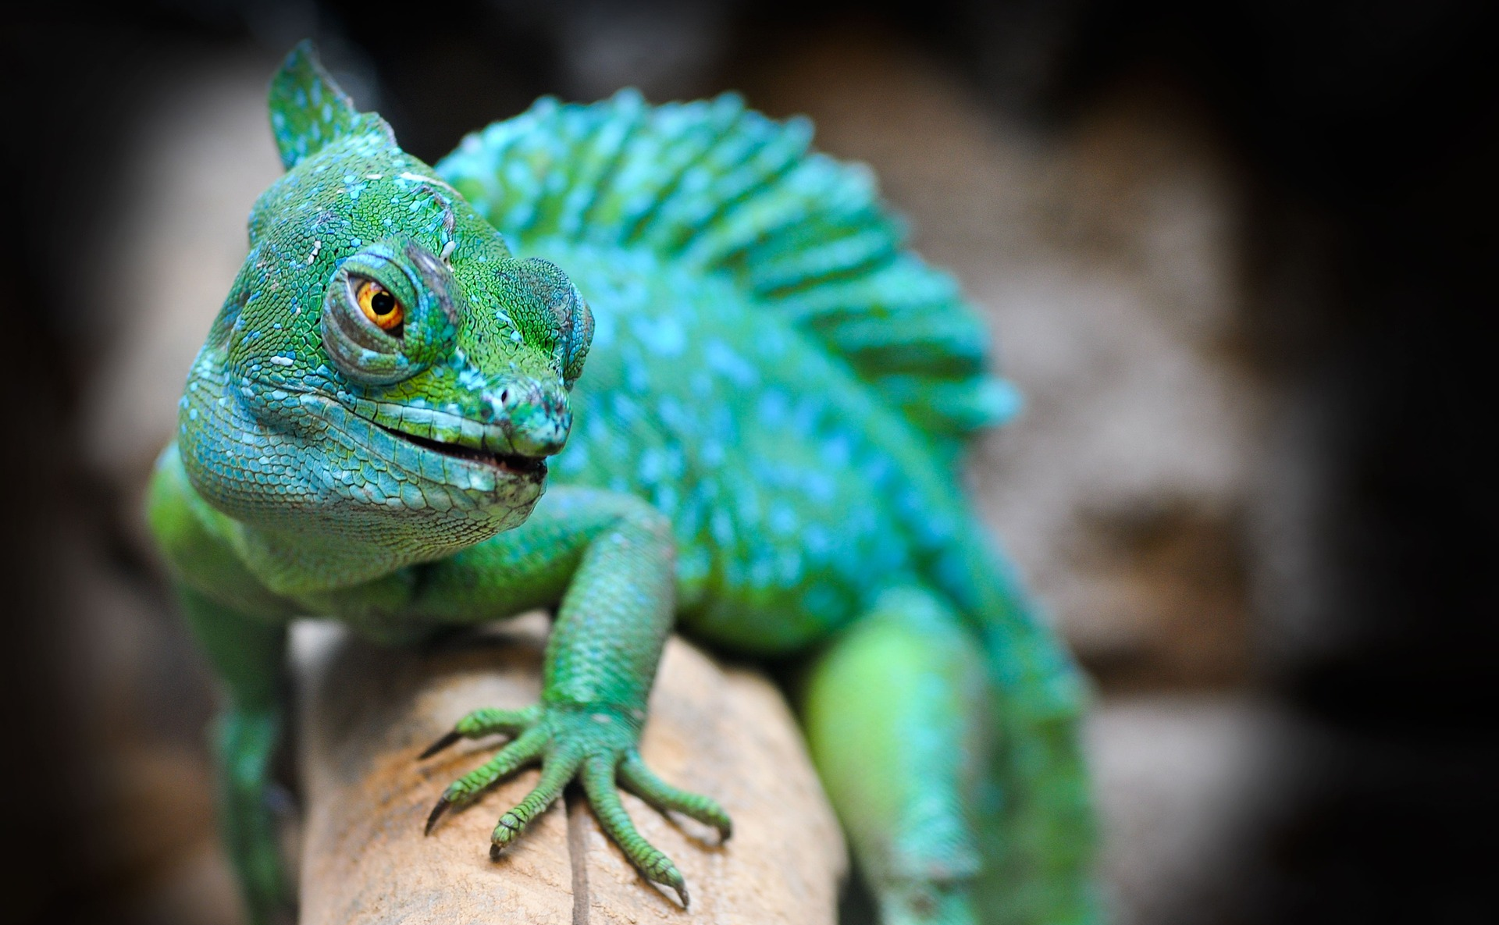
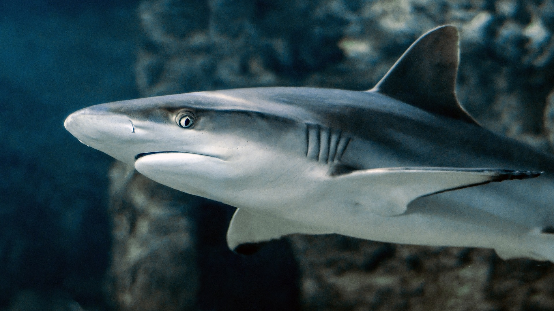
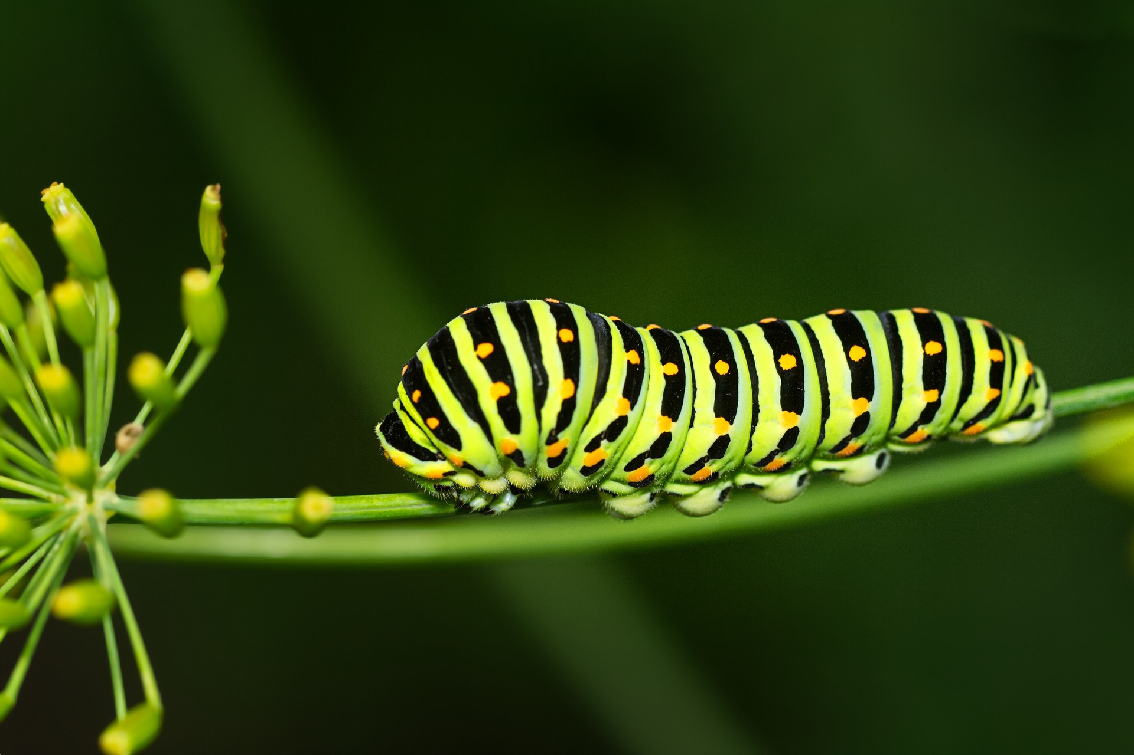
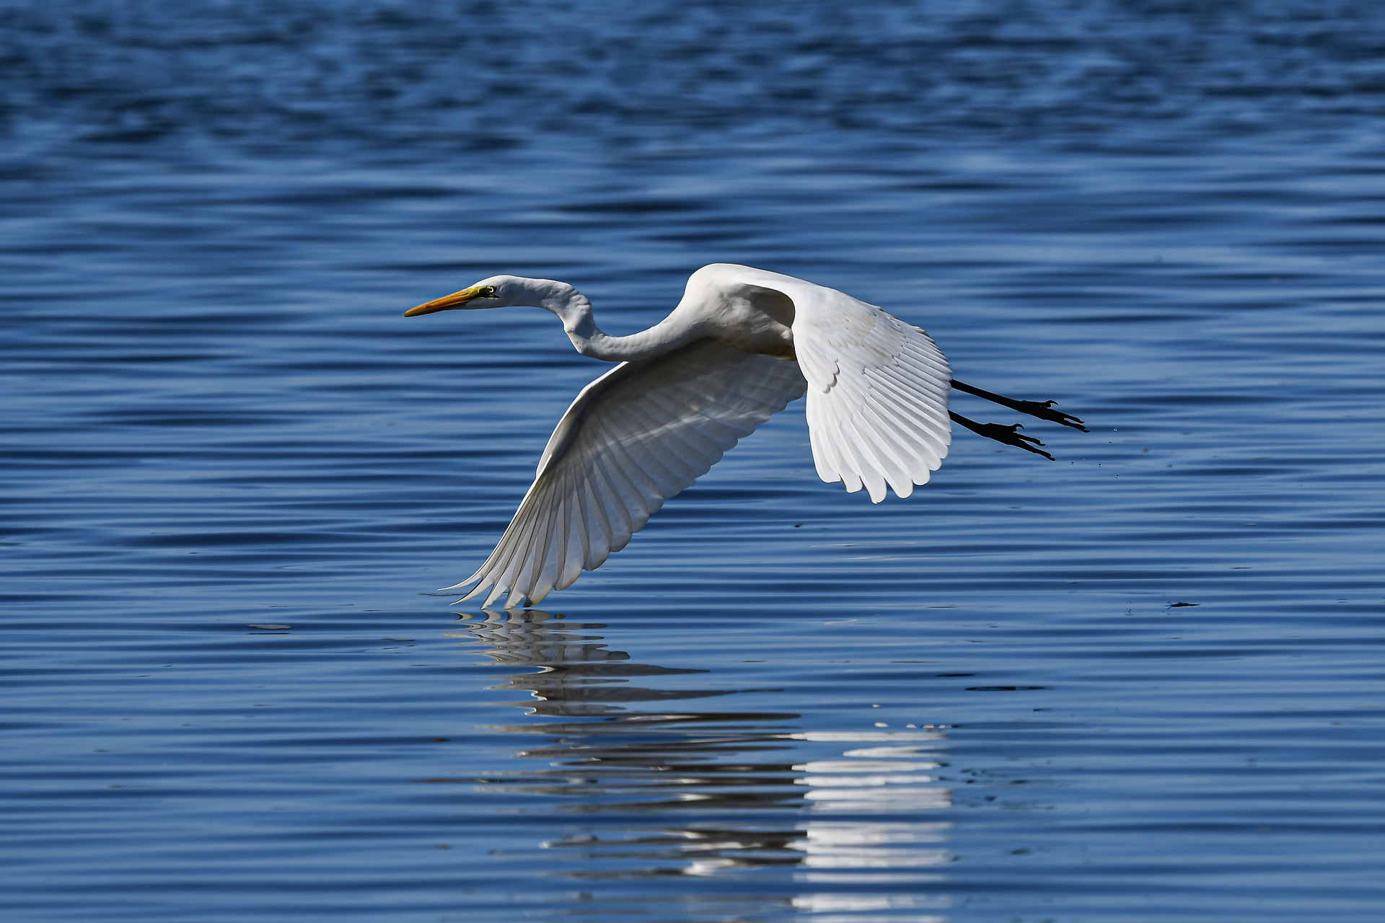
Follow up 1:
Écoute. C’est [e] ou [é]/[er] ?
[é][er]
Le léopard au Maroc est en danger d’extinction !
1
2
prononcer
3
4
_
_
_
_
u n s a n g l i e r
u n r e n a r d
u n h é r i s s o n
u n l é z a r d
5
6
7
8
_
_
_
_
u n c h e v a l
u n e b r e b i s
u n l é o p a r d
u n é l é p h a n t
9
_
_
_
_
u n c a m é l é o n
u n r e q u i n
u ne c h e n i l l e
u n h é r o n
Notes:
Timing: 3 minutes
Aim: to develop phonological awareness of SSC [é, er].
Procedure: Part A
Click to listen to each city name.
Pupils write the missing letter or letters. Make it clear to pupils that they are differentiating two sounds, but that the é sound can be written in two ways – in this task, it is written –er at the end of a word, but é everywhere else.
Click to check.
Part B
Click to bring up instruction.
Partner A writes down one animal name, partner B tries to guess by asking ‘Tu as… ? + one of the animals on the board.
3. Teachers circulate to listen to pupils’ pronunciation and praise/correct as necessary.
Transcript un sanglier un renard un hérisson un lézard un cheval une brebis un léopard un éléphant un caméléon un requin une chenille un héron

Slide 5
Follow up 2: Vocabulaire
mots
Excellent !
vocabulaire
3. une image
8. ce, c’
5. un pays
6. prononcer
1. dessiner
10. un mot
9. facile
11. aujourd’hui
2. chercher
4. un jour
7. chaque
12. présenter
to draw, drawing
a country
a word
to look for, looking for
a day
today
a picture
to pronounce, pronouncing
this, that
each, every
easy
to present, presenting
Notes:
Timing: 5 minutes Aim: to practise written comprehension and spoken pronunciation of vocabulary.
Procedure: 1. Students write 1-12 in books.
2. Ask students to say the French word and write down the English translation before the word has faded away (5 sec per word)
3. Click for English translation to be highlighted. 4. Repeat for all 12 items.
5. Check answers by eliciting the French from students, (i.e. so that they are translating back from their written English into spoken French).
6. If desired, click on the English meanings to hear the French.
Note: Students have not yet done numbers but will be taught them explicitly in Week 7. However, in the next few weeks, certain activities will prime for them. Here the teacher can say the number when eliciting the answers, but support understanding by holding up the appropriate number of fingers each time. Obviously, the items proceed in number order in any case, so the finger gesture is more to draw learners attention to the sound – meaning connection of the number with the French word for that number.
ANSWERS dessiner chercher une image
un jour
un pays
prononcer
chaque
ce, c’
facile
un mot
aujourd’hui
présenter

Slide 6
Follow up 3:
Pierre parle avec Max..
Écoute. Le verbe, c’est quoi ?
écouter
Écris la lettre et l’adjectif en anglais.
A
B
 | image | adjectif | information extra
to have
1
B/D
super
(having) a French club
2
F
interesting
(to look for) a text
C
D
3
A
fun
(to draw) an animal
to have
4
E
easy
(reading) in French
B/D
possible
(to have) ^{an exercise book} ^{for vocabulary}
E
F
5
6
C
important
(to pronounce) a text well
Notes:
Timing: 5 minutes
Aim: to practise aural comprehension of infinitive verbs (and the two ways of translating them into English) and other vocabulary.
Procedure:
Read the title / context of the activity.
Click x2 to bring up instructions in French.
To support pupils, elicit the French for A-F.
Do number 1 with them. Click to listen and bring up answer.
Pupils listen to 2-6. The first time of listening, pupils write the letter. The second time, pupils aim to write down the English meaning of the adjective and any additional details.
Click to reveal answers.
Transcript:
1. Avoir un club de français, c’est super! 2. C’est intéressant de chercher un texte.
3. C’est amusant de dessiner une image d’un animal. 4. Lire en français, c‘est facile !
5. C’est possible d’avoir un cahier pour le vocabulaire.
6. C’est important de prononcer bien un texte.

Slide 7
Follow up 4a:
A Lis les phrases.
Le verbe correct, c’est où ?
lire
 | Phrase en français
 | C’est facile de prononcer un mot en anglais.
 | C’est important d’écouter bien Madame Nancy.
 | C’est amusant de chercher un mot en ligne.
 | Dessiner une image d’un pays, c’est facile pour moi !
 | Lire un texte en français, c’est intéressant !
 | C’est amusant de parler en français avec un ami.
 | C’est intéressant de présenter un pays en français.
verbe en anglais
to pronounce | pronouncing | to talk | talking
to speak | speaking | listening | to listen
singing | to sing | to look for | looking for
looking for | to look for | drawing | to draw
to write | to read | writing | reading
to speak | to pronounce | to present | speaking
speaking | to present | presenting | to pronounce
1
2
3
4
5
6
7
Notes:
Timing: 5 minutes
Aim: to revisit the position of the infinitive in French and its translation into English.
Procedure:
Read the instruction in French.
Click to bring up further instruction and clarify meaning.
Do number 1 with pupils. Paying attention to the position of the infinitive, pupils to identify the correct translation.
Pupils do 2-6.
Go through answers.

Slide 8
Follow up 4b:
B Écris les phrases en anglais.
 | Phrase en français | Phrase en anglais
 | C’est facile de prononcer un mot en anglais.
 | C’est important d’écouter bien Madame Nancy.
 | C’est amusant de chercher un mot en ligne.
 | Dessiner une image d’un pays, c’est facile pour moi !
 | Lire un texte en français, c’est intéressant !
 | C’est amusant de parler en français avec un ami.
 | C’est intéressant de présenter un pays en français.
It’s easy to pronounce a word in English.
1
2
It’s important to listen to Ms Nancy.
3
It’s fun to look for a word online.
4
Drawing a picture of a country is easy for me!
5
Reading a text in French is interesting!
6
It’s fun to speak in French with a friend.
7
It’s interesting to present a country in French.
Notes:
Timing: 5 minutes
Aim: to practise written comprehension of infinitives and adjectives.
Procedure:
Read the instruction in French.
Pupils use their notes from [A] to translate the sentences.

Slide 9
vocabulaire
Follow up 5 - Écris en français : Can you get at least 15 points?
mots
 | today | this, that | difficult
 | Thursday | Friday | Saturday
 | Monday | Tuesday | Wednesday
 | interesting | each, every | a day
 | a word | a text | easy
 | to pronounce | a picture | a country
 | to look for | to draw, drawing | to present
aujourd’hui
ce, c’
difficile
x3
jeudi
vendredi
samedi
lundi
mardi
mercredi
x2
intéressant
chaque
un jour
un mot
un texte
facile
prononcer
une image
un pays
x1
chercher
dessiner
présenter
Notes:
Timing: 5-10 minutes
Aim: to practise written comprehension of vocabulary from this week and previous weeks.
Procedure: Give pupils a blank grid. They fill in the French meanings of any of the words they know, trying to reach 15 points in total.
Note: The most recently learnt and practised words are pink, words from the previous week are green and those from week 1 are blue, thus more points are awarded for them, to recognise that memories fade and more effort (heavy lifting!) is needed to retrieve them.
9

Slide 10
vocabulaire
Écris en français : Can you get at least 15 points?
mots
 | today | this, that | difficult
 | Thursday | Friday | Saturday
 | Monday | Tuesday | Wednesday
 | interesting | each, every | a day
 | a word | a text | easy
 | to pronounce | a picture | a country
 | to look for | to draw, drawing | to present
x3
x2
x1
Notes:
HANDOUT
10

