Slide 1
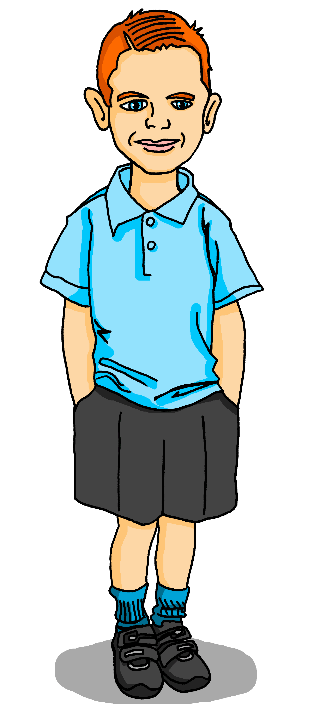
Saying what I and others have
jaune
« Avoir » : j’ai, il/elle a
C’est quoi ? intonation + wh-word questions
SSC [ch]
Term 1 Week 9
Notes:
Artwork by Steve Clarke. Pronoun pictures from NCELP (www.ncelp.org). All additional pictures selected from Pixabay and are
available under a Creative Commons license, no attribution required.
The AUDIO version of the lesson material includes additional audio for the new language
presented (phonics, vocabulary) and audio for the instructions on the slide.
In addition, it includes VIDEO clips of the phonics and the phonics’ source words. Pupils can be
encouraged to look at the shape of the mouth/lips on slides where these appear, and try to copy
it/them.
Artwork by Steve Clarke. Pronoun pictures from NCELP (www.ncelp.org). All additional pictures selected from Pixabay and are available under a Creative Commons license, no attribution required.
Frequency of new vocabulary and phonics:
Phonics: [ch] dimanche [1235] marché [280] chercher [336] chat [3138] bouche [1838]
Vocabulary: avoir [8] j’ai, il a, elle a, quoi [297] chat [3138] crayon [>5000] dessin [2624] message [792]
Revisit 1: ce (c') [12] lundi [1091] mardi [1044] mercredi [1168] jeudi [1112] vendredi [1086] samedi [1355] dimanche [1235] aujourd’hui [233]
Londsale, D., & Le Bras, Y. (2009). A Frequency Dictionary of French: Core vocabulary for learners London: Routledge.
The frequency rankings for words that occur in this PowerPoint which have been previously introduced in these resources are given
in the SOW and in the resources that first introduced and formally re-visited those words.
For any other words that occur incidentally in this PowerPoint, frequency rankings will be provided in the notes field wherever
possible.
1

Slide 2
[ch]
prononcer
chercher
[to look for]
Notes:
Timing: 2 minutes
Aim: to present SSC [ch].
Procedure:
Click to bring up the SSC [ch]. Repeat the SSC [ch] and the source word chercher with the class.
Click to bring up the English translation and picture.
Pupils to practise saying the SSC and source word several times.

Slide 3
[ch]
chercher
prononcer
bouche
chat
marché
dimanche
[to look for]
Sun
Notes:
Timing: 2 minutes
Aim: to practise the pronunciation of SSC [ch] in four cluster words.
Procedure:
Click to bring up the SSC [ch]. Repeat the SSC [ch] with the class and the source word chercher.
Click to bring up the English translation and picture. Do the gesture, if using.
Click to bring up each cluster word in turn: bouche, chat, marché, dimanche. The pictures appear after the words to give a further opportunity for word repetition.
Suggested gesture: The 3rd video (the woman)’s version is the one I like the best for search, look for: https://www.signbsl.com/sign/search

Slide 4
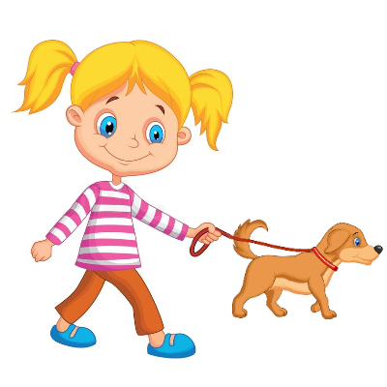
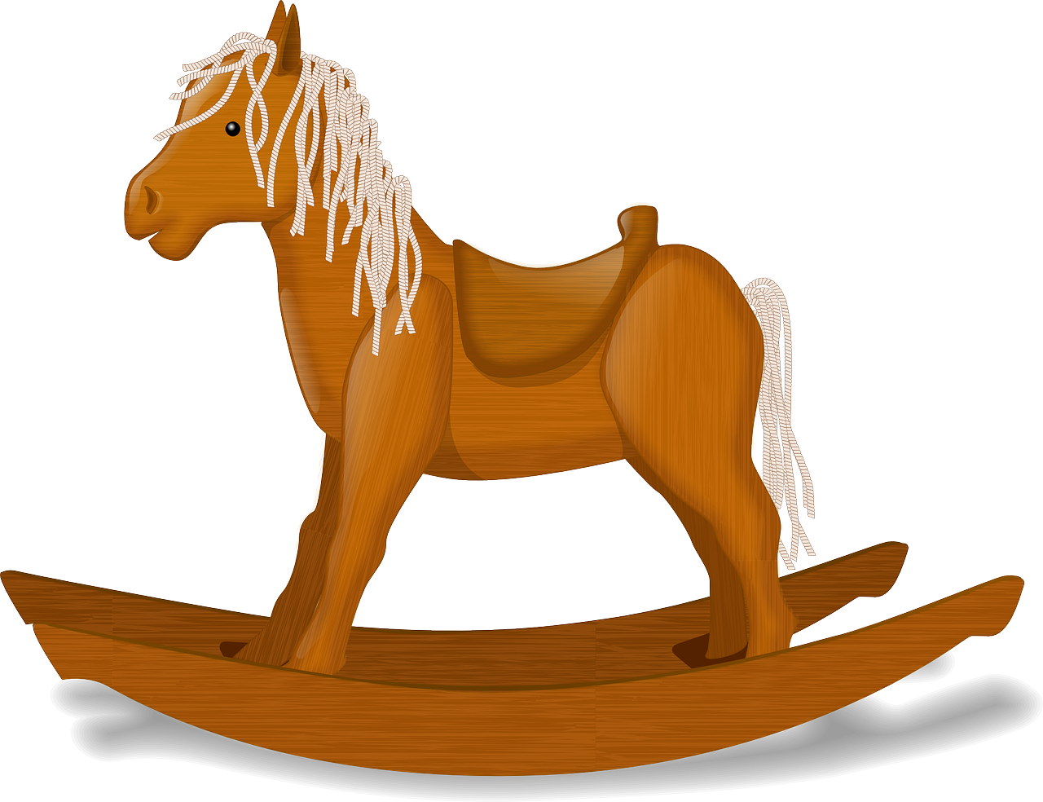
[ch]
.
Prononce les mots.
prononcer
Sun
marcher
chaise
dimanche
45
[to walk]
chat
affiche
chambre
marché
cheval
échanger
0
[to exchange]
DÉBUT
Notes:
Timing: 2 minutes
Aim: to practise the pronunciation of SSC [ch] in familiar and a few unfamiliar words.
Procedure: 1. Start the timer. Pupil A tries to read aloud all of the words within the 45seconds allowed.
2. Pupil B listens. If Pupil A pronounces [ch] in an English way by mistake, Pupil B can direct him/her to start again from the beginning. 3. They swap roles and repeat the task.
Note: ensure pupils know they don’t need to rush too much. They have 5 seconds per word. If preferred, remove the timer altogether.
Frequency of unknown words and cognates (1 is the most frequent word in French): échanger [1452] marché [280] marcher [1532]
Source: Londsale, D., & Le Bras, Y. (2009). A Frequency Dictionary of French: Core vocabulary for learners London: Routledge.

Slide 5
lire
Pierre a un ami*, Max, en Angleterre.
un ami – a friend (m)
Salut ! Je suis Max.
J’ai un ami* en Angleterre !
Notes:
Time: 1 minute
Aim: to introduce Max, Pierre’s pen friend from the UK.
Procedure:
Read the context and clarify meaning.
Click to bring up speech bubbles and elicit translations from pupils.

Slide 6
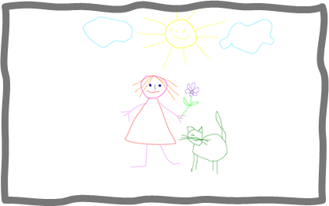
lire
Pierre a un ami*, Max, en Angleterre.
un ami – a friend (m)
Pierre has a penfriend, Max.
Max and Pierre are learning about French and English schools in lessons.
un dessin
un crayon
un message
un chat
Notes:
Time: 1 minute
Aim: to introduce four new items of vocabulary.
Procedure:
Read the context and clarify meaning.
Click to bring up each word and picture. Elicit repetition of the new words in French.
Check pupil understanding of each word.

Slide 7
Asking questions
Remember! To change a statement into a yes/no question, raise your voice at the end:
C’est un chat.
C’est un chat ?
Is it a cat?
It’s a cat.
Non, c’est un chien.
No, it’s a dog.
To ask an information question (e.g. what?) raise your voice and put a question word at the end:
C’est quoi ?
In English, we usually put question words at the start:
C’est un chat.
What is it?
It’s a cat.
Notes:
Timing: 3 minutes
Aim: to revisit how to form intonation questions and intonation questions + wh-words.
Procedure:
Click to present the information.
Elicit the English at each stage from pupils after presenting the French examples.

Slide 8
vocabulaire
.
C’est… ou*… ?
ou - or
mots
C’est un bureau.
Notes:
Timing: 3 minutes (six slides)
Aim: to practise oral recognition and pronunciation of vocabulary.
Procedure: 1. Click to listen to the audio.
2. Pupils respond orally, i.e., c’est un animal.
3. Click to bring up the written answer. 4. Repeat for the following 5 slides.
Transcript: C’est un bureau ou c’est un message ?
8

Slide 9
vocabulaire
C’est… ou*… ?
.
ou - or
mots
C’est un chat.
Notes:
[2/6]
Transcript:
C’est un cheval ou c’est un chat ?
9

Slide 10
vocabulaire
C’est… ou*… ?
.
ou - or
mots
C’est un crayon
Notes:
[3/6]
Transcript:
C’est un crayon ou c’est un dessin ?
10

Slide 11
vocabulaire
C’est… ou*… ?
.
ou - or
mots
C’est une affiche.
Notes:
[4/6]
Transcript:
C’est une chaise ou c’est une affiche ?
11

Slide 12
vocabulaire
C’est… ou*… ?
.
ou - or
mots
C’est un message.
Notes:
[5/6]
Transcript:
C’est un message ou c’est un dessin ?
12

Slide 13
vocabulaire
C’est… ou*… ?
.
ou - or
mots
C’est une chaise.
Notes:
[6/6]
Transcript:
C’est une chaise ou c’est un chat ?
13

Slide 14
vocabulaire
. Écoute les noms des animaux. C’est [ien] ou [(a)in]?
C’est quoi ? C’est ‘un’ ou ‘une’ ?
mots
un
une
Notes:
Timing: 4 minutes
Aim: to practise connecting taught nouns with their gender / indefinite article; to practise oral recall of new and revisited nouns.
Procedure:
Each item is triggered, allowing the teacher to elicit answers in any order from pupils.
When pupils say a noun with its correct article, e.g. une chaise, the teacher clicks on the word and the animation sees it slot into the correctly gendered box.
3. Repeat for all 8 nouns.
14

Slide 15
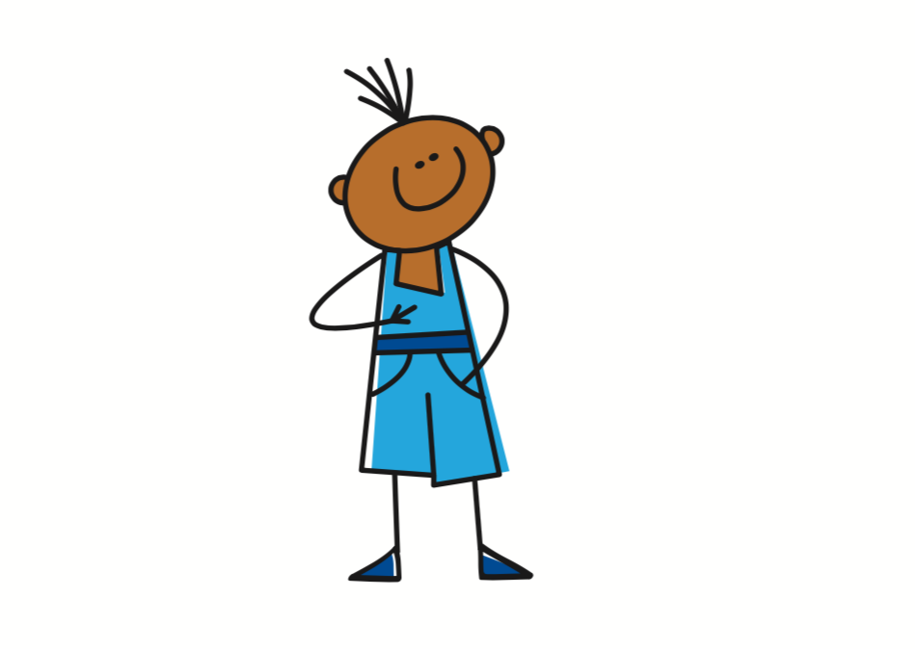
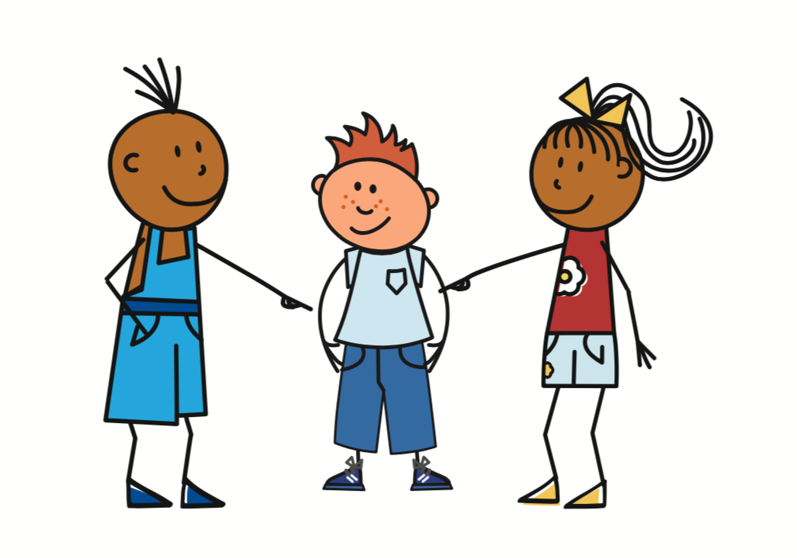
Avoir [to have, having]
The verb avoir means ‘to have’ or ‘having’:
I
je becomes j’ before a vowel.
j’ai
To say I have, use ______.
J’ai un chat.
I have a cat.
he
il a
Il a une chaise.
To say he has, use _____.
He has a chair.
she
elle a
Elle a une affiche.
To say she has, use _______.
She has a poster.
Notes:
Timing: 3 minutes
Aim: to introduce the verb avoir (to have), I have, he has and she has.
Procedure:
Click to present the information.
Elicit the English at each stage from pupils after presenting the French examples.

Slide 16
lire
Dans la salle de classe*
la salle de classe – classroom
C’est qui ? Pierre (je) ou Max (il) ?
Écris l’objet en anglais.
E
Il a un crayon.
Pierre (I) | Max (he)
1
j’ ai un chat.
2
j’ ai un dessin.
cat
pencil
3
il a une chaise.
picture
chair
4
4 j’ ai une affiche.
5
poster
horse
Il a un cheval.
6
Il a un message.
message
Notes:
Timing: 5 minutes
Aim: to practise written comprehension of ‘ai’ and ‘a’ and seven nouns
Procedure:
Read the title.
Click x2 to bring up context and clarify – Pierre writes about what he has and Max has.
Click x1 to bring up instruction in French – draw pupils’ attention to the meaning of ‘objet’
Do [E] with them.
Paying attention to the verb, pupils write the English word for the object in the correct column.
Correct the example.
Pupils complete 1-6.
Click to correct.
16

Slide 17
lire
Dans la salle de classe*
Lis les phrases. C’est possible ? C’est impossible ?
🤔
A
E
Il a un crayon.
Il a un crayon.
B
parler
1
j’ ai un chat.
C’est possible !
🤔
2
j’ ai un dessin.
3
il a une chaise.
4
4 j’ ai une affiche.
5
Il a un cheval.
6
Il a un message.
la salle de classe – classroom
Notes:
Timing: 3 minutes
Aim: to practise spoken pronunciation and consolidate comprehension of ‘ai’ and ‘a’ and seven nouns, responding to the likeliness of having these items in a classroom.
Procedure:
Read the title and the instruction.
Click x2 to bring up speech bubbles and model the conversation.
Pupil take turns to read statements 1-6 and react to them according to whether they are logical in this context (classroom).
Frequency of unknown words and cognates:
possible [175] impossible [652]
Londsale, D., & Le Bras, Y. (2009). A Frequency Dictionary of French: Core vocabulary for learners London: Routledge.
17

Slide 18
écouter
Dans la salle de classe*
C’est qui ? Pierre (je) ou Max (il) ?
Écris l’objet en anglais.
 | Pierre (I) | Max (he) | anglais
 |  |  | desk
 |  |  | picture
 |  |  | chair
 |  |  | pencil
 |  |  | poster
 |  |  | message
1
1
2
2
3
3
4
4
5
5
6
6
Notes:
Timing: 4 minutes
Aim: to practise aural comprehension of ‘ai’ and ‘a’.
Procedure:
Read the title and click to bring up the instructions in French.
Do the example (E).
Pupils listen and select the correct person, based on hearing the difference between ‘ai’ and ‘a’. Then they write (in English) the item mentioned.
Click to reveal answers.
Continue with items 2-6.
Transcript 1
[j’] ai un bureau.
[il] a un dessin.
[j’] ai une chaise.
[il] a un crayon.
[il] a une affiche.
[J’] ai un message.
Transcript 2
j’ ai un bureau.
il a un dessin.
j’ ai une chaise.
il a un crayon.
il a une affiche.
J’ ai un message.
18

Slide 19
Au revoir !
jaune
Notes:
19

