Slide 1
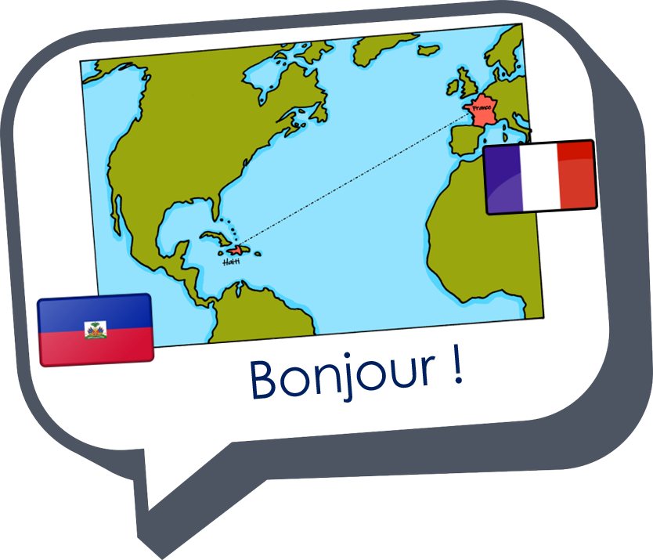
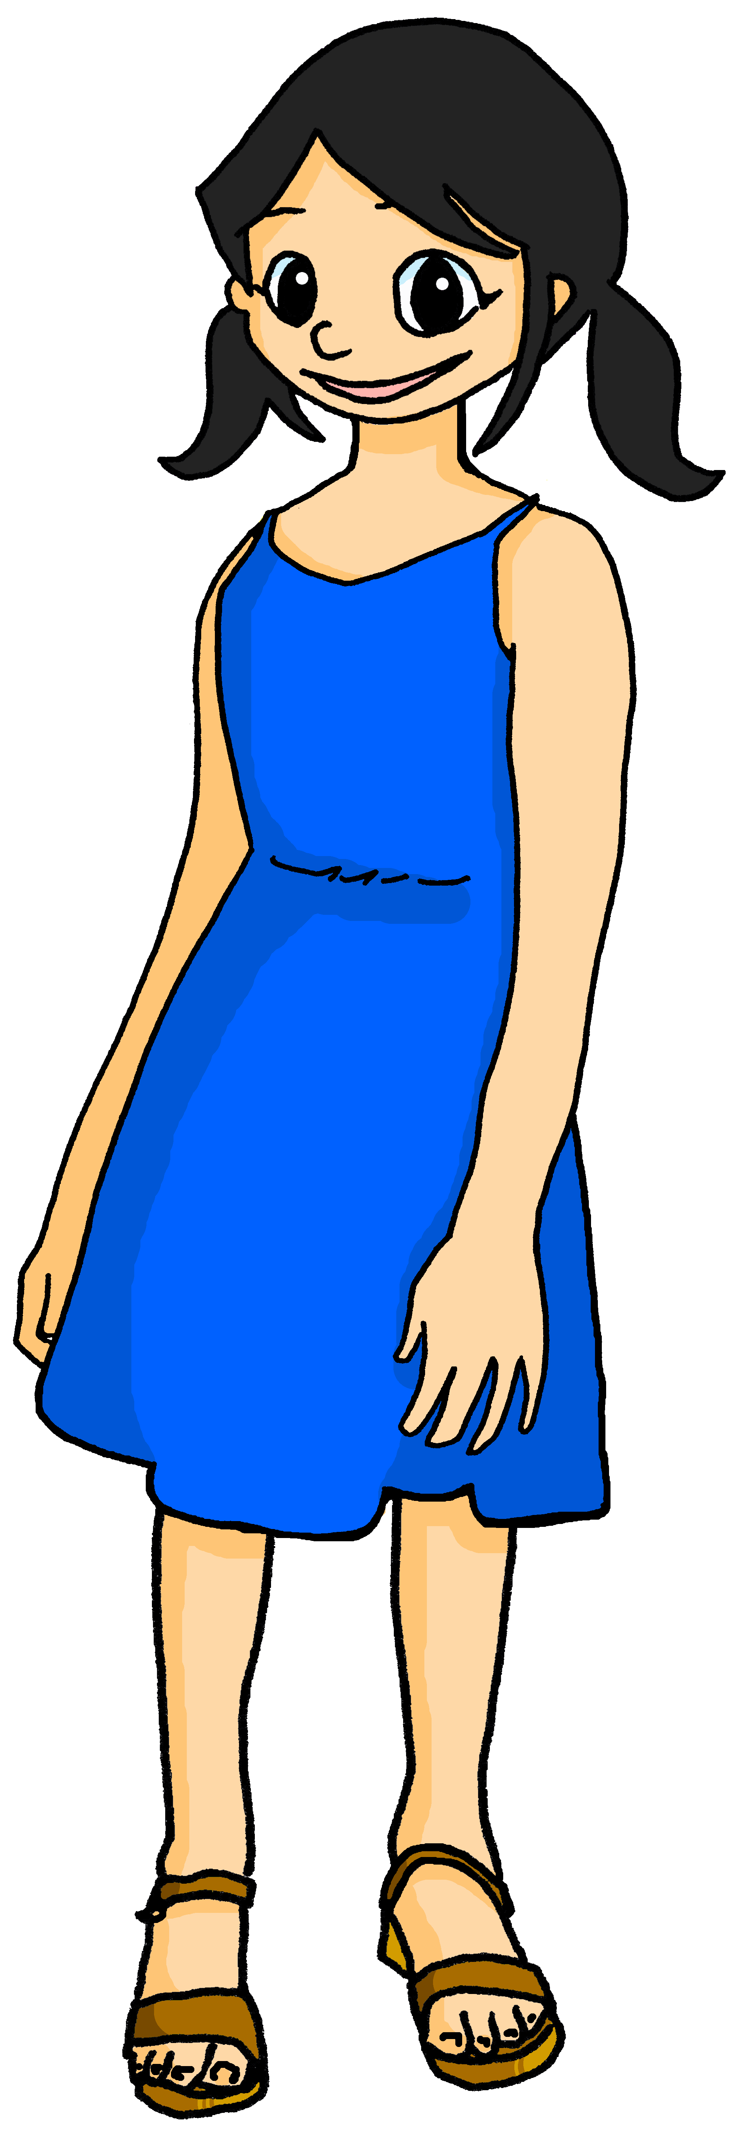
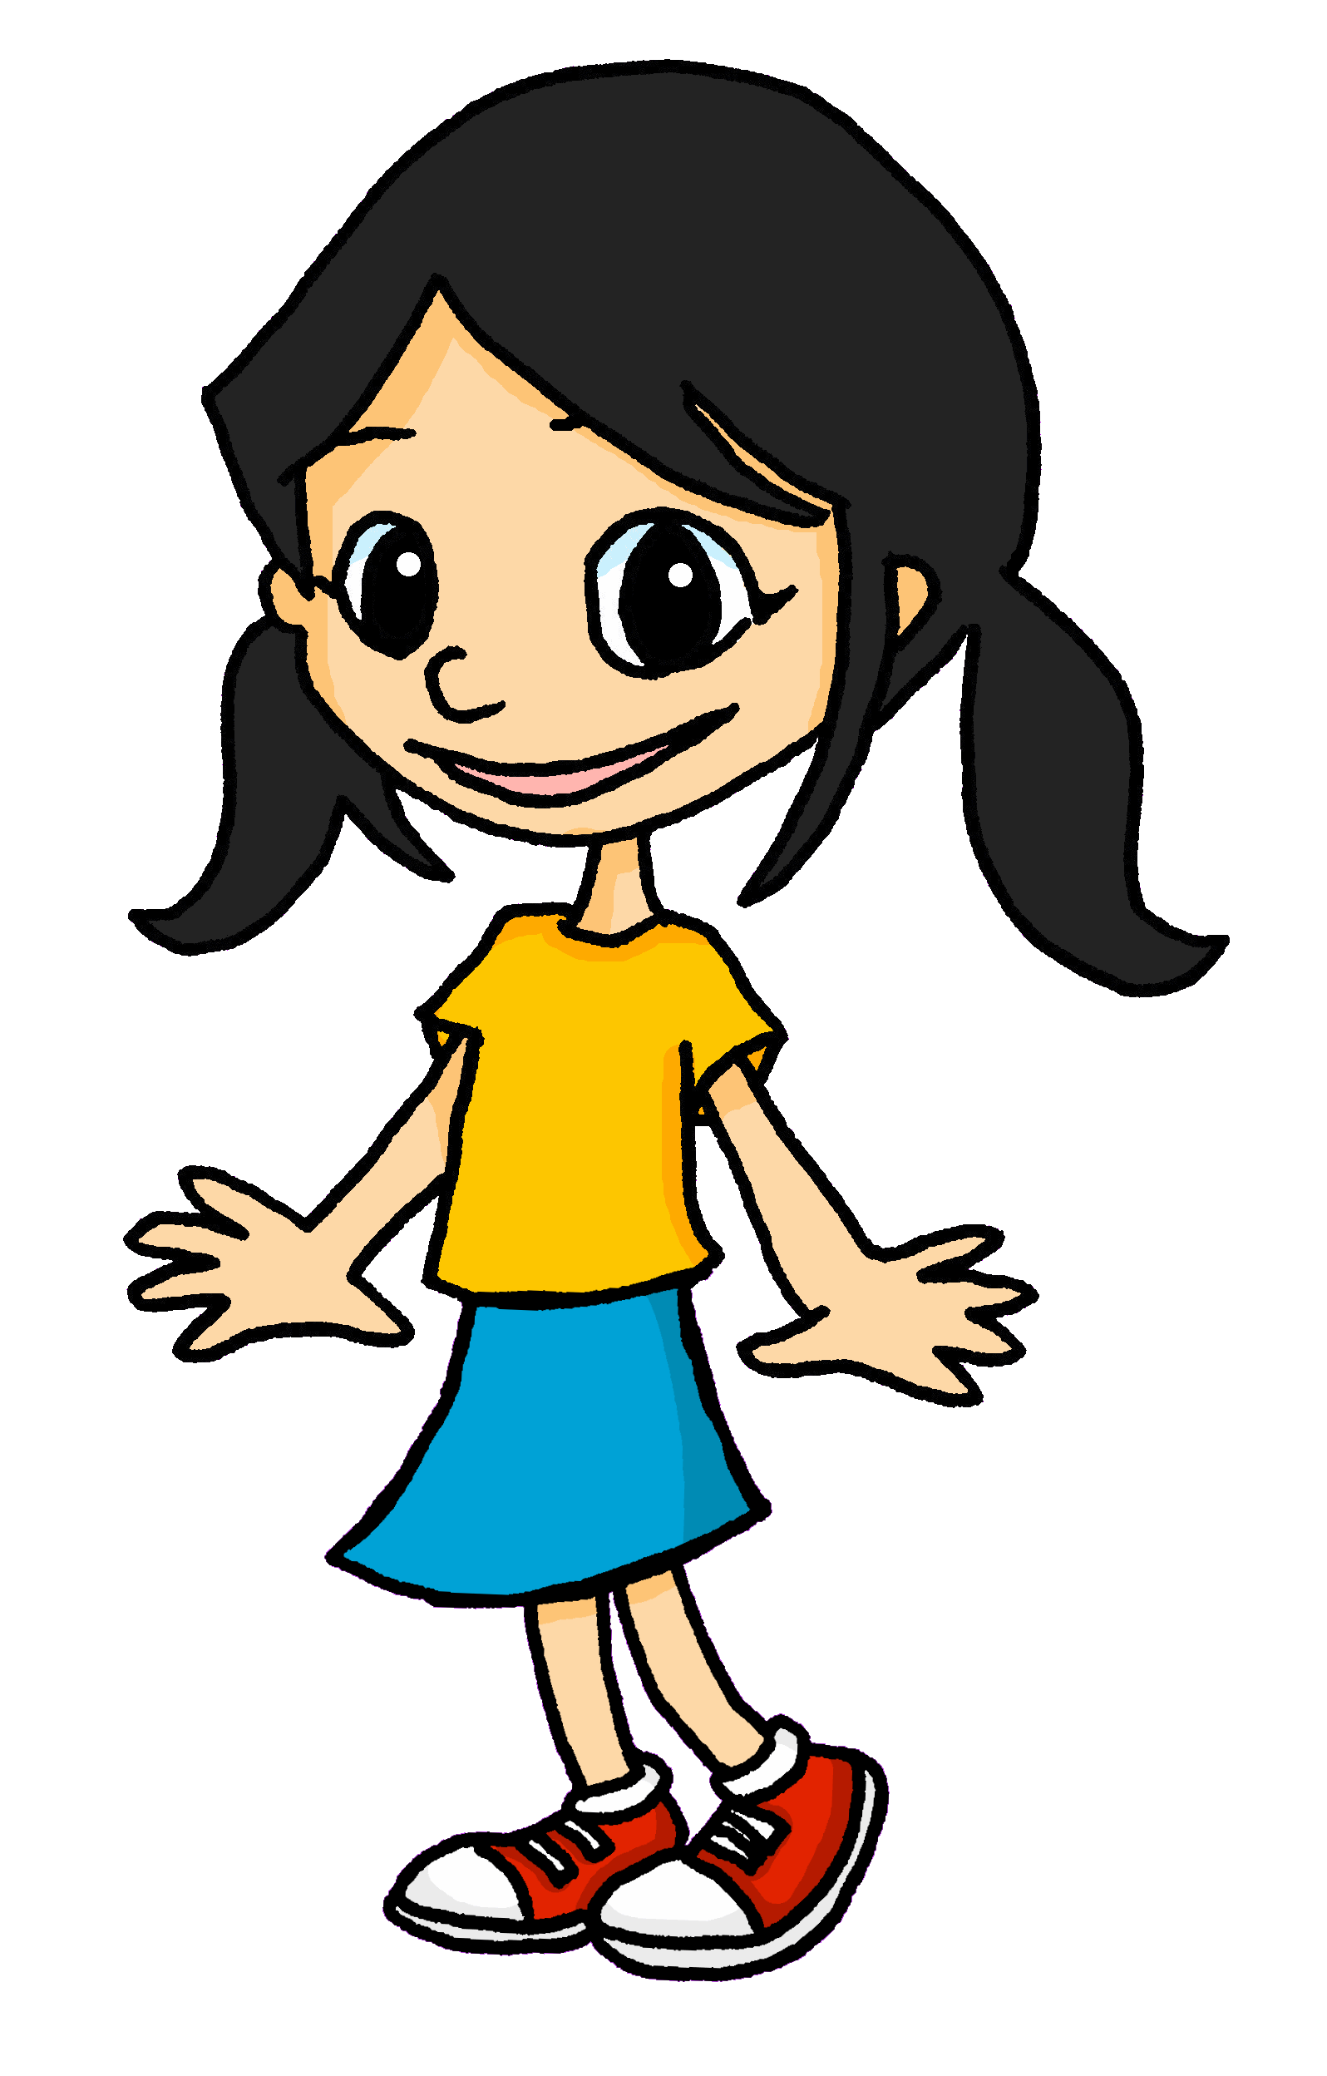
Describing me and others
jaune
Follow ups 1-5
Notes:
Artwork by Steve Clarke. Pronoun pictures from NCELP (www.ncelp.org). All additional pictures selected from Pixabay and are
available under a Creative Commons license, no attribution required.
Phonics: [eu] and [SFC] with words ending in -x
Frequency of new words:
Phonics: deux [41] un (petit) peu [91] un jeu [291]
Vocabulary: ce (c') [12] lundi [1091] mardi [1044] mercredi [1168] jeudi [1112] vendredi [1086] samedi [1356] dimanche [1235] aujourd’hui [233]
Londsale, D., & Le Bras, Y. (2009). A Frequency Dictionary of French: Core vocabulary for learners London: Routledge.
The frequency rankings for words that occur in this PowerPoint which have been previously introduced in these resources are
given in the SOW and in the resources that first introduced and formally re-visited those words.
For any other words that occur incidentally in this PowerPoint, frequency rankings will be provided in the notes field wherever
possible.

Slide 2
Follow up 1
[eu]
deux
Écoute.
écouter
Is the speaker describing a masculine or feminine noun?
 |  |  | en anglais
joyeuse |  |  | joyous
ambitieuse |  |  | ambitious
miraculeux |  |  | miraculous
religieuse |  |  | religious
vigoreux |  |  | vigorous
contagieuse |  |  | contagious
malheureux |  |  | unhappy
Ex
1
2
3
4
5
6
Notes:
Timing: 5 minutes (two slides)
Aim: to practise aural recognition of masculine –eux and feminine –euse adjective endings in some unknown words.
Procedure:
Click on each audio symbol to listen to the word.
Pupils write 1-6 and M or F for each word, paying attention to the ending.
Click for the answer ticks, the French word and then the English word (which pupils may offer suggestions for, as we include some written cognates here).
Transcript Ex. joyeuse [1] ambitieuse [2] miraculeux [3] religieuse [4] vigoreux [5] contagieuse
[6] malheureux
Frequency of unknown words and cognates: ambitieux [2905] contagieux [>5000] joyeux [3987] malheureux [2372] miraculeux [>5000] religieux [1203] vigoreux [>5000]
Londsale, D., & Le Bras, Y. (2009). A Frequency Dictionary of French: Core vocabulary for learners London: Routledge.

Slide 3
Follow up 2
Lis le texte.
In her diary, Adèle describes how her friends are.
Aïe, aïe, aïe ! She is as clumsy as Pierre! With hot chocolate on it we can’t read the names. Is it Léa or Yves or could it be either?
lire
les deux – both
Léa est curieuse, aujourd’hui.
Écris : Léa, Yves ou les deux* ?
Léa est drôle.
adjectif | Léa | Yves | either | anglais
Yves est triste.
curieuse
curious
drôle
funny
Yves est différent aujourd’hui.
triste
sad
Yves est sérieux.
différent
different
Léa est seule aujourd’hui.
sérieux
serious
seule
alone
Notes:
Timing: 6-8 minutes
Aim: to practise written understanding of adjective agreement and vocabulary from this and previous weeks.
Procedure:
Explain the task to pupils.
Ask students to write down the adjective & the person it refers to (Léa, Yves or either). Encourage them to write down the English meaning too.
The answers are animated – click to bring up the adjective, again for the tick and the name in the diary, and again to reveal the English meaning. For those statements that could be both, you can ask students to suggest who they think it is briefly before revealing the name (Léa ou Yves?).

Slide 4
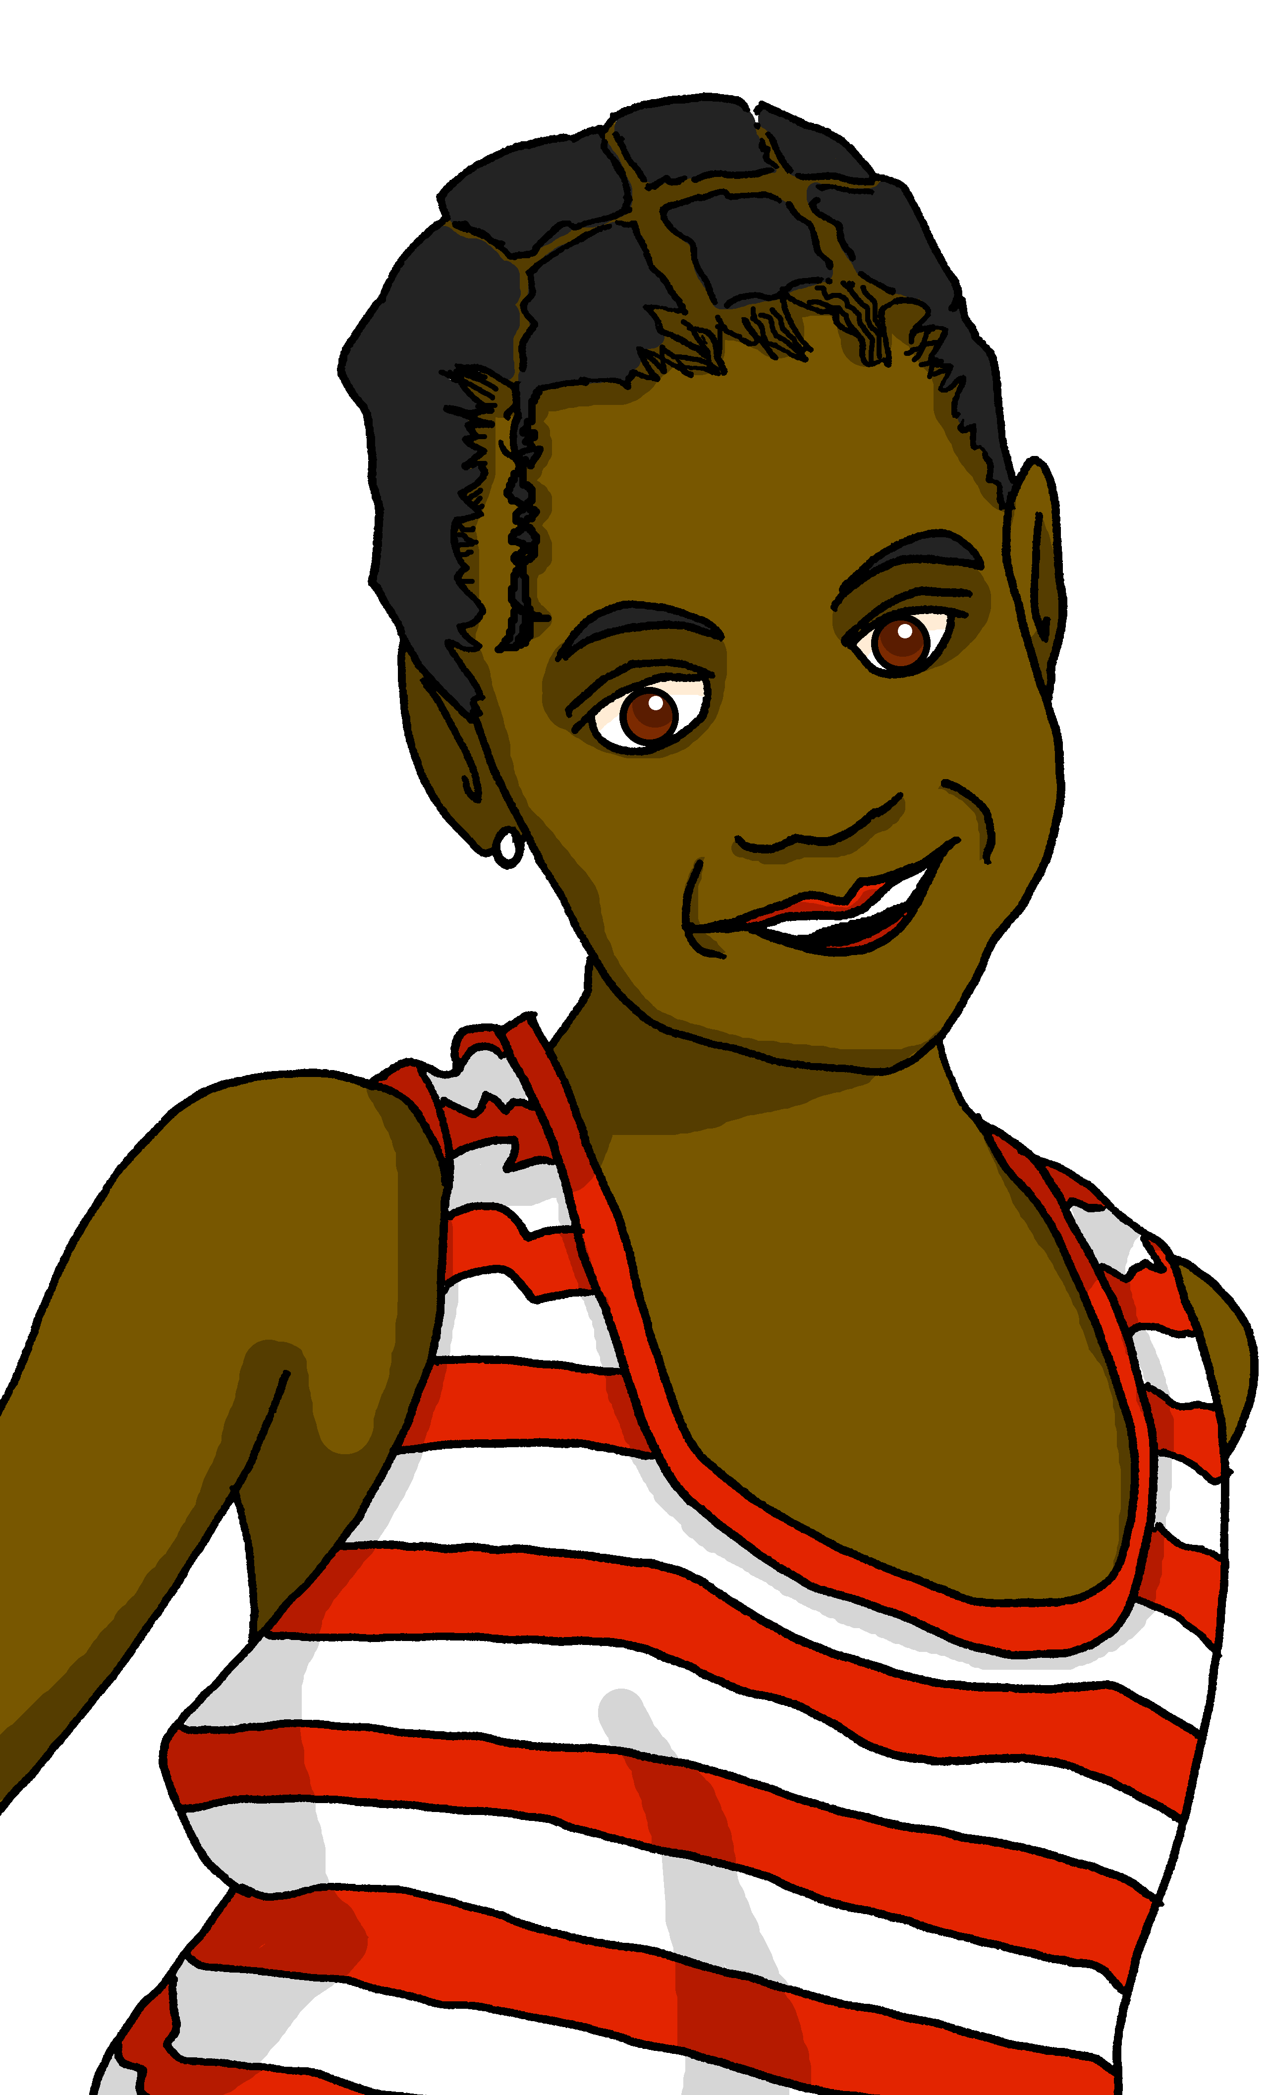
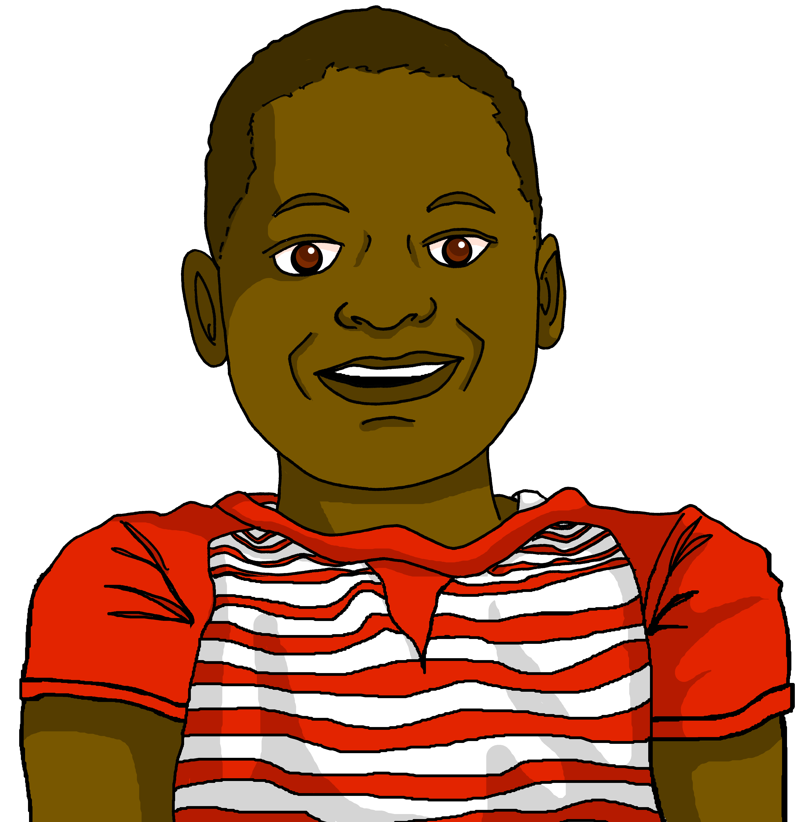
Follow up 3 [1/7]
Écoute.
Who is Clémentine talking to? Her cousin Adèle or her cousin Pierre?
écouter
Tu es sérieuse, aujourd’hui.
œ is the same sound as open [eu].
Clémentine est la sœur (sister) de Jean-Michel.
Pierre
Adèle
Notes:
Timing: 5 minutes (five slides)
Aim: to practise aural recognition of masculine and feminine adjective forms and connect them to the correct gender.
Procedure:
Click on Clémentine to hear her speak.
Pupils listen and select the correct person who is being addressed.
Click for answer, to see and to see the written form of Clémentine’s utterance.
Click for an introduction to Clémentine, Jean-Michel’s sister and the pronunciation tip for œ.
Transcript: Tu es sérieuse, aujourd’hui.

Slide 5
Follow up 3 [2/7]
écouter
Tu es importante !
Pierre
Adèle
Notes:
[2/7]
Transcript: Tu es importante !

Slide 6
Follow up 3 [3/7]
écouter
Tu es courageux !
Pierre
Adèle
Notes:
[3/7]
Transcript: Tu es courageux !

Slide 7
Follow up 3 [4/7]
écouter
Aujourd’hui, tu es seul.
Pierre
Adèle
Notes:
[4/7]
Transcript: Aujourd’hui tu es seul.

Slide 8
Follow up 3 [5/7]
écouter
Tu es
contente ?
Pierre
Adèle
Notes:
[5/7]
Transcript: Tu es contente ?

Slide 9
Follow up 3 [6/7]
écouter
Tu es curieuse.
Pierre
Adèle
Notes:
[6/7]
Transcript: Tu es curieuse.

Slide 10
Follow up 3 [7/7]
écouter
Aujourd’hui tu es différent !
Pierre
Adèle
Notes:
[7/7]
Transcript: Aujourd’hui tu es différent !

Slide 11
Follow up 4

Écris.
Write a phrase stating the day of the week, and another to describe how you are.
écrire
Une semaine | Aujourd’hui, c’est lundi.
Ça va ? | Je suis sérieux | sérieuse.
Notes:
Timing: 10 minutes
Aim: to practise written production of the days of the week and different adjectives.
Procedure:
Pupils write a set of short statements, following the model: Aujourd’hui, c’est lundi. Je suis sérieux | sérieuse.

Slide 12
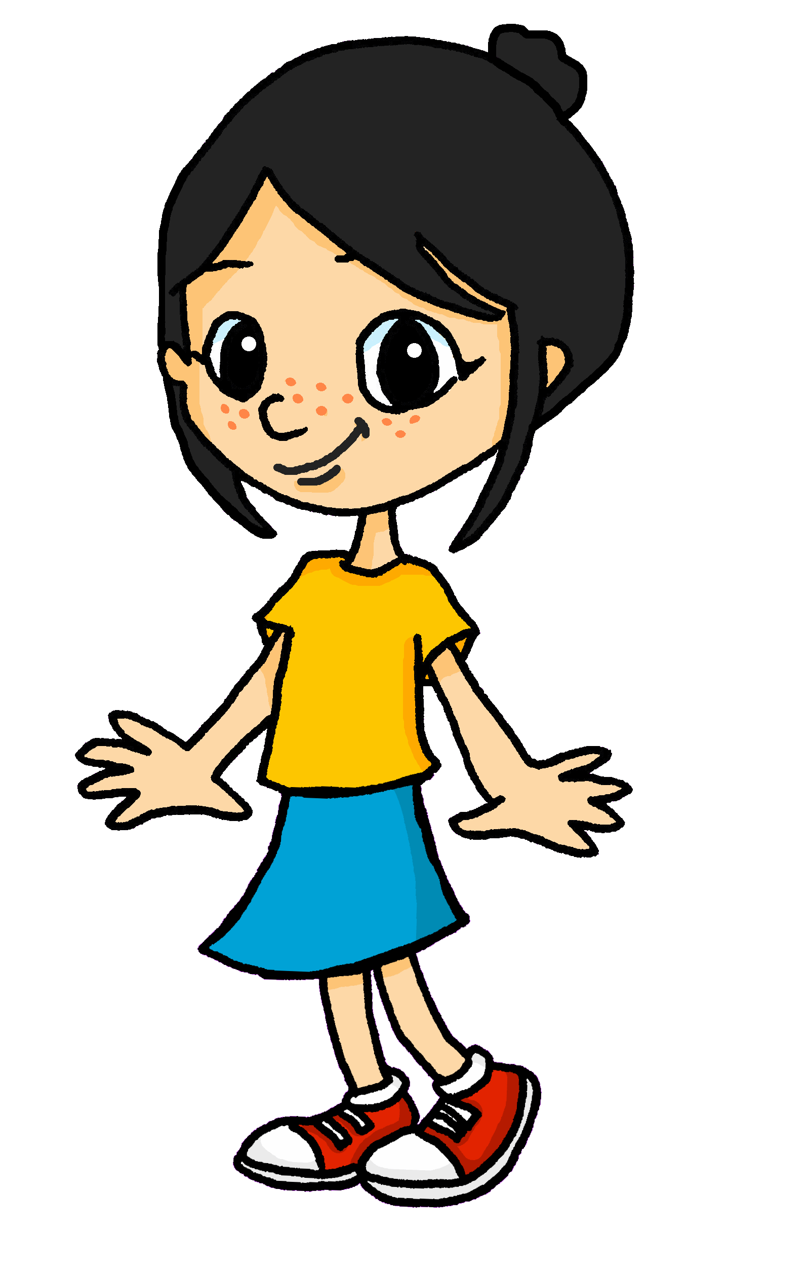
Follow up 5A
Parle en français.
Léa is playing a word game with her sister, Eugénie. What does Euégenie have to say?
parler
Aujourd’hui, c’est mercredi. Je suis prudent|prudente.
Aujourd’hui, c’est vendredi. Je suis important|importante.
Aujourd’hui, c’est lundi. Je suis curieux|curieuse.
Aujourd’hui, c’est samedi. Je suis heureux|heureuse.
Aujourd’hui, c’est dimanche. Je suis courageux|courageuse.
Aujourd’hui, c’est jeudi. Je suis sérieux|sérieuse..
1 | Friday
2 | Thursday
3 | Saturday
4 | Monday
5 | Sunday
6 | Wednesday
1 | curious
2 | serious
3 | important
4 | brave
5 | happy
6 | careful
Notes:
Timing: 5 minutes
Aim: to practise oral production of the days of the week and different adjectives.
Procedure: 1. Click to ‘roll’ the dice.
2. Students pick the day and adjective whose numbers correspond to the respective dice, then make two short sentences using the pattern, ‘Aujourd’hui, c’est (lundi). Je suis (sérieux).’ They should make the adjective agree for them. They say the answer chorally.
3. Click to reveal the correct sentence.
4. Repeat until all combinations have been tried.

Slide 13
Follow up 5B
[eu]
deux
Écoute et lis le poème.
prononcer
Mathieu, le merveilleux
Mathieu a deux yeux bleus Il n’a plus de cheveux Mais il est merveilleux Mathieu est courageux Il n’est pas malheureux Mais il est très curieux
Notes:
ADDITIONAL
Timing: 5 minutes
Aim: to practise oral production of SSC [eu] and [SFC].
Procedure:
Click to play the video from the beginning up to 28s (the first two verses) and ask pupils to follow along.
Play the extract again.
The third time, encourage pupils to read along as you play the clip.
Ask pupils to tell you the words they recognise. (deux, mais, il, est, courageux, heureux, curieux).
Clarify the meaning of the lines.
Translation: Matthew has two blue eyes He has no hair (He no longer has any hair)
But he is marvellous Matthew is brave He is not unhappy But he is very curious
Link: https://www.youtube.com/watch?v=03F-BxFi3y0 Note: these two verses contain a lot of familiar language and structures but even in the first two verses there is unknown language. For example, it is not until next week that pupils will learn avoir (to have) and it will be some time before we introduce negative structures. However, we introduce this part of the poem here for pronunciation practise of [eu] and [SFC].
Frequency of unknown words and cognates: merveilleux [2209] œil (pl. yeux) [474] bleu [1216] plus [19] de [2] cheveu [2296] malheureux [2372]
Londsale, D., & Le Bras, Y. (2009). A Frequency Dictionary of French: Core vocabulary for learners London: Routledge.

