Slide 1
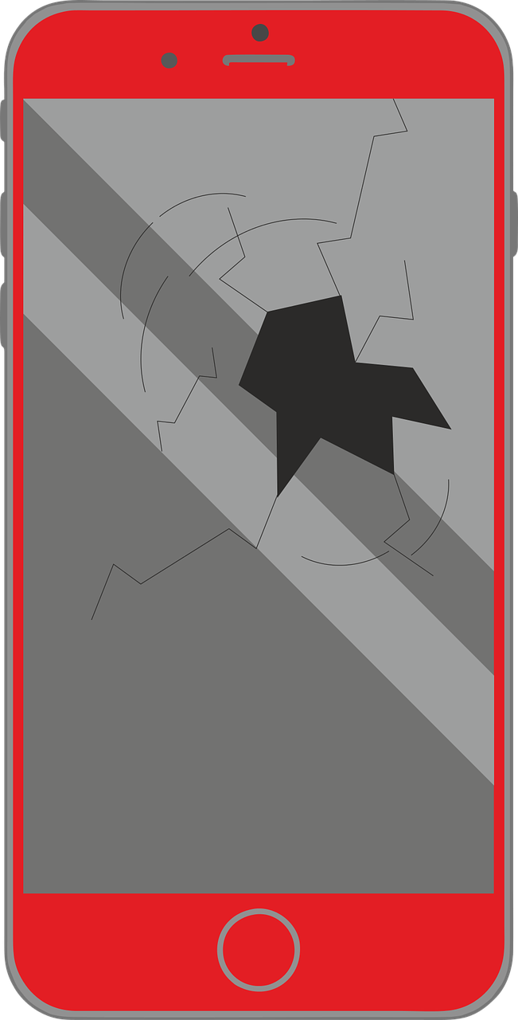
Describing me and others
jaune
Review of « Être » : je suis, tu es, il/elle est
Adjectival agreement
Intonation questions
SSC [an/en] (nasal sound)
SFC
Term 1 Week 5
Notes:
Artwork by Steve Clarke. Pronoun pictures from NCELP (www.ncelp.org). All additional pictures selected from Pixabay and are
available under a Creative Commons license, no attribution required.
The AUDIO version of the lesson material includes additional audio for the new language
presented (phonics, vocabulary) and audio for the instructions on the slide.
In addition, it includes VIDEO clips of the phonics and the phonics’ source words. Pupils can be
encouraged to look at the shape of the mouth/lips on slides where these appear, and try to copy
it/them.
Phonics: [an/en] and [a], also [SFC] with final -t
Frequency of new words:
Phonics: enfant [126] maman [2168]
Vocabulary: difficile [296] drôle [2166] jeune [152] joli [2398]
Londsale, D., & Le Bras, Y. (2009). A Frequency Dictionary of French: Core vocabulary for learners London: Routledge.
The frequency rankings for words that occur in this PowerPoint which have been previously introduced in these resources are
given in the SOW and in the resources that first introduced and formally re-visited those words.
For any other words that occur incidentally in this PowerPoint, frequency rankings will be provided in the notes field wherever
possible.
1

Slide 2
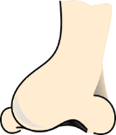
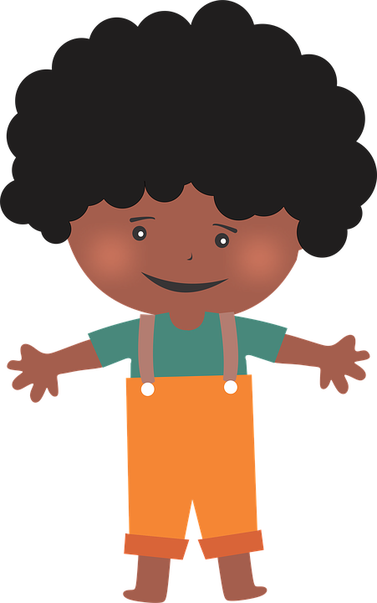
[an|en]
prononcer
enfant
French vowels are either nasal like [an|en] or
non-nasal (oral) like [e] and [a].
When you say a nasal vowel, air passes through your nose as well as your mouth.
Notes:
Timing: 1 minute
Aim: to re-introduce SSC [an|en], which pupils met last week.
Procedure:
Introduce and elicit the pronunciation of the individual SSC [an|en]. Practise saying it several times.
Click to bring up the information about nasal and oral vowel sounds. Practise saying [a] then [an|en] several times.
Click to bring up the source word ‘enfant’ (with gesture, if using). Say the word several times.
Click to bring up the picture and get pupils to repeat the words (with gesture, if using).
Pupils can also practise in pairs.

Slide 3
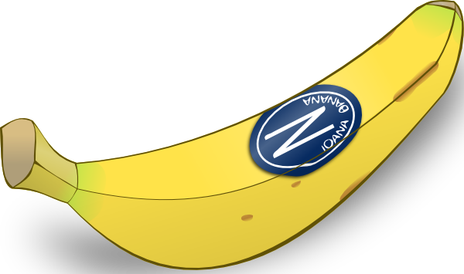
[a]
banane
prononcer
[a] is an oral vowel.
Notes:
Timing: 1 minute
Aim: to remind pupils of SSC [a]
Procedure:
Elicit the pronunciation of the individual SSC [a] and then the source word ‘banane’ (with gesture, if using).
Click to bring on the picture and get students to repeat (with gesture, if using).
Note: a gesture for ‘banana’ – we suggest making the shape of a banana with both hands – start with finger tips together in the middle, pull them apart and upwards to trace the shape of a banana (like the shape of a smile).
3

Slide 4
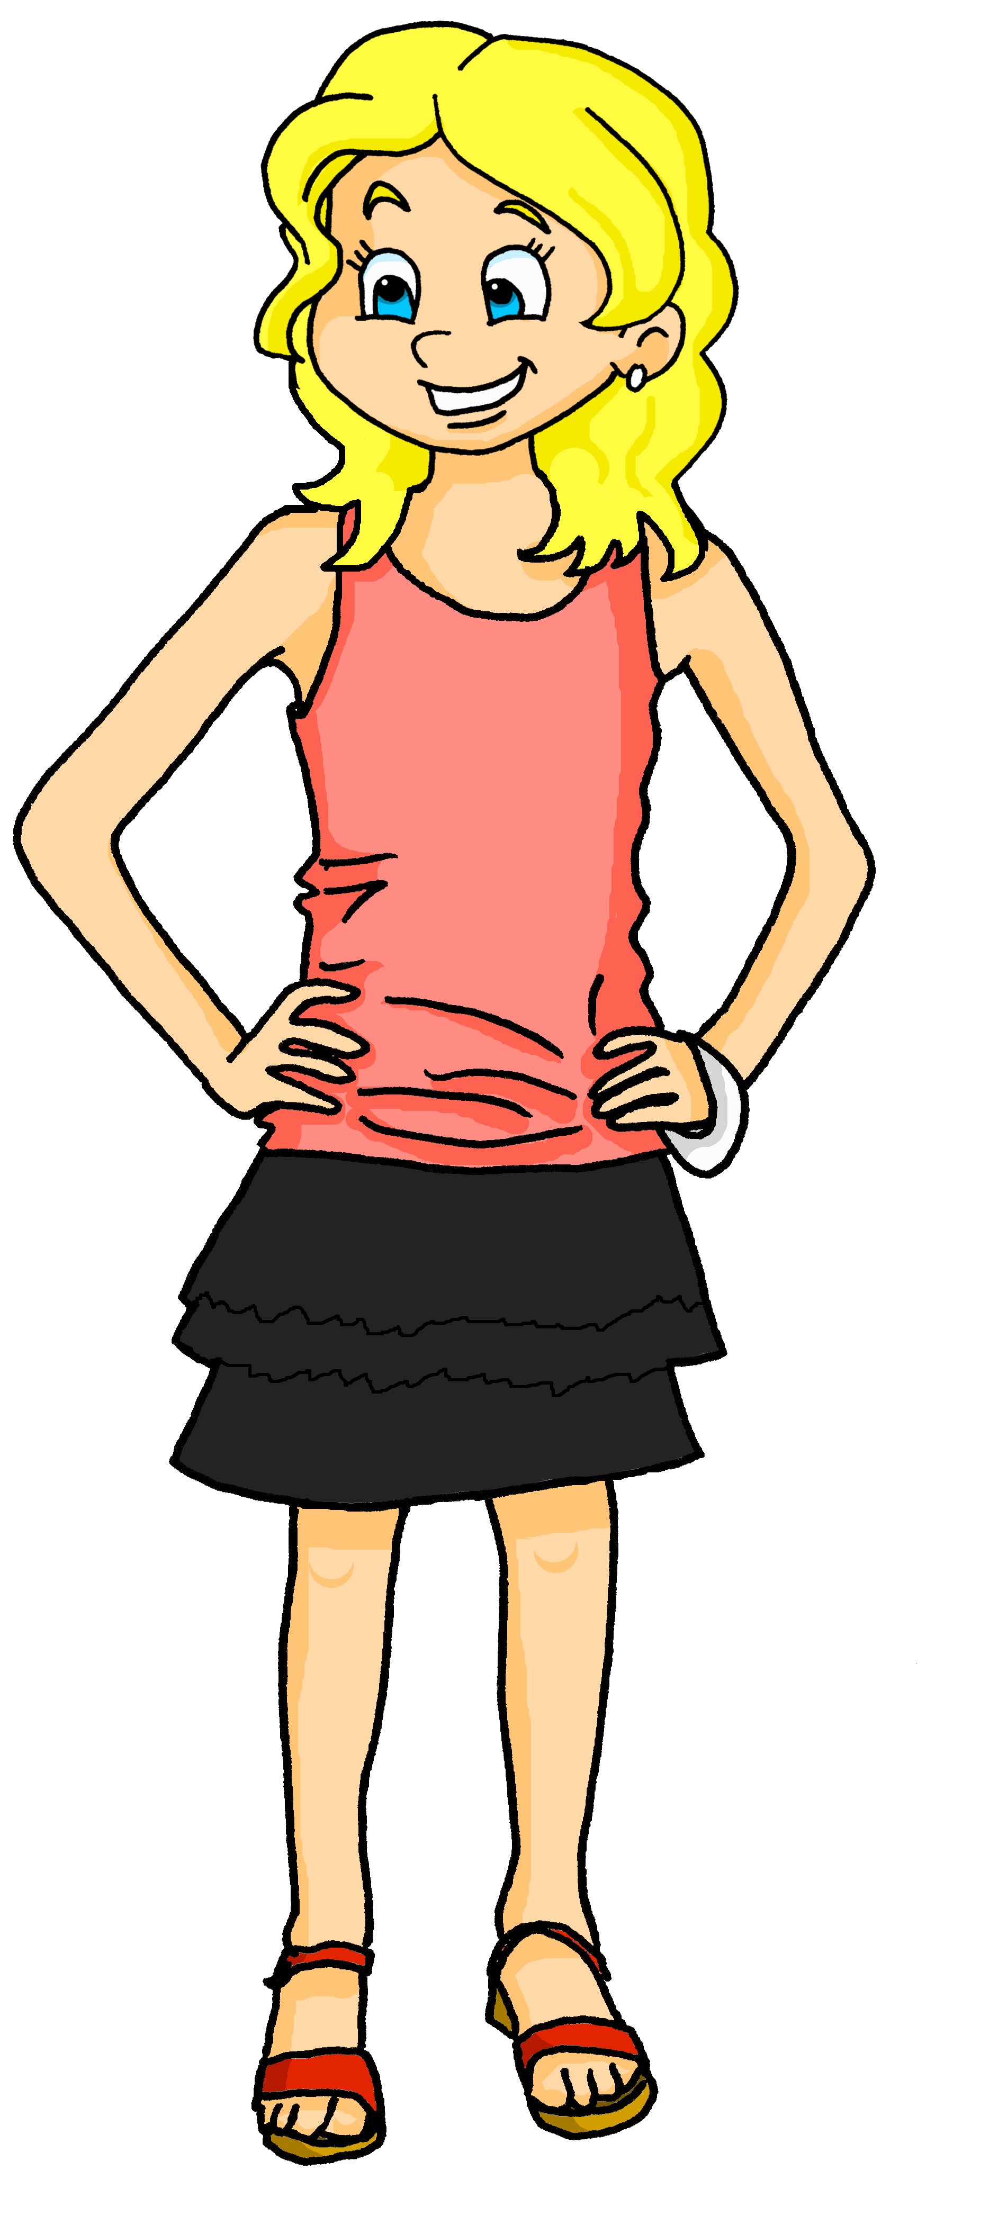
[a]
[an]
prononcer
This common French word has both an oral vowel and a nasal vowel.
Maman
oral vowel
nasal vowel
Voici Claudine, la maman de Pierre et Adèle.
Notes:
Timing: 1 minute
Aim: to focus further on the difference in sound between [a] and [an|en].
Procedure:
Click to bring up the two SSC [a] and [an|en].
Click to bring up the cluster word ‘maman’. Say the word several times.
Click to bring up the call out and labels for [a] and [an|en].
Click to introduce Claudine, Pierre and Adèle’s mum.
4

Slide 5
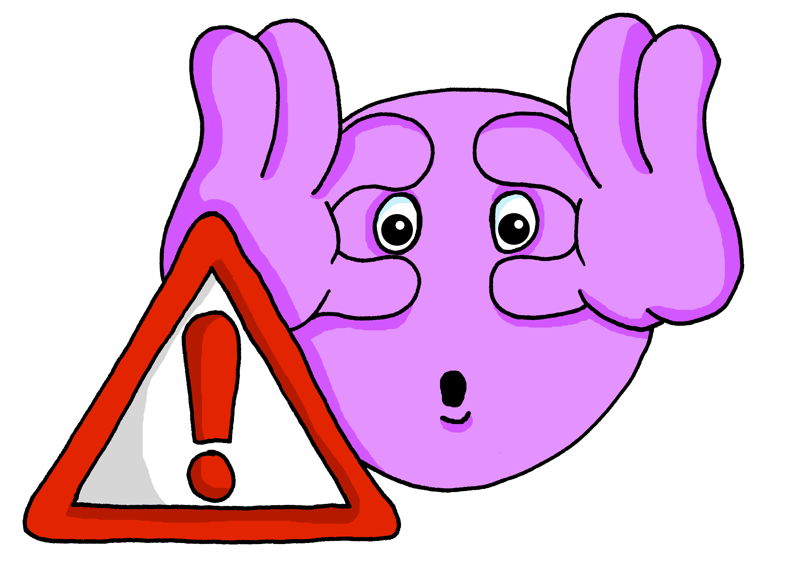
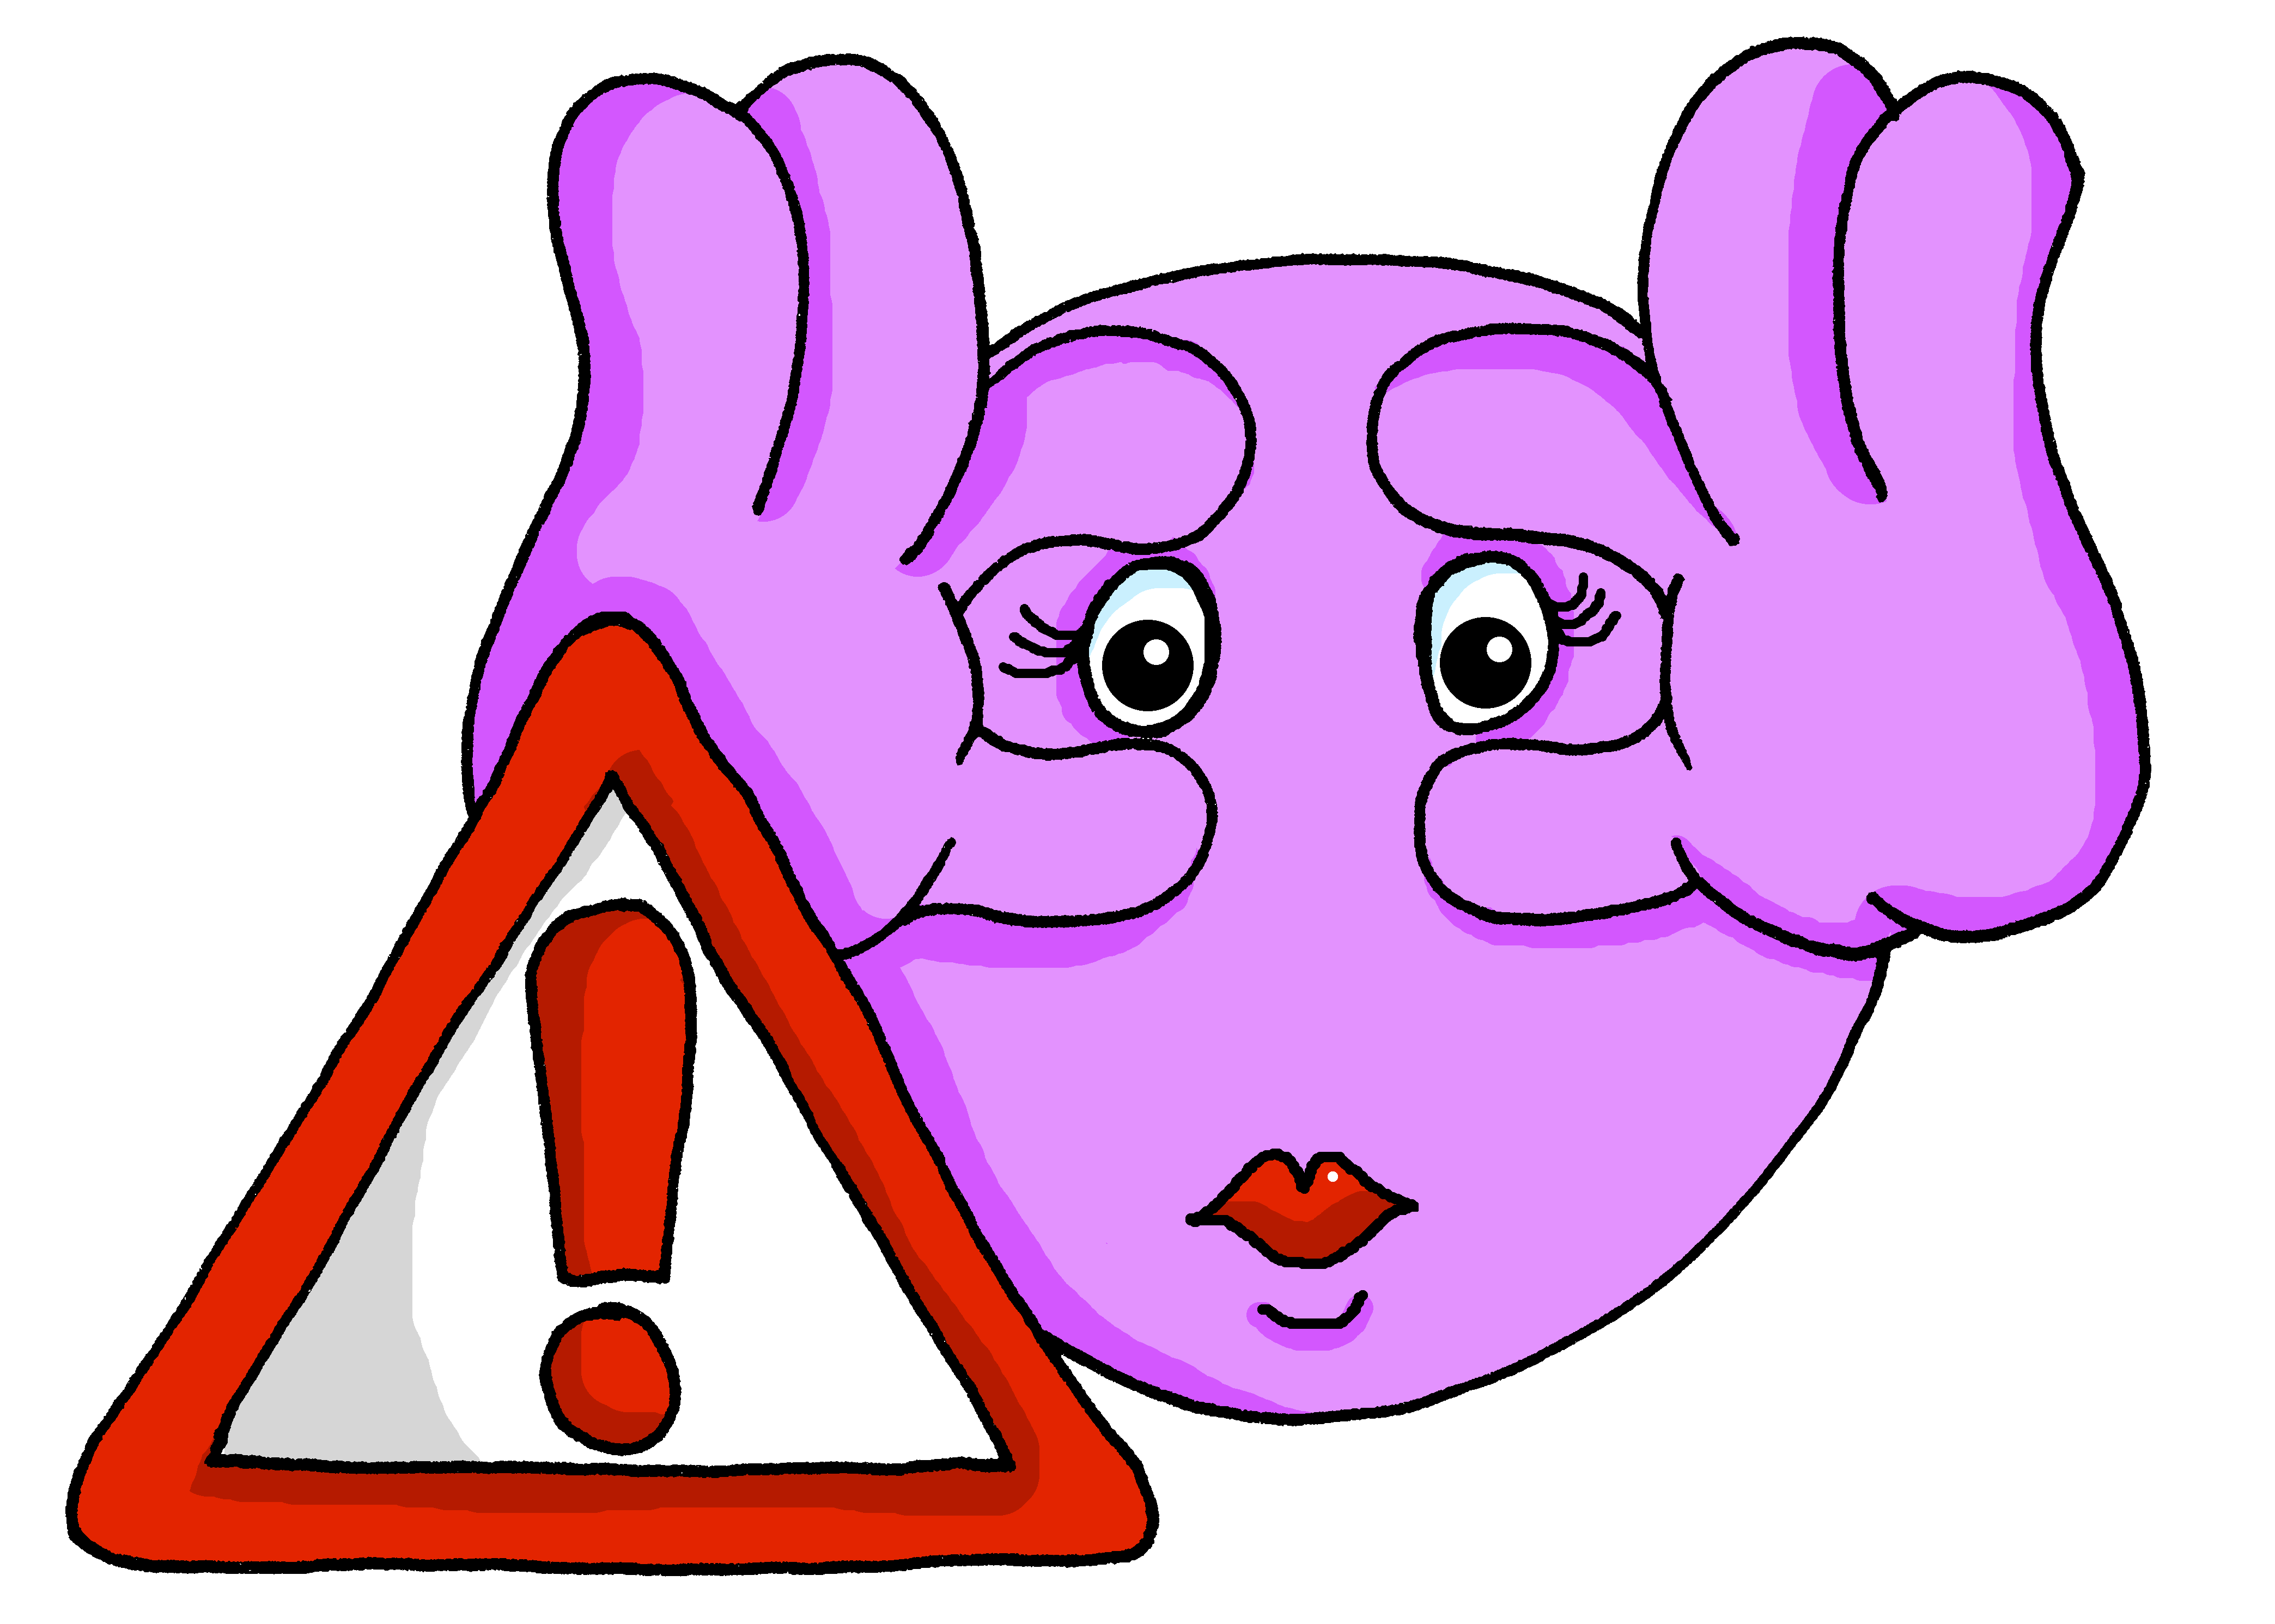
vocabulaire
Écoute et répète.
mots
The ‘e’ at the end means you do pronounce the ‘t’. This ‘e’ is called Silent Final ‘e’ [Sfe].
prudent
prudente
careful (m)
careful (f)
Notes:
Timing: 4 minutes (five slides)
Aim: to present and practise new vocabulary for this week.
Procedure:
Click to bring up the word. Say the word.
Click for the English meaning. Say the French word again. Pupils repeat.
Click to bring up the picture. Say the word again, together with pupils this time. Do the accompanying gesture.
Teacher uses the gesture again to elicit the word again from pupils.
Click for the reminder of the silent final –t for the masculine, and the pronounced –t for the feminine form.
Continue with the next four slides.
5

Slide 6
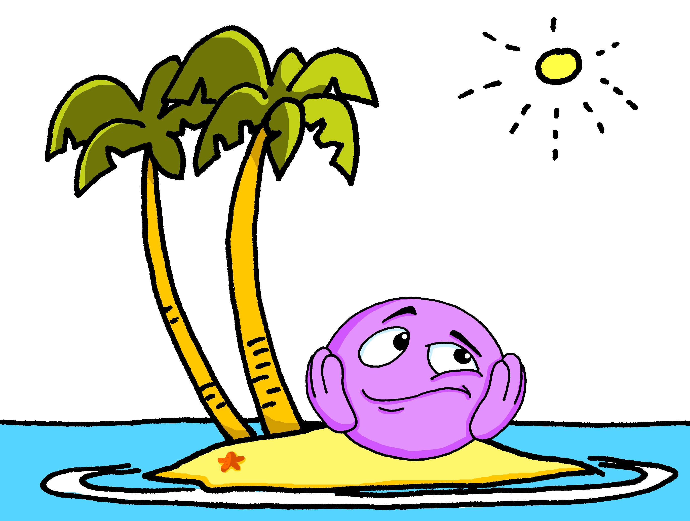
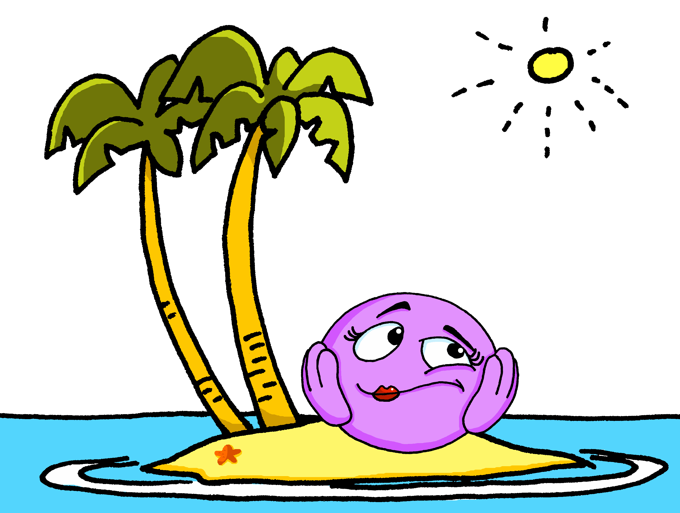
vocabulaire
Écoute et répète.
mots
CaReFuL! Often you do pronounce the C – R – F – L at the end of French words.
You add ‘e’ to describe a feminine noun BUT seule sounds the same as seul.
seul
seule
alone (m)
alone (f)
Notes:
6

Slide 7
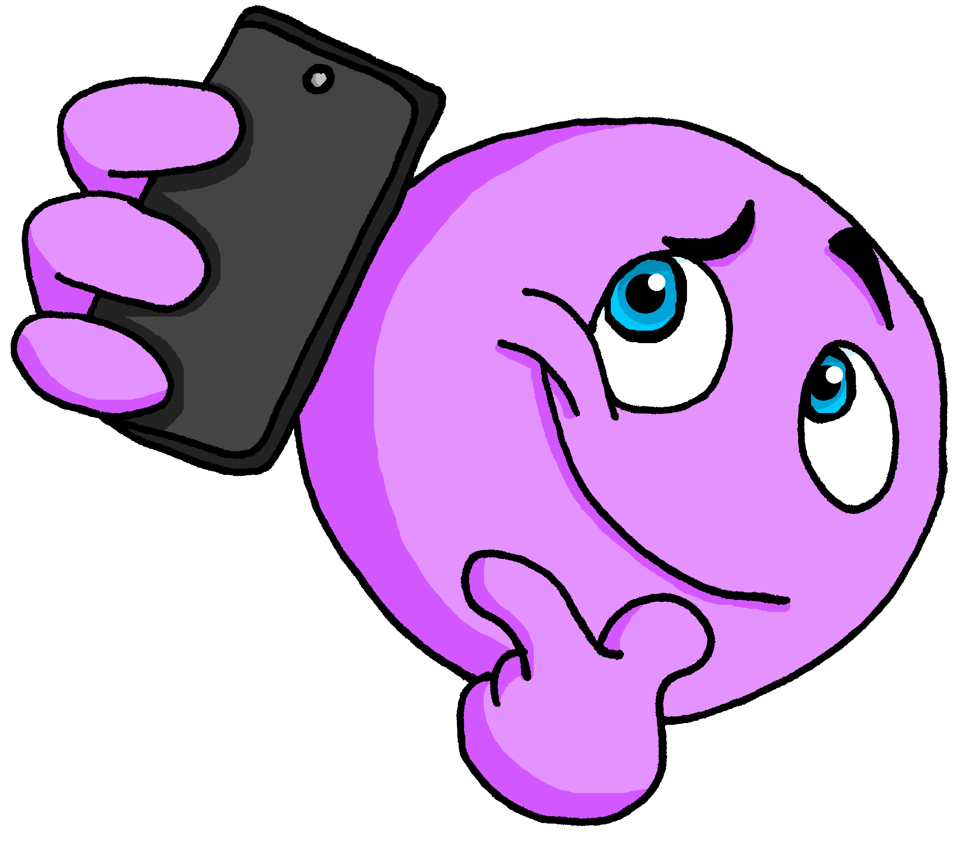
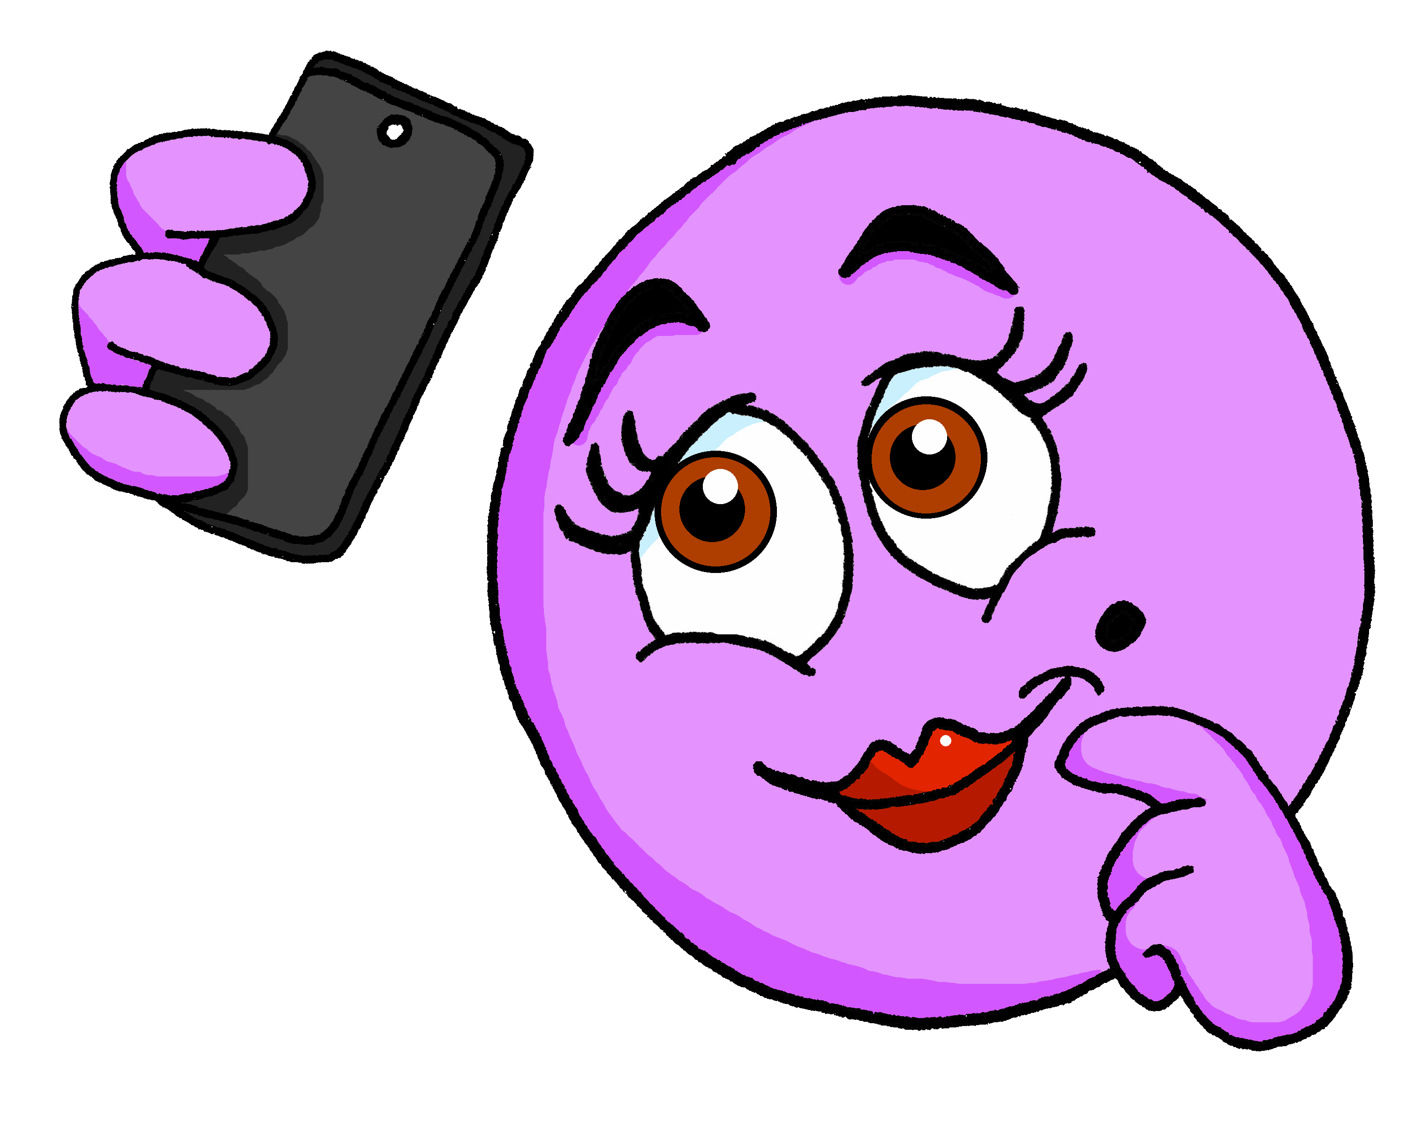
vocabulaire
Écoute et répète.
mots
joli
jolie
pretty, attractive (m)
pretty, attractive (f)
Notes:
7

Slide 8
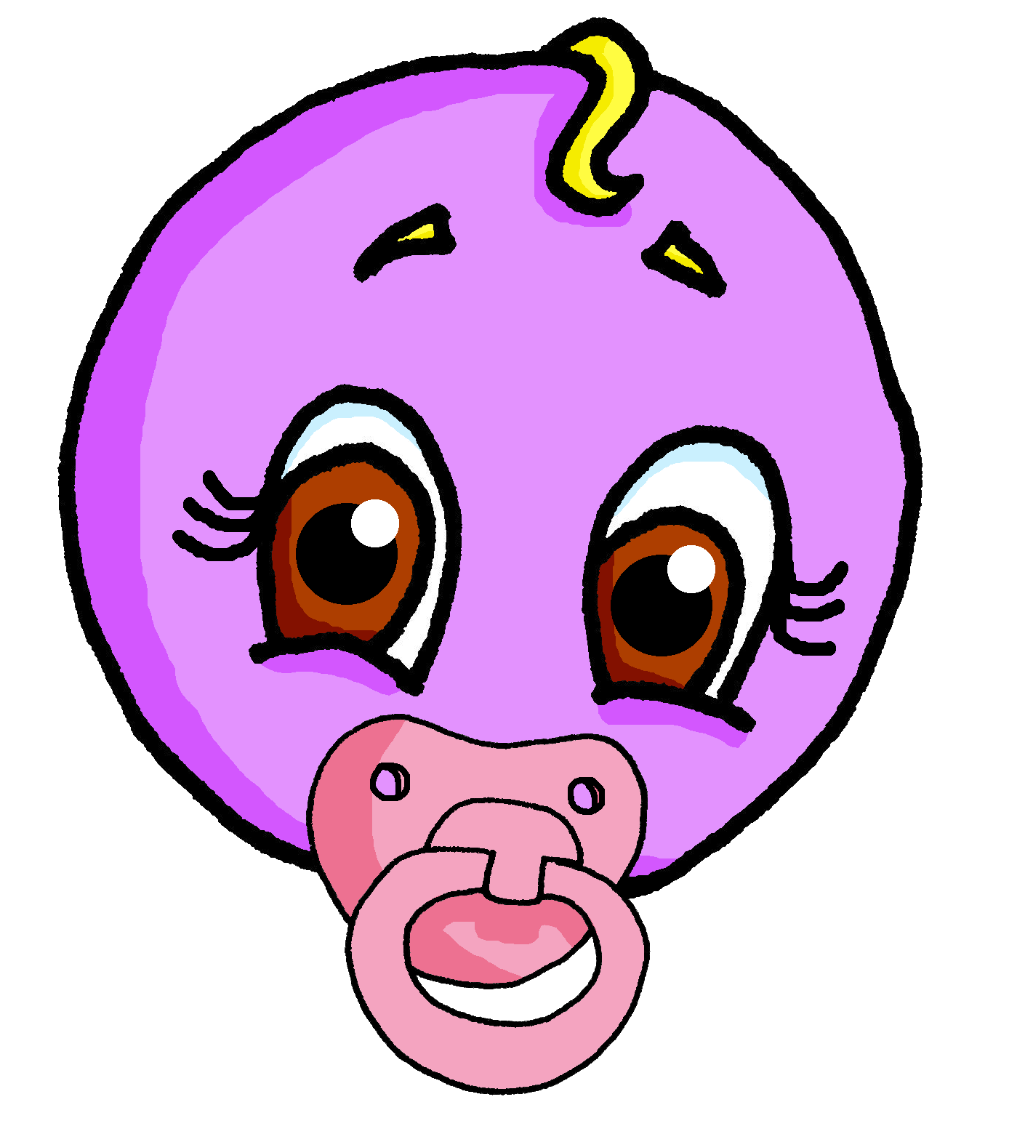
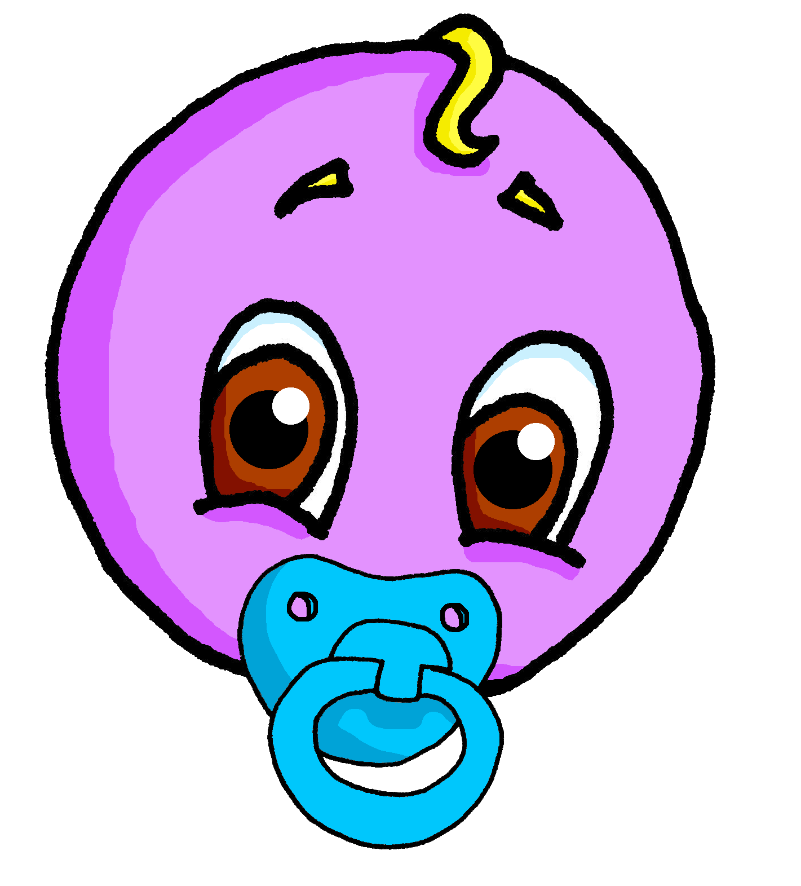
vocabulaire
Écoute et répète.
mots
jeune
jeune
young (m)
young (f)
Notes:
8

Slide 9
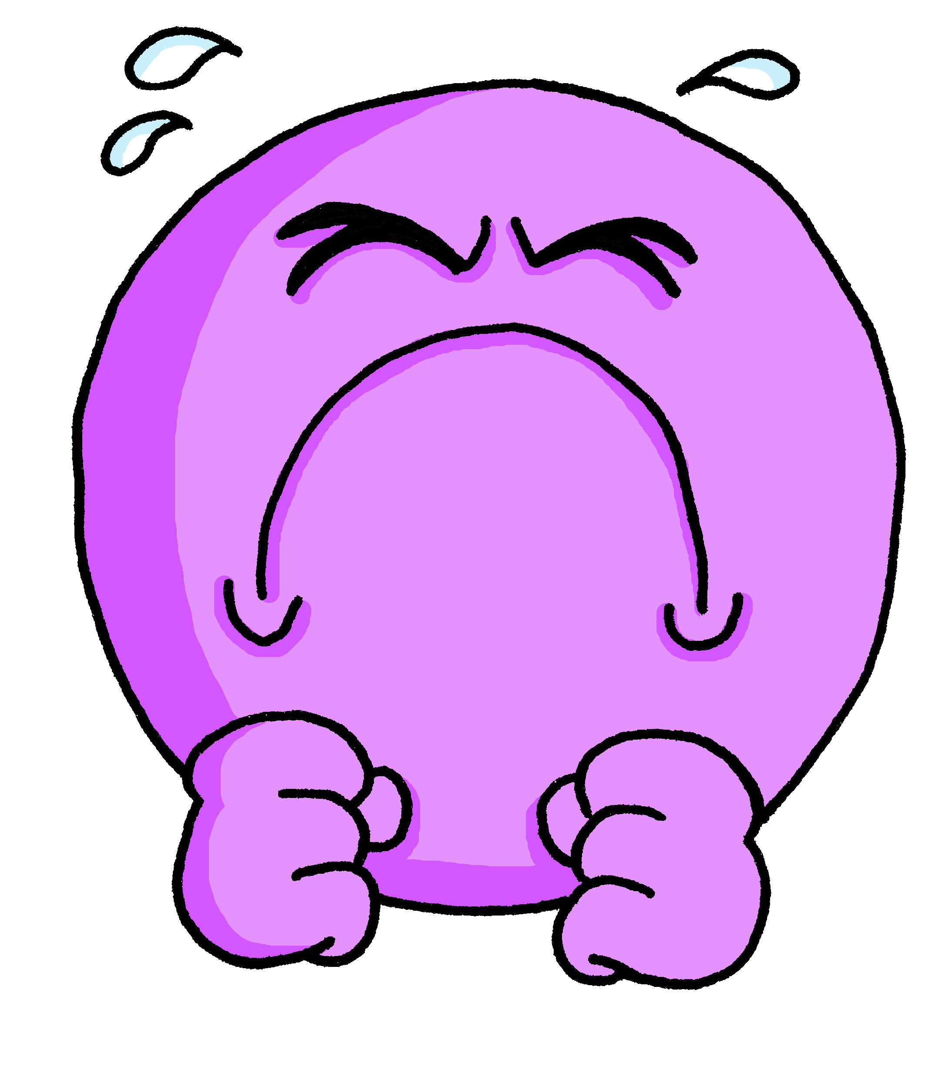
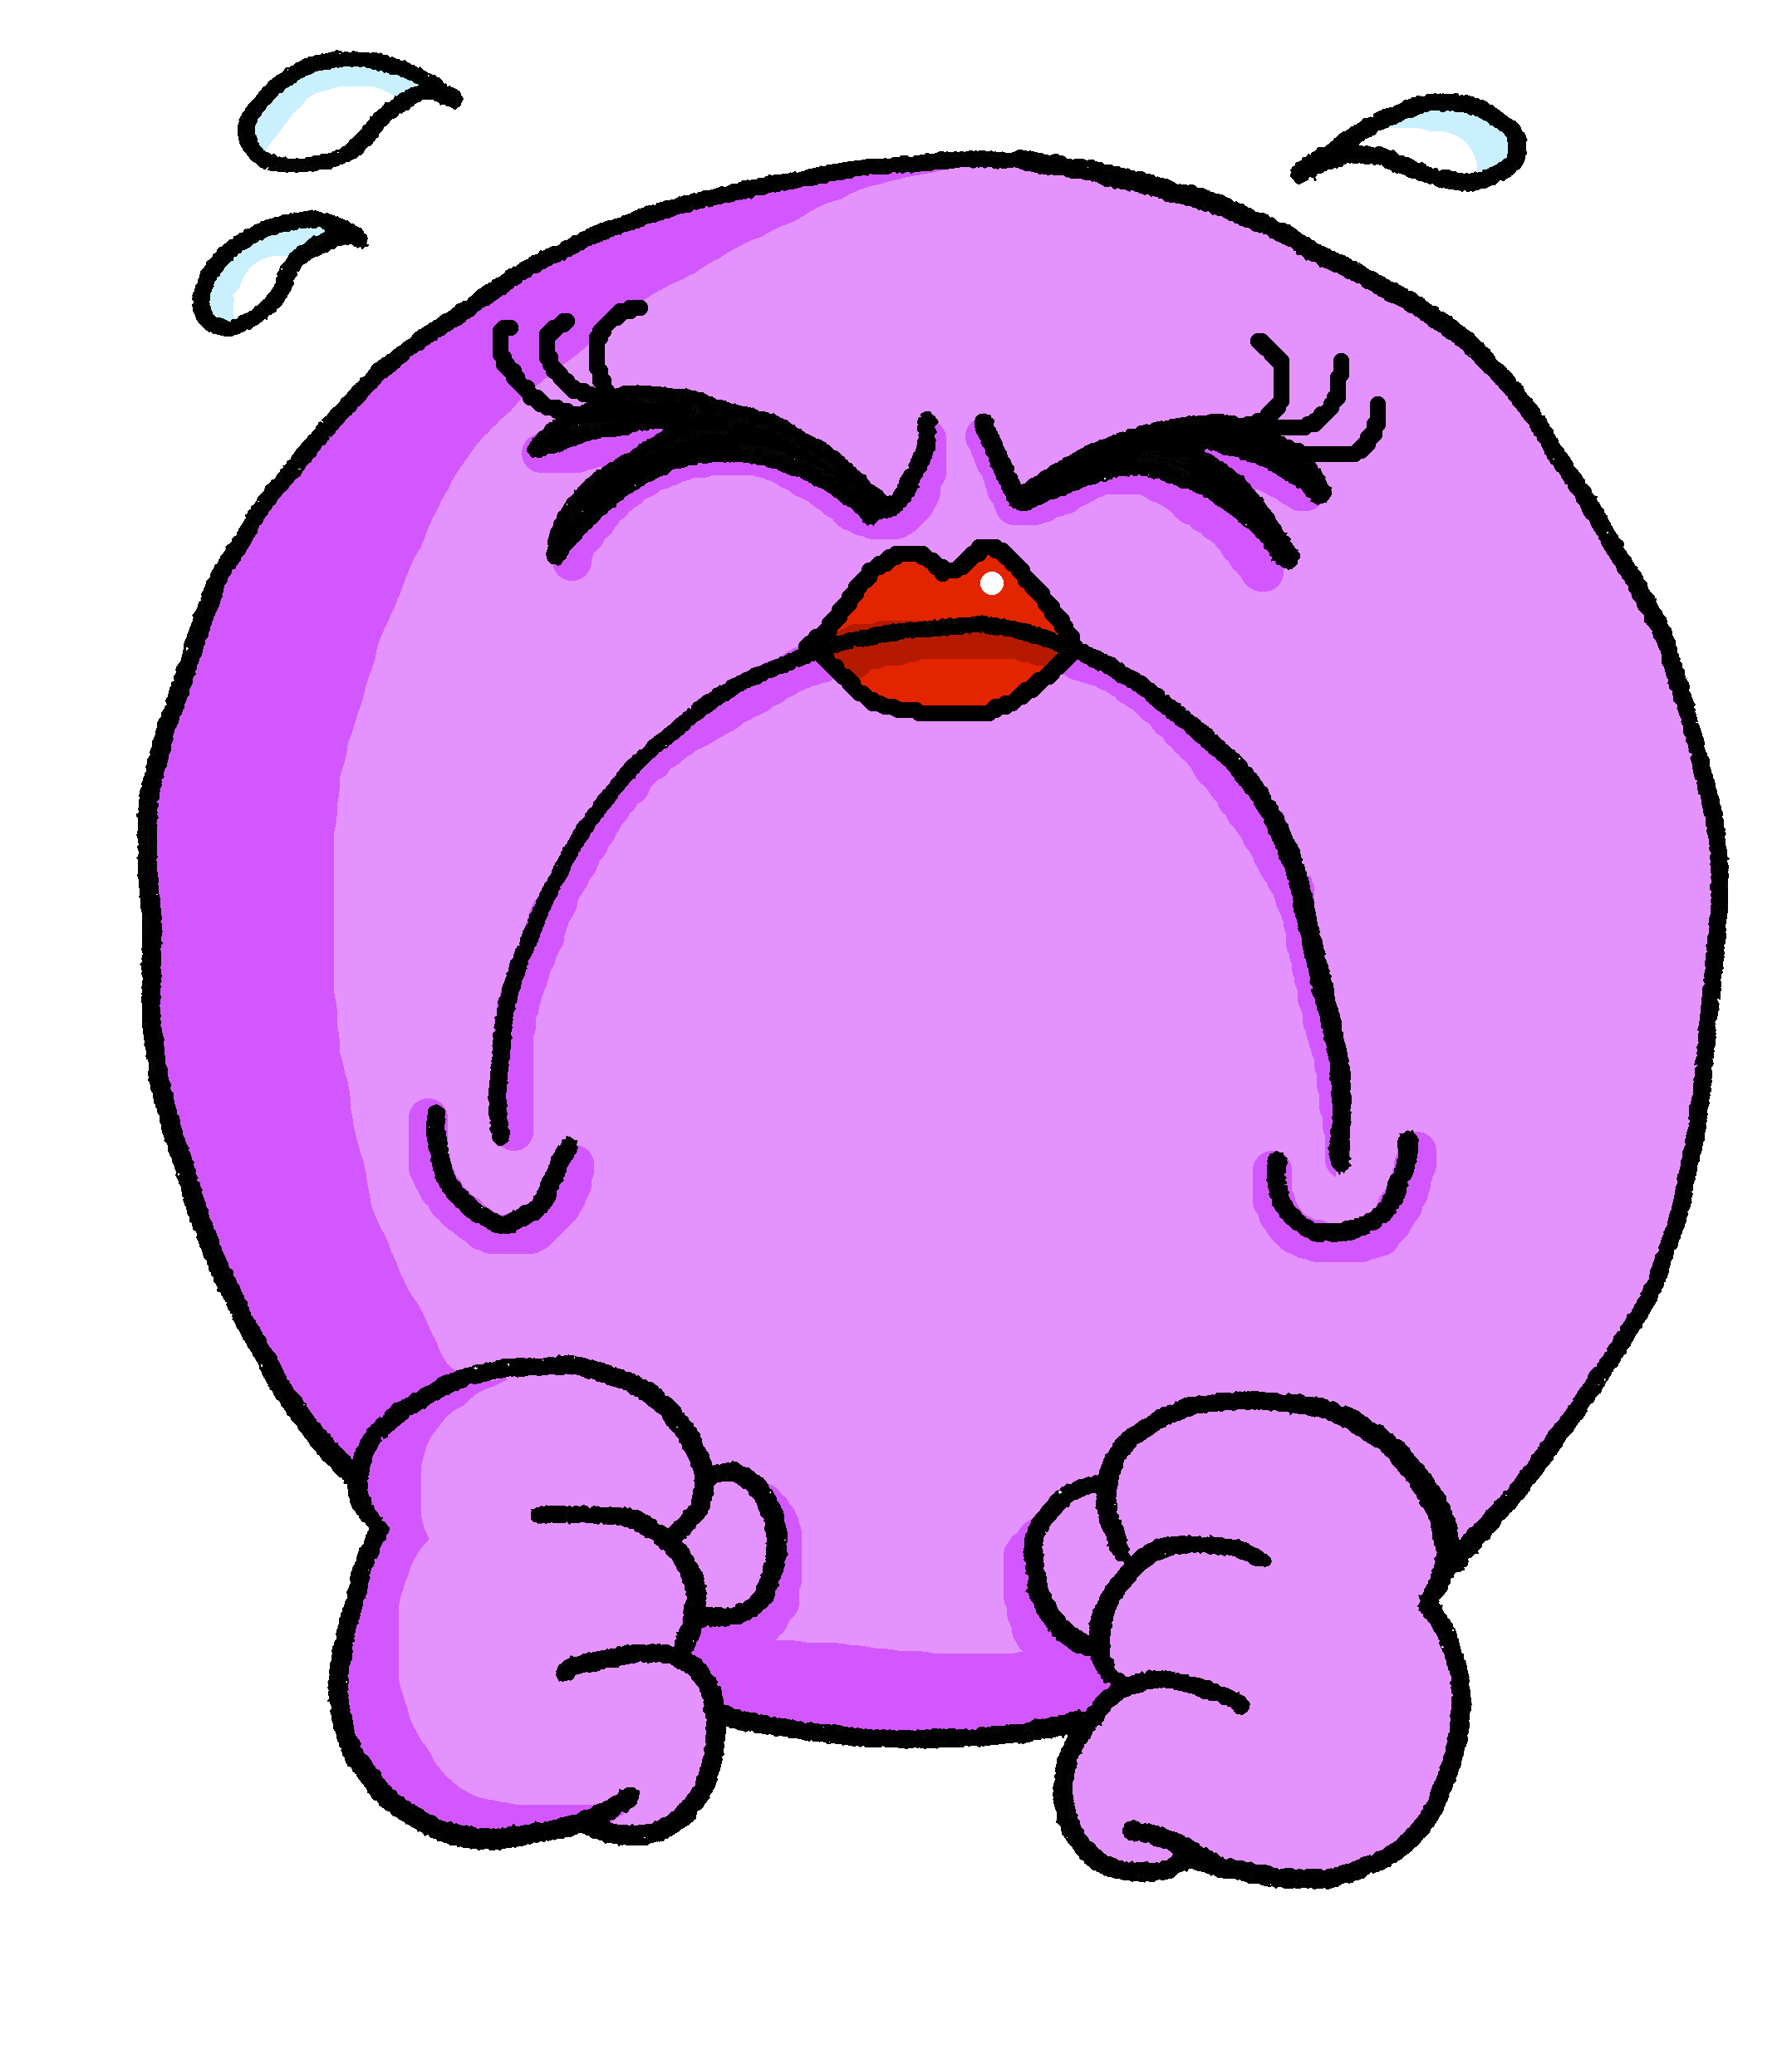
vocabulaire
Écoute et répète.
mots
difficile
difficile
difficult (m)
difficult (f)
Notes:
9

Slide 10
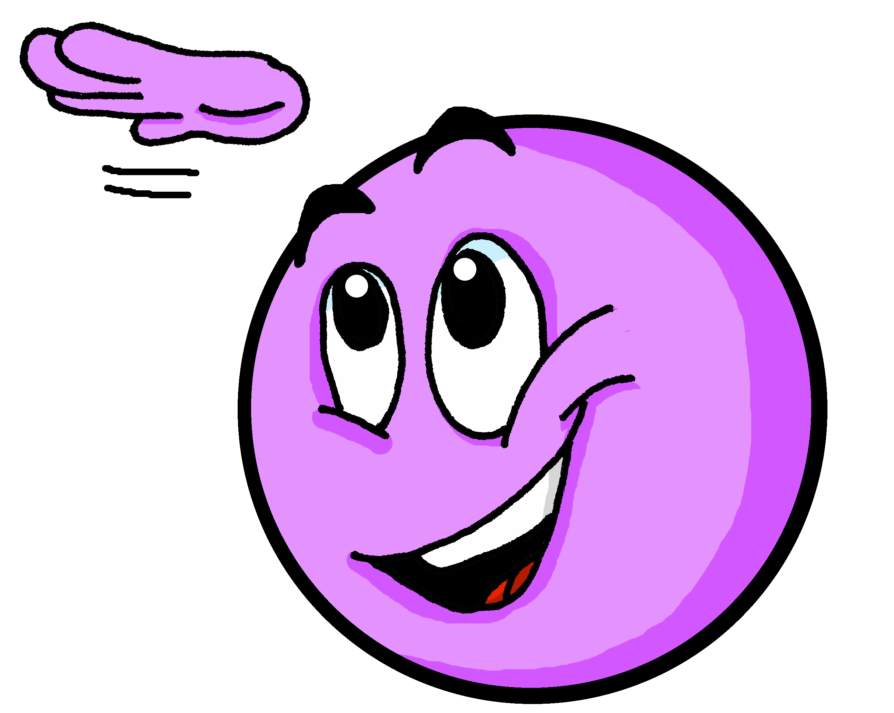
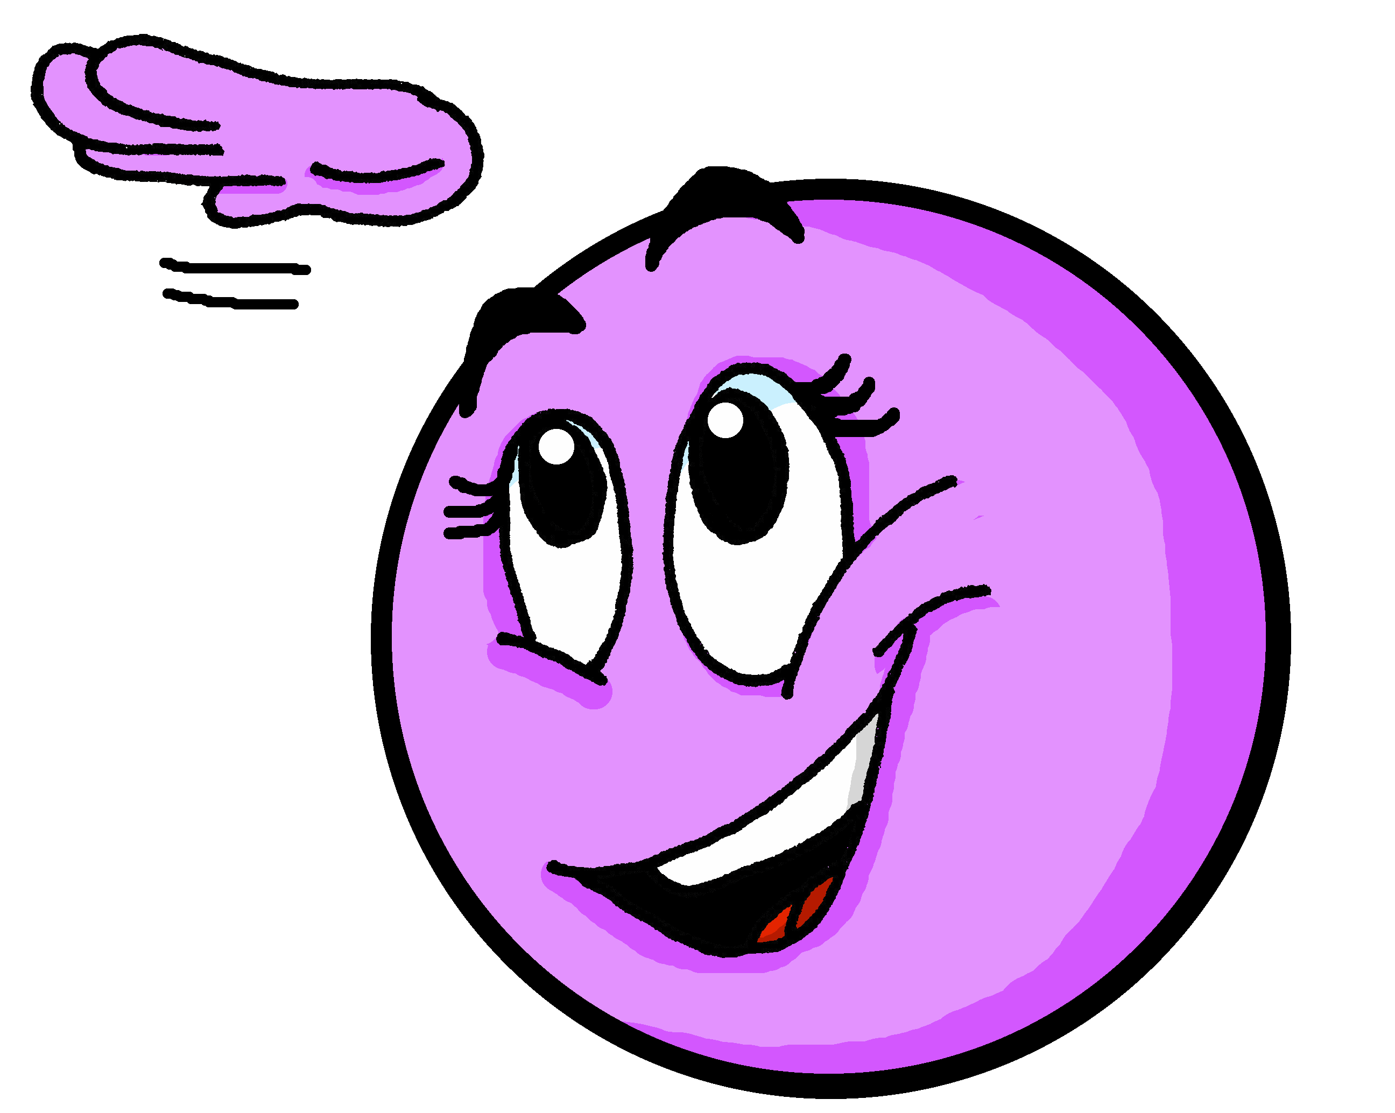
Using adjectives [1/2]
The spelling and sound of adjectives sometimes change.
The most common change is to add ‘e’ to the end of the word in the feminine form.
Je suis grand.
I (a boy) am tall.
Masculine
Tu es grand.
You (a boy) are tall.
An ‘e’ at the end means you do pronounce the ‘d’.
Il est grand.
He is tall.
Je suis grande.
I (a girl) am tall.
Feminine
Tu es grande.
You (a girl) are tall.
Elle est grande.
She is tall.
Notes:
Timing: 3 minutes
Aim: to revisit the pattern for regular adjective agreement (add-e to form the feminine adjective)
Procedure:
Read the grammar explanation about adjective agreement.
Elicit English translations for the French examples provided.
Draw pupils’ attention to the SFC ‘t’ and to the change you hear when an ‘e’ is added.

Slide 11
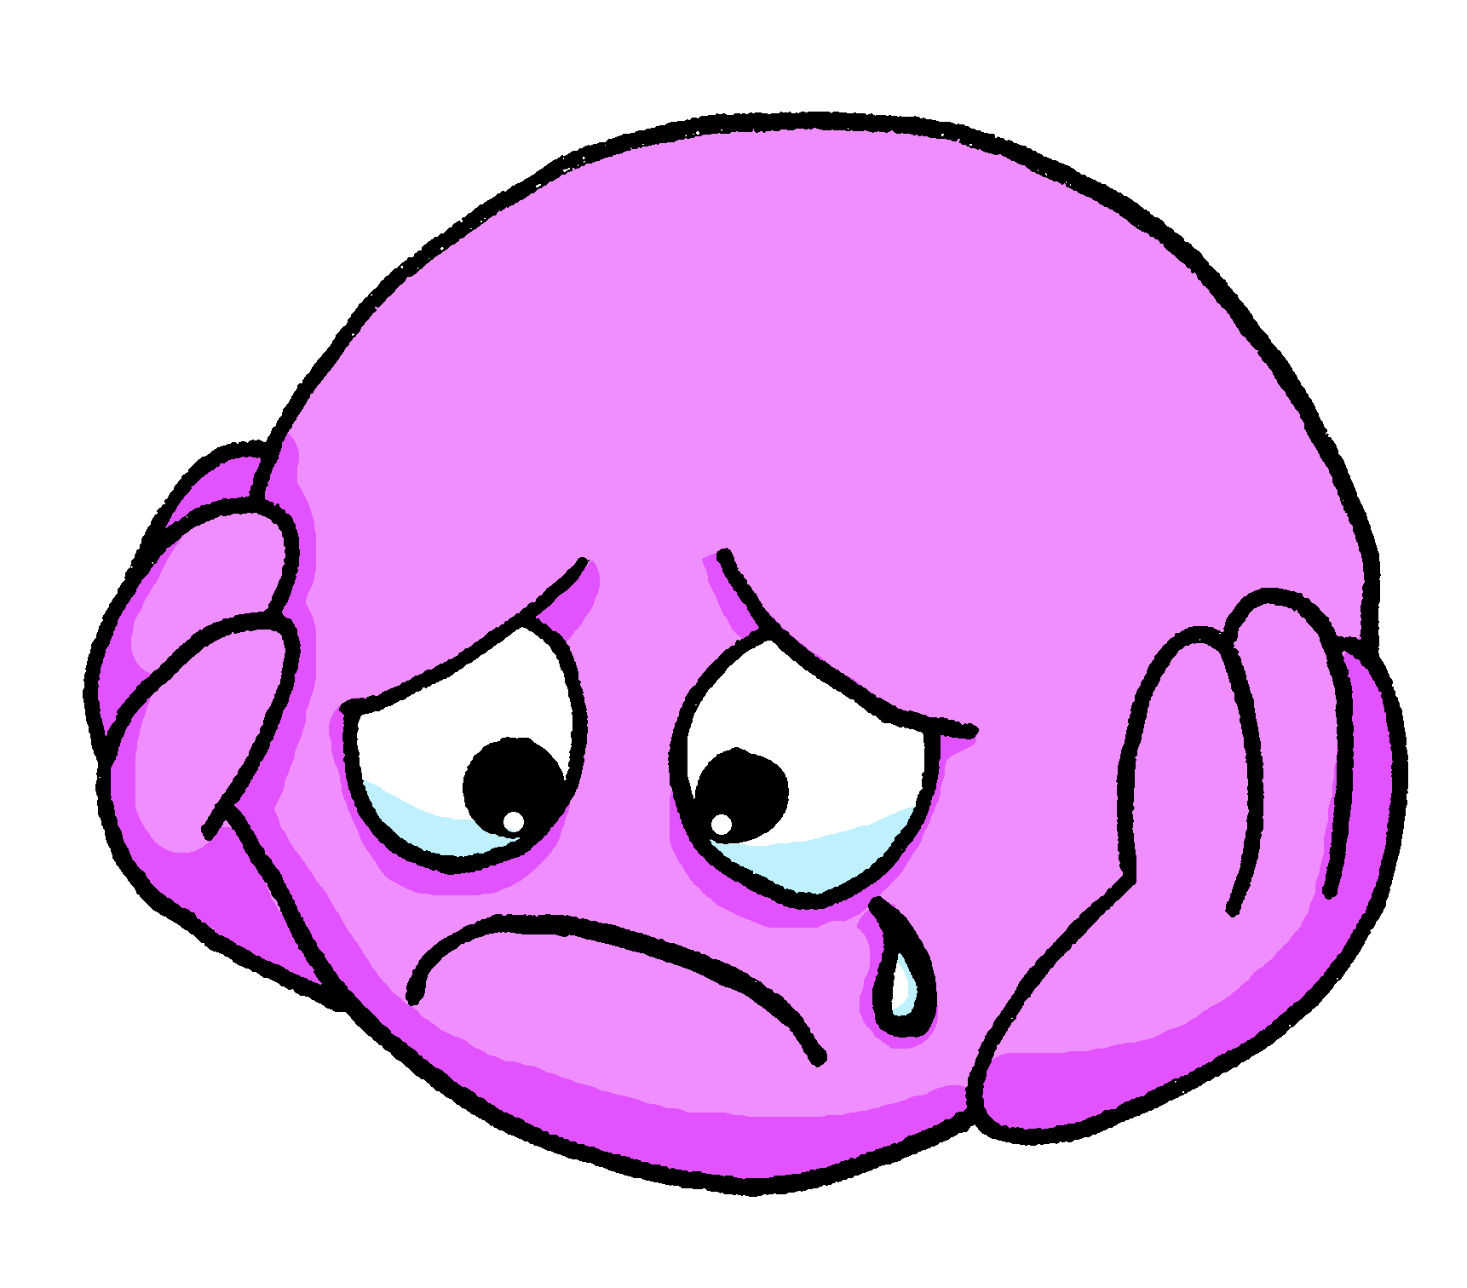
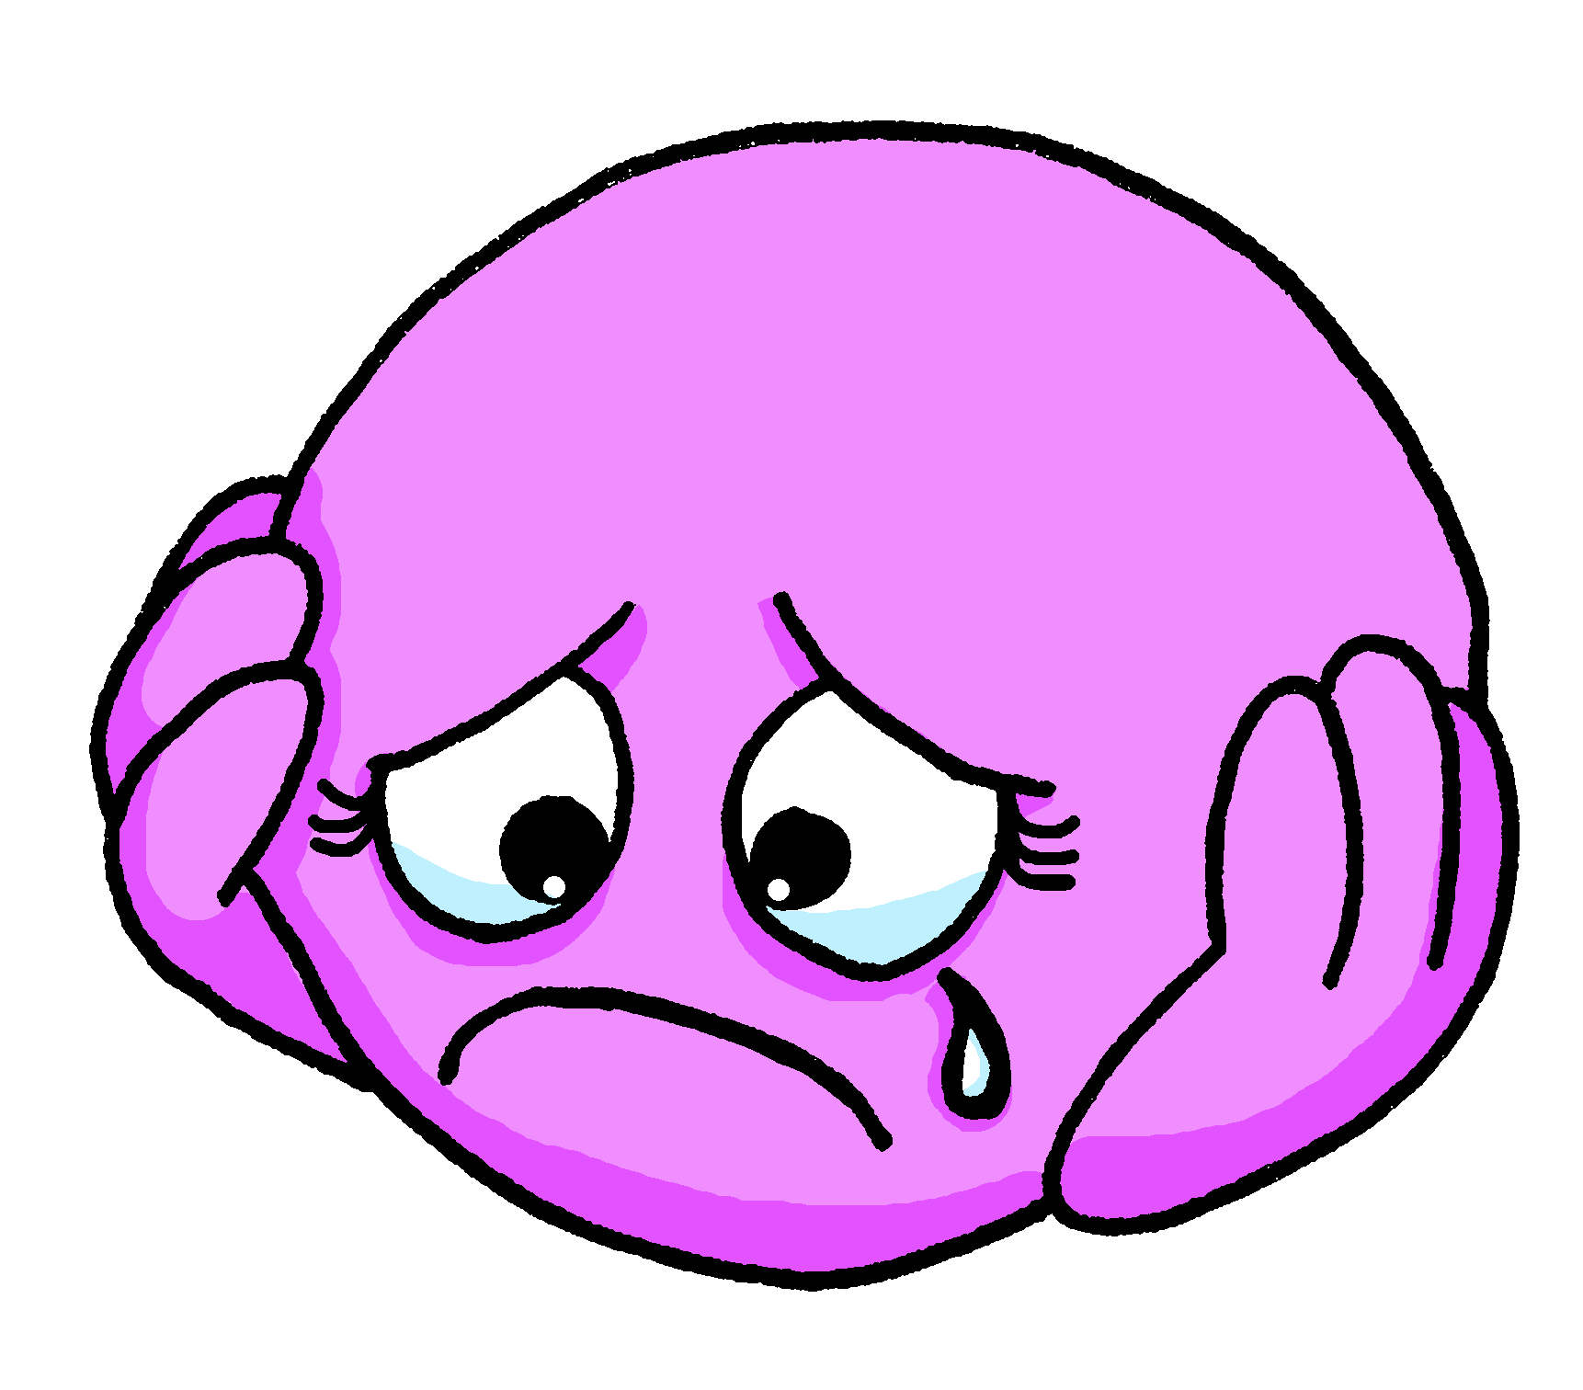
Using adjectives [2/2]
The spelling and sound of adjectives ending in e do not change.
An ‘e’ at the end means you do pronounce the ‘t’.
They are the same when describing feminine and masculine nouns.
Je suis triste.
I (a boy) am sad.
Masculine
Tu es triste.
You (a boy) are sad.
Il est triste.
He is sad.
Je suis triste.
I (a girl) am sad.
Feminine
Tu es triste.
You (a girl) are sad.
Elle est triste.
She is sad.
Notes:
Timing: 3 minutes
Procedure:
Read the grammar explanation about adjective agreement.
Elicit English translation for the French examples provided.
Draw pupils’ attention to the SFC ‘t’ and to the change you hear when an ‘e’ is added.

Slide 12
lire
Adèle’s phone got dropped.
She can’t read all her messages.
Help her. Write 1-6 and the correct friend’s name.
1
Marianne est jeune et jolie.
Martin is
Marianne is young and pretty.
2
Yves est seul aujourd’hui.
Léa is
Yves is alone today.
3
Lara est drôle et différente.
Lara is funny and different.
et – and mais – but aujourd’hui – today
Marc is
Notes:
Timing: 5 minutes (two slides)
Aim: to practise written comprehension of masculine and feminine adjectives.
Procedure:
Pupils write 1-6.
First they look at the adjectives to decide who is being talked about (the male or female friend).
Then they complete the sentence in English.
Click to bring up a tick to identify the correct name, and again to reveal the full sentence.
et [6] mais [30] aujourd’hui [233]
Londsale, D., & Le Bras, Y. (2009). A Frequency Dictionary of French: Core vocabulary for learners London: Routledge.
12

Slide 13
lire
Adèle’s new phone got dropped. [2/2]
4
Lucas est jeune mais prudent.
Lucas is young but careful.
Odile is
5
Ali est différent aujourd’hui.
Sara is
Ali is different today.
6
Garice est drôle mais difficile.
Garice is funny but difficult.
et – and mais – but aujourd’hui – today
Coralie is funny but difficult.
Notes:
[2/2]
et [6] mais [30] aujourd’hui [233]
Londsale, D., & Le Bras, Y. (2009). A Frequency Dictionary of French: Core vocabulary for learners London: Routledge.
13

Slide 14
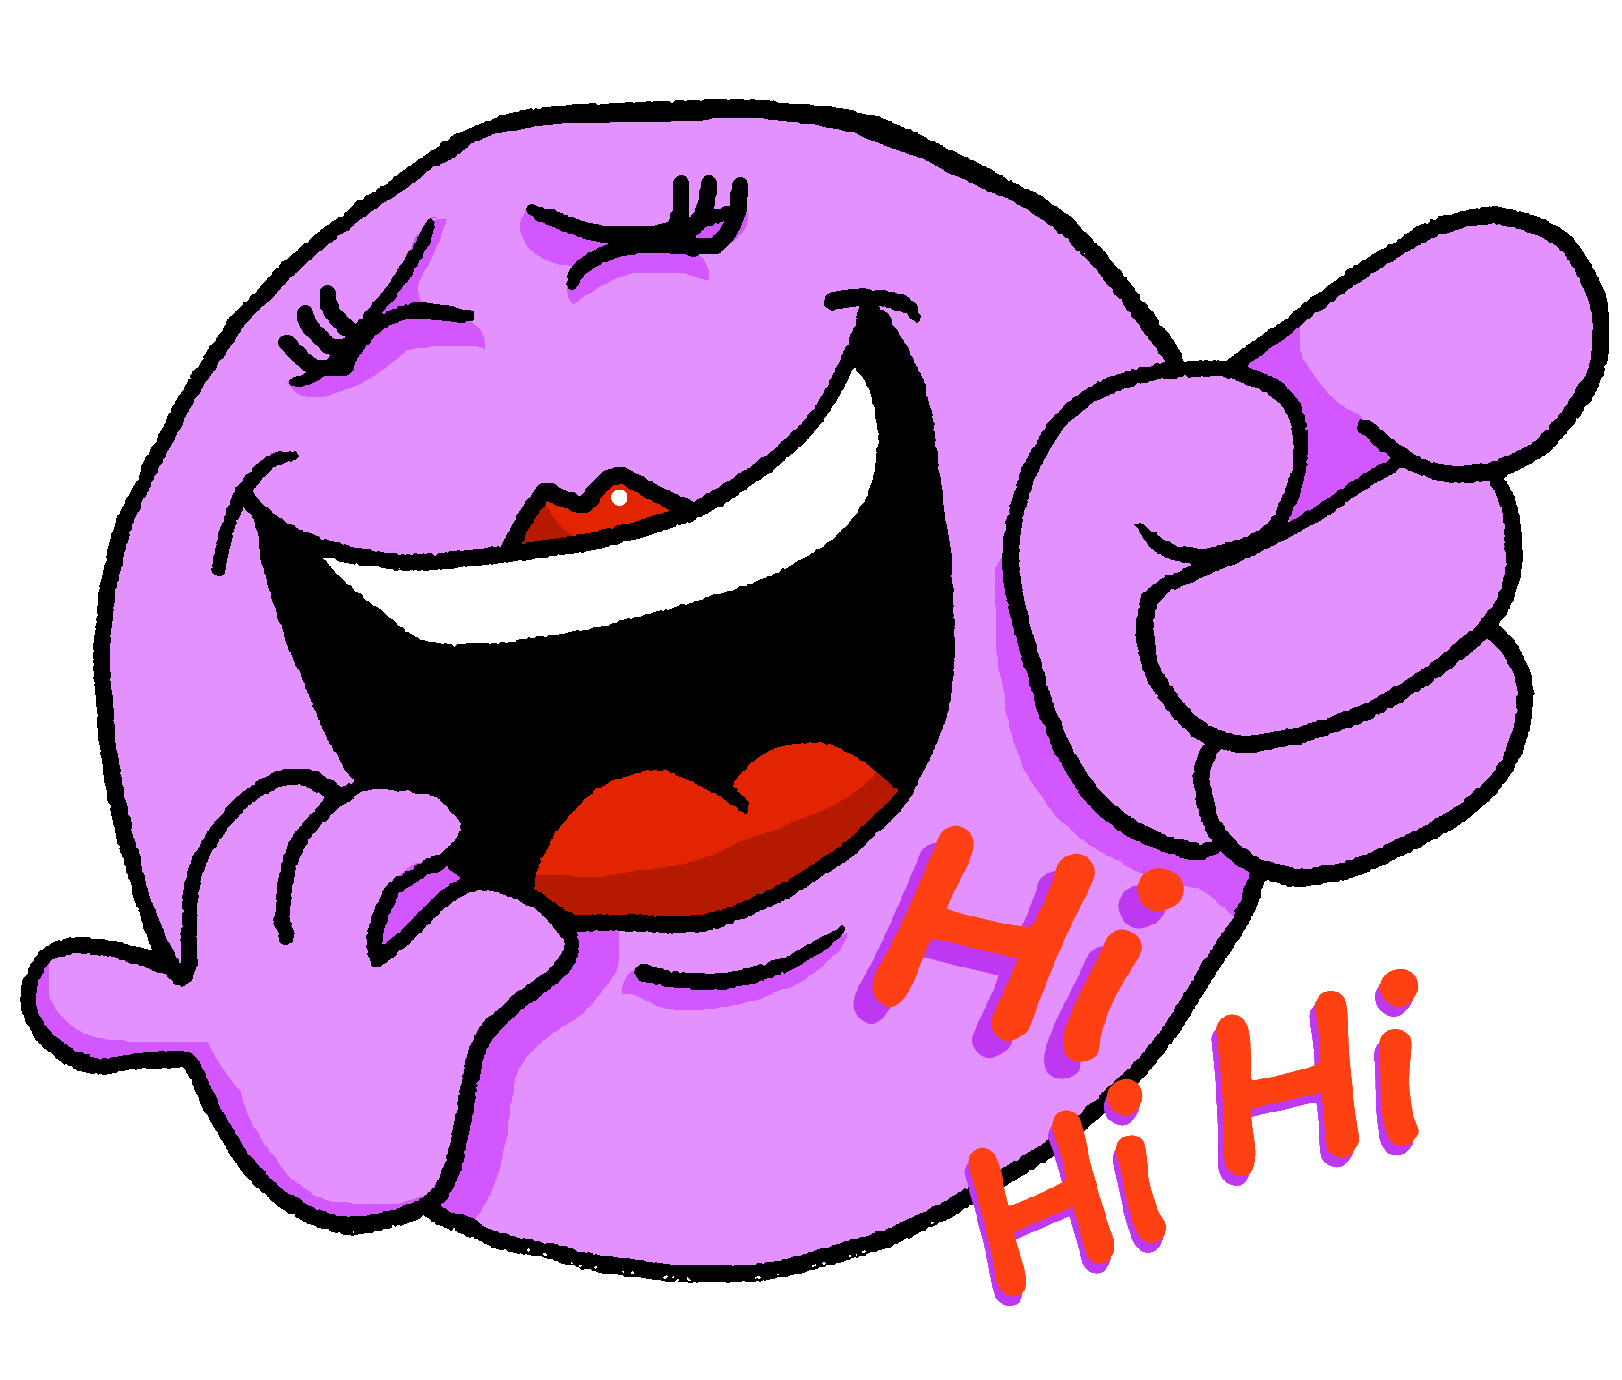
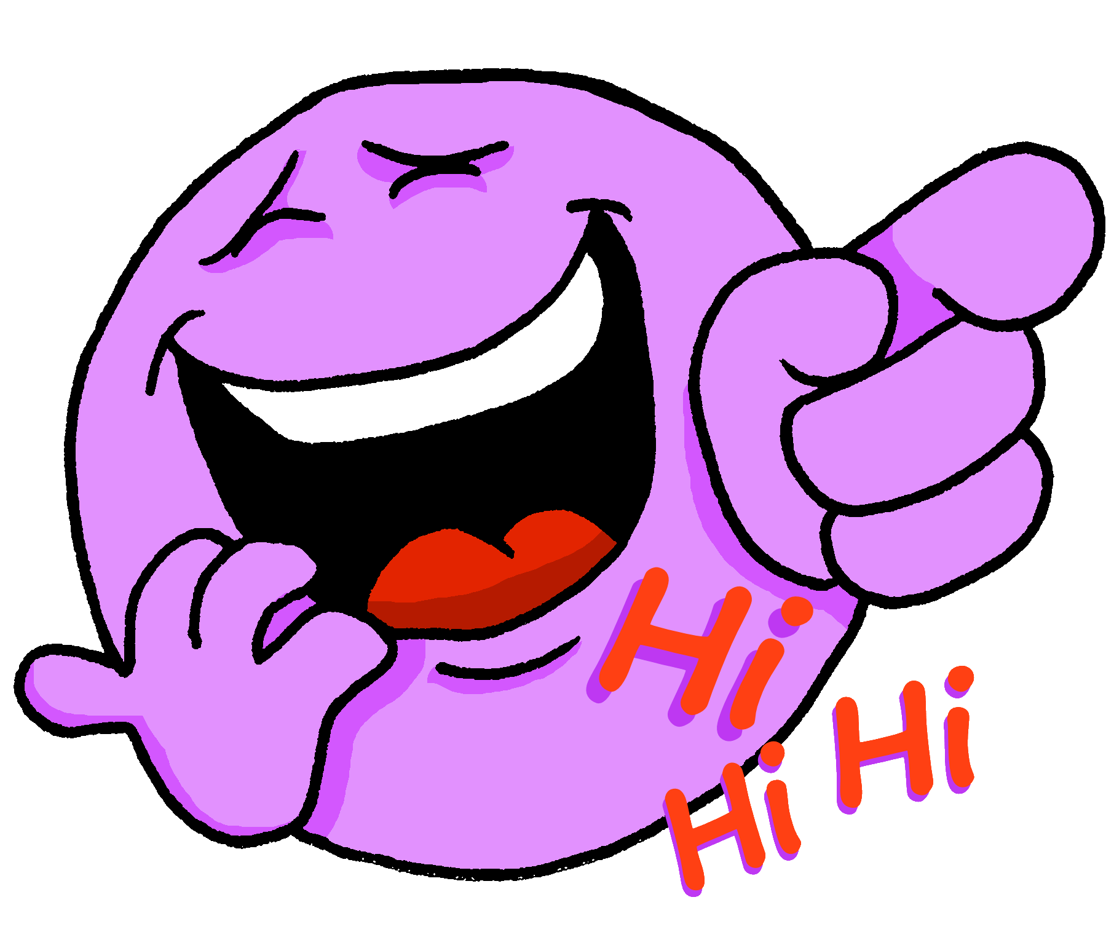
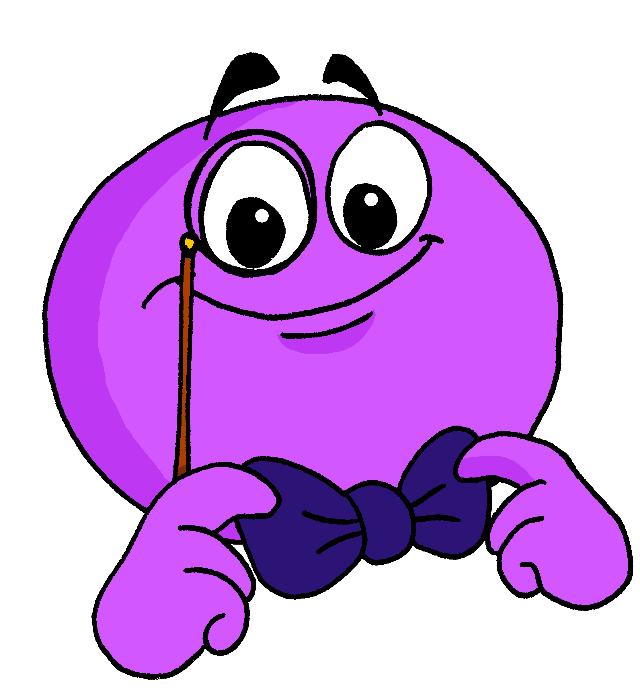
écouter
Écoute.
Is the person being described male or female?
Écris de 1 à 8 ‘A’ ou ‘B’ ou ‘A + B’.
Then write the adjective in English.
 | A (male) | B (female) | ?
1
young
1
2
careful
2
3
pretty, attractive
3
4
difficile
4
5
funny
5
6
elegant
6
7
absent
7
8
careful
8
Notes:
Timing: 7 minutes
Aim: to practise aural recognition of feminine and masculine adjectives and their meaning; to practise aural comprehension of this week’s vocabulary.
Procedure:
Explain to pupils that they will not here the pronoun ‘elle’ or ‘il’ so they will need to listen for the adjective form to know if the sentence refers to a male or female person.
2. Click to hear audio.
3. Pupils write 1-8 and A or B.
4. Click to listen again. Pupils write the adjective meaning they hear in English.
5. Click for answers to provide feedback.
6. If time allows, click to bring up a 2nd set of audio buttons, which have the full sentences. Click to play and students repeat.
7. Final set of clicks brings up the emojis one by one. When pupils have listened to the full sentence, they should be able to identify which person (male or female) is being described. Click to ‘disappear’ the other emoji, leaving the correct version only.
8. The emojis could be used to elicit further repetitions of the sentences.
Transcript:
1. [Elle] est jeune.
2. [Elle] est prudente.
3. [Il] est joli.
4. [Elle] est difficile.
5. [Il] est drôle.
6. [Il] est élégant.
7. [Elle] est absente.
8. [Il] est prudent.
Transcript 2: 1. Elle est jeune.
2. Elle est prudente.
3. Il est joli.
4. Elle est difficile.
5. Il est drôle.
6. Il est élégant.
7. Elle est absente.
8. Il est prudent.
Cognates:
élégant [4747]
Londsale, D., & Le Bras, Y. (2009). A Frequency Dictionary of French: Core vocabulary for learners London: Routledge.
14

Slide 15
vocabulaire

Écris en anglais. Can you get at least 15 points?
mots
 | Madame | là | Monsieur
 | présente | absent | ici
 | oui | bien | ça va ?
 | non | Au revoir ! | mal
 | important | seule | prudente
 | jeune | difficile | indépendante
 | joli | drôle | jolie
Mrs, Miss (teacher)
there
Mr, Sir (teacher)
x3
present (f)
absent (m)
here
yes
good/well
is it going ok?
x2
no
Goodbye!
bad(ly)
important (m)
alone (f)
careful (f)
young (m/f)
difficult (m/f)
independent (f)
x1
pretty, attractive (m)
pretty, attractive (f)
funny (m/f)
Notes:
Timing: 5 minutes
Aim: to practise written comprehension of vocabulary from week 1, last week and this week.
Procedure: 1. Give pupils a blank grid. They fill in the English meanings of any of the words they know, trying to reach 15 points in total. 2. Remind pupils that adjectives can refer to male or female persons and they should note this in their translations. E.g. tall (f), careful (m). We will be practising adjective agreement in the follow ups.
Note: The most recently learnt and practised words are pink, words from the previous week are green and those from week 1 are blue, thus more points are awarded for them, to recognise that memories fade and more effort (heavy lifting!) is needed to retrieve them.
15

Slide 16
Au revoir !
jaune
Notes:
16

