Slide 1
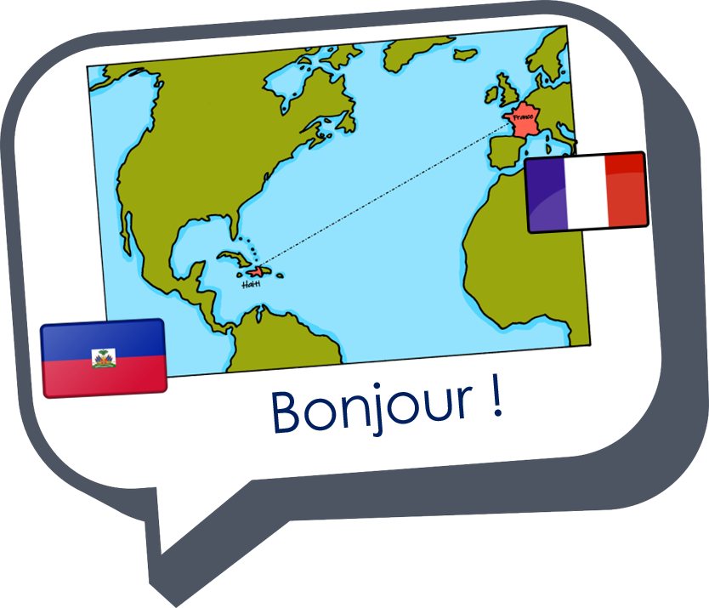
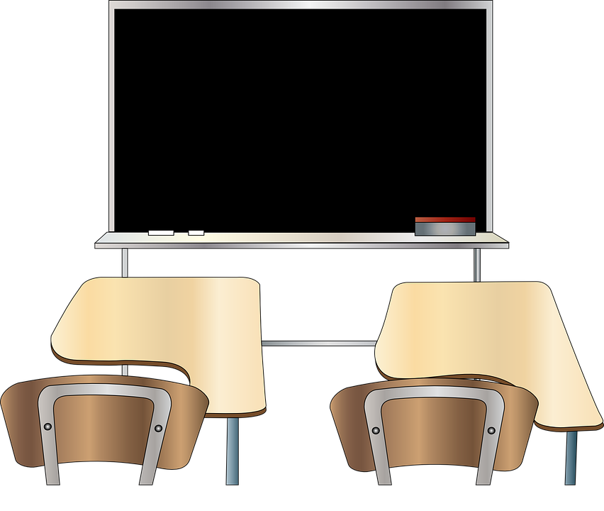
Describing me and others
Lucas ?
jaune
Follow ups 1-5
Notes:
Artwork by Steve Clarke. Pronoun pictures from NCELP (www.ncelp.org). All additional pictures selected from Pixabay and are available under a Creative Commons license, no attribution required.
Frequency of new words:
Phonics: SFC (Silent final consonant) source word: petit [138]
Vocabulary: Salut ! [2205] présent [216] absent [2016] je [22] il [13] elle [38] être [5] suis, est
Londsale, D., & Le Bras, Y. (2009). A Frequency Dictionary of French: Core vocabulary for learners London: Routledge.
The frequency rankings for words that occur in this PowerPoint which have been previously introduced in these resources are given in the SOW and in the resources that first introduced and formally re-visited those words.
For any other words that occur incidentally in this PowerPoint, frequency rankings will be provided in the notes field wherever possible.

Slide 2
Follow up 1a
Prononce les mots.
mots
Say each word in French before it disappears.
vocabulaire
présent
est
ici
je
être
Salut !
il
absente
suis
Bonjour !
elle
là
Notes:
Timing: 5 minutes (two slides)
Aim: to practise spoken production and recall of this week and last week’s vocabulary.
Procedure:
1. Click to action the disappear animation on first word.
2. Pupils read the word aloud in French before it disappears. 3. Continue for all 12 words. 4. Continue to the next slide.

Slide 3
Follow up 1b
Parle en français.
mots
Say each word in French before the English word disappears.
vocabulaire
present (m)
is
here
I
to be, being
Hi!
he
absent (f)
am
Hello!
she
there
Notes:
Aim: to practise spoken production and recall of this week and last week’s vocabulary.
Procedure:
1. Click to action the disappear animation on first word.
2. Pupils translate and say the word in French before it disappears. 3. Continue for all 12 words.

Slide 4
Follow up 2
Lis le texte.
After lunch, Monsieur Lemaire takes the register again.
To whom does each English statement refer?
lire
1 | Coralie ? | Elle est absente.
2 | Lara ? | Elle est ici.
3 | Laure ? | Je suis ici.
4 | Thérèse ? | Elle est ici.
5 | Charles ? | Il est là.
6 | Pauline ? | Je suis ici.
7 | Garice ? | Il est là.
Laure
Pauline
1 I’m here.
2 He is there.
Lara
3 She is here.
4 She is absent.
Charles
Garice
Coralie
Notes:
Timing: 5 minutes
Aim: to practise written comprehension of this week’s new language.
Procedure:
1. Explain the task to pupils 2. Elicit the first name from the whole class, to model the task.
3. Give pupils time to complete the questions.
4. Elicit answers from the class and click to reveal the correct names.

Slide 5
Follow up 3
Écoute.
Bonjour !
Salut !
écouter
Bonjour ! (Hello!) is more formal than Salut ! (Hi!). You would say ‘Salut !’ to a friend and ‘Bonjour !’ to your teacher.
Notes:
Timing: 5 minutes (4 slides)
Aim: to reintroduce the word ‘Salut’, which has a silent final consonant, and revisit the greeting ‘Bonjour’.
Procedure:
Click to bring up the teacher saying ‘Bonjour’. Accompany this with a circular gesture with left palm facing the class, if desired.
Click to bring up the teacher saying ‘Salut’. Accompany this with a circular gesture with right palm facing the class, if using gestures.
Click to bring up the SFC icon ‘shh’ and point to the ‘t’ at the end of Salut.

Slide 6
Follow up 3
Parle.
parler
Use Madame to mean Mrs, for a teacher or female adult you don’t know well.
Bonjour !
Madame Vidal
Notes:
[2/4]
Aim: to practise spoken production of the greetings ‘salut’ and ‘bonjour’ with the appropriate level of formality.
Procedure: 1. Click for bring up Madame Vidal.
2. Pupils say an appropriate greeting. 3. Click for a call out to introduce the two word Madame.
4. Click to bring up the Madame Vidal’s matching response. 5. Do the same with the information on the following slide. Note: The names have been chosen with familiar SSC so for additional practice in pronunciation, pupils could also say the names.

Slide 7
Follow up 3
Parle.
parler
Use Monsieur to mean Mr, for a teacher or male adult you don’t know well.
Bonjour !
Pronounce it like this:
Monsieur Caput
Notes:
[3/4]

Slide 8
Follow up 3
Greet each person. Navigate the maze.
Parle.
Monsieur Lemaire
Odile
parler
Charlotte
Ali
Madame Vidal
Milo
Madame Dior
Monsieur Caput
Notes:
[4/4]
Procedure: 1. Pupils have to say an appropriate greeting and the person’s name to navigate their way around the maze to the end.
2. On first click the person spins and pupils greet that person, e.g. Bonjour, Madame Vidal ! Salut, Ali !
3. They continue until they exit the maze. 4. In case required, click on the names to hear them pronounced.
Note: The names have been chosen with familiar SSC to facilitate additional practice in pronunciation.

Slide 9
Follow up 4
Say the French sentence.
Parle.
You do not need all of the words!
ici
parler
Salut !
suis
15
Bonjour ! Je suis ici.
Hello! I am here.
est
je
S
Bonjour !
il
0
là
DÉBUT
Notes:
Timing: 5 minutes (6 slides)
Aim: to practise oral sentence building, deciding between the target features of je suis | il/elle est and masculine | feminine adjective forms.
Procedure:
1. Click for English sentence and French prompt words. 2. Click Début to start the timer.
3. Pupils select from the words given to create and say the sentence out loud before the time elapses. 4. Click for the French sentence to appear. Answer: Bonjour ! Je suis ici.

Slide 10
Follow up 4
Say the French sentence.
Parle.
You do not need all of the words!
elle
parler
Salut !
oui
15
Oui, elle est présente.
Yes, she is present.
est
présente
S
présent
il
0
non
DÉBUT
Notes:
[2/6]
Answer: Oui, elle est présente.

Slide 11
Follow up 4
Say the French sentence.
Parle.
You do not need all of the words!
elle
absente
parler
non
15
Non, Madame. Il est absent.
No, Miss. He is absent.
est
Monsieur
S
Madame
il
0
absent
DÉBUT
Notes:
[3/6]
Answer: Non Madame, il est absent.

Slide 12
Follow up 4
Say the French sentence.
Parle.
You do not need all of the words!
elle
parler
Salut !
suis
15
Salut Lara ! Monsieur, elle est là !
Hi Lara! Sir, she is there!
est
Madame
S
Monsieur
il
0
là
Lara
DÉBUT
Notes:
[4/6] Answer:
Salut Lara ! Monsierur, elle est là !

Slide 13
Follow up 4
Say the French sentence.
Parle.
You do not need all of the words!
elle
parler
Madame
absente
15
Elle est absente, Monsieur.
She is absent, Sir.
est
je
S
Monsieur
il
0
absent
DÉBUT
Notes:
[5/6] Answer:
Elle est absente, Monsieur.

Slide 14
Follow up 4
Say the French sentence.
Parle.
You do not need all of the words!
elle
parler
Salut !
Madame
15
Bonjour, Madame ! Oui, il est présent.
Hello, Miss! Yes, he is present.
est
présente
S
Bonjour !
il
oui
0
présent
DÉBUT
Notes:
[6/6] Answer:
Bonjour, Madame ! Oui, il est present.

Slide 15
Follow up 5:

.
Écris en français.
- Bonjour, Anne !
- Bonjour, Madame.
- Luc ?
- Non, il est absent, Madame.
- Bonjour, Milo !
- Bonjour, je suis ici.
- Odile ?
- Elle est présente, Madame. Elle est là.
écrire
[Hello]
Madame Vidal
[he is]
[I am here.]
[She is present]
[She is there.]
Notes:
Timing: 10 minutes
Aim: to practise written production of the vocabulary and structures from this week’s learning.
Procedure: 1. Tell pupils this is a conversation between teacher and pupils in a classroom. 2. They try to write the French for the pink English prompts. 3. Click to reveal the French words. 4. Click the player to hear the conversation in full.

