Slide 1
Saying what I and others have
jaune
Follow ups 1-5
Term 1 Week 12
Notes:
Artwork by Steve Clarke. Pronoun pictures from NCELP (www.ncelp.org). All additional pictures selected from Pixabay and are available under a Creative Commons license, no attribution required.
Phonics: [u] [ou] tu [112] salut ! [2205] amusant [4695] utiliser [345] nous [31] bonjour ! [1972] douze [1664] jouer [219] jour [78]
Vocabulary: chaque [151] jour [78] revisit days of the week
Revisit 1: avoir [8] j’ai, il a, elle a, quoi [297] chat [3138] crayon [>5000] dessin [2624] message [792]
Revisit 2: bien [47] mal [277] Oui [284] Non [75] Au revoir [n/a] Ça va ? [54/53]
Londsale, D., & Le Bras, Y. (2009). A Frequency Dictionary of French: Core vocabulary for learners London: Routledge.
The frequency rankings for words that occur in this PowerPoint which have been previously introduced in these resources are given in the SOW and in the resources that first introduced and formally re-visited those words.
For any other words that occur incidentally in this PowerPoint, frequency rankings will be provided in the notes field wherever possible.

Slide 2
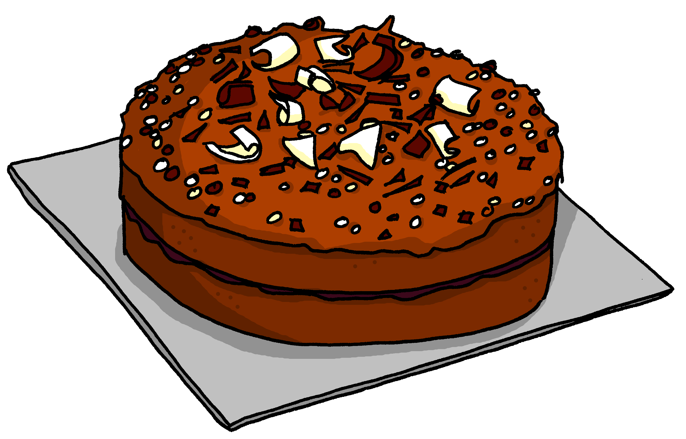
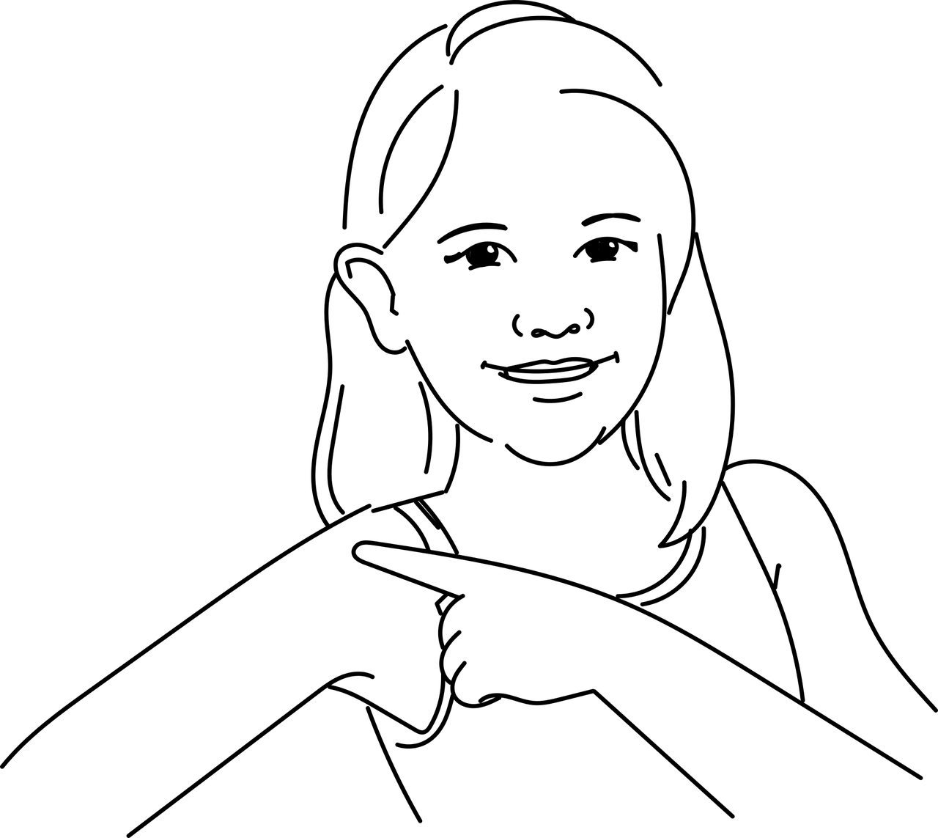
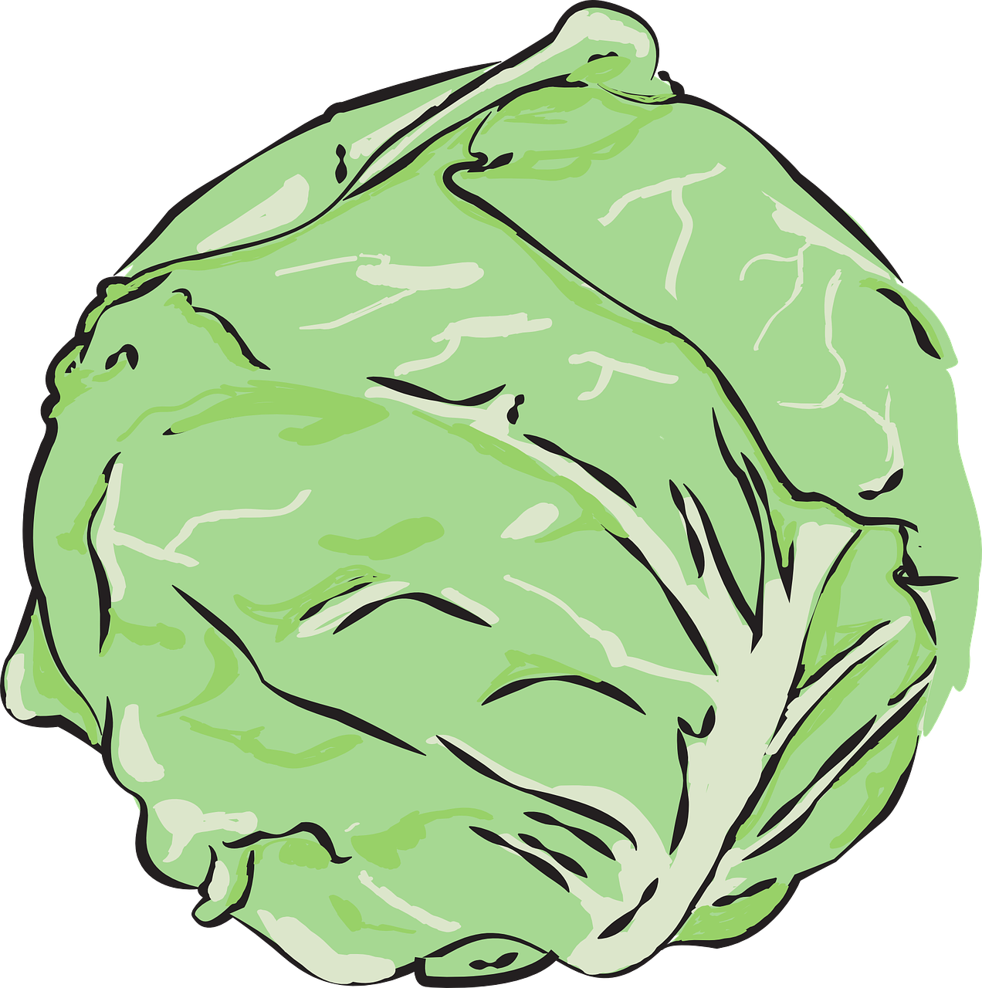
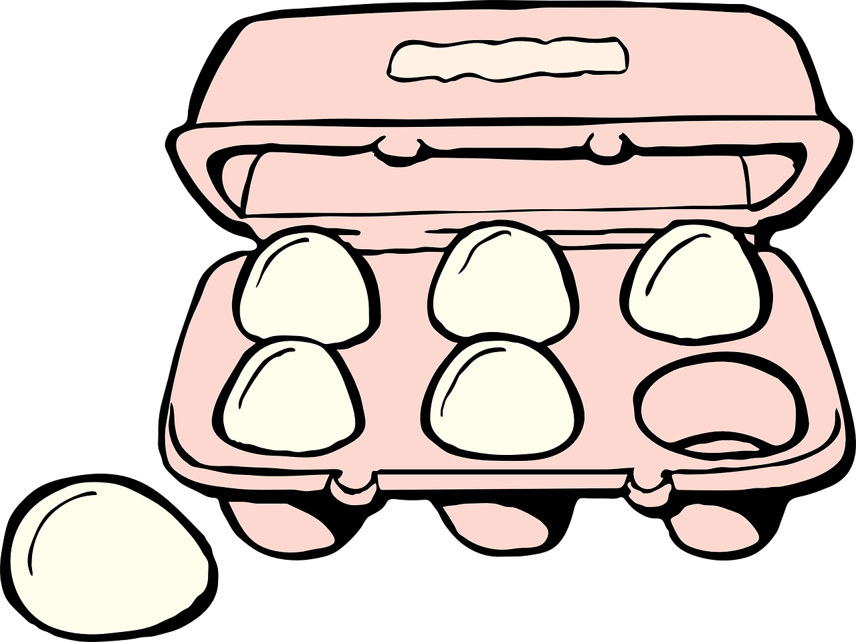
Follow up 1:
. Écoute les noms des animaux. C’est [ien] ou [(a)in]?
A Écoute et écris. [ou] ou [au] ?
B Say these words one after the other as quickly as you can. Your partner will check.
1
2
3
4
g â t e a u
c o u p e r
c h a u d
_ _
t o u r n e r
_ _
_ _
_ _
5
6
7
8
c h o u
é p a u l e
p o u l e t
_ _
o u b l i e r
_ _
_ _
_ _
9
10
11
12
c a d e a u
d r a p e a u
d o u z a i n e
_ _
_ _
j a u n e
_ _
_ _
Notes:
Timing: 5 minutes
Aim: to practise aural recognition of this week’s SSC [au] and differentiate it from [ou].
Procedure:
Click to listen. Pupils write 1-12 and [au] or [ou] for each word.
Click to reveal the missing letters.
Click to bring up the instruction for Part B.
Pupils pronounce all of the words.
Teacher circulates to listen and support, as needed.
Transcript Part A: [1] gâteau [2] couper [3] chaud [4] tourner [5] chou [6] épaule
[7] oublier [8] poulet
[9] cadeau
[10] drapeau
[11] douzaine
[12] jaune

Slide 3
Follow up 2:
Eugénie range* sa chambre. Elle écrit une liste.
Elle a un petit accident avec un chocolat chaud !
. Écoute les noms des animaux. C’est [ien] ou [(a)in]?
Lis la liste. C’est ‘I have’ (Eugénie) ou ‘she has’ (Léa) ?
lire
I have… | She has…
1
Elle a un bureau.
J’ ai un lit.
J’ ai un chat.
Elle a une chaise.
J’ ai un crayon.
J’ ai un dessin.
Elle a une affiche.
2
a bed
a desk
3
a cat
a chair
4
5
a pencil
a poster
6
a drawing
7
ranger – to tidy, put away
Notes:
Timing: 5 minutes
Aim: to practise written comprehension of j’ai and elle a and previously taught nouns.
Procedure: 1. Explain the scenario and the task: Eugénie has written a list of things she and her sister have in their rooms. She thinks Léa has better things! She’s hoping she might get some things for Christmas, maybe.
2. Then she spills hot chocolate on her list! Can pupils still tell who has what? They write a list with ‘I have’ and ‘he has’ headings.
3. Click to remove the ‘spills’ and bring up the nouns.

Slide 4
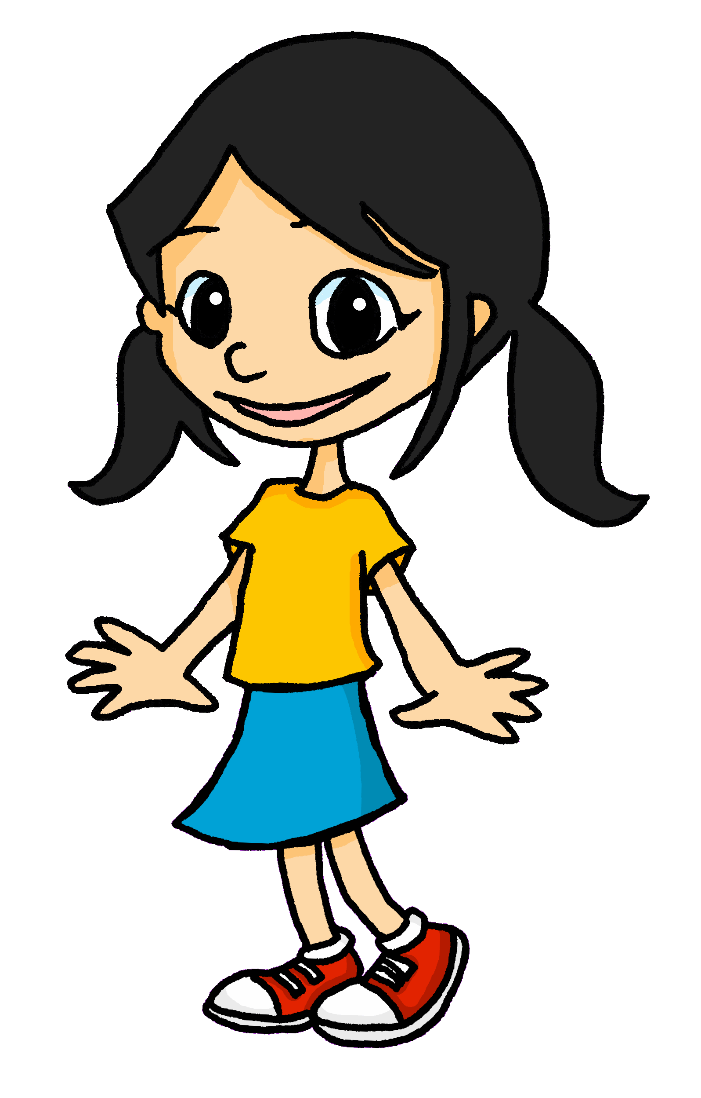
Follow up 3:
. Écoute les noms des animaux. C’est [ien] ou [(a)in]?
Écoute. Écris l’object en anglais sur la bonne liste*.
1
2
3
4
5
6
écouter
I have…
you have…
a drawing
a chair
a card
a bed
an idea!
a desk
la bonne liste – the correct list
Notes:
Timing: 5 minutes
Aim: to practise aural comprehension of the I and you forms of avoir and previously taught nouns.
Procedure: 1. Tell pupils that they need to pay attention to the forms of avoir – ai for ‘I have’ and as for ‘you have’. The pronouns will be beeped out.
2. Pupils write two headings ‘I have’ and ‘you have’ and list the three items that each person has, in English, underneath.
3. Click to reveal the six answers. Click on each text box answer to hear the full phrase in French.
Transcript:
1. [J’] ai un dessin. 2. [tu] as une chaise. 3. [tu] as un lit. 4. [j] ai une carte.
5. [tu] as un bureau. 6. [j‘] ai une idée.

Slide 5
Follow up 4:
Eugénie parle avec Léa.
. Écoute les noms des animaux. C’est [ien] ou [(a)in]?
Écoute et lis la conversation. Écris les mots en anglais.
écouter
Noël – Christmas | pas encore – not yet
Salut Léa, ça va ?
how’s it going?
Hi Léa, __________________?
You
have
Tu as aussi une liste pour Noël*,
oui ?
______ also ______ a list for Christmas, _____?
yes
Non !?! Oh, pas encore* !
No!?! Oh, not yet!
But
a card
_____ you have ___ __________ _______ mum? ________.
Mais tu as une carte pour
Maman ? Bien.
for
Good
She
you
_____ ________ a card for _____, _________!
has
Elle a une carte pour toi, aussi !
too
Me
I have
card
_______, ___ _______ a __________ _______ _______! ☺
Moi, j’ai une carte pour Papa ! ☺
for
dad
Notes:
Timing: 5 minutes
Aim: to practise written comprehension of revisited vocabulary in a longer (conversation) context.
Procedure: 1. Click on each sentence to hear it.
2. Pupils can number 1-6 and just write down all the missing English meanings within each sentence.
3. Click to bring up written answers.

Slide 6
vocabulaire
Follow up 5 - Écris en français : Can you get at least 15 points?
mots
 | yes | no | Goodbye!
 | well, good | how’s it going? | bad, badly
 | she has | you have | what?
 | I have | to have, having | he has
 | Friday | Saturday | Sunday
 | Tuesday | Wednesday | Thursday
 | a day | each, every | Monday
oui
non
Au revoir !
x3
bien
ça va ?
mal
elle a
tu as
quoi ?
x2
j’ai
avoir
il a
vendredi
samedi
dimanche
mardi
mercredi
jeudi
x1
un jour
chaque
lundi
Notes:
Timing: 5-10 minutes
Aim: to practise written comprehension of vocabulary from this week and previous weeks.
Procedure: Give pupils a blank grid. They fill in the French meanings of any of the words they know, trying to reach 15 points in total.
Note: The most recently learnt and practised words are pink, words from the previous week are green and those from week 1 are blue, thus more points are awarded for them, to recognise that memories fade and more effort (heavy lifting!) is needed to retrieve them.
6

Slide 7
vocabulaire
Écris en français : Can you get at least 15 points?
mots
 | yes | no | Goodbye!
 | well, good | how’s it going? | bad, badly
 | she has | you have | what ?
 | I have | to have, having | he has
 | Friday | Saturday | Sunday
 | Tuesday | Wednesday | Thursday
 | a day | each, every | Monday
x3
x2
x1
Notes:
HANDOUT
7

