Slide 1
Saying what I and others have
jaune
« Avoir » : tu as, il/elle a
« Être » : tu es, il/elle est
intonation questions + quoi
SSC [au]
Term 1 Week 11
Notes:
Artwork by Steve Clarke. Pronoun pictures from NCELP (www.ncelp.org). All additional pictures selected from Pixabay and are
available under a Creative Commons license, no attribution required.
Phonics: [au/eau/o] gauche[607] faux [555] eau[475] photo [1412] aussi [44]
Vocabulary: moi [132] toi [510] [38] carte [955] 2298] idéal [1429] de [6] pour [10]
Revisit 1: affiche [2886] bureau [273] chaise [3419] chambre [633] idée [239] lit [1837] un [3] une [3] (revisit moto, cheval)
Revisit 2: je [22] il [13] elle [38] être [5] suis, est monsieur [79] madame [294] présent [216] absent [2016] ici [167] là [109] Bonjour ! [1972] Salut ! [2205]
Londsale, D., & Le Bras, Y. (2009). A Frequency Dictionary of French: Core vocabulary for learners London: Routledge.
The frequency rankings for words that occur in this PowerPoint which have been previously introduced in these resources are given
in the SOW and in the resources that first introduced and formally re-visited those words.
For any other words that occur incidentally in this PowerPoint, frequency rankings will be provided in the notes field wherever
possible.
1

Slide 2
[au]
[au / eau / o]
prononcer
gauche
Notes:
Timing: 2 minutes
Aim: to present SSC [au].
Procedure:
Click to bring up the SSC [au]. Repeat the SSC [au] and the source word gauche with the class. Introduce the gesture, if using.
Click to bring up the picture.
Pupils to practise saying the SSC and source word several times.
Suggested gesture: https://www.signbsl.com/sign/left Tap the left forearm with the right hand.

Slide 3
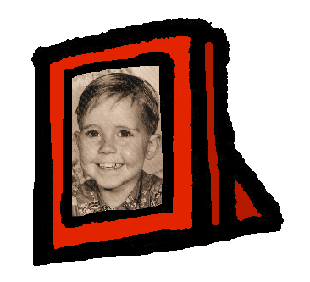
[au]
[au / eau / o]
gauche
prononcer
faux
eau
photo
aussi
[also]
Notes:
Timing: 2 minutes
Aim: To introduce SSC [au]
Procedure:
1. Introduce and elicit the pronunciation of the individual SSC [au] and then the source word again ‘gauche’ (with gesture, if using). 2. Then present and elicit the pronunciation of the five cluster words.
Frequency:
gauche [607] faux [555] eau [475] photo [1412] aussi [44]
Londsale, D., & Le Bras, Y. (2009). A Frequency Dictionary of French: Core vocabulary for learners London: Routledge.

Slide 4
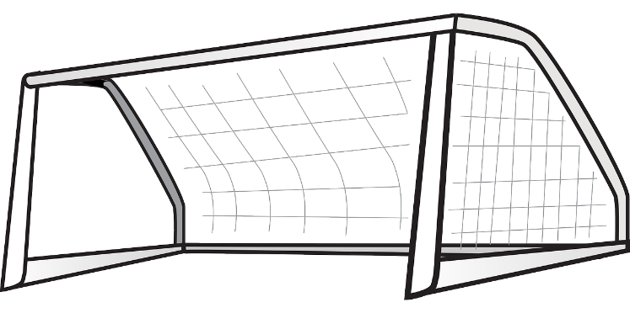
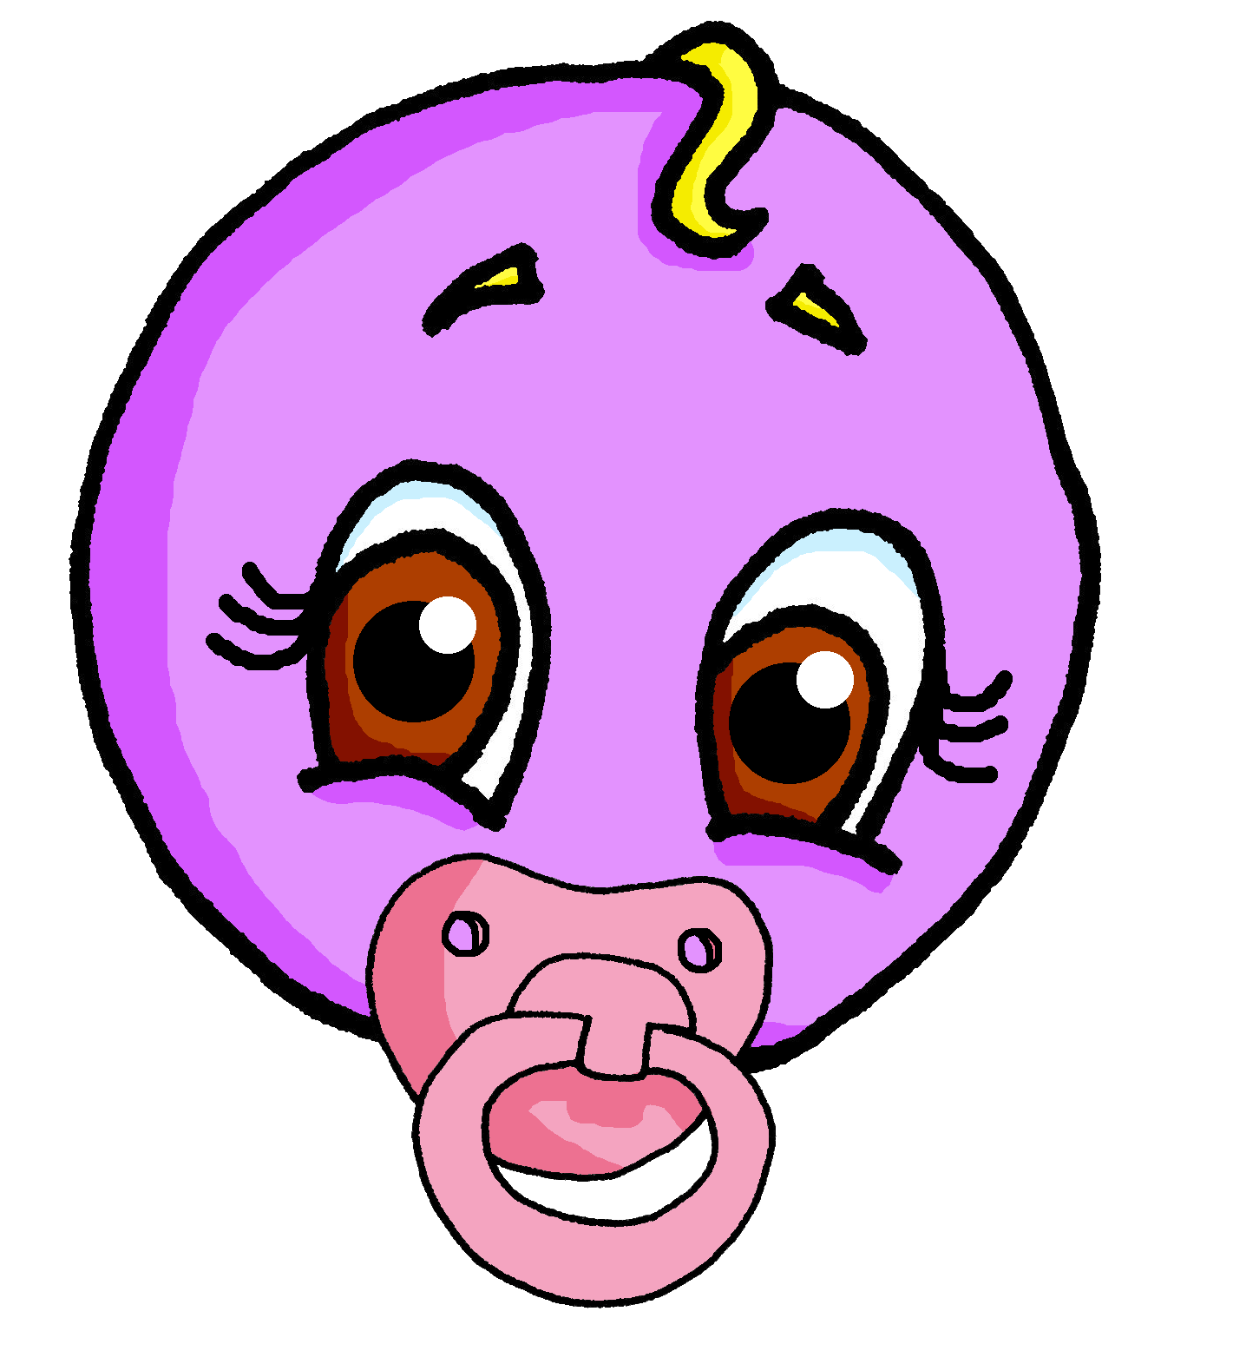
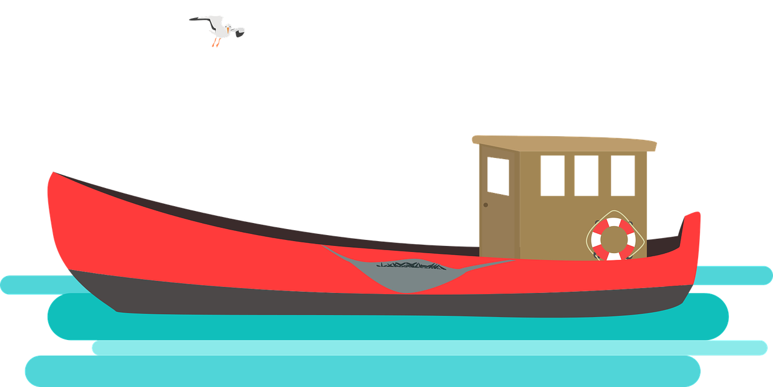
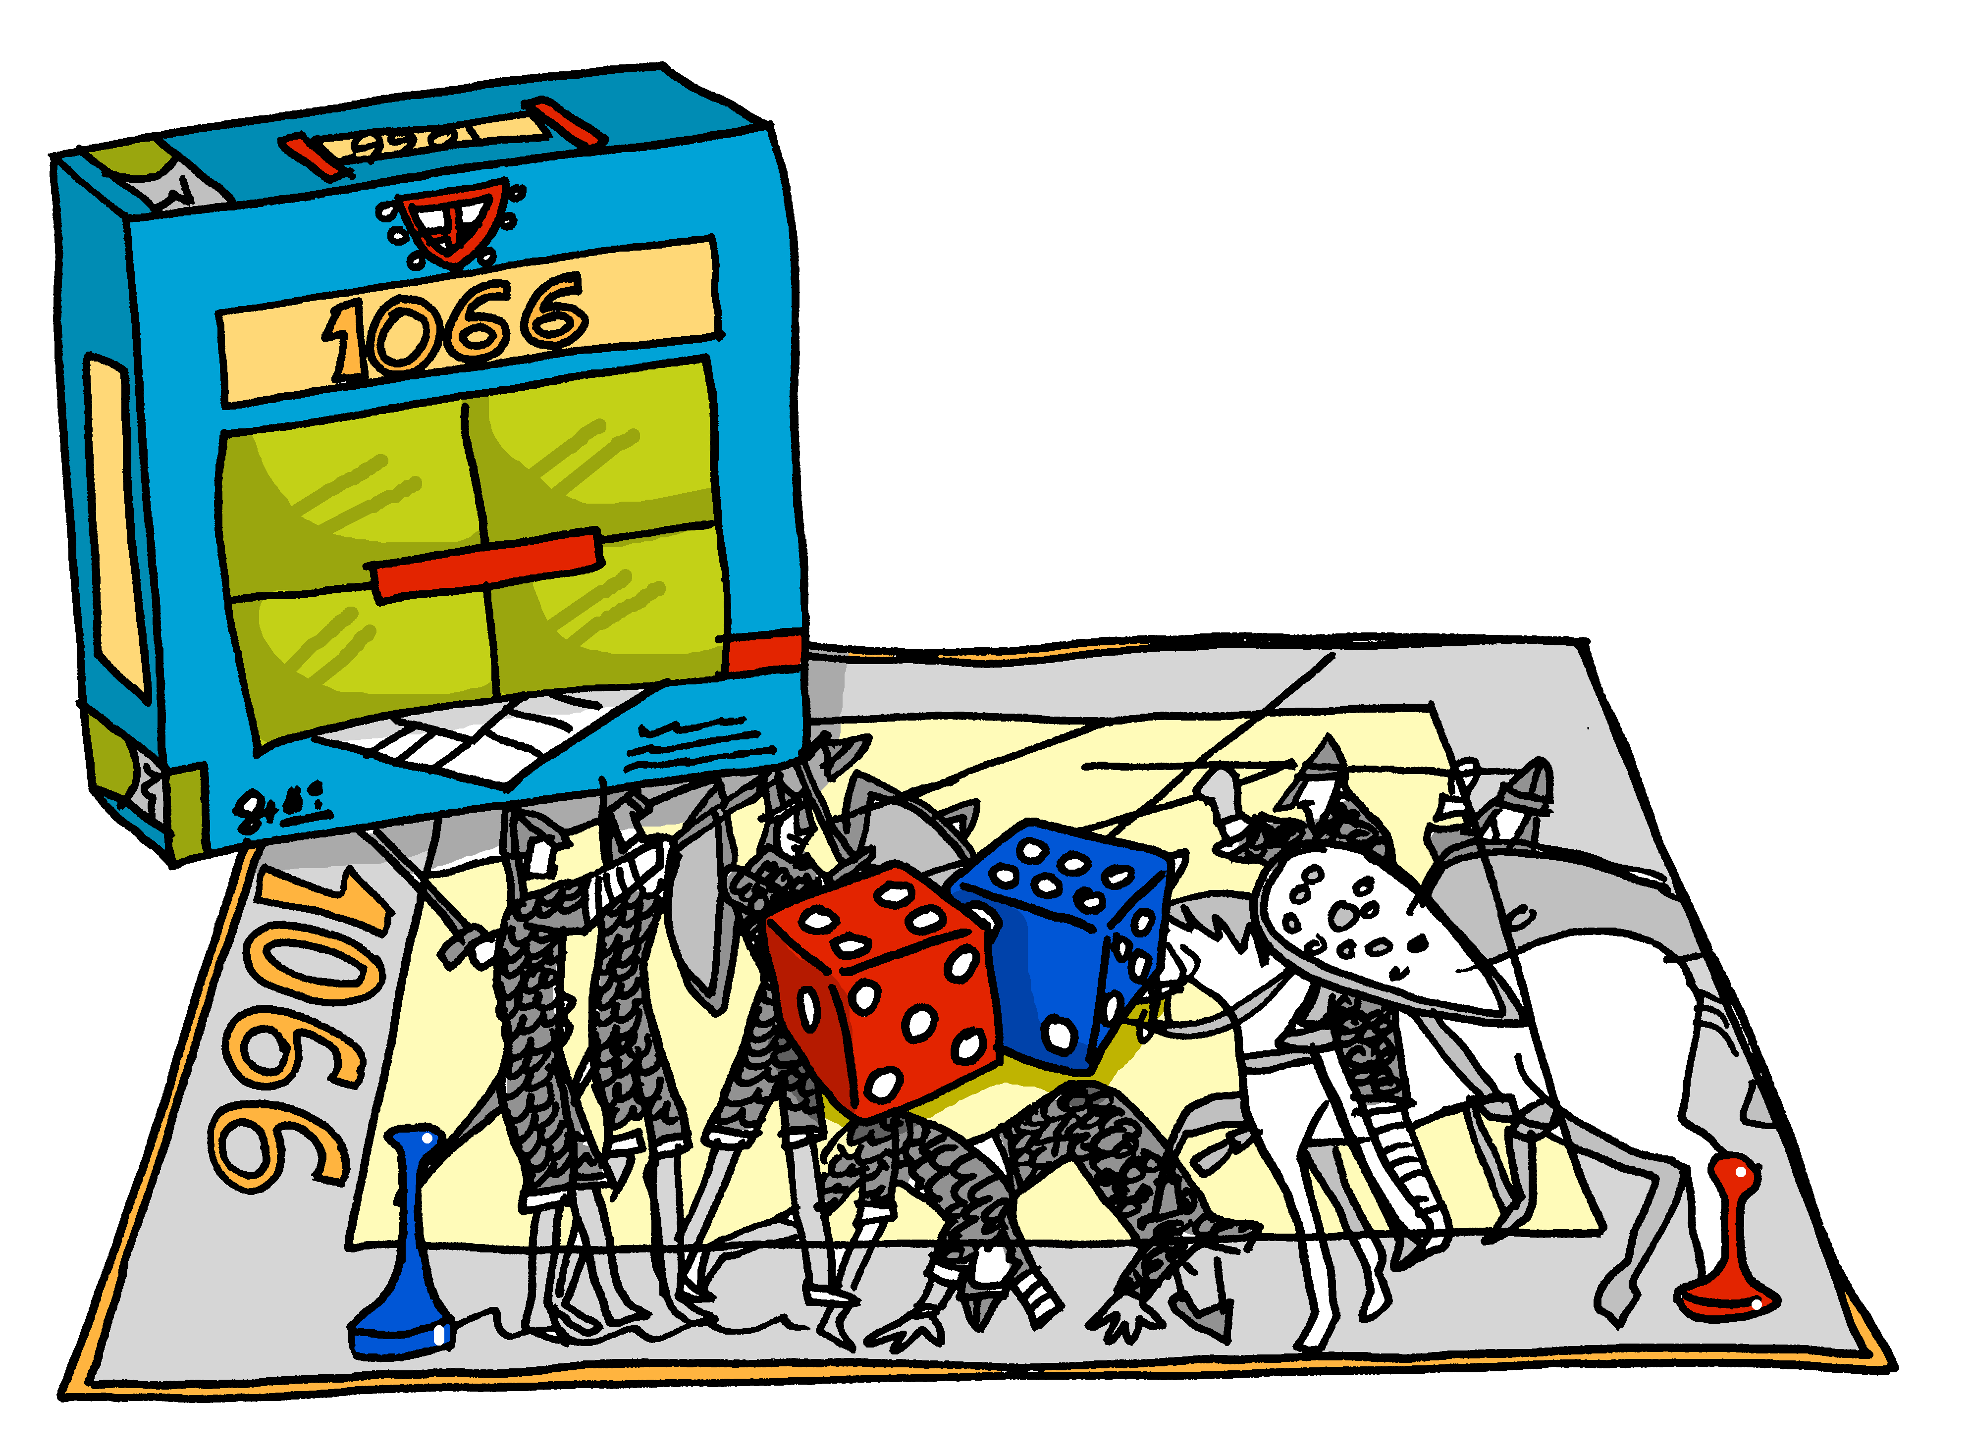
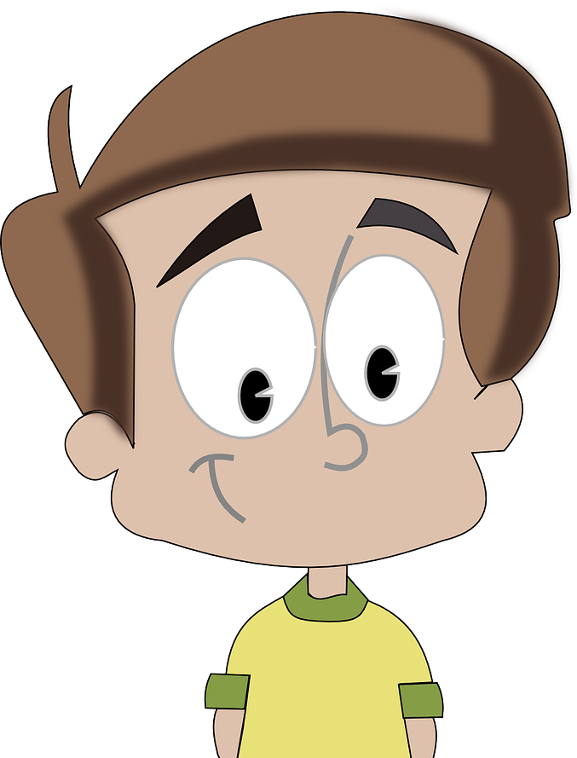
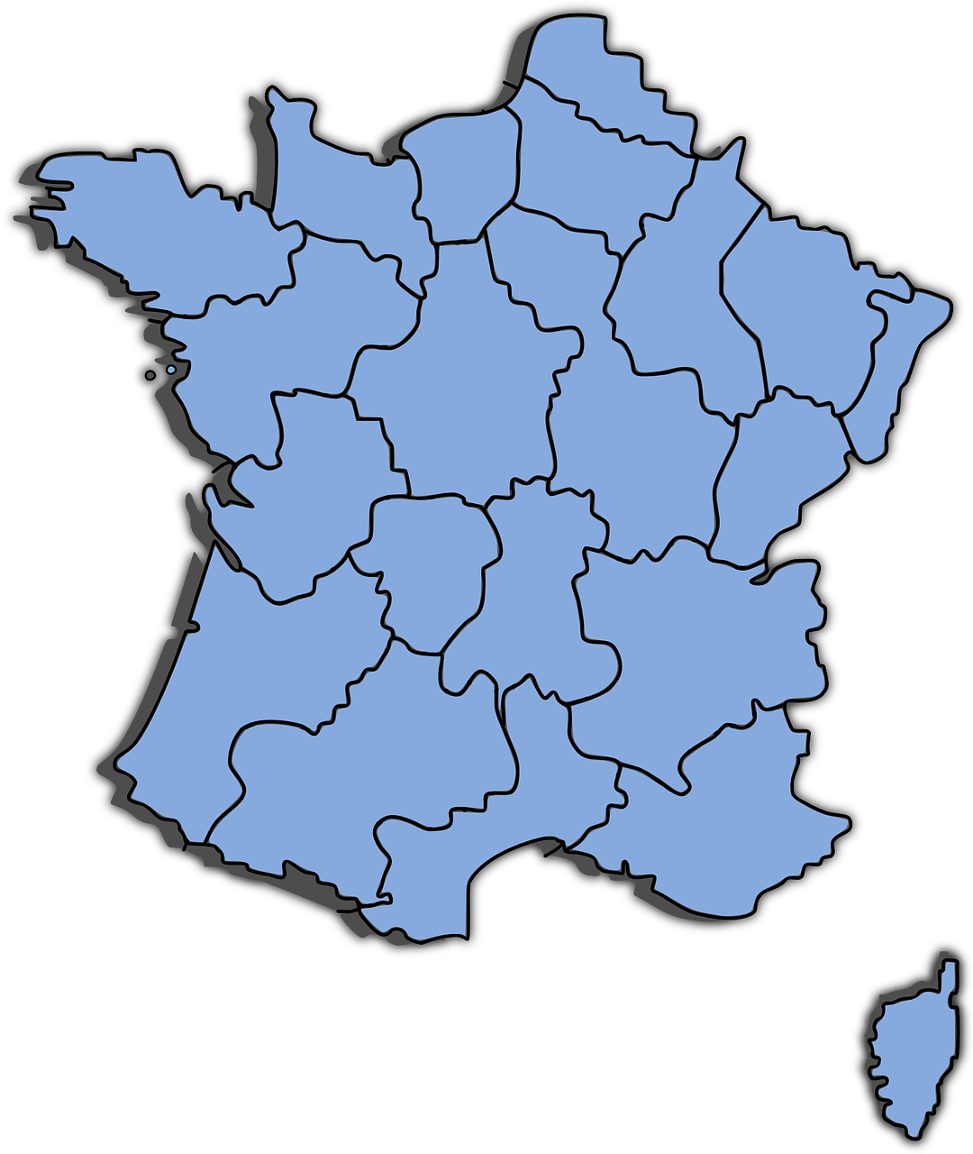
écouter
.
.
Écoute. C’est [(e)au] ?
Écris 1-10 et [(e)au] ou [eu].
[(e)au]
[eu]
joyau
jeune
Europe
bateau
joyeux
jeu
Aurélie
Pau
cadeau
[merry]
Eude
Pau est une ville,* en France, près* des Pyrénées et de l’Espagne.
???????
???????
???????
???????
???????
???????
???????
???????
???????
???????
Notes:
Timing: 5 minutes
Aim: Aural recognition of SSC [(e)au/o] and [eu].
Procedure:
Click on the [au] and [eu] to hear the difference, first.
Click to bring up a football and listen to a word. (Note: if the audio doesn’t sound, just roll back the animation and try again – the audio is there!)
Students allocate each word to either the left goal, if they think the SSC they hear is [au] or the right goal, if it is [eu].
Click to check (the ball moves to the goal and reveals the word) and clarify the meaning of the words.
Continue with all 10 words.
Click to bring up the callout about Pau.
Students now try saying the words.
Word frequency of unknown words and cognates (1 is the most frequent word in French):
bateau [1287] cadeau [2298] Europe [n/a] jeu [291] jeune [152] joyau [>5000]
Note: most of the words in this task will be taught later in the scheme of work.
Transcript: joyau jeune
Europe bateau Aurélie cadeau jeu
joyeux
Eude Pau
4

Slide 5
Avoir
[to have | having]
You already know some parts of avoir (to have):
You also know some parts of être (to be):
Tu as
you have
Tu es
you are
__
__
Il a
he has
Il est
he is
__
__
Elle a
she has
Elle est
she is
__
__
Tu as un dessin.
Tu es ici.
You have a drawing.
You are here.
Elle a une carte.
Il est là.
She has a card.
He is there.
Notes:
Timing: 3 minutes
Aim: To recap the 2nd and 3rd persons singular of avoir and être.
Procedure:
Teacher to remind students of the meaning of the forms of avoir that they already know, eliciting the pronouns from pupils
Teacher to repeat the elicitation with the same parts of être.
Continue with the meanings of the short sentences.
5

Slide 6
écouter
. Écoute les noms des animaux. C’est [ien] ou [(a)in]?
Écoute. C’est a(s) ou es(t) ?
. Écoute les noms des animaux. C’est [ien] ou [(a)in]?
Écris de 1 à 8 et le verbe. Puis écris A ou B.
 | have | are has | is | A | B
 | Tu as | Tu es | ici | un crayon
 | Tu as | Tu es | une idée | absent
 | Il a | Il est | idéal | un lit
 | Il a | Il est | une chambre | là
 | elle a | elle est | un bureau | idéale
 | elle a | elle est | une affiche | présente
 | tu as | tu es | ici | une chaise
 | tu as | tu es | présent | une moto
1
1
2
2
3
3
4
4
5
5
6
6
7
7
8
8
Notes:
Timing: 8 minutes
Aim: to practise aural distinction of a(s) and es(t) and connect the verbs with meanings (have or be); to revisit previously taught vocabulary.
Procedure:
Click to play audio.
Pupils write the verb.
Repeat for items 2-8.
Click to check answers.
Pupils then select the correct sentence ending, based on the verb meanings. They write A or B.
Click to check answers.
Click for the 2nd set of audio buttons. Elicit the full sentences (read aloud) from pupils. After each one, click to listen and check pronunciation. Check understanding by eliciting English meanings.
Transcript 1:
1. Tu es [ici]. 2. Tu as [une idée]. 3. Il a [un lit].
4. Il est [là]. 5. Elle est [idéale].
6. Elle a [une affiche].
7. Tu as [une chaise]. 8. Tu es [présent].
Transcript 2:
1. Tu es ici. 2. Tu as une idée. 3. Il a un lit.
4. Il est là. 5. Elle est idéale.
6. Elle a une affiche.
7. Tu as une chaise. 8. Tu es présent.
6

Slide 7
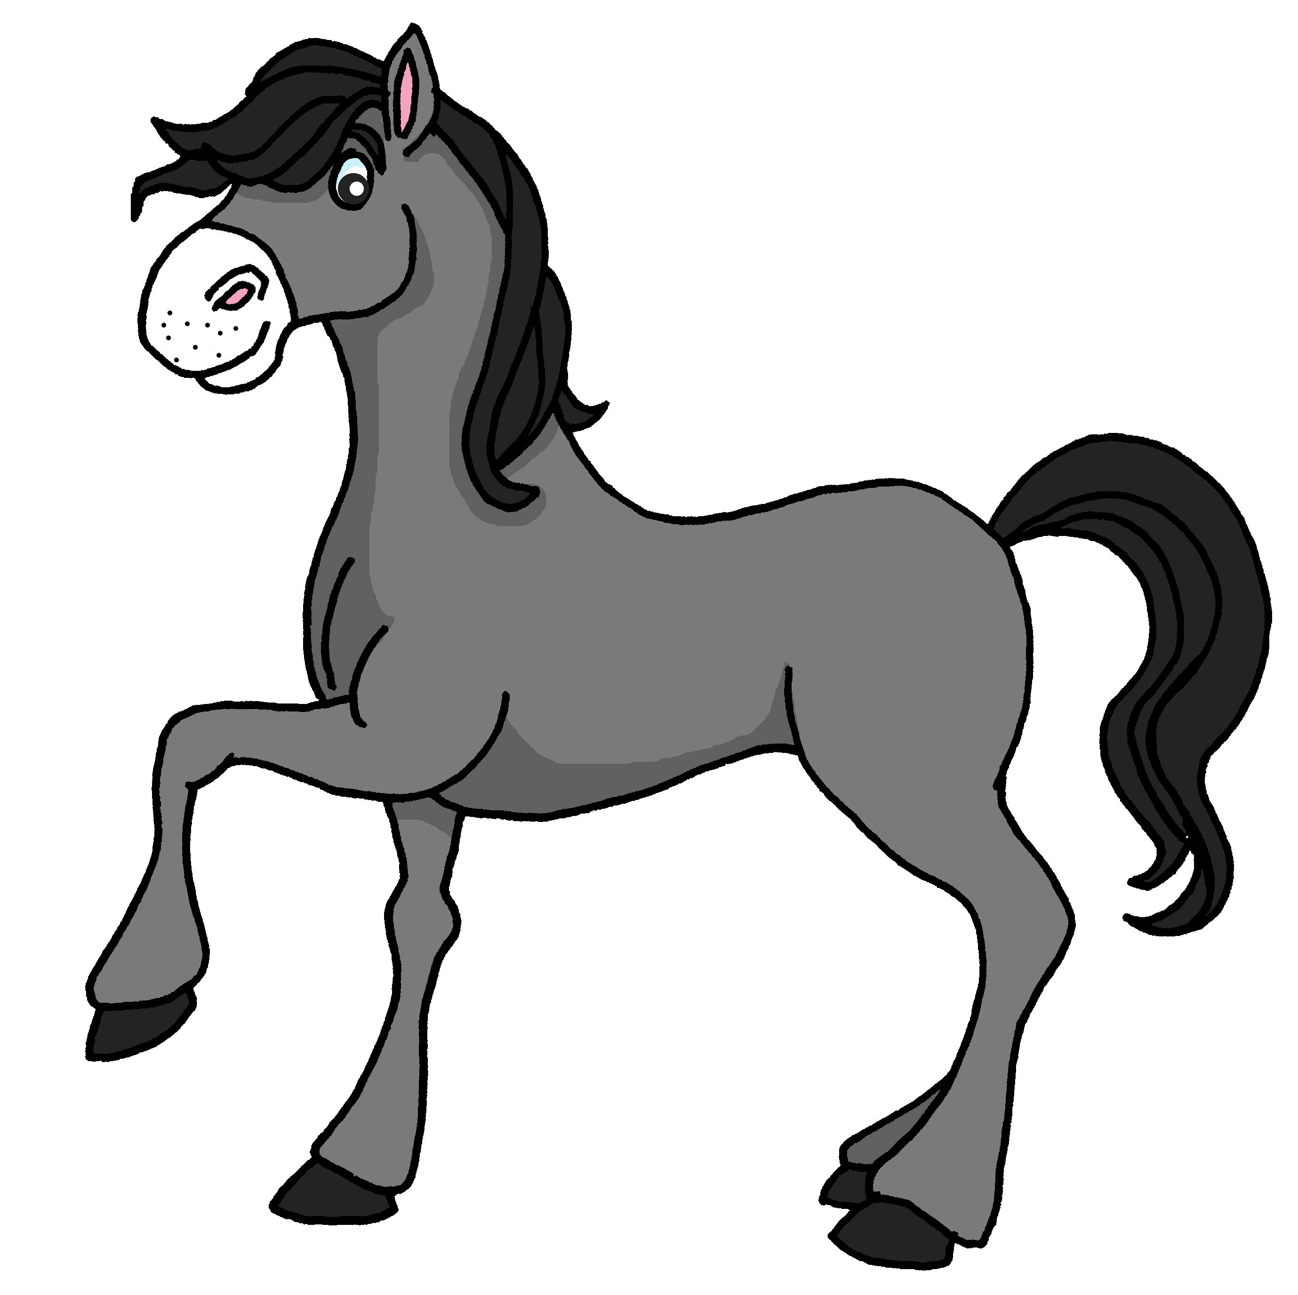
lire
Jean-Michel rêve* et c’est bizarre !
Un lit, c’est idéal pour Lucie la souris !
J’ai une carte pour toi, Lucie.
Pour moi ?
?
rêve – dreams, is dreaming
Notes:
Note: For an audio version of the story, download the other version of the lesson.
Timing: 10 minutes (7 slides)
Aim: to practise pronunciation of new words with a variety of SSC, and to revisit vocabulary from this term in a story context.
Procedure:
Ensure that the context is clear. Pierre is dreaming about some animals, after watching a nature documentary on tv.
Pupils read the story aloud, line by line, as per the animations.
Click on each speech bubble to hear each line pronounced by a native speaker.
Click to highlight the revisited noun word and to bring up the card with ?. Elicit the meaning of the noun and then click to reveal the picture on the birthday card that each character has received (to practise written comprehension of previously taught nouns.
Continue with the remaining 6 slides of the story.
7

Slide 8
lire
Jean-Michel rêve* et c’est bizarre !
Un bureau, c’est idéal pour Hugo le rhinocéros !
J’ai une carte pour toi, Hugo.
Pour moi ?
?
rêve – dreams, is dreaming
Notes:
[2/7]
8

Slide 9
lire
Jean-Michel rêve* et c’est bizarre !
Un chat, c’est idéal pour Nicolas le panda !
J’ai une carte pour toi, Nicolas.
Pour moi ?
?
rêve – dreams, is dreaming
Notes:
[3/7]
9

Slide 10
lire
Jean-Michel rêve* et c’est bizarre !
Un crayon, c’est idéal pour Gaston le lion !
J’ai une carte pour toi, Aaron.
Pour moi ?
?
rêve – dreams, is dreaming
Notes:
[4/7]
10

Slide 11
lire
Jean-Michel rêve* et c’est bizarre !
Un cheval, c’est idéal pour Pascal le cheval !
J’ai une carte pour toi, Pascal.
Pour moi ?
?
rêve – dreams, is dreaming
Notes:
[5/7]
11

Slide 12
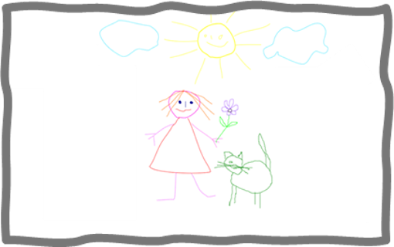
lire
Jean-Michel rêve* et c’est bizarre !
Un dessin, c’est idéal pour Martin le pengouin !
J’ai une carte pour toi, Martin.
Pour moi ?
?
rêve – dreams, is dreaming
Notes:
[6/7]
12

Slide 13
lire
Jean-Michel rêve* et c’est bizarre !
Une affiche, c’est idéal pour toi, Maurice !
J’ai une carte pour toi, Maurice.
Pour moi ?
?
Notes:
[7/7]
13

Slide 14
parler
. Écoute les noms des animaux. C’est [ien] ou [(a)in]?
Parle avec ton ou ta partenaire.
Personne A
1)
2)
Personne B
………………….a poster.
………………….a cat.
…………………..a pencil.
………………….a chair.
……………….a room.
Il a un crayon.
He has
Notes:
Timing: 8 minutes
Aim: to practise spoken production of singular parts of avoir and previously taught nouns.
Procedure:
1. Model the task.
2. Use the handouts at the end of this presentation.
3. Personne A uses the prompt to say who has what item.
4. Personne B listens and notes down who has each item.
Note: the layout of the task as it is includes an additional level of challenge, as Partner B’s items are not on the page in numerical order. This forces Partner B to attend to the meaning of the noun and the verb form at the same time. If felt to be too challenging, the items can be edited to follow the same order as Partner A’s items 1-5. For a higher level of challenge, pupils could be expected to write both the verb, person and noun.
14

Slide 15
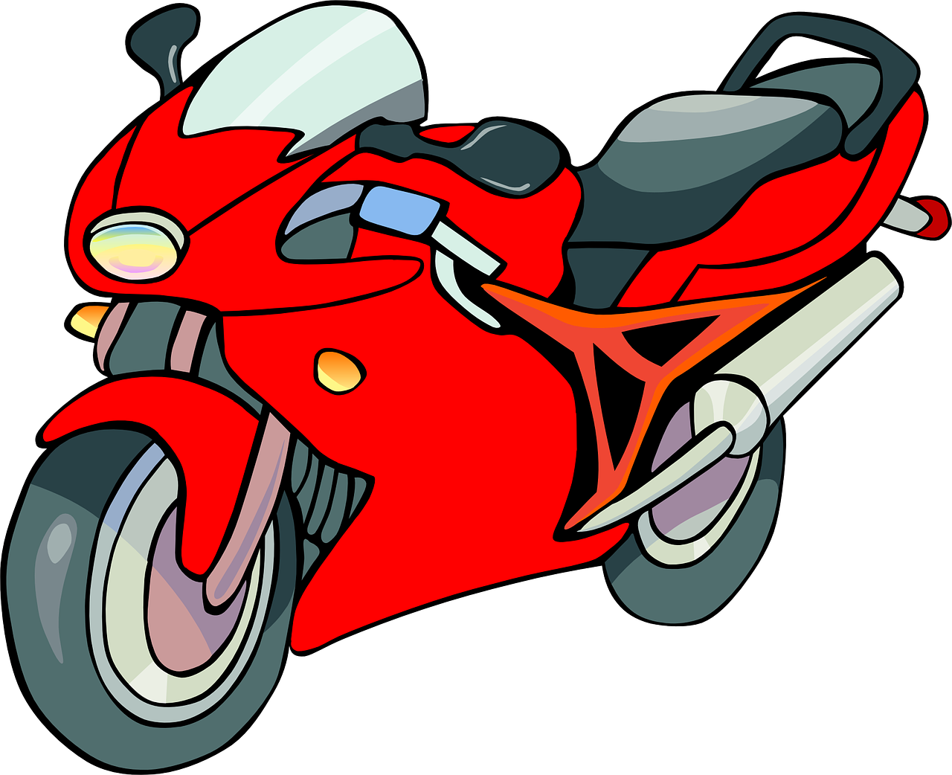
parler
Personne A
1)
2)
3)
4)
5)
6)
Personne B
………………….a horse.
………………….a pencil.
…………………a card.
………………….a cat.
……………….a desk.
……….........a motorbike.
Il a une carte.
I have
J’ai un chat.
She has
Elle a un crayon.
He has
I have
Tu as un bureau.
You have
J’ai un cheval.
Il a une moto.
He has
Notes:
ANSWERS Round 1
15

Slide 16
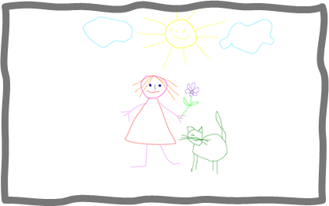
parler
Personne B
1)
2)
3)
4)
5)
6)
Personne A
………………….a message.
………………….a poster.
…………………a bed.
………………….a room.
…………………..a chair.
………...............a drawing.
Tu as un lit.
She has
Elle a une affiche.
She has
J’ai une chambre.
You have
I have
Il a un dessin.
You have
Tu as une chaise.
Elle a un message.
He has
Notes:
ANSWERS Round 2
16

Slide 17
Au revoir !
jaune
Notes:
17

Slide 18
parler
Handout
Round 1
Personne A
1)
2)
3)
4)
5)
6)
Round 2
Personne A
………………….a message.
………………….a poster.
…………………a bed.
………………….a room.
…………………..a chair.
………...............a drawing.
Notes:
Handout A
18

Slide 19
parler
Handout
Personne B
………………….a horse.
………………….a pencil.
…………………a card.
………………….a cat.
……………….a desk.
……….........a motorbike.
Round 2
Round 1
Personne B
1)
2)
3)
4)
5)
6)
Notes:
Handout B
19

