Slide 1
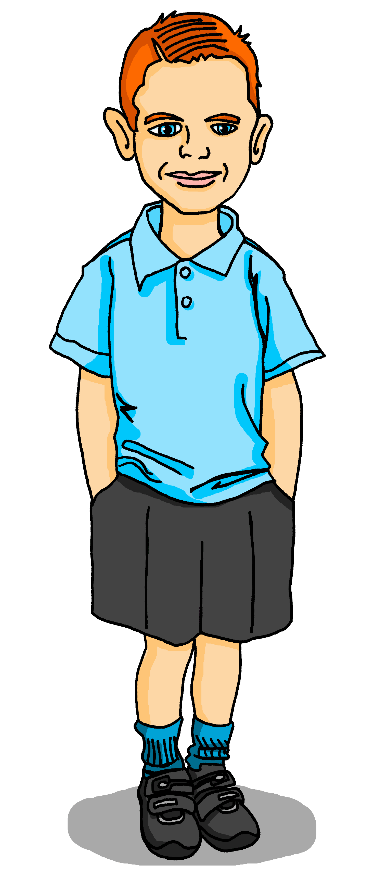
Saying what I and others have
jaune
« Avoir » : tu as
C’est où ? intonation + wh-word questions
SSC [on]
Notes:
Artwork by Steve Clarke. Pronoun pictures from NCELP (www.ncelp.org). All additional pictures selected from Pixabay and are
available under a Creative Commons license, no attribution required.
The AUDIO version of the lesson material includes additional audio for the new language
presented (phonics, vocabulary) and audio for the instructions on the slide.
In addition, it includes VIDEO clips of the phonics and the phonics’ source words. Pupils can be
encouraged to look at the shape of the mouth/lips on slides where these appear, and try to copy
it/them.
Artwork by Steve Clarke. Pronoun pictures from NCELP (www.ncelp.org). All additional pictures selected from Pixabay and are available under a Creative Commons license, no attribution required.
Frequency of new vocabulary and phonics:
Phonics: [on] non ! [72] crayon [>5000] onze [2447] monde [77] pont [1889]
Vocabulary: tu as [8] question [144] réponse [456] où [48] dans [11] sur [16] sous [122]
Revisit 1: ce (c') [12] lundi [1091] mardi [1044] mercredi [1168] jeudi [1112] vendredi [1086] samedi [1355] dimanche [1235] aujourd’hui [233]
Londsale, D., & Le Bras, Y. (2009). A Frequency Dictionary of French: Core vocabulary for learners London: Routledge.
The frequency rankings for words that occur in this PowerPoint which have been previously introduced in these resources are given
in the SOW and in the resources that first introduced and formally re-visited those words.
For any other words that occur incidentally in this PowerPoint, frequency rankings will be provided in the notes field wherever
possible.
1

Slide 2
[on]
Non !
prononcer
[on] is another nasal vowel like [an|en].
[un] is nasal before a consonant and at the end of words.
When you say a nasal vowel, air passes through your nose as well as your mouth.
Notes:
Timing: 1 minute
Aim: to present and practise SSC [on].
Procedure:
Introduce and elicit the pronunciation of the individual SSC [on] the source word ‘Non !’ with gesture, if using.
Click to bring on the picture and get students to repeat (with gesture, if using).
Click to bring up the callout about nasal vowels. Ask pupils if they can remember any words, or names they know with the [an | en] sound. (e.g. orange, dimanche, vendredi, maman, grand, enfant, content, anglais etc – there are lots!)
Move onto the next slide to practise [on] in four cluster words.
Note: gesture for Non ! – moving your index finger in a ‘wagging’ motion left to right in an exaggerated way.

Slide 3
prononcer
[on]
non !
crayon
monde
pont
onze
Notes:
Timing: 2 minutes
Aim: to present and practise SSC [on]
Procedure:
Present and elicit again the pronunciation of the individual SSC [on] the source word ‘Non !’ with gesture, if using.
Click to bring on the picture and get students to repeat (with gesture, if using).
Click again to bring up four cluster words to practise the sound. Repeat the words several times.
Note: gesture for Non ! – moving your index finger in a ‘wagging’ motion left to right in an exaggerated way.
3

Slide 4
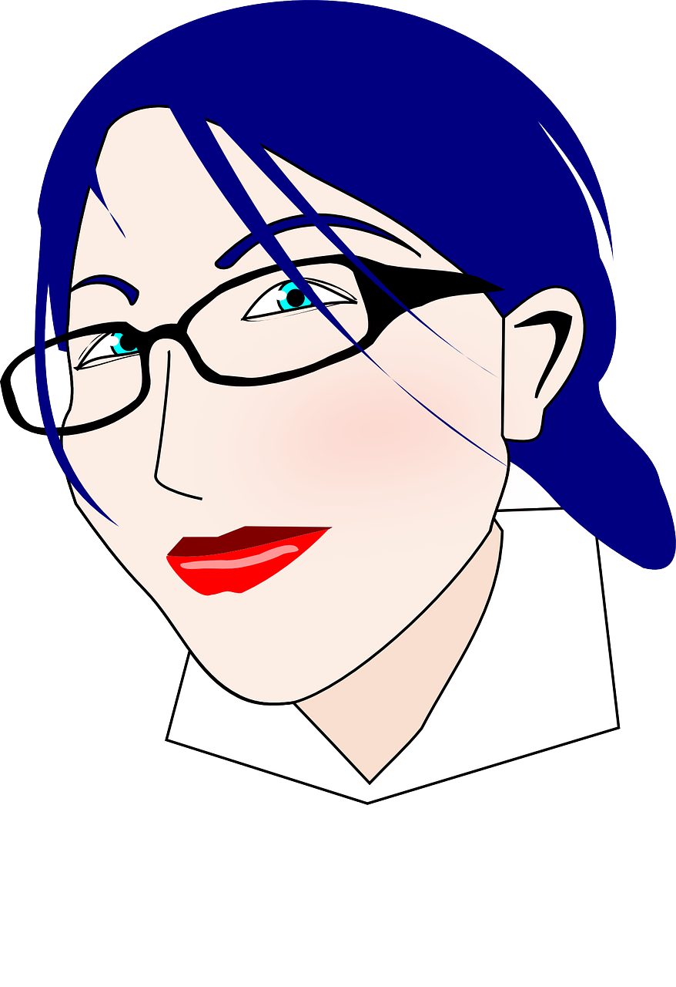
[on]
Prononce les mots.
.
avion
concert
contrôler
réponse
prononcer
25
lion
crayon
patron [boss]
prononcer
télévision
continuer
0
DÉBUT
Notes:
Timing: 3 minutes
Aim: to practise the pronunciation of SSC [on] in mostly unfamiliar words.
Procedure: 1. Pupil A selects 4 of the words (making a note of them).
2. Start the timer. Pupil B tries to guess Partner A’s four words by pronouncing them within the 25 seconds time limit.
3. Pupil B listens and ticks off Pupil A’s correct attempts.
4. They swap roles and repeat the task (taking turns until each has managed to get all four words. 5. The activity can be repeated multiple times.
Note: ensure pupils know they don’t need to rush too much. They have 2.5 seconds per word so will be able to say them all. If preferred, remove the timer altogether.
Frequency of unknown words and cognates (1 is the most frequent word in French): avion [1409] concert [1679] continuer [113] contrôler [1069] leçon [1300] lion [>5000] patron [1706] prononcer [706] télévision [1179]
Source: Londsale, D., & Le Bras, Y. (2009). A Frequency Dictionary of French: Core vocabulary for learners London: Routledge.

Slide 5
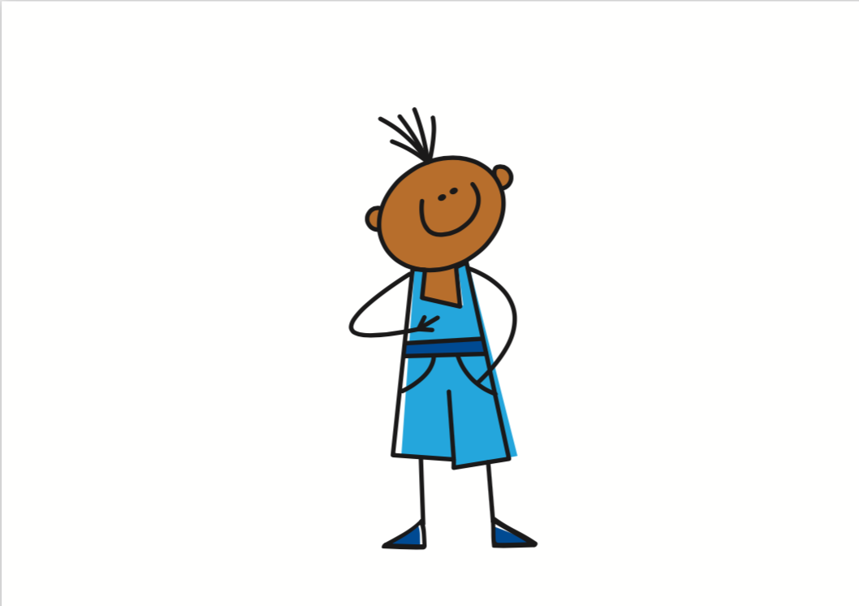
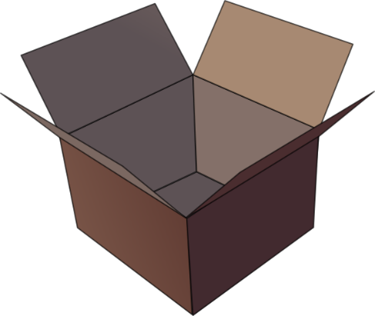
vocabulaire
have
j’ai
où ?
mots
have
tu as
dans
[on (top of)]
une question
sur
une réponse
sous
[under(neath)]
Notes:
[1/3]
Timing: 3 minutes
Aim: to introduce new vocabulary.
Procedure 1. Pupils either work by themselves or in pairs, reading out the words and recapping their English meaning (1 minute). 2. Then, on the next slide, students try to recall the English orally (chorally), looking at the French (1 minute). 3. Then, on the following slide, they try to recall the French meanings orally (again, chorally), looking at the English (1 minute).
Notes:
Note that images/words won’t disappear and appear in this activity as in previous resources.

Slide 6
vocabulaire
I have
j’ai
where?
où ?
mots
you have
tu as
in
dans
(the) question
on (top of)
sur
la question
(the) answer
la réponse
under(neath)
sous
Notes:
[2/3]
Procedure: 1. Students try to recall the English orally (chorally), looking at the French (1 minute). 2. Elicit answers and click to reveal. 3. Then, on the following slide, they to recall the French meanings orally (again, chorally), looking at the English (1 minute).

Slide 7
vocabulaire
where?
o_ ?
mots
I have
j’ai
où ?
j’_ _
tu as
d_ _ _
you have
t_ _ _
in
dans
(the)
question
on (top of)
s_ _
l_ q_ _ _ _ _ _ _
sur
la question
(the)
answer
under (neath)
s_ _ _
la réponse
sous
l_ r _ _ _ _ _ _
Notes:
[3/3]
Procedure: 1. Students recall the French meanings orally (again, chorally), looking at the English (1 minute)
2. Click to reveal the answers.

Slide 8
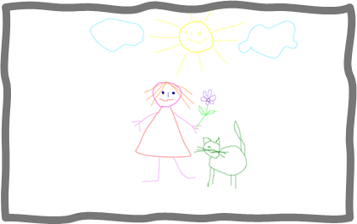
Avoir [to have, having]
You know that the verb avoir means ‘to have’ or ‘having’:
I
je becomes j’ before a vowel.
j’ai
To say I have, use ______.
J’ai une idée.
I have an idea.
you
tu as
Tu as un dessin.
To say you have, use _____.
You have a drawing.
Notes:
Timing: 3 minutes
Aim: to introduce the verb avoir (to have), I have, he has and she has.
Procedure:
Click to present the information.
Elicit the English at each stage from pupils after presenting the French examples.

Slide 9
écouter
Pierre parle avec Max.
C’est qui ? Pierre (je) ou Max (tu) ?
Écris l’objet en anglais.
 | Pierre (I) | Max (you) | anglais
 |  |  | idea
 |  |  | motorbike
 |  |  | univers
 |  |  | drawing
 |  |  | cat
 |  |  | message
1
1
2
2
3
3
4
4
5
5
6
6
Notes:
Timing: 4 minutes
Aim: to practise aural comprehension of ‘ai’ and ‘as’.
Procedure:
Read the title and click to bring up the instructions in French.
Do the example (E).
Pupils listen and select the correct person, based on hearing the difference between ‘ai’ and ‘as’. Then they write (in English) the item mentioned.
Click to reveal answers.
Continue with items 2-6.
Transcript 1
[tu] as une idée.
[j] ai une moto.
[j’] ai un univers.
[tu] as un dessin.
[j’] ai un chat.
[tu] as un message.
Transcript 2
tu as une idée.
j’ai une moto.
j’ai un univers.
tu as un dessin.
j’ai un chat.
tu as un message.
9

Slide 10
Asking questions
Remember! To change a statement into a yes/no question, raise your voice at the end:
J’ai un crayon.
J’ai un crayon ?
I have a pencil.
Do I have a pencil?
Tu as un crayon.
Tu as un crayon ?
You have a pencil.
Do you have a pencil?
In English, we add ‘do’, in French we just make our voice go up.
Notes:
Timing: 2 minutes
Aim: to revisit how to form intonation questions.
Procedure:
Click to present the information.
Elicit the English at each stage from pupils after presenting the French examples.

Slide 11
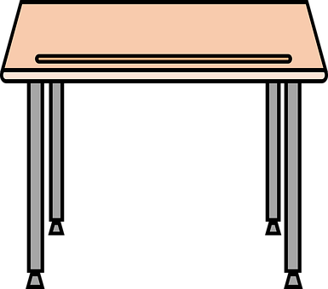
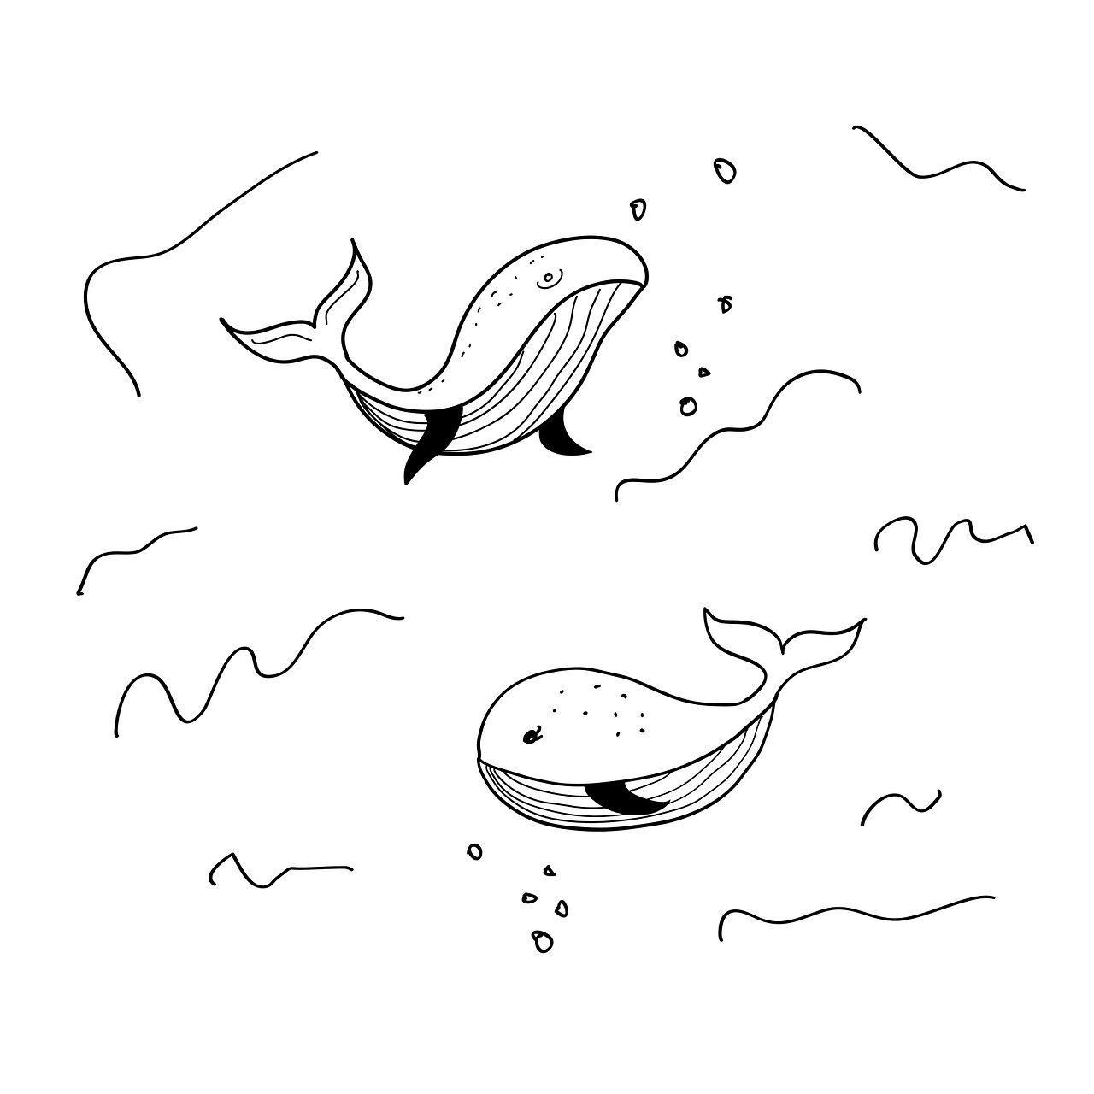
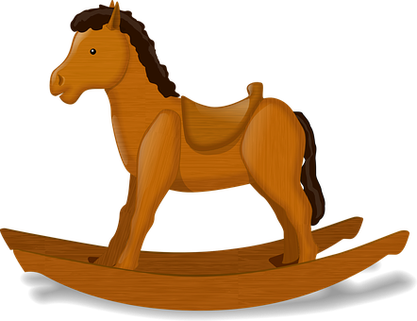
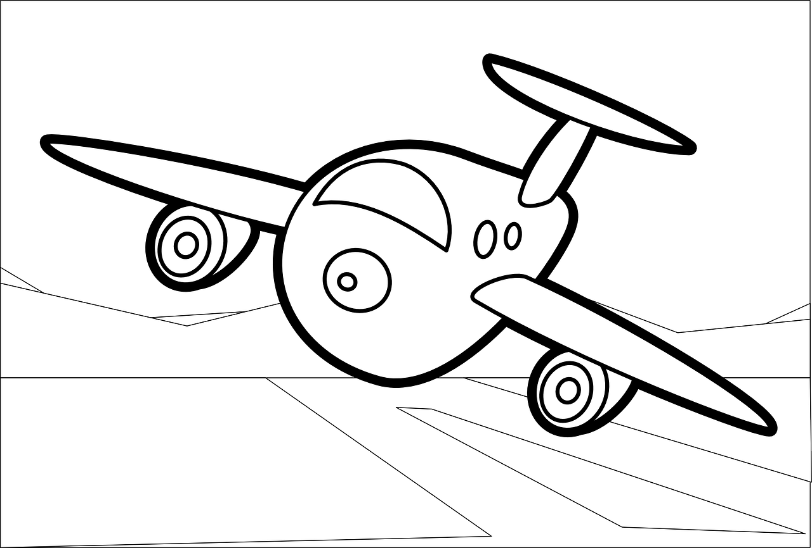
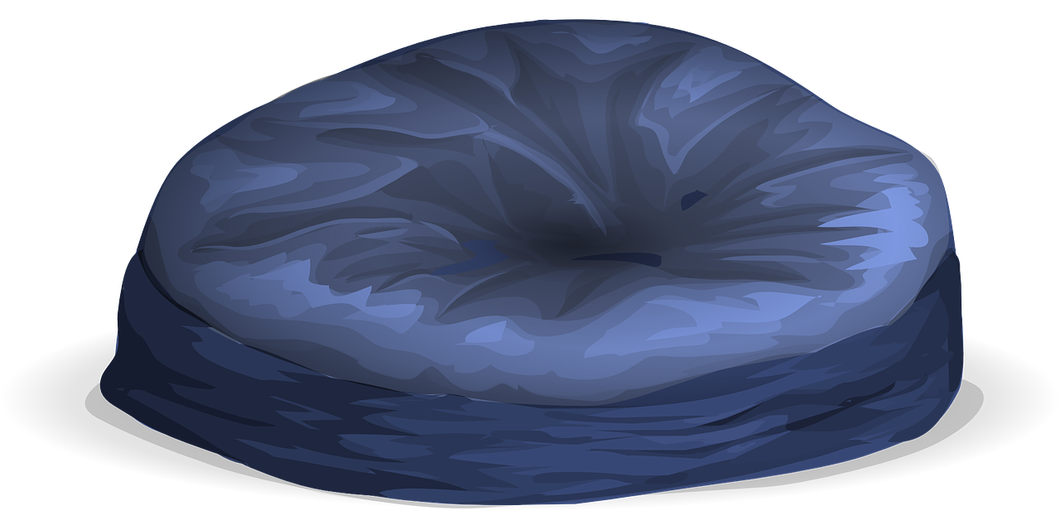
lire
Pierre et Max.
Pierre and Max exchange information about their homes.
C’est qui ? Pierre (je) ou Max (tu) ?
Notes:
[1/2]
Timing: 5 minutes (two slides)
Aim: to explain the context for this task (there will be a speaking task in the follow ups based on the same context).
Procedure:
Teachers read the title and information.
They explain that the two penfriends are sharing photos of their homes/rooms.
Move to the next slide for the reading/listening activity.
11

Slide 12
lire
Pierre et Max.
C’est une question ou une phrase ?
C’est qui ? Pierre (je) ou Max (tu) ?
1
4
J’ai une question.
J’ai un univers sur une affiche.
I|you | ? | . | anglais
.
I
a question
2
5
.
Tu as une réponse.
J’ai une banane sur un bureau ?
you
an answer
you
?
a drawing on a chair
.
I
a universe on a poster
3
6
Tu as un dessin sur une chaise ?
?
a banana on a desk
Tu as un chat sous un dessin ?
I
you
?
a cat under a drawing
Notes:
[2/2]
Aim: to practise written comprehension and aural recognition of questions and statements.
Procedure:
Pupils write 1-6 and the correct English subject (I/you).
They also write the English for the remainder of the message.
Click to reveal the answers in columns 1 and 3.
To decide if it is a question or a statement, they must listen to the full messages. Teachers point out that they cannot tell from the written message without the punctuation.
Click to bring up whatsapp icons. Click each to listen to the full message. Pupils identify question (?) or statement (.).
Click to elicit and reveal answers.
12

Slide 13
Au revoir !
jaune
Notes:
13

