Slide 1
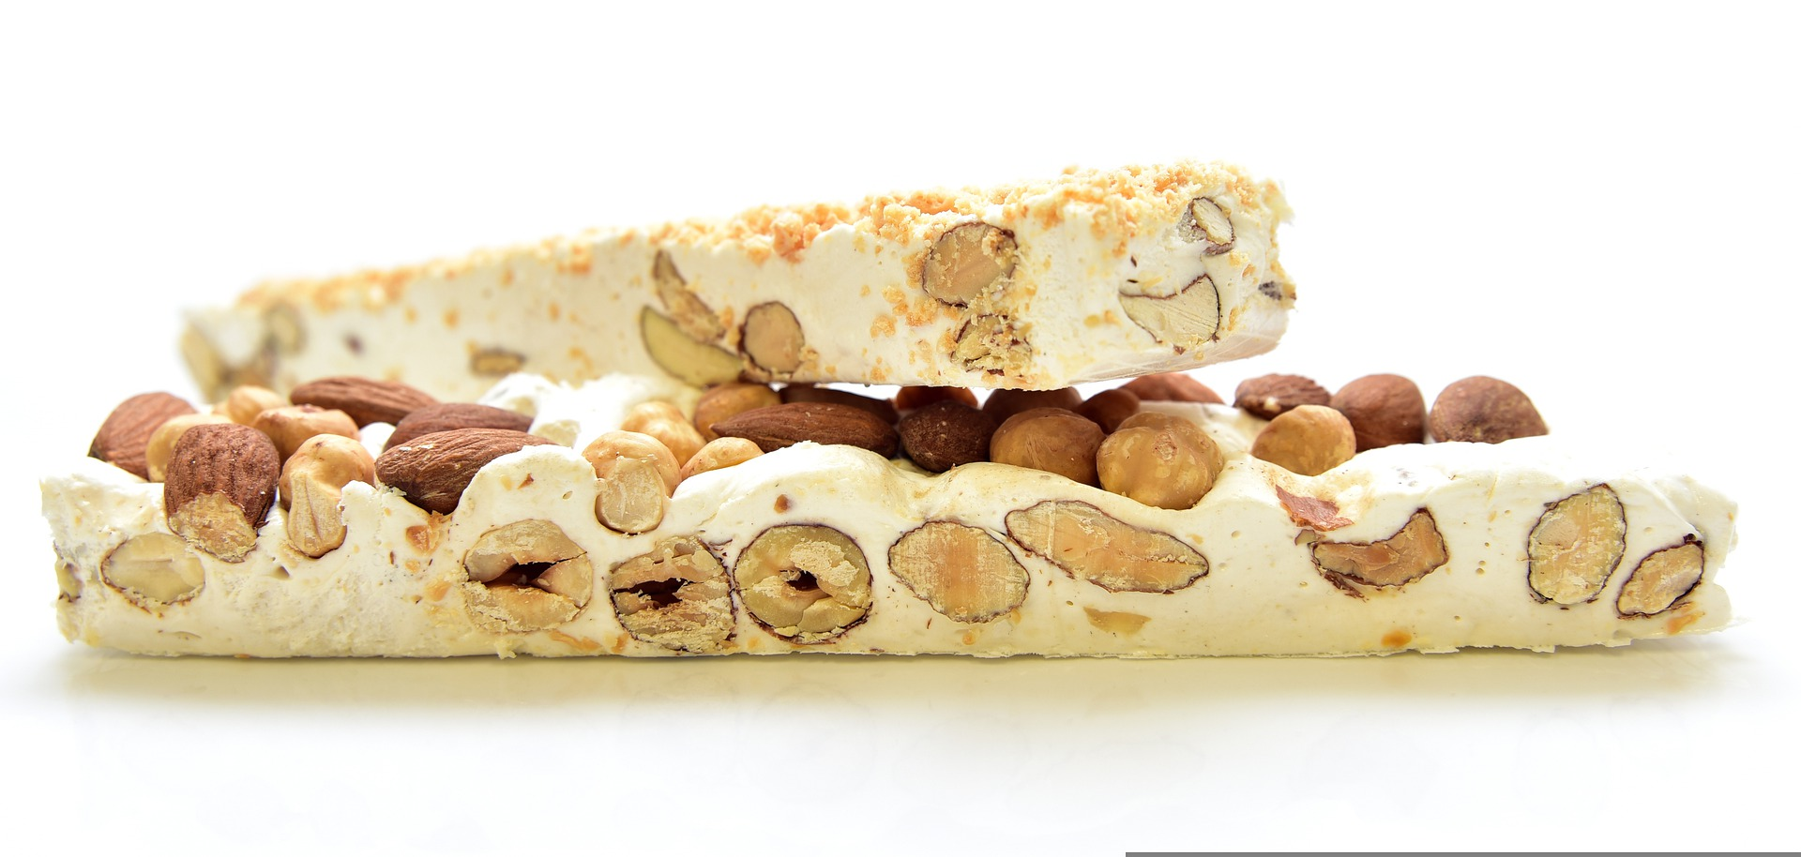
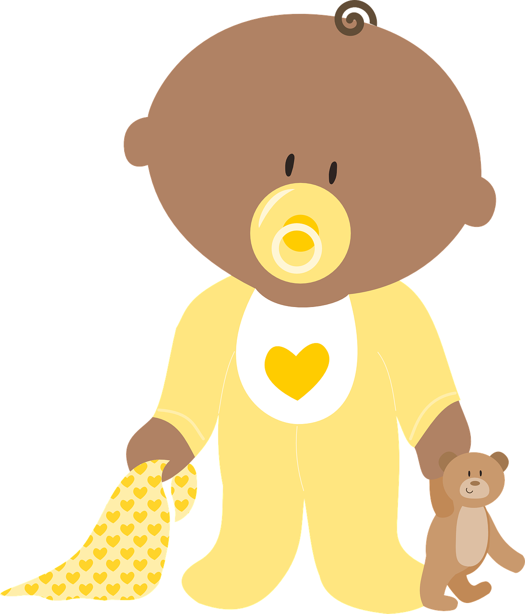
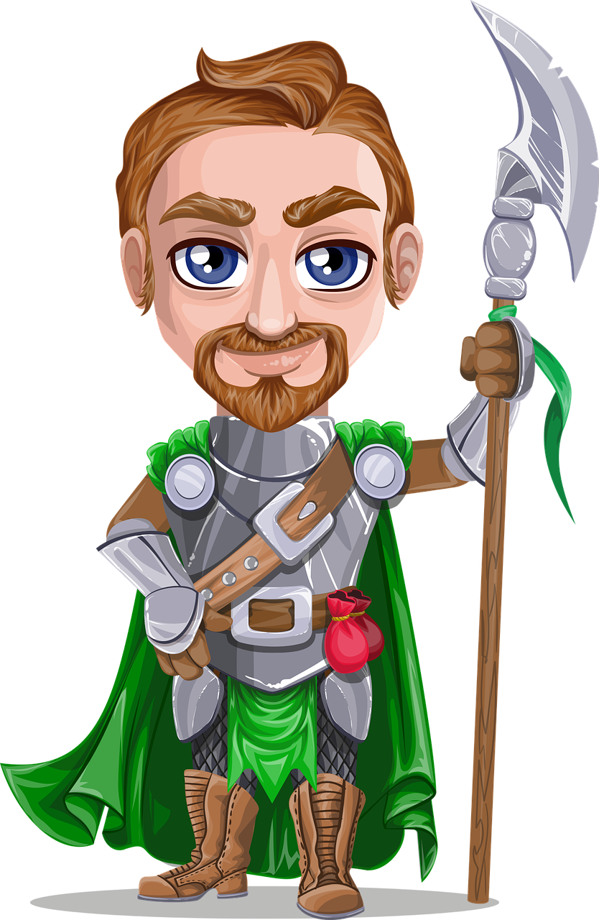
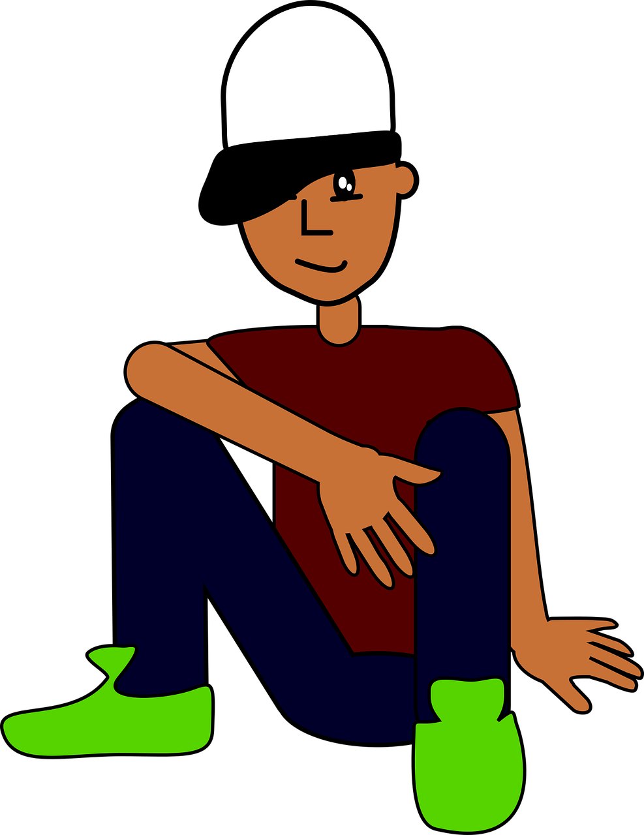
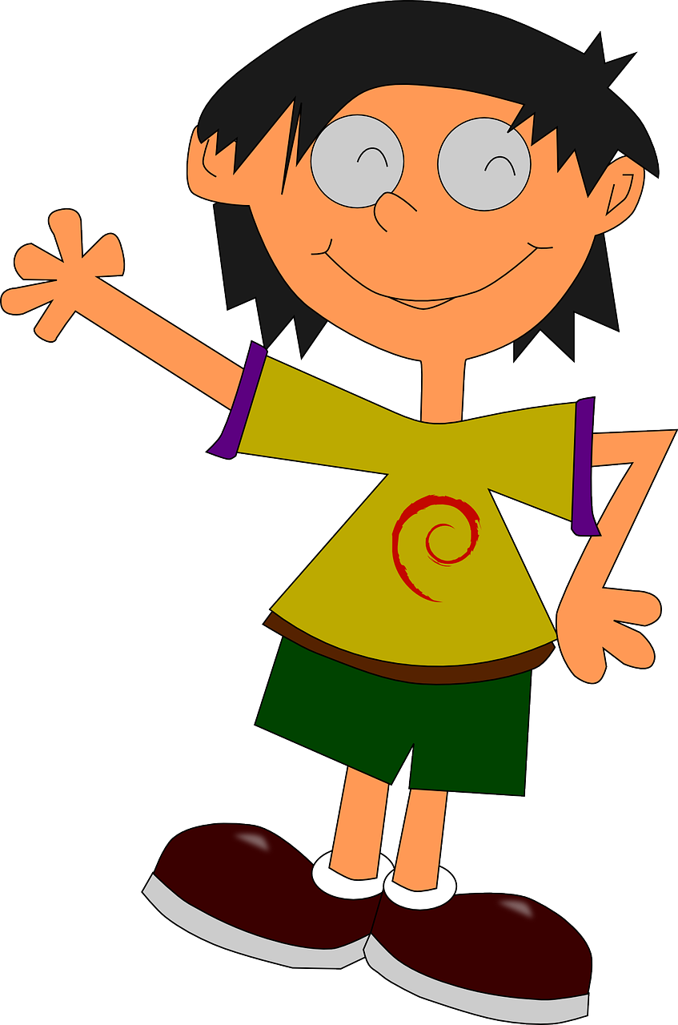
Phonics quiz
Phonics quiz
Pupil name: ____________________________
Total score: _____ / 16
Pupil name: ____________________________
Total score: _____ / 16
 | Present | Name
1 | nougat | Nicolas
2 | drapeau | Beau
3 | tenue (de foot) | Sabinu
4 | broche | Gavroche
5 | avion | Manon
6 | preux | Bartholmieu
7 | pervenche | Blanche
8 | bijou | Arnou
Joyeux Noël !
Read aloud the French name and the Christmas present with the same final sound.
You have not learnt these words so use what you know about how to pronounce French. Remember Silent Final Consonants!
 | Present | Name
1 | nougat | Nicolas
2 | drapeau | Beau
3 | tenue (de foot) | Sabinu
4 | broche | Gavroche
5 | avion | Manon
6 | preux | Bartholmieu
7 | pervenche | Blanche
8 | bijou | Arnou
Joyeux Noël !
Read aloud the French name and the Christmas present with the same final sound.
You have not learnt these words so use what you know about how to pronounce French. Remember Silent Final Consonants!
Notes:
Pupil feedback and assessment sheet
1

