Slide 1
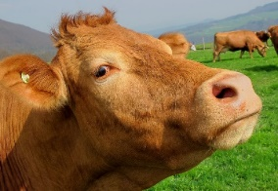
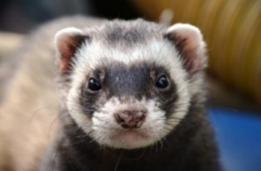
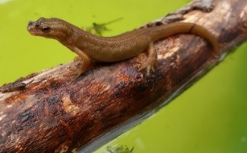
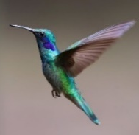
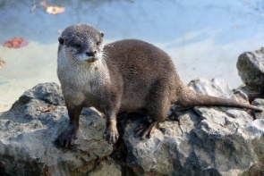
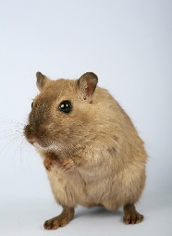
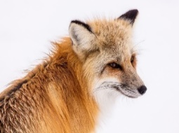
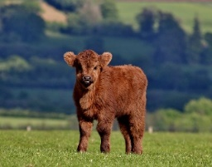
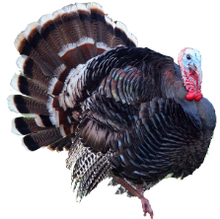
Le zoo Read aloud the French name of each animal.
Pupil name: ___________________________________
Total score: _____ / 14
 | Name | Animal | SSC | p/ x
1 | Marie-Lou | la loutre | [ou]
2 | Treveur | le rongeur | open [eu]
3 | Baltazar | le renard | [e] + SFC-d
4 | Akash | la vache | [ch]
5 | Marion | le triton | [on]
6 | Jaufret | le furet | [u] + SFC -t
7 | Magali | les colibris | [i] + SFC -s
8 | Enzo | le veau | [(e)au]
9 | Florinde | la dinde | [in] + SFe
10 | Cléo | le manchot empereur | [em]
You have not learnt these words so just use what you know about how to pronounce French. ☺
ZOO
Remember Silent Final Consonants!
1 | 2 | 3
4 | 5 | 6
 | Name
1 | Marie-Lou
2 | Treveur
3 | Baltazar
4 | Akash
5 | Marion
6 | Jaufret
7 | Magali
8 | Enzo
9 | Florinde
10 | Cléo
la vache
le furet
le triton
le manchot empereur
la loutre
les colibris
7 | 8 | 9 | 10
le rongeur
le renard
le veau
la dinde
Note: Teachers award one point for each SSC, one or two points per item, as per SSC list above.
Notes:
Teacher handout
Audio provided for teacher preparation, if required.

Slide 2
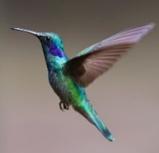
Le zoo Read aloud the French name of each animal.
Pupil name: ___________________________________
Total score: _____ / 14
 | Animal | SSC [sound-symbol correspondence] | p/ x
1 | la vache | [ch]
2 | le furet | [u] + SFC -t
3 | le triton | [on]
4 | la loutre | [ou]
5 | le manchot empereur | [em]
6 | les colibris | [i] + SFC -s
7 | le rongeur | open [eu]
8 | le renard | [e] + SFC-d
9 | le veau | [(e)au]
10 | la dinde | [in] + SFe
You have not learnt these words so just use what you know about how to pronounce French. ☺
ZOO
Remember Silent Final Consonants!
1 | 2 | 3
4 | 5 | 6
la vache
le furet
le triton
le manchot empereur
la loutre
les colibris
7 | 8 | 9 | 10
Note: Teachers award one point for each SSC, one or two points per item, as per SSC list above.
le rongeur
le renard
le veau
la dinde
Notes:
Phonics assessment Week 14 – Teacher version
Timing: 1 minute per pupil
Aim: to assess pupils’ ability to read aloud the SSC taught this term. Procedure: 1. Give out the independent task that pupils will work on during the lesson. 2. Listen to individual pupils reading the 8 pairs of words aloud. Mark in real time.
Note:
there are no follow up lessons this week, so it would be possible to continue the speaking assessments in the follow up time during this week, as needed.
if preferred, and the resources are available, pupils could record their answers (e.g. on computer or ipad) though this would involve the teacher listening back to assess them.

