Slide 1
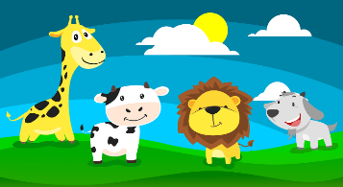
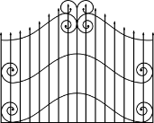
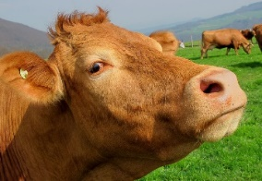
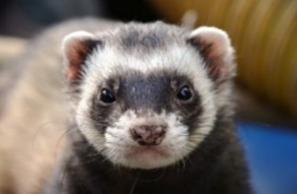
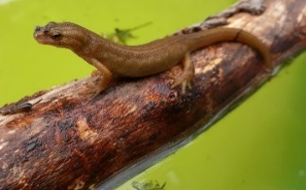
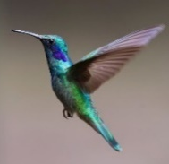
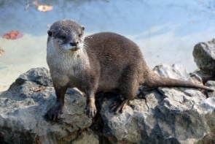
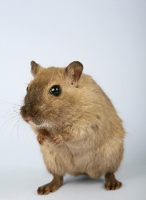
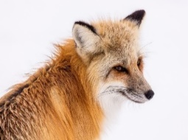
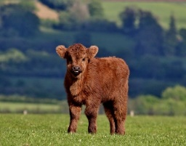
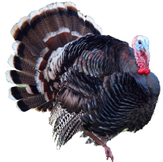
Le zoo Read aloud the French name of each animal.
Le zoo Read aloud the French name of each animal.
You have not learnt these words so just use what you know about how to pronounce French. ☺
ZOO
You have not learnt these words so just use what you know about how to pronounce French. ☺
ZOO
Remember Silent Final Consonants!
Remember Silent Final Consonants!
1 | 2 | 3
4 | 5 | 6
1 | 2 | 3
4 | 5 | 6
 | Name
1 | Marie-Lou
2 | Treveur
3 | Baltazar
4 | Akash
5 | Marion
6 | Jaufret
7 | Magali
8 | Enzo
9 | Florinde
10 | Cléo
 | Name
1 | Marie-Lou
2 | Treveur
3 | Baltazar
4 | Akash
5 | Marion
6 | Jaufret
7 | Magali
8 | Enzo
9 | Florinde
10 | Cléo
la vache
le furet
le triton
la vache
le furet
le triton
le manchot empereur
le manchot empereur
la loutre
les colibris
la loutre
les colibris
7 | 8 | 9 | 10
7 | 8 | 9 | 10
le rongeur
le renard
le veau
la dinde
le rongeur
le renard
le veau
la dinde
Notes:
Pupil handout To copy and cut in half
Note: There is a version with the animals only without names on the next slide, if preferred.

Slide 2
Le zoo Read aloud the French name of each animal.
Le zoo Read aloud the French name of each animal.
You have not learnt these words so just use what you know about how to pronounce French. ☺
ZOO
You have not learnt these words so just use what you know about how to pronounce French. ☺
ZOO
Remember Silent Final Consonants!
Remember Silent Final Consonants!
1 | 2 | 3
4 | 5 | 6
1 | 2 | 3
4 | 5 | 6
la vache
le furet
le triton
la vache
le furet
le triton
le manchot empereur
le manchot empereur
la loutre
les colibris
la loutre
les colibris
7 | 8 | 9 | 10
7 | 8 | 9 | 10
le rongeur
le renard
le veau
la dinde
le rongeur
le renard
le veau
la dinde
Notes:
Alternative version with animals only.

