Slide 1
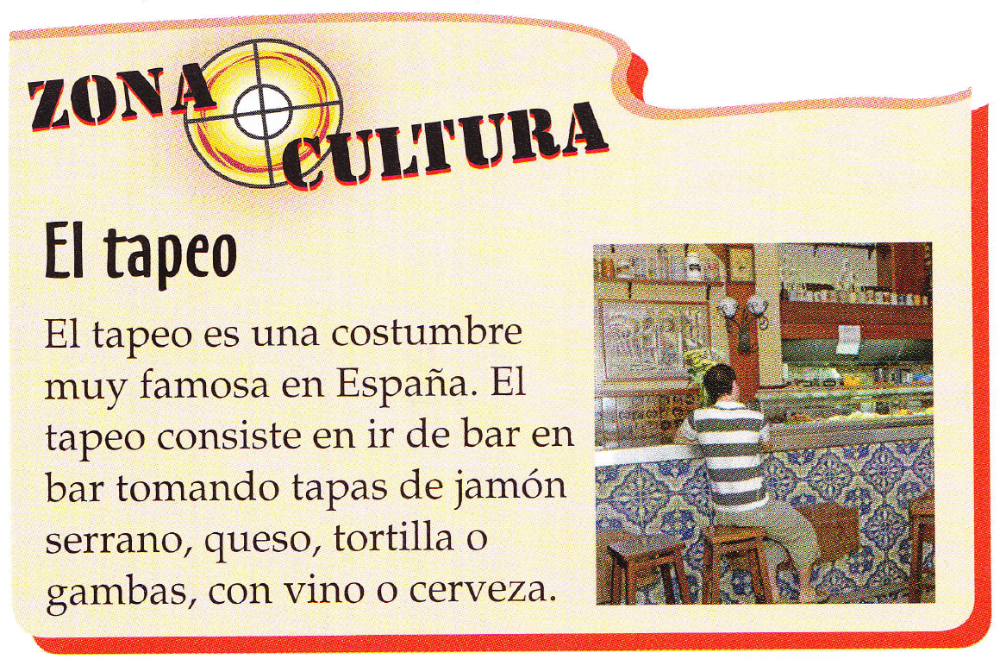

Slide 2
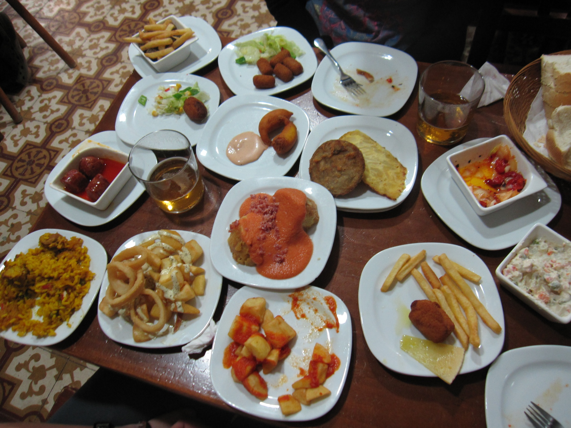

Slide 3
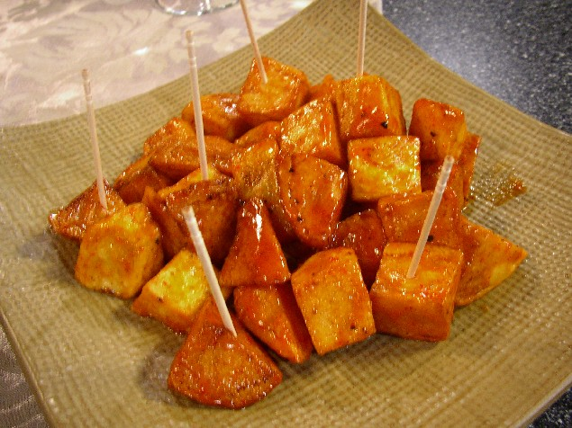
las patatas bravas

Slide 4
las patatas bravas
¿Qué piensas de(l/la) ?
Yo creo que ………………. es/son ……….. / ¡Qué ……….!
¿Qué piensas tú?
Estoy de acuerdo / No estoy de acuerdo.
¡Qué va! ¿Estás loco/a?
positivo | negativo
rico delicioso dulce sano saludable bueno | asqueroso raro picante repugnante soso insípido

Slide 5
¿Qué va a tomar?
1 I would like a tapa (snack-size portion) of cheese and a white coffee please.
2 I would like a ham sandwich and a coke please.
3 I would like an omelette with salad and a lemonade.
4. I would like the paella and a small beer.
5. I would like a hamburger and chips and a mineral water.

Slide 6
¿Qué va a tomar?
1 I would like a tapa (snack-size portion) of cheese and a white coffee please.
2 I would like a ham sandwich and a coke please.
3 I would like an omelette with salad and a lemonade.
4. I would like the paella and a small beer.
5. I would like a hamburger and chips and a mineral water.
Quisiera una tapa de queso y un café con leche, por favor.
Quisiera un bocadillo de jamón y una coca cola, por favor.
Quisiera una tortilla con ensalada y una limonada.
Quisiera la paella y una caña.
Quisiera una hamburguesa con patatas fritas y una agua mineral.

Slide 7
¿Qué va a tomar?
1 I would like a tapa (snack-size portion) of cheese and a white coffee please.
2 I would like a ham sandwich and a coke please.
3 I would like an omelette with salad and a lemonade.
4. I would like the paella and a small beer.
5. I would like a hamburger and chips and a mineral water.

Slide 8
1 | Individual consultations | 9.10 – 9.20
2 |  | 9.20 – 9.30
3 |  | 9.30 – 9.40
4 |  | 9.40 – 9.50
5 |  | 9.50 – 10.00
6 |  | 10.00 – 10.10
1 http://oye.languageskills.co.uk – Y10/11 topics – Food Instructions on the A4 sheet
2. http://www.bbc.co.uk/languages/spanish/lj/night_out/tapas/ Do all activity stages 1-4
3 http://www.bbc.co.uk/languages/spanish/lj/night_out/menu/ Do all activity stages 1-4
4 Vocab Express – is now live! Go to Travel – a. Food & Drink b. In the restaurant
5 After your 10 minute preparation with me, you can choose to practise the conversation in the restaurant for next assessment.
Homework: Complete Vocab Express sections Food & Drink and In the restaurant and practise the restaurant conversation.

