Slide 1
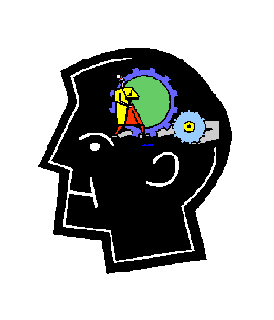
Memory techniques: 1 Chunking
Break your work down into sentence ‘chunks’
Take one paragraph and count the number of sentences
Draw that number of boxes onto a page
Write each sentence into a box from left to right
Look at the first sentence in your notes and read it out loud. Then, close your eyes and say (‘seeing the words in your mind’) or ‘air write’ the sentence without looking at it
Repeat the step above, this time with the first 2 sentences
Next, try it with 3 sentences. Then 4. Repeat until you have (mostly)memorized the first paragraph

Slide 2
Now turn over and draw the boxes again
This time put the first letter of each word only, followed by a line. E.g. m__ g________ l__ c_________
When you have finished, try to complete the text without looking at your notes.
Now take a 3 minute break
Now turn over and draw the boxes again
This time put a picture in each box instead of any words
Try to use colourful, humorous images to link to the idea of the sentence
When you have finished, try to complete the text without looking at your notes.

Slide 3
Memory techniques: 2 Visualisation
Use images to help you remember
Assign a picture to each sentence or part of a sentence
E.g. L’affiche = poster (in French)

Slide 4
Top tips for using mneumonics to remember your text:
Use positive, pleasant images.
Your brain often blocks out unpleasant ones.
Use vivid, colourful, sense-laden images - these are easier to remember than drab ones.
Use all your senses to code information or dress up an image. Remember that your mnemonic can contain sounds, smells, tastes, touch, movements and feelings as well as pictures.
Give your image three dimensions, movement and space to make it more vivid.
You can use movement either to maintain the flow of association, or to help you to remember actions.
Exaggerate the size of important parts of the image.
Use humour! Funny or peculiar things are easier to remember than ordinary ones.
Similarly, silly (or rude) rhymes are very difficult to forget!
Symbols (red traffic lights, pointing fingers, road signs, etc.) can code quite complex messages quickly and effectively.

Slide 5
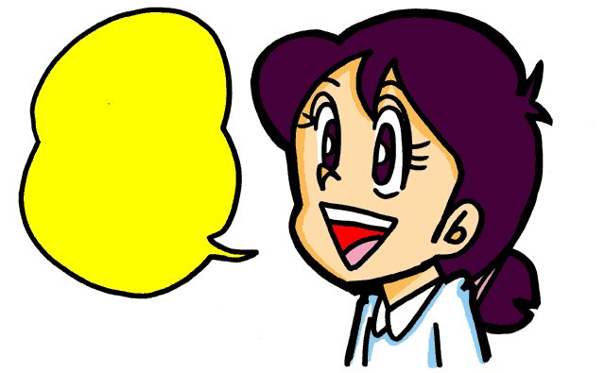
A Try thinking of images for the next paragraph of your text. Remember to make them as vivid and unusual as possible so they stick in your mind.
B Speak your text through with these pictures to prompt you (then have a 2-minutes chat with your partner).
C Now see if you can remember your text by just thinking of, or looking at your images.

Slide 7
Memory techniques: 3 All in a song!
Using a simple tune you know well can be a powerful aid to memory.
Choose a very simple tune (children’s songs work best because they are in our long term memory)
Take a line of text from one paragraph and fit it to the tune
Add the next line, and so on for a whole paragraph. Keep checking the text at this stage!
Keep singing it over and over until you can cover the text and sing the song without referring.

Slide 8
Try:
If you’re happy and you know it
Baa Baa Black Sheep
She’ll be coming round the mountain

Slide 9
Memory techniques: 4
The Roman Room method - mentally picture a room in your house and select several items in it e.g. if you choose your bedroom and mentally in that room picture your bed, your lamp, your PC, your wardrobe ...
Then mentally place your sentences on / in / under / next to these places in your room - remember that the more unusual you can make these connections the better - you can use images to help you remember your sentences too.
Mentally you can then walk around your room reciting you text
The items in your room act as prompts for each sentence and the route you take around the room helps you form your whole text.
At home you can physically put post-its with your sentences on these items of furniture and walk your route using a different room for each question

Slide 10
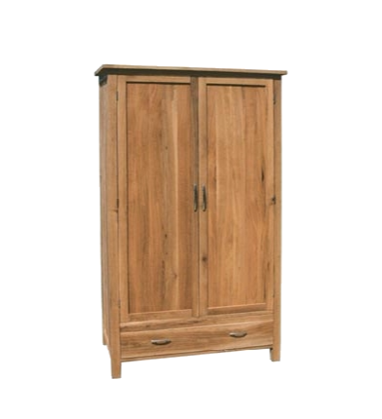
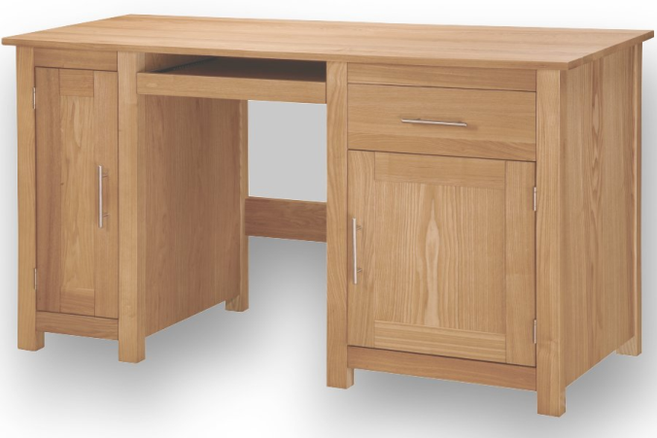
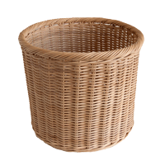
Voy a menudo al cine porque me gusta mucho.
Mis películas favoritas son las comedias y las películas de acción.
Pero a mi madre le encantan las películas románticas.
Prefiero ir al cine con mis amigos.
No me gustan las películas románticas porque son aburridas.
Try this with a paragraph of your text

Slide 11
Memory techniques: 5
Key words and/or pictures
Take a piece of paper for each bullet and paragraph.
Split the paper in half like this:
At the top is the English bullet and on the left is your answer broken down into sentences or chunks
On the right hand side you write key words or draw pictures to prompt your response
When ready, cover the left side and use the right to help you recite the text
Try this with the next paragraph of your text

Slide 12
Plenary 1 - pair discussion
Which 5 methods have you looked at today?
Which method(s) do you think might work best for you and why?
Which method are you going to use to learn the answer to your controlled assessment?
Are you going to use the same technique for all of the text?
And finally........on lined paper
Write down which method(s) you found most useful
Write down an example of what you learnt today using the method(s).
This week
Use the method(s) to help you complete your learning for the assessment next week

