Slide 1
Los deportes

Slide 2
Task: Open book assessment
Write a letter about what you like to do in your free time.
You could mention:
What different activities you do
Your favourite thing to do in your free time
Why you like some things and dislike others
What you generally do at the weekends
Activities you have done recently/ in the past
Any things you would like to try in the future NB: Try to write 30-35 words per bullet point.
Notes:
Open book assessment task

Slide 3
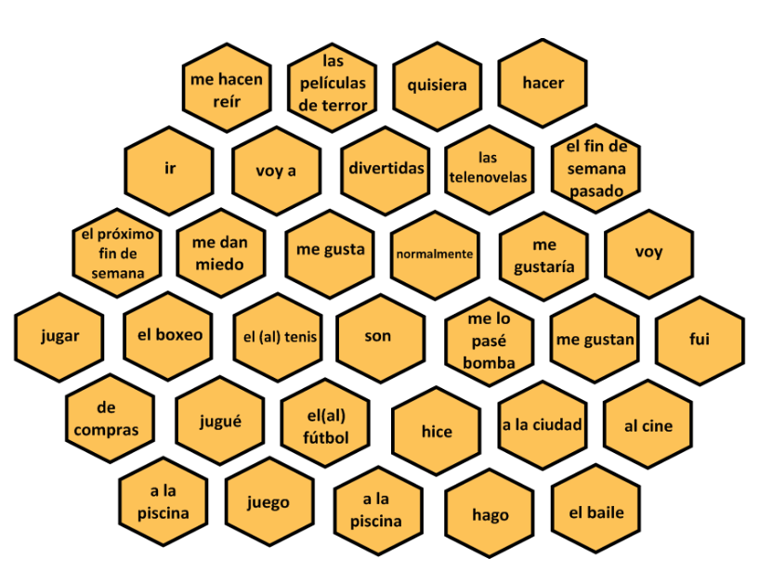
Notes:
Thank you Amanda Salt for reminding me about this!

Slide 4
Write a 30-second mini-presentation about sports using this as a framework. Then do a prompt sheet with 10 words maximum and practise until you can deliver the presentation with only the prompts.
One or two sports you like and why
los deportes
Your plans for next weekend + extra details
What you did last weekend (+extra detail + opinion)
Where? When? With whom?
Say a sport that someone else you know likes.
Notes:
This was homework from last week. They are going to give a short oral presentation based on 10 word prompt.

Slide 5
Write a 30-second mini-presentation about sports using this as a framework. Then do a prompt sheet with 10 words maximum and practise until you can deliver the presentation with only the prompts.
One or two sports you like and why
los deportes
Your plans for next weekend + extra details
What you did last weekend (+extra detail + opinion)
Where? When? With whom?
Say a sport that someone else you know likes.

Slide 6
Do your 10 word prompt sheet here. Use colours to remind you about the different tenses and pictures too.
los deportes

