Slide 1
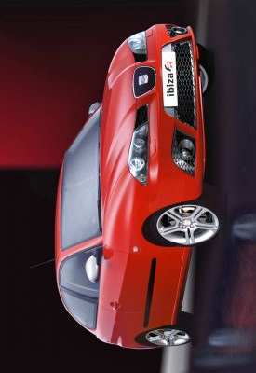
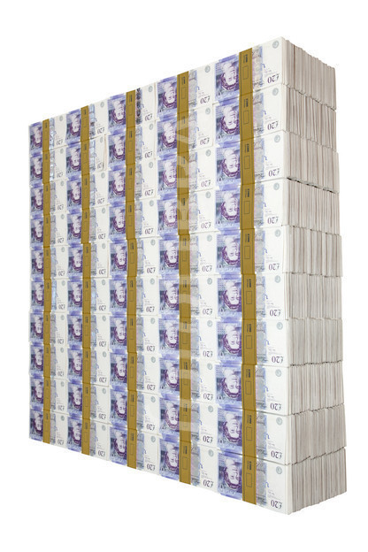
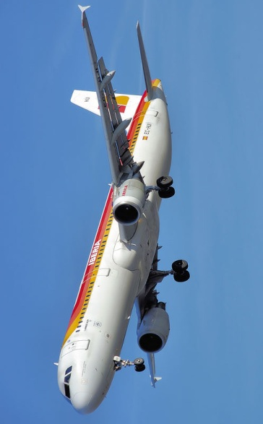

Slide 2
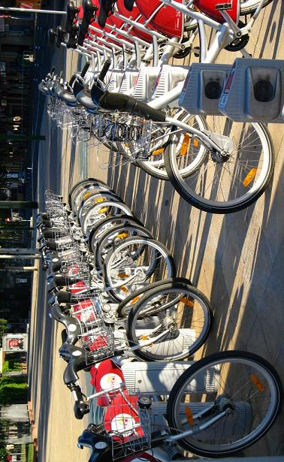

Slide 3
vocabulario 3 (para el 22 de mayo 2012)
Mi vocabulario – versión inglesa | Mi vocabulario - español
1 by car
2 by plane
3 cheap
4 expensive
5 relaxing
6 fast
7 good for the environment / ecological
8 práctical / handy / convenient
9 uncomfortable
10 exciting
11 to hire
12 to travel

