Slide 1
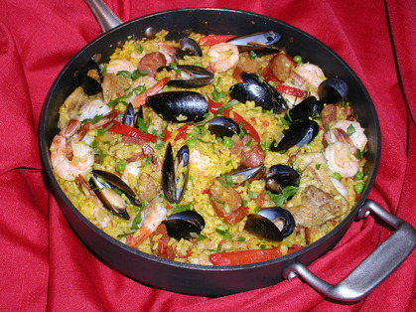
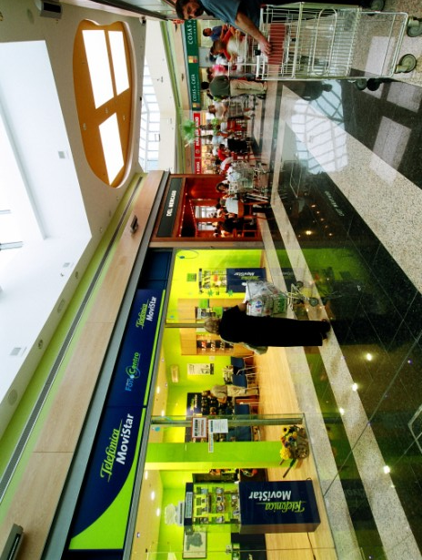

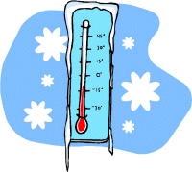


Slide 2

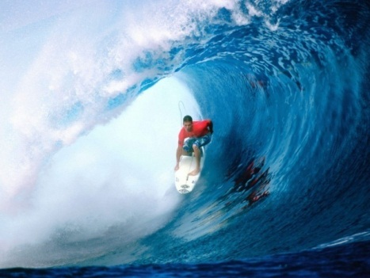
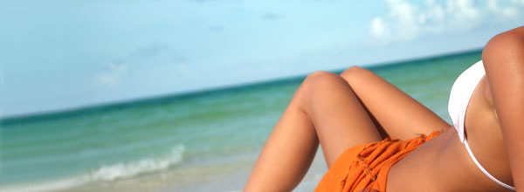
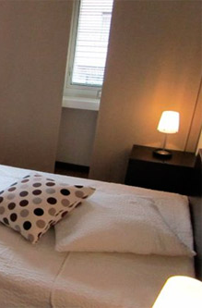
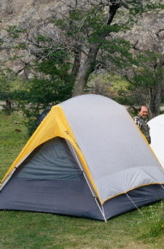
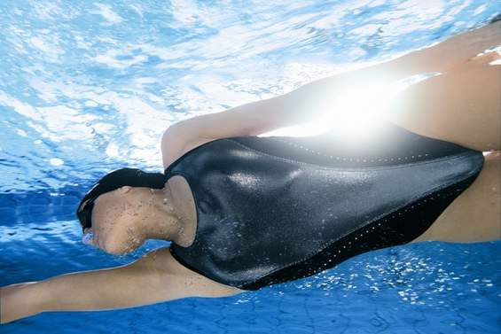




Slide 3
vocabulario 2 (para el 8 de mayo 2012)
Mi vocabulario – versión inglesa | Mi vocabulario - español
1 (the) food
2 (the ) shops
3 (the ) accommodation
4 it’s sunny
5 it’s hot
6 it’s cold
7 it rains
8 there
9 every year
10 to do surfing
11 to sunbathe
12 to swim (in the sea)

