Slide 1
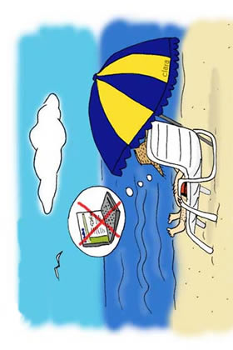

Slide 2
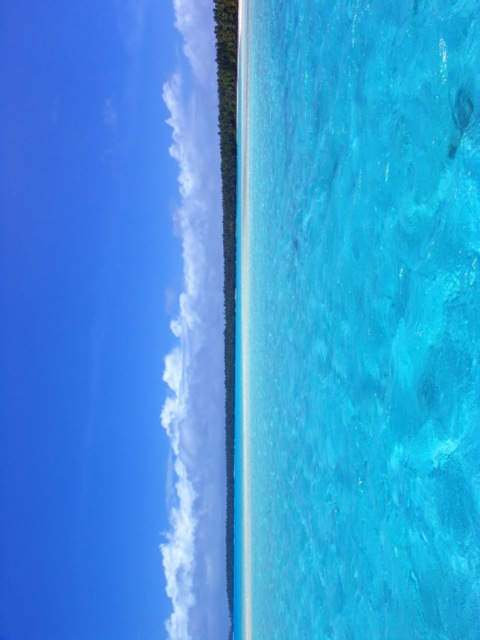

Slide 3
vocabulario 1 (para el 30 de abril 2012)
Mi vocabulario – versión inglesa | Mi vocabulario - español
1 (the) holidays
2 (the) facilities
3 I want
4 I can
5 (the) winter
6 (the) summer
7 (the) people
8 I go
9 we go
10 to go / going
11 I have to
12 the sea

