Slide 1
¿Qué planes tienes para el futuro?

Slide 2
Words from Quizlet – homework test (p.26 GCSE booklet 2)
in the future
next year
to travel
when I’m older
to earn lots of money
to go to university
to carry on studying
to work as a volunteer
to do an apprenticeship
to look for a job
to do A levels
I want
I’m going to
I hope to
I intend to

Slide 3
 | Classroom Learning Profile | Independent Learning Profile
 | Judgements will be made based on their attitudes to learning in the classroom, particularly the following: a) Speed to start work and industry during tasks b) Thoroughness and quality of work completed c) Attention to instructions d) Punctuality e) Bringing relevant equipment to lessons f) Contributions to discussion g) Behaviour and focus during lessons h) Presentation of classwork | Judgements will be made based on their attitudes to learning outside the classroom, particularly the following: a) Efficiency and effectiveness in homework tasks b) Thoroughness and quality of homework tasks c) Recording and responding to homework instructions d) Meeting homework deadlines e) Using relevant resources in homework tasks f) Mastering and revising material when appropriate g) Research skills h) Presentation of homework
1* | A pupil who has demonstrated effort over and above normal expectations in the classroom. He/she has been exemplary in the sense that his/her efforts have been a model for others and so have enhanced the learning culture of the classroom. | A pupil who has demonstrated effort over and above normal expectations in work undertaken outside the classroom. He/she will have been exemplary in the sense that his/her efforts have been a model for others in terms of their independent learning skills.
1 | A pupil who has consistently met our expectations in the classroom. He/she has done everything asked of them and so is likely to have made excellent progress relevant to targets. | A pupil who has consistently met our expectations in homework and independent study. He/she has done everything asked of them and so is likely to have made excellent progress relevant to targets.
2 | A pupil who has usually met our expectations in the classroom. He/she has done most of what is asked of them and so is likely to have made progress broadly in line with targets. | A pupil who has usually met our expectations in homework and independent study. He/she has done most of what is asked of them and so is likely to have made satisfactory progress relevant to targets.
3 | A pupil who has sometimes met our expectations in the classroom. He/she has not done everything that is asked of them in class and so it is possible that they have made slower than expected progress relevant to targets. | A pupil who has sometimes met our expectations in homework and independent study. He/she has not done everything that is asked of them working outside the classroom and so it is possible that they will have made slower than expected progress relevant to targets.
4 | A pupil who has often not met our expectations in the classroom. He/she has regularly not done everything that is asked of them in class. It is therefore not only likely that they have made slower than expected progress themselves but that they may have affected the learning of others. | A pupil who has often not met our expectations in homework and independent study. He/she has regularly not done everything that is asked of them when working outside the classroom. It is therefore not only likely that homework will have been of poor quality, but this has had implications which impact seriously on learning in the classroom.

Slide 4
in the future | en el futuro
next year | el año que viene
to travel | viajar
when I’m older | cuando sea mayor
to earn lots of money | ganar mucho dinero
to go to university | ir a la universidad
to carry on studying | seguir estudiando
to work as a volunteer | trabajar como voluntario
to do an apprenticeship | hacer un aprendizaje
to look for a job | buscar un puesto de trabajo
to do A levels | hacer el bachillerato
I want | quiero
I’m going to | voy a
I hope to | espero
I intend to | tengo la intención de

Slide 5
carusel
 | 1 | 2 | 3
A Ben, Adam, Fraser, Sophie, Amber | ordenadores | leer | hablar
B Rav, Charlie, Chloe, Leo, Izzy | leer | hablar | ordenadores
C Taj, Jamie, James, Ellis, Phoebe, Ryan | hablar | ordenadores | leer
Notes:
hablar = work in small group with me practising discussion about future plans leer = doing a past GCSE set of questions on work and school ordenadores = languages on line (material on jobs)

Slide 6
ICT
www.languagesonline.org.uk
Español
Caminos 3
Unidad 15
Exs 1-8, 17
Extension
Unidad 16
All exs
Si terminas pronto, usa www.quizlet.com

Slide 7
¿Qué planes tienes para el futuro?
No lo sé exactamente pero…
¿Quieres seguir estudiando?
¿Qué vas a estudiar?
¿Dónde esperas estudiar?
¿Tienes la intención de ir a la universidad? (¿Para estudiar qué? ¿Sabes dónde?)
Y más en el futuro, ¿en qué piensas trabajar? (OR ¿qué quieres hacer como profesión?
¿Qué otros planes tienes?
(¿Quieres tener una familia? ¿Te gustaría viajar? (¿Dónde?) ¿Tienes la intención de vivir en otro país? (¿Dónde?)

Slide 8
1. ¿Qué planes tienes para el futuro? (¿Quieres seguir estudiando?)
2. ¿Qué vas a estudiar? (Y ¿dónde esperas estudiar?
3. ¿Tienes la intención de ir a la universidad? (¿Para estudiar qué? ¿Sabes dónde?)

Slide 9
4. Y más en el futuro, ¿en qué piensas trabajar? (OR ¿qué quieres hacer como profesión?
5. ¿Qué otros planes tienes? (¿Quieres tener una familia? ¿Te gustaría viajar? (¿Dónde?) ¿Tienes la intención de vivir en otro país? (¿Dónde?)

Slide 10
Si elijo estudiar. ¿Qué carrera?

Slide 11
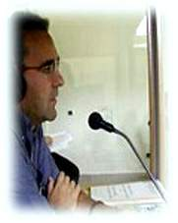
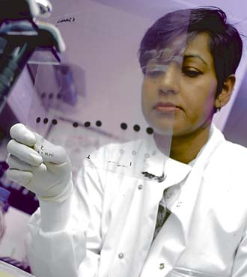
Carreras
abogado/a
médico/a
contador/a
estudiar medicina
estudiar contabilidad
estudiar abogacía
científico/a
profesor/a
traductor/a
estudiar ciencias
estudiar educación
estudiar idiomas

Slide 12
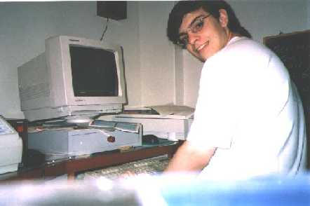
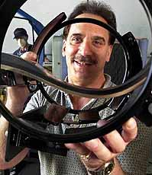
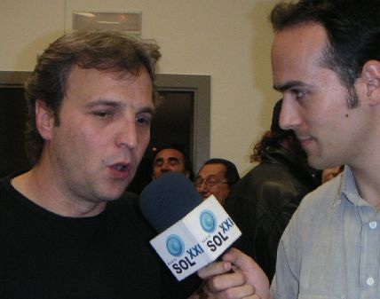
.... más carreras
inventor/a
periodista
programador/a
estudiar periodismo
estudiar computación
estudiar ingeniería
¿Conoces otras carreras? Escribe en tu cuaderno todas las que conozcas o las que encuentres en el diccionario.

Slide 13
... ¿Y si no quiero ni estudiar ni trabajar?

Slide 14
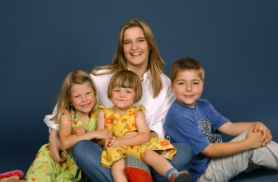
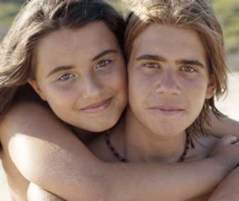
¡Otras posibilidades!
ir de viaje
el programa au pair
iniciar mi propio negocio
formar una familia
encontrar a mi pareja ideal

Slide 15
carusel
 | 1 | 2 | 3
A Ben, Adam, Fraser, Sophie, Amber | ordenadores | leer | hablar
B Rav, Charlie, Chloe, Leo, Izzy | leer | hablar | ordenadores
C Taj, Jamie, James, Ellis, Phoebe, Ryan | hablar | ordenadores | leer

Slide 16
En el futuro
Phrases needing the subjunctive because they refer to things that aren’t reality (yet)
When I leave school – Cuando deje el colegio……………
When I’m older – Cuando sea mayor……………
When I’m thirty – Cuando tenga 30 años
When I finish at university – Cuando termine la universidad
Future tense
I will continue my studies – Continuaré estudiando
I will go to university – Iré a la universidad
I will work abroad – trabajaré al extranjero
I will be rich – Seré rico
I will earn a lot of money – Ganaré mucho dinero
I will get married - Me casaré
I will (not) have children - (No) tendré niños
Future meanings expressions requiring the infinitive
I hope to – Espero………..
I want to – Quiero…….
I would like to – Me gustaría…..
I intend to – Tengo la intención de……..

