Slide 1
Comberton Village College
Vocabulary learning in the 21st century: motivating, effective and independent for all ability classes
Things we know about vocabulary learning Variety of strategies Lessons from one ‘Mixed Age’ class
Rachel Hawkes
Notes:
10 minutes – Justin 25 minutes - me 10 minutes – Q&A
This session focuses on effective strategies for vocabulary learning. Whatever else we do as language teachers, we must give learners the means to memorise and retain language over extended periods of time. This is often perceived as the ‘hard work’ of language learning but there are classroom strategies and commercially available tools to make this learning effective (and even fun!) for learners of all abilities. Examples of lesson ideas and vocabulary learning strategies focus particularly on the hard to motivate students.

Slide 2
Comberton Village College
Things we know about vocabulary learning
It is essential for progress and motivation It is hard for most / all learners It is not exciting
Rachel Hawkes
Notes:
All of us would I think agree that we need to know words, vocabulary in the language to make progress. Some would say, with good reason, I think, that success, particularly at GCSE, is to a large extent defined by the number of words we know, although also I think that it is also about the choice of words that we learn – some have a higher currency for me than others. But we will certainly not argue too long about the role vocabulary knowledge plays in making progress in the foreign language. Perhaps more importantly and less often considered is the interplay between the words students know in their heads and can produce without reference to notes and their motivation. Surveying around 300 students from different secondary schools in Years 7-10 revealed a remarkable consistency in the belief that what they know in their heads and can produce confidently by heart is the true representation of what they know/can do/ their level of the language at any particular time. It is not therefore much of a leap to say that if they don’t know many words they won’t feel very confident in the language – the link between confidence and motivation is clear in language learning (most other learning too, come to that).
Secondly, vocabulary learning is hard. Even for higher ability learners, considerable work is required to fix words in memory and keep them there over the medium- longer term. For learners with auditory and / or kinaesthetic learning preferences, it can be particularly hard, particularly to retain spellings (auditory learners) or pronunciation (kinaesthetic learners) over time. A lot of traditional vocabulary learning methods do play to the visual learning preference.
Finally (although we could talk at length about all of these points!) it is not exciting. Learners know it is important, but the combination of difficulty + lack of excitement do make a set vocabulary learning homework the least popular and most often ‘left until last’ homework.
So, what can help? Well, there are no universally right answers to this, or at least no completely easy solutions that just make the whole thing effortless and painless. If I could present that, perhaps I would not be long for the working world and might soon be sunning myself on a beach in the Bahamas! However, there are some strategies, types of activity, ways of learning, even ways to engage 3rd parties that can be of benefit and it’s just a few of those that I’m going to mention here. Please note that I have had to strip down my initial brainstorming for this session, knowing how important it is to keep to time, so there are lots more ideas, many that I’m sure you all use already, but I’m just confining this to a sharing of a few key ideas. I’m drawing most particularly on the experience of teaching lowest GCSE groups and NVQ level 2 groups.

Slide 3
Comberton Village College
Variety of strategies
Contextualisation and repetition Choice of method (and language) Uses of music Online possibilities
Rachel Hawkes

Slide 4
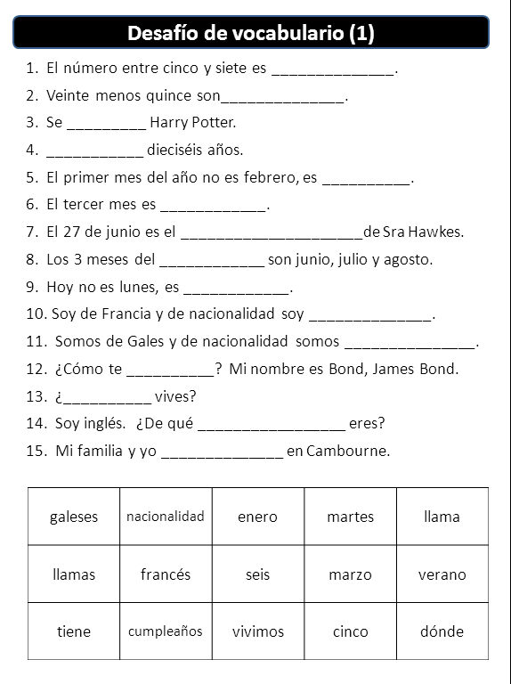
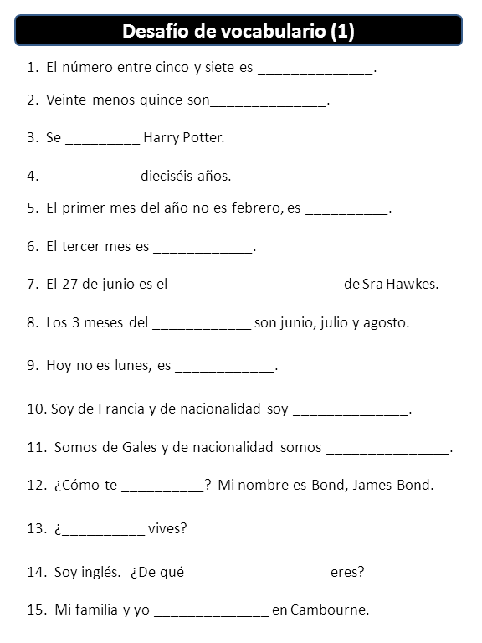
Comberton Village College
Contextualisation and repetition
Rachel Hawkes
Notes:
At all levels, but particularly at KS4 where the first step is often to find out what students already know/can do in the language based on their vocabulary from previous years, it’s often useful to give vocabulary activities as embedded items at sentence level. The example on the left is clearly a first stage, where it is receptive knowledge and the ability to decode meaning at sentence level and use the language in context which is assessed here. Assuming that they have managed this first stage fairly confidently, a subsequent stage (several lessons every weeks later) would be to give the same sentences again but without the words listed below. Alternative answers that fit do need to be accepted, but either way, we are still consolidating on vocabulary. I have made the start of a bank of these using the Edexcel Spanish vocabulary list. They are on the TES website but also on mine – links on the final slide.
I like the fact that with these I am able to test vocabulary but also develop reading skills. I find that students of all abilities (you can vary the difficulty obviously) find this challenging but engaging and you can hear from their verbalisations that they are really thinking actively about the meaning of the words. It is also something very active you can give students to do for homework, rather than just set ‘learn 20 words’.

Slide 5
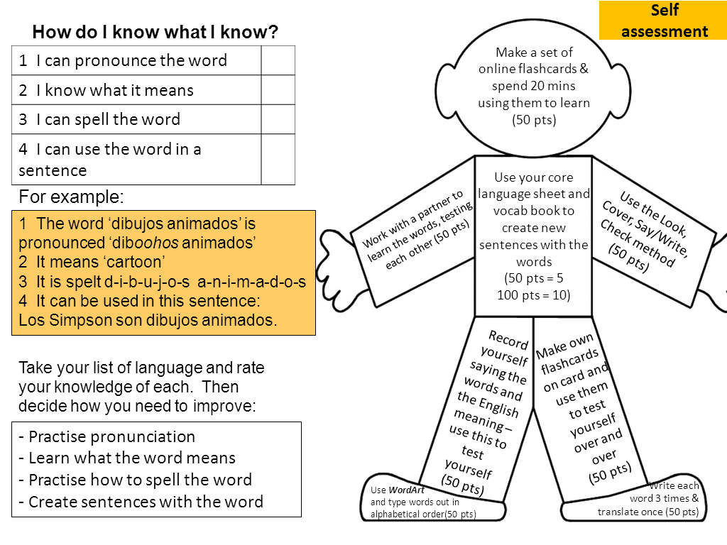
Comberton Village College
Choice of method and language
Rachel Hawkes
VocabMan adapted from MFL resrouces
Notes:
Go through with students how they learn their vocabulary and keep the conversation going with them about this during the year so that they don’t forget at any point that they need to be very active when doing vocabulary hw. There should be evidence that you can see that they have done the hw, rather than just having to spend class time doing a test to see that.
In terms of choice of language, I do think it can be very useful to get students to select their own list of 10, 15, 20 words to learn on a given topic. This personalisation not only leads to the student learning the words that they are most likely to want to use (paragliding need not be learnt actively by all!) but it also neatly injects the elements of autonomy and active learning into a learning homework.
Showing them how to use www.wordreference.com rather than google translate is a helpful first step here – to avoid blunders!

Slide 6
Comberton Village College
Uses of music
Y7 song competition highlights value of music for memory Using music in lessons for creative language use supports vocabulary learning
Rachel Hawkes
Notes:
Links to ideas on this on final slide. Just explain super-briefly!

Slide 7
Comberton Village College
Online possibilities
Vocab Express Quizlet
Rachel Hawkes
http://quizlet.com/6985620/gcse-free-time-2-flash-cards/
Notes:
Describe briefly how I have used both of these and spell out the typical differences between the free possibilities and vocab express i.e. the ads of the latter are the monitoring, tracking, homework setting, competition possibilities as well as the lack of making and preparation of course.

Slide 8
Comberton Village College
Lessons from a ‘mixed age’ class
Rachel Hawkes
Northgate High School
Comberton Village College
Notes:
Rush past this slide!

Slide 9
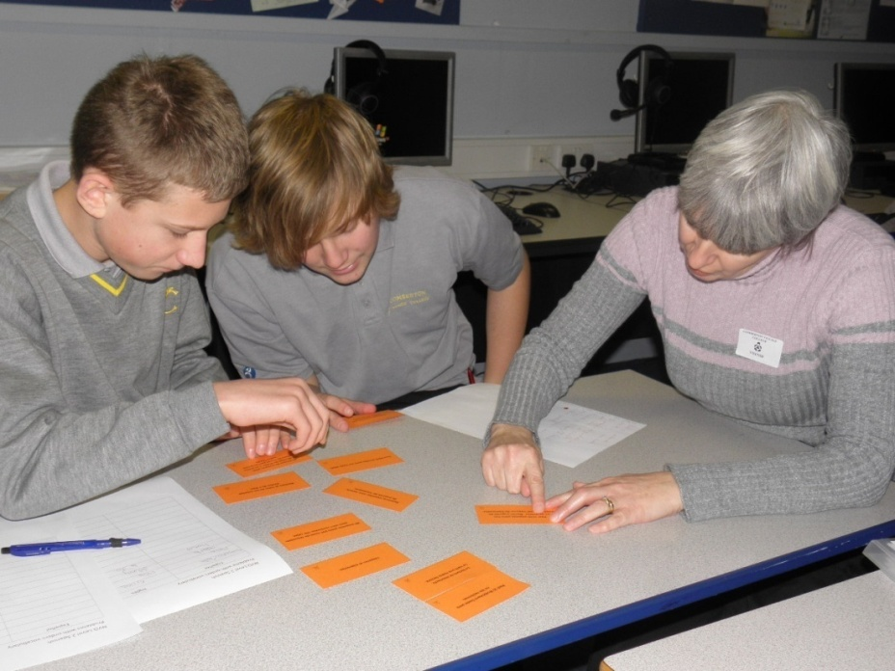
Comberton Village College
Adults and Year 10 students working together
Rachel Hawkes
Notes:
And this one – just for ‘scene-setting’
The adults are still there – they have all completed 9 of 14 assessments and they will continue now into Y11. There is so much to talk about with this project, but I am only going to give a very quick summary here. More details are available on the Linked Up website, including resources, case study etc.. And also on my website – Links on the final slide.
Key Points to mention:
contributes to calm, mature learning environment
models ‘active engagement’ e.g. questioning
highlights the value of language learning
literacy levels and ‘world knowledge’ are shared by adults
linguistic and ICT skills are shared by students

Slide 10
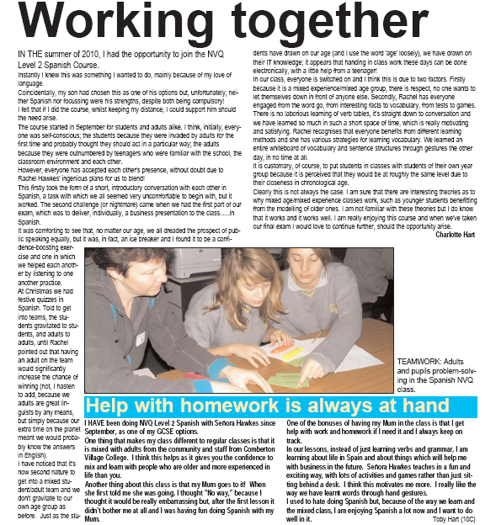
Comberton Village College
Adults and Year 10 students working together
Rachel Hawkes
Both students and adults highlight the benefits.
Notes:
It was really good that both students and adults recognised the benefits. Early on one of the adults wrote a short article for our school magazine and a student did the same.

Slide 11
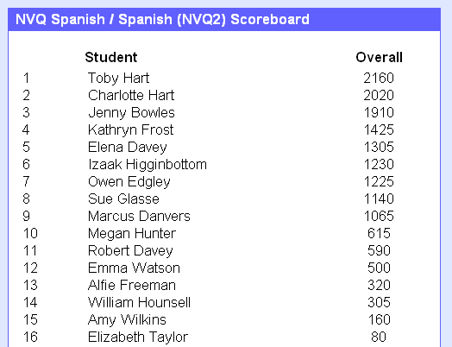
Comberton Village College
Collaboration and competition
Rachel Hawkes
Vocab Express Leader Board – Mixed Age Learning project

Slide 12
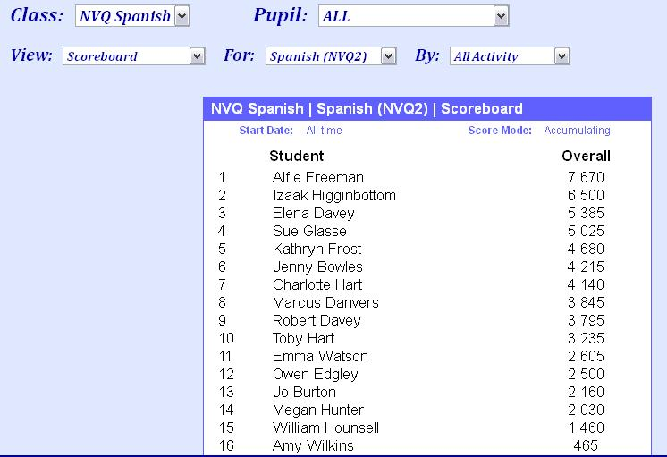
Comberton Village College
Collaboration and competition
Rachel Hawkes
Vocab Express Leader Board – Mixed Age Learning project June 2011
Notes:
Not always the same ones who shine. Student who is a school refuser tops the board in June. Particularly attractive to boys but girls love competition too – as we will see!.

Slide 13
Comberton Village College
Vocab Express EDL Championships
Rachel Hawkes
Notes:
3.07p.m. 20,000 points approx ahead Last minute steal from Tunbridge Well Girls’ Grammar School Relate the excitement – the use of IT rooms at lunchtimes, breaks, before school!
Comberton answered 236,669 questions during the course of the competition (an average of almost 30,000 per day).

Slide 14
Comberton Village College
Vocab Express EDL Championships
Rachel Hawkes
Personal stories
Notes:
More than just the whole school this was also a week of extraordinary personal stories. Just pick out 3 x stories of these individuals – give their profiles and how they approached the competition etc…
Over 26 hours on vocab learning over the course of a week from Alexia Sloane is not bad (that’s an average of 3.3 hours per day for each of the eight days).

Slide 15
Comberton Village College
My contact details and links to resources
www.tes.co.uk (type ‘rhawkes’ into search to pull up all resources) Vocabulary challenges http://www.rachelhawkes.com/Resources/GCSE/GCSE.php Using music http://www.rachelhawkes.com/RPP/Song/SongContests.php Mixed age learning http://www.rachelhawkes.com/RPP/MixedAge/MixedAge.php
Rachel Hawkes
www.rachelhawkes.com rhawkes@comberton.cambs.sch.uk 01223 262503 ext.222

