Slide 1
Change is inevitable.
Progress is optional.
Notes:
Change is inevitable. Progress is optional. As long as education continues to be a political football, frequent, (even ill-advised!) change is guaranteed. However, it is we as teachers who mediate the impact of those changes, and ultimately, we who refashion change into progress. How do we best ensure that we do this for the language learners we teach? What does progress look like for them in the new educational landscape?

Slide 2
KS2: Languages statutory Y3 to Y6
KS3: Assessment beyond NC Levels
KS4: New GCSE- new grading system / new level challenge in new specifications
KS5: New A level courses
Notes:
A lot of change!

Slide 3
To progress
verb
prəˈɡrɛs/
To develop towards an improved or more advanced condition.
synonyms: | develop, advance, make headway, take steps forward, make strides, get better, improve, thrive, prosper, blossom, flourish, grow, expand, increase, mature, evolve.

Slide 4
What are the key drivers for progress?
Teachers need to be clear what it looks like (irrespective of how it is labelled and reported).
Teachers need to know what their learners know (on entry) and build on it.
Teachers need to plan the learning steps skilfully.
Learners need very simple ways to know what progress looks (and feels) like.
We all need to feel motivated!
Notes:
Here we are not talking about Level 5,6,7 or 70%, 80%, 90% or even Grades 1 – 9 but what it means in terms of what students actually know (vocabulary and grammatical structures, cultural knowledge) and how well they can apply that to understanding, speaking and writing in the language, and steps forward we might expect learners to make if they are really working hard, applying themselves in lessons and at home, and are motivated to improve.

Slide 5
MFL Pedagogy Review Report November 2016
Research supports the Ofsted finding that factors other than a subject’s ‘usefulness’ or importance for future life or work influence pupil choice. Intrinsic motivation, which comes from a sense of progress, growing knowledge and understanding, and achievement, is a prime factor for pupils when they are asked to exercise choice about subjects to be pursued. That sense of real progress in inextricably linked to the way in which the subject matter of the course is planned, sequenced and taught. (p.7)

Slide 6
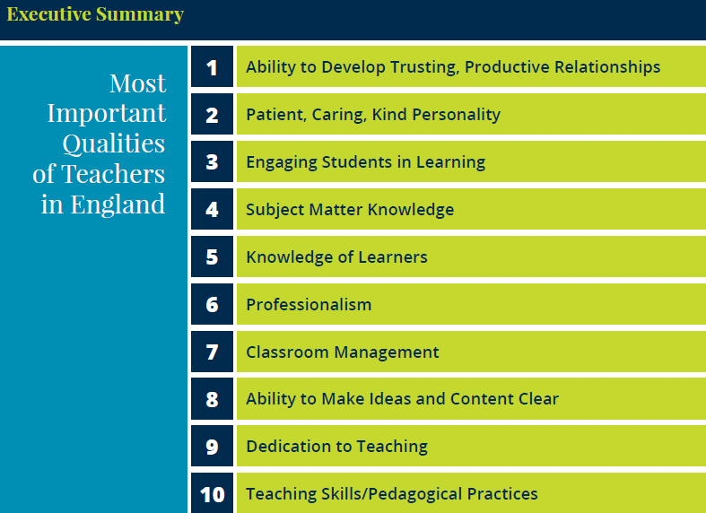
England: What makes an effective teacher?
Inicio
60 segundos
60
45
30
15
0
Katherine McKnight, PhD, Pearson
Lacey Graybeal, Jessica Yarbro, & John Graybeal, George Mason University
Notes:
https://www.pearson.com/content/dam/one-dot-com/one-dot-com/global/Files/efficacy-and-research/schools/global-survey/reports/RINVN9283_UK_July_ExecSum.pdf

Slide 7
Planning for progress
Use (in speech / writing) in free communication
Produce (in speech / writing) from memory
Produce (in speech / writing) with support
Pronounce (independently)
Understand (in sound / writing)
Recognise (in sound / writing)
The main curriculum content in language learning is grammar and vocabulary. Apply these stages in your planning whether the learning focus is grammar or vocabulary, or both.

Slide 8
siempre
Usar para comunicarse Producir de memoria Producir con ayuda Pronunciar Comprender Reconocer
todos los días
…………………………………………………………
normalmente
a menudo
a veces
nunca

Slide 9
siempre
Usar para comunicarse Producir de memoria Producir con ayuda Pronunciar Comprender Reconocer
todos los días
…………………………………………………………
normalmente
a menudo
a veces
nunca

Slide 10
s_ _ m _ _ _
Usar para comunicarse Producir de memoria Producir con ayuda Pronunciar Comprender Reconocer
t_ d_s l_ _ d_ _ _
…………………………………………………………
n_ _ _ _ _ m_ _ _ _
a m_ _ _ _ _
a v_ _ _ _
n_ _ _ _

Slide 11
Usar para comunicarse Producir de memoria Producir con ayuda Pronunciar Comprender Reconocer
…………………………………………………………

Slide 12
Usar para comunicarse Producir de memoria Producir con ayuda Pronunciar Comprender Reconocer
Notes:
Some students will automatically understand that this is what happens. They won’t even really think about it. They have a sense that learning is a good thing and they are happy to have more of it. Those people are like those in this room! Other students are helped by having the point of what they are doing made explicit (not every lesson!) but at the beginning when you are building the learning relationship with the class, and every now and then, when you feel you need to add to that relationship, steer it back on course, do mini interventions etc.. So I do show the ladder still, every now and then, and share examples like this, back with the class.
This is all very well, but if we teach 10+ classes of 30 students?
This is just a tiny specific example of progress from one student with one set of vocabulary. What do we focus on that tell us if students are making progress? We cannot focus on everything. Teachers I work with, in this time of upheaval and uncertainty, are keen to have a few, key essential indicators so that they don’t lose sight of the picture.

Slide 13
Essentials for progress
Key questions (and answers)
Verbs
Vocabulary
Conceptual knowledge (grammar)
Personal repertoire
Complexity
Skills development
Notes:
Personally I can only focus on so many things at once and if I lose the specific focus the bigger picture of progress for individual pupils gets too blurry, so I’ve realised that I focus a lot on these things. In addition, I try to build in cultural knowledge and references as often as possible, but I’m very aware that at the moment, I’ve been very focused on helping other teachers and myself to get clear about linguistic progress.

Slide 14
Overview | Theme / Topic | Key questions
Autumn Term [1] – 7 weeks | Phonics, greetings, name, age, alphabet, where you live, countries, months, birthdays Classroom instructions / language Baseline Milestones (Listening, Speaking, Reading, Writing) | ¿Cómo te llamas? ¿Dónde vives? ¿De dónde eres? ¿Cuál es tu nacionalidad? ¿Qué idiomas hablas? ¿Cuántos anos tienes? ¿Cuándo es tu cumpleaños? ¿Qué tipo de persona eres? ¿Quién es tu mejor amigo/a? ¿Quiénes son tus amigos/as? ¿Tienes mascotas?
Autumn Term [2] – 7 weeks | Free time activities, sports, opinions and reasons for activities, saying what others do, asking and answering questions | ¿Qué te gusta hacer? ¿Te gusta (cantar)? ¿Qué deportes haces? ¿Qué haces en tu tiempo libre? ¿Con qué frecuencia (cantas)?
Spring Term [1] – 5 weeks | Saying what subjects you study, giving opinions and reasons, describing the facilities in your school, saying what you do at break time | ¿Qué estudias? ¿Cuándo? ¿Cuál es tu día favorito? (tu asignatura favorita / tu profesor/a favorito/a) ¿Te gusta(n)…? ¿Por qué (no)? ¿Cómo es tu profesor/a de …? ¿Qué opinas de… ? ¿Qué hay en tu insti? ¿Cómo es tu insti? ¿Qué comes / bebes / tomas? ¿Qué haces durante el recreo?
Spring Term [2] – 6 weeks | Milestones (L, S, R, W) Family members, describing self and others physically | ¿Cuántas personas hay en tu familia? ¿Tienes hermanos o hermanas? ¿Cómo eres? ¿De qué color tienes el pelo? ¿De qué color tienes los ojos? ¿Cómo es (tu madre)?
Summer Term [1] – 5 weeks | Saying what is in your town, saying what you do there, ordering in a café, saying what you are going to do, saying if and why you like / don’t like your town | ¿Qué hay en tu ciudad? ¿Qué haces en tu ciudad? ¿Qué hora es? ¿Qué vas a hacer este fin de semana? ¿Te gusta tu ciudad?
Notes:
These are the key questions that Y7 learns how to ask and answer. The asking part is absolutely central. If they can ask they can answer, and you can start a conversation with anyone, but most importantly your learning partner in the lesson, if you can ask the questions. This means that a lot more interactions / conversations are possible, than if it is the only the teacher who has the competence to ask questions in the TL.
It also feels empowering to be able to initiate a conversation and you need to be able to ask questions to do that. We start with the individual question words – and we check frequently that students know what these are still - that need to recycle continuously. Then we learn and practise key Qs and As in the context of the topic we are doing, but constantly modelling how new questions can be formed from small adaptations, once you know the main question words. At the start the process is modelled by the teacher, in response to students wanting to say new things, but over time this will develop into students finding they can innvoate and manipulate, too.
But also to encourage students to use the question words and key verbs in other contexts, as often as possible, in listening / reading etc….
We keep coming back to the questions from the topic before, so that students need to recycle the previous questions – this is vital and I still don’t think I do it enough, even though I’m conscious of trying to do it. Forgetting will happen if we don’t do it, it won’t, if we do, very simple…
The need to recycle continuously…
And in Y8? And Y9? Do we go back to these Y7 questions and ensure that students can still ask / answer / converse on these topics… Do we help them see the links between the questions / structures?
By the time you get to the summer term, the questions are all repeats of previous question structures, except the near future tense ones.

Slide 15
¿Quién?
¿Con quién?
¿Cómo?
¿Por qué?
¿Qué?
¿Cuánto?
¿Dónde?
¿Cuántos?
¿Cuándo?
¿Cuál?
http://www.youtube.com/watch?v=iqCvE258vY0
Notes:
Teach the key question words with gestures. See this video for suggested gestures.
http://www.youtube.com/watch?v=iqCvE258vY0

Slide 16
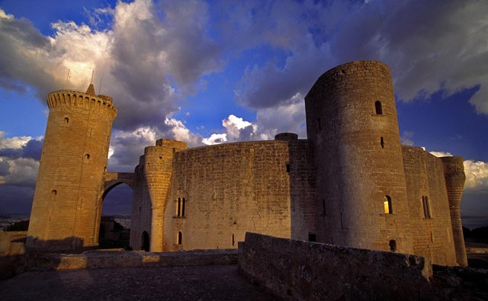
¿Qué? ¿Dónde? ¿Cómo? ¿Cuándo? ¿Por qué (visitar)?
El Castillo de Bellver en las Islas Baleares es famoso por su forma circular sobre una colina de 140 metros. Construido en el siglo XIV, posee vistas espectaculares hacia la ciudad de Palma de Mallorca.
una colina?
sobre?
el siglo?
vistas?
Notes:
1) Pronunciation 2) Main details 3) Deduction of key vocabulary colina – siglo - vistas

Slide 17
¿Cuáles son las preguntas?
7. En mi tiempo libre juego al fútbol, y me gusta salir con mis amigos.
1. Me llamo Amanda
6. En mi instituto hay muchos laboratorios.
2. Mi instituto se llama CVC.
1¿C… t. l…..?
2 ¿C… s. l…. t. i……..?
3 ¿T. g…. t. i……..?
4 ¿Q.. a……… t. g….?
5 ¿C… e. t. i……… 6 ¿Q.. h.. e. t. i……..? 7 ¿Q.. h…. e. t. t….. l….?
1 ¿Cómo te llamas?
5. Mi instituto es mixto.
2 ¿Cómo se llama tu instituto?
3. Me gusta mi instituo porque es moderno
3 ¿Te gusta tu instituto?
4 ¿Qué asignatura te gusta?
4. Me gustan las ciencias pero no me gusta la informática.
5 ¿Cómo es tu instituto?
6 ¿Qué hay en tu instituto?
7 ¿Qué haces en tu tiempo libre?
Notes:
Give pupils time to ask and answer the questions in pairs. Elicit the correct questions.
Then get them to repeat the Q & A but to add or change something in the answers to make them more personal to them.

Slide 18
Essentials for progress
Key questions (and answers)
Verbs
Vocabulary
Conceptual knowledge (grammar)
Personal repertoire
Complexity
Skills development

Slide 19
Verbs
In the early stages of a language course, particular attention should be paid to the planned building of pupils’ verb lexicon, focussing on the meaning of the stem or infinitive form of common verbs. A strong basic verb lexicon has been found to relate positively to pupils’ ability to learn to manipulate those verbs at later stages.
p.10 MFL Pedagogy Review Report November 2016

Slide 20
Year 7
Grammar & Vocabulary
STEP 6
STEP 5
recall and use 30 verbs in the present tense and the simple future, use question words with more confidence to frame spontaneous questions, and use the relative pronoun ‘which’ in a variety of contexts to extend sentences, and use 80 cognate and 50 non-cognate words.
I can:
STEP 4
use nouns and adjectives, subject pronouns and present tense verbs (regular and key irregular) to generate positive and simple negative sentences independently, recalling at least 20 verbs, and use 50 cognate and 30 non-cognate words.
STEP 3
use high-frequency verb forms, nouns, articles and adjectives to form simple sentences independently, and has a basic repertoire of words and phrases related to people, places, things and simple actions.
use definite and indefinite articles, agree adjectives for number and gender, use all persons of several regular verbs in the present tense (with a writing frame) and use days of the week in simple sentence formation.
Notes:
Draws on PDC in MFL work – the grammar and vocabulary strands

Slide 21
cantar | llamarse
tocar | osar
hablar | jugar*
sacar | pensar*
montar | odiar
bailar | dibujar
navegar | preguntar
mandar | trabajar
escuchar | encontrar
chatear | ayudar
leer
ver
aprender
escribir
salir
ser
tener
hacer
gustar
encantar

Slide 22
AR, ER and IR!
Busca los infinitivos en el diccionario
To work
To jump
To ask
To use
Trabajar
Saltar
Preguntar
Usar
Ahora traduce al inglés (p. 24 guía de vocabulario)
Trabajamos
Salto
Preguntas
Usáis
We work
I jump
You sing. ask
You all use

Slide 23
Vamos a usar un diccionario inglés-español
para buscar vocabulario en español.
Es posible usar un diccionario tradicional o un diccionario online.
Notes:
We are going to use an English-Spanish dictionary to look for vocabulary in Spanish.
It’s possible to use a traditional dictionary or an online dictionary.

Slide 24
Es posible buscar vocabulario español o inglés.
Notes:
It’s possible to look for Spanish or English vocabulary.

Slide 25
Essentials for progress
Key questions (and answers)
Verbs
Vocabulary
Conceptual knowledge (grammar)
Personal repertoire
Complexity
Skills development

Slide 26
Student targets
☺
T
I need to…
I can…
1. spell key topic words accurately.
2. use adjectives correctly (agreement and position).
3. use correct determiners (definite and indefinite article).
4. agree verb and subject.

Slide 27
Essentials for progress
Key questions (and answers)
Verbs
Vocabulary
Conceptual knowledge (grammar)
Personal repertoire
Complexity (ASL)
Skills development

Slide 28
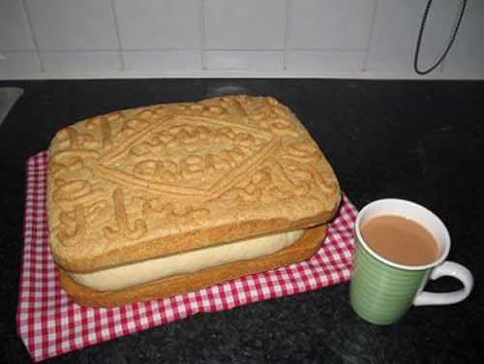
Y7 Práctica de tiro 3: Autumn Writing Assessment
NB: Write any tasks out in full in the back of your exercise books.
1 It’s time you nailed these words 100%! Write them out carefully in Spanish three times each. 1. England 6. but 2. passion 7. because 3. boring 8. English (if you are a girl) 4. birthday 9. football 5. shy 10. a bit of Spanish Now write out any other spelling mistakes from your own writing, three times.
6 / 7 / 10 Look at p.24. Translate this sentence into Spanish. I love going out with my friends and I also like listening to music because it’s fun but I don’t like writing emails and I hate watching tv because it isn’t interesting. (30 words – Spanish version) Now go back to your own writing and add a sentence of similar length to it (20-30 words)
9 / 11 / 12 / 13 Translate these sentences into English. Then write a similar sentence and put a * in your work to show where it would fit. 1. En mi tiempo libre, juego a los videojuegos, normalmente por la tarde. 2. Los lunes siempre hago natación, pero mi hermano nunca hace natación. 3. Los fines de semana a menudo juego al squash con mi padre. 4. Los sábados a veces mis amigos y yo jugamos al fútbol. 5. Los jueves mis amigas y yo hacemos baile.
2 / 3 / 4 Translate these sentences carefully. Pay attention to the adjectives, the determiners (a / the) and the verb forms. 1. I am from England and I live in Cambridgeshire. 2. I have a brother who is called David. 3. My sister is very nice but sometimes a bit silly. 4. She is also English. 5. I speak English and a bit of Spanish, but she also speaks French.
Links Opinions and reasons Variety of structures Extended sentences Interesting vocabulary Tenses
Love it!
8 p.42. Complete with a correct verb form. Then translate into English. 1. Mi amiga Anna ____________. 2. Mis padres ___________. 3. Yo __________. 4. Mis amigos y yo __________. 5. Mis amigo Dan ________. 6. Mis amigos Emily y Tom _________. escuchar música / cantar / bailan / tocar el piano / estudiar /montar en bici
10 Now go back to your own work again. Join up more of your short sentences, using y, y también, or pero.
TARGETS 5,6,7,8,9 and 10 focus on making your sentences longer, more interesting and flow better.
Y7 SHOWCASE Some of the best sentences taken from Y7 writing. Take one or two of these, personalise them and add them to your work to improve it. 1. No tengo mascotas pero quiero un perro. 2. No tengo mascotas pero mi hermana tiene muchos peces. 3. El cumpleaños de mi hermana es el veinticinco de junio. 4. En mi tiempo libre me gusta ver la tele porque es divertido. 5. Mi pasión es la música; toco el piano y mi héroe es X. 6. De vez en cuando canto pero prefiero la natación. 7. No me gusta cantar porque es aburrido; nunca canto porque no es divertido. 8. Mis mejores amigos son X, Y y Z pero también tengo otros amigos. 9. Tengo muchos amigos pero sobre todo paso tiempo con X, Y y Z. 10. ¿Qué te gusta hacer en tu tiempo libre?
5 From p.16 add a suitable opinion phrase to start each sentence: (I think that / In my opinion etc…NOT I like etc..) 1. ____________ mi hermano es listo y divertido. 2. ____________ mi hermana es un poco tonta. 3. ____________ escuchar música es relajante. 4. ____________ navegar por Internet es divertido. 5. ____________ ver la televisión es un poco aburrido.
What is the ASL (average sentence length) for all of these sentences?
En mi opinión

Slide 29
Essentials for progress
Key questions (and answers)
Verbs
Vocabulary
Conceptual knowledge (grammar)
Personal repertoire
Complexity
Skills development

Slide 30
La predicción
un refresco
bocadillo
un zumo
agua
juego al fútbol
chocolate
leo mis SMS
una chocolatina
juego al baloncesto
Notes:
Slide to model and practise prediction as a listening skill Students do this in pairs or fours.
Escucha. ¿Qué no se menciona? Escribe las dos letras correctas.
¿Qué haces durante el recreo, Juana?
Durante el recreo... a ver… primero como algo, un bocadillo o a veces una chocolatina.
Un momentito… primero comes un bocadillo, o a veces una chocolatina… muy bien. ¿Qué más?
Normalmente bebo agua.
…bebes agua… ¿Y luego? ¿Qué haces?
Luego juego al fútbol o al baloncesto en el patio con mis amigos.
Juegas al fútbol o al baloncesto… muy bien. ¿Algo más?
A veces leo mis SMS.

Slide 31
What it looks like in the classroom
thinking
making links
asking questions / enquiry / interest
supported risk-taking (in TL interaction and discussion about language)
hard work / challenge
strong relationships (humour)
shared class culture / history

Slide 32
What it looks like in books
care
individual / peer marking responsibility
teacher feedback
student follow up
recycling of ☺s and addressing of Ts
written work showing longer, more detailed and complex sentences with an increasing repertoire of vocabulary and structures (explicit ASL)
Notes:
What do we mark? What do students mark? What is the point of marking?

Slide 33
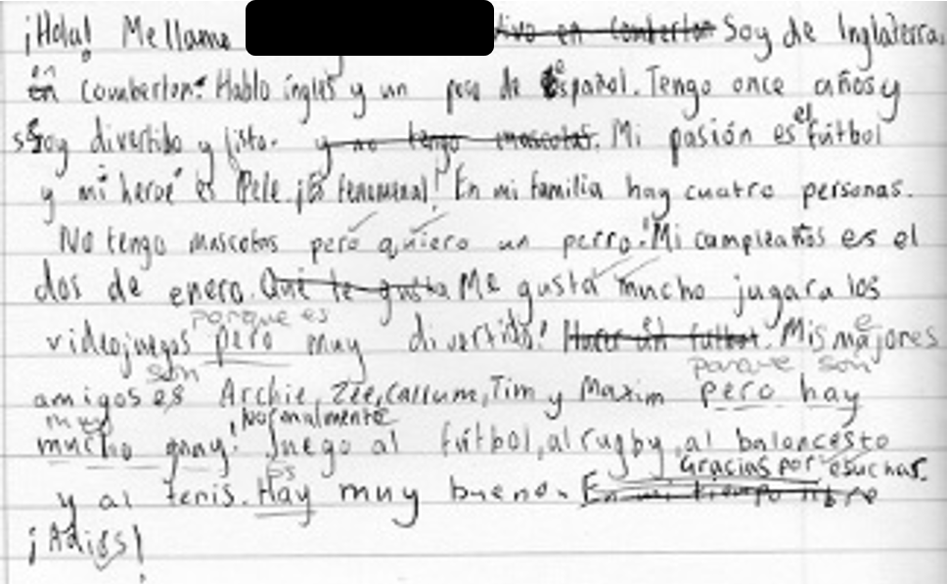
November 2016
Red = problem areas
¡Hola! Me llamo ……. Soy de Inglaterra en Comberton. Hablo inglés y un poco de español. Tengo once años y soy divertido y listo. Mis pasión es fútbol y mi heroé es Pele. ¡Es fenomenal! En mi familia hay cuatro personas. No tengo mascotas pero quiero un perro. Mi cumpleaños es el dos de enero. Me gusta mucho jugar a los videojuegos pero muy divertido. Mis majores amigos es Archie, Zee, Allum, Tim y Maxim pero hay mucho guay! Normalmente juego al fútbol, al rugby, al baloncesto y al tenis. Hay muy bueno. Gracias por escuchar. ¡Adiós!
95 words / 13 sentences = 7.3 words ASL (Average Sentence Length)
Notes:
We should see progress in books, too…

Slide 34
February 2017
Mi insti se llama Comberton VC. En mi insti hay unas clases, una biblioteca, un campo de fútbol grande y mucho más. No hay bonitos servicios, son malos! Estudio español, inglés, historia y dibujo, por ejemplo. Me gusta la educación física, la música y el teatro porque es muy divertidos. No me gustan las matemáticas porque no son interesantes y el profesor es aburridísimo. Pienso que la profesora de teatro es muy raro y mi profesor favorito es Señor Gooch. Durante el recreo como un bocadillo, una bolsa de patatas y fruta y bebo un agua o un zumo. A veces juego al fútbol en el recreo, pero en mi tiempo libre me gusta mucho jugar a los videojuegos. Me gusta mi insti porque es moderno, interesante y divertido.
Red = problem areas
Green = words that the learner was using incorrectly in November and here shows in correct use.
Purple = language re-used / recycled from the previous piece.
129 words / 10 sentences = 12.9 words ASL
Notes:
Progress can be very visible in writing – here it is clearly demonstrable as longer (more to say, greater vocabulary) and better (more compound and complex sentences, greater range of structures, wider variety of verbs).

Slide 35
Change is inevitable.
Progress is optional, (but achievable, and essential for motivation. ☺)
Notes:
Change is inevitable. Progress is optional, (but achievable, and essential for motivation).

