Slide 1


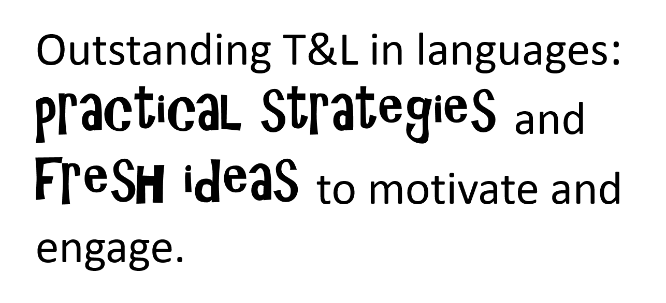
Northern Lincolnshire Education Consortium
Joint training day
Tuesday 22nd April 2014
John Leggott College
Dr Rachel Hawkes

Slide 2
Aims for the day
Explore ways to meet the needs of all language learners
Examine strategies for improving memory and maximising retention
Consider ways to make learning active
Focus on excellent uses of technology, inside and outside of the classroom

Slide 3
Differentiation
Teachers use well-judged and often imaginative teaching strategies, including setting appropriate homework that, together with clearly directed and timely support and intervention, match individual needs accurately. Consequently, pupils learn exceptionally well across the curriculum.
Notes:
Ofsted – Teaching Standards Jan 2014 – Outstanding.
This does not mean produce 3 x different worksheets for every task you want to do.
Differentiation can come in a variety of different, yet appropriate ways in language teaching & learning.

Slide 4
Differentiation
All four skills essentially differentiate by:
Key for teachers is:
manageability (!)
ensuring optimum progress for each student
creating a positive classroom atmosphere
outcome
support
task

Slide 5
Outcome
build flexibility into a learning sequence so that the different tasks can be completed at a different rate

Slide 6



¿Cómo se dice … en inglés / español?
1
Pienso que …es…
¿Qué piensas?
¡No lo sé!
¡Sí!
¡No!
Week 1 Year 7
Notes:
Teaching the language of working together – asking for each other’s prior knowledge, but also encouraging hypothesising, risk-taking.

Slide 7

2
Me llamo Carlos Vicente. Soy de España pero mis padres son de Argentina así que soy medio argentino medio español. Hablo español, por supuesto, inglés y un poco de francés. Vivo ahora con mis padres; vivimos en Valencia, en el este del país. Mi hermana no vive allí. Ella y su amiga viven en Barcelona.
Notes:
Year 7 – Week 1. Start with a text and see what students know first.
1. Give them some time to interrogate each other’s knowledge and make some hypotheses about words they might know.
When they have finished talking they could record their group knowledge in a couple of different ways.
They could have a red / yellow / green post-it notes for unknown / think we know / know words
They could shade a large copy of the text with these colours.
Next steps depend on the knowledge of the class, but there are certain key activities that we can be sure will be beneficial for linguistic and skill development. So, for example:
2. Teacher reads the text several times through (3-4 times) at normal speed, but with a few differences. These could be differences in wording where the meaning is the same OR different words which change the meaning of the text, but I think it’s clearer to choose either one or the other and keep consistent throughout the text. So, with this text, I’ve chosen to do different wording where the meaning is the same. As below:
Mi nombre es Carlos Vicente. Soy de España pero mis padres son argentinos así que soy medio argentino medio español. Hablo español, claro, inglés y un poco de francés. Vivo ahora con mi familia; vivimos en Valencia en el este de España. Mi hermana no vive en Valencia. Ella y su amiga tienen un apartamento en Barcelona.
There are 6 x differences. First, students can be asked to underline where the text is different. On subsequent listenings, they can try to identify what the exact differences are and write down the words they hear. This is transcription! It reinforces phonic knowledge that they may have from primary school. If they find this hard, the teacher will know that they need some phonics reinforcement (may need to revise the key sounds with gestures from phonics words).
The teacher can take whole class feedback here and display the words that are different. The class can be asked whether the meaning is the same. Significa lo mismo? Algo diferente? The word ‘sinónimo’ is one they will be familiar with from KS2 literacy – this will make a useful link for them. It lays a bit of a foundation marker for the next 5 x years of language work too, as we will want them to use a variety of different language in their work.

Slide 8
Me llamo Carlos Vicente. Soy de España pero mis padres son de Argentina así que soy medio argentino medio español. Hablo español, por supuesto, inglés y un poco de francés. Vivo ahora con mis padres; vivimos en Valencia, en el este del país. Mi hermana no vive allí. Ella y su amiga viven en Barcelona.
Notes:
1. Teacher reads the text several times through (3-4 times) at normal speed, but with a few differences. These could be differences in wording where the meaning is the same OR different words which change the meaning of the text, but I think it’s clearer to choose either one or the other and keep consistent throughout the text. So, with this text, I’ve chosen to do different wording where the meaning is the same. As below:
Mi nombre es Carlos Vicente. Soy de España pero mis padres son argentinos así que soy argentino. Hablo español, claro, inglés y un poco de francés. Vivo ahora con mi familia; vivimos en Valencia en el este de España. Mi hermana no vive en Valencia. Ella y su amiga tienen un apartamento en Barcelona.
Students can be invited to compare their answers in their groups, or not, depending on time etc.
There are 6 x differences. First, students can be asked to underline where the text is different. On subsequent listenings, they can try to identify what the exact differences are and write down the words they hear. This is transcription! It reinforces phonic knowledge that they may have from primary school. If they find this hard, the teacher will know that they need some phonics reinforcement (may need to revise the key sounds with gestures from phonics words). The task has built-in differentiation.

Slide 9
Mi nombre es
___________ Carlos Vicente. Soy de España pero mis padres son __________ así que soy medio argentino medio español. . Hablo español, __________, inglés y un poco de francés. Vivo ahora con ___________; vivimos en Valencia, en el este __________. Mi hermana no vive allí. Ella y su amiga ________________ en Barcelona.
argentinos
claro
mi familia
de España
tienen un apartamento
Notes:
The teacher can take whole class feedback here and display the words that are different. The class can be asked whether the meaning is the same. Significa lo mismo? Algo diferente? The word ‘sinónimo’ is one they will be familiar with from KS2 literacy – this will make a useful link for them. It lays a bit of a foundation marker for the next 5 x years of language work too, as we will want them to use a variety of different language in their work.

Slide 10
3
Me llamo Carlos Vicente. Soy de España pero mis padres son de Argentina así que soy medio argentino medio español. Hablo español, por supuesto, inglés y un poco de francés. Vivo ahora con mis padres; vivimos en Valencia, en el este del país. Mi hermana no vive allí. Ella y su amiga viven en Barcelona.
vivir | to live
vivo | I live
 | she lives
 | we live
 | they live
 | I call myself
me llamo
hablo
 | I speak
vive
vivimos
soy
 | I am
viven
son
 | they are
Notes:
3. After the listening / transcription tasks, there are some next steps that focus further on meaning and/or structure. The teacher may need to choose here, rather than do everything with one text in one lesson!
With this text there are 3 x obvious possibilities:
1. Focus on verb forms.
2. Focus on country / nationality / place vocabulary
3. Focus on the meaning of high frequency language – de – pero – y – con – en – así que – por supuesto – allí - su
I would be most tempted to start with the verb forms, to tease out prior knowledge but also work on inference skills.

Slide 11
4
Me llamo Carlos Vicente. Soy de España pero mis padres son de Argentina así que soy medio argentino medio español. Hablo español, por supuesto, inglés y un poco de francés. Vivo ahora con mis padres; vivimos en Valencia, en el este del país. Mi hermana no vive allí. Ella y su amiga viven en Barcelona.
País
Nacionalidad / Idioma
Ciudad
Notes:
4 Focus on country / nationality + language / place vocabulary
I would expect that before doing this activity, the teacher will need to explain the categories.
The idea would be to try to do this in the TL – this provides additional linguistic input through listening, and has the advantage of dealing with one of the words most pupils are unlikely to know – i.e. país
It highlights the all important category words, too, which often get overlooked.
Many pupils can name lots of individual countries but don’t know the word for country itself. Try this out on your classes…
How to circumlocute these words?
1. País – por ejemplo, España es un país. Inglaterra es un país. Italia es un país. Birmingham no es un país. País?...
2. Nacionalidad / Idioma
Soy inglés. Es mi nacionalidad.
Hablo (showing hand gesture for talk, as necessary) inglés. Es mi idioma nativo.
3. Ciudad
Birmingham no es un país. Birmingham es una ciudad. Liverpool es una ciudad. Cambridge es una ciudad. Londres es una ciudad. Madrid es una ciudad….
Then give students a few moments to identify the words from the text in each category and take whole class feedback.

Slide 12
Me llamo Carlos Vicente. Soy de España pero mis padres son de Argentina así que soy medio argentino medio español. Hablo español, por supuesto, inglés y un poco de francés. Vivo ahora con mis padres; vivimos en Valencia, en el este del país. Mi hermana no vive allí. Ella y su amiga viven en Barcelona.
País
Nacionalidad / Idioma
Ciudad
España
argentino
español
Valencia
Argentina
inglés
francés
Barcelona
Notes:
2.2
2
It’s also always useful to see what other knowledge they bring to the table, so an additional oral prompt to name any other countries in Spanish and / or languages and/or cities in Spain is a really good way to extend / differentiate and get to know the prior knowledge of learners. Opening out each task to prior knowledge is a useful principle to keep in mind at each stage of lesson planning.
When taking whole class feedback it would be a lovely opportunity (if you have not already done this with the new Y7 class to ask them to tell you other languages that they speak or if their parents are different nationalities. That’s one reason for choosing a text where the character has parents from a different country). This can be done using the text for reference.
Ok, todos. Escuchad. Carlos es de España. Vive en España, no es así? Pero sus padres son de Argentina, verdad?
Y vosotros? Vuestros padres son de Inglaterra or de otro país? De Holanda? De un país en Africa? O Italia?
If they volunteer some different countries, collect them on a list on the board. Ask about languages? En casa (gesture for house if necessary), habláis inglés? No? Qué idioma habláis?

Slide 13
5
Me llamo Carlos Vicente. Soy de España pero mis padres son de Argentina así que soy medio argentino medio español. Hablo español, por supuesto, inglés y un poco de francés. Vivo ahora con mis padres; vivimos en Valencia, en el este del país. Mi hermana no vive allí. Ella y su amiga viven en Barcelona.
Notes:
5 Focus on the meaning of high frequency language – de – pero – y – con – en – así que – por supuesto – allí - su
It is really up to the teacher (and to time) how many high frequency words to focus on in one lesson.
At the start of the year with year 7 we will not know which words they know.
One thing is sure, though, high frequency words can and should be a priority as they will be needed in every lesson, for understanding but also for sentence-building.
It doesn’t matter if there are some students in the class for whom these are all new. They have by now had so much exposure to the text that the overall content meaning of most of it will be familiar. They will in many cases now be able to infer the meaning of these high-frequency words.
Inference from the other words in the sentence, leading to a conclusion as to ‘what makes sense here?’ and ‘what sounds right?’ is a linguistic skill that we want to promote from day 1.
Give students some time in their group – get them to use the group talk routine again to discuss meanings.
Then take feedback. Draw out the dual meaning of ‘de’ in particular. Do all this orally, without writing up the English on the board.
There may be some that you have to ‘model’ with the correct intonation (e.g. por supuesto / ahora / allí ) or help to define but pupils will get there.
At the end of this task, perhaps get students to add these words to the back of their exercise books in a ‘high – frequency words’ list.
It might not be a dreadful idea, at the conclusion of these 3 x text-focused tasks to ask each group to translate one sentence each from the text into English!
This is just an indication of how I might include transcription and translation into one teaching sequence, rather than ever having one whole lesson on either.

Slide 14


6
Me llamo Carlos Vicente. Soy de España pero mis padres son de Argentina así que soy medio argentino medio español. Hablo español, por supuesto, inglés y un poco de francés. Vivo ahora con mis padres; vivimos en Valencia, en el este del país. Mi hermana no vive allí. Ella y su amiga viven en Barcelona.
¿Qué idiomas hablas?
¿Cómo te llamas?
¿Dónde vives?
¿De dónde eres?
¿Cuál es tu nacionalidad?
Notes:
6 Reading into speaking → hotseating task
We can guess that most students will know the question como te llamas. It may be (perhaps is most likely) that they will not know the others, except perhaps ‘donde vives’.
In this lesson, the focus is mainly on them answering, but clearly we will need soon to do a lot of work on asking questions. At this point the skills we are focusing on are:
1. Understanding the questions
2. Using the text as support to extract answers to questions – it is useful to highlight here that we can answer without using whole sentences – differentiate for learners to make it clear that your main goal here is that they understand the questions and can respond quickly in some way.
Give them the choice of just a name, a single word etc.. OR the whole sentence. Tell them that in real conversational talk, people often just respond with single words. The key in spontaneous talk is to be able to join in and respond immediately and for that, you have to understand the question.
Model this to show what you mean.
3. Get them to practise in pairs. (They will need to read the questions in this lesson as we have not learnt how to ask the questions yet). Check that they can pronounce any new key words – e.g. cual and que and donde.
Using the text as support to structure whole sentence answers to questions – model this too.
Make clear that whole sentences are always appropriate in writing (and only sometimes in speaking). Get them to answer your asking of the questions in whole sentences, using the text as support.

Slide 15

7
Me llamo Carlos Vicente. Soy de España pero mis padres son de Argentina así que soy medio argentino medio español. Hablo español, por supuesto, inglés y un poco de francés. Vivo ahora con mis padres; vivimos en Valencia, en el este del país. Mi hermana no vive allí. Ella y su amiga viven en Barcelona.
¿Qué idiomas hablas?
¿Cómo te llamas?
¿Dónde vives?
¿De dónde eres?
¿Cuál es tu nacionalidad?
Notes:
7 Reading → Speaking → Writing
1 Take the text away. Ask them to pretend to be Carlos. Get them to answer by tracing the words with a finger on the table. Ask ‘Cómo te llamas?’ Bring the text back to see if they spelt Me llamo Carlos correctly. Do the same with the other questions.
4.2 Ask them to be themselves now. Give them mini whiteboards (or exercise books if you prefer) Ask ‘Cómo te llamas?’ and ask them to write a full sentence answer. This time, do not bring the text back each time between questions.
Do the same for all questions.
NB: Tell them that they can ask you for words they need e.g. Inglaterra that have not come up in the lesson so far.
They know how to ask “Como se dice…?” If you haven’t talk “Como se escribe?” yet this is the time to do it – i.e. when they need it.
Make is very very clear that you know they are writing from memory and that there will be some mistakes and this is fine!
Tell them how important writing from memory is and that copying will not teach them as much.
They will end up having written a short paragraph about themselves in Spanish. Level 3 / 4 on NC.
Ask them to add any sentences they want to at the end of the text and to give their work in to you.
Use what you find in their books to inform your next teaching sequence!
One of the things you probably won’t find is extensive use of the high-frequency words OR different verb forms apart from the first person.
So this sets up some learning objectives for the first term immediately.

Slide 16
Summary of learning
Task | Learning objective
1 Group speaking - ¿Cómo se dice? | Retrieve prior knowledge and share it Identify gaps in current knowledge Use TL for routine communication Ask / answer questions in TL
2 Listening | Develop attention to detail in listening Consolidate the sound-writing relationship through transcription Begin to acquire some new vocabulary
3 Reading (in detail) → literacy | Knowledge about verb forms Identify patterns in verb formation Infer meaning of unknown words Acquire high-frequency words Acquire new content/topic vocabulary Show understanding by translating short text into English
4 Speaking – question & answer | Improve speed of understanding spoken language Develop ability to respond spontaneously Recognise the difference in language use (spoken / written register)
5 Writing – question & answer | Write in sentences / short paragraph from memory

Slide 17
Support
In listening tasks (ones you make up yourself) start hard and progress to easy so that finally you give the answer on a plate and everyone gets it, but some have been able to get the answer earlier from the more challenging material. They can signal by making a gesture when they have got it, but keep listening to the end.

Slide 18
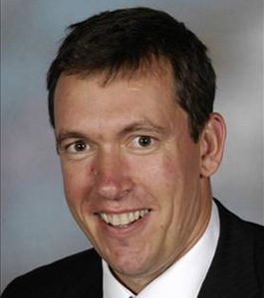
Wer ist das?
Er spielt gern Fußball.
Er macht viel Sport.
Er hat an der Uni in Cambridge studiert.
Er wohnt nicht in Comberton.
Er arbeitet an CVC.
Er ist älter als Frau Hawkes.
Er ist unser Schuldirektor.
Notes:
Listening task with ‘gradual reveal’. The last sentence makes it very obvious. The other sentences add information but do not get you closer.
Say it then reveal and repeat it.

Slide 19
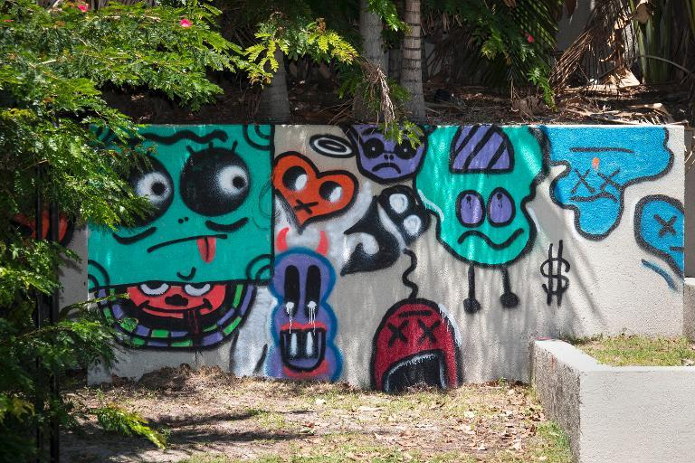
las autoridades = the council
Qué:
Cuándo:
Quién:
Dónde:
Notes:
To be done as a blind listening. Ask Students to write down the 4 x question words in their books.
Students try to pick out the 4 x details needed. The question words are not in the same order as the information as it’s important that they know the meaning of the question words.
When going through the answers, bring the text up so that learners who found it difficult can now read the text.

Slide 20
las autoridades = the council
Grafiti
Qué:
Cuándo:
Quién:
Dónde:
el jueves
Justin Bieber
en Australia
Justin Bieber está en Australia. Está en un hotel y el jueves pintó grafitis en el hotel. Le gustan los grafitis. Al hotel le gustan los grafitis de Justin Bieber. Pero a las autoridades no les gustan los grafitis. Dicen que Justin Bieber tiene que eliminar los grafitis.
Notes:
To be done as a blind listening. Ask Students to write down the 4 x question words in their books.
Students try to pick out the 4 x details needed. The question words are not in the same order as the information as it’s important that they know the meaning of the question words.
When going through the answers, bring the text up so that learners who found it difficult can now read the text.
Justin Bieber estaba en Australia. Estaba en un hotel y el jueves pintó grafitis en el hotel. Le gustan los grafitis. Al hotel le gustan los grafitis de Justin Bieber. Pero a las autoridades no les gustan los grafitis. Dicen que Justin Bieber tiene que eliminar los grafitis.

Slide 21
Task
Include support material (or not!) to create different tasks
e.g.
the transcript or
the first letter of each answer or
the possible answers jumbled at the bottom or
a glossary of key words or
a multiple choice support sheet or
a dictionary (+/- maximum no. of words that can be looked up)

Slide 22

Difícil – nivel 4b
Responde a las preguntas en inglés
1. What does Sergio have for breakfast?
2. What does he drink?
3. What time does he have breakfast?
4. What does he eat for lunch?
5. What time is his lunch?
6. What does he have for tea?
7. What time does he have dinner?
8. What does he have for dinner?
Mira 2 p.60
Listening = level 4 6/8 = level 4
Notes:
Listening activity for independent consolidation.

Slide 23
Fácil– nivel 3b
Circle the correct option
1. What does Sergio have for breakfast?
2. What does he drink?
3. What time does he have breakfast?
4. What does he eat for lunch?
5. What time is his lunch?
6. What does he have for tea?
7. What time does he have dinner?
8. What does he have for dinner?
1. What does Sergio have for breakfast?
cereal toast biscuits
2. What does he drink?
milk coffee orange juice
3. What time does he have breakfast?
8 o’ clock 7.30 8:30
4. What does he eat for lunch? (3)
chips salad meat pizza burger vegetables
5. What time is his lunch?
1:00 12:00 3:00
6. What does he have for tea?
Cake Biscuits nothing
7. What time does he have dinner?
8:00 6:00 7:00
8. What does he have for dinner?
fish and salad burger and chips meat and salad
Mira 2 p.60
Listening = level 3b 6/8 = level 3b
Notes:
Listening activity for independent consolidation.

Slide 24
La ciudad hoy y mañana
Difícil – contesta las preguntas en inglés
What is Ramón worried about? (1)
What does he do every day and why? (2)
How does he describe the town where he lives? (3)
What should be done to improve the area he lives in? (2)
What does he suggest would be a good idea? (1)
Notes:
p133 Ex 3 Ramón. Students complete the option of their choice as a listening task. They then looked at the full transcript and completed the other as a reading comprehension.
I asked them to choose between written answers to questions or a gap-fill exercise of the transcript. Once they had completed the listening task they then completed the other option as a reading comprehension. I did that with Y11 and they quite liked having the chance to engage with the text in written form having listening to it already. It meant that the ones who had completed the transcript gap fill then felt confident enough to have a go at the written answers as a reading comprehension. Those who had done the written answers then tackled the gap fill from the more challenging angle of reading, rather than just listening for the words.

Slide 25
La ciudad hoy y mañana
Menos difícil – completa el texto con las palabras abajo
Me llamo Ramón. Me preocupa mucho el ________ ____________, y por eso soy miembro de un grupo ecologista. Creo que tenemos que cambiar nuestra manera de vivir. Me gusta mucho la __________ y todos los días escribo un ______ sobre el medio ambiente.
Vivo en una __________ donde hay mucha _____________. Hay mucho tráfico, y lo malo es que también hay mucha ___________. No hay ni árboles, ni espacios verdes, ¡es una pena!
Deberíamos ______________ nuestro entorno. Deberíamos construir áreas de ________ con árboles para los _____________. Me gustaría mejorar la red de transporte público, así habría menos coches y menos contaminación. Un sistema de alquiler de _______________ sería una idea muy buena. También construiría casas ______________, es importante para nuestro futuro.
mejorar | medio | ambiente | ocio | ciudad
lectura | sostenibles | jóvenes | bicicletas | contaminación
basura | grandes | tráfico | blog | pueblo

Slide 26


1 Read the handout ‘Differentiation’
2 Think of one successful differentiation strategy you like to use.
3 Share with your table.
4 Choose a spokesperson to feed back.

Slide 27
Key aims of assessment / features of successful assessment:
it leads to improvement in student outcomes over time
the student puts in as much effort into the response to marking/feedback as the teacher
high quality work/achievement is affirmed and the student knows why
misconceptions are addressed (either in subsequent teaching, or student response to feedback dialogue in the book)
targets set are appropriate to the needs/ability level of the student (differentiated scaffolding model = Question or Prompt or Example or Explicit modelling

Slide 28
Suggestions / items for discussion:
do as much assessment work during class time as possible (what could this look like?
don’t mark everything?
carousel clinics?
Set a feedback hw – i.e. action with an outcome whereby students prepare something that addresses the issue they were having
Build response to feedback tasks into classroom lesson planning (a la ‘DIRT’ model = Directed Improvement and Reflection Time)

Slide 29
Feedback and targets
Scaffolded targets
‘Book back’ or individual follow up tasks
Whole class tasks with different levels of challenge
Whole class analysis → setting own targets
Notes:
We have worked as a department on feedback, marking and targets this year.

Slide 30
Scaffolded targets
Explicit model
Example
Scaffold
Reminder
Implicit ----------------------------------------------------------------→ Explicit
Notes:
According to Vygotsky, support should be contingent – i.e. dependent on and responsive to learner need. One way to individualise/differentiate support is to move from implicit to explicit support in terms of prompts for improvement. Here are 3 different types of prompt that could be used to structure formative feedback/target:
reminder
scaffold
Example
Explicit modelling
Here is an example of each. Reminders are clearly the most implicit and examples the most explicit and supportive.
‘Say more about how you feel about this person.’
‘Can you describe how this person is a ‘good friend’?’
‘Describe something that happened that showed they are a good friend.’
‘Choose one of these or your own: “He is a good friend because he never says unkind things about me”, “My friend is a friend because he never tells me lies.’” (Shirley Clarke)

Slide 31
‘Book back’ tasks
I find that I am able to do quite a bit of this with my new approach to target setting at KS4. As we now spend 5/10 minutes working on individual targets to improve work when I first return marked books, I am able to reinforce and consolidate for those who need extra support, and extend the most able by introducing new ideas (eg. some of the most able in y11 are now able to use the subjunctive in a number of key areas through my having given them a few pointers and having referred them to a website/grammar note in textbook).

Slide 32
Whole class tasks with challenge
Based on their assessments/homework I create a 'Curry' sheet of the common errors they have made. Each statement has the number of errors written next to it and this corresponds to the maximum number of points available for that statement. If they successfully identify and correct the errors they are awarded all the marks. Each 'Curry' has a different difficulty rating (Korma - a deliciously nice and easy way to start, Jalfrezi! You must be crazy, Vindaloo - Ay! Only for the very brave) and there is a leader board whereby their marks are noted down. This has worked nicely post-marking as a feedback and consolidation lesson.

Slide 33
Main Problem Areas of Translation
Translating the word ‘in’:
In Cambridge = ___ Cambridge (note that ___ also means ____)
In my/the village = ______ mon/le village
In England = _____ Angleterre
2. Who is called/who are called =______________/_____________
3. ‘de’ after negative phrases (and therefore no un/une/des:
I don’t have any brothers/sisters = Je n’ai pas ___ frères/soeurs
There isn’t a swimming pool = Il n’y a pas ___ piscine
4. Translating the word ‘to’ + a certain place:
to = à but ‘to the’ = _____ , _______, or ______ and _______if it is followed by a masculine or feminine word which starts with a vowel
5. Difference between (1) préféré and (2)préfère:
= _____________
=_____________
6. Translating the word ‘you’:
One person (familiar) = ________ One person or more (polite) =_______
You meaning ‘one in general’ = _______
7. You can/one can = _____ ______ and is followed by a verb in the
____________ form e.g. _____ _____ ______ = You/one can do.
8. It is = ________; is = _________; isn’t = ____________
are=__________; they are =___________; they aren’t=___________
9. Present Tense Verbs:
-e,-es,-e,-ons-ez,-ent + irregular verbs (avoir, être & aller)
In particular there are problems with:
I go/I am going = ___ ______
My mum likes = ____ ______ ______
My friends play = ____ _______ __________
Whole class focus on problem areas following a prose translation ‘milestone’ assessment.

Slide 34
Main Problem Areas of Translation: TEST
Translating the word ‘in’:
In Cambridge = ___ Cambridge
In my/the village = ______ mon/le village
In England = _____ Angleterre
2. Who is called/who are called =______________/_____________
3. ‘de’ after negative phrases (and therefore no un/une/des:
I don’t have any brothers/sisters = Je n’ai pas _________/________
There isn’t a swimming pool = Il n’y a pas _____________
4. Translating the word ‘to’ + a certain place:
to = à but ‘to the’ = _____ , _______, or ______ and _______if it is followed by a masculine or feminine word which starts with a vowel
5. Difference between (1) préféré and (2)préfère:
= _____________
=_____________
6. Translating the word ‘you’:
One person (familiar) = ________ One person or more (polite) =_______
You meaning ‘one in general’ = _______
7. You can/one can = _____ ______ and is followed by a verb in the
____________ form e.g. _____ __________ = You/one can do.
8. It is = ________; is = _________; isn’t = ____________
are=__________; they are =___________; they aren’t=___________
9. Present Tense Verbs:
-e,-es,-e,-ons-ez,-ent + irregular verbs (avoir, être & aller)
In particular there are problems with:
I go/I am going = ___ ______
My mum likes = ____ ______ ______
My friends play = ____ _______ __________
Whole class given their own milestone task back and asked to:
1) set own targets based on the areas 1-9 that they had difficulty with
2) revise for a test on the main problem areas.

Slide 35
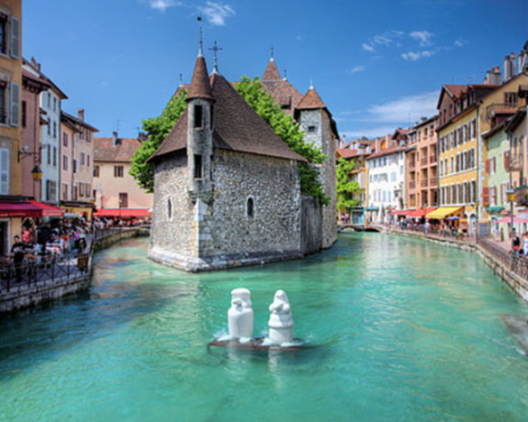
Class (a week later) given a similar, yet different prose translation to do.
Hello. My name is Sophie and I live in Annecy (3). I have a brother who is called Marc (3). I don’t have any sisters (3). In Annecy there is a market, some restaurants and some shops (3). My brother likes to go to the swimming pool (3) but I prefer to go to the lake *(3).
*le lac= lake
*à la montagne= in the mountains
There isn’t an ice rink in Annecy (3) but you can go skiing in the mountains*(3). I like my town and in my opinion it’s pretty (3) but it isn’t big (3). Sometimes I go to the leisure centre with my friends(3) and we play table tennis or tennis (3). I like playing table tennis because it’s fun (3) but I can’t play tennis! (3)

Slide 36
Answer slide
Bonjour. Je m’appelle Sophie et j’habite à Annecy (3). J’ai un frère qui s’appelle Marc (3). Je n’ai pas de soeurs (3). À Annecy il y a un marché, des restaurants et des magasins (3). Mon frère aime aller à la piscine(3) mais je préfère aller au lac (3). Il n’y a pas de patinoire à Annecy(3) mais on peut faire du ski à la montagne (3). J’aime ma ville et à mon avis c’est jolie (3) mais ce n’est pas grande (3). Quelquefois je vais au centre de loisirs avec mes amis (3) et nous jouons au ping-pong ou au tennis(3). J’aime jouer au ping-pong parce que c’est amusant (3) mais je ne peux pas jouer au tennis! (3)
/42
Notes:
Mark 2nd prose translation in class.

Slide 37

Aims for the day
Explore ways to meet the needs of all language learners
Examine strategies for improving memory and maximising retention
Consider ways to make learning active
Focus on excellent uses of technology, inside and outside of the classroom

