Slide 1

Developing memory skills in language learning
Rachel Hawkes
Director International Education and Research
Comberton Academy Trust, Cambridge
Notes:
Session 6
Thursday 4th February 2016
Memory
Developing Memory Skills in Language Learning
Rachel Hawkes
Associate Deputy Principal and SLE
Comberton Academy Trust, Cambridge
The ability to retain and recall new words (with increasing speed) is central to language learning and, alongside an ability to pronounce the foreign language well and the ability to put together words and structures into new sentences, it is one of the three essential skills we focus on the very beginning. With the move to linear GCSEs the ability to store and retrieve knowledge to and from long term memory has become of paramount importance, not just in MFL but across the curriculum. By including explicit work on memory within our teaching, we can not only enable students to get better at languages, we can also flag up a unique selling point to SLTs, colleagues in other departments and parents!
In this session Rachel will draw on cognitive psychology, considering how we create memories, retrieve stored information and how we know what we know. She will share ideas and strategies which she has used with her own students and in her own school for many years to help learners remember language and retrieve it successfully over time.
Rachel Hawkes works across the four secondary schools in the Comberton Academy Trust. Associate Deputy Principal and SLE for languages, she is Languages Advisor for TES Resources and Past President of ALL. She has a PhD from Cambridge University, focusing on teacher and learner interaction in the secondary languages classroom.

Slide 2
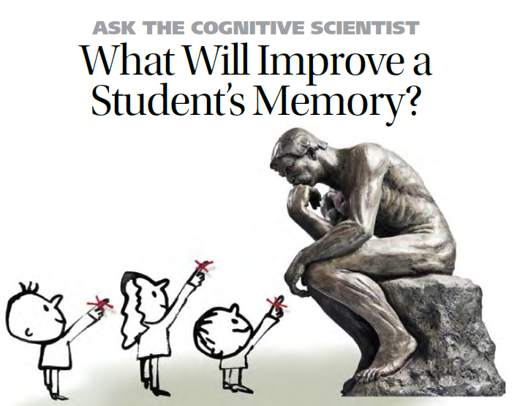
Notes:
The content of this talk was inspired by an article by cognitive scientist Daniel Willingham published back in 2008 in The Educator and entitled ‘Ask the cognitive scientist: what will improve a student’s memory?’

Slide 3

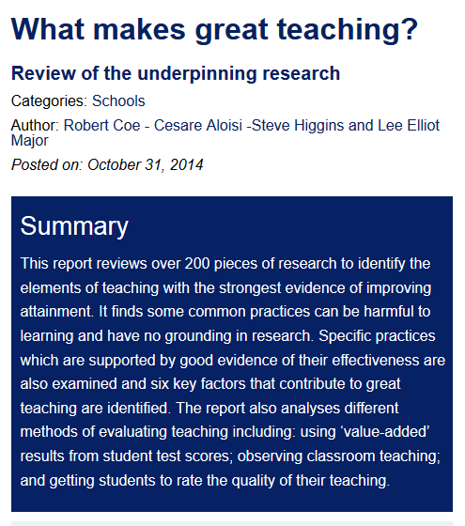
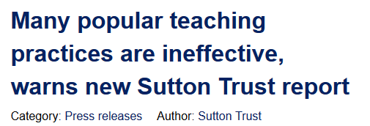

Notes:
My journey to the article itself is worth a little more detail:
I came across the article when following up some of the references from a high-profile report published by the Sutton Trust that came out in October last year, entitled: What makes great teaching?
The report itself was then picked up in the press…

Slide 4

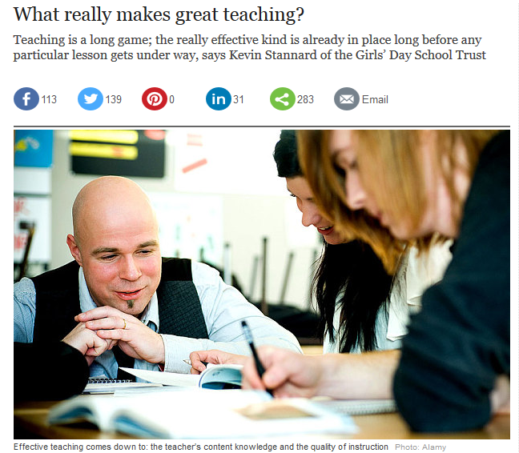

Slide 5

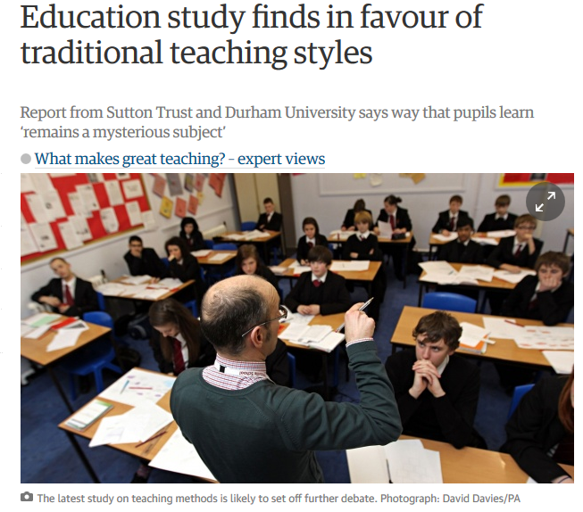

Slide 6
No empirical support for…
Using praise lavishly
Allowing learners to discover key ideas for themselves
Grouping learners by ability
Addressing issues of confidence and low aspirations before you try to teach content
Presenting information to learners in their preferred learning style
Encouraging re-reading and highlighting to memorise key ideas
Ensuring learners are always active, rather than listening passively, if you want them to remember
Notes:
As well as identifying some key factors that support great teaching, the report also sought to debunk some popular practices that are not supported by evidence.
According to the report, 7 popular practices are not supported by empirical research.
Now reading this provoked two reactions: first, I felt a bit awkward – I’m sure I’m not the only one to leap on a widely publicised idea and extrapolate strategies and tasks based on its principles without thoroughly researching all of the evidence that may (or may not) support it, but nevertheless I thought ‘Ooops!’ Second, though, I found myself re-evaluating some of those ideas and strategies and finding that the reason I might still be using them is that they actually work for me and those I teach in the classroom. And I reminded myself that, whilst empirical evidence is useful, teaching is a very dynamic, fast-moving job. We don’t always have the luxury of waiting until educational researchers have had the time to set up, implement, evaluate, analyse and publish studies before we try out new ideas. Sometimes we just try them for ourselves and judge whether they work, or not, for us at the local level. We don’t then pronounce that these ideas are the new methodology, transferable to all classrooms and generalizable to every learning situation. We just share what we have found, and invite others to try or adapt the thoughts.
That is the beauty of teaching as a profession. And, whilst there have been pressures that have stymied our attempts to take risks in the classroom, there are signs that these are lessening a little! Even Ofsted has publically and unequivocally declared itself methodologically neutral…!

Slide 7
Ofsted: Observing teaching and learning
Ofsted does not favour any particular teaching style and inspectors must not give the impression that it does….they should not criticise teacher talk for being overlong or bemoan a lack of opportunity for different activities in lessons unless there is unequivocal evidence that this is slowing learning over time. It is unrealistic, too, to expect that all work in all lessons will be matched to the specific needs of each individual pupil. Inspectors should not expect to see pupils working on their own or in groups for periods of time in all lessons. …Pupils may rightly be expected to sit and listen to teachers, which of itself is an ‘active’ method through which knowledge and understanding can be acquired effectively. Inspectors should not criticise ‘passivity’ as a matter of course …and certainly not unless it is evidently stopping pupils from learning new knowledge or gaining skills and understanding.
When observing teaching, inspectors should be ‘looking at’ and reflecting on the effectiveness of what is being done to promote learning, not ‘looking for’ specific or particular things.
Notes:
School inspection handbook
January 2015 , No. 120101
p.57-58
Work like this has no doubt been helpful in encouraging certain organisations to be less dogmatic about particular practices.
Whilst there were statements from Ofsted along these lines from as early as late 2013, it has taken a while for messages to get through.
This wording from the SIH Jan 2015 is certainly the strongest yet.
So, with that freedom very much in mind, let’s return to memory!

Slide 8
Ofsted: Assessment
I also want to take this opportunity to raise the issue of marking. I recognise that marking and feedback to pupils, both written and oral, are important aspects of assessment. However, as inspectors we should not expect to see any specific frequency, type or volume of marking and feedback; these are for the school to decide through its assessment policy. Marking and feedback should be consistent with that policy, which may cater for different subjects and different age groups of pupils in different ways, in order to promote learning effectively. These activities need to be useful for pupils and sustainable for teachers. As a result, the clarification document has been amended to reflect this. If it is necessary to identify marking/feedback as an area for improvement for a school, inspectors must pay careful attention to the way recommendations are written to ensure that these do not drive unnecessary workload for teachers.
Notes:
Ofsted has updated its guidance: https://www.gov.uk/government/publications/ofsted-inspections-clarification-for-schools
March 2015
In the document, they address the issue of marking:
Pupils’ work
n Ofsted does not expect to see a particular frequency or quantity of work in pupils’ books or folders. Ofsted recognises that the amount of work in books and folders will depend on the subject being studied and the age and ability of the pupils.
n Ofsted recognises that marking and feedback to pupils, both written and oral, are important aspects of assessment. However, Ofsted does not expect to see any specific frequency, type or volume of marking and feedback; these are for the school to decide through its assessment policy. Marking and feedback should be consistent with that policy, which may cater for different subjects and different age groups of pupils in different ways, in order to be effective and efficient in promoting learning.
n While inspectors will consider how written and oral feedback are used to promote learning, Ofsted does not expect to see any written record of oral feedback provided to pupils by teachers.
n If it is necessary for inspectors to identify marking as an area for improvement for a school, they will pay careful attention to the way recommendations are written to ensure that these do not drive unnecessary workload for teachers.
In a separate update for inspectors, Ofsted gives this message:
I also want to take this opportunity to raise the issue of marking. I recognise that marking and feedback to pupils, both written and oral, are important aspects of assessment. However, as inspectors we should not expect to see any specific frequency, type or volume of marking and feedback; these are for the school to decide through its assessment policy. Marking and feedback should be consistent with that policy, which may cater for different subjects and different age groups of pupils in different ways, in order to promote learning effectively. These activities need to be useful for pupils and sustainable for teachers. As a result, the clarification document has been amended to reflect this. If it is necessary to identify marking/feedback as an area for improvement for a school, inspectors must pay careful attention to the way recommendations are written to ensure that these do not drive unnecessary workload for teachers.

Slide 9
Notes:
And so back to memory.
This was the aspect of the report I followed up in most detail for two main reasons:
1) I had done some previous work on memory strategies within language learning and wanted to re-visit those ideas, following up on new references including ideas from cognitive psychology.
2) I am looking ahead to teaching current Y8 from 2016 and preparing them for a GCSE in which long-term retention will be much more important than it has been, and still is, for the current CA-version of GCSE.
I found a lot within Daniel Willingham’s work that resonates with my experiences in the classroom (both positive and negative) and so I’ve structured this session around 7 ideas I’ve drawn from his article, illustrated with ideas / strategies and resources from my teaching.

Slide 10
1 Memory is…
the residue of thought, meaning that the more you think about something, the more likely it is that you’ll remember it later.
Advice to teachers: focus on “ways to help them think about meaning and avoid study methods that do not encourage them to think about meaning”.
AMERICAN EDUCATOR | WINTER 2008-2009 p.18 David Willingham

Slide 11
Teaching idea [1]
Present new language by asking students to generate the meaning of each key word themselves (either by drawing a representation or writing what they think it means). Then reveal the meanings and ask students to correct their drawings / written versions.
Generating errors followed by feedback led to significantly better memory for the correct
definition/translation than either reading or making incorrect choices.
Potts, R; Shanks, DR; (2014) The Benefit of Generating Errors During Learning. Journal of Experimental Psychology: General , 143 (2) pp. 644-667
Notes:
http://discovery.ucl.ac.uk/1399515/
Potts, R; Shanks, DR; (2014) The Benefit of Generating Errors During Learning. Journal of Experimental Psychology: General , 143 (2) pp. 644-667. 10.1037/a0033194.
This study (four replicated experiments) used unknown vocabulary – presented it to learners. They either generated guesses, read a definition that was given, or chose the answer from a multi-choice selection.
Each time the self-generation of answers, even where those answers were wrong and that was sorted out through feedback, resulted in better retention of the correct definition.
Why does this work? There are several theories. I don’t know. My gut feeling is that students are involved in more thinking when they generate their own idea of what the word could mean.

Slide 12
O português
1 | 2 | 3
4 | 5 | 6
beach | cheese
work | chewing gum
city | heart

Slide 13






O português
queijo
coração
trabalho
1 | 2 | 3
4 | 5 | 6
praia
chiclete
cidade
beach | cheese
work | chewing gum
city | heart

Slide 14
O português
queijo
coração
trabalho
1 | 2 | 3
4 | 5 | 6
praia
chiclete
cidade
beach | cheese
work | chewing gum
city | heart

Slide 15
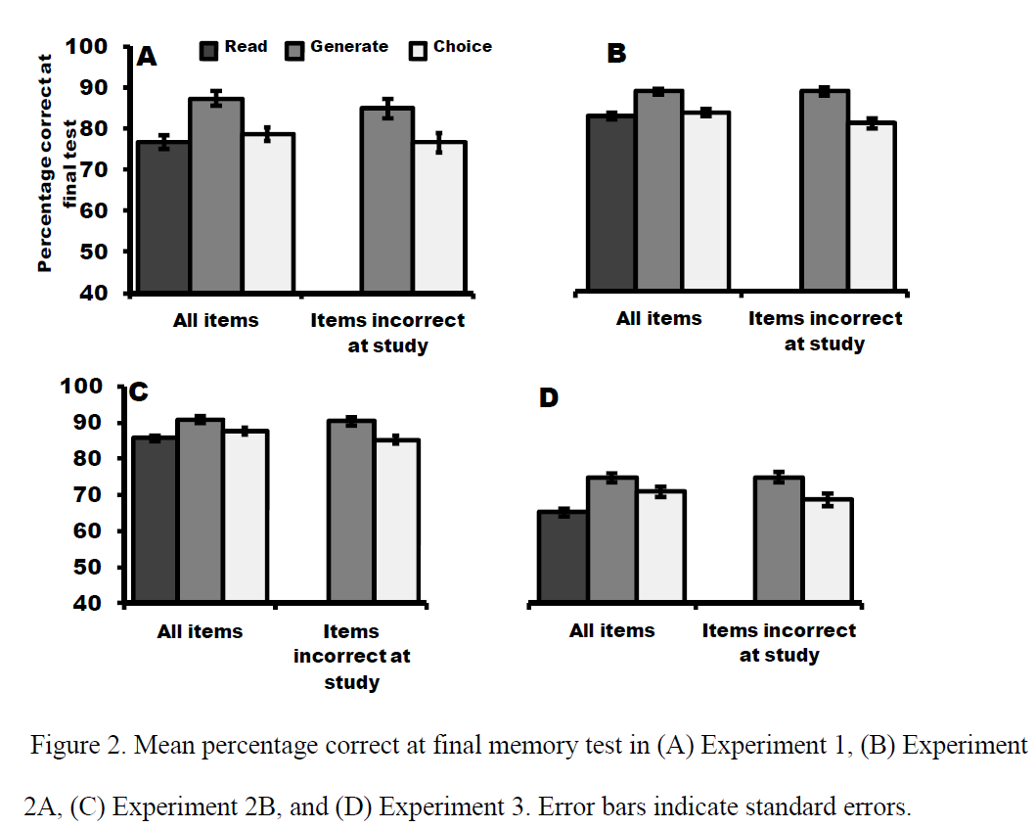

Slide 16
2 Repetition is…
helpful, but only when one repeats thinking about meaning. “Shallow” repetition…i.e. repetition without thinking about the meaning is not helpful to learning.
Advice to teachers: consider the drilling activities we use. Can they be tweaked so that the word-meaning relationship is sustained throughout?
AMERICAN EDUCATOR | WINTER 2008-2009 p.21 David Willingham

Slide 17
Teaching idea [2]
Put students frequently in the situation where they need to retrieve language from memory, but keep the link to meaning. E.g. Mini whiteboard Q&A, sentence-completion, translation – cued by pictures, gestures, English. Also works orally.
The “testing effect," later renamed "retrieval practice" refers to the fact that trying to remember something can actually help cement things in memory more effectively than further study.
Agarwal, P. K., Bain, P. M. & Chamberlain, R. W. (2012). The value of applied research: Retrieval practice improves classroom learning and recommendations from a teacher, a principal, and a scientist. Educational Psychology Review, 24, 437-448.
Notes:
Agarwal, P. K., Bain, P. M. & Chamberlain, R. W. (2012). The value of applied research: Retrieval practice improves classroom learning and recommendations from a teacher, a principal, and a scientist. Educational Psychology Review, 24, 437-448.
https://www.google.co.uk/search?q=+Agarwal,+P.+K.,+Bain,+P.+M.+%26+Chamberlain,+R.+W.+%282012%29.+The+value+of+applied+research:+Retrieval+practice+improves+classroom+learning+and+recommendations+from+a+teacher,+a+principal,+and+a+scientist.+Educational+Psychology+Review,+24,++437-448.&ie=utf-8&oe=utf-8&gws_rd=cr&ei=_3PjVLDPEebl7gabjIGQCQ
Little tweaks to recall / retrieval activities that increase the thinking needed (makes the brain hurt more!) are easily achieved and improve memory.
Again, feedback is needed, though.
We mustn’t lose sight of what’s important here!
Just setting lots of tests without feedback learning in between to correct misunderstandings and develop knowledge will not help!
We need perhaps to relabel some of our ‘tests’ as tasks or activities. Test is not necessarily a positive, motivating word for all learners, and they do often ask, when they are doing something without their books, whether it is a test. We just perhaps need to agree an answer for that within our departments.

Slide 18












Don Glotón
Don Tontainas
Don Feliz
Don Curioso
Don Alreves
Don Cosquillas
Don Pupas
Don Lioso
Don Inteligente
Don Pequeño
Don Vago
Don Quisquilloso

Slide 19
3 Your access to…
things that are stored in your memory will succeed or fail depending on the quality of the cues or triggers that get you back to the information.
Advice to teachers: experiment with different types of triggers: visuals, gestures, miming. Where possible, involve students in the generation of the cues.
AMERICAN EDUCATOR | WINTER 2008-2009 p.18 David Willingham

Slide 20
Teaching idea [3]
Use gestures to teach key language and to retrieve it.
Involve students in suggesting cues at the introduction phase.
Language I have tried this with includes: days of the week, months, question words, pronouns, verb endings, animals, transport, modal verbs (1st person) + infinitives, and of course, phonics key words, preterite and present 1st person regular verbs, etc…
Retrieval:
In the initial stages peg the new language to a particular student in the class, and keep returning to that student.
‘Das ist Joels Wort. Wie war das noch mal?’ As you elaborate with them, extend outwards to elicit the same words from others, but keep the personal connection. It just acts as another neural ‘fixant’.

Slide 21
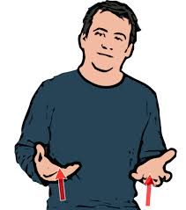
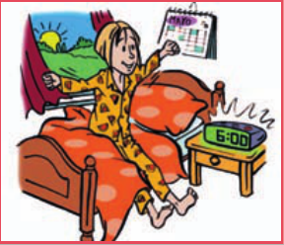
lenguaje de señas
= sign language
me levanto
Notes:
Drill vocab call response 5 mins

Slide 22
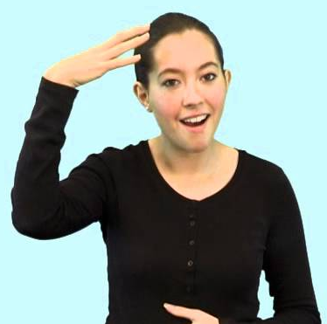
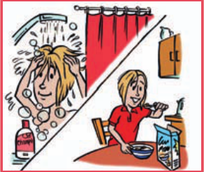
me ducho

Slide 23

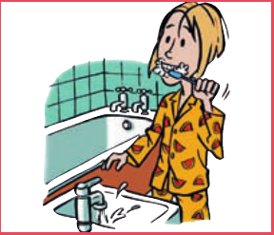
me lavo los dientes

Slide 24
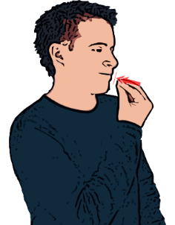
desayuno

Slide 25

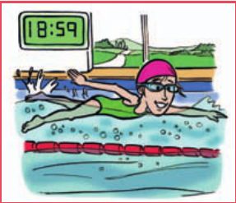
hago natación

Slide 26
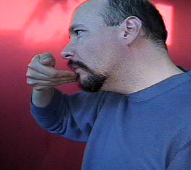
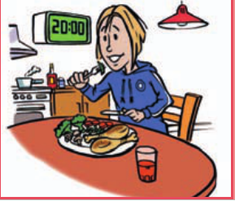
ceno

Slide 27

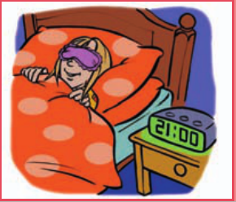
me acuesto

Slide 28

A | B | C
D | E | F

Slide 29
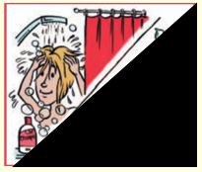
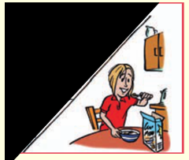
me levanto | me lavo los dientes | me ducho
desayuno | ceno | me acuesto
T vs P
Reveal
Magic 3
Notes:
5 mins

Slide 30
Teaching idea [3 cont’d.]
Retrieval:
In the initial stages peg the new language to a particular student in the class, and keep returning to that student.
‘Das ist Joels Wort. Wie war das noch mal?’ As you elaborate with them, extend outwards to elicit the same words from others, but keep the personal connection. It just acts as another neural ‘fixant’.

Slide 31





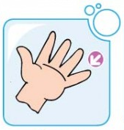
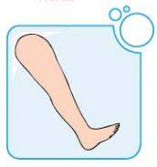

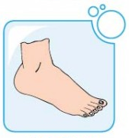
1 | 2 | 3
4 | 5 | 6
7 | 8 | 9
la cabeza
los hombros
el brazo
el codo
la mano
el dedo
la pierna
la rodilla
el pie
Notes:
Present the parts of the body one by one and begin to work to fix the vocabulary, using the numbers to elicit in various ways as in previous lessons. (See for example the food lesson in Y3 for detailed instructions of 5-6 practice activities to do with a slide like this).
1 = la cabeza
2 = los hombros
3 = el brazo
4 = el codo
5 = la mano
6 = el dedo
7 = la pierna
8 = la rodilla
9 = el pie

Slide 32
1 | 2 | 3
4 | 5 | 6
7 | 8 | 9
la cabeza
los hombros
el brazo
el codo
la mano
el dedo
la pierna
la rodilla
el pie
Notes:
Present the parts of the body one by one and begin to work to fix the vocabulary, using the numbers to elicit in various ways as in previous lessons. (See for example the food lesson in Y3 for detailed instructions of 5-6 practice activities to do with a slide like this).
1 = la cabeza
2 = los hombros
3 = el brazo
4 = el codo
5 = la mano
6 = el dedo
7 = la pierna
8 = la rodilla
9 = el pie

Slide 33
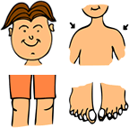
cabeza hombro rodilla pie
rodilla pie
cabeza hombro rodilla pie
rodilla pie
ojo oreja boca y nariz
cabeza hombro rodilla pie
rodilla pie
Notes:
To the tune of Heads Shoulders Knees and Toes
Next slide has only the picture prompts

Slide 34




Notes:
Sing from just the pictures, doing the gestures too.

Slide 35
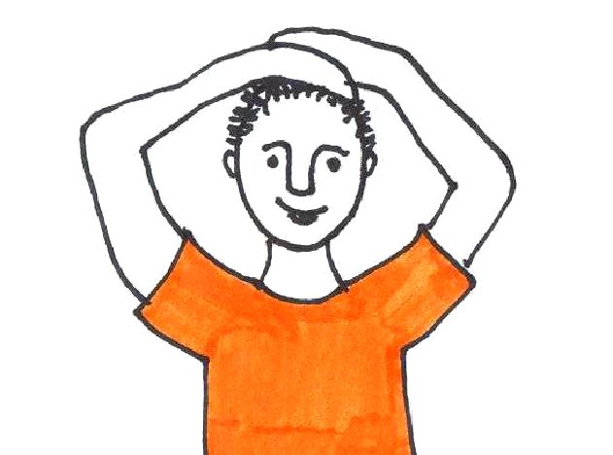
Juan dice……
¡Tocaos las piernas!
Notes:
Introduce a game of Simon says
At the moment, just use ‘Tocaos la / el / los / las’ with the different parts of the boday.

Slide 36

Kas?
Kaip?
Kodėl?
ką?
Kiek?
Kur?
Kiek?
Kada?
Kuris?
Notes:
These are Lithuanian question words. Let’s see how many we can learn?
Teach the key question words with gestures. See this video for suggested gestures.
http://www.youtube.com/watch?v=iqCvE258vY0

Slide 37
4 But…
some to-be- remembered material interferes with other to-be-remembered material, and the greater the similarity between them, the more likely that the cues will be the same, and therefore the more ambiguous they will be.
Advice to teachers: to minimize forgetting,
focus on ways to ensure that we have cues and
that they are distinctive.
AMERICAN EDUCATOR | WINTER 2008-2009 p.19 David Willingham

Slide 38


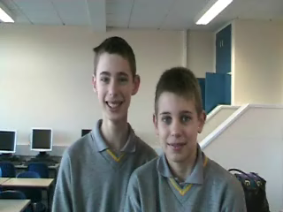
Teaching idea [4]
ser - to be
avoir: to have
j’
ai
tu
as
il
a
elle
a
yo |  | nosotros
tú |  | vosotros
él/ella Ud |  | ellos/ellas Uds
avons
soy
somos
nous
vous
avez
eres
sois
ils
ont
es
son
elles
ont
Notes:
Choose different songs / gestures / pictures for different languages – don’t overlap them.
This is why remembering a two-week timetable is hard. Same structural cues but different information to slot in.

Slide 39
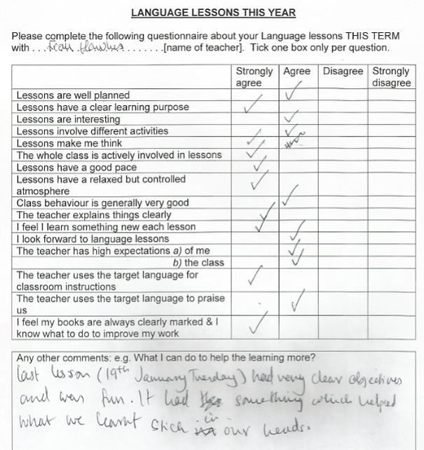
Student voice

Slide 40
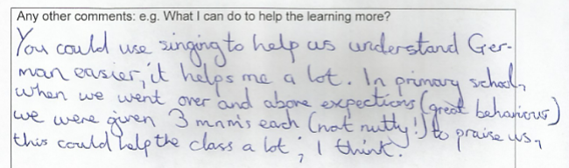
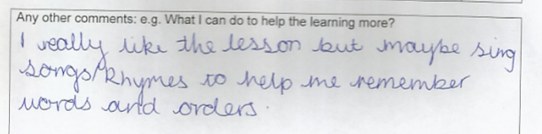
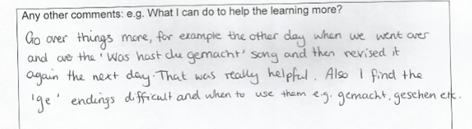

Slide 41

ins Kino gehen
Frag ‘what did you do?’
Sag ‘I went to the cinema’ und ‘We saw a …film’
Sag deine positive / negative Meinung ‘which was (entertaining / interesting / great / boring)
Nenne 8 Filmarten

Slide 42
V = Vergangenheit, Pr = Präsens, F = Futur
 | Ich werde einen Horrorfilm sehen.
 | Ich gehe am Wochenende ins Kino.
 | Ich habe den Actionfilm toll gefunden.
 | Ich bin mit Freunden ins Kino gegangen.
 | Ich finde Liebesfilme nicht so interessant.
 | …der nicht so unterhaltsam war. (which was not to entertaining)
 | Was hast du gemacht?
 | Ich sehe gern Fantasyfilme.
 | Wir haben einen Film gesehen.

Slide 43
32
F
21
Pr
76
V
Ich werde einen Horrorfilm sehen. | Ich gehe am Wochenende ins Kino. | Ich habe den Actionfilm toll gefunden.
Ich bin mit Freunden ins Kino gegangen. | Ich finde Liebesfilme nicht so interessant. | …der nicht so unterhaltsam war. (which was not so entertaining)
Was hast du gemacht? | Ich sehe gern Fantasyfilme. | Wir haben einen Film gesehen.
82
V
14
Pr
55
V
V
94
Pr
78
V
37
Notes:
Sing the song – they write down the numbers of the lines
1 Was hast du gemacht?
2 Was hast du gemacht?
3 Ich bin mit Freunden ins Kino gegangen.
4 Wir haben einen Film gesehen
5 Der nicht so unterhaltsam war.
Oh la la la la Oh la la la la Oh la la la la la

Slide 44
Ins Kino gehen
37
Was hast du gemacht?
37
Was hast du gemacht?
82
Ich bin mit Freunden ins Kino gegangen.
78
Wir haben einen Film gesehen,
55
der nicht so unterhaltsam war.
Oh la la la la Oh la la la la Oh la la la la la.

Slide 45
totally
(not) so
(not) very
quite
not at all
total
Ins Kino gehen
(nicht) so
(nicht) sehr
W__ h___ d_ g_____?
ziemlich
gar nicht
W__ h___d_ g_____?
I__ b__ m__ F_______ i__ K___ g_______.
W__ h_____ e_____ F___ g______,
d__ n____ s_ u__________ w__.
Frag ‘what did you do?’
Sag ‘I went to the cinema’ und ‘We saw a …film’
Sag deine positive / negative Meinung ‘which was (entertaining / interesting / great / boring)
Nenne 8 Filmarten
Notes:
Elicit the German.

Slide 46
Person A
Person B
What did you do at the weekend?
I went with friends to the cinema.
We saw a …..film, which was …
And you, what did you do at the weekend?
Frag ‘what did you do?’
Sag ‘I went to the cinema’ und ‘We saw a …film’
Sag deine positive / negative Meinung ‘which was (entertaining / interesting / great / boring)
Nenne 8 Filmarten

Slide 47
5 Students (and adults)…
over-estimate what they know and therefore under-allocate time to study (just 68% of the time needed to achieve their target knowledge)
Advice to teachers: find ways to get students to assess their own knowledge more realistically.
AMERICAN EDUCATOR | WINTER 2008-2009 p.20 David Willingham

Slide 48
Teaching idea [5]
Look at the following list of words and give each one a number rating 1-5 based on how well you know the word.
Look at the VKS (Vocabulary Knowledge Scale) below:
1. I don’t remember having seen this word before.
2. I have seen this word before but I don’t know what it means.
3. I have seen this word before and I think it means….
4. I know this word: it means…….
5. I can use this word in a sentence, e.g……….
(ref: Wesche M & Paribakht T.S. (1996) “Assessing second language vocabulary knowledge: depth versus breadth”, The Canadian Modern Language Review 53, 1:28)
Notes:
Advantage of this is that students think individually about their own knowledge – a personal response to the word, so the approach is differentiated / personalised from the outset (very useful for Y7 who increasingly come to us with a variety of learning experiences / previous knowledge).
It needs follow up activity – it is just a first step.
Could you do it at the end of a lesson to gather information from students to inform your planning for the next lesson?
Could you use it at the start of a lesson and then again at the end to measure progress in knowledge?
Could peers teach each other all the words they’ve given 4 to?
Could they use it to set themselves learning targets for the lesson?

Slide 49
6 Master it and…
keep going (an extra 20% of the time it took to master) – overlearn. Some forgetting occurs so don’t just learn to the point where you only just have it memorised, keep going beyond that point.
Advice to teachers: convince students of this! Tell them “Don’t learn it until you get it right, keep going until you can’t get it wrong!”
AMERICAN EDUCATOR | WINTER 2008-2009 p.20 David Willingham

Slide 50

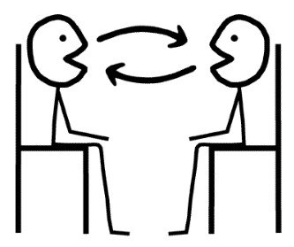
Teaching idea [6]
Use peer tasks to make over-learning varied and enjoyable, either Q&A style such as speaking lines, or peer testing style, where one has access to the answers.
Lynch, D., & Maclean, J. (2001). A case of exercising: effects of immediate task repetition on learners' performance. In M. Bygate, P. Skehan, & M. Swain (Eds.), Researching pedagogic tasks: Second language learning, teaching and testing. Harlow, Essex: Addison Wesley Longman.
Notes:
There is empirical support for the benefits repeating speaking tasks immediately:
Lynch, D., & Maclean, J. (2001). A case of exercising: effects of immediate task repetition on learners' performance. In M. Bygate, P. Skehan, & M. Swain (Eds.), Researching pedagogic tasks: Second language learning, teaching and testing. Harlow, Essex: Addison Wesley Longman.

Slide 51
Teaching idea [6 cont’d.]
Online vocabulary / language learning tools are helpful. (e.g. Quizlet, Vocab Express, Memrise, Duolingo
Competitions like the Translation Bee are also useful.
Notes:
There is empirical support for the benefits repeating speaking tasks immediately:
Lynch, D., & Maclean, J. (2001). A case of exercising: effects of immediate task repetition on learners' performance. In M. Bygate, P. Skehan, & M. Swain (Eds.), Researching pedagogic tasks: Second language learning, teaching and testing. Harlow, Essex: Addison Wesley Longman.

Slide 52

KS3 Translation Bee
Stage 1: Present Tense
Students translate from English into German as many sentences as possible in one minute.
All sentences in Stage 1 are drawn from the vocabulary list.
For example: We travel to Italy. >> Wir fahren nach Italien.
To gain a point, pronunciation and accuracy must be good.
http://thisissurreal.com/shai/flsb/screen/

Slide 53
Stage 1: Present Tense
Ich fahre / Wir fahren | nach | Spanien / Frankreich / Deutschland / Italien / Österreich
 | mit | dem Bus / dem Zug / dem Auto / dem Flugzeug / der U-Bahn
Ich esse / Wir essen | Pizza / Pommes / Obst / Salat / Reis
Ich trinke / Wir trinken | Orangensaft / Wasser / Limonade / Tee / Kaffee
Ich lerne / Wir lernen | Deutsch / Französisch / Spanisch / Englisch / Mathe / Naturwissenschaften / Theater / Kunst / Erdkunde / Geschichte
Ich spiele / Wir spielen | Fußball / Basketball / Tennis / Golf / Hockey / Rugby / Karten / Tischtennis / Federball / Volleyball
Ich gehe / Wir gehen | ins Kino / ins Theater / ins Restaurant / zur Schule / nach Hause
Ich wohne / Wir wohnen | in einem Dorf / in einer Stadt / auf dem Land / an der Küste / in den Bergen
Ich kaufe / Wir kaufen | ein T-Shirt / ein Hemd / ein Kleid / einen Rock / einen Pulli / eine Jacke / eine Hose / Socken / Schuhe / Turnschuhe

Slide 54
7 Make the meaningless…
meaningful.
“’Think about meaning’ sounds like good advice, but there are
things to be learned that are, essentially, meaningless. For example,
what should students do when learning that rojo is the Spanish
word for red? Meaningless material is difficult to learn because
it is hard to find a good cue. As discussed above, remembering is
prompted by cues, and it is hard to associate the cue (the Spanish
word for red) with the target memory (rojo) when the cue and
memory have no meaningful relation.”
Advice to teachers: don’t give up!
AMERICAN EDUCATOR | WINTER 2008-2009 p.22-3 David Willingham
Notes:
This is a biggie! It’s led me to THREE very different avenues of thought:
First…
Well, on the one hand, it’s a bit of an earth-shattering moment, when you realise that essentially your whole subject has been dubbed meaningless.
This is not the only time I’ve run into this view this year.
There have been two further times.
First, in the school in Peterborough where I’m currently teaching and doing a stint as head of department, I’ve taken on a small Y10 class which started out as not so very motivated or high achieving. A few weeks ago we started the topic of school and future plans. I felt that I’d at least made enough headway with them to elicit their opinions about Spanish. One girl gave a very hesitant ‘mmm me gusta’ and then trailed off. I sensed she had a view she wanted to share but not the Spanish to express it, so asked for more information in English. She said ‘Well, I like the lessons but the thing is with Spanish you don’t actually learn anything new do you?’ Essentially, she meant you just learn how to say the things you already know but with different words, but no new conceptual knowledge.
I was given the same view in a meeting with an EAL expert adviser I was meeting with earlier this term. When I suggested that EAL students should always stay in MFL lessons as this is one place where they succeed (in my mind I was thinking that the reasons for this are the fact that it’s a level playing field. Lessons are taught in the TL heavily supported with gesture, picture etc.. And so all can achieve. And he said, “Well yes of course, but that’s because there’s no content, no new conceptual knowledge’
I’m still grappling with the implications of this and my response.
Caught unawares, with the EAL expert, I said: What about grammatical knowledge? That is conceptual, and new to the vast majority. Even where students have been introduced to grammar they frequently only begin to understand it conceptually in their foreign language lessons (as many of us did). He grunted, which I took to be an assent.
With the Y10 student, I was equally taken aback, and said: “Oh, you’ve just punctured a hole in my entire reason for existence. I’m going to have to go away and think about that.”
I’ve since returned to the theme a couple of times with them, and rather than the grammar tack (which I don’t think would impress), I’ve explained what it has meant to me in my lifetime so far to meet people and be able to communicate with them without resorting to English: the friendships I’ve made, the responses I’ve had, the thrill of confounding expectations in tourist resorts, the smiles, the human interactions, the fact that a greater part of the world is open to me in this way because of the languages I can speak, and those I will have a go at.
I’m not sure if they’re convinced, but what I do know is that the attitudes of the students towards me and the subject are changed and changing.
One student in the class has learnt how to say: Mi asignatura favorita es el español porque puedo expresarme y comunicarme con mucha gente.
It’s not a finished answer – I still feel I need re-examine for myself the point of this subject of ours.
One thing it has reminded me of however, is the centrality of relationships in the classroom.
Perhaps because our subject lacks new facts and its purpose is essentially communication using new words for familiar ideas, it is far more important in our subject that students like the lessons, enjoy the experience of being in the classroom, and therefore make a positive, personal connection with us.
We may not feel this is fair or right, but in my experience, it is the case, and therefore it is important for us to put time and effort into creating those relationships. That is one key way in which the subject acquires meaning for the students.
Second,
It’s reminded me that as far as is possible, we should situate new language within a text that is meaningful. Rather than present isolated words as often as we might do, especially with younger learners, presenting them in the context of a text, and drawing the language out from the text, both encourages thinking and meaning making.
Third
We can make use of a whole range of memory strategies to make the meaningless meaningful. The David Willingham article lists these on p.23
These can involve a whole range of strategies: pegword, method of loci, acronyms, acrostics, music or rhyme, mnemonic associations (grammar – don’t ‘mar’ your word with bad grammar – principal – s/he is my pal), keyword (often used in FL learning – use a sounds like English word association to fix the meaning)

Slide 55
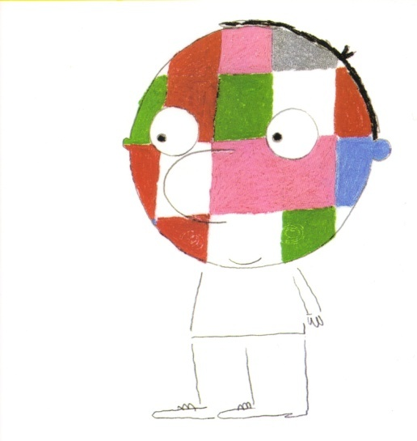
Teaching idea [7]
¡Hombre de Color!
un libro de Jérôme Ruillier

Slide 56

Yo, cuando tomo el sol, soy..
...negro.

Slide 57
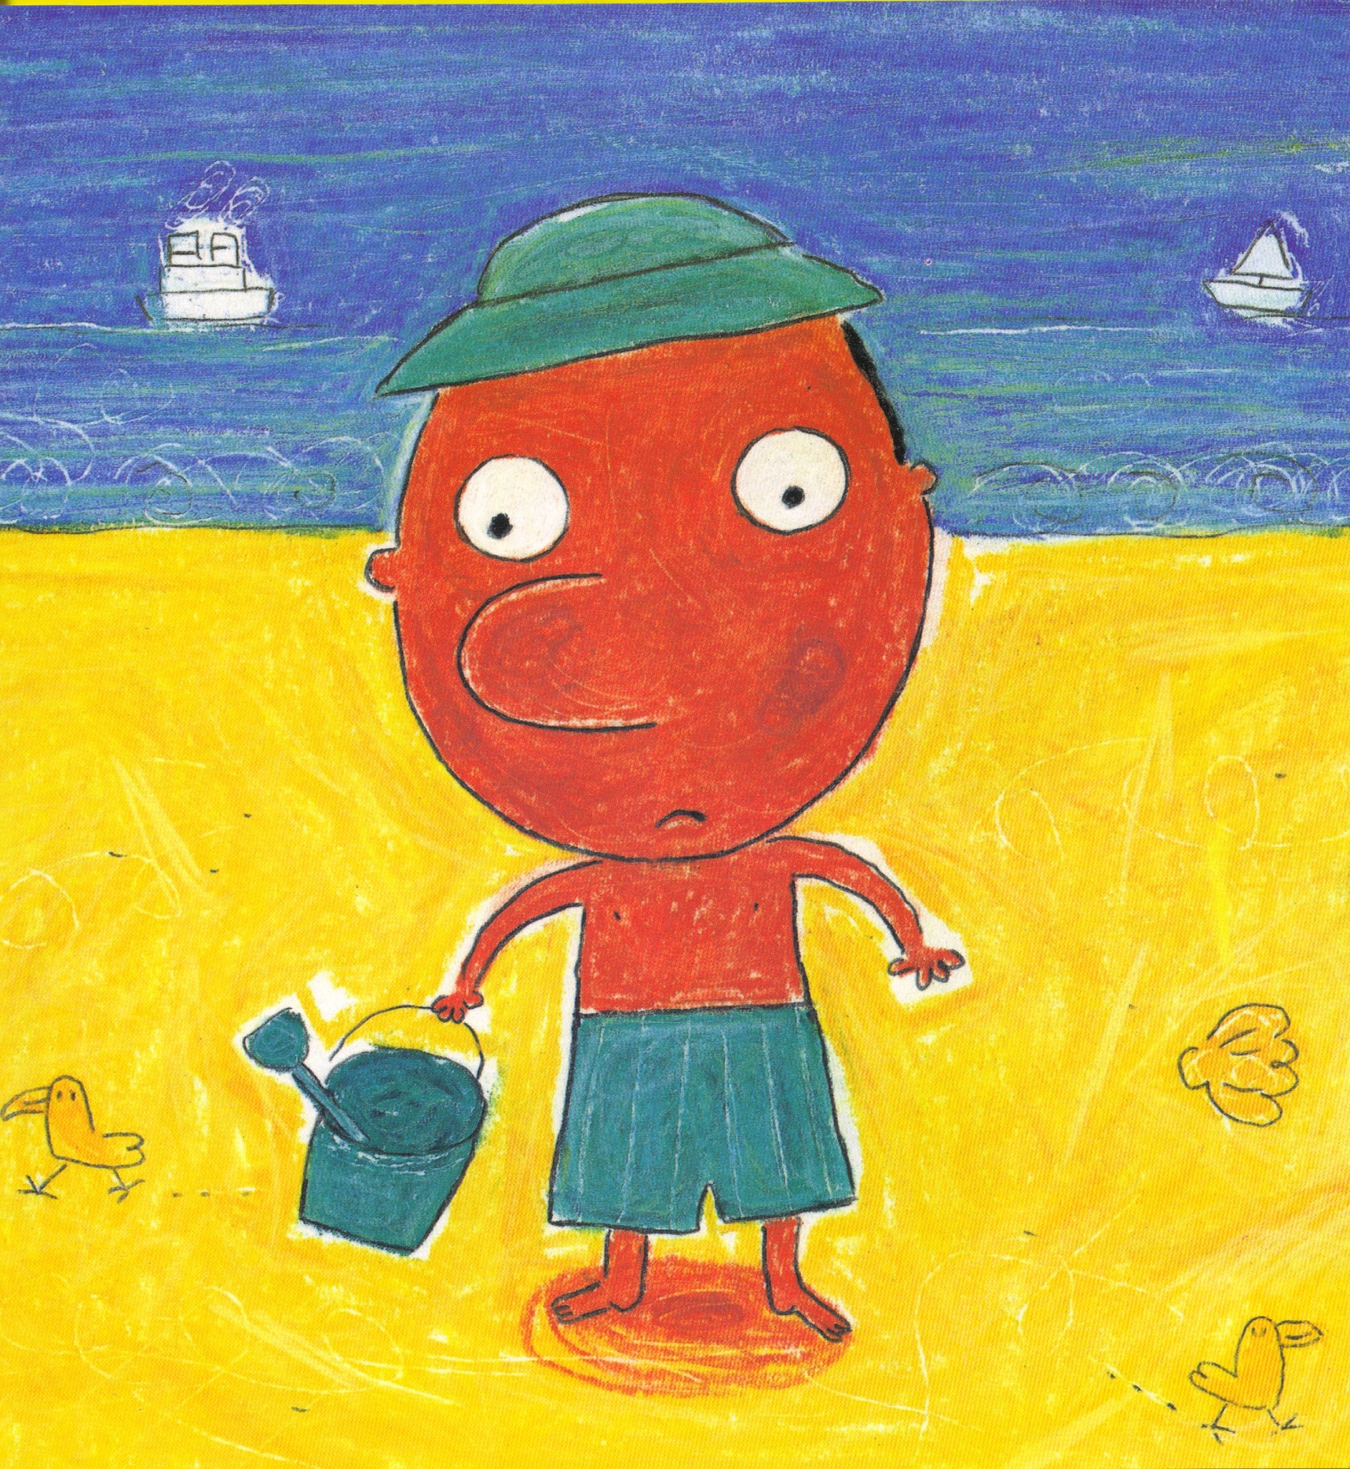
Tú, cuando tomas el sol, eres
...rojo.

Slide 58
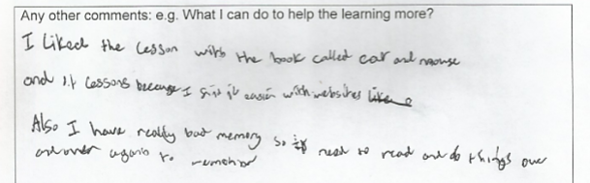
Student voice

Slide 59


Slide 60
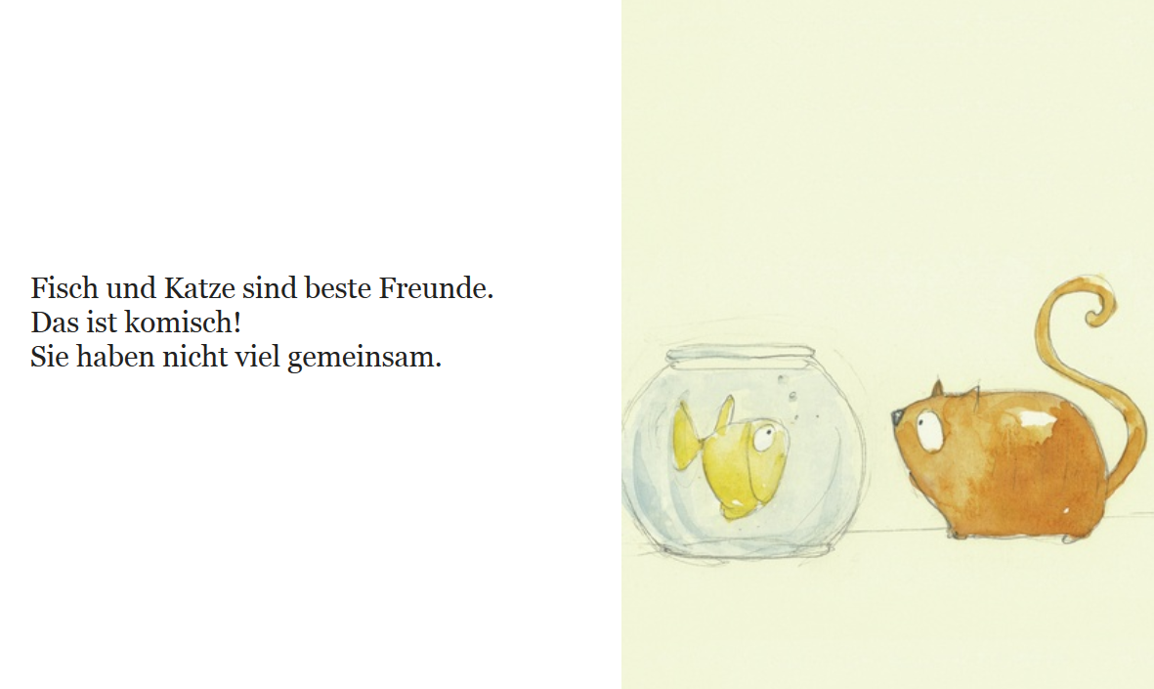

Slide 61


Slide 62
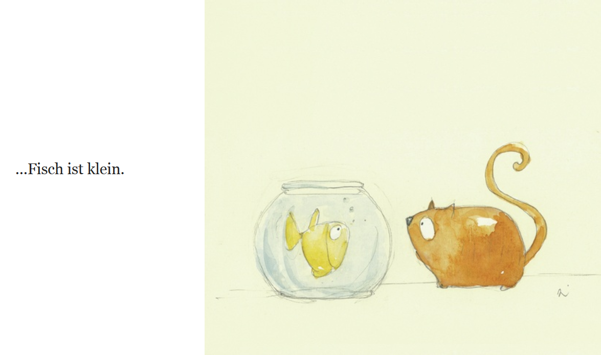

Slide 63


Slide 64
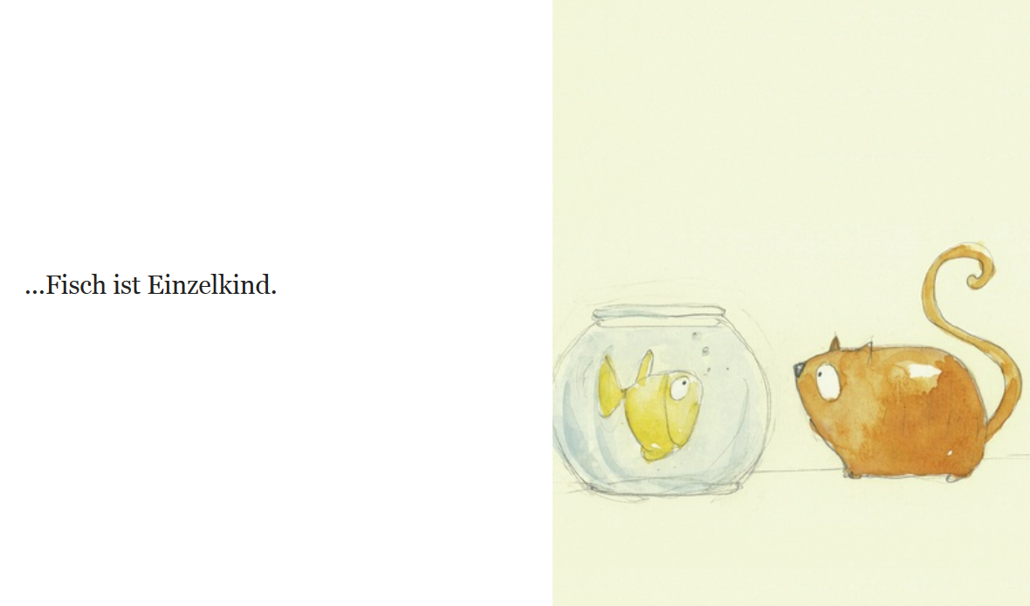

Slide 65


Slide 66


Slide 67
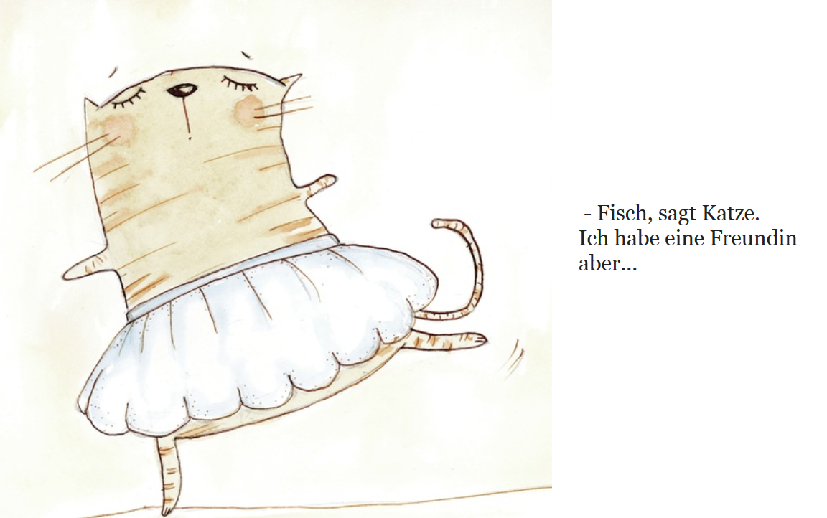

Slide 68
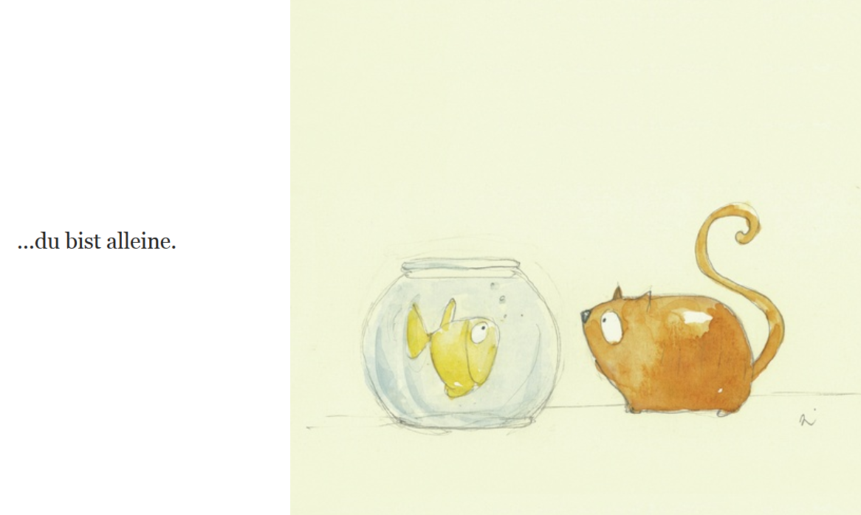

Slide 69
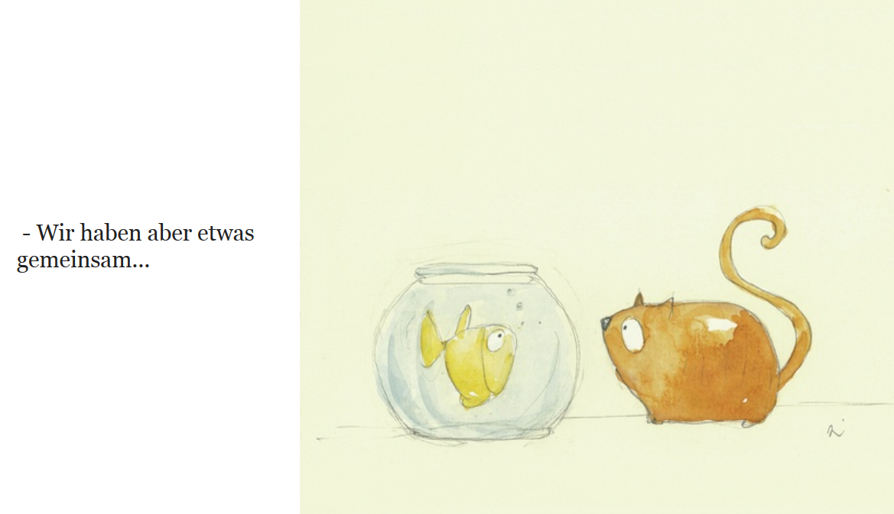

Slide 70
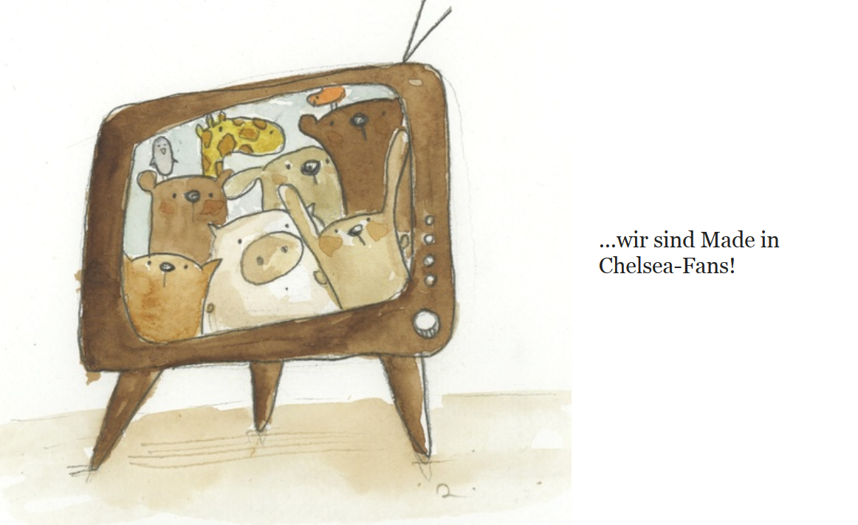

Slide 71
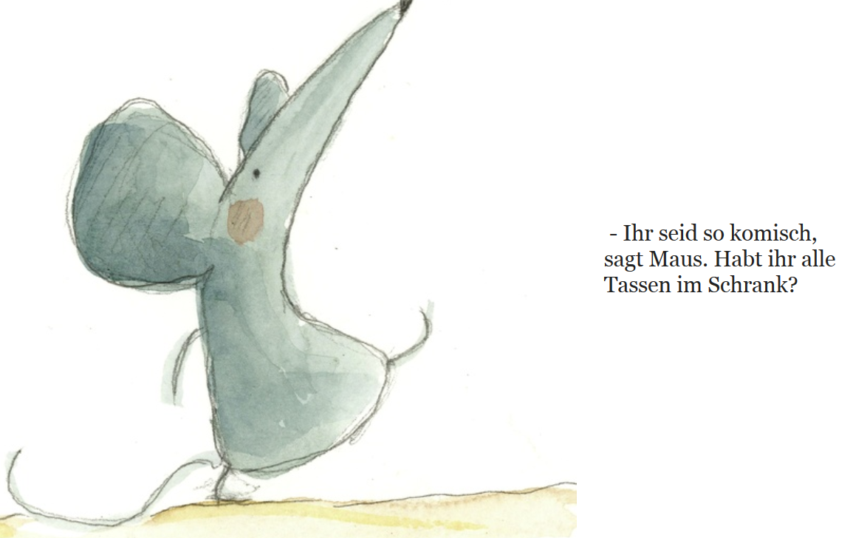

Slide 72
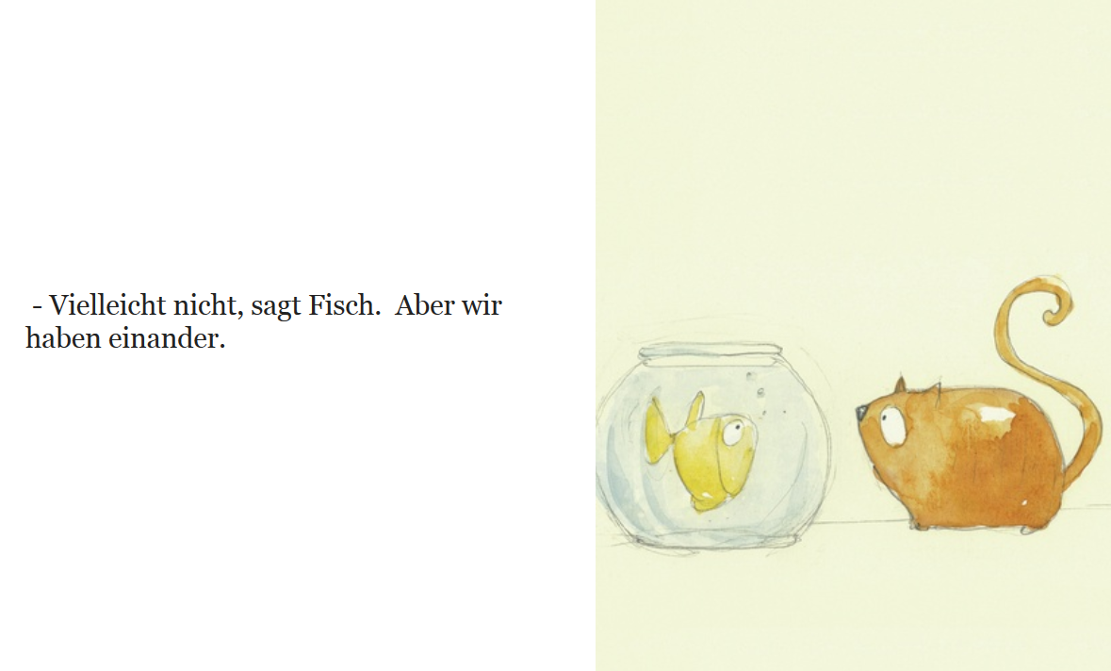

Slide 73
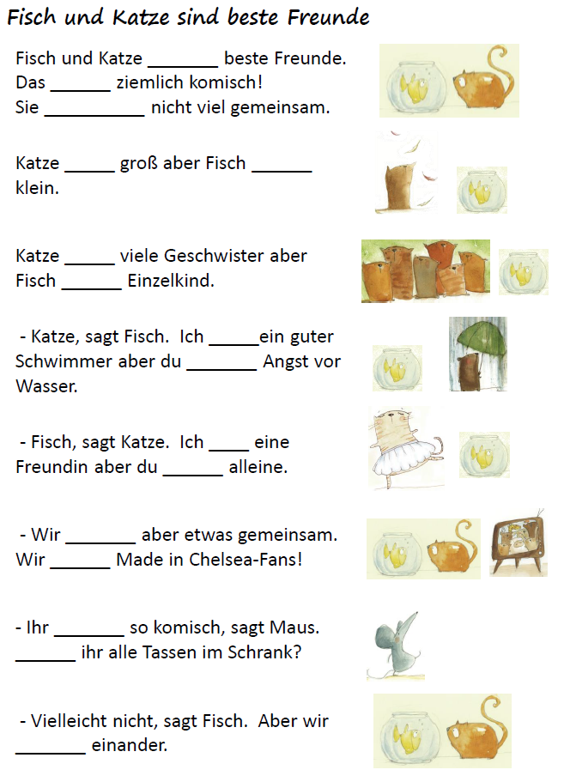
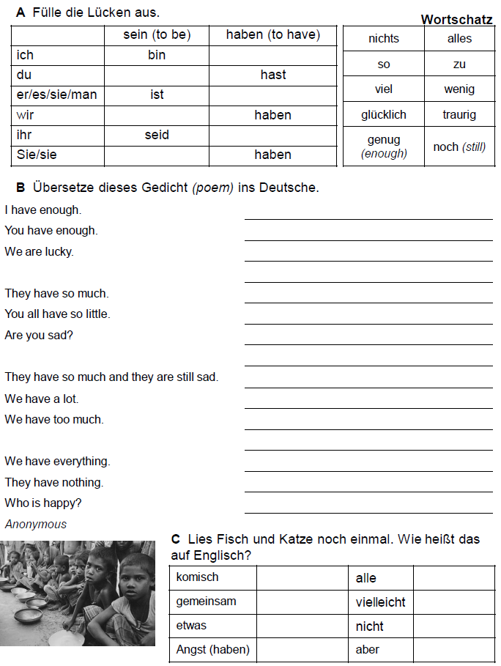

Slide 74

Teaching idea [8]
What are the two things a chicken does?
Notes:
An example of the Keyword idea

Slide 75
8 Test yourself…
the way you will be tested.
Advice to teachers: think carefully about the precise demands of the assessment, but with sufficient time to allow planning for the gradual accumulation of knowledge and skills.
AMERICAN EDUCATOR | WINTER 2008-2009 p.21 David Willingham
Notes:
Planning for the new GCSE, knowing that it will require students to have a better grasp of individual word and structure meaning, that they will need to manipulate language more independently to create meaning in response to unseen tasks, means that we need to work with current Y8 and Y7 now, requiring of them that they build sentences of increasing length and complexity, combining and re-combining high frequency words and structures from memory in writing. In speaking our classrooms need to be full of situations where students respond to questions they are not reading from the whiteboard, but only hear, and that we are constant recycling familiar question words and verbs in different contexts, refusing to allow ourselves to be confined by what is within the specific double-spread / unit / topic on the SOW, but remembering and recalling what they covered last term, last year, two years ago, to plan for a continual process of learning and over-learning. That’s our job, our responsibility. Our planning needs to be multi-perspective and long-distance – looking forward from Y7 to the GCSE in Y11, but also continually casting the net back to pick up language that they covered last month, last term, last year, two years, three years ago.
And so our KS3 teaching must include translation into FL and into English, working with authentic texts that challenge and extend skills, vocabulary and grammar knowledge.

Slide 76


Slide 77






1 Ich finde Deutsch einfach.
2 Ich finde Informatik langweilig.
3 Ich finde Mathe toll.
4 Ich finde Technik nützlich.
5 Ich finde Geschichte interessant.
6 Ich finde Naturwissenschaften schwierig.
7 Ich finde Englisch furchtbar.
8 Ich finde Sport nutzlos.
benutzen – to use
nützlich = useful
nutzlos = useless

Slide 78


1 Introducing an opinion
2 Agreeing
3 Disagreeing
4 Surprise
5 Uncertainty
6 Disinterest
Ja,das stimmt.
Also, ich denke…
Ich auch.
Also, ich denke, Mathe ist…
Also, ich denke, Naturwissenschaften sind…
Also, ich denke, Geschichte ist…
Also, ich denke, Sport ist toll.
Egal!
Das stimmt nicht.
Du spinnst!
Weiß nicht.
Was?!
Ja, echt?!
Was denkst du?

Slide 79
And finally…
Hail, MEMORY, hail! in thy exhaustless mine
From age to age unnumber'd treasures shine!
Thought and her shadowy brood thy call obey,
And Place and Time are subject to thy sway!
The Pleasures of Memory
Samuel Rogers (1792)
Notes:
A literary quote to finish, reminding us that the link between thought and memory is nothing new!
Having said that, I commend Daniel Willingham’s article (itself not new) to you – worth reading and digesting in full and letting the ideas seep into your planning.
1792 ENGLISH POETRY 1579-1830: SPENSER AND THE TRADITION
The Pleasures of Memory, a Poem. In two Parts. By the Author of An Ode to Superstition, with some other Poems.
Samuel Rogers
18th century poem

Slide 80
Memory and thought: why we can’t have one without the other
Rachel Hawkes
Language World 2015
Notes:
1 Memory and thought: why we can’t have one without the other
This session draws on key messages from cognitive psychology about how we create memories, how we retrieve stored information and how we can know what we know. We then look at how this applies to our practice as languages teachers. What can we do in our teaching that ensures that our learners remember language and can retrieve it successfully over time? This will be ever more relevant as we move from controlled assessments to terminal examination at GCSE.
Saturday 21 March 14.00 – 14.45

