Slide 1
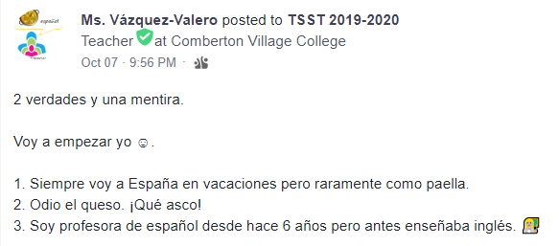
Creo que _________ es mentira / verdad porque …

Slide 2
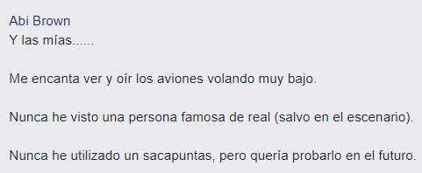
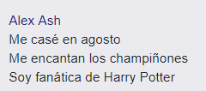
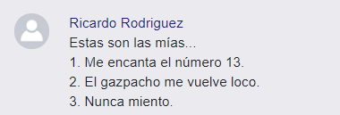
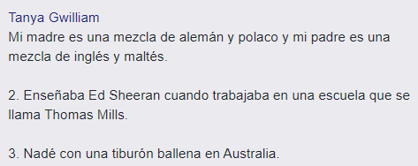
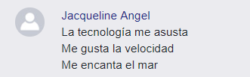
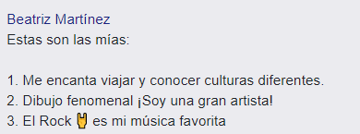
TSST Day 2: Planning and preparing high-quality Spanish lessons
+

Slide 3



Teacher Specialist Subject Training
Day 2: Planning and preparing high-quality Spanish lessons
Español
TSST

Slide 4
Wifi
Join the CATguest Wireless, then open a web browser.
When prompted to enter an email and PW, use:
username: guest@combertonvc.org
password: Giraffe1

Slide 5
Aims of TSST Day 2
Using the stages of knowing in language learning in our planning
Exploiting the 3Ps, particularly the productive phase
Considering a range of presentation methods
Integrating the skills in our planning to promote mastery

Slide 6

Timings | Group 1 [language] | Group 2 [pedagogy]
9.15-10.45 | Language | Methodology
10.45-11.00 | Break
11.00-12.15 | Language | Methodology
12.25-13.00 | lunch
1.05-2.00 | Y7 observations
2.00 – 2.45 | Lesson reflection and lesson planning reconstruction

Slide 7
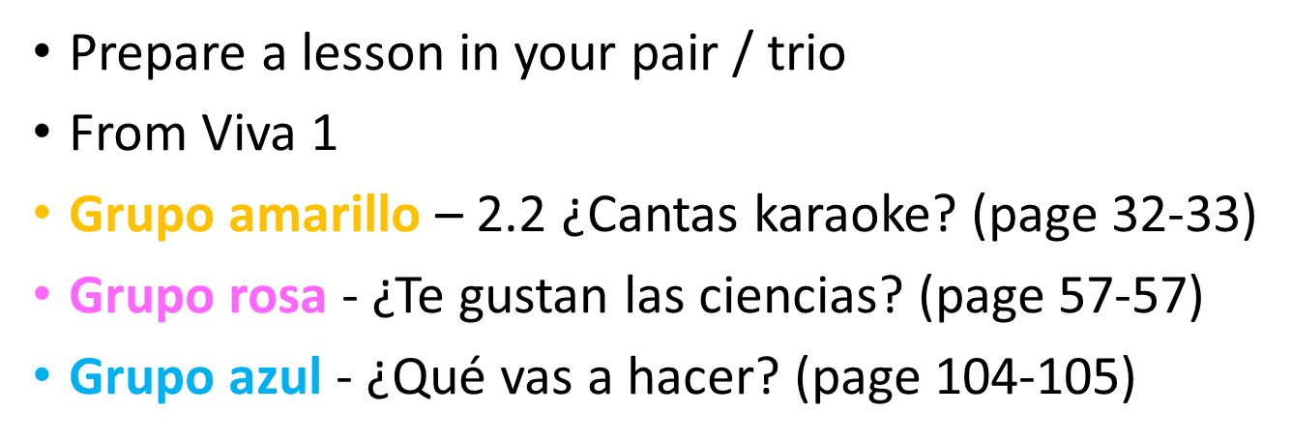

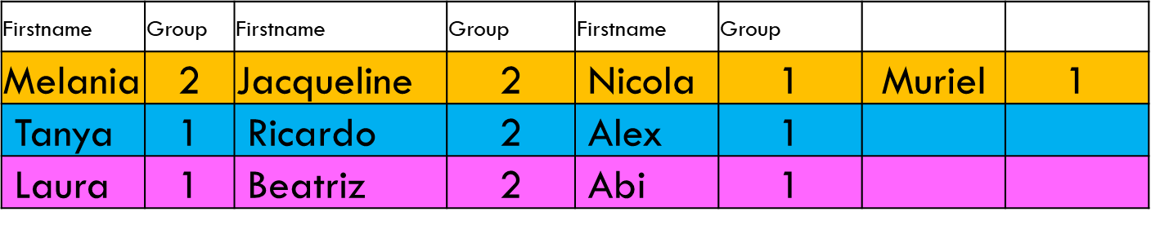
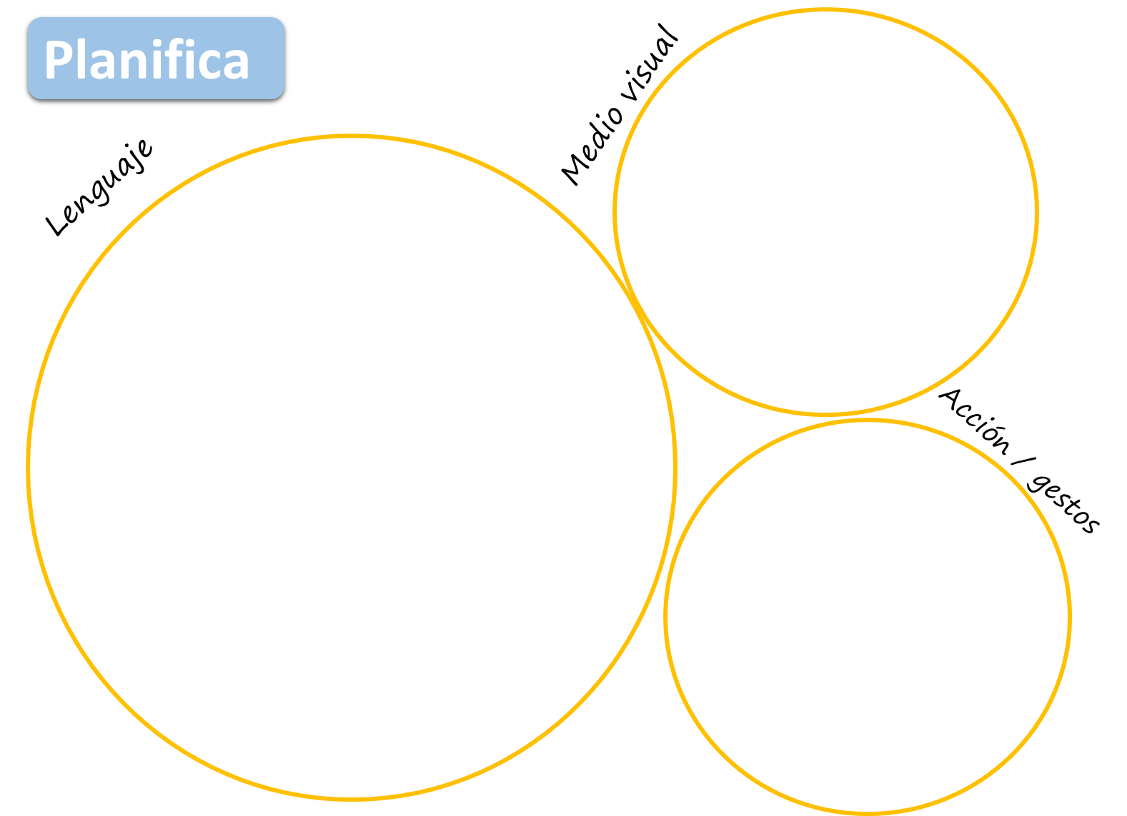

Slide 8

3 minutos
Alex & Tanya
Melania & Nicola
Beatriz
Ricardo
0
EMPEZAR
Jacqueline & Muriel
Abi & Laura
Notes:
https://pixabay.com/illustrations/pirate-ship-gold-treasure-pirate-3946618/

Slide 9

3 minutos
Abi & Laura
Melania & Nicola
Beatriz
Ricardo
Alex & Tanya
0
EMPEZAR
Jacqueline & Muriel
Notes:
https://pixabay.com/illustrations/pirate-ship-gold-treasure-pirate-3946618/

Slide 10
Observations / the afternoon
Timings | Group 1 [laguage] | Group 2 [pedagogy]
12.25-13.00 | lunch
1.05-2.00 | Y7 observations
2.00 – 2.45 | Lesson reflection and lesson planning reconstruction

Slide 11






Rock, paper, scissors
evolution!
Share one idea that you want to try in your teaching.
Rock paper scissors!
You lose – you stay the same. You win – you evolve!

Slide 12
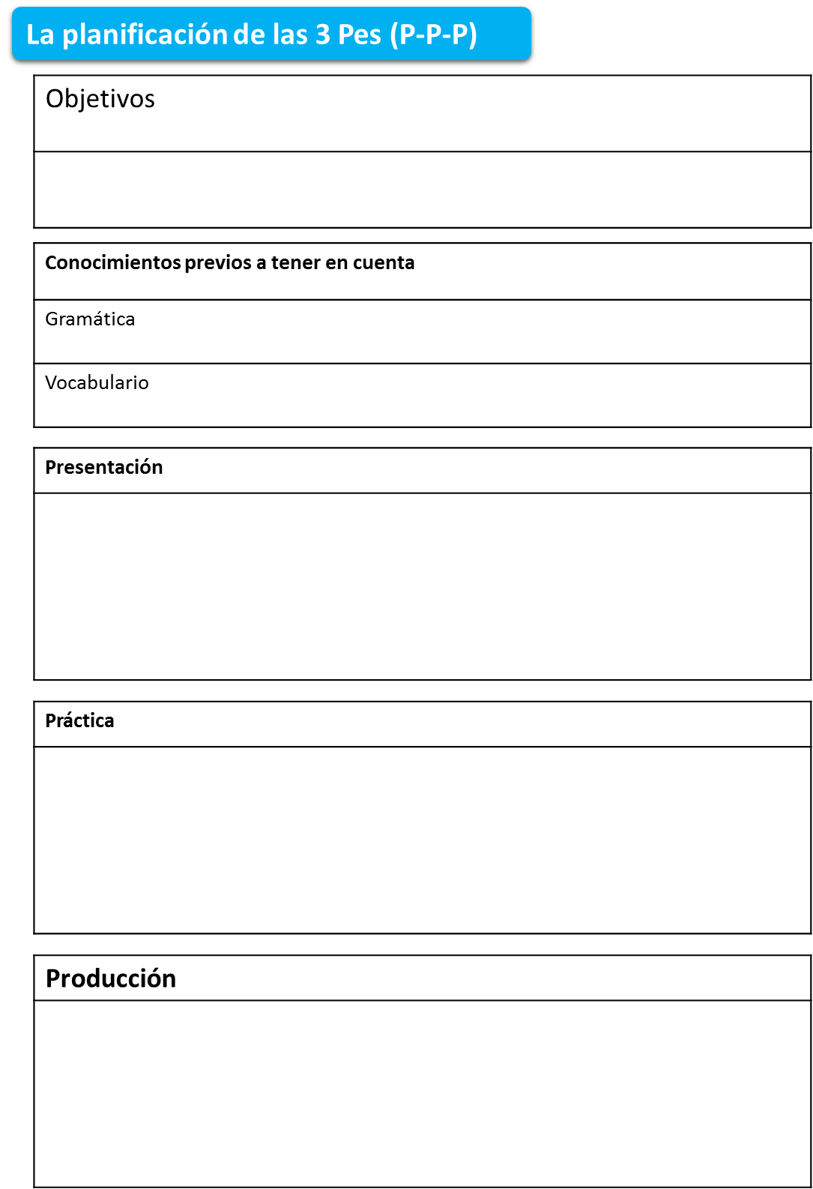
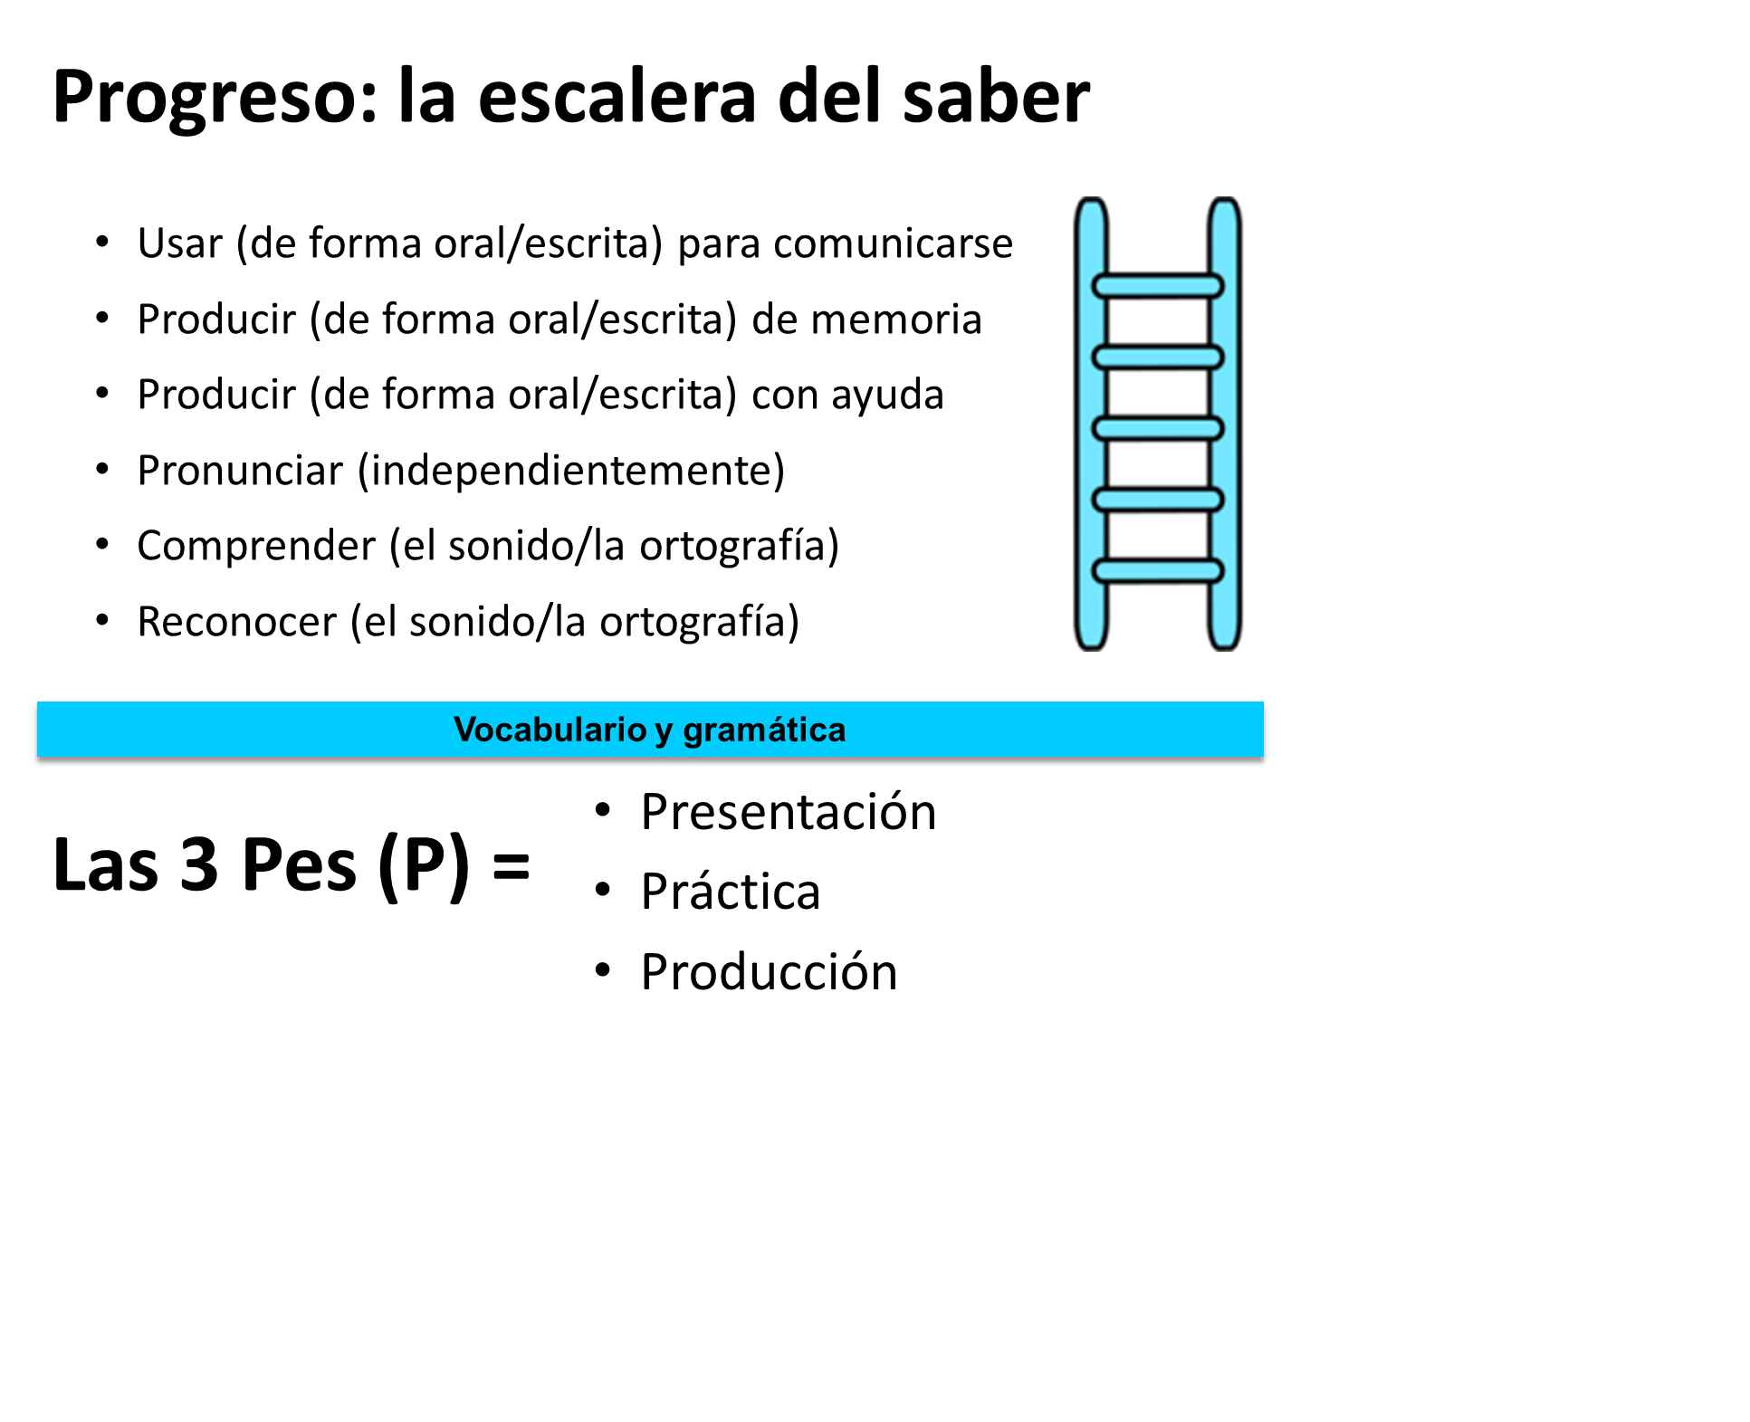
Notes:
teaching objectives and learning outcomes (both in terms of communicational objectives, and language objectives → think about previous knowledge demonstrated during the lesson (grammar / vocab).
Note down the learning activities that take place during the lesson and identify the key stages of language learning (PPP in the lesson)
How do the methods/activities carry out during the lesson contribute to meet those learning objectives?
Teacher’s language to describe activities (if possible, annotate key TL phrases for teacher and pupil use)
How does the teacher review the learning at the end of the lesson / each activity?

Slide 13
Room | Class | Teacher | Observers
ML8 (downstairs) | 7Y5 - Málaga (ability - set 5 of 5, age 11) | Agnieszka Barcz-Morgan | Melania Jacqueline Muriel
ML7 (downstairs) | 7Y4 - Santander (ability – set 1 of 2, age 14-15) | Paula Vázquez-Valero | Tanya Ricardo Alex Nicola
ML1 (upstairs) | 7Y2 - Granada (ability – set 2 of 5 age 11) | Adina Hategan | Beatriz Laura Abi

Slide 14
Notes:
teaching objectives and learning outcomes (both in terms of communicational objectives, and language objectives → think about previous knowledge demonstrated during the lesson (grammar / vocab).
Note down the learning activities that take place during the lesson and identify the key stages of language learning (PPP in the lesson)
How do the methods/activities carry out during the lesson contribute to meet those learning objectives?
Teacher’s language to describe activities (if possible, annotate key TL phrases for teacher and pupil use)
How does the teacher review the learning at the end of the lesson / each activity?

Slide 15
Pairs / Trios
First name | Group | First name | Group | First name | Group
Melania | 2 | Nicola | 1 | Abi | 1
Tanya | 1 | Ricardo | 2
Laura | 1 | Beatriz | 2 | Alex | 1
Jacqueline | 2 | Muriel | 1

Slide 16
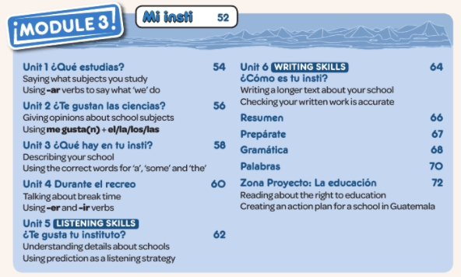

Viva 1 – Module 3
Work for next time
Pink groups – Unit 1 ¿Qué estudias?
Orange groups - Unit 3 ¿Qué hay en tu insti?
Blue groups – Unit 4 Durante el recreo
Planning to include 3 Ps, choosing from a range of presentation methods
Plan for a mixed ability class, and include thinking about differentiation

Slide 17
First name | Group | First name | Group | First name | Group
Melania | 2 | Nicola | 1 | Abi | 1
Tanya | 1 | Ricardo | 2
Laura | 1 | Beatriz | 2 | Alex | 1
Jacqueline | 2 | Muriel | 1
Group 2 delegates to explore Activelearn and set a variety of tasks / assignments for group 1 delegates in your pair/trio (Module 4 & 5).
Attempt the tasks yourself to get an idea of how long the tasks you have assigned will take them. Bear in mind they are “Y7 students”.
Choose a variety of listening / reading / grammar / vocab learning from Module 4 + 5. The idea is that they will invest 20-30 mins weekly on Activelearn between session 2 and session 3.

Slide 18

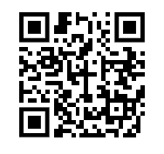
If you don’t have a Quizlet account, create one and play around with the study sets / lists of essential KS3 vocabulary that we have added to the TSST folder.
We will post the link to the folder on Edmodo.

Slide 19

Progreso: la escalera del saber
Usar (de forma oral/escrita) para comunicarse
Producir (de forma oral/escrita) de memoria
Producir (de forma oral/escrita) con ayuda
Pronunciar (independientemente)
Comprender (el sonido/la ortografía)
Reconocer (el sonido/la ortografía)
Vocabulario y gramática
Las 3 Pes (P) =
Presentación
Práctica
Producción
Notes:
Es importante considerar cuál es mi objetivo principal para saber que los alumnos han aprendido. Cuando los alumnos alcanzan el ultimo escalón de la escalera es cuando son capaces de usar el lenguaje de forma autónoma.
El contenido de currículo de español está compuesto tanto de gramática como de vocabulario. Aplica estos niveles de comprensión en la planificación tanto para el contenido grammatical como el de vocabulario, o para los dos.

Slide 20
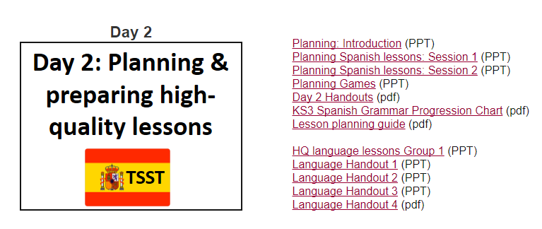
Course resources
http://www.rachelhawkes.com/PandT/TSST/TSST.php

