Slide 1
Teacher Specialist Subject Training
Day 1: Using the target language Session 1
Español
TSST
Notes:
Not every theory of language learning does this to same extent!
Qualify the theoretical position – different theories hold different places for interaction Krashen – Input hypothesis Long – Interaction hypothesis Swain – Output hypothesis Lantolf – SCT

Slide 2
Why is use of target language important?
It is implicated in every theory of language learning and many theories of language learning prioritise interaction as the primary site of learning (Long, 1985; Swain, 1995, 2000; Lantolf, 2000).
Students equate the ability to speak in the target language with learning the language (it is the subject to them).
Students believe that what they can produce in unrehearsed situations is what they really know.
(Spontaneous) target language use (or lack of it) has been highlighted in every Ofsted (English school inspection) report (since records began!).
It has a central place in our national curriculum and examination system.
Notes:
Handout 1: Why is use of target language important? 5 minute introduction
Not every theory of language learning does this to same extent!
Qualify the theoretical position – different theories hold different places for interaction Krashen – Input hypothesis Long – Interaction hypothesis Swain – Output hypothesis Lantolf – SCT
However, the balance of research evidence weighs heavily in favour of good, appropriate target language input being the essential component in language learning.

Slide 3
Why is it not happening?
Inspection findings 1993 - present
“Overall there is insufficient emphasis on helping students to use the language spontaneously for real situations. Consequently too few students could speak creatively, or beyond the topic they were studying, by making up their own sentences in an unrehearsed situation.” (OFSTED, 2008, p.12) “In many of the secondary schools visited, opportunities for students to listen to and communicate in the target language were often limited by many teachers’ unpreparedness to use it. Too often, students were not taught how to respond to everyday requests and thus routine work in the target language and opportunities to use it spontaneously were too few.” (OFSTED, 2011, p.6).

Slide 4
Benefits | Challenges | Solutions to challenges
engagement / confidence of students | effort to be consistent yourself as teacher
better pronunciation | difficulty if dept is not consistent in its approach
better for speaking assessments – more able to speak off the top of their heads | resistance from students if you don’t start early | start in Y7 or have gimmick / reward system if starting later
curiosity about language – ask more questions | lack of teacher expertise / confidence (2nd / 3rd language) | paradoxically teachers are often better in their 2nd / 3rd language as they think more carefully about which language to use
accelerated grammatical progress | tension with teaching grammar | lots of cognates are involved grammatical language can be taught as any other students can justify their thinking in TL about grammar if all / more of the talk is TL talk students gain listening skills at the same time doesn’t create a strange hierarchy (e.g. English needs to be used for grammar because grammar is important)
longer utterances when they speak
transfer into better written work
higher uptake
more integrated, joined up experience of learning
Notes:
Slide of benefits and challenges according to teachers in the video – to prompt further discussion

Slide 5
Why is there a low level of student TL talk?
low levels of teacher target language use (but high levels of teacher target language ≠ high levels of student target language use)
increased use of English tasks – ‘learning to learn’, ‘AfL’, ‘thinking skills’ – brought in with the KS3 National Strategy (DFEE, 2001)
tension (perceived or otherwise) between grammar teaching and target language use
tension between teaching and assessment, recognising that external examinations (in England!) reward memorisation over independent communication
teacher-fronted talk that militates against learner talk
preclusion of the third ‘P’ (production/use) in PPP through an over-emphasis on pre-communicative, drilling activities
(Hawkes, 2012)
Notes:
A detailed reading and analysis of the literature in the field of target language use in classrooms in England (Hawkes, 2012) suggests several reasons why students are not using the target language frequently or extensively enough.

Slide 6
How do we generate more (and better) talk in our classrooms?
increased pair/group work → task-based learning
re-examine and re-construe the rule of teacher talk
Notes:
The teacher role is not currently à la mode. The emphasis in recent times, both in terms of foreign language teaching and more broadly in education in England, has been away from the teacher and towards pair and group work. In language acquisition research, this is called task-based learning. Advocates of task-based language learning suggest that teacher-dominated classrooms cannot be fully interactive and that only pair and group tasks provide the level of interaction required for acquisition.
In addition, Indications from both SLA and classroom interaction literature which were considered more fully in early chapters of my thesis indicate that in teacher-led classrooms where IRE/F interactions are the norm, learner talk is minimal.
The main reasons for this preference for talk-based learning are clear. In pair and group work:
learners get more opportunity to talk, and
learners experience less anxiety when they speak.
However, there are two principal problems with this:
1) Learners who share the same mother tongue will ‘fall out’ of target language use when they encounter a communication difficulty, and work around it in English.
One of the ‘central dilemmas in encouraging spontaneous language use’ (Harris et al., 2001, p.97) is that ‘the very process of becoming genuinely interested in what they are talking about means that pupils may want to move beyond the language that has been so carefully identified, presented and practised’ (2001, p.97) and L1 is the result. The risk with learners relying solely on each other for support as they struggle to express meaning with their limited interlanguage is that the attempt breaks down and the interaction spills over into L1.
2) The second reason is that, in my view and the findings in my research to date, show that the teacher is uniquely placed to create certain interactions with students that cannot be replicated in pair and group work.
So, whilst there are compelling reasons to introduce peer and group tasks to give more opportunities for learners to engage in authentic L2 interaction, there are also persuasive arguments to consider the role that teacher-learner interaction might play in the generation of higher levels of spontaneous L2 use.

Slide 7
Teacher TL use
Student to student use
Student to teacher use
Notes:
It can be helpful as teachers or heads of department, when thinking about target language use to consider 3 x aspects of classroom TL interaction. Every teacher is different, every class / student is different and we are all at different places with respect to our own practice, that of our students and that of departments as a whole. Considering these aspects separately often helps us to pinpoint the areas for development that we have.
In the rest of this section we will look at examples of Teacher TL use and Student to teacher use. In session 2, we will look at specific tasks and strategies for students to talk to each other.

Slide 8
Teacher talk – the 5Cs
Consistent
Clear / concise
Communicative
Checks understanding
Creative
Notes:
Handout 3: SOTB Classroom Talk
1. Consistent Absolutely vital. If you use the TL one day and not the next, you erode its effectiveness. If you use the TL and then translate yourself, you reduce its effectiveness. Consistency in TL use by the teacher involves planning, even scripting, and certainly thinking through each task / each explanation / each feedback and anticipating the language that you can use to communicate the meaning effectively to learners without resorting to English. If, at the planning stage, you realise that the message you need to give is vital but that you cannot conceive of how to do it in TL (or that doing it would take 20 minutes instead of 1) then you are justifying the use of English for that explanation / message. This is not the same for each teacher and it should be something we can all make progress in, such that we grow our use of TL and get more able to use it for a greater range of teaching activities. One teacher in my department, who has been working on this hard for 6 years, is currently challenging herself to 100% TL with a beginner Y8 German class. I observed and videoed several lessons at the start of the year and I’ve only seen her use English once for the word ‘exception’ which came up unexpectedly and she couldn’t immediately think how to convey its meaning clearly in the TL. 2. Clear / concise Using the TL makes us consider v carefully the words we use to explain things and the bring in additional non-verbal support mechanisms too, such as visuals, mimes, props, gestures. At the very beginning we will need to be very concise indeed. And the words that we do need to teach as TL in the course of our explanations will be incredibly useful language and should be flagged up in the lesson. One method for this that works effectively is to arrive at a class understanding of the word through teacher TL explanation, example, miming etc.. and then to ask a class member to provide the English meaning orally. The teacher only writes down the German and the students write down both (but still having to think rather than just copy down the English). On the next slide I have an example of the words that have come up in this way over the first half-term of German lessons (2 x lessons per week). 3. Checks understanding
Of course we all use expressions to check understanding in our classrooms. But sometimes we don’t perhaps put enough emphasis on the expectation for a reply! I’ve often heard ‘Alles klar?’ by the teacher or ‘Entendéis?’ said almost as a rhetorical utterance. When there is barely a murmur in response, the teacher has not followed this up. if we think of the purpose of saying ‘ Is that clear?’ it seems really important that we accompany it with an expectation that students will either say confidently ‘Ja’ or will have questions because they are not clear about it. We have a couple of legendary stories in our department about this. In one class of lower ability learners one Y11 student, who had had the same teacher throughout Y10 too, and was used to his teacher saying to the class ‘Entendéis?’ suddenly asked her at Easter of Y11 – Miss, what is this about 10 days? What is going to happen in 10 days? You’ve been saying that since the start of Y10! So it’s a salient lesson that we need to ensure that we check understanding, of crucial terms and also of our teacher talk, especially key terms that we are going to repeat and repeat. Having said that, checking understanding also involves seeing how students respond. If they do what we ask readily, if the work produced matches expectations, then we can also be confident that they have understood. 4. Creative With the still limited language of our learners, teachers have to be creative about TL use. We will need to use cognates at the start (but also withdraw them as soon as we can if there is a better TL word) – I can think particularly of Moglichkeit in German rather than Possibilitat. If we first teach Possibilitat and then we introduce them to Moglichkeit we can then stop using possibilitat fairly soon. To get meanings across we will also need our ingenuity. Getting into the habit of using examples to get meanings across is invaluable, especially if they involve the immediate setting of the classroom. Referring to things that are too far removed from the classroom can lose beginner students. I watched a teacher come up with a very good way to tell her learners in lesson one that she wanted to know their preferred names, not just their register names, by using a member of the class who she imagined would prefer Kate rather than Kathryn. In this, as in other aspects of teacher talk, we can grow our ability. 5. Communicative Keeping it real. This doesn’t necessarily mean having a conversation with learners that is ‘off-topic’ although it can be nice to do this occasionally. It means responding to unplanned talk or learner questions in terms of the message rather than slipping into accuracy mode and correcting every utterance. This is very much about clarity of purpose for each activity. If you are practising pronunciation in a given task, then correct pronunciation errors. If you are practising producing correct forms e.g. perfect tense, then correct errors. But in every lesson there must be a decent chunk of time allocated to communicating through the TL. In these sorts of activities, where communication of the message is dominant, correction of errors is an unhelpful addition, because it blurs the purpose and demotivates the learner who is actually trying to really tell you about his/her pet. That doesn’t mean that as the teacher you don’t recognise that when Jimmy is talking he still hasn’t got the idea of where to put the adjective in French when he speaks spontaneously, but that doesn’t mean he wouldn’t know if he had time to plan to write or plan to speak. What we can do accurately in an unplanned situation is different to what we can do when we have time to reflect. And research is unclear at best about what a learner can take from explicit accuracy feedback while they’re in the act of talking. So if you notice in spontaneous speaking that there are fundamental errors, make a note that some more practice activities are needed down the line, but don’t stop him mid-flow. Only signal problems if they are genuine communication problems – i.e. you don’t know what he means. Then ask follow up questions to try to get to the meaning. Smile as you do this and encourage further communication. Offer alternatives to see if you can arrive at what he wanted to say.

Slide 9
What can we use the target language for?
Greetings
Setting lesson objectives
Classroom instructions / routines
Task explanations
Teaching and talking about grammar
Asking (and answering) questions
Spontaneous interactions
Evaluating / Plenary tasks
Introducing humour / jokes
Setting homework

Slide 10
What can students use the target language for?
Greetings
Classroom routines
Talking about grammar
Asking (and answering) questions
Spontaneous interactions
Practice / drills
Pair / group conversations
Playing games
Making jokes / introducing humour
Leading / Being the teacher
Give peer feedback / assessment (WWW / EBI)

Slide 11
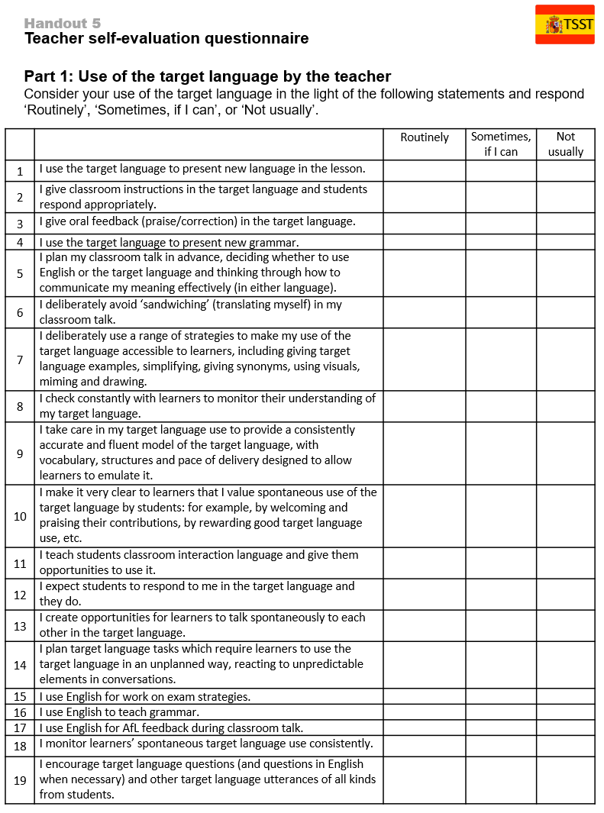
Teacher self-evaluation questionnaire
Notes:
Handout 5

