Slide 1
Day 3: Teaching Spanish grammar
Extract taken from:
MODERN FOREIGN LANGUAGES PEDAGOGY REVIEW
A review of modern foreign languages teaching practice in key stage 3 and key stage 4 Review report written by Ian Bauckham for the Teaching Schools Council, November 2016. http://tscouncil.org.uk/wp-content/uploads/2016/11/MFL-Pedagogy-Review-Report-2.pdf
Grammar teaching and sequencing
5.1 We use the grammar of a language to say what we wish or need to say, whether orally or in writing, and to understand what is said to us. Grammar is, therefore, indispensable for communication in the new language. During our investigations, we have seen courses which do not include well planned grammatical progression at their core. In such cases, this could lead to pupils being confused and ultimately demotivated, and also inadequately prepared for progressing to study at a higher level, for example A Level. Teachers need to give careful consideration to the grammar that is taught at each stage, and to how each topic is introduced, explained and practised.
5.2 Grammatical knowledge of a language is cumulative. Sometimes, course books often overlook this and do not build knowledge consistently or cumulatively. In these cases pupils are simply confused because they are taught disjointed segments of grammar at different points and are not given the chance to build and consolidate a larger grammatical system.
5.3 We recommend that standard grammatical terminology is taught to pupils. This has sometimes been eschewed by teachers in recent decades, but we see no reason to do so. Giving pupils clear knowledge of accepted terminology is empowering and facilitates application of concepts associated with that terminology in different contexts, including in future language learning.
5.4 There is significant evidence that points to the effectiveness of a combination of approaches which is summarised as follows:
An explicit but succinct description of the grammatical feature to be taught, its use/meaning/function, and where appropriate a comparison with English usage (eg when the new language differs in complex ways to English) is conducive to correctly and efficiently understanding the function and meaning of grammar. There is evidence that waiting for pupils to identify grammatical patterns, without prompting them to do so, is not usually conducive to effective learning, particularly for complex or unfamiliar structures. Short descriptions of grammatical features and their function can be helpful if preceding practice, but such descriptions can also emerge out of grammar awareness-raising activities, such as being asked to notice a specific form and its function in the input. The latter (awareness-raising) seems most likely to be effective where the grammar and/or concepts being expressed are simple or familiar.

Slide 2
Practice of the grammar point in ‘input language’ (listening and reading), doing structured tasks which require identification of a grammatical feature and linking it to a meaning or function, normally with other contextual clues stripped away. For example, distinguishing between different tense forms with no adverbs of time to offer clues; or distinguishing between different persons of verbs without the pronoun to assist. This aspect of grammar practice is very underdeveloped in many contexts, and not well supported by many course books. Too often, teaching jumps from a formal explanation straight to a demand to use the grammar productively. This can lead to poor mastery.
Practice in productive use of the features being taught, initially in carefully structured or supported contexts. The scaffolding effectively relieves pressure on the working memory by allowing it to focus on the one new grammatical feature which has not yet been automatised into the long term memory. This is usually achieved by limiting the choice of forms, or supplying part of the structure or sentence so the pupil can focus on getting the new grammatical feature correct. As automatisation increases (so as the language is transferred to the long term memory), the scaffolding can be incrementally removed.
Productive use in free writing and speech in a range of contexts will be most likely to be successful if it has been accompanied by ample more structured practice as outlined above. Teachers should be aware that in spontaneous production, particularly in speech, where there is less time for active thinking and the pressure on the working memory is therefore greatest, there is still likely to be a level of error. We discuss how this should be handled in the section on error.
5.5 French, German and Spanish are the most commonly taught foreign languages in English schools. In these languages, agreements on verbs and on other parts of speech such as pronouns, articles and adjectives, convey important meanings which express tense, person, number, gender, case, and aspect. These constitute a large part of grammatical systems. They need to be taught directly, because they
a) are not naturally salient to pupils (eg small sounds at the end or start of words)
b) do not have direct links to English (eg ‘je mange’ is both ‘I eat’ and ‘I am eating’)
c) do not have unique meanings (eg the sounds /a/ and /e/ in French have multiple grammatical functions eg ‘mangé’ and ‘manger’ which sound identical)
d) have complex or subtle relations with the surrounding discourse (eg in Spanish a subject pronoun is not used if who you are talking about is already obvious from the language that came before but is used if the speaker wants to introduce or emphasise a particular person).
5.6 By the end of the first year pupils should have good knowledge of one or two tense systems, a good range of agreements, and how to form negatives using the verbs they know. By the end of the second year of learning pupils should have extended their knowledge of agreement systems, and be able to use two or three tense systems in regular and the most common irregular forms. Confidence and accuracy of use should be expected in contexts where pupils can use the knowledge they have gained.

Slide 3
3.3 Grammar
The grammar requirements for GCSE are set out in two tiers: Foundation Tier and Higher Tier.
GCSE students will be expected to have acquired knowledge and understanding of Spanish grammar during their course. In the exam they will be required to apply their knowledge and understanding, appropriate to the relevant tier of entry, drawing from the following lists. The examples in brackets are indicative, not exclusive. For structures marked (R), only receptive knowledge is required. Students will be expected to develop and use their knowledge and understanding of this grammar progressively throughout their course.
3.3.1 Foundation Tier
3.3.1.1 Nouns
gender
singular and plural forms
3.3.1.2 Articles
definite and indefinite
lo plus adjective (R)
3.3.1.3 Adjectives
agreement
position
comparative and superlative: regular and mayor, menor, mejor, peor
demonstrative (este, ese, aquel)
indefinite (cada, otro, todo, mismo, alguno)
possessive, short form (mi)
possessive, long form (mío) (R)
interrogative (cuánto, qué)
3.3.1.4 Adverbs
formation
comparative and superlative: regular
interrogative (cómo, cuándo, dónde)
adverbs of time and place (aquí, allí, ahora, ya)
common adverbial phrases
3.3.1.5 Quantifiers/intensifiers
(muy, bastante, demasiado, poco, mucho) 3.3.1.6 Pronouns
subject
object (R)
position and order of object pronouns (R)
reflexive
relative: que

Slide 4
3.3.1.6 Pronouns continued…
relative: quien, lo que (R)
disjunctive (conmigo, para mí)
demonstrative (éste, ése, aquél, esto, eso, aquello)
indefinite (algo, alguien)
interrogative (cuál, qué, quién)
3.3.1.7 Verbs
regular and irregular verbs, including reflexive verbs
all persons of the verb, singular and plural
modes of address: tú and usted
radical-changing verbs
negative forms
interrogative forms
reflexive constructions (se puede, se necesita, se habla)
uses of ser and estar
Tenses:
• present indicative
• present continuous
• preterite
• imperfect: in weather expressions with estar, hacer
• imperfect (R)
• immediate future
• future (R)
• perfect: most common verbs only
• conditional: gustar only in set phrases
• pluperfect (R)
• gerund (R)
• imperative: common forms including negative
• subjunctive, present (R) in certain exclamatory phrases (¡Viva! ¡Dígame!)
• subjunctive, imperfect: quisiera
• impersonal verbs: most common only.
3.3.1.8 Prepositions
common, including personal a
por and para
3.3.1.9 Conjunctions
common, including y, pero, o, porque, como, cuando
3.3.1.10 Number, quantity, dates
3.3.1.11 Time
Use of desde hace with present tense (R)

Slide 5
3.3.2 Higher Tier
Students entering for Higher Tier assessments will be required to apply all grammar and structures listed for Foundation Tier, in addition to the new grammar and structures listed for Higher Tier.
3.3.2.1 Articles
lo plus adjective
3.3.2.2 Adjectives
comparative and superlative
possessive, short and long forms (mi, mío)
relative (cuyo)
3.3.2.3 Adverbs
comparative and superlative
3.3.2.4 Pronouns
object
position and order of object pronouns
relative: all other uses including quien, lo que, el que, cual
possessive (el mío, la mía)
3.3.2.5 Verbs
Tenses:
• future
• imperfect
• imperfect continuous
• perfect
• pluperfect
• conditional
• passive voice (R)
• gerund
• present subjunctive: imperative, affirmation and negation, future after conjunctions of time (cuando),
after verbs of wishing, command, request, emotion, to express purpose (para que)
• imperfect subjunctive (R).
3.3.2.6 Time
• use of desde hace with present tense
• use of desde hace with imperfect tense (R).

Slide 6
Day 3: Teaching Spanish grammar
Online resources
 | SER y ESTAR
1 | http://zachary-jones.com/zambombazo/infografia-usos-de-los-verbos-ser-y-estar/
2 | http://zachary-jones.com/zambombazo/billetes-los-perezosos-de-zootopia/ http://zachary-jones.com/zambombazo/documents/2016/los_perezosos_de_zootopia_zootropolis_billetes.pdf https://www.youtube.com/watch?v=IrHH8SfLe18
3 | https://prezi.com/czpxavvlctls/ser-vs-estar/
4 | https://es-tema.de/describir-personas
5 | https://www.youtube.com/watch?v=PEIKa88nQDg&feature=youtu.be ESTAR song
6 | https://www.youtube.com/watch?v=m2UWFQD1SB8 Excellent animated video explanation of the different uses of SER / ESTAR in Spanish.
7 | https://www.youtube.com/watch?v=PfhOssJx6FQ STOP the ELF – alternative acconym for SER / ESTAR (2 minute video in English)
8 | https://www.youtube.com/watch?v=C0NtdD5NcNw Jesse y Joy – song – SER o ESTAR
9
10
11
12
13
14
15

Slide 7
 | SER | ESTAR
I am
you are (singular/familiar)
s/he is (you are – singular/formal)
we are
you are (plural/familiar)
they are (you are – plural/formal)

Slide 8
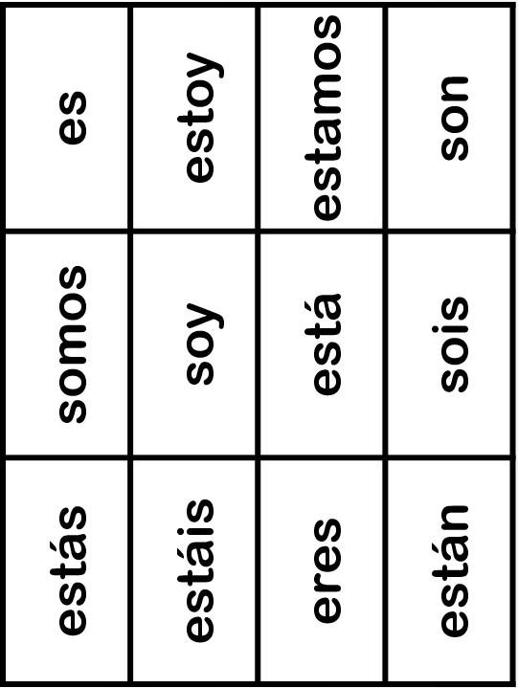

Slide 9
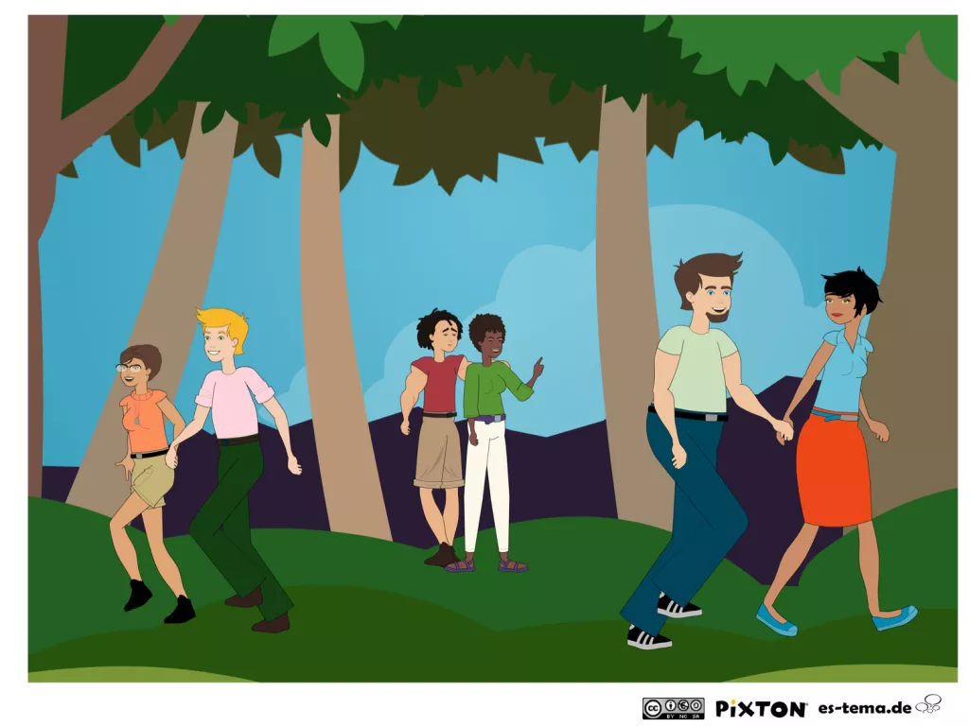
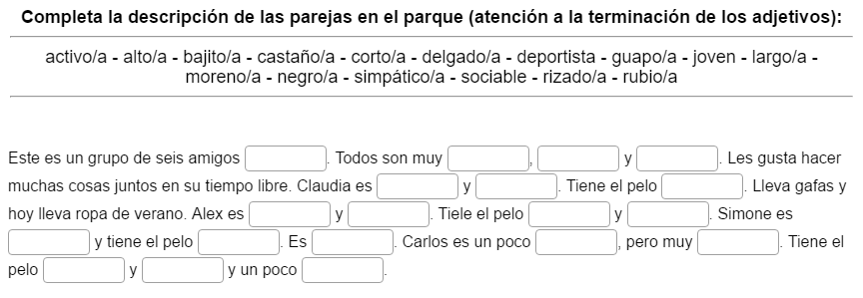
En el parque

Slide 10
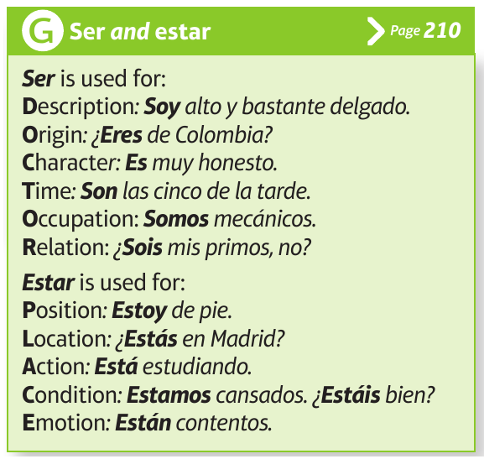
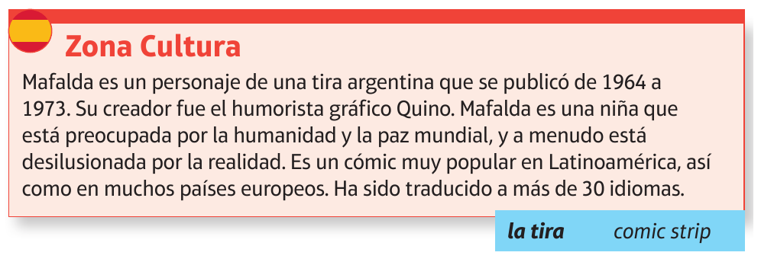
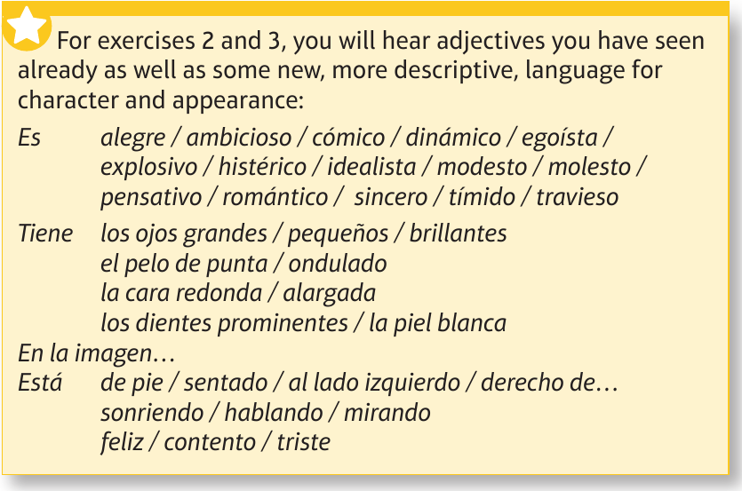
Mafalda
1
2
3
1
2
3

Slide 11
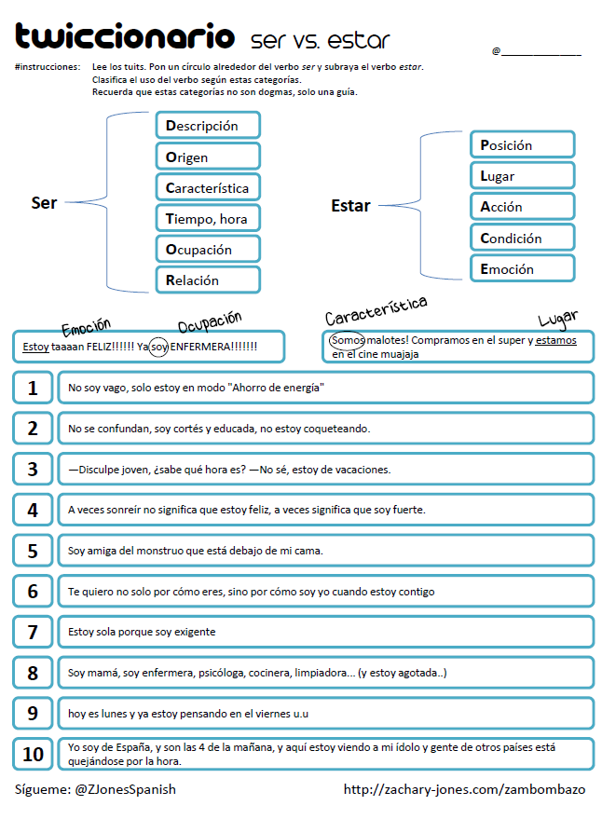

Slide 12
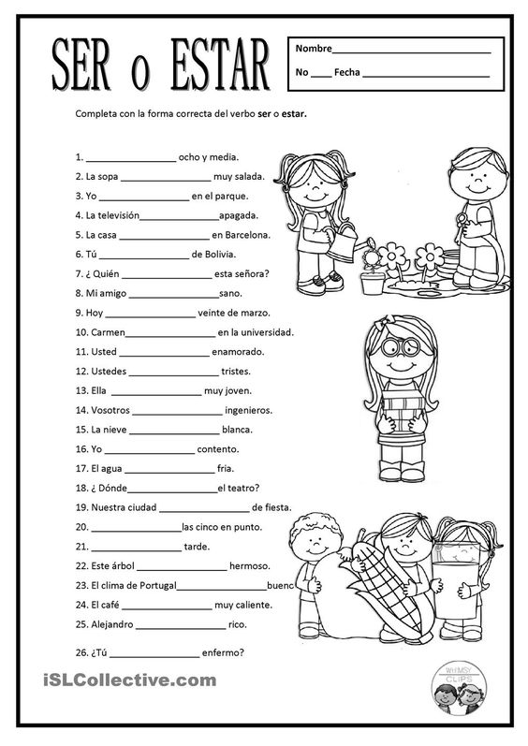

Slide 13
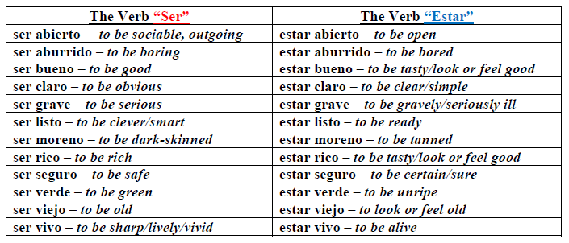
Adjetivos con SER y ESTAR

Slide 14
Day 3: Teaching Spanish grammar
Online resources
 | Los verbos reflexivos
1 | http://me-encanta-escribir.blogspot.co.uk/search/label/verbos%20reflexivos Loads of useful material for the classroom
2 | https://www.youtube.com/watch?v=D-GKEDDDUuI Short video with daily routine of a dancer – very useful
3 | https://www.youtube.com/watch?v=7SZbWj-glSI (start from 3min30s)
4 | https://www.youtube.com/watch?v=biVUd58echg video with 3rd person video reflexive forms (differentiating between reflexive and non-reflexive forms of the same verbs).
5 | http://www.aprenderespanol.org/verbos/reflexivos-reciprocos-impersonales-pronominales.html Online exercises
6 | https://espanol.lingolia.com/es/gramatica/verbos/verbos-reflexivos/ejercicios More online exercises
7 | http://www.ux1.eiu.edu/~cfcca/1reflexive1.html Tasks are not interactive but answers are provided
8 | https://ejerciciosdeele.wordpress.com/ Excellent site for Spanish teachers with explanations and links to exercises and videos for pupils.
9 | https://uk.pinterest.com/jlparrott70/verbos-reflexivos/ An amazing Pinterest board with a 1000 reflexive verbs links!
10 | http://palmyraspanish1.blogspot.co.uk/2013/02/teaching-reflexive-verbs.html Really useful blog entry about teaching reflexive verbs – lots of ideas in here.
11 | https://mfl-storybirds.wikispaces.com/Spanish+Storybirds
12 | http://www.slideshare.net/kcolby/froggy-se-viste (preterite reflexives)
13 | http://www.slideshare.net/ssumod/reflexive-verbs-in-spanish (flipped learning?)
14
15

Slide 15
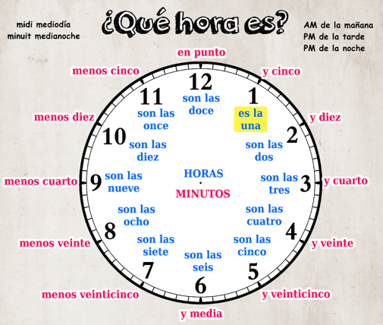
1. Completa los verbs reflexivos.
2. Escribe las frases en el orden correcto.
despierto siete. las Me a
me Normalmente enseguida. levanto
me y fruta Desayuno ducho.
las me a visto siete media. y Luego
a lavo las Me dientes los ocho.
acuesto las Finalmente me diez. a
1
2
3
4
5
6
¿A qué hora (te levantas)? At what time (do you get up)? (Me levanto) a las siete y media. (I get up) at 7.30.
3. ¿Cuáles son las preguntas?
1
2
3
4
5
6
7

Slide 16
4. La rutina diaria de un bailarín Mira el video y contesta a las preguntas en español.
 | Preguntas | Respuestas
1 | ¿Cómo se llama?
2 | ¿Cuántos años tiene?
3 | ¿En qué trabaja?
4 | ¿A qué hora se levanta?
5 | ¿Qué hace por las mañanas?
6 | ¿A qué hora come / almuerza?
7 | ¿Con quién?
8 | ¿Qué hace después de comer?
9 | ¿Qué hace por las tardes?
10 | ¿A qué hora se acuesta?

Slide 17
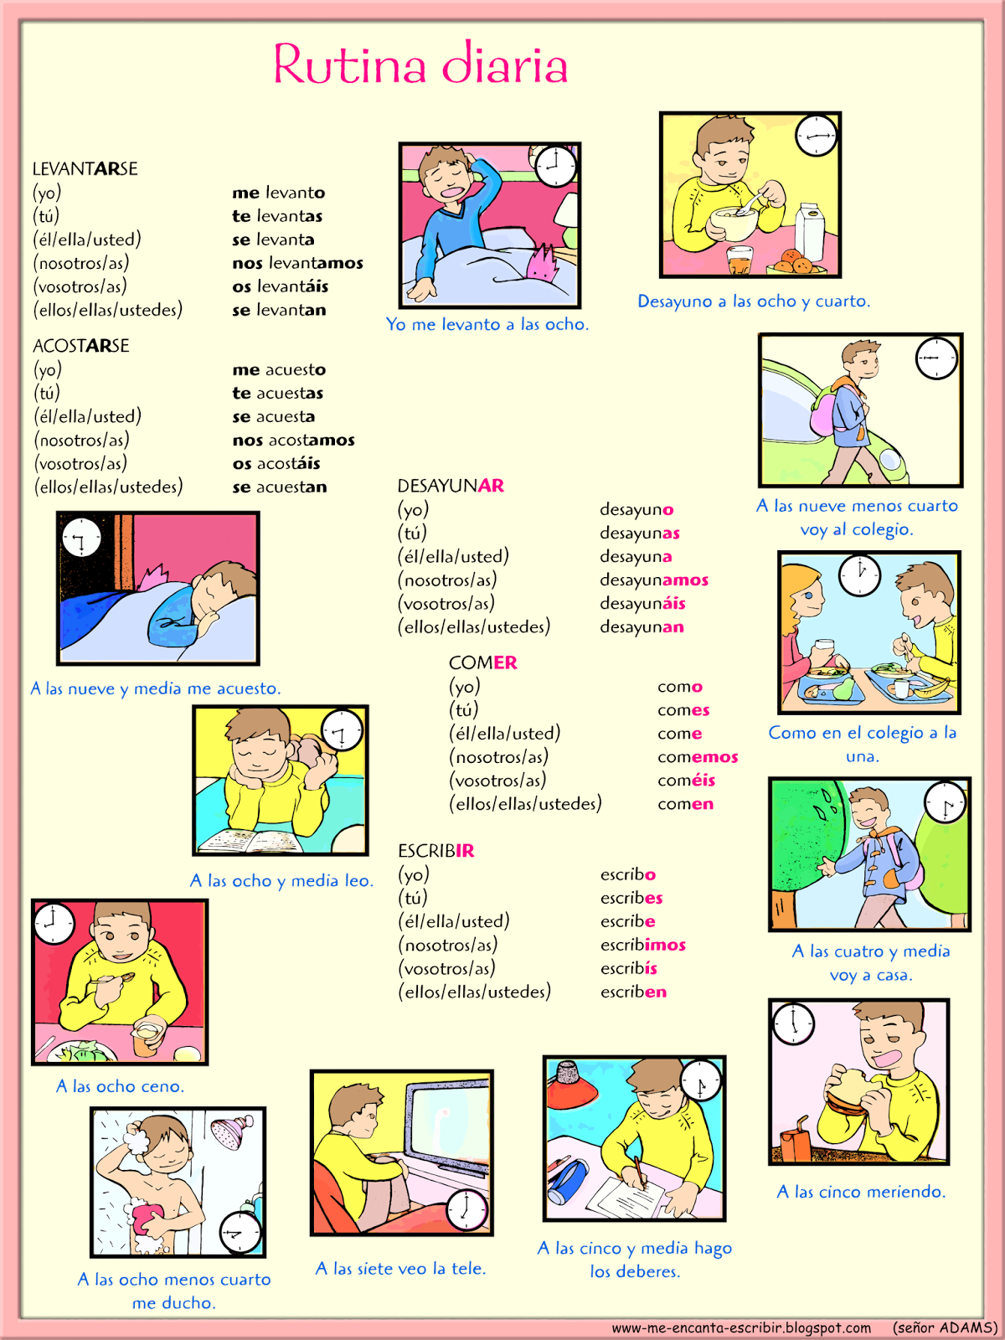

Slide 18
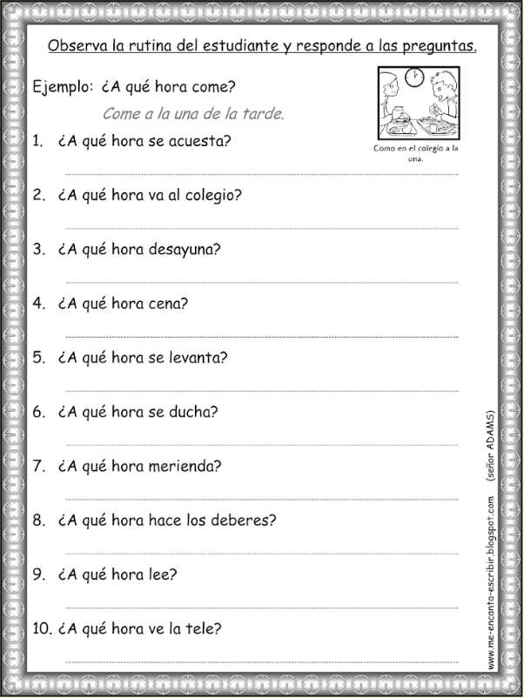

Slide 19
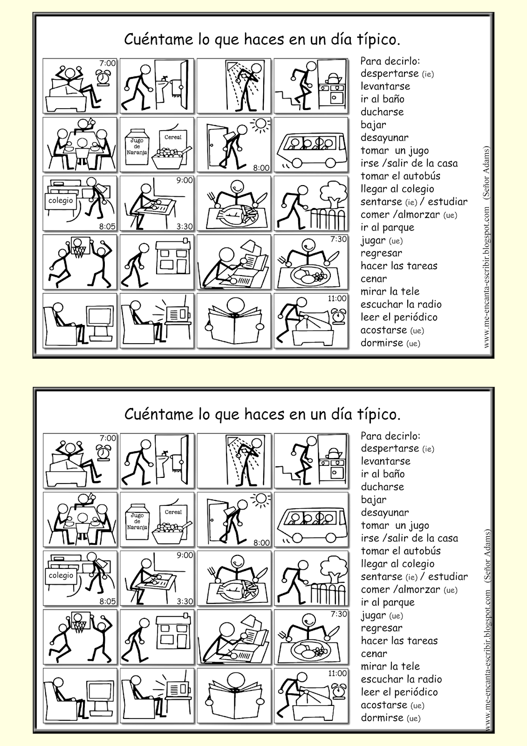

Slide 20
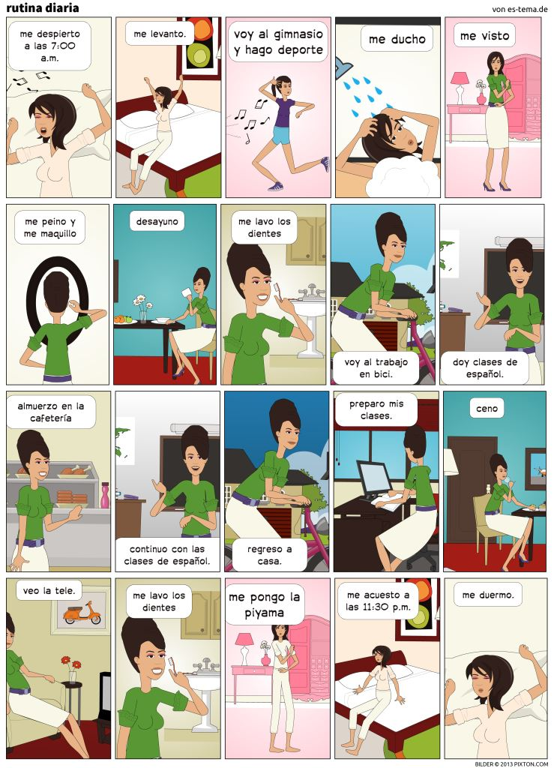

Slide 21
Day 3: Teaching Spanish grammar
Online resources
 | El imperativo
1 | https://www.youtube.com/watch?v=sPf7Zwevwas Juan pequeño baila - song for parts of the body
2 | http://www.aprenderespanol.org/verbos/imperativo.html Online activities
3 | http://www.todo-claro.com/castellano/intermedio/gramatica/El_imperativo/Seite_2.php (includes negative forms using the subjunctive)
4 | https://espanolparainmigrantes.wordpress.com/2010/02/01/conjugacion-verbal-el-imperativo/ lots of excellent resources (infographics, video links)
5 | http://www.videoele.com/B1_Consejos_para_ser_feliz.html
6 | https://www.youtube.com/watch?v=flTMHB16K7M Sonríe y sé feliz – comes with a gap-fill worksheet, too - https://www.dropbox.com/s/lwxdlxrs45jx422/ficha-sefeliz-a2-b1.pdf?dl=0#ficha-sefeliz-a2-b1.pdf
7 | https://www.youtube.com/watch?v=4z9qbgT0lgk - video – Mensaje en una botella
8 | http://liceohispanico.com/wp-content/uploads/2013/09/IMPERATIVO_LIDIA-GORDO_Ele-de-Liceo.pdf Good ideas, including a game idea
9
10
11
12
13
14
15

Slide 22
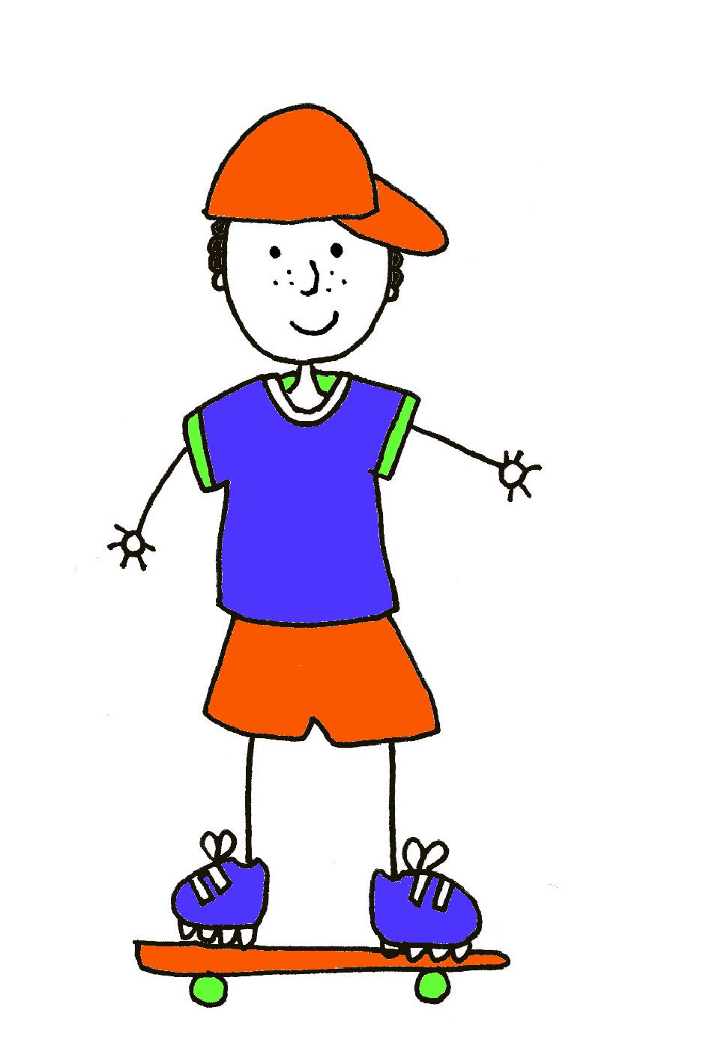
El imperativo
1. Rellena los espacios con las vocales que faltan.
La c___ b ___ z ___
Los h ___ m b r ___ s
El b r ___ z___
El c ___ d ___
La m ___ n ___
El d ___ d ___
La p ___ ___ r n ___
La r ___ d ___ l l ___
El p ___ ___
El ___ s t ___ m ___ g ___
2. Escribe las partes del cuerpo en español.

Slide 23
3. Empareja los infinitivos
doblar
levantar
moverse
estirar
cruzar
girar
sentarse
levantarse
to cross
to stretch
to raise
to bend
to turn
to sit (yourself) down
to move (yourself)
to stand (yourself) up
4. Escribe instrucciones para una rutina de baile / de ejercicio.
1
2
3
4
5
5. Apunta tus consejos favoritos para ser feliz.
1
2
3
4
5

Slide 24
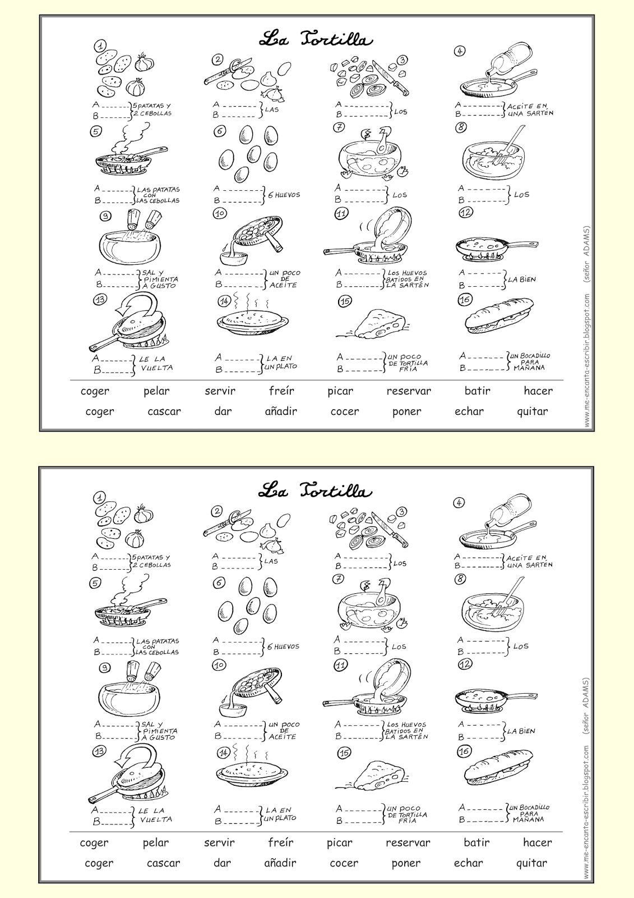
Notes:
http://3.bp.blogspot.com/-Kmqg9iD4czg/VKmfot9oqGI/AAAAAAAAESU/KHC49g7d850/s1600/Tortilla%2Bde%2Bpatatas%2B-%2BMe%2Bencanta%2Bescribir%2Ben%2Bespa%C3%B1ol%2B-%2BSe%C3%B1or%2BADAMS%2Bfiche%2BELEVE.png

Slide 25
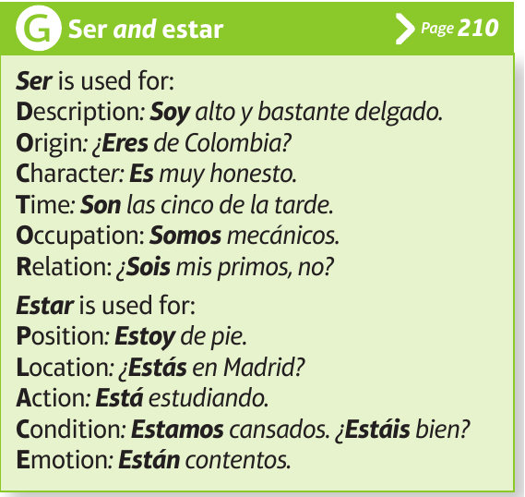
Common errors and misconceptions
1. TENER not ‘to be’
In English we use the verb “to be” when talking about age: “I am 25 years old.” But in Spanish the verb “tener” (to have) is used with age. To say that you are 25 years old, you would say “Tengo 25 años” (I am 25). This translates literally to “I have 25 years,” hence the common mistake by both English and Spanish speakers in their respective second language. There are a quite a few other Spanish phrases that use the verb “to have”(tener) while their English counterparts use “to be”. Here are ten of these phrases with which you should tener cuidado (be careful) when using:
tener calor (to be hot)
tener cuidado (to be careful)
tener frío (to be cold)
tener hambre (to be hungry)
tener miedo de/a (to be afraid of)
tener prisa (to be in a hurry)
tener razón (to be right)
tener sed (to be thirsty)
tener sueño (to be sleepy)
tener suerte (to be lucky)
2. SER or ESTAR Useful ways to help students remember when to use ESTAR:
“How you feel and where you are, that is when you use estar.” Location, location, location = estar State – how you are now = estar
Capitalization rules
Words that are capitalized in both Spanish and English:
Names of people (Cristiano Ronaldo)
Names of places (Madrid, España)
Names of newspapers and magazines (El País)
The first word of titles (movies, books, articles, plays)
Words that are not capitalized in Spanish but are in English:
Days of the week (lunes, martes, miércoles – Monday, Tuesday, Wednesday)
Months of the year (enero, febrero, marzo – January, February, March)
Words in titles, except the first (“Cien años de soledad” – “100 Years of Solitude”)
Languages (Estudio español. – I study Spanish.)
Religions (Mis padres son católicos. – My parents are Catholic.)
Nationality (Soy estadounidense. – I’m American.)
4. Adjectival position
The fact that Spanish adjectives often come after the noun is a challenge for learners new to Spanish.
http://www.elearnspanishlanguage.com/vocabulary/falsosamigos.html

Slide 26
5. Gender
The fact that each noun is either masculine or feminine and must be learnt with its word for a / the is difficult for many learners. It’s not hard to understand it, it’s just hard to remember to learn and use the correct gender word with every new noun. It helps to have the pattern that most nouns that end in –a are feminine, and most that end in –o are masculine, (and –e ending nouns are more often masculine but could be either). It’s then helpful to know the main exceptions:
Masculine nouns ending in –a: el problema, el programa, el sistema, el poema, el idioma, el tema, el clima, el telegram, el mapa, el planeta, el día, el sofá Feminine nouns ending in –o: la radio, la mano
6. Use and omission of articles. Spanish and English differ in their use / omission of articles in several ways. Here are some of the key differences: i. SER + professions Soy professor. = I am a teacher. ii. Abstract nouns La paz es muy importante. = Peace is very important.
iii. GUSTAR + nouns Me gustan las películas de terror. = I like horror films.
7. Collective nouns In English, many collective nouns can be used with either a singular or plural verb. E.g. family, government, team, audience. However, there are a few, notably police and people, which must be used with a plural verb. In Spanish, collective nouns are almost always used with a singular verb.
8. GUSTAR (and other similar verbs) A more accurate translation of gustar might be "to be pleasing to“, because it better explains why the indirect object pronouns me, te, le, nos, os, and les are used in conjunction with it, and why it needs either 3rd person singular or plural endings.
9. Pronouns (and their omission)
Pupils learn the subject pronouns only to need to be told that they don’t often need to use them, unless for emphasis. Remembering that ‘voy’ = I go, particularly when translating from English into Spanish is not straightforward.
10. Double negatives
In English, these are incorrect. In Spanish, they are necessary: No tengo nada = I don’t have anything. Rule: In Spanish, negative sentences need negative words. Don’t’ mix negative and positive.
Barron’s 1001 Pitfalls in Spanish – Holt & Dueber 4th edition (2010)
https://www.amazon.co.uk/1001-Pitfalls-Spanish-Marion-Holt/dp/0764143476/ref=tmm_pap_swatch_0?_encoding=UTF8&qid=1477326875&sr=8-2

