Slide 1

Comberton Village College
Spontaneous classroom talk
Introduction (Rachel) Practical examples building from the earliest stages (Morag) Further examples – beginning from scratch with KS4 class (Rachel)
Rachel Hawkes
Spontaneous classroom talk

Slide 2
Comberton Village College
What is it?
Spontaneous contributions in the TL as part of the language of the classroom Unplanned / unscripted talk as part of a lesson task or activity Whole-class teacher-led interactions (that may prime for subsequent pair work)
Rachel Hawkes

Slide 3
Comberton Village College
Why is it important?
Students equate the ability to speak in the TL with learning the language (it is the subject to them) Students believe that what the can produce in unrehearsed situations is what they really know Spontaneous TL use (or lack of it) has been highlighted in every Ofsted report since records began Secondary Curriculum, KS3 Framework and GCSE specifications (not all) highlight its importance
Rachel Hawkes

Slide 4
Comberton Village College
What is the teacher role in spontaneous talk ?
Source of high quality language input for acquisition Contingent feedback Sensitive co-construction Creation of a ‘safe place’ for trial and error Inclusion of humour
Rachel Hawkes

Slide 5
Comberton Village College
What about the rest of the class?
Source of high quality language input for acquisition a) The unpredictability and humour of these interactions encourage active listening for comprehension. The stability and continuity of the theme/topic of the talk enable learners to understand longer stretches of interaction (teacher talk and visual stimulus are the scaffolding) ‘Off line’ opportunities for reflection and planning Comparing the talk of teacher and peer Using the time to plan next contribution
Rachel Hawkes

Slide 6

Hoy vamos a hacer preguntas

Slide 7

Comberton Village College
Increasing interactivity (spontaneity, sustaining the flow, intonation) Questioning
WHAT ARE THE QUESTIONS
Idea 1

Slide 8

¿Cuáles son las preguntas?
7. Sí, pero es un poco aburrido.
1. Me llamo Adam.
2. Tengo 15 años.
6. Sí, por supuesto. ¿Y tú?
3. En Cambourne.
5. Sí, me gusta mucho.
4. Sí.
Notes:
8

Slide 9
Comberton Village College
Increasing interactivity (spontaneity, sustaining the flow, intonation) Questioning
Rachel Hawkes
FIND SOMEONE WHO
Idea 2

Slide 10
Busca a la persona que / a quién…
juega al fútbol los sábados.
va al cine a menudo.
lee todos los días.
ve la tele cada día.
nunca descarga música del Internet.

Slide 11
Busca a la persona que / a quién…
le gusta Come Dine with Me.
no le gusta Top Gear.
le gusta Factor X.

Slide 12
Comberton Village College
Manipulating language (Sentence-building, creativity, improvisation)
Rachel Hawkes
TARGET TALK
Idea 3

Slide 13

¿Qué programas te gustan?
Your answer must contain EXACTLY 7 words!
¿Qué programas no te gustan?
Your answer must contain more than 9 words!
Notes:
The conditions or ‘targets’ can be many and varied. It ALMOST doesn’t matter as the point of putting a condition there is to cause students to think their sentences through carefully as they build them. It makes them much more aware of what they’re saying. And making a sentence of exactly 8 words will involve usually a very short clause with ‘weil’ or two clauses linked with ‘und’ or additional details like when and where. So they focus on different ways to make their sentences longer. It also works well to set >9 words or <5 words at times too.
13

Slide 14
Comberton Village College
Increasing interactivity (spontaneity, sustaining the flow, intonation) Questioning
Rachel Hawkes
GROUP TALK
Idea 4

Slide 15

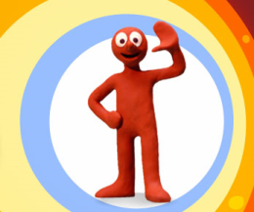
http://www.youtube.com/watch?v=VNktrq3w6pE - Morph short episode 4

Slide 16
¡Vamos a mirar algo!
Título del programa/de la película: ………………………………….
1. ¿Qué tipo de programa es?
3. ¿Dónde tiene lugar?
5. ¡Añade tu opinión!
 | película
 | dibujos animados
 | telenovela
 | noticias
 | programa de deporte
 | telecomedia
 | concurso
 | programa de música
 | afuera
 | me gustó
 | no me gustó
 | en la ciudad
 | en el campo
 | adentro
Escribe en español lo que ves en el programa.
 | en el estudio
 | en un edificio
____________________________________________________________________________________________________________________________________________________________________________________________________________________________________________________________________________________________________________________________________________________________
4. ¿Cómo es?
2. ¿Para quién es ?
 | divertido
 | cómico
 | triste
 | informativo
 | serio
 | interesante
 | emocionante
 | aburrido
 | adultos
 | niños
 | todos
Notes:
Students should use this sheet from last lesson to write a short intro paragraph about their Morph episode. In lesson 3 they are going to work on narrating the story in the past to add to this. If necessary there is more structured guidance given on Slide 8 for this task.

Slide 17
¿Qué opinas de estos programas?
Creo que… es/son … Pienso que… (no) es/son … Me parece … | Me gusta /Prefiero…porque….
un concurso un programa de deportes unos dibujos animados un programa de música / musical un documental un informativo (noticias) un programa infantil una telecomedia una telenovela una película | divertido cómico informativo triste serio interesante emocionante aburrido entretenido gracioso para niños/jóvenes/adultos
¡Qué va! ¡Hombre! ¡Vaya! ¿Estás loco/a? | ¿Qué opinas tú? ¿Qué piensas tú? ¿Qué te parece? Pues yo creo que …..
Notes:
Group talk activity to use to discuss the programmes from the video clip. In the boxes to the right they can put the number of the clip and note what their impression of the clip is. They may need to watch the sequence a couple of times before they talk about it.

Slide 18




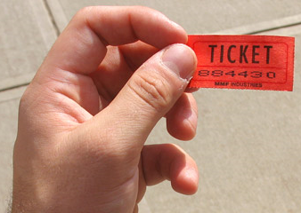
Comberton Village College
Increasing interactivity (spontaneity, sustaining the flow, intonation) Questioning
9Rachel Hawkes
REWARDING SPONTANEITY
Idea 5

Slide 19
Comberton Village College
Manipulating language (Sentence-building, creativity, improvisation)
Rachel Hawkes
ODD ONE OUT
Idea 6

Slide 20
1908
1992
2012
1948
Notes:
Pilla al intruso. Students may say anything from ‘2012 porque es futuro y los otros son pasados’ or ‘2012’ porque son ‘dos mil’ y los otros son ‘mil novecientos’. My answer is ‘1992’ porque los juegos olimpicos tuvieron lugar en Barcelona y los otros en Londres.

Slide 21

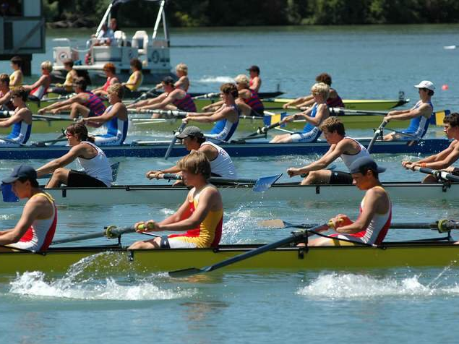
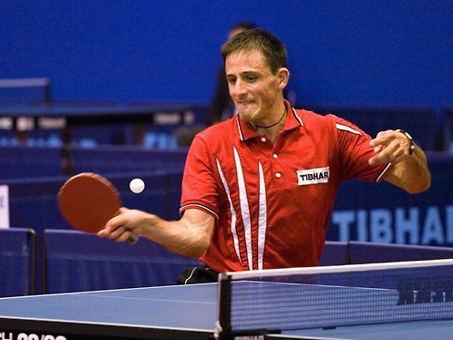
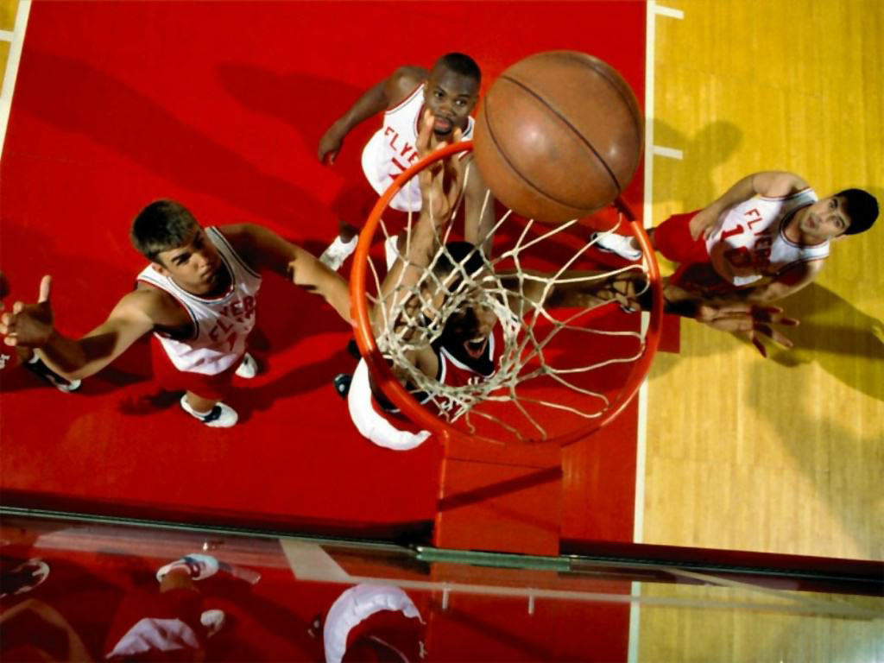
Notes:
Pilla al intruso. El hockey, el remo, el tenis de mesa o el baloncesto. El remo porque es el unico que necesita agua? El remo porque los otros tienen pelotas? El tenis de mesa porque es el unico deporte individual – los otros son deportes de equipo?

Slide 22
Comberton Village College
Increasing interactivity (spontaneity, sustaining the flow, intonation) Questioning
Rachel Hawkes
SPEND THE WORDS
Idea 7

Slide 23

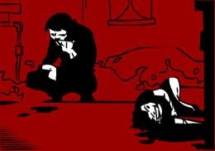
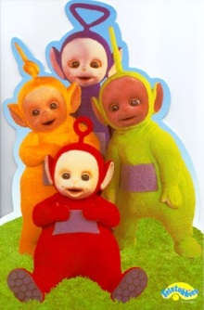


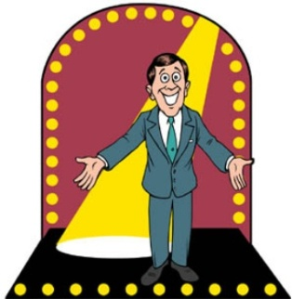
Me gustan mucho | tiene lugar en | Mi programa preferido
entretenido (a/os/as) | son | Prefiero
porque | trata de | No me gustan tanto
A mi madre | una telenovela | tonto (a/os/as)

Slide 24
Comberton Village College
Increasing interactivity (spontaneity, sustaining the flow, intonation) Questioning
Rachel Hawkes
JUST A MINUTE! (GROUPS)
Idea 8

Slide 25
Me gustan las telenovelas
Me gustan las telenovelas como Eastenders que trata de la vida de familias que viven en el este de Londres
Slide from Neil Jones (with thanks!)

Slide 26

Son____________que tienen lugar en _____________. Tratan de un personaje hecho de _______ que se llama ________. Es un programa para _______ pero pienso que es también para _______. El programa es muy _______ y los episodios son cortos. El episodio 4 me _______ mucho porque era muy __________.
unos dibujos animados | divertido | todos
niños | un estudio | gracioso
plastilina | gustó | Morph

Slide 27
Comberton Village College
Increasing interactivity (spontaneity, sustaining the flow, intonation) Questioning
Rachel Hawkes
STARTER ACTIVITIES (KS4-5)
Idea 9

Slide 28
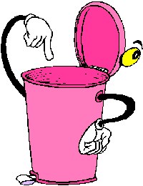
Cubo de basura
¿Qué vas a tirar?
¿Por qué?
Notes:
http://www.muchosgifs.com/1a1a1a/hogar/cubos/basura25.gif

Slide 29
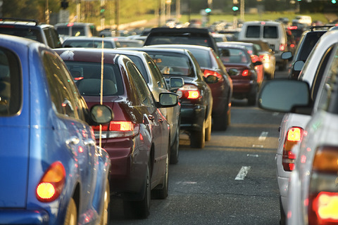
¡Atasco!
¿Adónde ibas?
¿A qué hora saliste de casa?
¿Cuánto tiempo llevas esperando?
¿Qué harás mientras sigues esperando?
Notes:
http://www.cosasdemotor.es/images/novedades_ley_de_trafico.jpg

Slide 30
Comberton Village College
Manipulating language (Sentence-building, creativity, improvisation)
Rachel Hawkes
IN THE ZONE
Idea 10

Slide 31

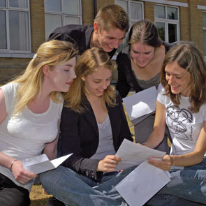



(nicht) bestehen
Letztes Jahr
wenn
wann
Was ich am liebsten mag
Notes:
Pairs work with this stimulus (within given time limit) to come up with as many statements/utterances using one or more of the picture or verbal prompts. This one has the theme of school.

Slide 32
Comberton Village College
Manipulating language (Sentence-building, creativity, improvisation)
Rachel Hawkes
PIMP MY FRENCH
Idea 11

Slide 33
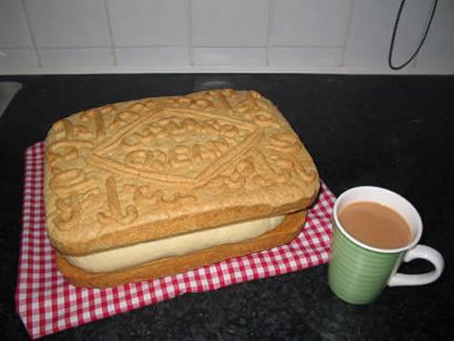
Pimp my sentence!
Je joue au tennis.
J’habite au nord de l’Angleterre.
Mon chien s’appelle Bob.

Slide 34
Comberton Village College
Manipulating language (Sentence-building, creativity, improvisation)
Rachel Hawkes
SAY SOMETHING ELSE
Idea 12

Slide 35


HAVE I GOT NEWS
FOR YOU
Hinesh, 14ans, va
jouer pour…
Chloe admet: Je fume…cigarettes
par jour
Selon Adam, Alex a acheté des
chocolats...
Abir fait… tous les jours, dit James.

Slide 36
Meine Schule ist eine gemischte Schule.
Meine Schule ist eine Schule,die sich in Naturwissenschaften spezialisiert.
Meiner Meinung nach sind die Schulregeln nicht zu streng.
Die besten Schulen haben eine Uniform.
Mein Lieblingsfach ist Englisch, weil ich gern Geschichten schreibe.
Um meine Schule zu verbessern, muß man mit den Strafen aufhören.
Nächstes Jahr möchte ich Spanisch studieren.
Notes:
Students have to change something in the sentence – it could be one detail, it could be the whole thing, it could be adding an additional detail to ‘grow’ the sentence.

Slide 37
Comberton Village College
Manipulating language (Sentence-building, creativity, improvisation)
Rachel Hawkes
THEN AND NOW
Idea 13

Slide 38
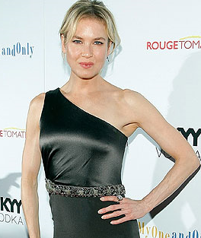
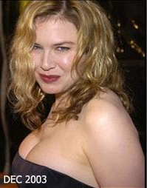
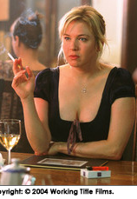
Antes…. | Ahora…
Cuando jugaba el papel de Bridget Jones… | Hoy en día …
Notes:
I used this after revising present and imperfect talking about healthy lifestyles so they could relate that
back to what they eat/drink.
I remember the girls being particularly enthusiastic, but the boys as well were quite quick to talk about era gorda porque comía muchas patatas fritas/comida rápida etc, no hacía deportes, era perezosa
Some also brought back in quite a lot that we had previously done on sports and related that in, so they started off with era gorda/es delgada but then extended into why - they just made it up obviously!
Using vocabulary they knew from talking about their own free time.

Slide 39
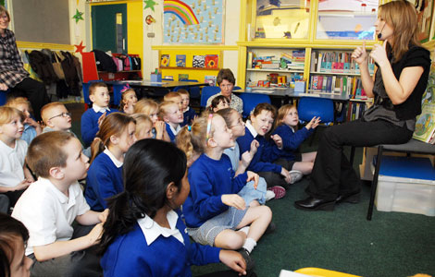
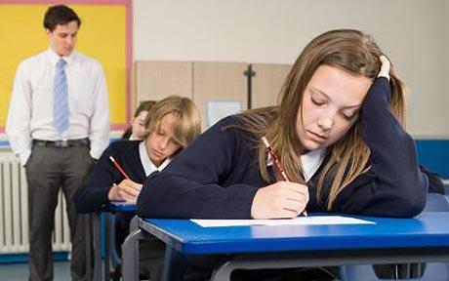
À mon école primaire, il y avait… | À mon école secondaire, il y a…

Slide 40
Comberton Village College
Increasing interactivity (spontaneity, sustaining the flow, intonation) Questioning
Rachel Hawkes
TALKING PYRAMIDS
Idea 14

Slide 41




¡Pensar y hablar!
Notes:
The individual thought bubbles are for something that is only applicable to that 1 person and not the other two e.g. VB is a woman The starburst in the middle is for something common to all e.g. They are famous and the rectangles between the pairs are for something that pair has in common. E.g. TH and DB are sporty. With a zillion thanks to Jackie Howis, AST and SSAT LP in Kent for this lovely visual lay-out of this fab task type!

Slide 42
le fastfood
manger et boire
les légumes
J’adore
les sandwichs

Slide 43
Comberton Village College
Developing quality (Assessing, improving, enhancing, modelling)
Rachel Hawkes
BINGO
Idea 15

Slide 44
Opinion | Present | Future
Reason | Time expression | Comparison
Complexity | Past | Reference to others
Rachel Hawkes
Notes:
Given a specific topic to talk about (or a set of questions if appropriate), students have to try to include each thing from the Bingo grid. When they do, they cross off the box and in their pairs, it’s the first person to cross everything off who wins (full house).

