Slide 1



Speak to me!
Spontaneous speaking and how to achieve it.
Notes:
Speaking a foreign language is something most students admit to wanting to be able to do. Yet this is not always what happens in the classroom. This session explores how we as teachers can create the conditions for talk, and offers specific tasks and ideas that work with all learners.

Slide 2
“Language ‘practice’ should lead to language ‘use’ but doesn’t.” (Salter, 1989)
‘Overall there is insufficient emphasis on helping students to use the language spontaneously for real situations. Consequently too few students could speak creatively, or beyond the topic they were studying, by making up their own sentences in an unrehearsed situation’
(Ofsted, 2008, p.12).
‘Opportunities for students to listen to and communicate in the target language were often limited by many teachers’ unpreparedness to use it. …thus routine work in the target language and opportunities to use it spontaneously were too few’
(Ofsted, 2011, p.6).
Notes:
Salter’s (1989) observation that language ‘practice’ should lead to language ‘use’ but doesn’t, sums up neatly the last 30 years’ experience of languages teaching and learning in England.
However, inspection findings (Ofsted, 1993, 1995, 1998, 2000, 2001, 2002, 2008, 2011) overwhelmingly describe classrooms as being characterised by students’ inability and unwillingness to use the target language spontaneously: ‘Overall there is insufficient emphasis on helping students to use the language spontaneously for real situations. Consequently too few students could speak creatively, or beyond the topic they were studying, by making up their own sentences in an unrehearsed situation’ (Ofsted, 2008, p.12).
More recently, reports note a lack of target language use by teachers. According to these reports, ‘In many of the secondary schools visited, opportunities for students to listen to and communicate in the target language were often limited by many teachers’ unpreparedness to use it. Too often, students were not taught how to respond to everyday requests and thus routine work in the target language and opportunities to use it spontaneously were too few’ (Ofsted, 2011, p.6).

Slide 3
Why is there a low level of student talk?
low levels of teacher target language use (but high levels of teacher target language ≠ high levels of student target language use)
increased use of English tasks – ‘learning to learn’, ‘AfL’, ‘thinking skills’ – brought in with the KS3 National Strategy (DFEE, 2001)
tension (perceived or otherwise) between grammar teaching and target language use
tension between teaching and assessment, recognising that external examinations (in England!) reward memorisation over independent communication
teacher-fronted talk that militates against learner talk
preclusion of the third ‘P’ (production/use) in PPP through an over-emphasis on pre-communicative, drilling activities
(Hawkes, 2012)

Slide 4
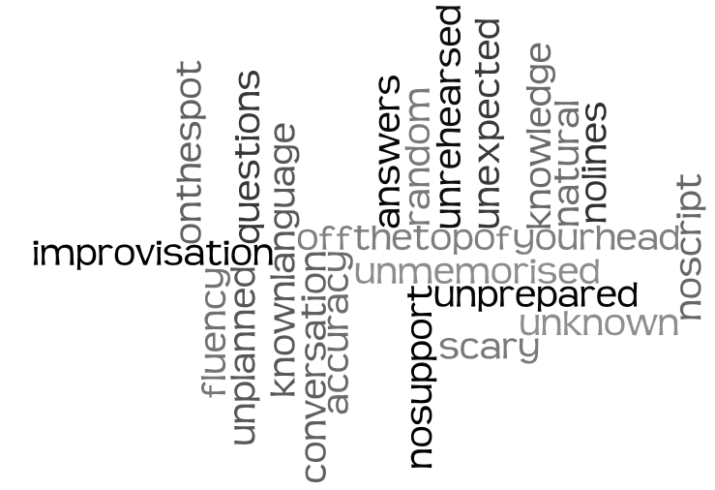
What do you think “unplanned” or “spontaneous” speaking means?
What students say
289 students from age 11 – 15 from 5 different secondary schools were asked:
Their answers highlighted:
a) Lack of prior preparation
b) Absence of written support
c) The immediacy of the experience
d) Like a conversation
e) Not knowing the questions/answers in advance
Linked Up Project Analysis, May 2010

Slide 5
What is spontaneous talk?
Spontaneous talk is an unscripted interaction, in which teachers do not know exactly what language the students will produce. The speaker, student or teacher, only has something to say as a result of having heard and understood what has been said to him/her. Talk is therefore both listening and speaking, reception and production. This talk may be learner-initiated or in response to a teacher’s question. It may be within an oral talk or part of everyday communication between tasks. However it occurs, it will be produced not read, improvised not rehearsed, and it will often have that element of ‘struggle’; the effort to communicate when linguistic resources are stretched (Hawkes, 2012).

Slide 6
Characteristics of spontaneous talk
improvised (oral/aural), unrehearsed
communicative, message-oriented
language use not language practice
natural (as outside the classroom)
authentic (real / purposeful)
respond to unexpected / unpredictable
conversations
‘struggle’ – communicate when linguistic resources are stretched

Slide 7
"Because in real life you don't know what the other person is going to say."
2/3 students asked equate spontaneous speaking with ‘real life’ activity.
Why do you think unplanned or spontaneous speaking is an important focus in language learning?
Students feel that what they can do without notes/preparation is what they 'truly' know.
"To make sure you definitely know it and are able to have conversations without reading off a sheet."
They also mention the link between spontaneous speaking and increased confidence.
Linked Up Project Analysis, May 2010

Slide 8
Why is spontaneous talk important?
Students equate the ability to speak in the target language with learning the language (it is the subject to them).
Students believe that what they can produce in unrehearsed situations is what they really know.
Spontaneous TL use (or lack of it) has been highlighted in every Ofsted (English school inspection) report (since records began!).
Theories of language learning prioritise interaction as the primary site of learning (Long, 1985; Swain, 1995, 2000; Lantolf, 2000).
Notes:
Not every theory of language learning does this to same extent!
Qualify the theoretical position – different theories hold different places for interaction
Krashen – Input hypothesis
Long – Interaction hypothesis
Swain – Output hypothesis
Lantolf – SCT

Slide 9
How do we generate more (and better) talk in our classrooms?
increased pair/group work → task-based learning
re-examine and re-construe the rule of teacher talk

Slide 10
Teacher TL use
Student to student use
Student to teacher use
Notes:
It can be helpful as teachers or heads of department, when thinking about target language use to consider 3 x aspects of classroom TL interaction.
Every teacher is different, every class / student is different and we are all at different places with respect to our own practice, that of our students and that of departments as a whole.
Considering these aspects separately often helps us to pinpoint the areas for development that we have.

Slide 11
The new GCSE speaking exam
What strategies can a teacher conducting the test use to ensure the student demonstrates spontaneity?
It is important to follow up on students’ replies to develop a natural conversation. This will demonstrate a student’s ability to use language spontaneously.
Notes:
AQA FAQ

Slide 12

Teacher talk - the 5Cs
Consistent
Clear / concise
Communicative
Checks understanding
Creative
Notes:
REFER TO HANDOUT – online…
1. Consistent
Absolutely vital. If you use the TL one day and not the next, you erode its effectiveness. If you use the TL and then translate yourself, you reduce its effectiveness. Consistency in TL use by the teacher involves planning, even scripting, and certainly thinking through each task / each explanation / each feedback and anticipating the language that you can use to communicate the meaning effectively to learners without resorting to English. If, at the planning stage, you realise that the message you need to give is vital but that you cannot conceive of how to do it in TL (or that doing it would take 20 minutes instead of 1) then you are justifying the use of English for that explanation / message. This is not the same for each teacher and it should be something we can all make progress in, such that we grow our use of TL and get more able to use it for a greater range of teaching activities. One teacher in my department, who has been working on this hard for 6 years, is currently challenging herself to 100% TL with a beginner Y8 German class. I observed and videoed several lessons at the start of the year and I’ve only seen her use English once for the word ‘exception’ which came up unexpectedly and she couldn’t immediately think how to convey its meaning clearly in the TL.
2. Clear / concise
Using the TL makes us consider v carefully the words we use to explain things and the bring in additional non-verbal support mechanisms too, such as visuals, mimes, props, gestures. At the very beginning we will need to be very concise indeed. And the words that we do need to teach as TL in the course of our explanations will be incredibly useful language and should be flagged up in the lesson. One method for this that works effectively is to arrive at a class understanding of the word through teacher TL explanation, example, miming etc.. and then to ask a class member to provide the English meaning orally. The teacher only writes down the German and the students write down both (but still having to think rather than just copy down the English). On the next slide I have an example of the words that have come up in this way over the first half-term of German lessons (2 x lessons per week).
3. Checks understanding
Of course we all use expressions to check understanding in our classrooms. But sometimes we don’t perhaps put enough emphasis on the expectation for a reply! I’ve often heard ‘Alles klar?’ by the teacher or ‘Entendéis?’ said almost as a rhetorical utterance. When there is barely a murmur in response, the teacher has not followed this up. if we think of the purpose of saying ‘ Is that clear?’ it seems really important that we accompany it with an expectation that students will either say confidently ‘Ja’ or will have questions because they are not clear about it. We have a couple of legendary stories in our department about this. In one class of lower ability learners one Y11 student, who had had the same teacher throughout Y10 too, and was used to his teacher saying to the class ‘Entendéis?’ suddenly asked her at Easter of Y11 – Miss, what is this about 10 days? What is going to happen in 10 days? You’ve been saying that since the start of Y10! So it’s a salient lesson that we need to ensure that we check understanding, of crucial terms and also of our teacher talk, especially key terms that we are going to repeat and repeat. Having said that, checking understanding also involves seeing how students respond. If they do what we ask readily, if the work produced matches expectations, then we can also be confident that they have understood.
4. Creative
With the still limited language of our learners, teachers have to be creative about TL use. We will need to use cognates at the start (but also withdraw them as soon as we can if there is a better TL word) – I can think particularly of Moglichkeit in German rather than Possibilitat. If we first teach Possibilitat and then we introduce them to Moglichkeit we can then stop using possibilitat fairly soon. To get meanings across we will also need our ingenuity. Getting into the habit of using examples to get meanings across is invaluable, especially if they involve the immediate setting of the classroom. Referring to things that are too far removed from the classroom can lose beginner students. I watched a teacher come up with a very good way to tell her learners in lesson one that she wanted to know their preferred names, not just their register names, by using a member of the class who she imagined would prefer Kate rather than Kathryn. In this, as in other aspects of teacher talk, we can grow our ability.
5. Communicative
Keeping it real. This doesn’t necessarily mean having a conversation with learners that is ‘off-topic’ although it can be nice to do this occasionally. It means responding to unplanned talk or learner questions in terms of the message rather than slipping into accuracy mode and correcting every utterance. This is very much about clarity of purpose for each activity. If you are practising pronunciation in a given task, then correct pronunciation errors. If you are practising producing correct forms e.g. perfect tense, then correct errors. But in every lesson there must be a decent chunk of time allocated to communicating through the TL. In these sorts of activities, where communication of the message is dominant, correction of errors is an unhelpful addition, because it blurs the purpose and demotivates the learner who is actually trying to really tell you about his/her pet. That doesn’t mean that as the teacher you don’t recognise that when Jimmy is talking he still hasn’t got the idea of where to put the adjective in French when he speaks spontaneously, but that doesn’t mean he wouldn’t know if he had time to plan to write or plan to speak. What we can do accurately in an unplanned situation is different to what we can do when we have time to reflect. And research is unclear at best about what a learner can take from explicit accuracy feedback while they’re in the act of talking. So if you notice in spontaneous speaking that there are fundamental errors, make a note that some more practice activities are needed down the line, but don’t stop him mid-flow. Only signal problems if they are genuine communication problems – i.e. you don’t know what he means. Then ask follow up questions to try to get to the meaning. Smile as you do this and encourage further communication. Offer alternatives to see if you can arrive at what he wanted to say.

Slide 13
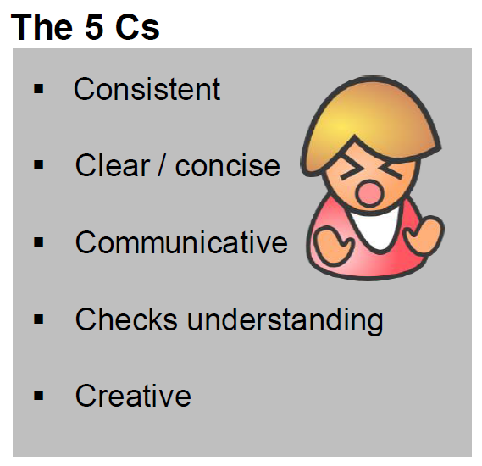
TL - theory into practice
If teachers don’t, students don’t
If teachers do, that’s not in itself a guarantee that students will!
Consistency is what counts, and also…
Careful planning and routines
Openness to interruptions / asides
Clarity of purpose (spontaneous / prepared)

Slide 14

1 Students will be more confident at speaking in the target language if they have a secure grasp of the sound/writing relationship.

Slide 15








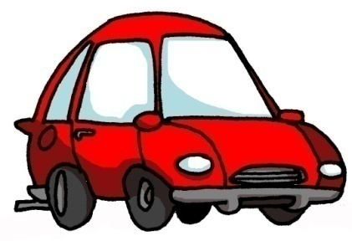



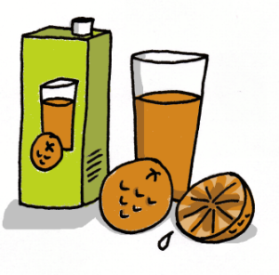



1 | 2 | 3 | 4
5 | 6 | 7 | 8
9 | 10 | 11 | 12
13 | 14 | 15 | 16
idea
araña
elefante
olvidar
universo
cerdo
ciclista
casa
coche
cucaracha
gimnasia
hamburguesa
España
zumo
gusano
llave
Notes:
Layering memory of the key phonics sounds – iconic word, image, gesture to represent each key sound, chosen for its difference to English pronunciation.

Slide 16

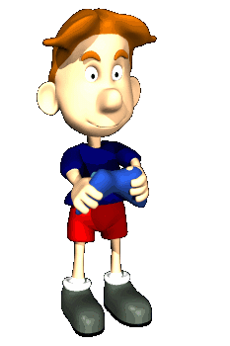


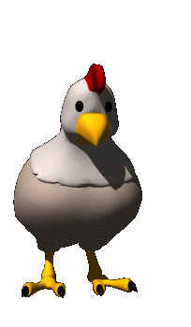







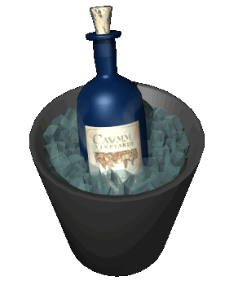


oi
ui
eu
au
le poisson
Oui!
le jeu-vidéo
les ciseaux
ou
i
u
é
la poule
le midi
les lunettes
le bébé
ez
er
qu
gn
le nez
danser
la question
la montagne
in
en
on
tion
le vin
le serpent
le pont
la pollution

Slide 17













1 | 2 | 3 | 4 | 5
6 | 7 | 8 | 9 | 10
Jo-jo
Buch
Zug
Vogel
Wildwassersport
ein Ei
Hi Hai!
die Biene
Haus
Deutschland
11 | 12 | 13 | 14
Mäuse
Mr Löwe Löwe
küssen
Bär

Slide 18


2 Students can initiate in the classroom as soon as they know the individual question words, so teach these with gestures asap!
http://www.youtube.com/watch?v=iqCvE258vY0

Slide 19

¿Quién?
¿Con quién?
¿Cómo?
¿Por qué?
¿Qué?
¿Cuánto?
¿Dónde?
¿Cuántos?
¿Cuándo?
¿Cuál?
Notes:
Teach the key question words with gestures. See this video for suggested gestures.
http://www.youtube.com/watch?v=iqCvE258vY0

Slide 20
Notes:
Recap the Q words often.

Slide 21

Was sind die Fragen?
Ja, ich mag Sport.
Meine Lieblingsfächer sind Theater und Musik!
Am Dienstag in der dritten Stunde.
Mein Lieblingsfach ist Deutsch!
Nein, ich mag Naturwissenschaften nicht.
Sie heißt Doktor Hawkes.
Am Donnerstag habe ich Geschichte.
Am Freitag in der ersten Stunde habe ich Kunst.
Ja, natürlich!
Notes:
Eliciting a mixture of yes/no questions AND question word questions- towards end of Year 8.
21

Slide 22

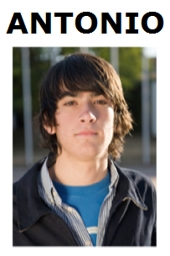
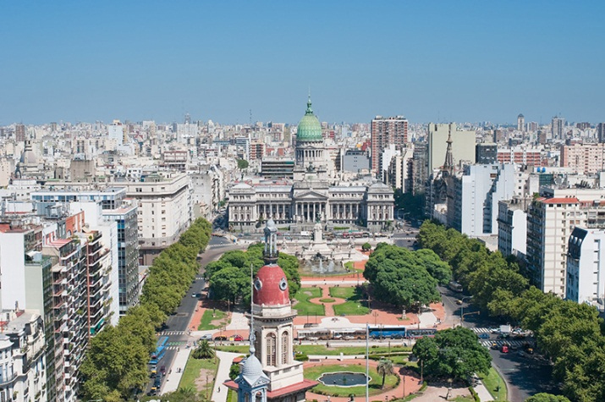
Hotseating
Argentina, el uno de enero, 2015
¡Hola! ¿Qué tal? Me llamo Antonio y vivo en Argentina, en Buenos Aires. Tengo trece años y mi cumpleaños es el quince de mayo.
Soy bastante sincero. También soy generoso, pero no soy tímido. Tengo una hermana que se llama Rosa. Tiene catorce años. En mi opinión, es un poco tonta.
Tengo un ratón y dos peces. Mi ratón es blanco y muy divertido.
Mis peces son azules y amarillos y son estupendos, pero no son muy listos. Mi color favorito es el amarillo.
Mi pasión es el rugby y mi héroe es Felipe Contepomi. ¡Es genial! Mi cantante favorita es Beyoncé porque es fenomenal.
Mi programa favorito es ‘Factor X’.
❶
❷
❸
❹

Slide 23
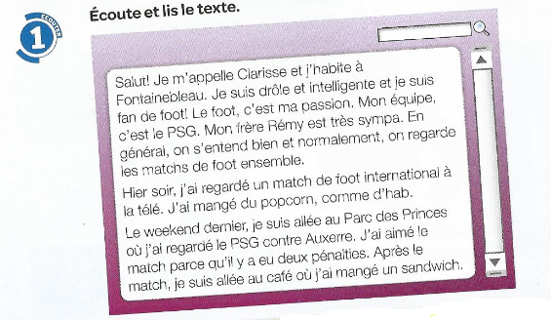
❶
Salut! Je m’appelle Clarisse et j’habite à Fonainebleau. Je suis drôle et intelligente et je suis fan de foot! Le foot, c’est ma passion. Mon équipe, c’est le PSG.
Mon frère Rény est très sympa. En genéral on s’entend bien et normalement on regarde les matches de foot ensemble.
Hier soir, j’ai regardé un match de foot international à la télé, J’ai mangé du popcorn, comme d’hab.
Le weekend dernier, je suis allée au Parc des Princes où j’ai regardé le PSG contre Auxerre. J’ai aimé le match parce qu’il y a eu deux pénalties. Après le match, je suis allée au café où j’ai mangé un sandwich.
❷
❸
❹
Notes:
Text taken from Studio 2 – Heinemann course. Module 3 unit 5. p.56

Slide 24
1 | Comment t’appelles tu?
2 | Où habites-tu?
3 | Tu es comment?
4 | Tu es drôle? Tu es intelligent?
5 | Quel est ton sport préféré?
6 | Quelle est ta passion?
7 | Quelle est ton équipe préférée?
8 | Qui est Rény?
9 | Tu as des frères ou des soeurs?
10 | Comment s’appelle ton frère?
11 | Ton frère, il est comment?
12 | On se dispute?
13 | Qu’est-ce qu’on fait ensemble?
14 | Qu’est-ce que tu aimes faire avec ton frère?

Slide 25
15 | Qu’est-ce que tu fais normalement avec ton frère?
16 | Qu’est-ce que tu as fait hier soir?
17 | Tu as mangé quelquechose?
18 | Qu’est-ce que tu as fait le weekend dernier?
19 | Le PSG, c’est quoi?
20 | C’était bien le match? Pourquoi?
21 | Le PSG a gagné?
22 | Qu’est-ce que tu as fait après le match?

Slide 26

1
2
3
Rosa.
David.
Felipe.
regular.
fatal.
bien.
11 años.
13 años.
12 años.
Hola, me llamo
Estoy
Tengo
4
5
20 de diciembre.
3 de enero.
31 de julio.
un gato
tres peces
un perro
Mi cumpleaños es el
Tengo
y
6
7
dos conejillos de Indias.
una serpiente.
nada más.
Francia
Jamaica
México
mi familia.
mis padres.
mis animales.
Vivo en
con
8
9
francés/francesa.
inglés/ inglesa.
mexicano/a.
francés y alemán.
inglés y español.
solo español.
Soy
y hablo
10
los Estados Unidos.
Escocia.
el Perú.
En el futuro me gustaría vivir en
Notes:
Build up to spontaneous speaking. You can only use spontaneously what you really know well, so practice and automatization is important.
This telepathy task builds confidence with answers.

Slide 27
1
2
3
Hola, me llamo…
Estoy…
Tengo…
4
5
Mi cumpleaños es el…
Tengo…
y…
6
7
Vivo en…
con…
8
9
Soy…
y hablo…
10
En el futuro me gustaría vivir en…
Notes:
This leads learners to personalize answers with prompts.

Slide 28








Inicio
60 segundos
1 | ¿C_____ t_ l________ ?
2 | ¿C____ e_____?
3 | ¿C______ a____ t______?
4 | ¿C_______ e_ t_ c__________?
5 | ¿T________ a________?
6 | ¿D_______ v_______?
7 | ¿C__ q_______ v_______?
8 | ¿C____ e__ t__ n______________?
9 | ¿Q__ i_______ h______?
10 | ¿D____ t_ g_______ v_____ e_ e_ f______?
60
45
30
15
0
Notes:
Pairs – Q&A with a time limit!

Slide 29
Quelles sont les questions?
2. La capitale de la Tunisie, c’est Tunis.
4. Je vais en Espagne pour aller à la plage.
1. Il fait beau.
3. S’il fait du soleil, je fais du cyclisme.
5. Oui, bien sûr. Et toi?
6. Hier je suis resté à la maison.
8. Je vais visiter le château
7. On peut faire du ski
9. Peut-être

Slide 30
Was sind die Fragen?
4. Ich fahre nach Schottland, um Nessie zu sehen.
1. Es donnert und blitzt.
2. Die Hauptstadt von Österreich ist Wien.
3. Wenn es heiß ist, esse ich Eis.
5. Ja, sicher. Und du?
6. Gestern bin ich zu Hause geblieben.
8. Ich werde die Burg besichtigen
7. Man kann Skifahren
9.Vielleicht
Notes:
Pupils have just learnt um..zu… and wenn clauses in the context of learning about Austria. This exercise also revises all tenses and modals as well as question-forming.

Slide 31
¿Cuáles son las preguntas?
9. Si, por supesto. ¿Y tú?
1. Mi instituto es un colegio mixto con mil quinientos alumnos.
2. La asignatura que más me gusta es la música.
8. Tengo pensado hacer mi bachillerato. Quisiera estudiar ciencias.
3. Es muy amable y abierto y explica todo muy bien
7. Hice dos semanas de prácticas laborales en un taller mecánico.
4. Soy socio del club de baloncesto.
6. Mi escuela primaria era muy pequeña y no teníamos que llevar uniforme.
5.Quizás

Slide 32

3 Pictures and authentic texts can be a powerful stimulus for spontaneous talk in the foreign language classroom.

Slide 33

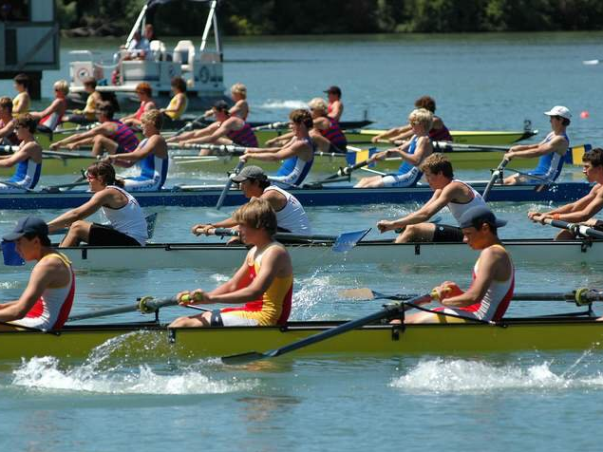
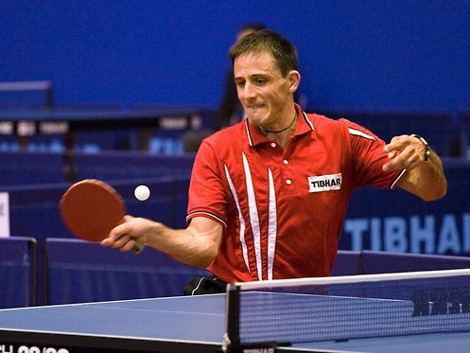
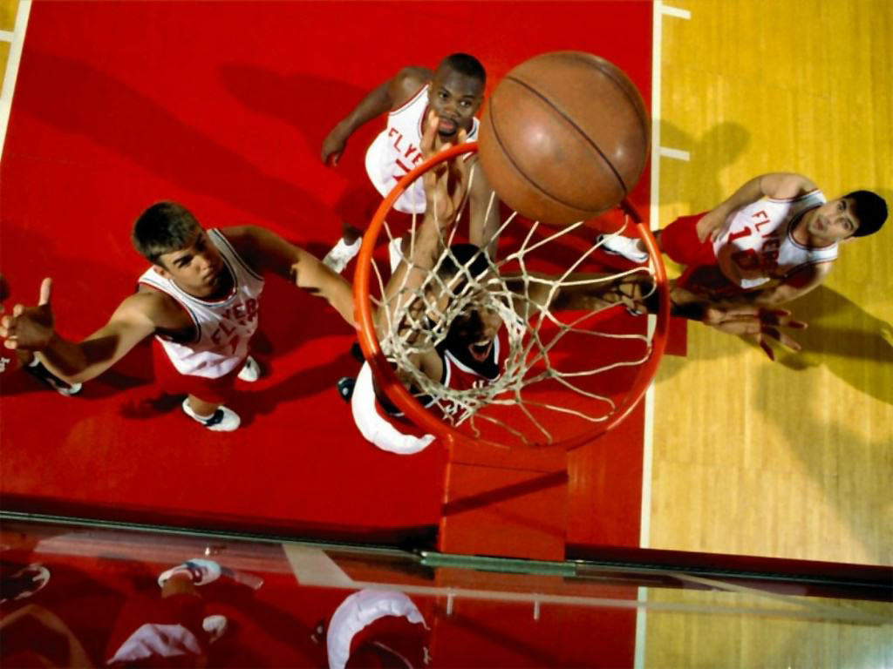
Notes:
This slide for delgates to suggest reasons (2-3 mins) and then share impressions (2-3 mins).
NB: Tell delegates that there is classroom footage of this activity in the toolkit.
Cherche l’intrus. The key with this task is that there must be several plausible answers. If there is topic specific language implicated in the task, then students should know this already. The language you need to do this type of task is very useful because it is essentially:
1) I think that the
2) 3rd persons (singular and plural) of the verb ‘to be’, …
3) ‘because’
4) 3rd persons (singular and plural) of the verb ‘to be’, …
5) complement (which can often be key grammatical words like noun, adjective, verb, masculine, feminine, singular, plural)
Hockey, rowing, table tennis and basketball.
A) Rowing because it’s the only water sport
B) Rowing because the other sports are ball sports
C) Table tennis because it’s the only individual sport
D) Hockey because it’s the only sport on grass
E) Hockey photo because it’s the only one without any people
F)…?

Slide 34
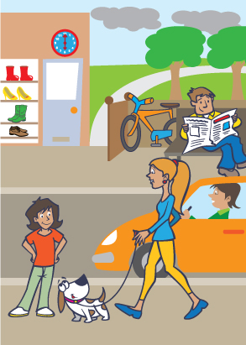
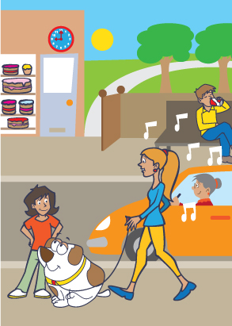
1) Menciona dos diferencias.
2) Responde a dos preguntas.
3) Haz dos preguntas.
B
Notes:
Get them to do this task as students (5 mins)
Pictures and task taken from ASSET Breakthrough speaking task – grade 3
1) Menciona dos diferencias.
2) Responde a dos preguntas.
3) Haz dos preguntas.

Slide 35
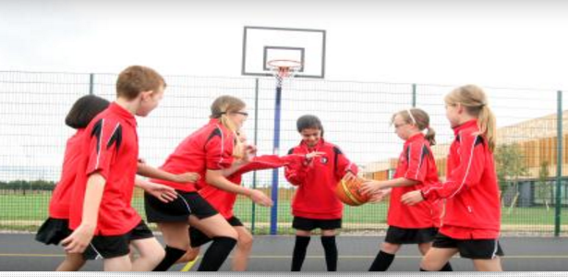
¿Est-ce que tu joues au basket?
Avec qui…?
Où?
Quand…?
Pourquoi…?

Slide 36
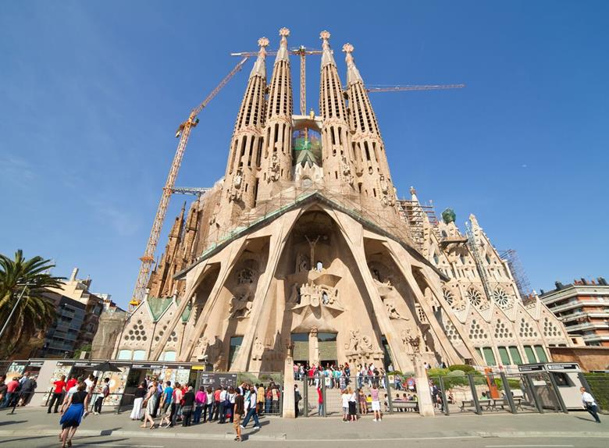

¿Qué hay en la foto?
¿Cómo es …?
¿Dónde está…?
¿Qué hacen?
People
Action
Location
Mood
(Weather)
Notes:
Aiming to elicit:
En la foto hay un edificio / un monumento / una iglesia (not exactly a catedral, it’s a basilica)
El edificio / la catedral es grande, enorme, bonito/a, histórico/a, antiguo/a – (started 1882 - ?? possible completion date - 2026?), impresionante, importante, alto/a
También hay unas personas (que visitan el monumento).
Las personas son turistas.
En mi opinión / Pienso que está en España.
También hay unos edificios modernos y una palmera, una grúa (crane).
NB: the greyed out questions are extension – additional for higher attaining students.

Slide 37
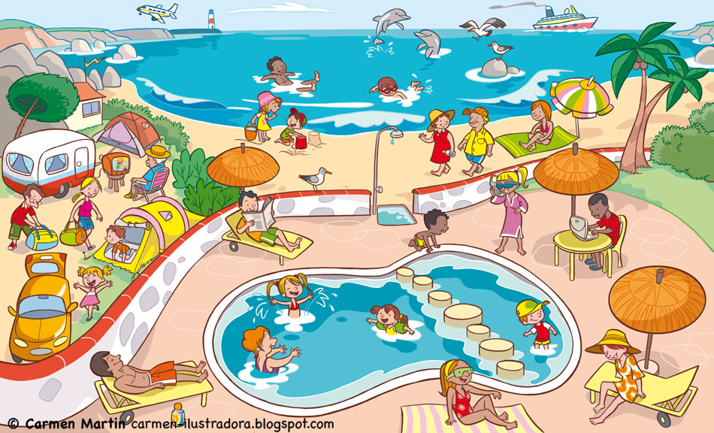
¿Qué hay en la foto?
¿Cómo es …?
¿Dónde está…?
¿Qué hacen?
People
Action
Location
Mood
(Weather)

Slide 38
¿Qué hay en la foto?
To say who is doing what, change the infinitive.
Remove –ar/-er/-ir and add:
I = -o
you = -as / -es
s/he = -a / -e
we = -amos / -emos / -imos
they = -an /-en
infinitivo
En la foto hay…
muchas personas / mucha gente
un camping / una playa / una piscina etc…
nadar
tomar el sol
escuchar
montar
tocar
descansar
comprar
bailar
usar
estar
jugar* (juego)
hacer* (hago)
ver
leer
salir* (salgo)
ir*
¿Qué tiempo hace?
Hace…
(No) llueve / nieva.
Más vocabulario:
en el mar / en la piscina
a caballo / en bici
la guitarra
un helado
el ordenador
al aire libre / de vacaciones
a los videojuegos / al voleibol / a la pelota
deportes acuáticos
submarinismo
la tele / una película
un libro / un periódico / una revista
con mis amigos
de compras / de excursión (en barco) / de paseo
¿Qué hace la gente?
Todas las personas…
Unas persons…
Otras personas…
Una persona … (un hombre / una mujer un chico / una chica)
Y tú, ¿Qué haces normalmente en verano / en invierno?

Slide 39
¿Qué hay en la foto?
To say who is doing what, change the infinitive.
Remove –ar/-er/-ir and add:
I = -o
you = -as / -es
s/he = -a / -e
we = -amos / -emos / -imos
they = -an /-en
infinitivo
En la foto hay…
muchas personas / mucha gente
un camping / una playa / una piscina etc…
nadar
tomar el sol
escuchar
montar
tocar
descansar
comprar
bailar
usar
estar
jugar* (juego)
hacer* (hago)
ver
leer
salir* (salgo)
ir*
¿Qué tiempo hace?
Hace…
(No) llueve / nieva.
Más vocabulario:
¿Qué hace la gente?
Todas las personas…
Unas persons…
Otras personas…
Una persona … (un hombre / una mujer un chico / una chica)
Y tú, ¿Qué haces normalmente en verano/ en invierno?

Slide 40
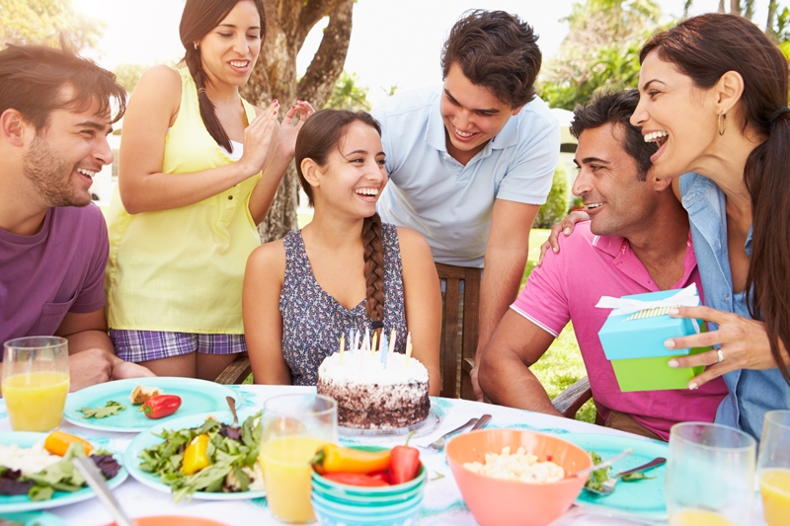
Escribe dos frases verdaderas y una frase falsa.
Luego haz ‘Quiz-Quiz-Trade’ en clase.
People
Action
Location
Mood
(Weather)

Slide 41
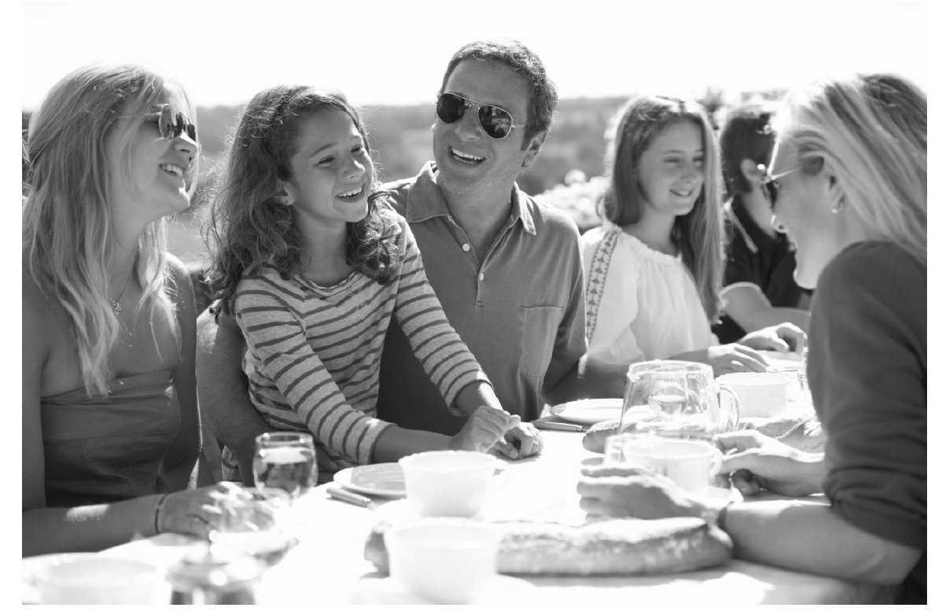
Qu’est-ce qu’il y a sur la photo?
¿Qué hay en la foto?
Was gibt es auf dem Foto?
People
Action
Location
Mood
(Weather)

Slide 42
Language functions/structures | Examples from the model answer
Physical description | tiene el pelo largo y marrón
Action | están comiendo y charlando, todos están sonriendo
Location | en la foto hay…, en el centro, a la derecha, al lado del (padre), en el fondo, están sentados, en una mesa, fuera,
Mood | están contentos, están sonriendo
Weather | hace mucho sol y calor
Speculation / Hypothesis | A lo mejor, podría ser, quizás, a mi parecer, en mi opinión, podrían estar, pienso que, parece, posiblemente, por lo visto, parecen, creo que
Reasons / Justifications | porque, pero, aunque, porque
Negation – i.e. Saying what isn’t there | no es un picnic, no se puede ver mucho en el fondo, no hay regalos ni tarta
General → specific vocabulary | un grupo de personas → una familia → el padre, la madre, una chica un event especial / una celebración → un cumpleaños

Slide 43
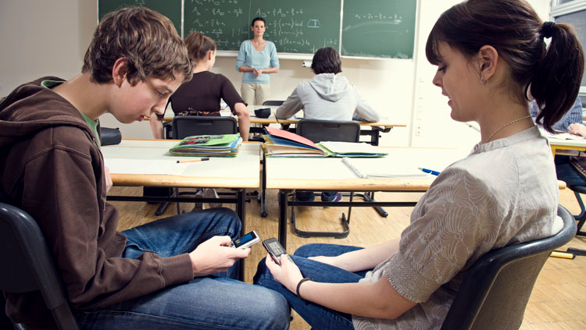
Vrai ou faux?
R
1. Il y a cinq personnes dans la photo.
F
2. Ils sont chez eux.
F
3. Les élèves portent un uniforme.
R
4. C’est un cours de mathématiques.
F
5. Tous les élèves travaillent bien .
Notes:
True/False

Slide 44
Vrai ou faux?
1. Il y a cinq personnes dans la photo.
2. Ils sont chez eux.
au collège.
3. Les élèves portent un uniforme.
4. C’est un cours de mathématiques.
5. Tous les élèves travaillent bien .
Notes:
True/False

Slide 45
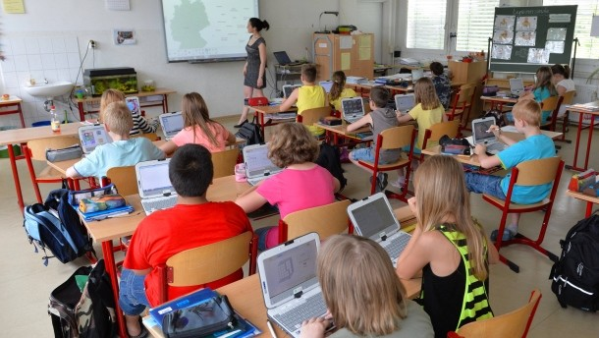
des infinitifs
to be*
to learn
to work
to write
to teach
to read
to speak
to wear
être
apprendre
travailler
écrire
enseigner
lire
parler
1. It is a school.
2. There are some pupils.
3. The teacher is teaching geography.
4. The pupils are working on computers.
5. They are not wearing a school uniform.
6. They are learning geography.
7. The teacher is speaking.
8. The pupils are not speaking.
porter
il y a
there is/are =
The teacher One boy One girl
The pupils The people
le/la prof
un garçon
une fille
les élèves
les gens
Notes:
Translate vocabulary, then sentences.
Focus on 3rd person singular and plural forms.

Slide 46
1. C’est un collège
1. It is a school.
2. There are some pupils.
3. The teacher is teaching geography.
4. The pupils are working on computers.
5. They are not wearing a school uniform.
6. They are learning geography.
7. The teacher is speaking.
8. The pupils are not speaking.
2. Il y a des élèves.
3. La prof enseigne la géo
4. Les élèves travaillent à l’ordinateur.
5. Ils ne portent pas d’uniforme.
6. Ils apprennent la géo
7. La prof parle.
8. Les élèves ne parlent pas.
Notes:
Whenever possible, use the 3rd person plural – it’s the same as the infinitive, and never irregular so much easier to get accurate!
Reminder that is/are + -ing in English is JUST THE PRESENT TENSE in GERMAN.

Slide 47
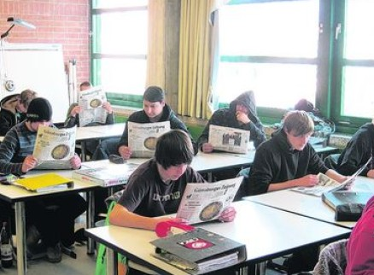
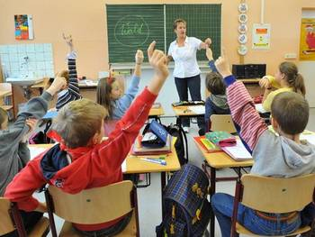
A
Ecris les phrases en français.
1. The pupils are in school.
2. They are reading the newspaper.
3. All the pupils are working.
4. It is a secondary school.
5. It is a primary school.
6. They are answering questions.
B
Photo A ou Photo B?

Slide 48
A
Ecris les phrases en français.
1. The pupils are in school.
2. They are reading the newspaper.
3. All the pupils are working.
4. It is a secondary school.
5. It is a primary school.
6. They are answering questions.
1. Les élèves sont au collège.
2. Ils lisent un journal.
3. Tous les élèves travaillent.
B
4. C’est une école secondaire.
5. C’est une école primaire.
6. Ils répondent aux questions.
Photo A ou Photo B?
le journal (the newspaper)
répondre (to answer)

Slide 49
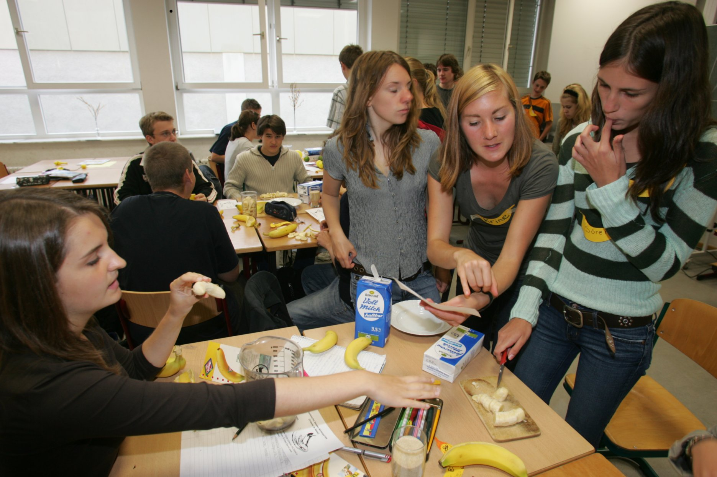
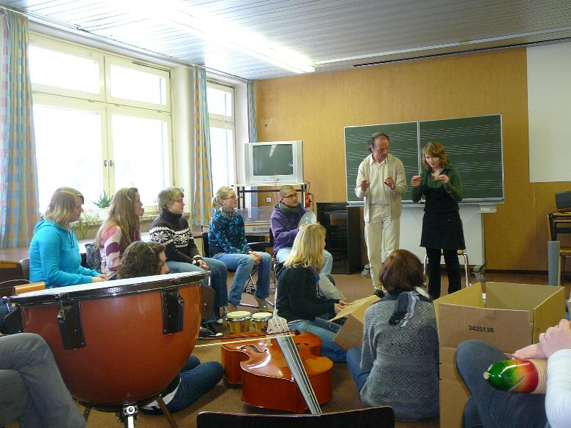
Ecris quatre phrases. Une phrase doit être fausse.
1
2
3
4
Ecris quatre phrases. Une phrase doit être fausse.
1
2
3
4

Slide 50
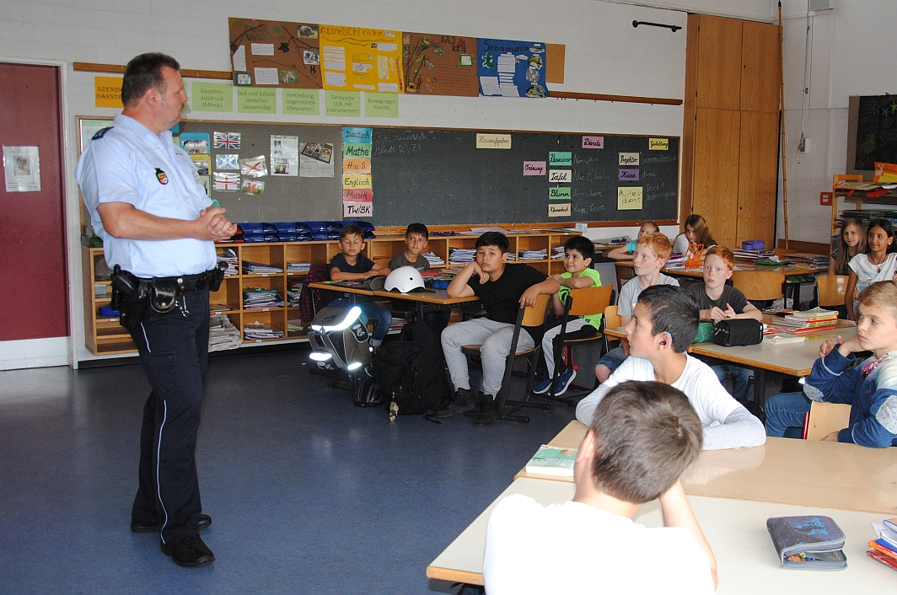
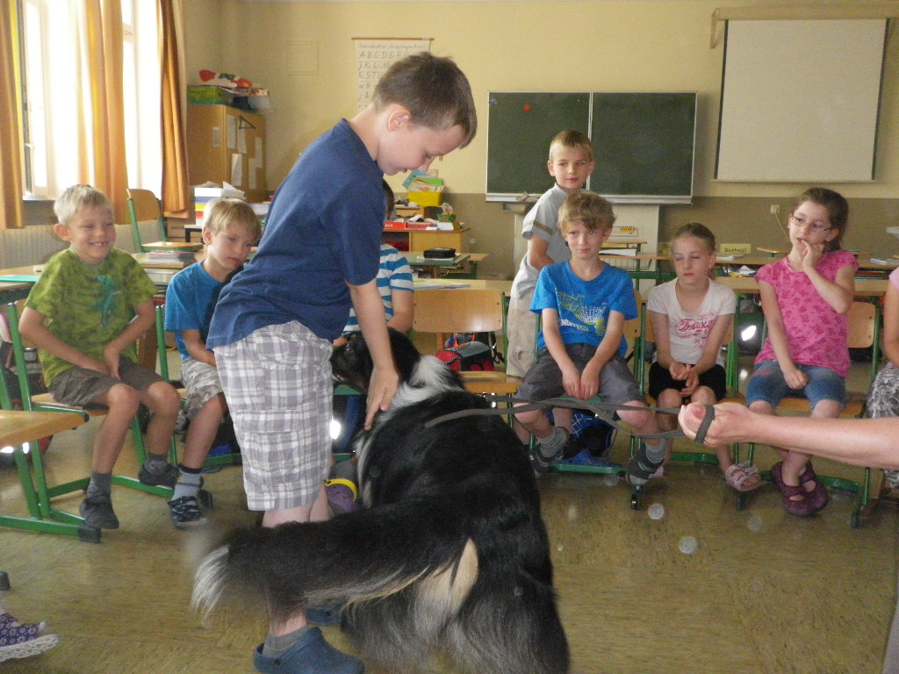
Ecris quatre phrases. Une phrase doit être fausse.
1
2
3
4
Ecris quatre phrases. Une phrase doit être fausse.
1
2
3
4

Slide 51
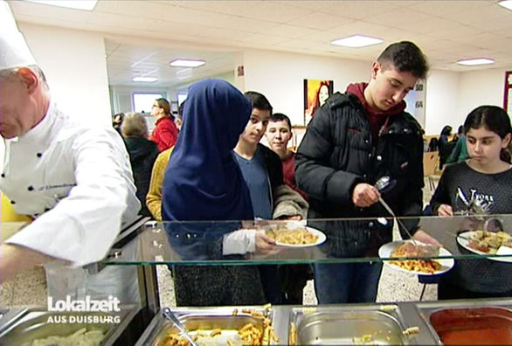
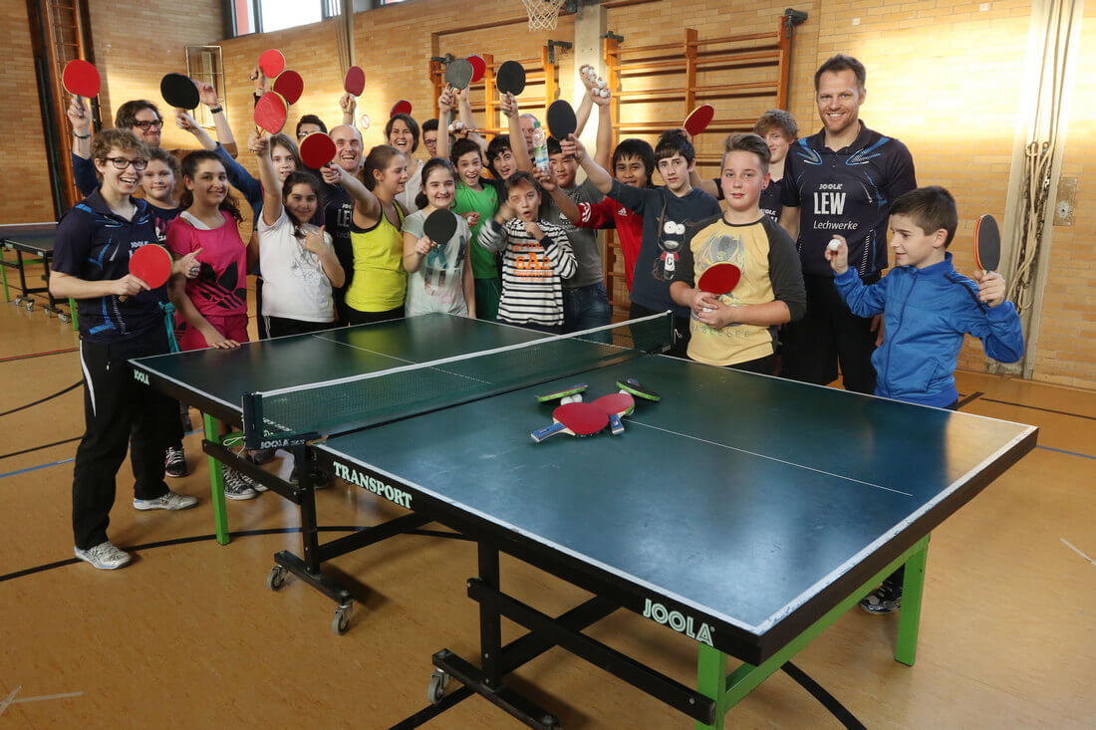
Ecris quatre phrases. Une phrase doit être fausse.
1
2
3
4
Ecris quatre phrases. Une phrase doit être fausse.
1
2
3
4

Slide 52

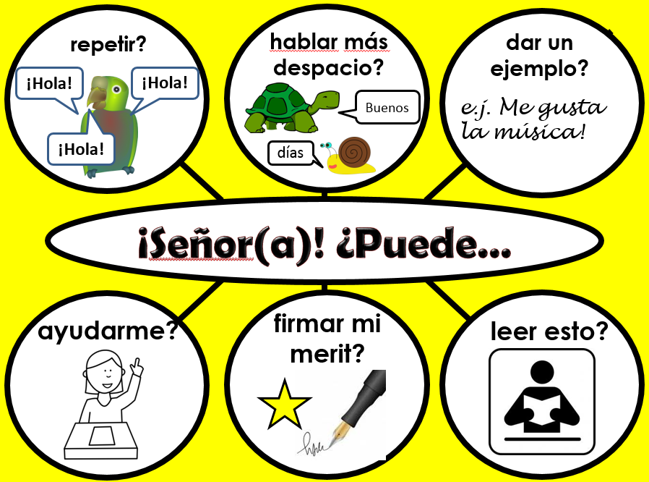
4 Interaction language needs teaching. Introduce key structures and encourage students to use and re-use them often.
http://www.tes.co.uk/teaching-resource/French-Classroom-Display-6336471/
http://www.tes.co.uk/teaching-resource/Spanish-Classroom-Display-6336470/
http://www.tes.co.uk/teaching-resource/German-Classroom-Display-6340641/

Slide 53






content(e)
fatigué(e)
le meilleur/
la meilleure!
Je suis…
triste
malade
perdu(e)

Slide 54







aller à mon cours de musique?
consulter mon vocabulaire?
m’asseoir là?
Je peux…
aller aux toilettes?
travailler avec…?
utiliser un dictionnaire?

Slide 55








travailler à deux?
parler?
écrire?
Il faut…
mémoriser?
coller?
vous donner nos cahiers?

Slide 56






répéter?
parler plus lentement?
donner un exemple?
Salut!
Salut!
Bonjour
ex: J’adore la musique!
Salut!
Ça va?
Pouvez-vous…
m’aider?
signer mon mérite?
lire ça?

Slide 57

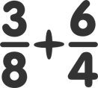




facile
difficile
pas mal
assez
très
C’était…
un peu
rigolo!
affreux!
ennuyeux
Ha ha ha!

Slide 58






fini
oublié
gagné
J’ai / Je n’ai pas…
mon cahier
perdu
compris

Slide 59








un problème
tout bon!
une idée
J’ai…
Geburtstag
un chien
faim/soif
mal à la tête
einen Hund
perdido

Slide 60







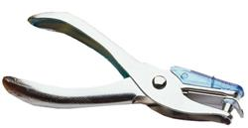
Belohnungskarte
Sprich Deutsch!
- Use the German talk mat to help you talk in German in the lesson.
- Over time try to use language from all categories.
- These are shown on your reward / punch card by these symbols/emojis:
- We will use the holepunch to punch the right category.
Wer?
Doktor Hawkes
der Klassensprecher (this role will rotate every week).

Slide 61
















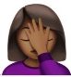























[3]
Wie geht’s? Mir… geht’s toll / gut. geht’s schlecht. ist kalt. ist heiβ. Ich bin krank. Ich bin müde. | Ich habe… es richtig. ein Problem. eine Idee. Hunger. Durst. Kopfschmerzen. einen Hund. vergessen. | Wie? Wo? Wann? Was? Wer? Mit wem? Warum? Wie viel? Wie viele? Welcher / welche / welches? Was für? Um wie viel Uhr? | Wie war es? Es war… einfach. schwierig. in Ordnung. lustig. langweilig. total schlecht. (sehr, ziemlich, ein bisschen)
Darf ich… einen Kuli haben? Papier/ein neues Heft haben? zu meiner Musikstude gehen? aufs Klo gehen? mit … arbeiten? ein Wörterbuch verwenden? | Müssen wir…? zu zweit arbeiten? schreiben? sprechen? das auswendig lernen? das einkleben? die Hefte abgeben? | Können Sie..? das wiederholen? langsamer sprechen? ein Beispiel geben? mir helfen? hier unterschreiben? das lesen? | Wie sagt man..? Wie schreibt man…? Was denkst du? Ich denke, …ist… Ja, das stimmt. Nein, das stimmt nicht. Ich auch. / Ich nicht. Ich weiß es nicht. Und du? Magst du…? Ich mag / Ich mag…nicht. Es ist mir egal. Spinnst du?! Ich verstehe (nicht).
[1]
[2]
[4]
Partnerarbeit
Los! | Ich bin dran.
Komm! | Du bist dran.
Du beginnst. | Du schummelst!
Würfle!. | Mach das nicht!
[5]
[6]
[7]
[8]
Guten
Tag!
Ich mag…
z.B. Popmusik!

Slide 62
8-Deutsch
HAMBURG
8-Deutsch
HAMBURG
8-Deutsch
HAMBURG
8-Deutsch
HAMBURG

Slide 63
Nivel 1 | How do you say…in German?
Nivel 2 | I think …is…
Nivel 3 | Yes, that’s right. Me, too!
Nivel 4 | No, that’s not right. Are you mad?!
Nivel 5 | I don’t know. What do you think?
Nivel 6 | I don’t care!
Wie sagt man…auf Deutsch?
Ich denke…ist…
Ja, das stimmt. Ich auch!
Nein, das stimmt nicht.
Spinnst du?!?!
Ich weiβ es nicht.
Was denkst du?.
Es ist mir egal!

Slide 64



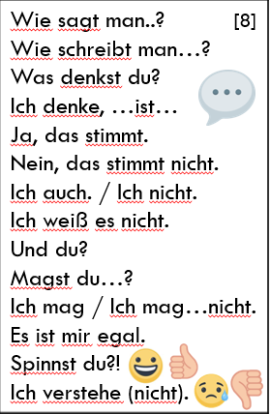
2
3
1 Ask a question
2 Give an answer
3 Agreeing
4 Disagreeing
5 Uncertainty
6 Disinterest
7 Ask someone else
Ich denke, …ist…
Ja,das stimmt.
1
Ich auch.
Wie sagt man…?
7
Und du?
Was denkst du?
‘bee’ auf Deutsch?
4
Nein, das stimmt nicht.
6
Ich nicht.
Es ist mir egal.
5
Du spinnst!
Ich weiß es nicht.

Slide 65
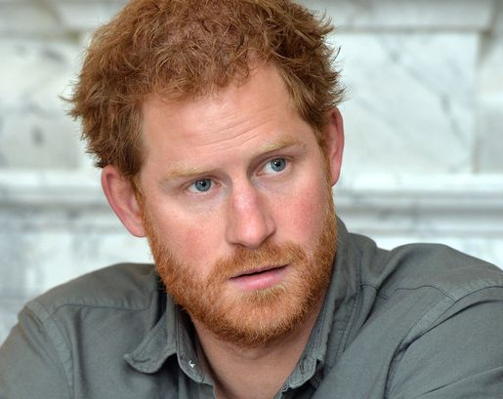
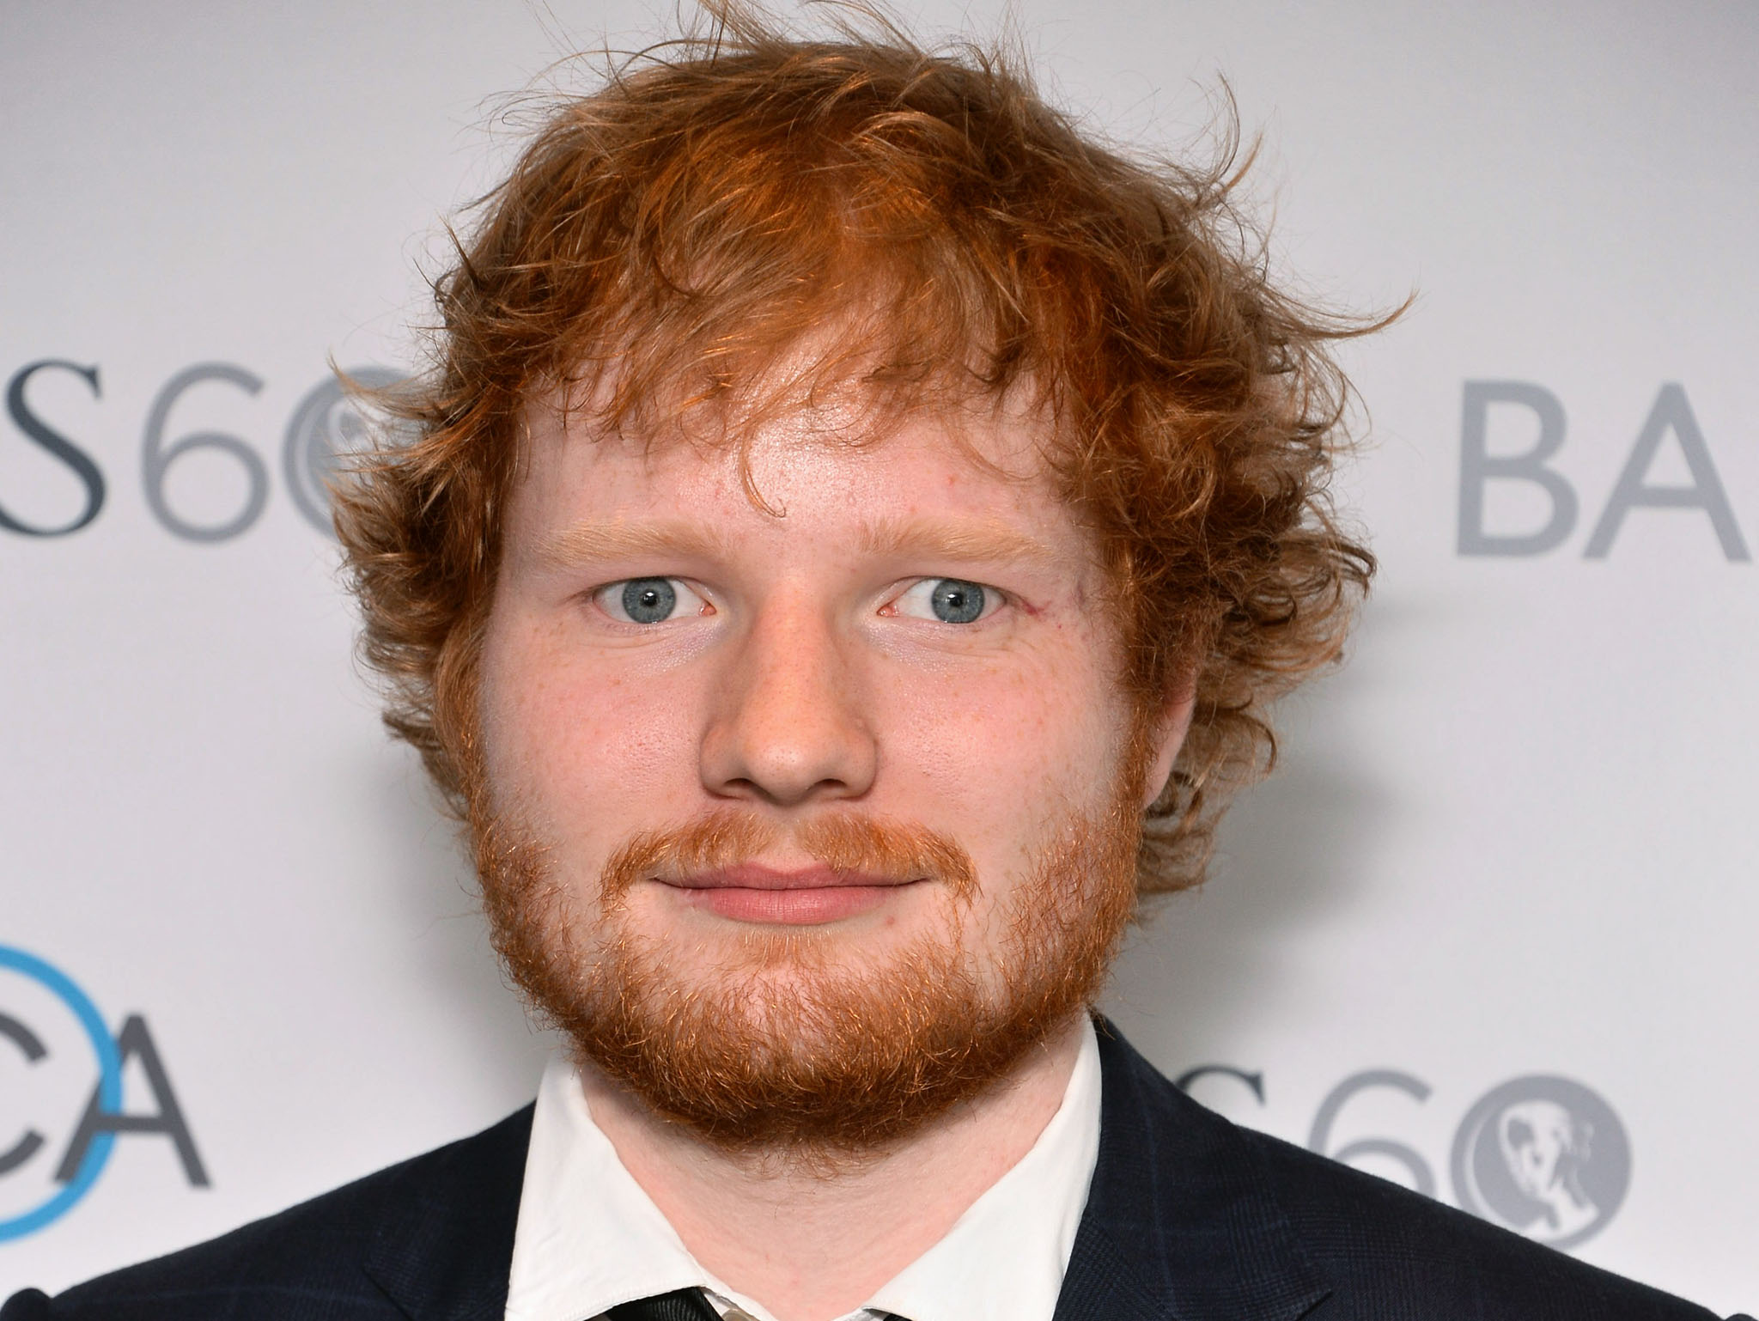
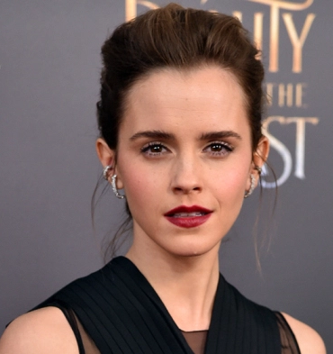
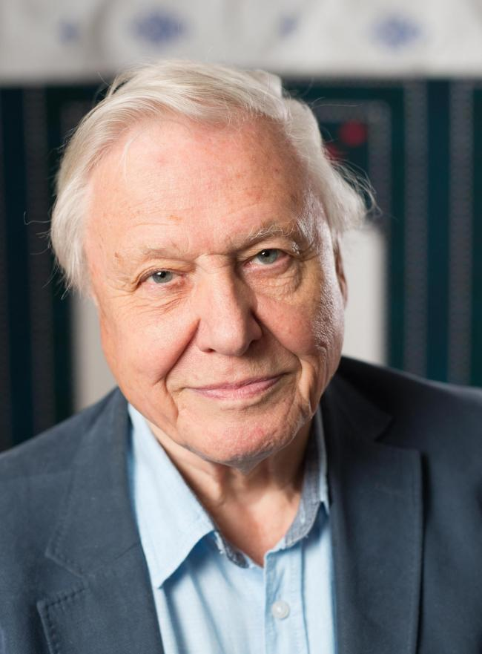

Wer ist das?
Wie alt ist er / sie?
27
33
26
1
91
Notes:
1. Prince Harry – 33
2. Ed Sheeran - 26
Emma Watson – 27
David Attenborough – 91
Finding Dory – 1

Slide 66
Tarjeta de puntos
¿Cuánto español uso en clase?
- Use the Spanish talk mat to help you talk in Spanish in the lesson.
- Over time try to use language from all categories.
- These are shown on your reward / punch card by these symbols/emojis:
- We will use the holepunch to punch the right category.
¿Quién?
Señorita Vázquez
El responsable (this role will rotate every week).

Slide 67



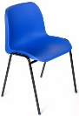






[3]
¿Cómo estás? Estoy… fenomenal. bien. confundido/a. cansado/a. enfermo/a. fatal. | Tengo… todo correcto. un problema. una idea. hambre. sed. dolor de cabeza. un perro. calor / frío | ¿Cómo? ¿Qué? ¿Dónde? ¿Cuándo? ¿Quién? ¿Con quién? ¿Por qué? ¿Cuánto? ¿Cuántos / as? ¿Cuál? ¿Qué tipo de? ¿A qué hora? | ¿Cómo fue? Fue… fácil. difícil. así así. divertido. aburrido. fatal. (muy, bastante, un poco)
 |  | En parejas Te toca a ti Has perdido Me toca a mí He ganado Tú empiezas ¡No hagas eso! Yo empiezo ¡Estás hacienda trampa!
¿Puede..? repetirlo? hablar más despacio? dar ejemplo? ayudarme? firmar mi mérito? leerlo ? | ¿Tenemos que…? trabajar en pareja? escribir? hablar? memorizarlo? pegarlo? entregar los cuadernos? | ¿Puedo..? sentarme allí? ir a mi clase de música? mirar en mi guía de vocabulario? ir al baño? trabajar con..? usar el diccionario? | ¿Cómo se dice..? ¿Cómo se escribe? ¿Qué piensas? Pienso que …es… Sí, es verdad / No, es mentira Yo también / Yo tampoco ¿Y tú? No lo sé. No estoy seguro /a Me da igual (=) ¿Te gusta…? ¿Estás loco/a?! ¿Tienes (un boli/una goma)? Necesito… (papel, un cuaderno nuevo, etc.).
[1]
[2]
[4]
[5]
[6]
[7]
[8]
Un animal
ej. Un perro

Slide 68
AÑADIR TEXTO AQUÍ
AÑADIR TEXTO AQUÍ
AÑADIR TEXTO AQUÍ
AÑADIR TEXTO AQUÍ

Slide 69



5 Keep the language of pair and group tasks more straightforward than teacher – student talk. There can be a mixture of language ‘practice’ and ‘use’ tasks.
NB: Simply having students mix up the order of their questions invokes spontaneity, as students have to respond to the unexpected.

Slide 70

Use a variety of tasks, as appropriate to the age, ability and interest of the pair / group:
(i) tandem
(ii) speed-dating
(iii) speaking lines
(iv) brainstorming
(v) give one, get one
(vi) target talk
(vii) telepathy
(viii) pair share
(ix) say something else
(x) spend the words

Slide 71
References
Hawkes, R. (2012) Learning to talk and talking to learn: how spontaneous teacher–learner interaction in the secondary foreign languages classroom provides greater opportunities for L2 learning, unpublished PhD thesis, University of Cambridge.
Lantolf, J.P. (2000) ‘Second language learning as a mediated process’, in Language Teaching 33: 79–96.
Long, M.H. (1985) ‘Input and second language acquisition theory’ in S. Gass and C. Madden (eds) Input in second language acquisition (377–393), Rowley, MA:
Office for Standards in Education (Ofsted) (2008) The changing landscape of languages: an evaluation of language learning 2004/2007, London: HMSO.
Office for Standards in Education (Ofsted) (2011) Modern languages: achievement and challenge 2007–2010, London: HMSO.
Salter, M.V. (1989) Languages for communication: the next stage: recommendations for action, London: DES and CILT.
Swain, M. (2000) ‘The output hypothesis and beyond: mediating acquisition through collaborative dialogue’ in J.P. Lantolf (ed.) Sociocultural Theory and Second Language Learning (97–114), Oxford: Oxford University Press.

Slide 72

Speak to me!
Spontaneous speaking and how to achieve it.
www.rachelhawkes.com
rhawkes@catrust.co.uk
@rachelhawkes60
Notes:
Speaking a foreign language is something most students admit to wanting to be able to do. Yet this is not always what happens in the classroom. This session explores how we as teachers can create the conditions for talk, and offers specific tasks and ideas that work with all learners.

Slide 73

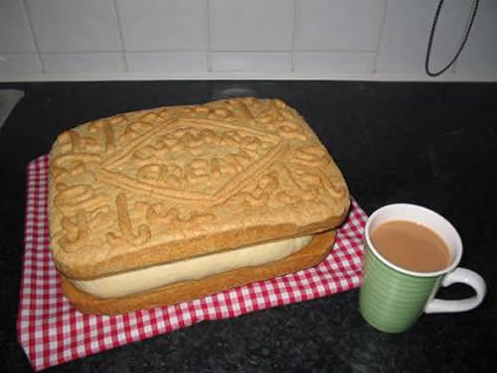
Grade 5
Links | y, también, pero, o, además, sin embargo, por eso, así que, primero, luego, después, por último, a menudo, a veces
Opinions and reasons | Creo que / Pienso que / Me parece que / En mi opinión / Para mí un poco, bastante, muy, demasiado
Variety of structures | Verb + infinitive: se puede / se debe / me gusta (etc.) / me gustaría / tengo que /quiero /espero / tengo la intención de /se debería Comparatives – más que / menos que Superlatives – el/la mejor, el/la peor
Extended sentences | Clauses with: porque, ya que, aunque, cuando, donde, que, si
Interesting vocabulary | don’t repeat interesante / aburrido!
Tenses | present, preterite, near future

Slide 74
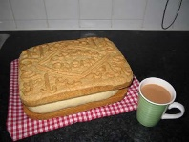
Grade 8/9
Links | y, también, pero, o, además, sin embargo, por eso, así que, por lo tanto, primero, luego, después, por último, a menudo, la última vez que…, por desgracia, sobre todo, incluso, en cambio, a causa de, gracias a, a pesar de
Opinions and reasons | Creo que/Pienso que / Me parece que / En mi opinión / Para mí / A mi modo de ver / Desde mi punto de vista / A mi juicio Verbs of opinions referring to others: A mi madre le encanta… Verbs of opinion in the past: me gustó… Lo que más/menos me gusta/gustó es que/fue que… para + infinitive – to explain something you do/did un poco, poco, bastante, muy, demasiado Exclamations: ¡Qué miedo! ¡Ni hablar!
Variety of structures | Verb + infinitive: se puede / se debe / me gusta (etc.) / me gustaría / tengo que /querer /poder / esperar / tener la intención de /se debería / quisiera / hay que / está prohibido/permitido / soler / acabar de / volver a/ empezar a / dejar de / terminar de / decidir Comparatives – más/menos que, tan…como, tanto/a/os/as + noun + como Superlatives – el/la menos…/más, el/la mejor/peor Absolute superlatives: muchísimo / importantísimo Range of negatives: no…nada, nunca, nadie, ningún/ninguna, ni…ni… Direct and indirect object pronouns, desde hace, desde que, no solo…sino también..
Extended sentences | 1. Sentences with more than one tense (e.g. antes..pero ahora…) 2. Comparing/referring to self and others 3. Contrasting two points of view – por un lado…por otro lado, una ventaja…otra ventaja 4. Complex sentences with: porque, ya que, dado que, aunque, cuando, donde, que, si (& some that need the subjunctive: para que, antes de que, con tal de que, siempre que, hasta que) 5. Phrases which introduce the subjunctive, e.g. Es importante que … (It is important that …) Es probable que … (It is likely that …) Espero que … (I hope that …) Quiero que … (I want …) No creo que … (I don’t believe that …), Me molesta que…, No es justo que… 6. Antes de / Después de + infinitive,…
Interesting vocabulary | A range of more unusual verbs and adjectives, and idioms
Tenses | present, present continuous, preterite, near future, future, imperfect, imperfect continuous, perfect, pluperfect, impersonal verbs, present subjunctive, imperfect subjunctive ®, passive ®

Slide 75
Grade 5
Links | et, aussi, mais, ou, en plus, qui plus est, cependant, pour cette raison, donc, d’abord, ensuite, et puis, après, enfin, souvent, quelque fois, de temps en temps, rarement, toujours
Opinions and reasons | je crois que / je pense que / il me semble que / il me paraît que / A mon avis / selon moi un peu, assez, très, trop, peu
Variety of structures | Verb + infinitive: on peut / on doit / il faut/ j’aime (etc.) / je voudrais / j’ai envie de / il me faut /je veux /j’espère / j’ai l’intention de / je devrais / je compte Comparatives – plus… que / moins… que / meilleur / pire Superlatives – le/la/les plus…/moins… / le meilleur, le pire
Extended sentences | Clauses with: parce que, puisque, car, quand, où, qui / que, si + present, future, si + imperf + conditional (set phrases only)
Interesting vocabulary | don’t repeat intéressant / ennuyeux / super
Tenses and moods | present, passé composé, near future, conditional (voudrais)

Slide 76
Grade 8/9
Links | et, aussi, mais, ou, en plus, qui plus est, cependant, pour cette raison, donc, d’abord, ensuite, et puis, après, enfin, souvent, quelque fois, de temps en temps, rarement, toujours, ce qui fait que, d’où il résulte que, par conséquent, heureusement, malheureusement, par contre, néanmoins, surtout, en ce qui concerne, malgré (le fait que), à cause de, à cause du fait que
Opinions and reasons | Je pense que/ je crois que / il me paraît que / il me semble que/ Selon moi/ à mon avis/ selon mon point de vue/ Verbs of opinions referring to others: il y en a qui pensent que / certains disent que / la plupart des gens aiment, etc. Verbs of opinion in the past: j’ai apprécié / il m’a plu / j’ai bien aimé…Ce que j’ai aimé le plus/ Ce qui m’a plu, c’était …/ pour + infinitive quantifiers: un peu, peu, assez, très, trop Exclamations: quelle horreur! Quel désastre!
Variety of structures | Verb + infinitive: on peut / on doit / il faut/ j’aime (etc.) / je voudrais / j’ai envie de / il me faut /je veux /j’espère / j’ai l’intention de / je devrais / je compte / il est interdit de / il est permis de / Verb + à / de: commencer à / réussir à / finir de / décider de / venir de / êre en train de Comparatives – plus… que / moins… que / meilleur / pire Superlatives – le/la/les plus…/moins… / le meilleur, le pire depuis / depuis que / Range of negatives: ne…pas /ne...plus/ne…jamais/ne…que/ne…ni..ni / ne… aucun / Direct and indirect object pronouns, y, en
Extended sentences | 1. Sentences with more than one tense (e.g. avant…mais maintenant…) 2. Comparing/referring to self and others 3. Contrasting two points of view – d’une part…d’autre part, un avantage est que, un inconvenient est que 4. Complex sentences with: parce que, puisque, car, étant donné que, quand, , où, qui/que, (& some that need the subjunctive: pour que, avant que, bien que 5. Phrases which introduce the subjunctive, e.g. il faut que … (one must…) il est probable que … (It is likely that …) je veux que … (I want …) je ne pense pas que … (I don’t believe that …), ce n’est pas juste que…, je doute que... (I doubt that …), il est possible que (it is possible that …), il se peut que (Maybe/It’s possible that…) 6. avant de + infinitive / en…...ant / après avoir + pp / après être + pp + agreement / ayant + pp
Interesting vocabulary | A range of more unusual verbs and adjectives, and idioms: Vouloir, c’est pouvoir! tout est bien qui finit bien!
Tenses and moods | present, passé composé, near future, future, conditional, imperfect, pluperfect, conditional perfect, impersonal verbs, present subjunctive, imperfect subjunctive ®, passive ®

Slide 77

Grade 5
Links | und, aber, oder, denn, entweder ... oder ... (+WO1) außerdem, deshalb, jedoch, ab und zu, manchmal, oft, dann, danach, früher, später, natürlich, im Großen und Ganzen, neulich, letzte Woche, nächstes Wochenende/Jahr (+WO2)
Opinions and reasons | ich denke, ich glaube, ich finde, ich mag, ich hasse, ich [snap verb] gern/lieber/am liebsten, ich liebe, meiner Meinung nach ein bisschen, ziemlich, sehr, echt, wirklich, viel, zu, total, völlig
Variety of structures | Present tense modal verbs (+ inf): ich darf, kann, muss, will… Past tense modal verbs (+ inf): ich durfte, konnte, musste, wollte… ich möchte, es gibt, es gab, ich/es hatte, ich/es war Comparatives - e.g. einfacher, schwieriger, besser als … Superlatives – e.g. am einfachsten, am schwierigsten, am besten
Extended sentences | denn (+WO1) weil/da, dass, obwohl, wenn, als (+WO3) um... zu + infinitive
Interesting vocabulary | Try to avoid gut, nicht gut, toll, interessant, langweilig!
Tenses | present, perfect, simple past (haben, sein, modal verbs), future

Slide 78
Grade 8/9
Links | ohne Zweifel, sonst, trotzdem, leider, deswegen, eigentlich, zufällig etc.
Opinions and reasons | Ich interessiere mich für …, Am liebsten …, Es macht Spaß/hat Spaß gemacht, … + infinitive, Ich kann … nicht leiden, Das Beste/Schlechteste/Wichstigste daran ist …, Mir ist klar, dass …, ein großer Vorteil/Nachteil ist, Es wäre viel besser, wenn … (+ conditional), Es geht mir auf die Nerven, Mir gefällt/gefallen …, Ich freue mich darauf, Das kann zu (Problemen) führen, Das finde ich schade, Es kommt darauf an, ob … relativ, besonders, irrsinnig, bestimmt, vielleicht, wahrscheinlich
Variety of structures | verbs used with zu + infinitive: Ich plane, … zu + inf, ich hoffe, … zu + inf, ich habe Lust, … zu + inf, ich habe vor, … zu + inf, ich versuche, … zu + inf weder… noch …, nicht nur… sondern auch … seit, statt, trotz, während, wegen (+ R4) nichts Besonderes, viel Neues, etwas Schreckliches, wenig Interessantes separable verbs, e.g. teilnehmen, vorbereiten, zurückkommen, stattfinden, einladen, auswählen impersonal verbs, e.g. es tut mir Leid, es tut weh, es schmeckt, es stimmt, es lohnt sich, es ist mir egal, es gefällt mir [es hat mir gefallen] reflexive verbs, e.g. ich langweilige mich, wir streiten uns, er freut sich (auf), wo treffen wir uns? adjective endings, e.g. es war ein lehrreiches Erlebnis
Extended sentences | two+ tenses in one sentence, e.g. Früher hat mein Vater es gemacht, aber jetzt muss ich es machen. relative pronouns, e.g. Es gibt Leute, die mich inspirieren. Er ist ein Mann, den ich bewundere. use of question words as WO3 conjunctions, e.g. Ich wohne in Berlin, wo es viel zu tun gibt. ohne... zu + infinitive, statt… zu + infinitive conjunctions als ob, bevor, bis, damit, nachdem, ob, während, sobald (+WO3) Einerseits …, andererseits …
Interesting vocabulary | Choose a range of more unusual verbs and adjectives (e.g. ähnlich, unterschiedlich, entsetzlich) & idioms (e.g. Ich habe die Nase voll) Weak nouns, e.g. der Junge, Herr, Mensch, Nachbar, Tourist, Student, Polizist
Tenses | Simple past of common verbs (e.g. ich ging, kam, blieb, aß, trank, las, gab, nahm, sprach, traf, schreib), conditional würde + infinitive (and hätte, wäre, könnte), pluperfect

