Slide 1

Comberton Village College
Saturday 4 February 2012 ISMLA National Conference Speaking: one skill or two? Ideas, strategies and resources for the language classroom.
Rachel Hawkes
Notes:
Project work undertaken with classes in a number of secondary schools over the past few years has led to a greater understanding of the skill of speaking as it relates to foreign language learning. Of particular interest is the notion that planned speaking implicates a different skills set from unplanned speaking; that both have an important place but that teachers might benefit from exploiting more fully opportunities for spontaneous or unplanned target language talk as this has perhaps been a somewhat neglected aspect of pedagogy in the early years of language learning.
This project work overlapped with the writing up phase of my PhD study into spontaneous talk but was separate from it. I will outline very briefly the outcomes from our student questionnaires and analysis thereof and detail briefly where that led us in terms of instruction.
I will then bring in elements of my PhD study, which focused on the spontaneous talk as played out in a teacher-fronted whole class interaction and in particular, focused on the teacher role in creating opportunities for this talk and the learning opportunities that arise as a result.

Slide 2
Comberton Village College
Spontaneous talk: What is it?
Spontaneous contributions in the TL as part of the language of the classroom Unplanned / unscripted talk as part of a lesson task or activity Whole-class teacher-led interactions (that may prime for subsequent pair work)
Rachel Hawkes

Slide 3
Comberton Village College
Why is it important?
Students equate the ability to speak in the TL with learning the language (it is the subject to them) Students believe that what the can produce in unrehearsed situations is what they really know Spontaneous TL use (or lack of it) has been highlighted in every Ofsted report (since records began!) Secondary Curriculum, KS3 Framework and GCSE specifications (not all) highlight its importance
Rachel Hawkes

Slide 4

Linked Up Project Analysis
May 2010
Rachel Hawkes

Slide 5
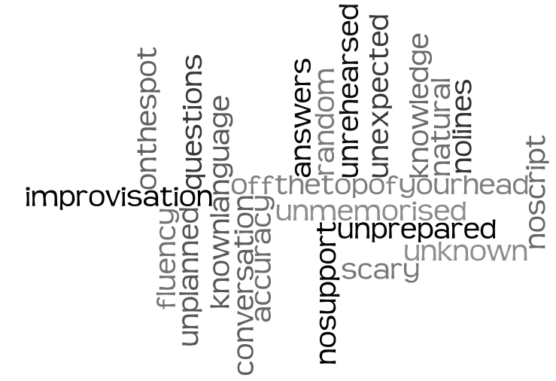
What do you think we mean by unplanned or spontaneous speaking?
289 students from Years 7 – 10 from 5 different secondary schools were asked.
a) Lack of prior preparation
b) Absence of written support
c) The immediacy of the experience
d) Like a conversation
e) Not knowing the questions/answers in advance
Rachel Hawkes

Slide 6
"Because in real life you don't know what the other person is going to say."
2/3 students asked equate spontaneous speaking with ‘real life’ activity.
Why do you think unplanned or spontaneous speaking is an important focus in language learning?
Students feel that what they can do without notes/preparation is what they 'truly' know.
"To make sure you definitely know it and are able to have conversations without reading off a sheet."
They also mention the link between spontaneous speaking and increased confidence.
Rachel Hawkes
Notes:
The vast majority of answers to this question centered on the fact that using the language for a real purpose will involve being able to talk spontaneously. The obvious conclusion to be drawn is that if they are therefore a) not doing any spontaneous speaking in their lessons or b) not feeling that they are getting better at speaking 'without a script' then they are not in their lesson time learning what they need to know to use language in the real world. The implications for motivation are apparent!
Other interesting responses - the link between speaking spontaneously and getting more confident plus the the other element of 'real' - students feel that what they can do without notes/preparation is what they 'truly' know. The suggestion is that what they can only do either from notes or after having a week to memorise is NOT real knowledge.

Slide 7
"They would cope really well because they would speak confidently and spontaneously really easily'
2/3 answers are unrealistic and do not mention strategies or attributes of a language learner in unrehearsed speaking situations.
Define a confident language learner - how would he/she cope in an unplanned speaking situation?
1) Most other answers stress fluency as key
2) Fewer mention accuracy
3) Top set students most likely to mention accuracy AND fluency together
4) A few mention quality of language, including range of vocabulary, tense use, opinions, extended answers - particularly Year 10 learners and 9 top sets
5) Rare answers mention attributes of a confident learner: risk-taking, not afraid of mistakes, responds readily, good pronunciation
6) Very few mentioned these strategies: listen carefully to pick out key words and understand the question, take time to think, use words and structures they know, ignore mistakes and keep going, use gestures and facial expression to help support meaning
Rachel Hawkes
Notes:
1) Around 2/3 students answered this question by stating something like:
"They would cope really well because they would speak confidently and spontaneously really easily' (no idea/unrealistic)
2) Of those that did answer more usefully, there was still not a clear sense of 'how' i.e. strategy use
3) Most answers stress fluency as key
4) Fewer mention accuracy
5) Top set students most likely to mention accuracy AND fluency together
6) A few mention quality of language, including range of vocabulary, tense use, opinions, extended answers - particularly Year 10 learners and 9 top sets
7) Attributes of a confident learner mentioned were: risk-taking, not afraid of mistakes, responds readily, good pronunciation
8) Strategies mentioned (very few answers but very good!) were: listen carefully to pick out key words and understand the question, take time to think, use words and structures they know, ignore mistakes and keep going, use gestures and facial expression to help support meaning

Slide 8
Speaking targets
Give detailed information
Express personal opinions
Justify points of view
Use longer sequences of speech
Use a variety of vocabulary and structures
Use time references
Refer to the past
Refer to the future
Do these speaking targets work for spontaneous talk?
Can learners have these sorts of targets in their heads in an unplanned speaking situation?
If not, what targets or strategies would we give to learners who are trying to hold a 'conversation' in the target language?
Rachel Hawkes

Slide 9
Conclusions:
Emerging from the analysis of our learner questionnaire data and analysis of learner responses to completing the different spontaneous talk tasks we prepared and trialled during this project is the notion that planned speaking implicates a different skills set from unplanned speaking; that both have an important place but that teachers should seek to exploit opportunities for spontaneous or unplanned target language talk as this has in our experience been a neglected aspect of pedagogy.
To encourage learners to approach spontaneous speaking in the classroom more effectively, it may be useful to stress certain skills that underpin unplanned spoken performance as distinct from others that are foregrounded in planned speaking activities.
A provisional list of strategies that may promote spontaneous interaction in the target language is on the next and final slide.
Rachel Hawkes

Slide 10
Listen to the question VERY carefully – work to make sense of it
Buy yourself time with a ‘hesitation’ word
Think of something you know you can say quickly – e.g. Repeat back a couple of words of the question with raised intonation - ¿Todos los días?
Use what you know how to say when you put your answer together (not necessarily exactly what you want to say)
Keep talking for as long as you can – it’s always easy to add in a ‘por ejemplo’ or an opinion
When you are beginning to run out of flow, ask a question! (¿Y tú?)
Use other ‘help’ to get your message across well – i.e. expression, emotion – sound like you mean it + facial expressions + body language + gestures
“A confident language learner wouldn't panic, would listen carefully for key words to respond to and take time to think about answer.”
“A confident learner would use the words they do know to turn the conversation to what they are comfortable to speak about - use heavy facial expression and body language.”
“A confident learner would be able to use what they know already to come up with appropriate responses - and maybe even ask new questions.”
Rachel Hawkes

Slide 11
Comberton Village College
What is the teacher role in spontaneous talk ?
Source of high quality language input for acquisition Contingent feedback Sensitive co-construction Creation of a ‘safe place’ for trial and error Broadening of a learner’s interactional repertoire Inclusion of humour Talking to mean AND implicit reflection on form
Rachel Hawkes
Notes:
Introduce the idea that the teacher role is not ‘in mode’ at the moment. The emphasis in recent times has been away from the teacher and towards pair and group work. In language acquisition research, this is termed task-based learning. Obvious reasons for this:
a. Learners get more opportunity to talk b. Reduces anxiety if learners work in pairs and groups
BUT there are 2 principal problems with this.
1. Learners who share the same mother tongue will ‘fall out’ of TL use when they hit an issue and work around it in L1 – completely natural, not necessarily meaning they don’t learn from the interactions but that they are qualitatively different from those that take place between the teacher and the learner
The teacher is able (not to say that this always happens, but the potential is there) to create very particular interactions with students that provide learning opportunities that are not to be found, in the same way, in pair and group work. These are some of the things that these interactions can provide.
Source of high quality language input for acquisition
Contingent feedback
Sensitive co-construction
Creation of a ‘safe place’ for trial and error
Broadening of a learner’s interactional repertoire
Inclusion of humour
Talking to mean AND implicit reflection on form
But this is not to say that any interaction – e.g. going through answers to an activity in TL, or a grammar drill or a regular Q&A session can provide all of these. The interactions need to have particular features. Primarily they need to:
a. Hand over the role of primary knower to the student – communicative impetus must be with the learner at times in the interaction
Questions must therefore be open (even when closed in form – they need to be open in function)
Responses to learner utterances need to be conversational (interested tone, phatic echos and repetition with raised intonations, exclamations)
Responses need to help to ‘buy’ learners’ time to construct their response – the teacher holds the interactional frame and fills pauses with padding
The correction, if at all, needs to be contained within implicit re-casts, so that the conversational frame remains intact for as long as possible
Humour is extremely important – inserting it and welcoming it from students
The talk must be inviting – students need to want to take part – feel they can enter – teacher needs to actively solicit learner opinions and contributions
It helps if the topic is stable but the individual contributions are unpredictable – the unpredictability retains the interest of learners and provides opportunities for noticing, the stability gives learners time to process for meaning and to think about their own contributions.

Slide 12
Comberton Village College
What about the rest of the class?
Source of high quality language input for acquisition a) The unpredictability and humour of these interactions encourage active listening for comprehension. The stability and continuity of the theme/topic of the talk enable learners to understand longer stretches of interaction (teacher talk and visual stimulus are the scaffolding) ‘Off line’ opportunities for reflection and planning Comparing the talk of teacher and peer Using the time to plan next contribution
Rachel Hawkes
Notes:
That has long been one of the arguments against having significant teacher-learner whole class interaction in a lesson. What is everyone else doing?
With spontaneous interaction, I found that learners were participating in different ways as 3rd parties. If the interactions are unpredictable and humorous and involve their peers saying something unexpected in the TL, other learners can benefit from these interactions in several ways, meaning that participation by proxy - audience, vicarious participation – is just as much a part of the overall interaction as the exchange itself.
Learners in the background make use of the dialogue as a learning resource, a source of input (i.e. they process it for meaning) but they also use it to ‘notice’ language, comparing teacher and learner utterances AND they use the time to plan their next utterances.

Slide 13
Comberton Village College
Spontaneous talk: What is it?
Spontaneous contributions in the TL as part of the language of the classroom Unplanned / unscripted talk as part of a lesson task or activity Whole-class teacher-led interactions (that may prime for subsequent pair work)
Rachel Hawkes
Notes:
So if we return to what we said ‘spontaneous talk in the classroom’ is, we can now begin to think about what we might be trying to add to our practice to trigger it.
And it’s not just one thing. Furthermore, it’s not to say that an either or position is proposed here. Pair work and group work are very important in developing speaking. I am just proposing a specific role also for a particular type of teacher:learner interaction, as well as ideas for more speaking activities that prepare the way for learners to do more ‘off the top of their heads’.
I think that there are obviously certainly types of activities that equip learners better than others for interacting spontaneously, without a script. Sometimes those strategies do involve starting with a script, though, as a springboard.
I’m going to focus mostly on ideas for getting learners to take part in short, structured but unscripted talk activities, i.e. addressing bullet point 2. These, though, over time make it far more likely that learners will contribute spontaneously in the TL between activities, before and after lessons, etc. but that is quite a gradual progression. Definitely important to encourage and reward.
I have a few ideas for how to do that:

Slide 14




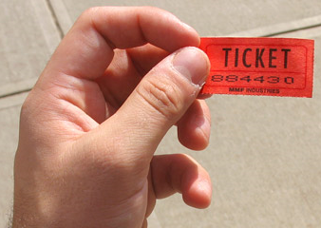
Comberton Village College
Increasing interactivity (spontaneity, sustaining the flow, intonation) Questioning
Rachel Hawkes
REWARDING SPONTANEITY
Notes:
Lots of ways to do this. Try out a different way with different classes. The essential idea is to a. Make it clear that this is something you value extremely highly b. Raise the profile and keep it raised over time. C. provide simple, manageable incentives to do it.
Ideas
1. Raffle tickets
2. Cards with key words (same ones each lesson OR per half term have key topic words included too) – they spread them out on the desk at the start and have to try to use as many as they can by the end of the lesson
Chart on wall or in the backs of their books that they colour in when they have made spontaneous contributions
Have a spontaneous TL monitor each lesson who ticks a register list for each spontaneous contribution (not the same as answering Qs in class)
Annotated seating plan for each lesson for the teacher – record actual utterances against name → phone call home
I use these also to chart the longer exchanges that I plan to have with individuals in a lesson, so that I am not trying to have a longer interaction every lesson with every student but that over a month I would try to have had at least one with all students.
OK, so now if we look at how we plan and prepare for spontaneity with specific task types. This might sound like a paradox – prepare for spontaneity, but spontaneity for learners doesn’t mean spontaneity for the teacher necessarily. Also as I said before, certain tasks teach the specific skills needed for unplanned TL interaction better than others – it is strategy training at times, at other times it is aiming to open up the space for spontaneity and make room for learners to take the initiative, other activities may just help learners glimpse fluency – an aspirational moment where they do feel in command of the words sufficiently that they can ‘say to mean’ without inhibition. Although these activities are scripted and the opposite of spontaneous, in a way, ironically perhaps they have a role to play in this because of the way they build a confident platform from which learners will springboard to greater spontaneity.

Slide 15
Comberton Village College
Lesson ideas and activities
Foretaste of fluency Questions Sentence-building Brief open-ended responses Extending
Rachel Hawkes

Slide 16

Comberton Village College
A foretaste of fluency
Idea 1: 1-2-1 dialogues

Slide 17


Para empezar…
Persona 1: Uno
Persona 2: Dos
Persona 1: Tres
1. En vez de decir la palabra ‘dos’, da una palmada.
1. En vez de decir la palabra ‘tres’, salta.

Slide 18
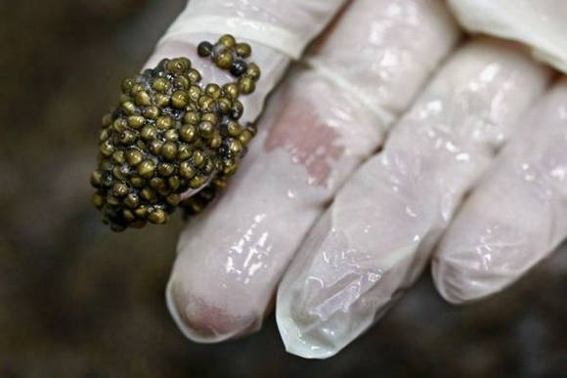

Slide 19





¡Un poco de teatro!
Persona 1: ¿Qué es esto?
Persona 2: No lo sé. Y tú, ¿qué piensas?
Persona 1: ¡No tengo ni idea!

Slide 21
¡Un poco de teatro!
Persona 1: ¿Qué es esto?
Persona 2: No lo sé. Y tú, ¿qué piensas?
Persona 1: ¡No tengo ni idea!

Slide 22
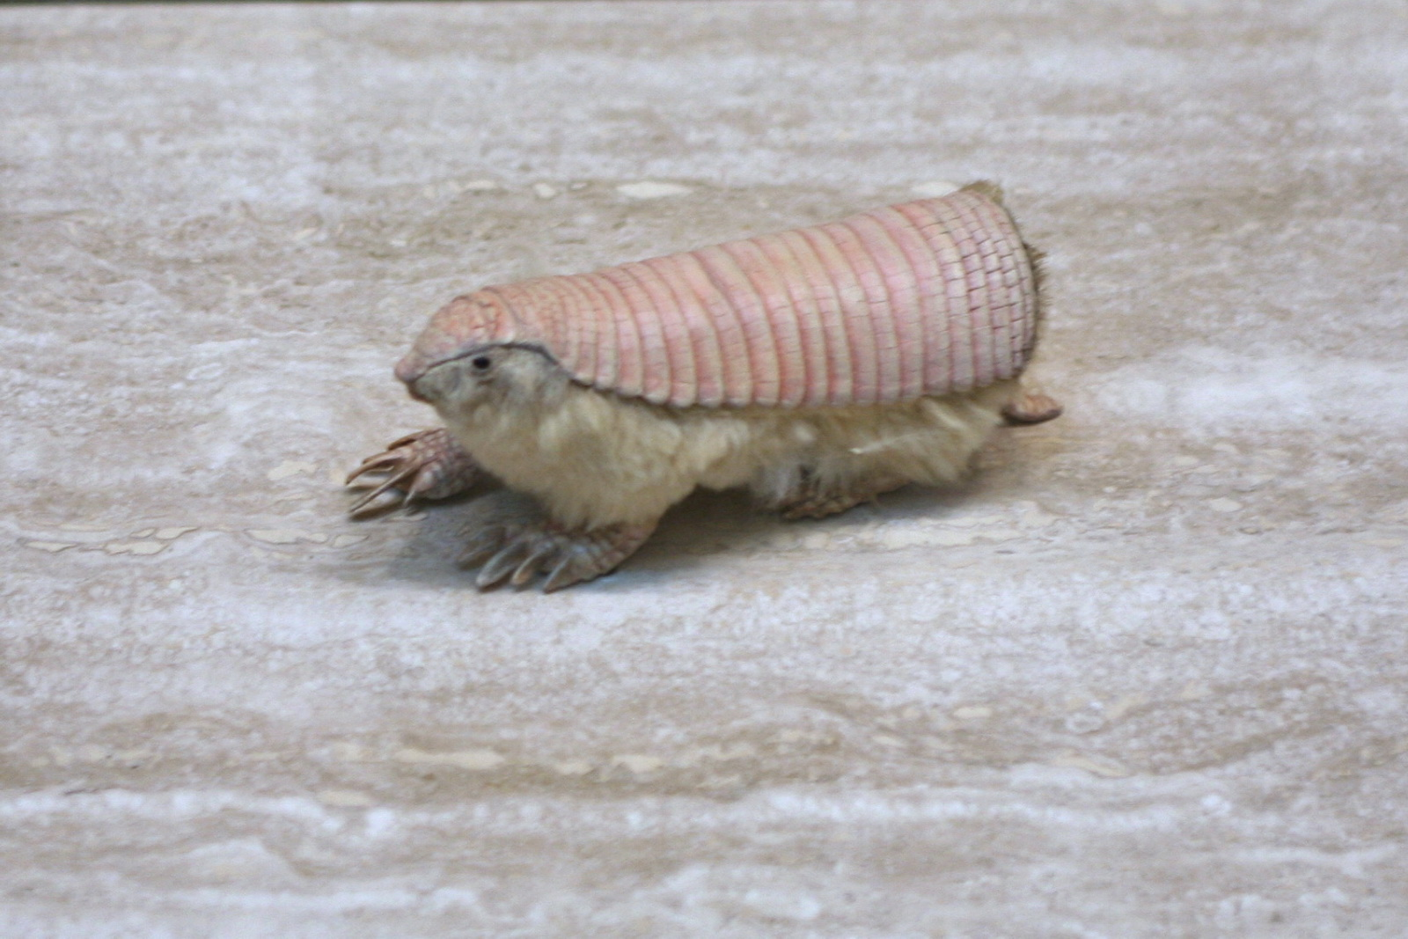

Slide 23
¡Un poco de teatro!
Persona 1: ¿Qué deportes te gustan?
Persona 2: Pues, me gustan mucho los deportes individuales.
Persona 1: ¡Los deportes individuales! ¡Yo prefiero los deportes de equipo!

Slide 24
¡Un poco de teatro!
Persona 1: ¿Qué deportes te gustan?
Persona 2: Pues, me gustan mucho los deportes individuales.
Persona 1: ¡Los deportes individuales! ¡Yo prefiero los deportes de equipo!
Persona 2: A mí me encanta el tenis.
Persona 1: ¿El tenis? Yo prefiero el hockey.

Slide 25
¡Un poco de teatro!
Persona 1: ¿Qué significa realmente la educación?
Persona 2: Pues hombre, son los estudios, no?
Persona 1: Sí, claro. Pero también se trata de los buenos modales.

Slide 26
Comberton Village College
A foretaste of fluency
Idea 2: Telepathy (trapdoor/bubbles)

Slide 27


L’année dernière, je suis allé(e)
en Espagne.
aux Étas-unis
en France.
dans un hotel
dans un camping
dans une gîte
confortable.
bien equipé(e).
très moderne.
Je suis resté(e)
et c’était
des monuments
des musées
des galeries
j’ai fait du cyclisme.
j’ai nagé dans la mer.
j’ai fait des excursions.
J’ai visité
et
les plages
les boîtes de nuit
les restaurants
la chaleur.
les toilettes.
les embouteillages.
J’aimais bien
mais pas
Écosse
Autriche
Australie
faire de l’alpinisme.
faire du canoë-kayac.
visiter les attractions.
L’année prochaine, j’irai en
pour
Notes:
Anna’s TES resources reminded me of this one! She calls it Trapdoor and it’s brilliant for a) memory and b) speaking (repetition with a reason!) It’s a competitive game in pairs. Each chooses and option for each sentence in their head. One starts reading out loud, trying to anticipate the other’s choices. Each time they make a choice, the partner either nods or shakes his/her head. If the choice is wrong, play passes to the partner who starts the same process. If it is the right choice, the student gets to continue. The aim is to get to the end first. Answers don’t change, so this is also a great memory developer.

Slide 28
Comberton Village College
A foretaste of fluency
Idea 3: Choral gap-fills

Slide 29
En mi tiempo libre me gusta ___________ al fútbol. Lo ________
normalmente los martes en el colegio. También _________los fines de semana con mis amigos en el parque. El fin de semana pasado, no ________ porque ________a Londres para ver un partido de Arsenal. ¡___________bomba! El próximo fin de semana_____________ al fútbol otra vez con mis amigos.
jugar
juego
juego
jugué
fui
Me lo pasé
voy a jugar

Slide 30
asatiempo
referido
1 | ¿Cuál es tu p_____________ p___________? (What is your favourite hobby?)
2 | ¿C____________ lo empezaste? (When did you start it?)
3 | ¿A____________ a alguien? (Do you admire anyone?)
4 | ¿Tienes una __________ preferida? (Do you have a favourite shop?)
5 | ¿Hay o_______ c____________ que te gustan hacer? (Are there other things you like doing?)
6 | ¿Qué h____________ el fin de semana p____________? (What did you do last weekend?
7 | ¿A____________ fuiste? (Where did you go?)
8 | ¿Qué p__________ tienes para el p__________ f__ de s________? (What are you planning to do next weekend?)
9 | Y tu programa favorito, ¿d__________ tiene l_________? (Your favourite programme, where is it set?)
10 | ¿De qué t___________? (What’s it about?)
11 | ¿Te g_____________ los medios s___________? (Do you like social media?)
12 | ¿Te gustaría p___________ algún deporte o_____________? (Would you like to try an olympic sport?)
uándo
dmiras
tienda
tras
osas
iciste
asado
dónde
lanes
róximo
in
emana
ónde
ugar
rata
ustan
ociales
robar
límpico

Slide 31
1 | ¿Cuál es tu p_____________ p___________? (What is your favourite hobby?)
2 | ¿C____________ lo empezaste? (When did you start it?)
3 | ¿A____________ a alguien? (Do you admire anyone?)
4 | ¿Tienes una __________ preferida? (Do you have a favourite shop?)
5 | ¿Hay o_______ c____________ que te gustan hacer? (Are there other things you like doing?)
6 | ¿Qué h____________ el fin de semana p____________? (What did you do last weekend?
7 | ¿A____________ fuiste? (Where did you go?)
8 | ¿Qué p__________ tienes para el p__________ f__ de s________? (What are you planning to do next weekend?)
9 | Y tu programa favorito, ¿d__________ tiene l_________? (Your favourite programme, where is it set?)
10 | ¿De qué t___________? (What’s it about?)
11 | ¿Te g_____________ los medios s___________? (Do you like social media?)
12 | ¿Te gustaría p___________ algún deporte o_____________? (Would you like to try an olympic sport?)

Slide 32
1 | (What is your favourite hobby?)
2 | (When did you start it?)
3 | (Do you admire anyone?)
4 | (Do you have a favourite shop?)
5 | (Are there other things you like doing?)
6 | (What did you do last weekend?
7 | (Where did you go?)
8 | (What are you planning to do next weekend?)
9 | (Your favourite programme, where is it set?)
10 | (What’s it about?)
11 | (Do you like social media?)
12 | (Would you like to try an olympic sport?)

Slide 33

Comberton Village College
Questions

Slide 34
Comberton Village College
Questioning
WHAT ARE THE QUESTIONS
Idea 4: What are the questions?

Slide 35

¿Cuáles son las preguntas?
7. Sí, pero es un poco aburrido.
1. Me llamo Adam.
2. Tengo 15 años.
6. Sí, por supuesto. ¿Y tú?
3. En Cambourne.
5. Sí, me gusta mucho.
4. Sí.
Notes:
35

Slide 36

Was ist die Frage?

Slide 37


5 Tage

Slide 38
in einem Karton

Slide 39
Nein, danke

Slide 40
ein Elefant

Slide 41
Nur am Montag!

Slide 42
Harry Potter

Slide 43
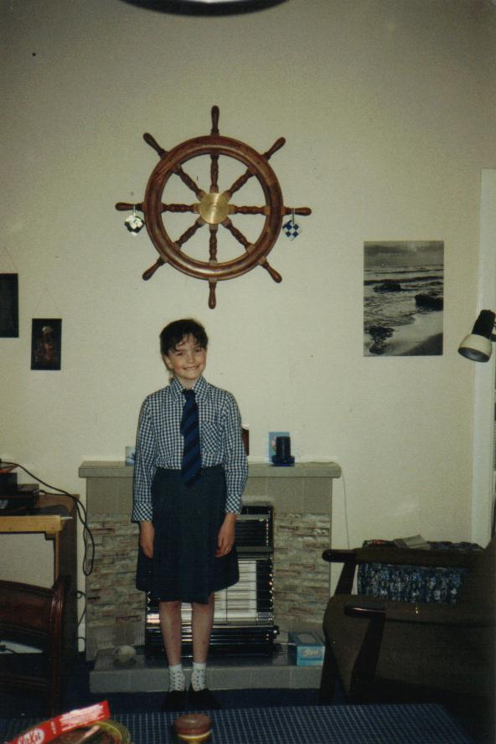
Mein Schultag beginnt um halb neun (1)
Nein. Deutsch ist natürlich mein Lieblingsfach. (2)
Das langweiligste Fach ist Englisch. (2)
Eine gute Frage. Ich finde Mathe nützlicher als Englisch. (2)
Ich habe Grammatik gelernt und ich habe gesungen (2)
Man darf niemanden hänseln oder ärgern (1)
Letztes Jahr war Geschichte sehr langweilig aber dieses Jahr ist es besser. (2)
Ja (5).
Manchmal ist es lustig aber leider ist Mathe oft nur langweilig. (2)
Ich werde immer pünktlich zur Deutschklasse kommen (1)
Nein. Ich muss Hausaufgaben machen (5)
Ich muss Hausaufgaben machen (2)

Slide 44
Deutsch ist schwierig, ja?
Hast du mein Goldfisch genommen?
Wie findest du Mathe?
Das langweiligste Fach ist Geschichte oder?
Magst du Pizzasaft?
Denkst du, dass Alex ist ein bisschen verrückt?
Was hast du in den Ferien gemacht?
Was ist das langweiligste Fach?
Was du in dein letztes Deutschfach gelernt?
Englisch ist interessant, oder?
Möchtest du ins Kino gehen?
Findest du Englisch langweilig, oder?
Später kannst du Schaflaufen ?
Was ist eine Schulregeln?
Warum kannst du nicht mit mir nach Cambridge gehen?
Magst du Geschichte?
Wie findest du Geschichte?
Frau Gillings, ist das du?
Was musst du nächstes Jahr gemachen?
Was musst du am Freitag machen?
Ist Mathe langweilig?
Variety of formulations
Mixture of tenses
Use of statements + oder?
Some more complex question structures
Some mistakes!
Message-oriented
Humour!
Like EFL sessions

Slide 45
Comberton Village College
Questioning
Rachel Hawkes
FIND SOMEONE WHO
Idea 5: Find someone who

Slide 46
Trouve quelqu’un qui………….
1. adore le tennis
2. déteste le rugby
3. fait du judo
4. joue au basketball
5. adore le VTT

Slide 47
Findet eine Person, die………….
1. nur einen Bruder hat
2. zwei Schwestern hat
3. in Toft wohnt
einen Hund und eine Katze hat
den Geburtstag im Dezember hat

Slide 48
Busca a la persona que / a quién…
juega al fútbol los sábados.
va al cine a menudo.
lee todos los días.
ve la tele cada día.
nunca descarga música del Internet.
Notes:
A step too far for Y10!

Slide 49
Comberton Village College
Questioning
Rachel Hawkes
20 QUESTIONS
Idea 6: 20 questions

Slide 50
20 questions
Have you…?
Do you like…?
How…?
Where…?
Is…?

Slide 51
¿Piensas que …?
Do you think that………..?
Notes:
Could generate a whole variety of questions at any stage!

Slide 52
Comberton Village College
Questioning
Rachel Hawkes
HOTSEATING
Idea 7: Hotseating

Slide 53
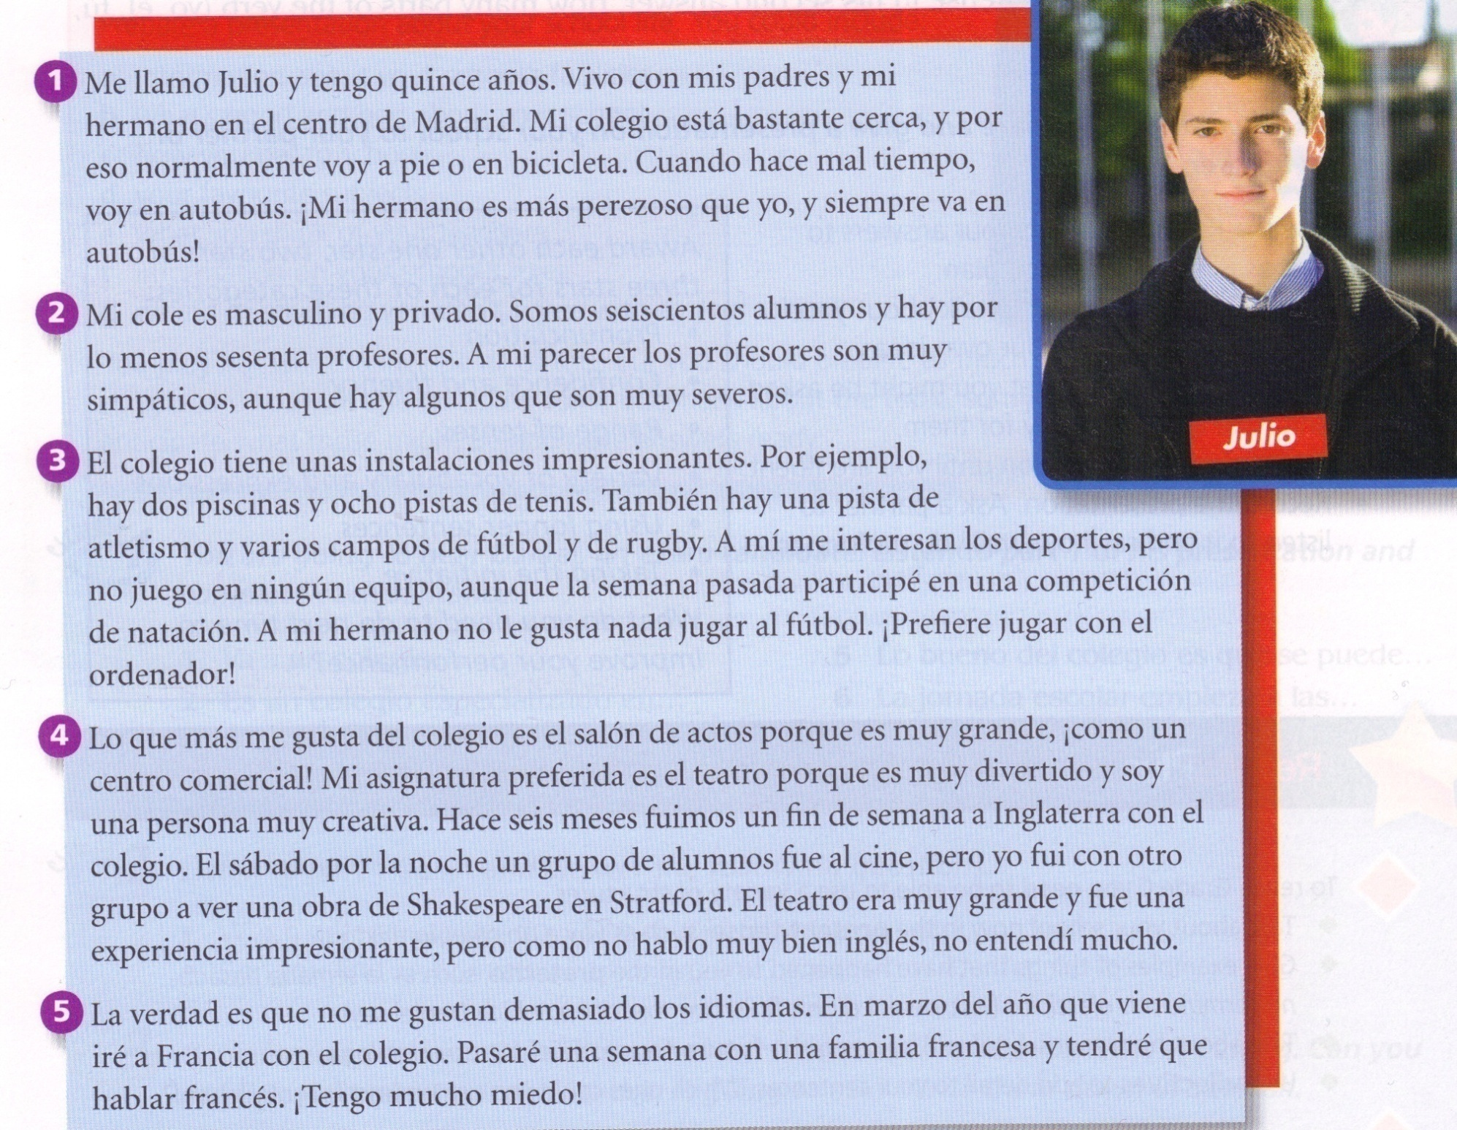
Notes:
Hotseating is for me one of the best ways to exploit some of the reading texts in any KS4 textbook. Here is one example of such a text from the School & Education theme. The idea is that the text, rather than being useful as reading comprehension – it is too straightforward for that really! – does provide some very useful language to be ‘harvested’ by students to help structure their own spoken responses. In this way it provides both the stimulus material for the class to generate questions and for one member of the class (or the group, if you can set this up as a group activity) to be ‘hotseated’ to answer the questions as if s/he were Julio. This particular text lends itself to 5 different ‘hotseats’ so that the role of answerer can be rotated around the group. The rest of the group have to generate questions on the content of the text. The idea is that the answers should ‘use up’ all of the information provided by the text.

Slide 54

Comberton Village College
Manipulating language (Sentence-building, creativity, improvisation)

Slide 55
Comberton Village College
Manipulating language (Sentence-building, creativity, improvisation)
Rachel Hawkes
MASTERMIND +
Idea 8: Mastermind +

Slide 56
El fin de semana pasado
al fútbol
jugué
juego
con los videojuegos
Normalmente
El próximo fin de semana
voy a jugar
al tenis
¿Cómo se dice en español?

Slide 57
juego
El fin de semana pasado
al tenis
voy a jugar
al fútbol
Normalmente
con los videojuegos
El próximo fin de semana
jugué
¿Cómo se dice en español?

Slide 58
juego
El fin de semana pasado
al tenis
voy a jugar
al fútbol
Normalmente
con los videojuegos
El próximo fin de semana
jugué
+ detalles / + opiniones / + razones

Slide 59
Comberton Village College
Manipulating language (Sentence-building, creativity, improvisation)
Rachel Hawkes
TARGET TALK
Idea 9: Target talk

Slide 60

¿Qué programas te gustan?
Your answer must contain EXACTLY 7 words!
¿Qué programas no te gustan?
Your answer must contain more than 9 words!
Notes:
The conditions or ‘targets’ can be many and varied. It ALMOST doesn’t matter as the point of putting a condition there is to cause students to think their sentences through carefully as they build them. It makes them much more aware of what they’re saying. And making a sentence of exactly 8 words will involve usually a very short clause with ‘weil’ or two clauses linked with ‘und’ or additional details like when and where. So they focus on different ways to make their sentences longer. It also works well to set >9 words or <5 words at times too.
60

Slide 61
Comberton Village College
Manipulating language (Sentence-building, creativity, improvisation)
Rachel Hawkes
SAY SOMETHING ELSE
Idea 10: Say something else

Slide 62
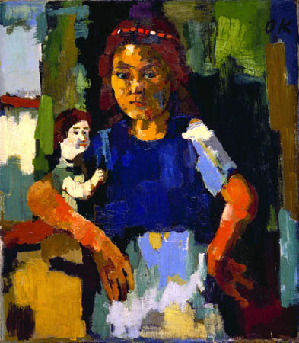
1. Das Mädchen ist zwanzig Jahre alt.
2. Es trägt ein schwarzes Kleid.
3. Es ist in der Küche.
4. Das Mädchen ist faul.
5. Es hat schwarze Haare.
6. Das Zimmer ist schwarz und weiβ.
7. Die Puppe ist glücklich und sehr groβ.
8. Ich finde das Bild fantastisch.
Sag etwas anders!
Notes:
Here learners need to change a detail or more in each sentence to say something different about the picture. The sentences give support to learners as they try to build sentences without writing preparation time.

Slide 63
Comberton Village College
Manipulating language (Sentence-building, creativity, improvisation)
Rachel Hawkes
ODD ONE OUT
Idea 11: Odd one out

Slide 64
1908
1992
2012
1948
Notes:
Pilla al intruso. Students may say anything from ‘2012 porque es futuro y los otros son pasados’ or ‘2012’ porque son ‘dos mil’ y los otros son ‘mil novecientos’. My answer is ‘1992’ porque los juegos olimpicos tuvieron lugar en Barcelona y los otros en Londres.

Slide 65

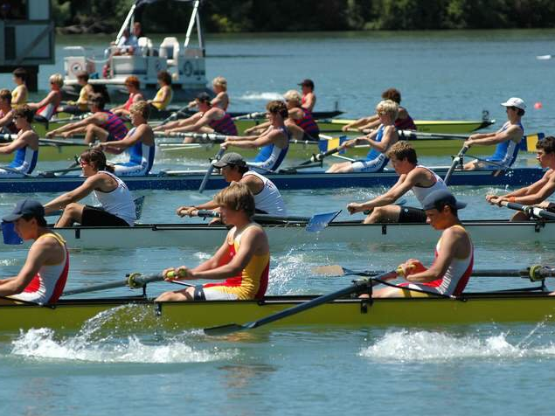
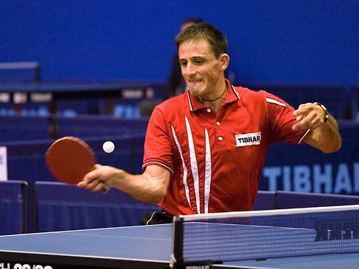
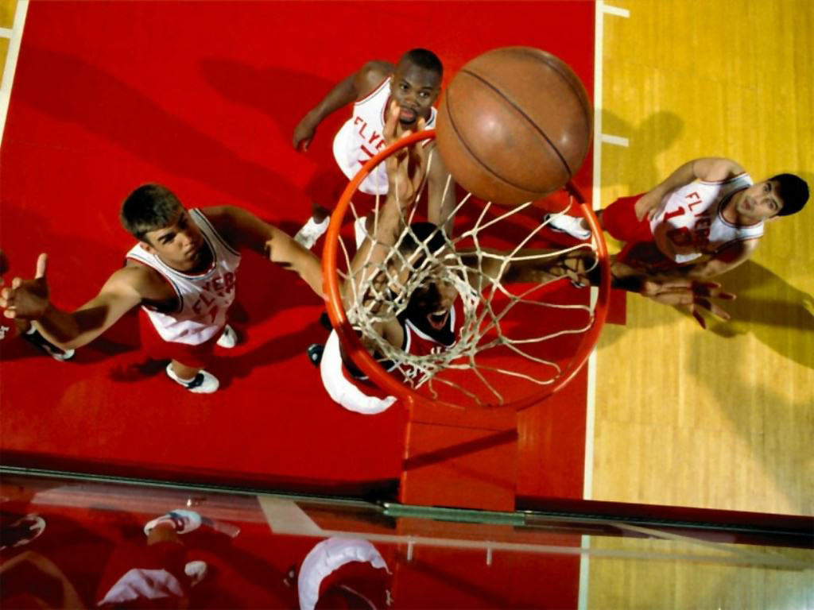
Notes:
Pilla al intruso. El hockey, el remo, el tenis de mesa o el baloncesto. El remo porque es el unico que necesita agua? El remo porque los otros tienen pelotas? El tenis de mesa porque es el unico deporte individual – los otros son deportes de equipo?

Slide 66
Comberton Village College
Manipulating language (Sentence-building, creativity, improvisation)
Rachel Hawkes
PICTURE RESPONSES
Idea 12: Picture responses

Slide 67
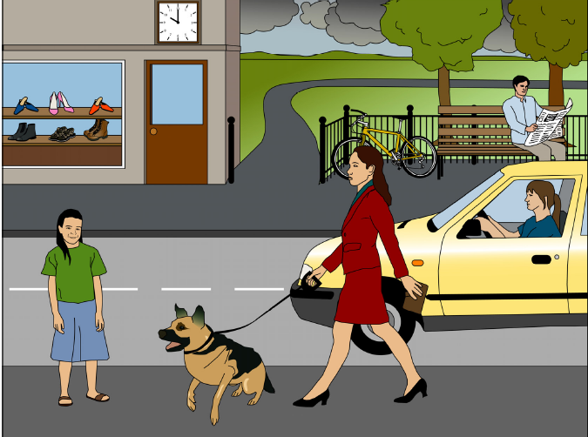
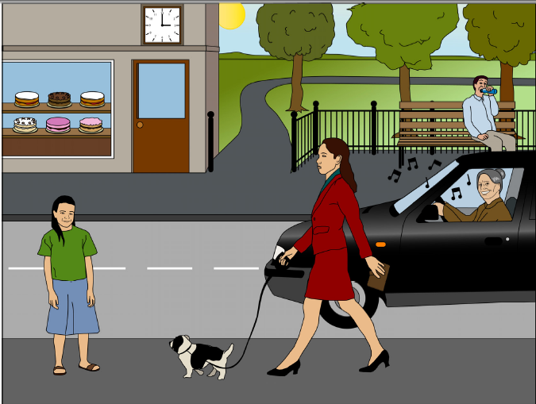
A
B
1) Mentionne 2 différences
2) Reponds à deux questions
3) Pose deux questions
Notes:
Pictures and task taken from ASSET Breakthrough speaking task – grade 3

Slide 68
Décris les différences:
Il est dix heures – il est trois heures
le chien est grand – le chien est petit
La voiture est jaune – la voiture est noire
il y a des chaussures dans le magasin – il y a des gâteaux
il y a un velo – il n’y a pas de velo
la dame dans la voiture est jeune– la dame est vieille
l’homme lit un journal- l’homme boit un coca
la dame dans la voiture n’écoute pas de musique- la dame dans la voiture ecoute de la musique
il fait mauvais – il fait beau
il y a deux arbres – il y a trois arbres
Questions
il y a combien de personnes dans les deux photos?
Quel temps fait-il?
Le chien est de quelle couleur?
Quelle heure est-il?
Que fait l’homme?
Il y a combien d’arbres?
Notes:
Year 7 differences

Slide 69
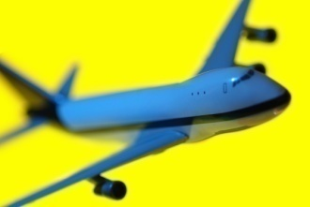






Qu’est-ce que Laura va faire pendant les vacances?
Qu’est-ce qu’elle ne va pas faire?
Notes:
This is a simple set of picture prompts for future holiday plans narrative. However, it can be turned into a much more creative and interesting activity if you ask what Laura is not going to do, to see, to eat, to visit, who she’s not going to go with etc... Learners have all the language they know available to them with this question and there can always be more to say!

Slide 70

Notes:
Brainstorm everything that you can say about this picture.
Hay una chica. Tiene un gato. Lee un libro. Está contenta. Tiene un ordenador. Le gusta su gato. El gato se llama… La chica se llama. La chica es verde. El gato es blanco y negro.

Slide 71
Comberton Village College
Manipulating language (Sentence-building, creativity, improvisation)
Rachel Hawkes
DEFINITIONS
Idea 13: Definitions

Slide 72
el atletismo
la hípica
el tenis de mesa
el bádminton
el hockey
el tiro
el baloncesto
el judo
el tiro con arco
el balonmano
la lucha
el triatlón
el boxeo
la natación
la vela
el ciclismo
pentatlón moderno
el voleibol
la esgrima
el piragüismo
el fútbol
el remo
la gimnasia
el taekwondo
la halterofilia
el tenis
Notes:
If time allows, here are the other olympic sports to practise pronunciation of. Note that halterofilia is weightlifting, hípica is equestrian. Hockey is pronounced is a rather english fashion (with the ‘h’ and rhyming with okay) and judo is pronounced ‘you-do’

Slide 73

¿De qué deporte se habla aquí?
1. Es el deporte más popular en Inglaterra y en España.
2. Es un deporte individual que es popular en Inglaterra, que se hace cerca del agua.
3. Es un deporte de equipo que se juega con una pelota y se puede jugarlo en la playa.
4. Es un deporte acuático y olímpico en el cuál ganó medalla de oro Rebecca Adlington en Beijing.
5. Es un deporte que originó en Inglaterra en una ciudad que lleva el mismo nombre.
6. Es un deporte individual cuyo objetivo es subir.
7. Es un deporte que es como una mezcla entre el fútbol y el baloncesto.
Rachel Hawkes

Slide 74
Es un deporte ... | It’s a..........sport | que se juega/se hace.... | ...that you play/do...
de equipo/individual | team/individual | con una pelota | with a ball
de combate | combat | en una cancha | on a court
acuático | water | con ...jugadores | with....players
olímpico | Olympic | sobre/en el agua | on/in the water
popular (en/con) | popular (in/with) | Es un deporte que... | It’s a sport that...
muy caro/barato | very expensive/ cheap | (no) me guesta porque... | I (don’t) like because...
emocionante/aburrido | exciting/boring | Es como una mezcla entre........ y.. | It’s like a mixture between.... and....
Rachel Hawkes

Slide 75

Comberton Village College
Increasing interactivity (spontaneity, sustaining the flow, intonation)
Rachel Hawkes
SPEND THE WORDS
Idea 14: Spend the words

Slide 76
Spend the Words
Take it in turns to ask and answer the same questions as before. This time, rather than speaking for as long as you can, you need to try and include the words below and ‘spend’ the words as you answer your 5 questions. Your partner will cross them off as you use them and you need to do the same for your partner. The first to use up all the words is the winner.
um...zu... | schwerer als | leicht | aufstehen | es würde...geben
man darf (nicht/kein(e)) | wir müssen | streng | nicht leiden | Mobbing
dreckig | meiner Meinung nach | AGs | ...fällt mir/fallen mir | gestern
letzte Woche | Deutschland | Schulregeln | weder…noch… | können
Mittagspause | gute Noten | vielleicht | Schuluniform | Gang

Slide 77

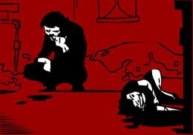
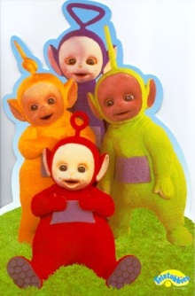



Me gustan mucho | tiene lugar en | Mi programa preferido
entretenido (a/os/as) | son | Prefiero
porque | trata de | No me gustan tanto
A mi madre | una telenovela | tonto (a/os/as)

Slide 78
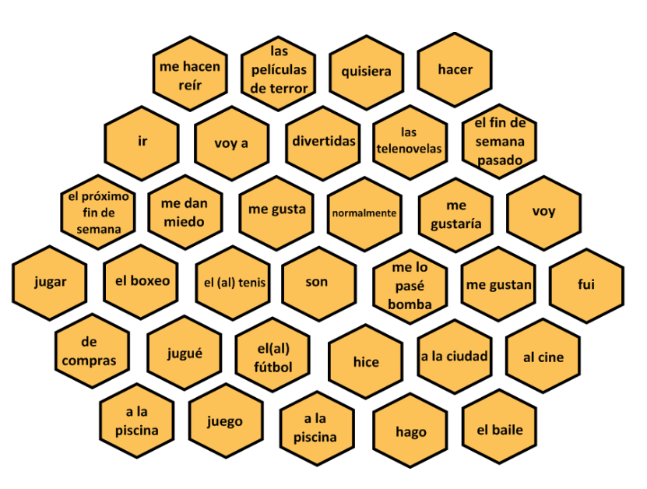
Notes:
Thank you Amanda Salt for reminding me about this!

Slide 79
Comberton Village College
Developing quality (Assessing, improving, enhancing, modelling)
Rachel Hawkes
BINGO
Idea 15: Bingo

Slide 80
Opinion | Present | Future
Reason | Time expression | Comparison
Complexity | Past | Reference to others
Rachel Hawkes
Notes:
Given a specific topic to talk about (or a set of questions if appropriate), students have to try to include each thing from the Bingo grid. When they do, they cross off the box and in their pairs, it’s the first person to cross everything off who wins (full house).

Slide 81


Comberton Village College
Increasing interactivity (spontaneity, sustaining the flow, intonation) Questioning
Rachel Hawkes
DEBATE
Idea 16: Debate

Slide 82
Los debates
This term we will have 8 short debates. Each person will have one debate where s/he defends the motion and one where s/he attacks it. For the other 6 debates, s/he will have the role of either supporting or criticising the argument, through questions, discussion, and giving opinions. Everyone must have prepared enough to talk in every debate. Each person only has the major preparation role twice this term and will make a presentation of 2-3 minutes laying out their arguments for or against the motion. Then there will be some discussion (up to 10 minutes) and finally a vote.
Week/Date | Motion | Defending | Attacking
Wk 2 Thurs 12 Jan | “Un buen profesor es un profesor estricto”. | Maria (Martha, Eden, Sofie) | Freddie (Eddie, Kate, Molly)
Wk 3 Thurs 19 Jan | “No hace falta aprender los idiomas extranjeros porque todo el mundo habla inglés.” | Martha (Eddie, Freddie, Molly) | Kate (Maria, Eden, Sofie)
Wk 4 Thurs 26 Jan | “El sistema educativo español es mejor que el sistema inglés.” | Eddy (Kate, Eden, Maria) | Molly (Martha, Freddie, Sofie)
Wk 6 Thurs 9 Feb | “La educación separada no es una educación buena.” | Sofie (Eddie, Molly, Kate) | Eden (Freddie, Martha, Maria)
Wk 9 Thurs 8 Mar | “Más vale la pena trabajar que estudiar.” | Freddie (Molly, Martha, Eden) | Maria (Eddie, Kate, Sofie)
Wk 11 Thurs 22 Mar | “Hay que controlar la venta de ropa barata para proteger a los niños del tercer mundo.” | Molly (Martha, Kate, Sofie) | Eddy (Freddie, Eden, Maria)
Wk 12 Thurs 29 Mar | “Los que no trabajan no merecen ayuda del Estado.” | Eden (Maria, Freddie, Molly) | Sofie (Martha, Eddy, Kate)
Wk 1 Thurs 18 Apr | “La descriminación laboral ya no existe”. | Kate (Sofie, Eddy, Molly) | Martha (Eden, Maria, Freddie)

Slide 83
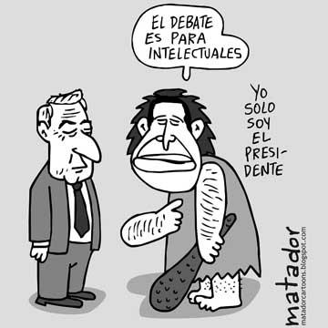
Un debate es una técnica, tradicionalmente de comunicación oral, que consiste en la discusión de opiniones antagónicas entre dos o más personas sobre un tema o problema.
Tema del debate:
“un buen profesor es un profesor estricto”

Slide 84
Si te entiendo bien, piensas que..
Tienes toda la razón
pero no es verdad..
Has dicho que ….pero
¡ni hablar!
En mi opinión
¡En absoluto!
Estoy totalmente de acuerdo
Bueno, depende
Notes:
To encourage students to respond to each other’s ranking suggestions

