Slide 1
Get the best grade you can in GCSE Spanish speaking
Session 3 Memory matters
Notes:
This morning we worked first on tone of voice, confidence and spontaneity. We also looked at quality of language and 10 key features of C/B grade work at GCSE. This afternoon we are going to look first at one memory strategy.

Slide 2
1 memory technique
Chunking

Slide 3
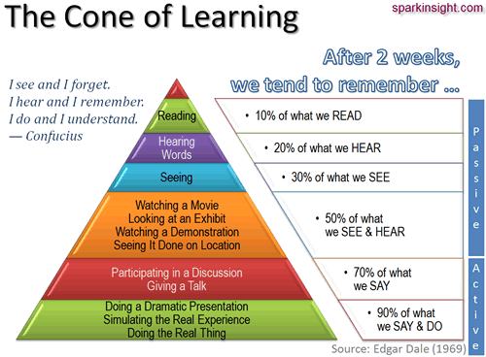
Notes:
Demonstrating the value of ‘active’ learning. You have to ‘do something’ to learn, not just read the sheet over and over and hope that the knowledge will go in. This hardly ever happens!
The other thing that is vital to know is that it is nearly impossible to memorise things well that you don’t understand. So, you need to take care that you don’t use google translate or copy down things in class that are too complex and you don’t understand each word. This is why you need to be independent in what you produce in the first place. Otherwise keeping it in your head will be a meaningless and probably unsuccessful endeavour.

Slide 4
Memory techniques: 1 Chunking
Break your work down into sentence ‘chunks’
Take one paragraph and count the number of sentences
Draw that number of boxes onto a page
Write each sentence into a box from left to right
Look at the first sentence and read it out loud. Then, close your eyes and say (‘seeing the words in your mind’) or ‘air write’ the sentence without looking at it
Repeat the step above, this time with the first 2 sentences
Next, try it with 3 sentences. Then 4. Repeat until you have (mostly)memorized the first paragraph
Notes:
This method – chunking – is the most successful and effective strategy to support memorisation for most people. We’re going to try it out this afternoon, with a short paragraph that uses a lots of the same language we were working with this morning, so you should already know it fairly well.

Slide 5
« El fin de semana pasado, (quería ir a Londres pero no pude así que) fui a la ciudad con mis amigos. Fuimos de compras. Compré una camiseta y un cd. Luego fuimos a Burger King para comer. Comí unas patatas fritas y bebí una cola. Después volví a casa para ver una película. ¡Fue fenomenal! »

Slide 6
« El fin de semana pasado, (quería ir a Londres pero no pude así que) fui a la ciudad con mis amigos. Fuimos de compras. Compré una camiseta y un cd. Luego fuimos a Burger King para comer. Comí unas patatas fritas y bebí una cola. Después volví a casa para ver una película. ¡Fue fenomenal! »

Slide 7
" Active learning is the key to remembering. You have to DO something to keep the words in your head.”

Slide 8
After a study session, take a quick nap or relax. New memories are very vulnerable, but studies have shown that sleep helps your new memories stick. After your nap, repeat the memory technique once more for maximum retention.
Ok, you can't sleep now but talk about something else for 3 minutes (yes, have a chat!) then we will do stage 2.
Try to do your Spanish learning work an hour before bed time - spend half an hour on it, half an hour getting ready for bed and then sleep.

Slide 9
" It's much easier to remember colourful, memorable mental images, than it is to remember dull facts."

Slide 10
Now turn over and draw the boxes again
This time put the first letter of each word only, followed by a line. E.g. m__ g________ l__ c_________
When you have finished, try to say the text just looking at this version
Now take a 3 minute break
Now turn over and draw the boxes again
This time put a picture in each box instead of any words
Try to use colourful, (even humorous) images to link to the idea of the sentence
When you have finished, try to say the paragraph without looking at your notes.

Slide 12
Get the best grade you can in GCSE Spanish speaking
Session 3 Memory matters
Notes:
What you’ve done this afternoon should convince you of the value of revising actively, of taking up the advantage the exam board gives of allowing some key words / pictures on a prompt sheet, and of the value of using that prompt sheet to prepare as thoroughly as you can. There will always be certain questions (no matter which exam board you do) that you can predict and prepare for.

