Slide 1

Primary Languages Session 1:
Part 1: Policy(?!), practice and potential
Part 2: Planning, Teaching & Learning
“Limba dultsi multu adutsi”.
Sweet language brings much.
Aromanian proverb
Rachel Hawkes
Notes:
The greatest number of Aromanian speakers are found in Greece, with substantial numbers of speakers also found in Albania, Bulgaria, Serbia, and in the Republic of Macedonia (the latter is the only country where Aromanians are officially recognized as a minority). Large Aromanian-speaking communities are also found in Romania, where some Aromanians migrated from Greece, Albania, Bulgaria and Serbia, mainly after 1925.

Slide 2
Part 1
Policy (?!), Practice & Potential
Rachel Hawkes

Slide 3

http://www.bbc.co.uk/news/education-15135560

Slide 4
On 1 October 2011, Michael Gove said:
"Learning a foreign language, and the culture that goes with it, is one of the most useful things we can do to broaden the empathy and imaginative sympathy and cultural outlook of children."
He also said that learning languages improved people's brain power.
"It is literally the case that learning languages makes you smarter. The neural networks in the brain strengthen as a result of language learning."
But, by 5 October 2011, this was the only mention made of languages:
And as well as reforming our teaching of English, we also need to make sure our children are fluent in the most important languages of the twenty-first century - maths and science.
5 October 2011
Education secretary Michael Gove's speech to the Conservative Party conference in Birmingham.

Slide 5

But then the first signs that some measures are being implemented!
We will offer the top level of bursaries for modern language trainees in 2012/13
The amount of modern language teaching has declined significantly in recent years. However schools that are choosing to offer pupils the English Baccalaureate are now restoring languages to the timetable. To meet this demand from schools for more modern language teachers, in 2012/13 secondary trainees will be eligible for the top level of bursaries. Once the modern language teacher workforce has grown to meet the needs of schools that offer the English Baccalaureate, we expect to lower these bursaries. In determining bursaries for 2013/14 we will therefore look in particular at the need for continuing the highest bursaries for modern languages.

Slide 6
We will encourage the recruitment and training of more specialist primary teachers
More schools should be able to employ primary teachers that they can deploy as specialist subject teachers in the sciences, mathematics, languages or other subjects. For the allocation of ITT places from 2012/13, TDA will prioritise primary courses that offer a specialism, particularly in the sciences, mathematics or modern languages. For 2013/14 we expect to adjust financial incentives for trainees to favour trainees on specialist primary courses with a good A-level in mathematics, a science, or a language, over those on generalist courses.
Training our next generation of outstanding teachers – Implementation plan – November 2011
http://media.education.gov.uk/assets/files/pdf/t/training%20our%20next%20generation%20of%20outstanding%20teachers%20nov%202011.pdf

Slide 7
Policy (?!...)
National Curriculum Review process (2011-2013)
Place of primary and KS3 languages? (NC subject, compulsory but without PoS, optional)
Introduction of statutory languages from Sept 2011 (recommended in Rose review) withdrawn
Current situation – non-statutory entitlement applies until 2014
From September 2014 = compulsory FL for 4 years of KS2 (same language)
Rachel Hawkes

Slide 8
Reshaping the Languages Curriculum
Languages for life
Specialist
Vocational
Personal
14+
KS3 Framework
11-14
KS2 Framework
7-11
KS1 (non statutory)
Taken from Lid King, Director of Languages, DCSF
Rachel Hawkes

Slide 9
Listening listen attentively to spoken language and show understanding by joining in and responding explore the patterns and sounds of language through songs and rhymes and link the spelling, sound and meaning of words Speaking engage in conversations; ask and answer questions; express opinions and respond to those of others; seek clarification and help* speak in sentences, using familiar vocabulary, phrases and basic language structures develop accurate pronunciation and intonation so that others understand when they are reading aloud or using familiar words and phrases* present ideas and information orally to a range of audiences* Reading read carefully and show understanding of words, phrases and simple writing appreciate stories, songs, poems and rhymes in the language broaden their vocabulary and develop their ability to understand new words that are introduced into familiar written material, including through using a dictionary Writing write phrases from memory, and adapt these to create new sentences, to express ideas clearly describe people, places, things and actions orally* and in writing Grammar understand basic grammar appropriate to the language being studied, such as (where relevant): feminine, masculine and neuter forms and the conjugation of high-frequency verbs; key features and patterns of the language; how to apply these, for instance, to build sentences; and how these differ from or are similar to English. | Listening listen to a variety of forms of spoken language to obtain information and respond appropriately transcribe words and short sentences that they hear with increasing accuracy Speaking initiate and develop conversations, coping with unfamiliar language and unexpected responses, making use of important social conventions such as formal modes of address express and develop ideas clearly and with increasing accuracy, both orally and in writing speak coherently and confidently, with increasingly accurate pronunciation and intonation Reading read and show comprehension of original and adapted materials from a range of different sources, understanding the purpose, important ideas and details, and provide an accurate English translation of short, suitable material read literary texts in the language, such as stories, songs, poems and letters, to stimulate ideas, develop creative expression and expand understanding of the language and culture Writing write prose using an increasingly wide range of grammar and vocabulary, write creatively to express their own ideas and opinions, and translate short written text accurately into the foreign language. Grammar identify and use tenses or other structures which convey the present, past, and future as appropriate to the language being studied use and manipulate a variety of key grammatical structures and patterns, including voices and moods, as appropriate develop and use a wide-ranging and deepening vocabulary that goes beyond their immediate needs and interests, allowing them to give and justify opinions and take part in discussion about wider issues use accurate grammar, spelling and punctuation.
KS2
KS3
Notes:
KS2 on the left and KS3 on the right
Adapted to show more clearly the continuity between KS2 and KS3
Joining up KS2 and KS3 – arguably the most important piece of work we will do in our careers over the next 5 x years. The level of responsibility for this will differ, Heads of languages in secondary schools will have an obligation to grapple with it – otherwise their learners will not reach the levels required at the end of KS4 (even though we have not see what those are, we can guess from Curriculum 14 that the standards will be tough). But classroom teachers have the responsibility similarly to respond to what the learners in front of them know – to build on it, to notice the words, skills they already have, and not to assume a ‘from zero’ approach in Y7.
There are things we can do to make this explicit, too.
Group learners strategically and give them the theme for the lesson and a piece of sugar paper to write down any TL words at all that they think they might be able to make use of in that topic area. Get them to share all of the words in the group – including teaching each other the words.
Welcome their previous knowledge, and make it clear that it all counts.
This new NC document may be minimal, but sometimes there is strength in that. I found that this has been the first document that I’ve been able to share with heads of primary schools to get the message across about the need for sharing a common 7-year purpose and framework. It really hasn’t been clear enough before now. For the first time, there is a sense of pulling together – and a championing of the languages cause in the same way that primary and secondary have come together over literacy and numeracy – in terms of transition – ie. recognising the need for regular meetings and for sharing practice. This all on one A4 page doc has been a helpful catalyst here.
Let’s just take the sound-spelling link statement at KS2.

Slide 10
Practice
92% of primary schools have started teaching a language
69% are teaching languages across the whole of KS2
90% are confident that the current provision is sustainable
Over two thirds of schools have accessed free training; most are using the KS2 framework
Main aims of primary languages are: enthusiasm for language learning, speaking and listening skills, understand other cultures
Time allocation averages 40 minutes a week
Teaching is most commonly carried out by class teachers
Primary Modern Foreign Languages: Survey Of National Implementation Of Full Entitlement To Language Learning At Key Stage 2
(NFER report, DCSF-RR127, July 2009)
Rachel Hawkes

Slide 11
Practice cont’d.
It noted that the main challenges remaining were:
lack of staff knowledge
assessment
transition to secondary school
Primary Modern Foreign Languages: Survey Of National Implementation Of Full Entitlement To Language Learning At Key Stage 2
(NFER report, DCSF-RR127, July 2009)
Rachel Hawkes

Slide 12
Practice cont’d.
Heads and teachers were committed and enthusiastic because languages enriched the curriculum and made a contribution to personal, social and literacy development in English.
Pupils were enthusiastic and motivated.
Training (funded) had been significant in the development of provision. Schools have an expectation that funding will be maintained.
Focus mostly on developing listening and speaking skills.
Languages Learning at KS2 report
(Open University et al, DCSF-RR198, January 2010)
Rachel Hawkes

Slide 13
Practice cont’d.
It also noted that:
children can achieve Y6 outcomes after 4 years of language learning but writing remains the most challenging area
there was little evidence of intercultural understanding objectives being met
whole school curriculum planning and assessment remain areas for development.
Languages Learning at KS2 report
(Open University et al, DCSF-RR198, January 2010)
Rachel Hawkes

Slide 14
Practice cont’d.
Key Findings
Achievement was good or outstanding in just under six out of ten of the primary schools visited.
Pupils made most progress in speaking and listening.
Planned teaching of reading and writing was much rarer.
Pupils’ enjoyment and enthusiasm was very evident.
Pupils were aware of the importance of learning another language.
Pupils were developing a good awareness of other cultures.
Teaching was good in two thirds of the 235 lessons observed.
Despite some occasional shortcomings in pronunciation and intonation, primary teachers’ subject knowledge and their teaching methods were predominantly good.
Senior leaders were very committed to introducing modern languages into primary schools.
Weaknesses lay in assessment, and the monitoring and evaluation of provision, often because leaders did not feel competent enough to judge language provision.
Achievement and Challenge 2007-2010, Ofsted, 2011
Rachel Hawkes

Slide 15
Ofsted recommendations
Primary schools should:
build on their good work in speaking and listening, including language learning strategies and knowledge about language, to develop pupils’ early skills in reading and writing
ensure intercultural understanding is built into work where it does not yet feature prominently.
Secondary schools should:
put much greater emphasis on regular use of the target language in all lessons
make more use of authentic materials to help develop students’ language skills and their intercultural understanding
broaden approaches to teaching and learning to enthuse students and increase their confidence, competence and ambition in modern languages
p.8 Achievement and Challenge, Ofsted
Rachel Hawkes
Notes:
Tension between ICU (and other aspects of language pedagogy such as AfL and language learning strategy development) and use of the TL must be met head on! TL is central to language learning and must not give way to discussions about culture in English.

Slide 16
Schools have had to consider…
Curriculum structure
Curriculum content
Resources
Delivery
Links to other curriculum subjects
Assessment, recording and reporting
Transition
Rachel Hawkes
Notes:
And ongoing issues are:
Sustainability, assessment, transition and progression, monitoring, language upskilling for teachers

Slide 17
What you may see …
Specialist teachers deliver/class teachers deliver
Discrete language lessons (all years, only Y5/6…)/ cross-curricular integration
Optional provision after school
Mixed year classes/single year classes
No languages at all
Rachel Hawkes

Slide 18
Potential (thinking positively!)
Next steps
4 years of progressive primary language teaching is implemented from September 2014 in one language
Practice is developed and shared between clusters of schools
Secondary and primary schools work together on pedagogy and curriculum
Links between and across subject areas are embedded
Literacy is a focus for further development
Intercultural understanding underpins curriculum planning
Assessment and recording methods are explored and developed jointly between primary and secondary schools
Rachel Hawkes

Slide 19
Part 2
Planning,
Teaching & Learning
http://www.rachelhawkes.com/Resources/KS2/KS2.php
Rachel Hawkes

Slide 20
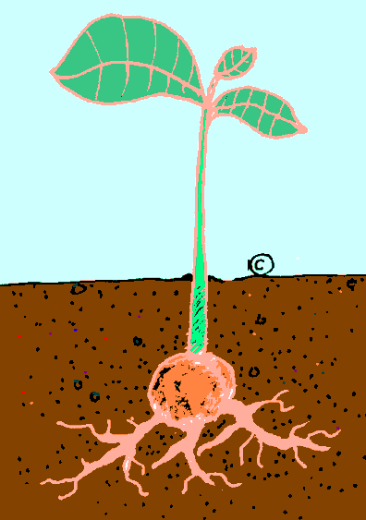
Life cycle of a plant
Hier is een zaad
De wortel groeit
Na de stam, de bladeren groeien
Na de bladeren, de bloem groeit
Na de bloem, de vrucht groeit
De vrucht geeft ons de zaden
Rachel Hawkes

Slide 21
Life cycle of a plant
Hier is een zaad
De wortel groeit
Na de wortel, de stam groeit
Na de stam, de bladeren groeien
Na de bladeren, de bloem groeit
Na de bloem, de vrucht groeit
De vrucht geeft ons de zaden
Rachel Hawkes

Slide 22
What should PMFL look like?
What should learners be able to do?
What should they be taught?
How should they learn?
How do learners and teachers know how well they are doing?
How will their learning continue to develop?
“An ounce of action is worth a ton of theory.” Friedrich Engels

Slide 23
Key features of the languages curriculum
Pronounce well and apply phonics knowledge
Listen attentively and join in
Ask and answer questions
Read and understand words and phrases
Appreciate songs, stories, rhymes
Deduce the meaning of new words from context
Learn some words!
Write words and sentences from memory
Use basic grammar (gender, adjectives, essential verb forms) to build sentences

Slide 24
Listening listen attentively to spoken language and show understanding by joining in and responding explore the patterns and sounds of language through songs and rhymes and link the spelling, sound and meaning of words Speaking engage in conversations; ask and answer questions; express opinions and respond to those of others; seek clarification and help* speak in sentences, using familiar vocabulary, phrases and basic language structures develop accurate pronunciation and intonation so that others understand when they are reading aloud or using familiar words and phrases* present ideas and information orally to a range of audiences* Reading read carefully and show understanding of words, phrases and simple writing appreciate stories, songs, poems and rhymes in the language broaden their vocabulary and develop their ability to understand new words that are introduced into familiar written material, including through using a dictionary Writing write phrases from memory, and adapt these to create new sentences, to express ideas clearly describe people, places, things and actions orally* and in writing Grammar understand basic grammar appropriate to the language being studied, such as (where relevant): feminine, masculine and neuter forms and the conjugation of high-frequency verbs; key features and patterns of the language; how to apply these, for instance, to build sentences; and how these differ from or are similar to English. | Listening listen to a variety of forms of spoken language to obtain information and respond appropriately transcribe words and short sentences that they hear with increasing accuracy Speaking initiate and develop conversations, coping with unfamiliar language and unexpected responses, making use of important social conventions such as formal modes of address express and develop ideas clearly and with increasing accuracy, both orally and in writing speak coherently and confidently, with increasingly accurate pronunciation and intonation Reading read and show comprehension of original and adapted materials from a range of different sources, understanding the purpose, important ideas and details, and provide an accurate English translation of short, suitable material read literary texts in the language, such as stories, songs, poems and letters, to stimulate ideas, develop creative expression and expand understanding of the language and culture Writing write prose using an increasingly wide range of grammar and vocabulary, write creatively to express their own ideas and opinions, and translate short written text accurately into the foreign language. Grammar identify and use tenses or other structures which convey the present, past, and future as appropriate to the language being studied use and manipulate a variety of key grammatical structures and patterns, including voices and moods, as appropriate develop and use a wide-ranging and deepening vocabulary that goes beyond their immediate needs and interests, allowing them to give and justify opinions and take part in discussion about wider issues use accurate grammar, spelling and punctuation.
KS2
KS3
Notes:
KS2 on the left and KS3 on the right
Adapted to show more clearly the continuity between KS2 and KS3
Joining up KS2 and KS3 – arguably the most important piece of work we will do in our careers over the next 5 x years. The level of responsibility for this will differ, Heads of languages in secondary schools will have an obligation to grapple with it – otherwise their learners will not reach the levels required at the end of KS4 (even though we have not see what those are, we can guess from Curriculum 14 that the standards will be tough). But classroom teachers have the responsibility similarly to respond to what the learners in front of them know – to build on it, to notice the words, skills they already have, and not to assume a ‘from zero’ approach in Y7.
There are things we can do to make this explicit, too.
Group learners strategically and give them the theme for the lesson and a piece of sugar paper to write down any TL words at all that they think they might be able to make use of in that topic area. Get them to share all of the words in the group – including teaching each other the words.
Welcome their previous knowledge, and make it clear that it all counts.
This new NC document may be minimal, but sometimes there is strength in that. I found that this has been the first document that I’ve been able to share with heads of primary schools to get the message across about the need for sharing a common 7-year purpose and framework. It really hasn’t been clear enough before now. For the first time, there is a sense of pulling together – and a championing of the languages cause in the same way that primary and secondary have come together over literacy and numeracy – in terms of transition – ie. recognising the need for regular meetings and for sharing practice. This all on one A4 page doc has been a helpful catalyst here.
Let’s just take the sound-spelling link statement at KS2.

Slide 25
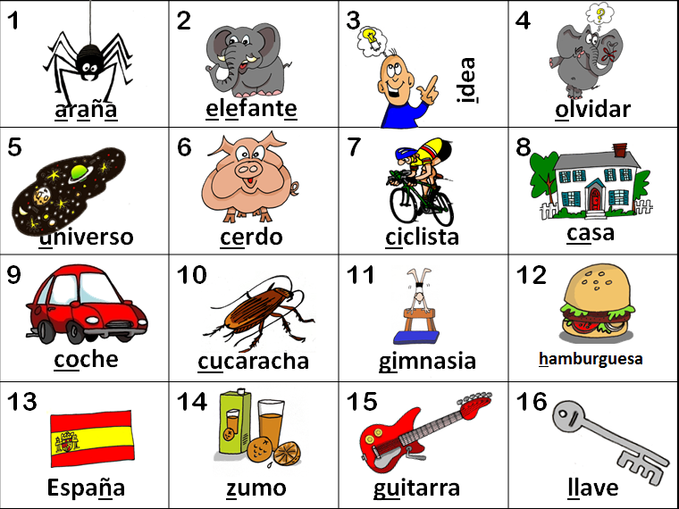
KS2
explore the patterns and sounds of language through songs and rhymes and link the spelling, sound and meaning of words

Slide 26
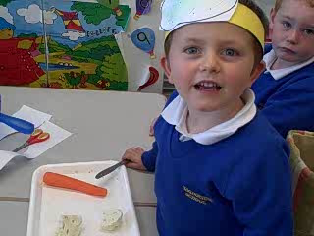
The power of song
Key Stage 1
Notes:
Not about song this one until the ends – but listen to the boy pronounce deux oignons better than the teacher – this is because he has picked it up from the song. Listen to them singing this at the end. You can hear how good the pronunciation is.

Slide 27





las vocales
Notes:
Pupils will learn how to pronounce the vowel sounds in Spanish. ‘las vocales’ = the vowels.
Click on words to hear them pronounced in this presentation.
By the end of this lesson pupils should be able to attempt to fill the vowels into Spanish words they hear pronounced.

Slide 28

Notes:
Audiovisual presentation of the ‘vocales’ (vowels) song. (Click on the grey square to activate.) Pupils should listen to this and begin to join in. It’s important that pupils are able to accurately pronounce the vowels as these are constant in Spanish pronunciation.

Slide 29

a
araña
Notes:
Pupils should pronounce the vowel first and then the word, learning to trust that producing the same vowel sound will allow them to pronounce the word accurately. Click on vowel and the written word to hear them pronounced. It is helpful to do an action as the word is pronounced to give pupils a physical trigger/hook to remember the word later. Click on the video box (top left) to see a suggested action which beats out the number of syllables the word contains. This should also encourage pupils to divide words into syllables as a coping mechanism in their learning. araña = spider

Slide 30

e
elefante
Notes:
Instructions as per slide 3. elefante = elephant

Slide 31

i
idea
Notes:
Instructions as per slide 3. idea = idea

Slide 32

o
olvidar
Notes:
Instructions as per slide 3. olvidar = to forget

Slide 33

u
universo
Notes:
Instructions as per slide 3. universo = universe

Slide 34
a
e
i
o
u
Notes:
Pointing at the vowels and asking pupils to produce them out of sequence, building up speed, forces pupils to produce the sounds quickly, accurately and automatically.

Slide 35
ba be bi bo bu
fa fe fi fo fu
la le li lo lu
ma me mi mo mu
pa pe pi po pu
ta te ti to tu
Notes:
Pupils should imagine how these syllable sounds will be pronounced in Spanish (by slotting in the vowel sounds they already know). These is designed to reinforce the fact that their knowledge of English will at times be helpful in their Spanish learning. The b, f, l, m, p, t are all pronounced as they are in English.

Slide 36




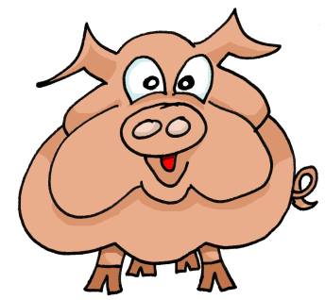











1 | 2 | 3 | 4
5 | 6 | 7 | 8
9 | 10 | 11 | 12
13 | 14 | 15 | 16
idea
araña
elefante
olvidar
universo
cerdo
ciclista
casa
coche
cucaracha
gimnasia
hamburguesa
España
zumo
guitarra
llave
Notes:
36

Slide 37

Key features of the languages curriculum
Pronounce well and apply phonics knowledge
Listen attentively and join in
Ask and answer questions
Read and understand words and phrases
Appreciate songs, stories, rhymes
Deduce the meaning of new words from context
Learn some words!
Write words and sentences from memory
Use basic grammar (gender, adjectives, essential verb forms) to build sentences

Slide 38

Notes:
Audiovisual ‘Hola’ song/rap. A lively opener to the lesson!

Slide 39
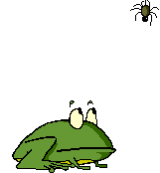
Araña arañita sube la escalera
Araña arañita, súbela otra vez.
¡Pum! se cayó. ¡Pum! se cayó
Vino un sapo gordo y se la comió.
Rachel Hawkes
Notes:
39

Slide 40
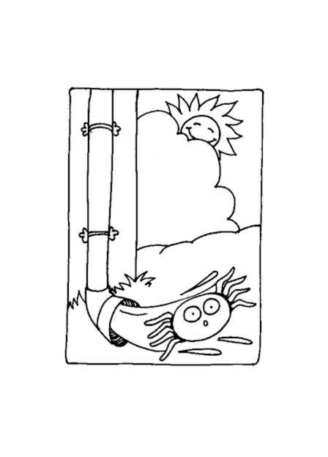

La araña
La araña pequeña
salió a pasear
cayó la lluvia
y tuvo que parar.
Salió el sol,
el charco se secó,
la araña pequeña
de nuevo caminó.

Slide 41
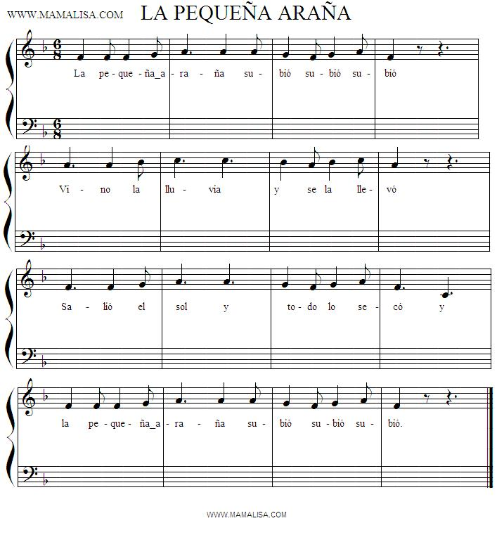
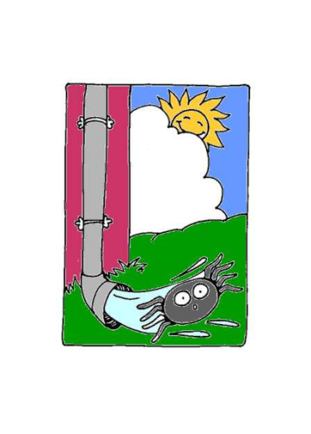
La pequeña araña
subió, subió, subió
vino la lluvia
y se la llevó.
Salió el sol
y todo lo secó
y la pequeña araña
subió, subió, subió.

Slide 42
Key features of the languages curriculum
Pronounce well and apply phonics knowledge
Listen attentively and join in
Ask and answer questions
Read and understand words and phrases
Appreciate songs, stories, rhymes
Deduce the meaning of new words from context
Learn some words!
Write words and sentences from memory
Use basic grammar (gender, adjectives, essential verb forms) to build sentences

Slide 43
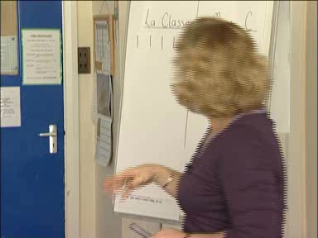

Slide 44
Learning Objective O3.2: to recognise and respond to sounds patterns and words
Learning opportunities:
to listen with care
identify phonemes which are the same as or different from English and other known languages
speak clearly and confidently
Lesson plan to achieve the learning objectives:
Sing a song together pronouncing most words clearly and confidently.
Step 1: listen carefully to the song (selected for specific sound patterns)
Step 2: identify words containing the specific phoneme
Step 3: write the sound spoken when heard
Step 4: write words containing the sound spoken by the teacher
Step 5: learn words containing the phoneme with actions or with picture cards/objects
Step 6: sing song clearly and confidently
Step 7: recognise phoneme in other songs, poems and finger rhymes
Rachel Hawkes

Slide 45

Joyeux Noël!
Il est né le divin enfant
Jouez hautbois, résonnez musettes
Il est né le divin enfant
Chantons tous son avènement
Rachel Hawkes

Slide 46
The sounds of French
Almost all the French phonemes are contained in the French words for animals, colours and the numbers 1-20.
O 3.2 To recognise and respond to sound patterns and words
Par exemple: OU
douze
les couleurs
rouge
une souris
L 3.2 Make links between some phonemes, rhymes and spellings and read aloud familiar words
L 3.3 Experiment with the writing of familiar words
Rachel Hawkes

Slide 47
Children might practise writing the letter pattern and begin to collect words containing it.
noir
They could make ‘phonic clouds’ and display them in the classroom and practise pronouncing them.
trois
froid
Rachel Hawkes

Slide 48
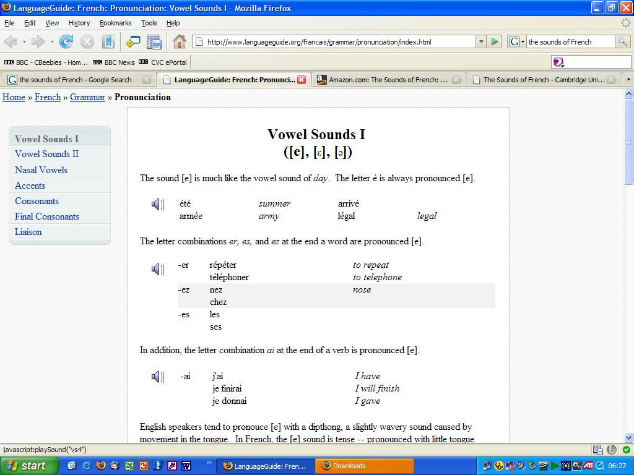
More help for teachers in planning which sounds to focus on can be found on numerous websites – I like this one! In the folders is also a 4-page list of all the French sounds.
http://www.languageguide.org/francais/grammar/pronunciation/index.html
Rachel Hawkes

Slide 49
Focus on the sound ‘on’
1. Ask the children to listen to these phrases and put their hands up when they hear the sound “ on”
1.en France
2.nous aimons
3.des bonbons
4.On a des pantalons
2. Say the following rhyme to the children and ask them to put up their hand when they think they hear the sound” on”.
Rachel Hawkes

Slide 50
En France
En France on aime les bonbons!
On a des grands bonbons.
Nous aimons les bonbons!
Allons et trouvons des bonbons!
En France on porte des pantalons!
On porte des grands pantalons.
Nous aimons les pantalons .
Allons et trouvons les pantalons!
Rachel Hawkes

Slide 51
3. You will need multi-link for each child for this activity. Encourage the children to listen again and to pass on a piece of multi-link to the child sat on the right when they hear the sound “on”.
4. Ask the children to repeat the first verse after you. Ask them to nod their heads when they say the sound “on”.
5.Try activities 2 ,3 and 4 at a more rapid speed as the children become more accustomed to listening for the sound.
Rachel Hawkes

Slide 52
KS2 Framework Learning Objectives addressed
O3.1:Listen and respond to simple rhymes and stories and songs ( identifying rhyming words/joining in with story telling)
O3.2 : Recognise and respond to sound patterns and words.(Listen with care, speak clearly and confidently)
O3.4 : Listen attentively and understand instructions…….(repeat words and phrases modelled by the teacher)
Rachel Hawkes

Slide 53
Children might practise writing the letter pattern and begin to collect words containing it.
on
They could make ‘phonic clouds’ and display them in the classroom and practise pronouncing them.
Bonjour
marron
Rachel Hawkes

Slide 54
Key features of the languages curriculum
Pronounce well and apply phonics knowledge
Listen attentively and join in
Ask and answer questions
Read and understand words and phrases
Appreciate songs, stories, rhymes
Deduce the meaning of new words from context
Learn some words!
Write words and sentences from memory
Use basic grammar (gender, adjectives, essential verb forms) to build sentences

Slide 55
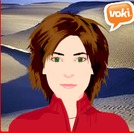
Primary Languages Session 1:
Part 1: Policy(?!), practice and potential
Part 2: Planning, Teaching & Learning
http://www.tes.co.uk/mypublicprofile.aspx?uc=1729417
rhawkes@comberton.cambs.sch.uk
www.rachelhawkes.com
www.rachelhawkes.typepad.com/linguacom
01223 262503 ext.222
More useful links:
TES collections: http://www.tes.co.uk/article.aspx?storyCode=6066908
My YouTube channel: http://www.youtube.com/rachelhawkes60
My delicious weblinks: http://www.delicious.com/rachelhawkes
Rachel Hawkes

Slide 56
The KS2 Framework
KS2 Framework | Renewed KS3 Framework
Oracy | Listening and speaking
Literacy | Reading and writing
Intercultural understanding | Intercultural understanding
Knowledge about language | Knowledge about languages
Language learning strategies | Language learning strategies
Rachel Hawkes
Notes:
The structures are there to help us to have continuity.
Conscious attempt to bring the different key stages together

Slide 57
Read aloud written texts with increasing fluency, accuracy and expression, showing awareness of meaning
5.6 – KAL – Y7, 8, 9
Recognise how sounds are represented in written form
L3.1 – KAL - Y3
Continuity and transition
Apply prior knowledge of sound/spelling system to
recognise the written word.
L6.3 LLS – Y6
Use phonic knowledge to support accurate pronunciation
L4.3 – KAL - Y4
Apply phonic and whole word knowledge in the new language in order to locate words in a reference source.
L5.3 – KAL - Y5
Rachel Hawkes

Slide 58
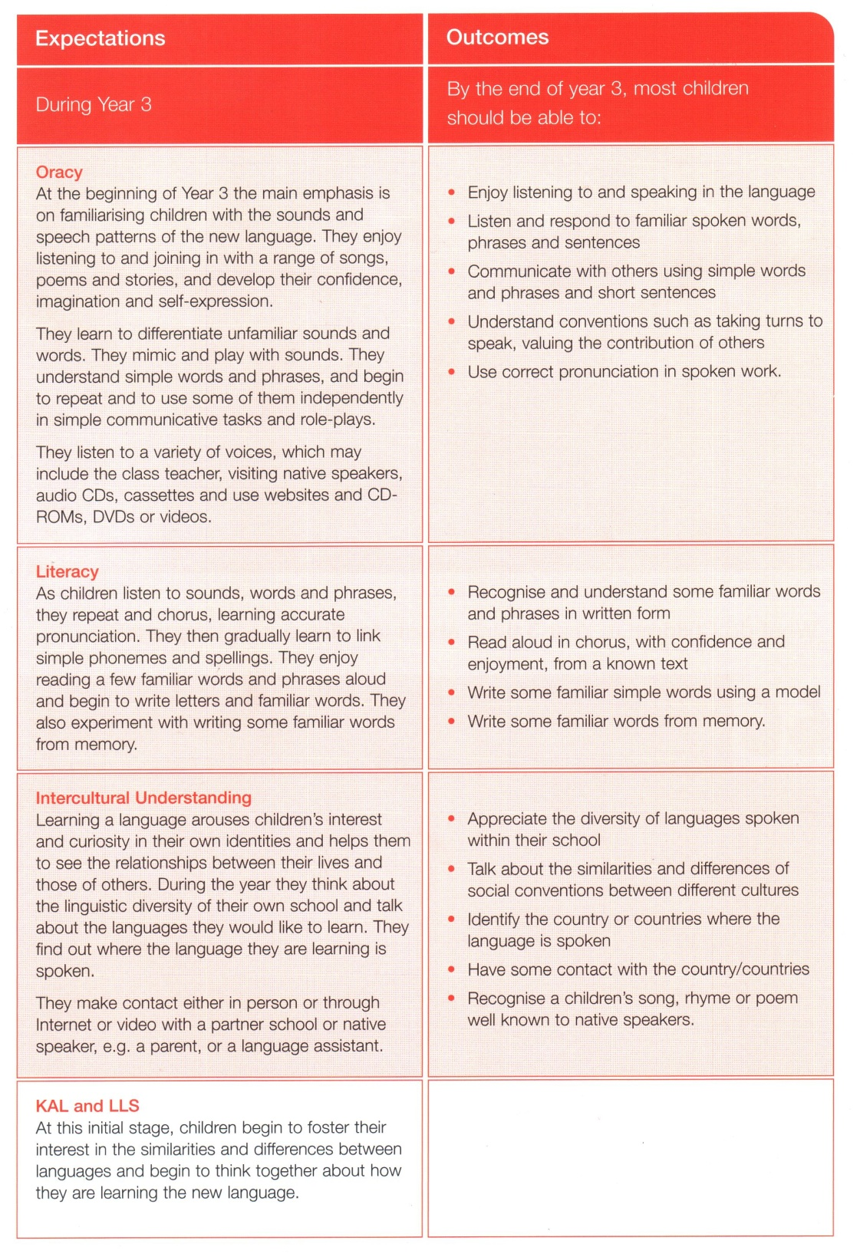
This could be listening to a song, a rhyme, a rap and repeating some or all of it along with the teacher.
This could be greeting each other and the teacher and asking how they are.
This could be reading and understanding the labels on equipment trays, or key words from displays, word mobiles, or word clouds and practising writing them from memory.
Find out how many languages are spoken.
Compare Christmases.
Label a map.

Slide 59
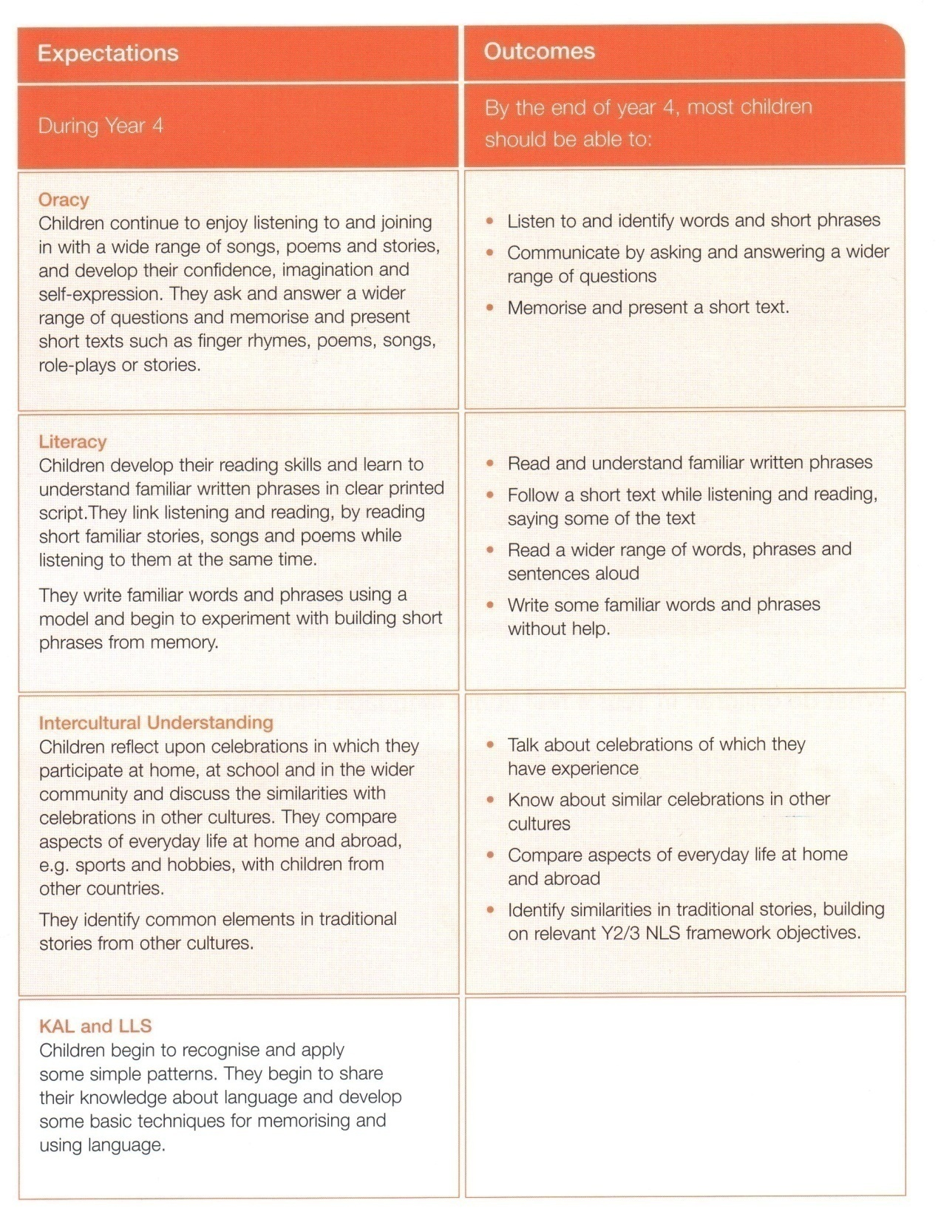
Listen to a short text and identify all the numbers or colours in it.
This could be asking and answering ‘Do you have..?’ and ‘What is…?’ questions
Following along with the text of any short story, song or poem, saying some or all of the words.
Reading out familiar whole phrases.
Practise writing simple whole phrases without help.
Comparing typical breakfasts in different countries, saying ‘I eat’ and ‘I drink’ to make full sentences.

Slide 60
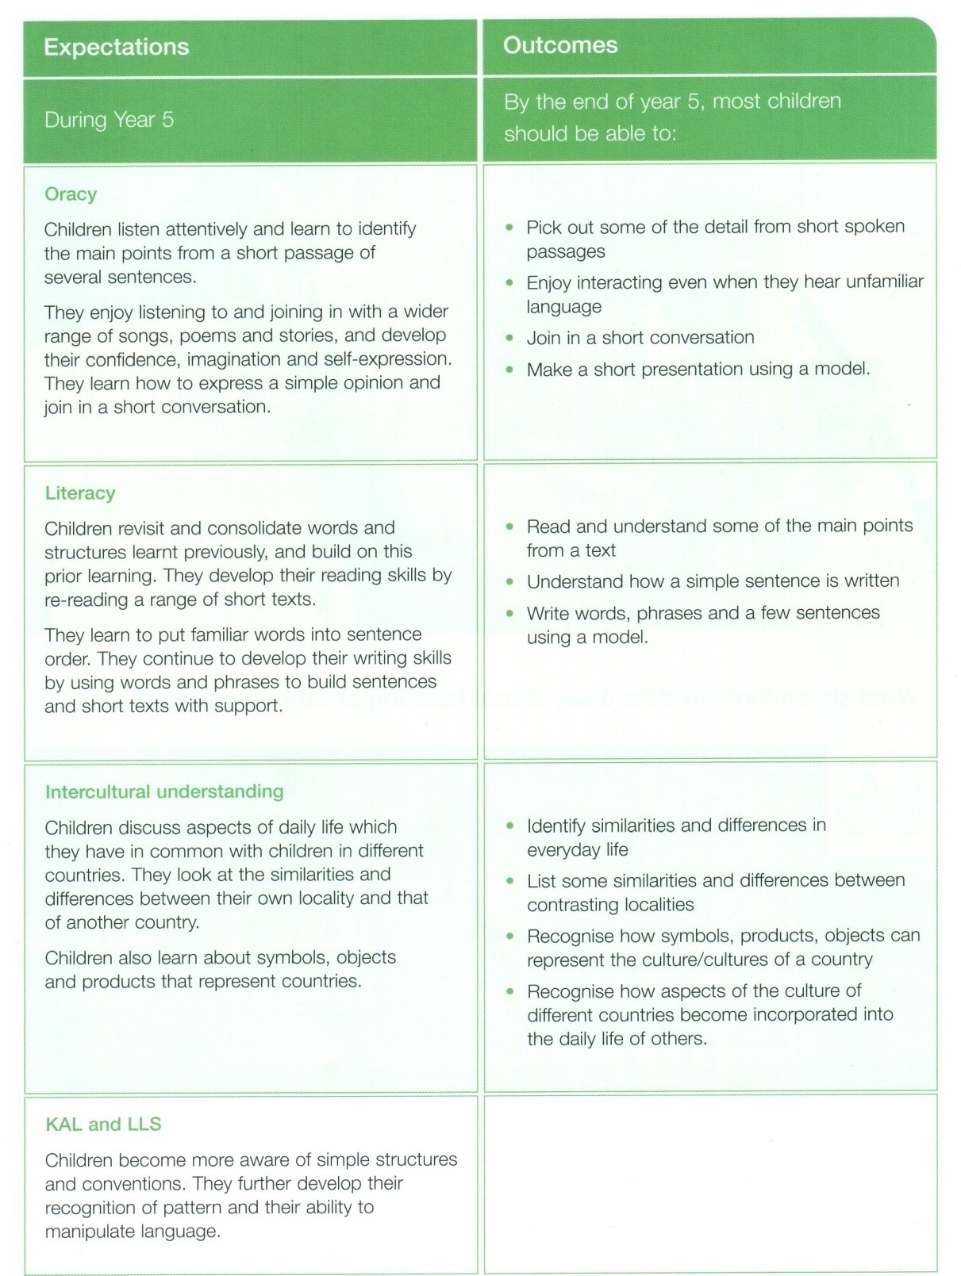
Listen to a short text noting key facts, e.g. times, opinions, nouns.
They sing along, repeat new words confidently and guess meanings
Simple role plays about likes & dislikes, their routines, hobbies, themselves & families.
Identify key building blocks in a sentence.
Write a short email about themselves from a model.
Project looking at different foods we take for granted here that come from other countries – song ‘English, half English’ Billy Bragg

Slide 61
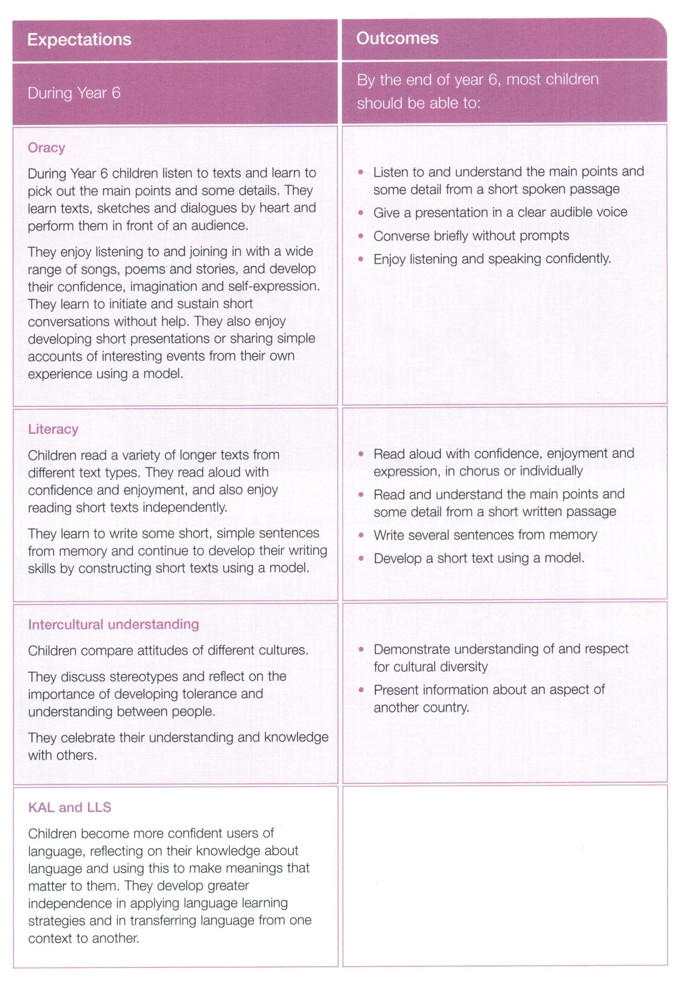
Say a few sentences about themselves to the class from memory.
Simple role plays (e.g.café, directions, xmas play) without prompts.
Read a simple story or poem in assembly or class to younger pupils.
Write about selves from memory.
Write a short email about themselves from a model.
Project looking at a typical celebration or religious festival in another country → display or class assembly, mixture of TL and English to present.

Slide 62
In broad terms -- after 4 years of language learning most Year 6 children will be able to understand simple spoken and written language, to speak aloud and take part in short conversations and to write simple sentences. They will also understand about different cultures and have an idea about how languages work and how to learn them. In short they will be becoming confident users and learners of a new language.
Rachel Hawkes

