Slide 1

Online resources
Interactive resources to use as you teach (Flash, video etc.)
Resources to download to use (PowerPoint, Word, Pdf etc.)
Resources to buy
Online games and activities for pupils to use
Rachel Hawkes

Slide 2
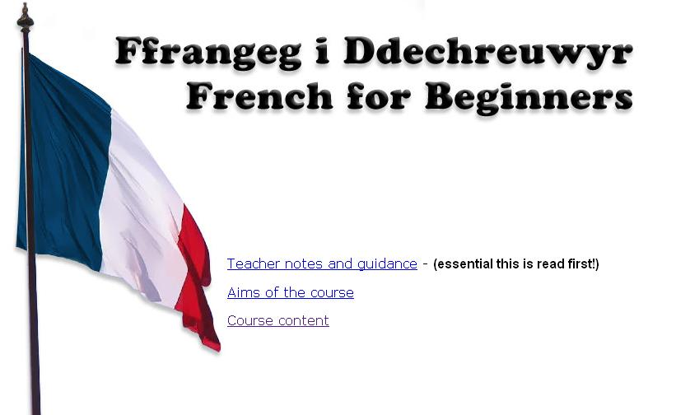
http://www.ngfl-cymru.org.uk/vtc/ngfl/french/primary_french/index.htm

Slide 3

http://www.ngfl-cymru.org.uk/vtc/ngfl/spanish/spanish_songs/index.html
Notes:
5 songs + activities – very well made

Slide 4
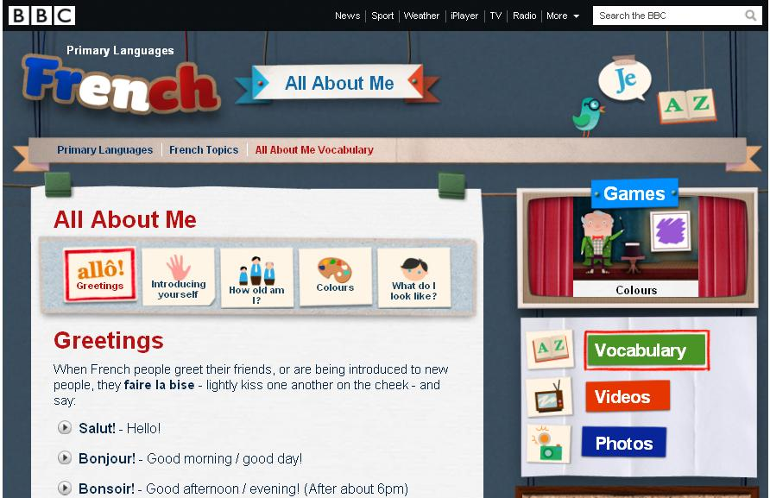
http://www.bbc.co.uk/schools/primarylanguages/french/all_about_me/
http://www.bbc.co.uk/schools/primarylanguages/spanish
Rachel Hawkes

Slide 5
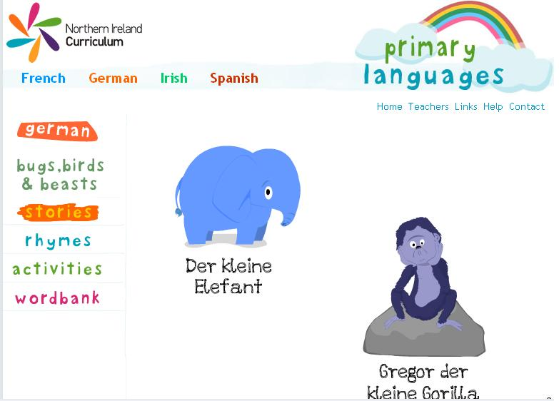
http://www.nicurriculum.org.uk/pl/

Slide 6
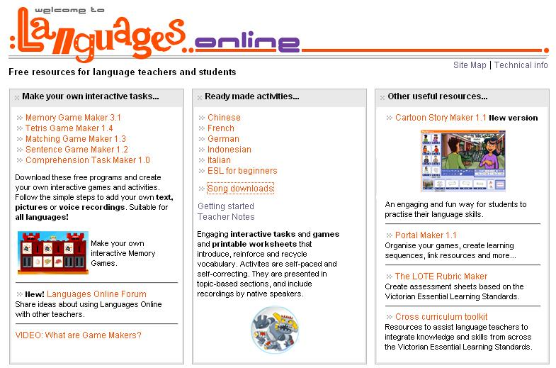
http://www.education.vic.gov.au/languagesonline/
Song downloads
http://www.education.vic.gov.au/languagesonline/audio.htm

Slide 7
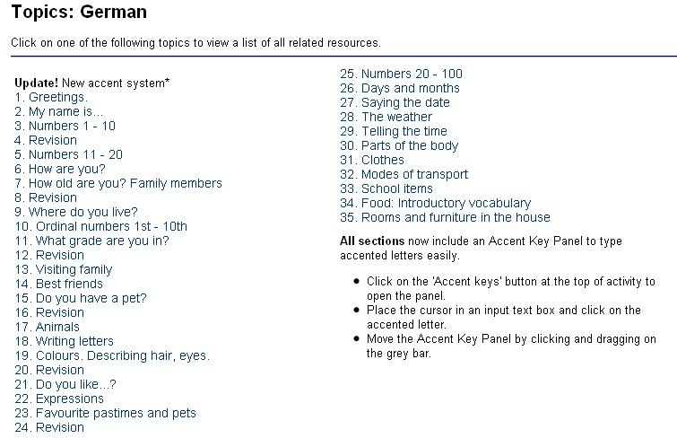
http://www.education.vic.gov.au/languagesonline/german/german.htm
http://www.education.vic.gov.au/languagesonline/french/french.htm

Slide 8
Online resources
Interactive resources to use as you teach (Flash, video etc.)
Resources to download to use (PowerPoint, Word, Pdf etc.)
Resources to buy
Online games and activities for pupils to use
Rachel Hawkes

Slide 9
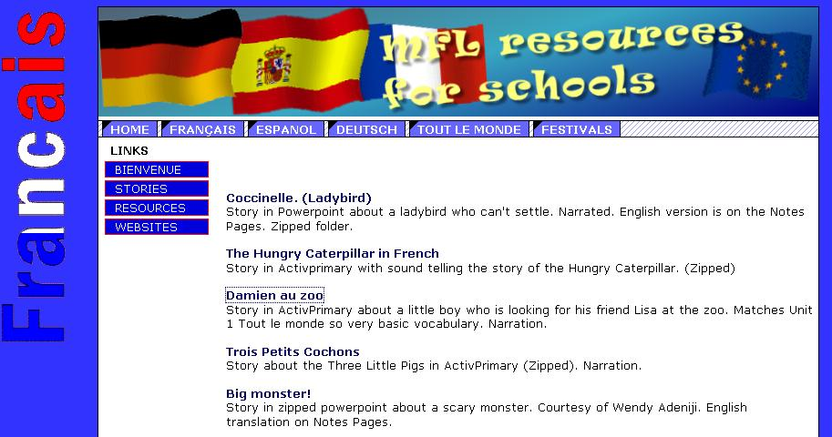
http://www.herefordlearning.org.uk/page.asp?PG_ID=32&GRP_ID=8
http://www.herefordlearning.org.uk/resources.asp?GRP_ID=10
http://www.herefordlearning.org.uk/page.asp?PG_ID=23&GRP_ID=9

Slide 10
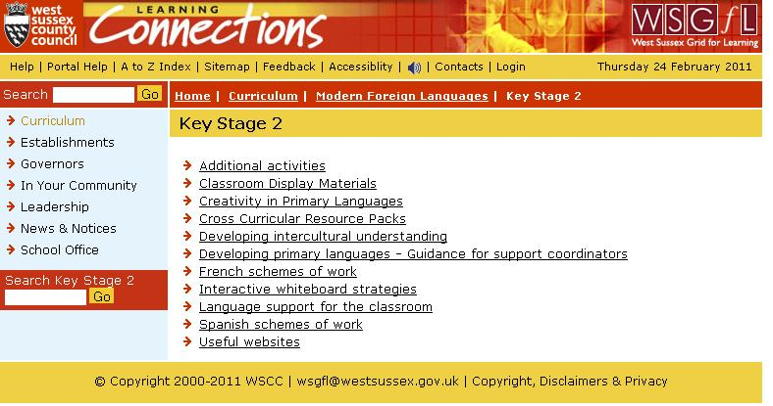
http://wsgfl.westsussex.gov.uk/ccm/navigation/curriculum/modern-foreign-languages/key-stage-2/
http://wsgfl.westsussex.gov.uk/ccm/navigation/curriculum/modern-foreign-languages/key-stage-2/cross-curricular-resource-packs/

Slide 11

http://www.sunderlandschools.org/mfl-sunderland/resources-pr-fr-newsunderlandmaterials.htm
http://www.sunderlandschools.org/mfl-sunderland/resources-pr-fr-ks1.htm

Slide 12
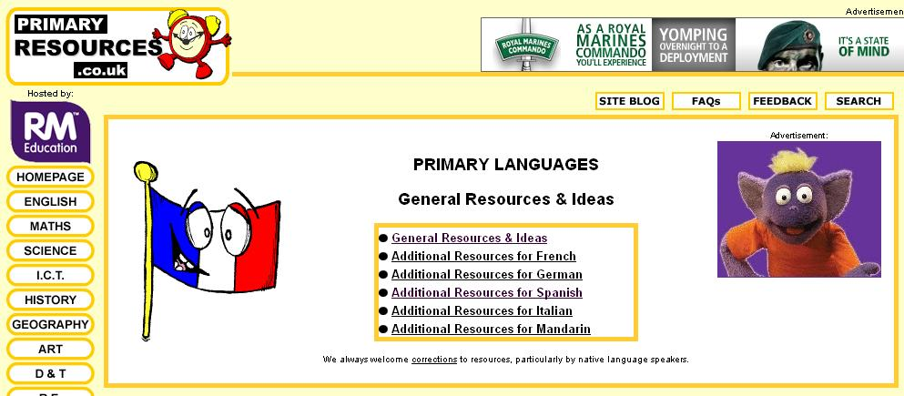
http://www.primaryresources.co.uk/mfl/mfl.htm
This is a good source of teaching ideas in general as well as an extensive archive of French, German and Spanish teaching materials.

Slide 13
Online resources
Interactive resources to use as you teach (Flash, video etc.)
Resources to download to use (PowerPoint, Word, Pdf etc.)
Resources to buy
Online games and activities for pupils to use
Rachel Hawkes

Slide 14
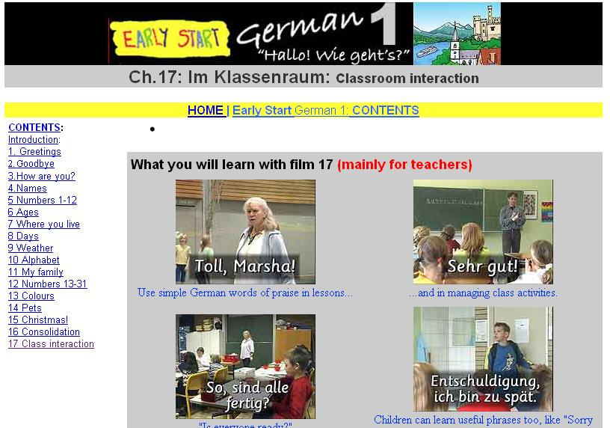
Rachel Hawkes

Slide 15


http://www.earlystart.co.uk/about.htm
Rachel Hawkes

Slide 16
There are 16 short films (on DVD or video), each introducing a very small number of key words and phrases: These are the Pack 1 contents.
Hola - greetings
Adiós - saying goodbye
¿Qué tal? - asking people how they are
¿Cómo te llamas? - introducing yourself and asking other children's names
Los colores - colours
Los números 1-12 - numbers 1-12
¿Cuántos años tienes? - saying how old you are and asking other children their age
Los meses del año - the months of the year
Los números 13-31 - numbers 13-31
¿Cuándo es tu cumpleaños? - saying when your birthday is and asking other children when their birthdays are
Los días de la semana - the days of the week
¿Qué día es hoy? - saying the date
¿Tienes hermanos? - talking about your brothers and sisters
¿Tienes alguna mascota? - talking about your pets
En la clase - useful Spanish words and phrases that teachers and pupils can use in the classroom when playing games and participating in language learning activities.
Rachel Hawkes

Slide 17
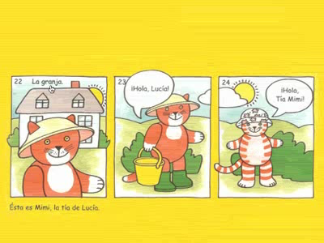
Rachel Hawkes

Slide 18
Online resources
Interactive resources to use as you teach (Flash, video etc.)
Resources to download to use (PowerPoint, Word, Pdf etc.)
Resources to buy
Online games and activities for pupils to use
Rachel Hawkes

Slide 19
Links to free online activities
http://www.languagesonline.org.uk/
http://www.sunderlandschools.org/estrellas/
http://www.atantot.co.uk/menu.htm (have to subscribe to this one now)
http://www.ltscotland.org.uk/c4modernlanguages/
http://www.goethe.de/ins/jp/pro/goethe-haus/
http://www.poissonrouge.com/redfish.php
http://www.learnalberta.ca/content/flbla/index.html

Slide 20
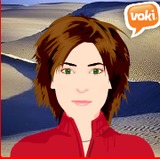
Primary Languages Session 2:
Teaching & Learning
rhawkes@comberton.cambs.sch.uk
www.rachelhawkes.com
www.rachelhawkes.typepad.com/linguacom
01223 262503 ext.222
More useful links:
TES collections: http://www.tes.co.uk/article.aspx?storyCode=6066908
My YouTube channel: http://www.youtube.com/rachelhawkes60
My delicious weblinks: http://www.delicious.com/rachelhawkes
Rachel Hawkes

