Slide 1
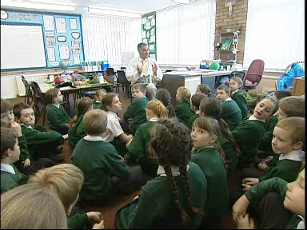

Slide 2
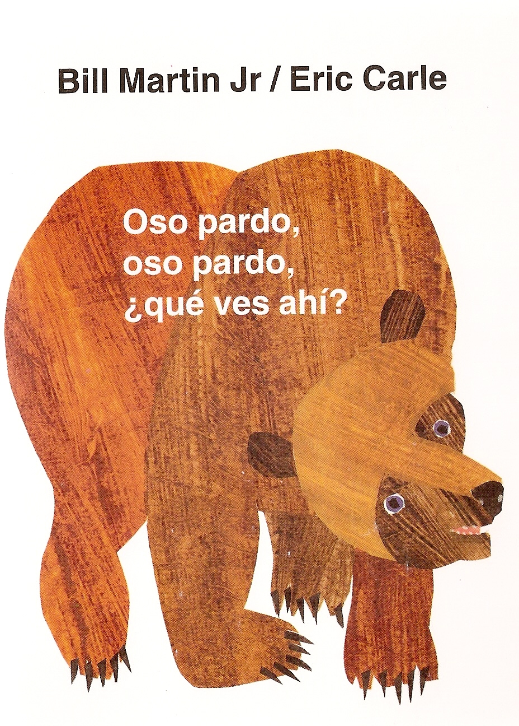

Slide 3
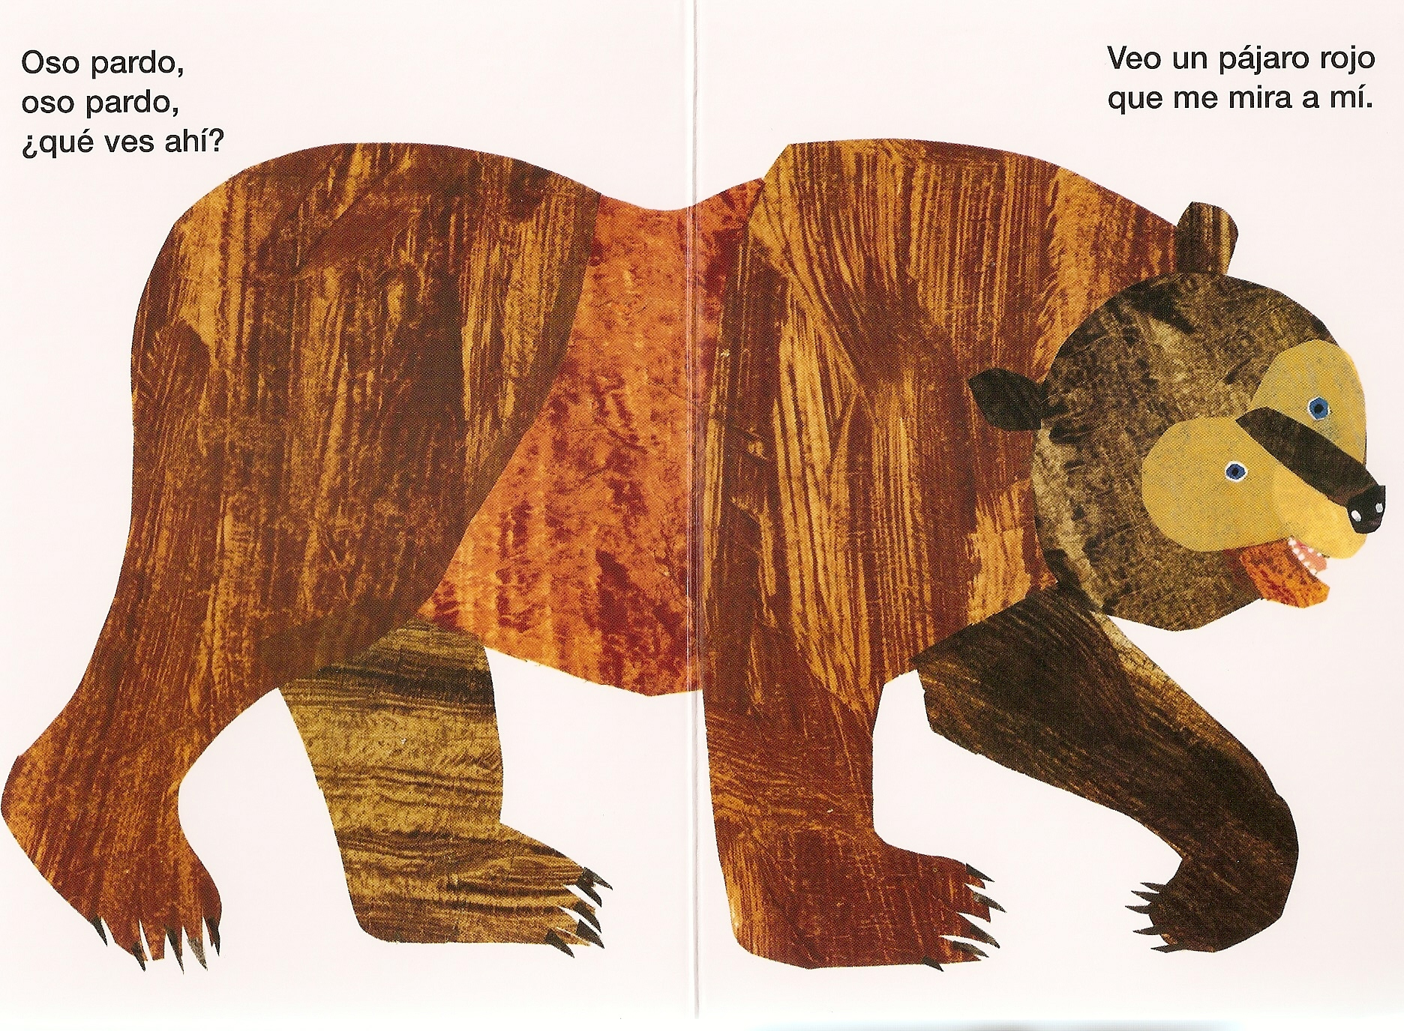
Notes:
¿Qué ves ahí? = What do you see there?
Veo … que me mira a mí = I see a … who is watching me.
pardo = brownish-grey

Slide 4
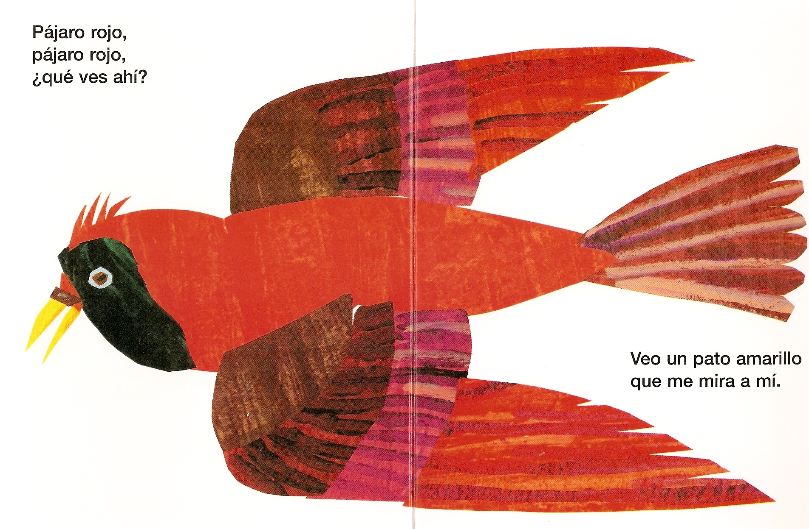

Slide 5
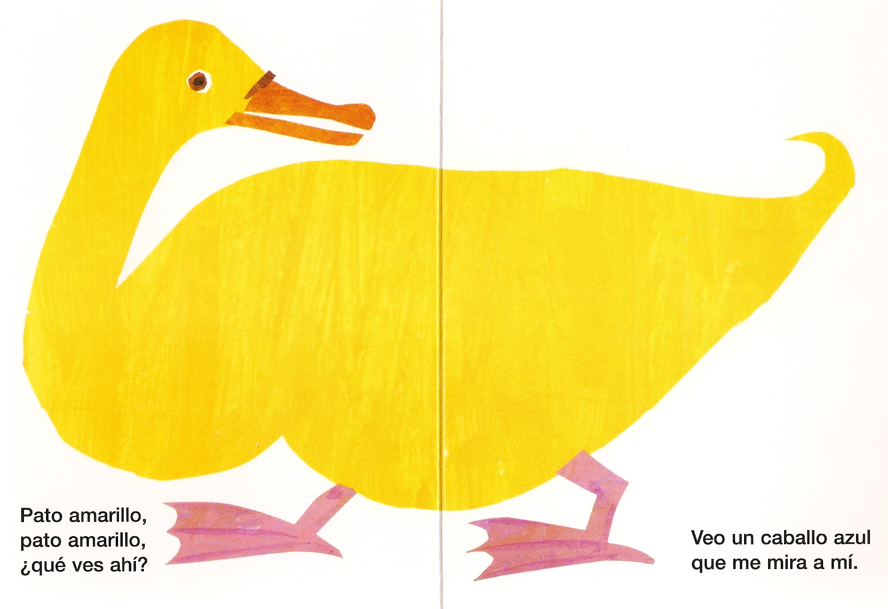

Slide 6
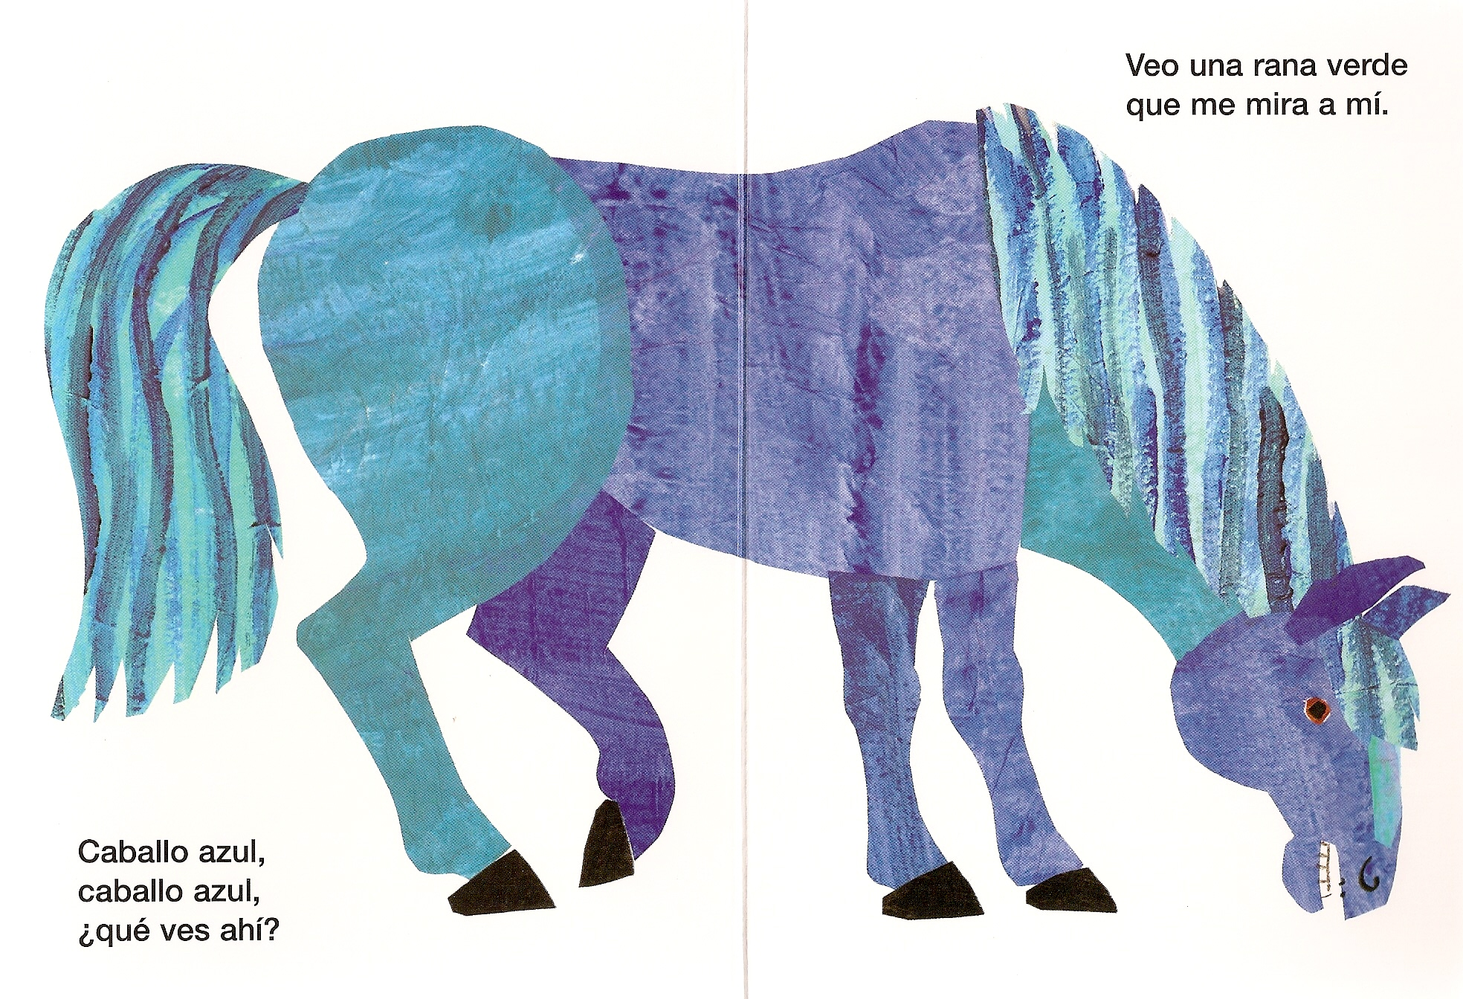

Slide 7
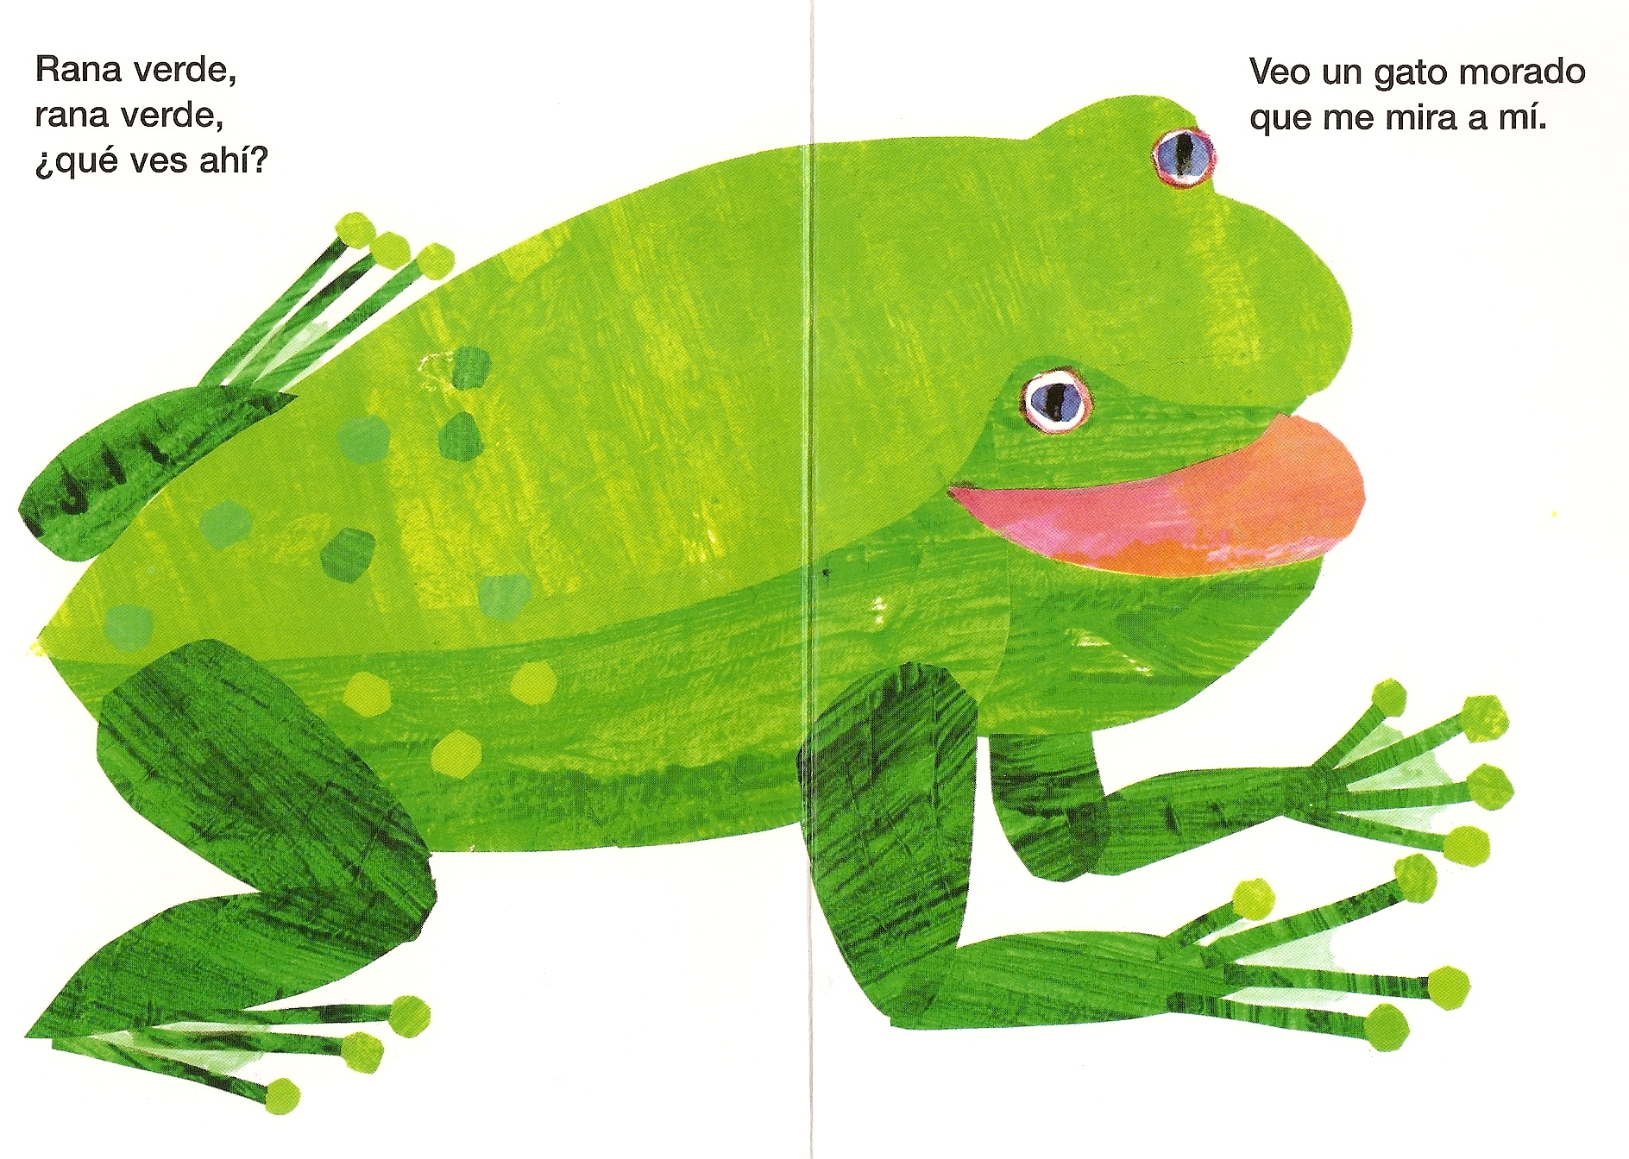
Notes:
morado = purple

Slide 8
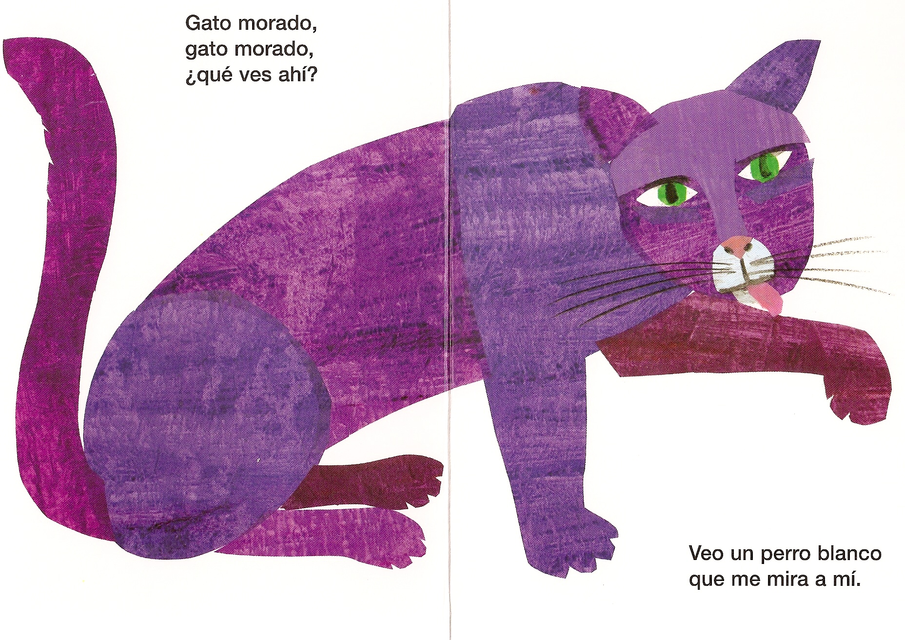

Slide 9
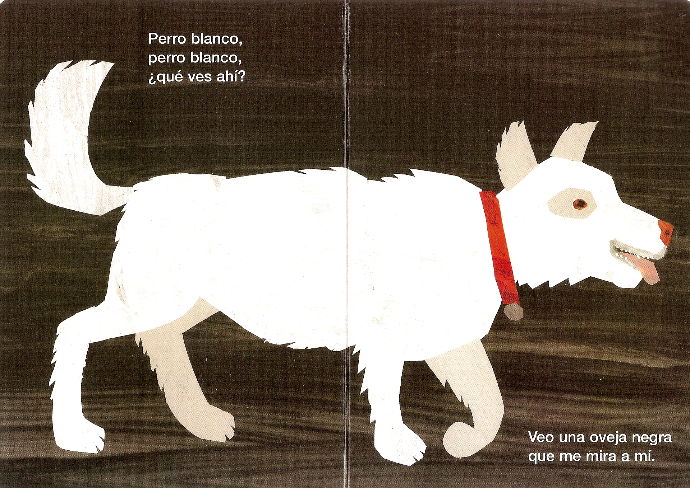

Slide 10
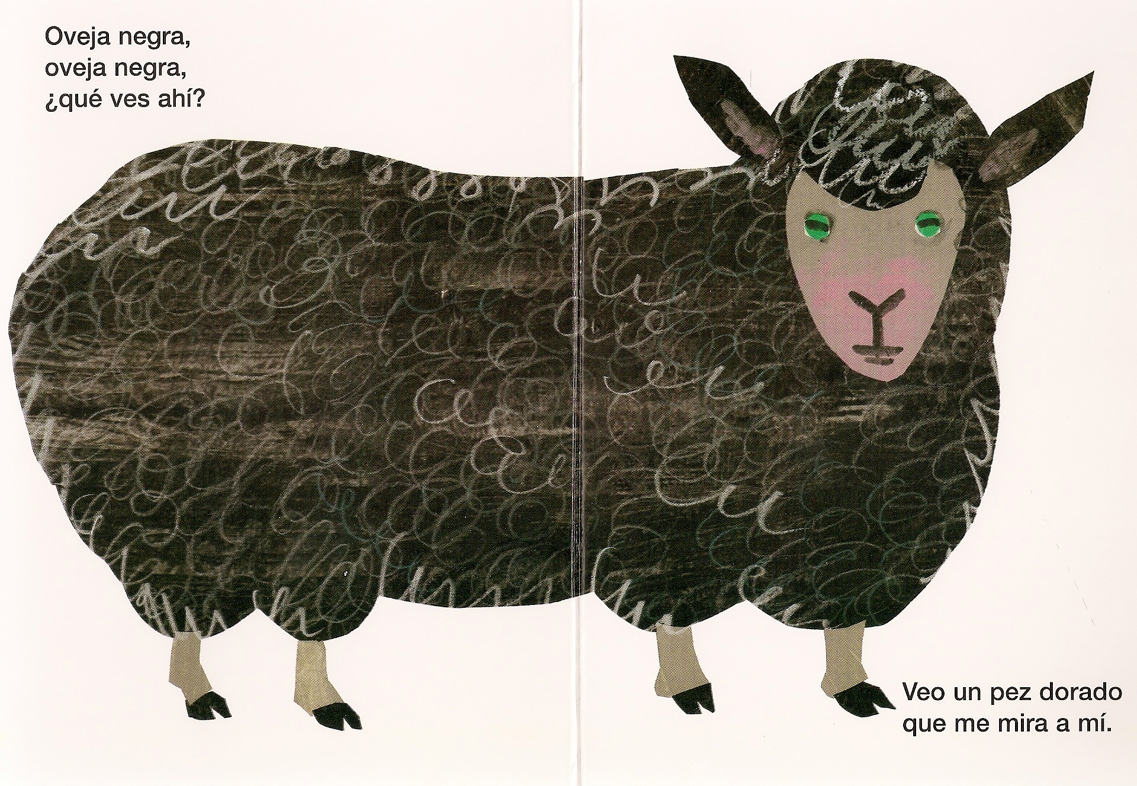

Slide 11
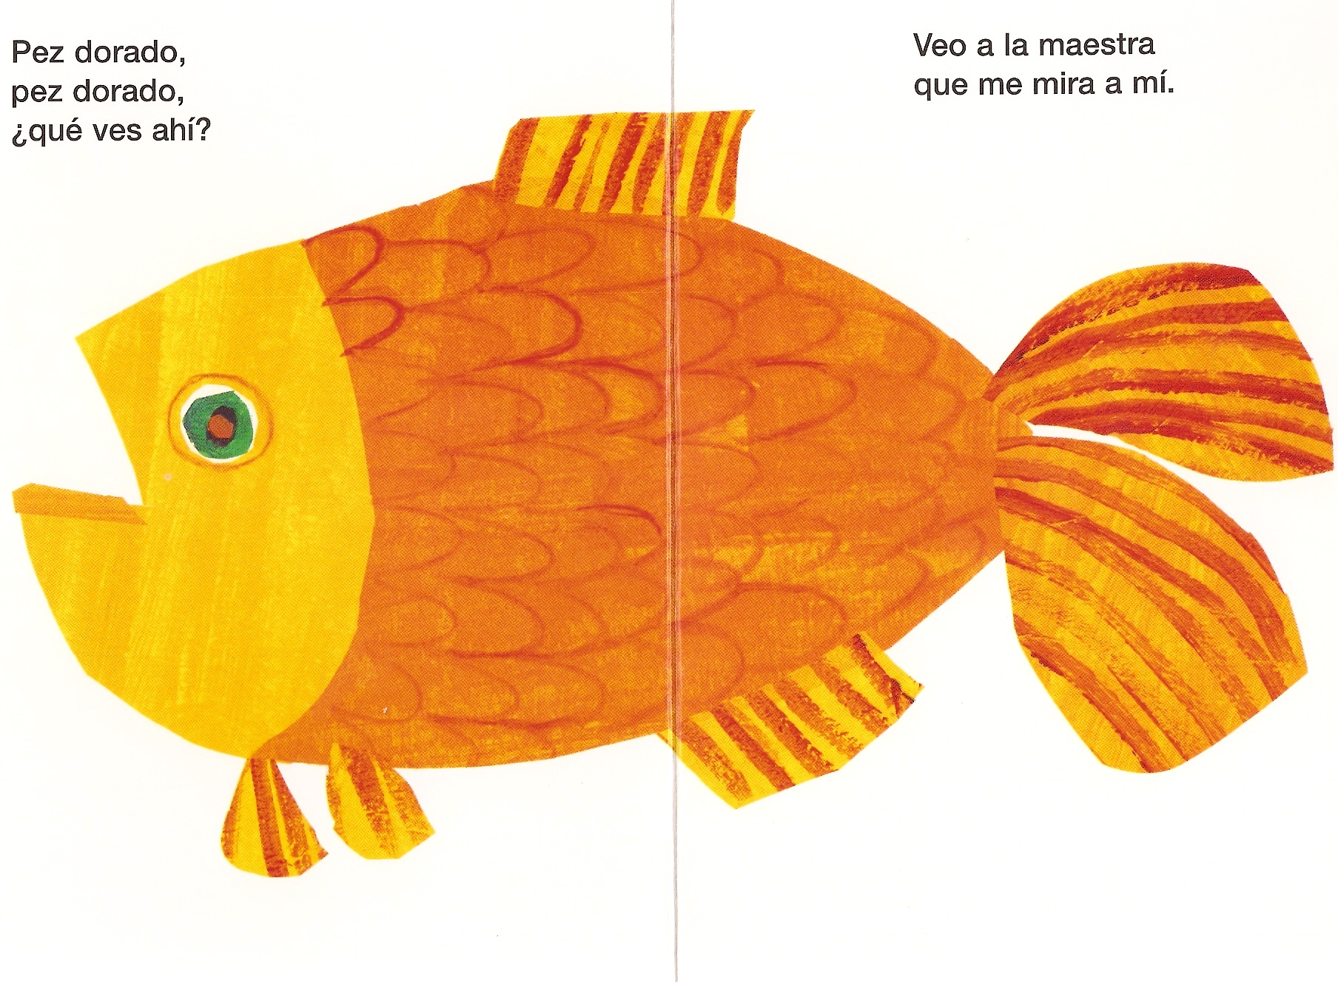
Notes:
dorado = golden
maestra = teacher (met this word in ‘Sustantivos’ song)

Slide 12
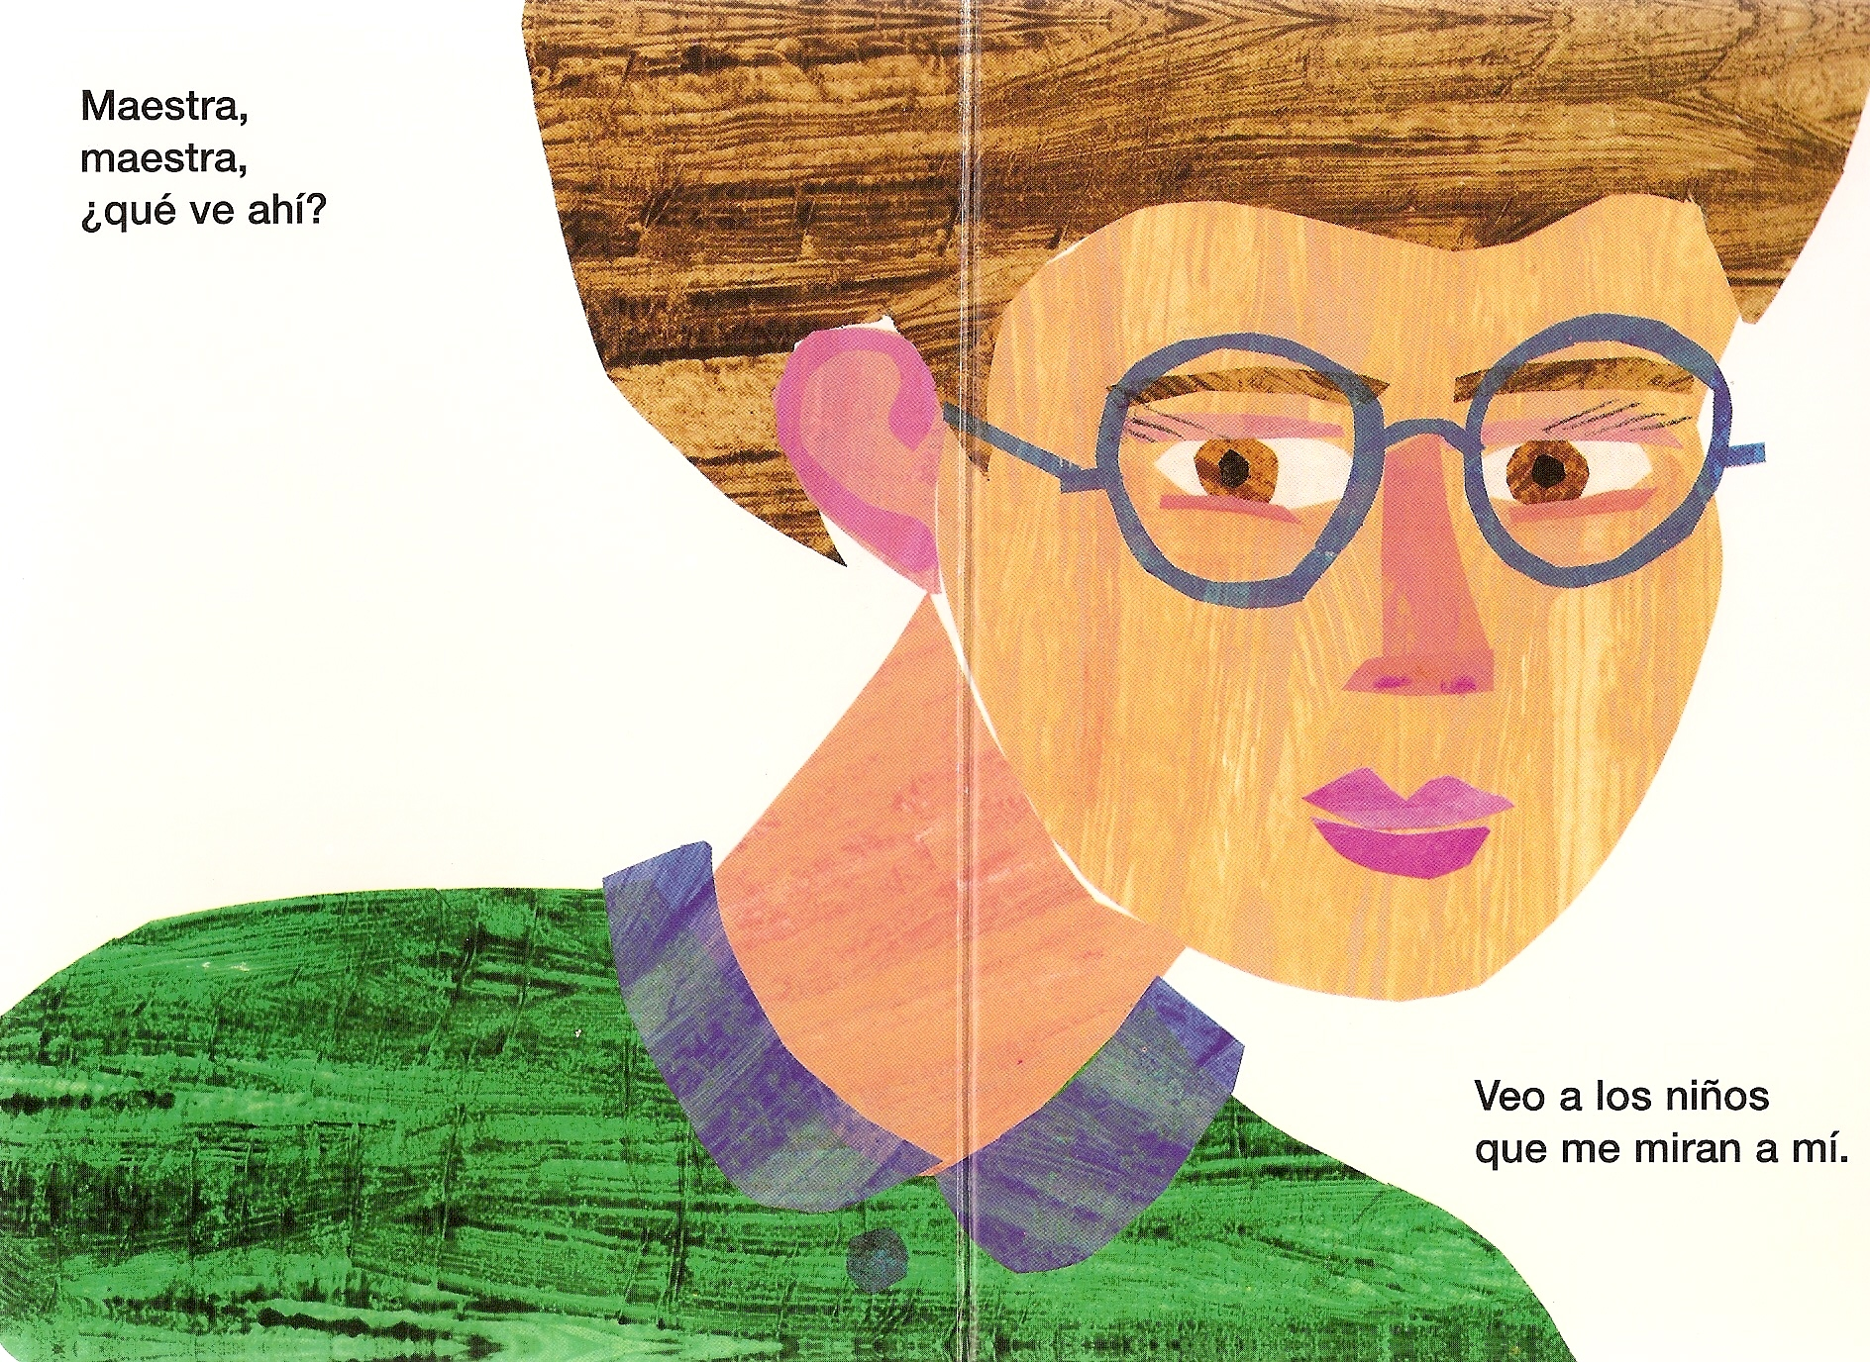
Notes:
niños = children (met ‘niño’ in phonic cards activity in unit 1)

Slide 13
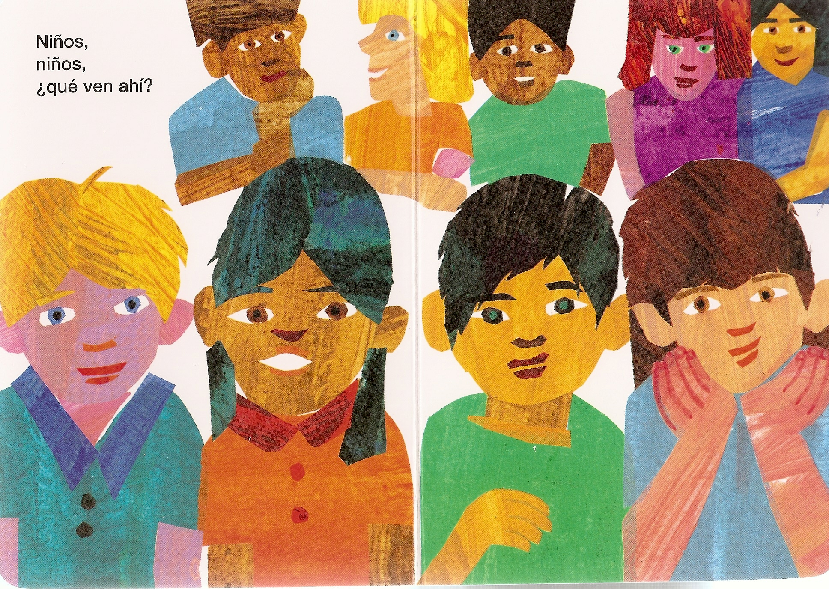

Slide 14
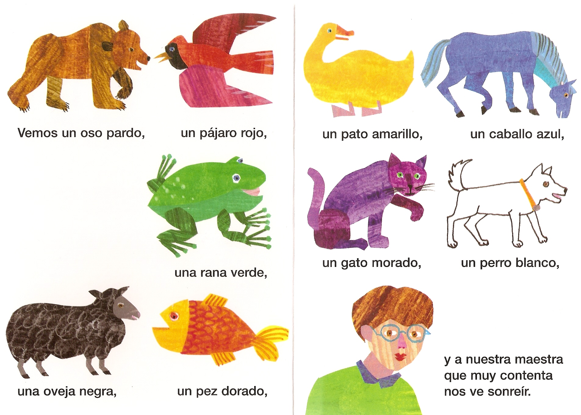
Notes:
Vemos = we see
y a nuestra maestra que muy contenta nos ve sonreír = and our teacher who, very happy, watches us smiling.

Slide 15
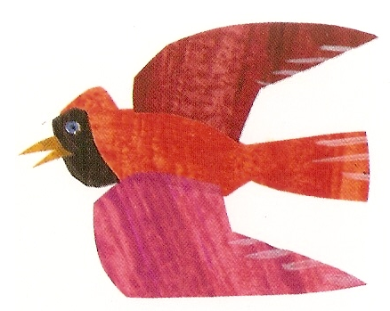
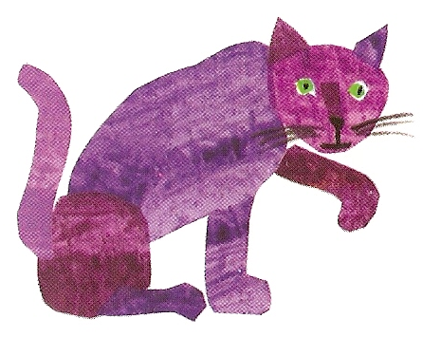
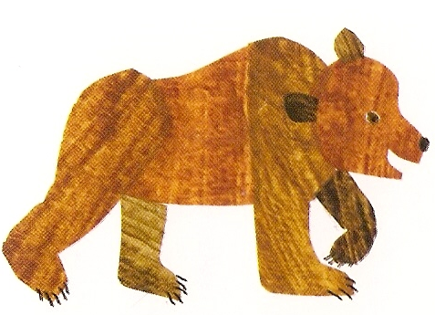
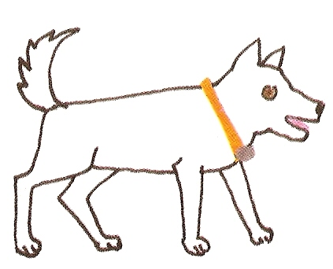
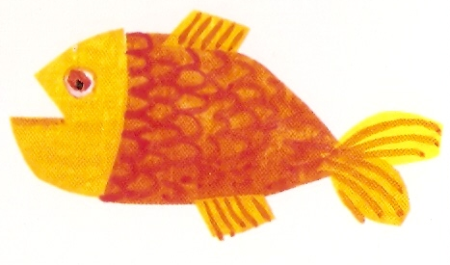
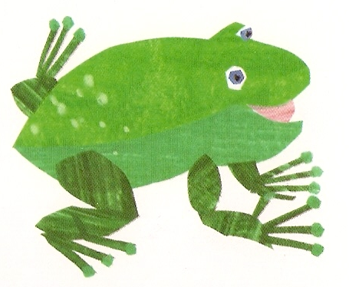
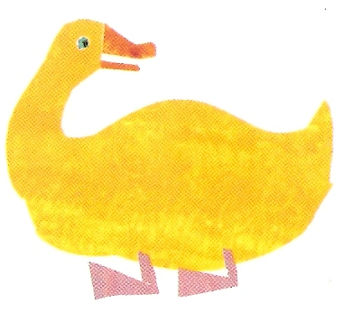
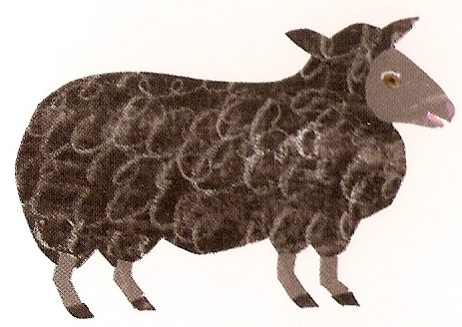
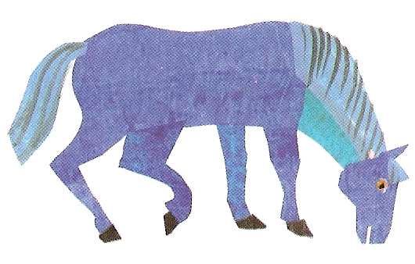
pardo
rojo
blanco
negra
azul
morado
amarillo
dorado
verde
Notes:
Pupils choose the correct adjective which they heard with the animal in the story. Click on animals/words to hear sounds. Add the new colours to the pupils’ vocabulary list – pardo, morado, dorado.

Slide 16


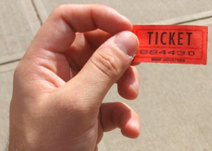


Differentiation ideas
Supported extension (e.g. language booklet)
Oral differentiation (questioning strategies – e.g. non-verbal, true/false, alternatives (2,3,4), yes/no, what, opinions, reasons)
Medals
Online – further research about content or www.wordreference.com for more language
Dictionary skills
Task differentiation – fewer words, choose own words
Rewards for spontaneous language
Rachel Hawkes

Slide 17
Respond quickly and appropriately to audience comments or questions following a talk or narrative
1.5 – Y9
Perform simple communicative tasks
using single words, phrases and short
sentences
03.3 – Oracy – Y3
Use some complex language in a prepared but unscripted talk or narrative
1.5 – Y8
Progression in planned speaking
Memorise and present a short
spoken text
04.1 – Oracy – Y4
Plan and present a short talk or narrative, speaking clearly, audibly and with accurate pronunciation
1.5 – Y7
Prepare a short presentation on a
familiar topic
(from memory)
O5.4 – Oracy – Y5
Present a short piece of narrative either from memory
or by reading aloud from text
06.2 – Oracy – Y6
Rachel Hawkes

Slide 18
Year 7 (Term 1)
Revision of phonics (pronunciation & memory)
Spanglovision (memory, pronunciation & performance)
Spelling Bee (memory, pronunciation & performance)
More formal introduction to verbs (pronouns, verb endings – SER and HABLAR) → (sentence-building)
Memory strategy lessons (memory & autonomy)
Dictionary skills lessons (autonomy & creativity)
Adjective endings (sentence-building)
Content: describing self and places (sentence-building & creativity)

Slide 19
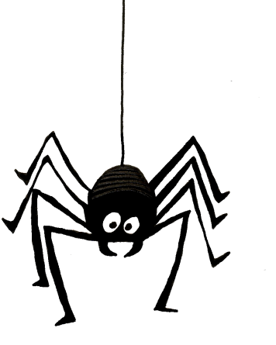
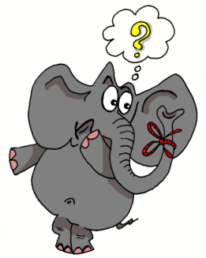
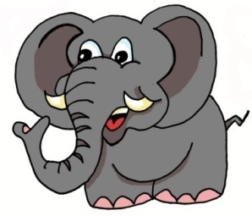

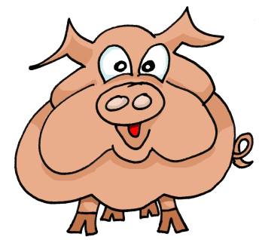
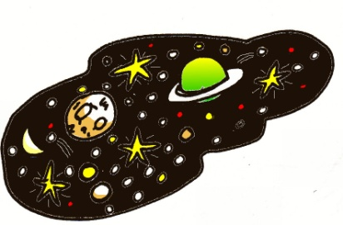
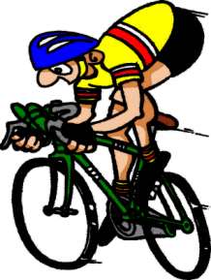
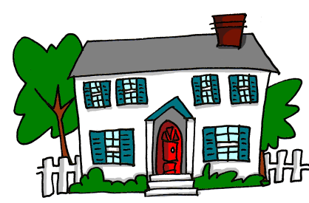
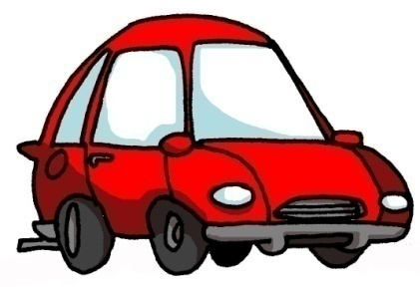
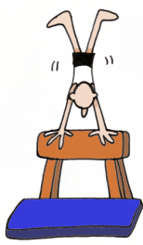
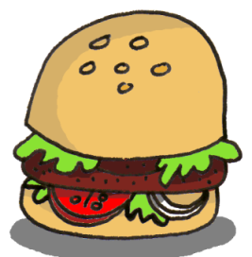
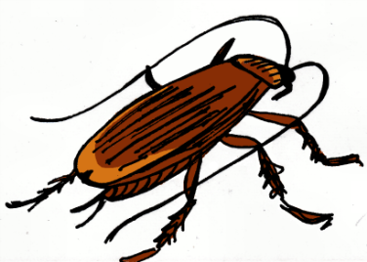
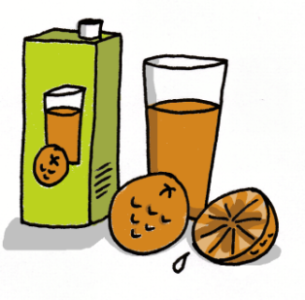


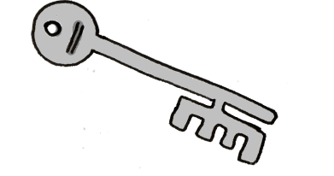
1 | 2 | 3 | 4
5 | 6 | 7 | 8
9 | 10 | 11 | 12
13 | 14 | 15 | 16
idea
araña
elefante
olvidar
universo
cerdo
ciclista
casa
coche
cucaracha
gimnasia
hamburguesa
España
zumo
guitarra
llave
Notes:
19

Slide 20
e.g. | ¿Cómo te |  | llamas?
1 | Madrid | A | en una casa cerca de Cambridge.
2 | Tengo | B | 12 de febrero
3 | Mi madre se llama | C | once años.
4 | Estoy muy | D | tu nombre?
5 | Vivo | E | dónde eres?
6 | ¿Cuál es tu | F | es la capital de España.
7 | Hoy es el | G | en inglés?
8 | ¿De | H | bien, gracias.
9 | ¿Cómo se dice | I | Rebecca.
10 | ¿Cómo se escribe | J | nacionalidad?

Slide 21
Y7 Speaking: Peer Assessment Sheet
 | Questions
1 | ¿Cómo te llamas?
2 | ¿Cómo estás ¿Qué tal?
3 | ¿Cómo se escribe?
4 | ¿De dónde eres?
5 | ¿Cuál es tu nacionalidad?
6 | ¿Qué idiomas hablas?
7 | ¿Dónde vives?
You are going to assess the speaking of others in your class today. You are going to assess at least 3 different students in your class in a speaking line. Ask your partner all of the 7 questions listed below and then s/he will ask you 3 questions. For each answer or question give him/her either 2,1 or 0. At least 3 students will also assess your speaking.
 | Name | Name | Name | Marksheme. Give 2, 1 or 0 for each answer
1 |  |  |  | 2 = full sentence answer (or question), ready response, not much hesitation, significant effort to sound Spanish 1 = answer that does communicate BUT might not be complete sentence, some attempt to sound Spanish 0 = cannot answer OR does not recognise the question so gives a different answer
2
3
4
5
6
7
?
?
?
Total | /20 | /20 | /20

Slide 22
Year 7 November Writing Assessment
Write a paragraph in Spanish all about you.
Use the questions on the right as a guide to what you should include.
You will be marked on:
a) How neatly you write
b) How accurately you write
c) How you extend some of the prompts (for example, when you write about where you live and pets.)
¿Cómo te llamas?
¿Cuántos años tienes?
¿ Cuál es tu nacionalidad?
¿ De dónde eres?
¿ Dónde vives?
¿ Algo más?
Make sure you show off how much you can say here (names, ages, nationality, colour etc)
Write your paragraph here. Accuracy Matters! Spelling matters!

