Slide 1

Progression – a Y3 sequence
Year 3 Term 1
Year 3 pupils started with the phonics, learning the vowels first and then other key sounds. They practised these using a variety of activities. They read rhyming stories, sang songs, practised tongue twisters and had further opportunities to make the sound-written link by listening to words and anticipating their spelling.
Year 3 Term 2
In this term pupils learnt some nouns (pencil case and classroom items). They were made aware of gender through colour coding. They used the verb forms ‘tengo – I have’, ‘es – it is’ and implicitly encountered the negative forms of these.
Rachel Hawkes

Slide 2
Year 3 Term 3
The theme is animals and colours. The linguistic focus is gender, articles (definite & indefinite), plurals and adjectives (position & basic agreement). The grammatical concepts are all based around a core vocabulary of 9 animal nouns and 6 colours so nothing so becomes too difficult.
The key verbs are ‘es’ (he/she/it is), ‘son’ (they are), hay (there is/are). The negative is revisited and there is also a subtle introduction to ‘también’ (also/too/as well), ‘pero’ (but).
Pupils are encouraged at all times to strive to work things out for themselves, work in pairs and small groups sharing knowledge, and to speak aloud when possible – thereby building confidence.
Pronunciation, memory, pattern finding, sentence building, autonomy, performance and creativity are the concepts at the heart of these resources.
Rachel Hawkes

Slide 3
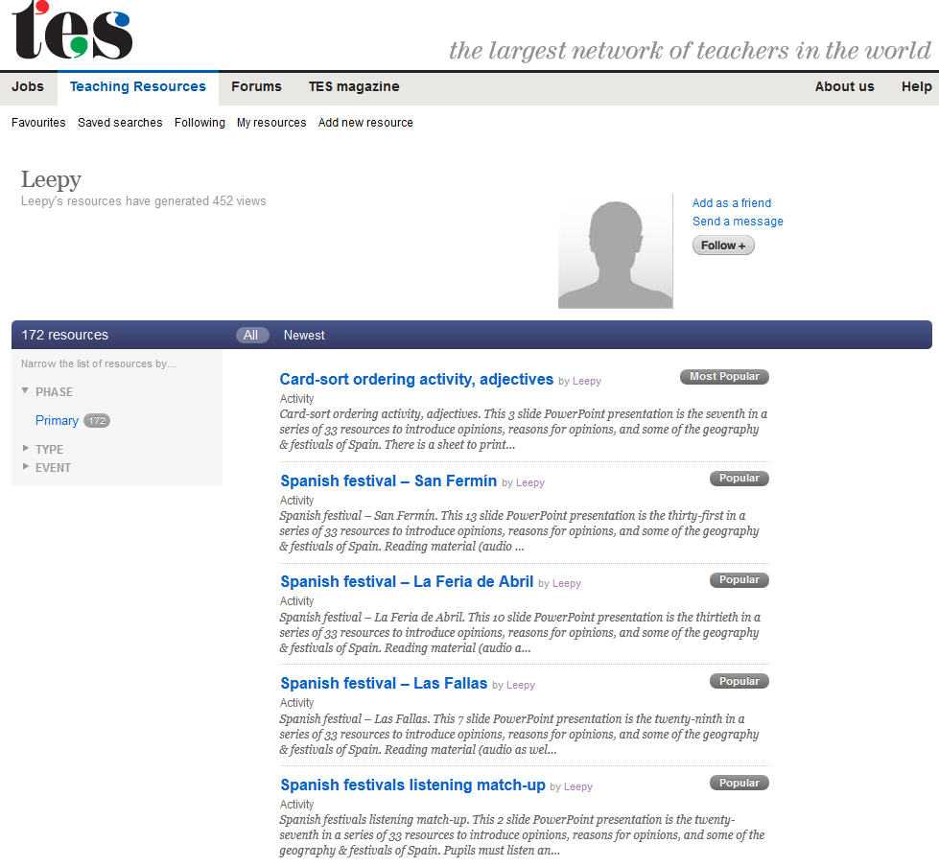
TES username: Leepy
http://www.tes.co.uk/mypublicprofile.aspx?uc=1729417

Slide 4
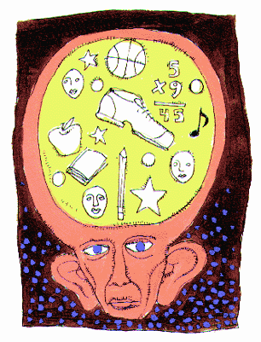
memoria
Notes:
memoria = memory
Click word to hear it pronounced.

Slide 5




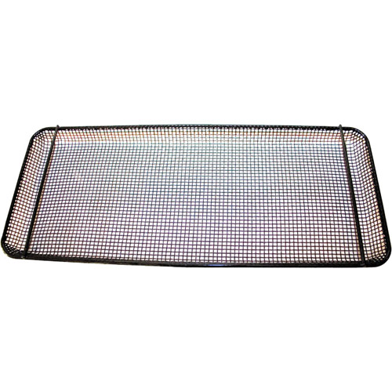
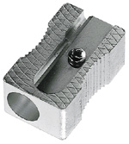
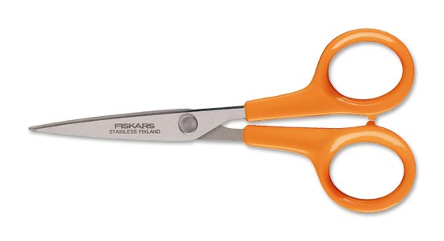

El gran juego
de la
memoria
¡Tenéis 10 segundos para memorizar!
Notes:
El gran juego de la memoria (The big memory game). ¡Tenéis 10 segundos para memorizar! = You all have 10 seconds to memorise! Click on text to hear instructions pronounced. The curtains open on click and then close when 10 seconds has passed. Pupils must use the time to memorize which items are on the tray and then recall them orally. Encourage them to remember whether they need to use un/una/unos/unas with each bit of vocabulary. If you ask different pupils for one item each then this will hopefully be manageable. The items are shown again on the next slide. Remember: if it’s too difficult/fast for pupils you can always repeat the slide.

Slide 7
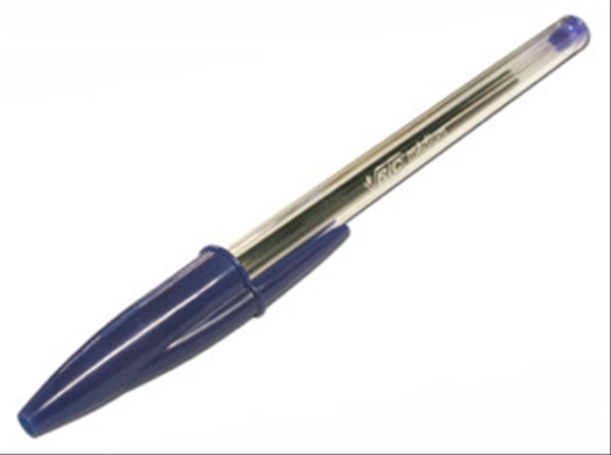



El gran juego
de la
memoria
¡Tenéis 8 segundos para memorizar!
Notes:
As before but pupils now only have 8 seconds to memorize to increase the challenge. (Sounds still included.)

Slide 9
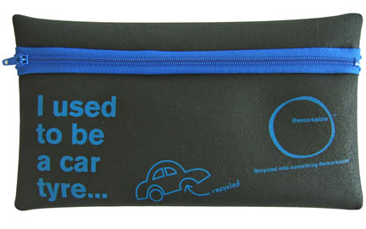
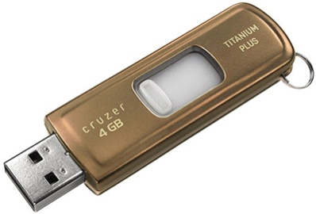
El gran juego
de la
memoria
¡Tenéis 6 segundos para memorizar!
Notes:
As before but pupils now only have 6 seconds to memorize. (Sounds still included.)

Slide 11
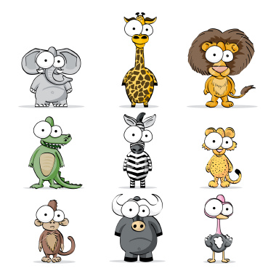
Vamos a aprender…
animales
Notes:
Vamos a aprender… animales = We are going to learn … animals. There follows an introduction to 7 masculine (blue background) & 2 feminine (red background) animals. These will be the animals used as examples in the next lesson with colours (and adjectival agreement) so it is very important that the pupils are confident with the gender of these nouns.

Slide 12
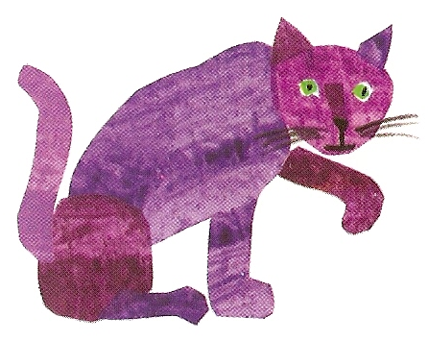
un gato
Notes:
Present new vocabulary as usual, including the indefinite article. Allow pupils to hear the sound (click on the picture) before you reveal the writing (click again on the writing to hear pronunciation). Pupils should get into the habit of predicting spelling, and dividing words up into syllables to aid pronunciation & spelling.

Slide 13
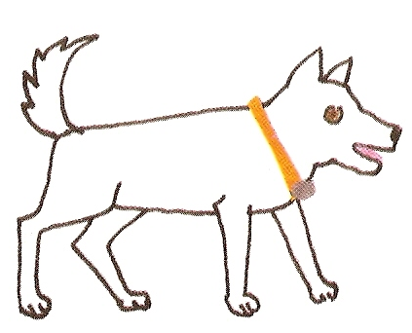
un perro
Notes:
Click on the picture of the animal to hear the pronunciation. Click on any other part of the slide and the spelling will appear at the bottom of the box. You may want your pupils to predict the spelling before you reveal it. The hope is that pupils will be able to cope well with the spelling before of the work they have done with pronunciation and predicting spelling in the first unit.

Slide 14
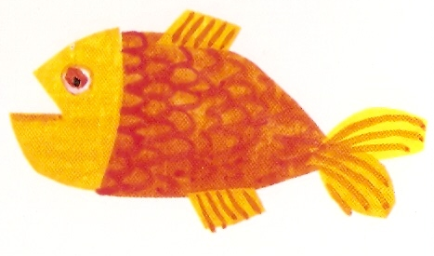
un pez

Slide 15
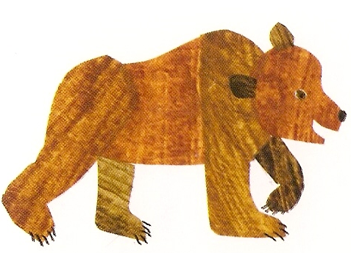
un oso

Slide 16
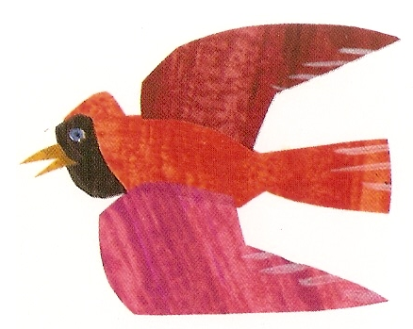
un pájaro

Slide 17
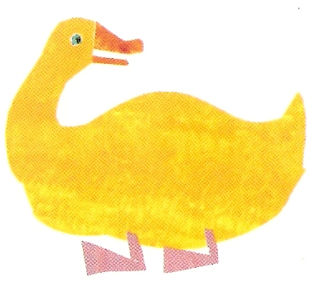
un pato

Slide 18
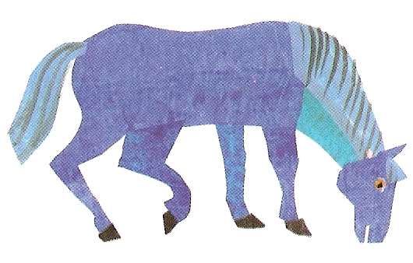
un caballo

Slide 19
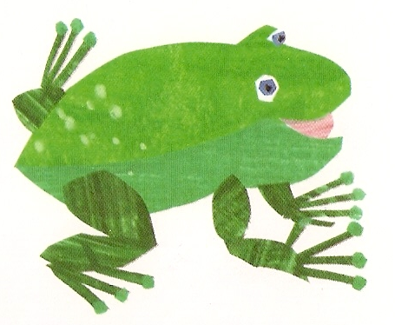
una rana

Slide 20
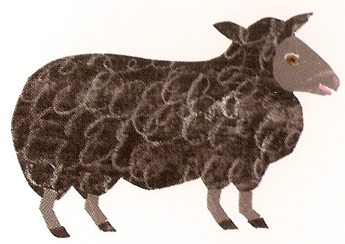
una oveja

Slide 21
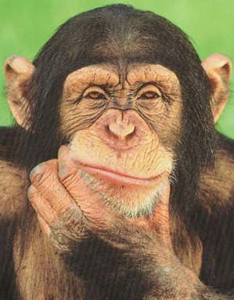
Decisiones
Notes:
Decisions. In this activity pupils must choose between two animal options to identify the correct animal asked for in the question. There are various different praise words used in the audio if the pupils get the right answer. They are explained in the notes for each slide.

Slide 22
¿Cuál de los animales es el gato? ¿A o E?
A
E
Notes:
Pupils must identify the animal asked for in the question (click to hear). I have used vowels to label the animals to allow pupils to revise/practise further the vowels from unit 1 which can pose ongoing problems with pronunciation. You may want to encourage pupils to come to the board to click on the animal to check their response is correct. They will hear ‘Muy bien’ (very good) if correct and ‘mala suerte’ (bad luck) if incorrect.

Slide 23
¿Cuál de los animales es el perro? ¿E o I?
E
I
Notes:
This time pupils will hear ‘genial’ (great) if they get the answer right.

Slide 24
¿Cuál de los animales es el pez? ¿I o A?
I
A
Notes:
This time pupils will hear ‘estupendo’ (marvellous) if they get the answer right.

Slide 25
¡Haz clic sobre la imagen correcta!
el pez
el oso
el gato
el pato
el perro
la oveja
la rana
el pájaro
el caballo
Notes:
Pupils should click on the animal when the Spanish word appears (on your click).
They can check that they are right by listening to the correct pronunciation of the animal.

Slide 26
¿Qué ves?
Veo …
Notes:
¿Qué ves? = What do you see? Veo = I see …
Animals will fly onto the screen and off again on your click. Pupils must say what the animal was. They should use ‘Veo …’ to answer.

Slide 27

Veo veo
¿Qué ves?
¿Y qué
cosita es?
Una cosita
¿Qué será, qué será, qué será?
Empieza por la ‘e’
‘r’
Notes:
Go to www.youtube.com & type in ‘veo veo’ – you’ll come up with several different versions – Teresa Rabal does one, but there are also cartoon versions.

Slide 28
¿Cuál de los 9 animales es tu animal preferido?
Mi animal preferido es …
Notes:
¿Cuál de los 9 animales es tu animal preferido? = Which of the 9 animals is your favourite?
Mi animal preferido es …= My favourite animal is …
Pupils choose which is their favourite and volunteer a sentence using the prompt provided. Click on the animal in question to check answer.

Slide 29

¡Desaparición!
Notes:
¡Desaparición! = Disappearance!
Pupils will see all 9 animals on the next screen, then, on your click, one will have disappeared. Pupils must volunteer which animal was the latest to disappear.

Slide 30
¿Qué desaparece?
Notes:
¿Qué desaparece? = What disappears? Click on the question to hear it pronounced.

Slide 31


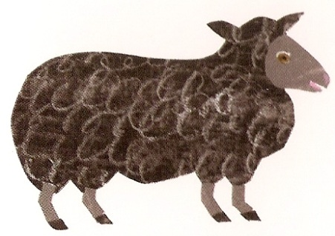
Fui a la tienda de animales y compré …
Notes:
Fui a la tienda de animales y compré …= I went to the pet shop and I bought ….
Pupils have to play this game building up the list of animals they bought as the animals appear. Click on the latest animal to hear the list so far. Pupils should say the Spanish prompt as well.

Slide 32
un
una
el
la
Singular y plural
(a, the, some)
unos
unas
los
las
Notes:
Here the pupils are introduced to all the words for a/some/the which remain colour-coded blue for masculine and red for feminine. The is an important skill to grasp as most sentences which contain a noun will also contain an article (definite or indefinite). The activity is designed to be interactive whereby pupils can come to the front and press/click on the buttons they believe to be appropriate to the animal featured. They will hear audio telling them whether they are correct or not. Pupils will hear ‘mala suerte’ (bad luck) if they choose something inappropriate, or praise & a translation if they choose something appropriate (grammatically correct).

Slide 33
un
una
el
la
Notes:
Pupils should click on the blue buttons because they have learnt that ‘un gato’ is masculine/blue. Because they have already learnt ‘un’ gato they should choose that button easily and then follow the blue pattern to get the correct word for ‘the’.

Slide 34
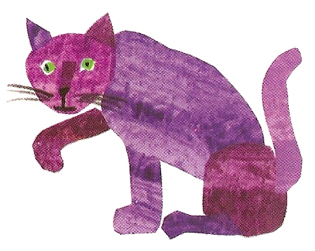
unos
unas
los
las
Notes:
Pupils will hopefully also make the connection with the colour blue here but it can be a process of trial & error. The buttons’ audio will tell pupils whether they are correct or not when pressed. It is important for pupils to grasp that the gender dictates the words used for ‘a’, ‘some’, ‘the’ and not knowing the gender will lead to later frustration!

Slide 35
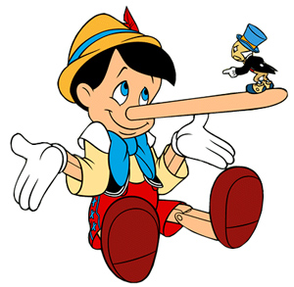
¿Verdad o mentira?
Notes:
¿Verdad o mentira? = True or false?

Slide 36
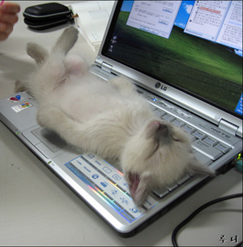
¿Verdad o mentira?
Verdad
Mentira
Notes:
Click on the photo to hear a statement in Spanish. Pupils must decide whether statements are true or false. Click on ‘Verdad’ if pupils believe that it’s true – you will hear ‘Muy bien’ if they are correct – or ‘Mentira’ if pupils believe that the statement is false – you will hear ‘Mala suerte’ (Bad luck) if they are wrong.

Slide 37
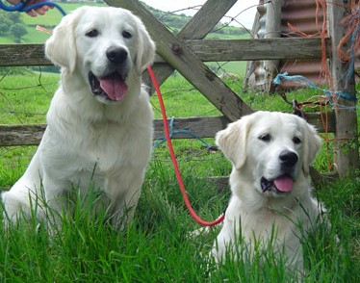
¿Verdad o mentira?
Verdad
Mentira
Notes:
Click on the photo to hear a statement in Spanish. Pupils must decide whether the statements are true or false. Click on ‘Verdad’ if pupils believe that it’s true – you will hear ‘Muy bien’ if they are correct – or ‘Mentira’ if pupils believe that the statement is false – you will hear ‘Mala suerte’ (Bad luck) if they are wrong.

Slide 38
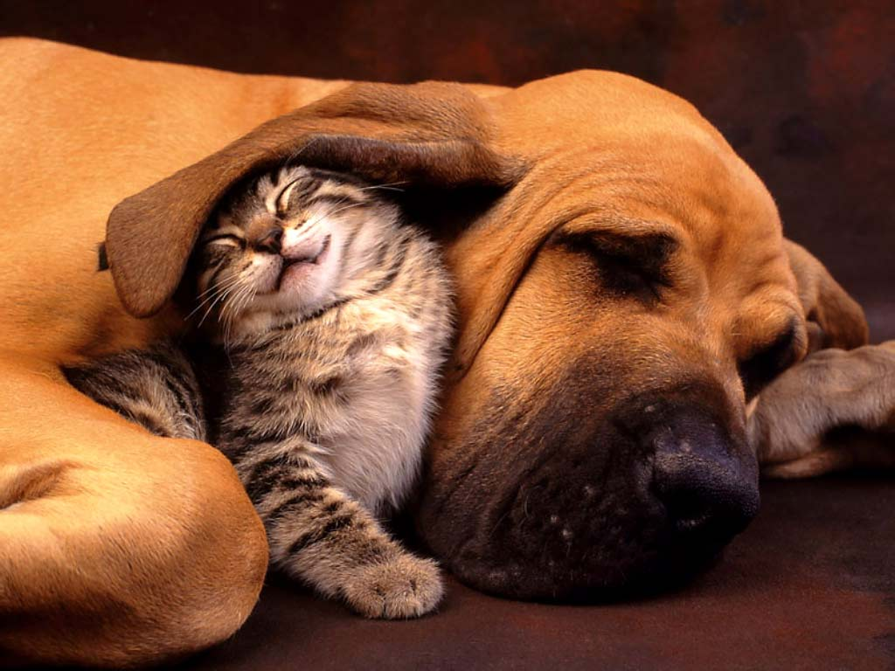
¿Verdad o mentira?
Verdad
Mentira
Notes:
Click on the photo to hear a statement in Spanish. Pupils must decide whether the statements are true or false. Click on ‘Verdad’ if pupils believe that it’s true – you will hear ‘Muy bien’ if they are correct – or ‘Mentira’ if pupils believe that the statement is false – you will hear ‘Mala suerte’ (Bad luck) if they are wrong.

Slide 39
¿Verdad o mentira?
Notes:
¿Verdad o mentira? = True or false?

Slide 40
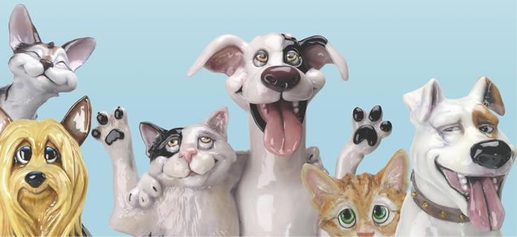
¿Verdad o mentira?
En la foto hay tres gatos pero solamente hay dos perros.
Verdad
Mentira
Notes:
Pupils must now read the statement in Spanish and decide whether the statement is true or false. Then click to check.

Slide 41
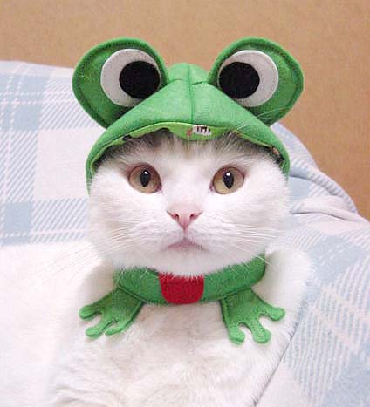
¿Verdad o mentira?
En la foto hay un gato
y una rana.
Verdad
Mentira
Notes:
Pupils must now read the statement in Spanish and decide whether the statement is true or false.

Slide 42
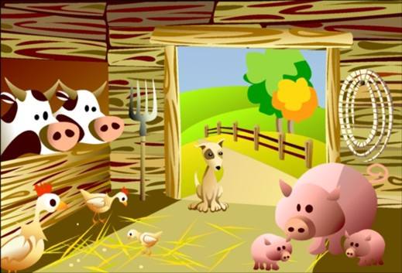
En la granja de mi tío
Notes:
Spanish version of ‘Old MacDonald had a farm’(En la granja de mi tío = On the farm of my uncle). Here pupils meet some new animal vocabulary in the form of ‘una cabra’ (goat) and ‘una vaca’ (cow). They are also introduced to the animals sounds before they have to sing along with the song.

Slide 43
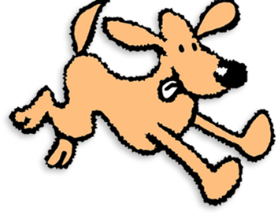
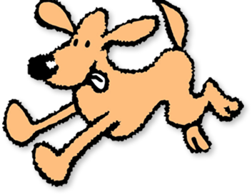
Hay diez perros.
Notes:
There are 10 dogs.

Slide 44
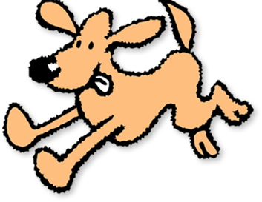
Guau
Guau
Los perros hacen ‘Guau’.
Notes:
Dogs say ‘woof’.

Slide 45
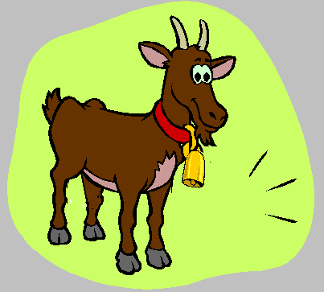
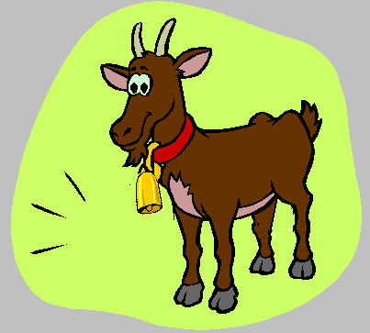
Hay diez cabras
Notes:
There are 10 goats.

Slide 46
Mee
Mee
Las cabras hacen ‘mee’.
Notes:
Goat say ‘Mee’.

Slide 47


Hay diez patos.
Notes:
There are 10 ducks.

Slide 48
Cuac
Cuac
Los patos hacen ‘cuac’.
Notes:
Ducks say ‘quack’.

Slide 49
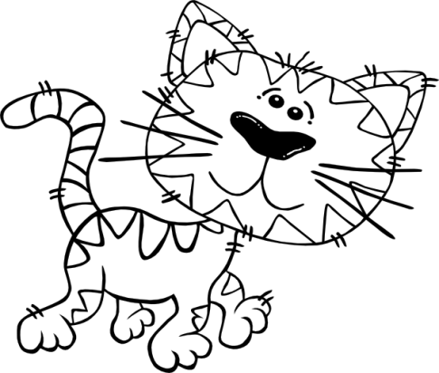
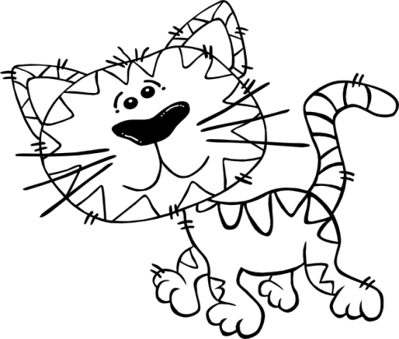
Hay diez gatos.
Notes:
There are 10 cats.

Slide 50
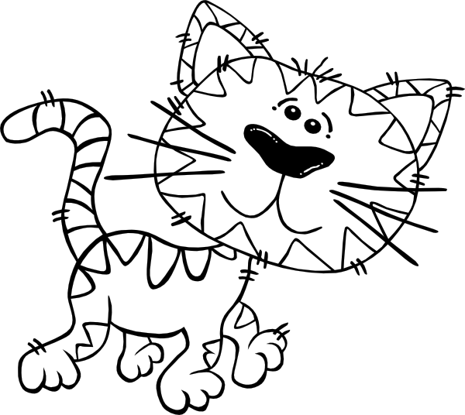
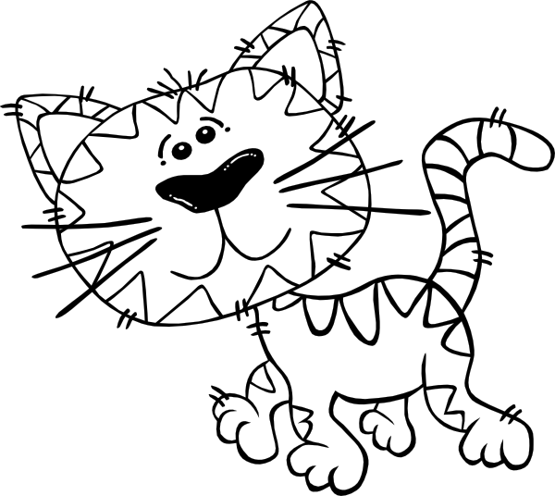
Miau
Miau
Los gatos hacen ‘miau’.
Notes:
Cats say ‘miao’.

Slide 51
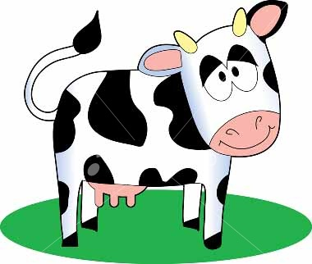
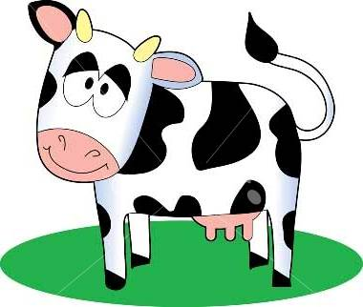
Hay diez vacas
Notes:
There are 10 cows.

Slide 52
Muu
Muu
Las vacas hacen ‘muu’.
Notes:
Cows say ‘moo’.

Slide 53

Notes:
Click anywhere on the back screen to start the video song. The lyrics are on the next slide if you want to print them off for your pupils.

Slide 54
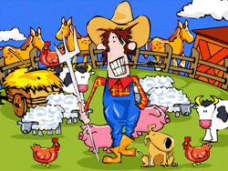
En la granja de mi tío i-a-i-a-o
Hay diez vacas que hacen muu i-a-i-a-o
Con una vaca aquí y una vaca allá
Muu muu muu muu
En la granja de mi tío i-a-i-a-o
Hay diez gatos que hacen miau i-a-i-a-o
Con un gato aquí y un gato allá
Una vaca aquí y una vaca allá
Miau miau muu muu
En la granja de mi tío i-a-i-a-o
Hay diez patos que hacen cuac i-a-i-a-o
Con un pato aquí y un pato allá
Con un gato aquí y un gato allá
Una vaca aquí y una vaca allá
Cuac cuac miau muu
En la granja de mi tío i-a-i-a-o
Hay diez cabras que hacen mee i-a-i-a-o
Con una cabra aquí y una cabra allá
Con un pato aquí y un pato allá
Con un gato aquí y un gato allá
Una vaca aquí y una vaca allá
Mee cuac miau muu
En la granja de mi tío
En la granja de mi tío i-a-i-a-o
Hay diez perros que hacen guau i-a-i-a-o
Con un perro aquí y un perro allá
Una cabra aquí y una cabra allá
Con un pato aquí y un pato allá
Con un gato aquí y un gato allá
Una vaca aquí y una vaca allá
Guau mee cuac miau muu
Notes:
Full lyrics to Old MacDonald song.

