Slide 1

Primary Languages Session 2:
Teaching & Learning
“Limba dultsi multu adutsi”.
Sweet language brings much.
Aromanian proverb
Rachel Hawkes
Notes:
The greatest number of Aromanian speakers are found in Greece, with substantial numbers of speakers also found in Albania, Bulgaria, Serbia, and in the Republic of Macedonia (the latter is the only country where Aromanians are officially recognized as a minority). Large Aromanian-speaking communities are also found in Romania, where some Aromanians migrated from Greece, Albania, Bulgaria and Serbia, mainly after 1925.

Slide 2
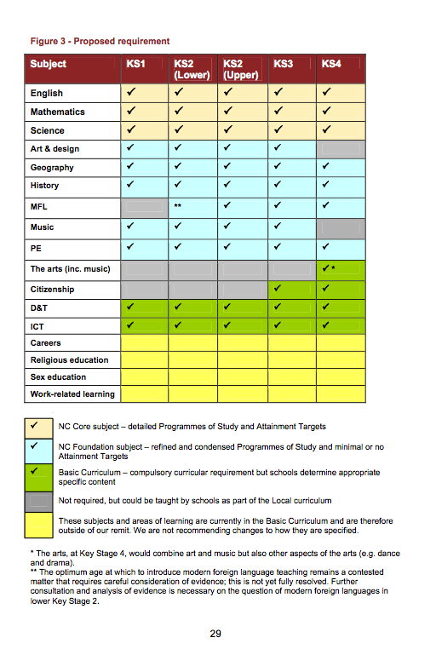
Michael Gove's statement on 19 December 2011 re the National Curriculum review revealed that the new National Curriculum PoS for all subjects will now be introduced together from September 2014.
He referred to the Expert Panel’s newly published report and its recommendations for the NC.
Chapter 4 contains the proposals for each subjects inclusion in the NC, KS1 – KS4.
The full report of the Expert Panel is here:
http://jsavage.org.uk/wp-content/uploads/2011/12/FINAL-Expert-Panel-Report.pdf

Slide 3
Languages spoken @ CVC
Afrikaans
Greek
Lithuanian
Shona
Arabic
Gujarati
Mandarin
Spanish
Bengali
Hausa
Malayalam
Swedish
Cantonese
Hebrew
Norwegian
Tagalog
Dutch
Hindi
Nyanja
Turkish
Farsi
Hungarian
Panjabi
Ukrainian
Finnish
Icelandic
Polish
Valenciano
French
Italian
Russian
Urdu
German
Japanese
Serbian
Welsh
More than 36 languages are spoken by students at CVC
Notes:
To pick up on something I mentioned last session about knowing your students as well as you can and valuing any heritage languages they have and bringing those into the classroom. This is one way

Slide 4

French?
Cantonese?
Turkish?
Russian?
Italian?
Gujarati?
Hindi?
German?
Bengali?
Polish?
Mandarin?
Arabic?
Portuguese?
Spanish?
Did you know? There are around 7,000 languages spoken in the world!

Slide 5
Name of Language
I use this language….
With my mum
With my dad
With my brother/sister
with my grandparents
With my friends
Name of Language
I use this language….
at home
in school
to read
to talk
to sing
Name of Language
I use this language….
to write
to pray
to play
to listen
to read
to hear stories
Rachel Hawkes

Slide 6
Aims of this session
Key principles (some Dos!)
Progression – Y3 sequence of lessons
Differentiation ideas
Teacher classroom language
(Fr, Gm, Sp)
Websites and resources for teaching
Rachel Hawkes

Slide 7
Some Dos
Keep the quantity of new language to a minimum (7-9 new words max) for each lesson
Allow lots of opportunities to hear the new words (your voice, song, video etc.)
Make questioning gradually progressive (physical response, repetition, choosing alternatives, independent production
Include multiple and overlapping learning approaches (physical, visual, auditory) to fix language in memory
Include a variety of activities – challenging but fun
Encourage reflection, link-making and pattern-finding (just as you would in science)
Use as much TL as you feel comfortable with (but plan your English and TL and avoid waffling)
Rachel Hawkes

Slide 8
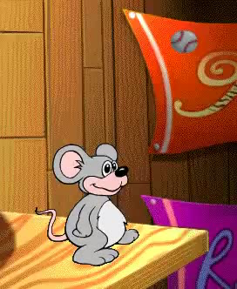
Empieza con uno
uno, dos, tres, cuatro, cinco
seis, siete, ocho, nueve, diez
y vamos a contar otra vez
uno, dos, tres, cuatro, cinco
seis, siete, ocho, nueve diez

Slide 9
1
2
3
4
5
6
7
8
9
10

