Slide 1
PHonics
A sound foundation for language learning at Ks2 and ks3
Notes:
The new Programme of Study for languages at KS2 and KS3 charts a progressive development of phonics knowledge, that begins by exploring the patterns and sounds of language through songs and rhymes and linking the spelling, sound and meaning of words and leads to the ability to transcribe words and short sentences with increasing accuracy.
This session looks closely at how to teach, embed and extend phonics knowledge, and the ways in which it underpins the development of all four language skills at KS2 and KS3. We will focus on practical strategies and ideas today that can be put into practice tomorrow!

Slide 2
Why?
Develops pronunciation
Builds pattern-finding and link-making
Increases autonomy
Improves confidence in production and performance
Facilitates comprehension

Slide 3



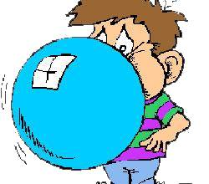

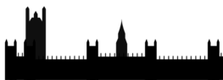



O português
idéia
queijo
quando
coração
cidade
chiclete
trabalho
praia
feliz

Slide 4
Para praticar
Se podes olhar, vê. Se podes ver, repara.
If you can look, see. If you can see, notice.
José Saramago, nobel prize in literature 1998
Nenhuma ideia brilhante consegue entrar em circulação se não agregando a si qualquer elemento de estupidez.
No intelligent idea can gain general acceptance unless some element of stupidity is mixed in with it.
Fernando Pessoa, Portuguese poet and writer, 1888-1935

Slide 5
KS2
explore the patterns and sounds of language through songs and rhymes and link the spelling, sound and meaning of words
transcribe words and short sentences that they hear with increasing accuracy
KS3
Programme of Study for languages 2014
Notes:
I think we would be hard pushed to find languages teachers that cannot see the rationale for explicitly teaching the sound: writing relationship. That is not to say that there are not still plenty of languages teachers not doing it, not doing it thoroughly enough, uncertain about how to go about doing it – we have the whole spectrum of experience and expertise in the area of phonics teaching.
But if we assume for a moment that learners at KS3 are learning to link the spelling, sound and meaning of words, would it not be a natural progression at KS3 to assume that they would be developing the ability to predict with some accuracy the spelling of new words they hear, and that they would naturally do this as part of practically every lesson.
So that, for example, having learnt the key phonics in Week 1 of German in Y8, learners in Week 4 would be trying to write down words they hear with increasingly accurate spelling, by applying their phonics knowledge.
The word TRANSCRIPTION has conjured up for some teachers a return to the ‘dictée’, whereas I see this process of transcription as naturally occurring in lesson activities, and fully integrated into message/meaning-focused communicative language teaching, not as an activity in its own right, where the meaning of the dictated text was somehow secondary or irrelevant.
So for me, this is no change – just a welcome reinforcement of the importance of phonics in our language teaching methodology. So ‘phonics’ is to stay.

Slide 6
KS2
develop accurate pronunciation and intonation so that others understand when they are reading aloud or using familiar words and phrases*
speak coherently and confidently, with increasingly accurate pronunciation and intonation
KS3
Programme of Study for languages 2014
Notes:
This also points towards the centrality of phonics.

Slide 7
How does it work in practice?
Teach the key sounds as key language
Use words that can have a picture and a gesture associated with them
Use the original phonics words to make a ‘bridge’ to other similar words when reading, listening, speaking and writing
Build in planned tasks that develop the sound-writing relationship
Respond to spontaneous opportunities to build the links
Notes:
Teach the key sounds ( i.e.) those sounds that would confuse a native English speaker because they are written down differently in English)
Layering (VAK) strategies to remember these key words is vital to the phonics process.
It gives a language of gesture to refer back to at any point when a learner mispronounces or can’t pronounce a new words.
There are tasks that can help, but it’s equally important to respond in the moment and spot when to guide learners to the correct pronunciation invoking the phonics words / gestures. Sometimes the gesture alone is enough.
Learning and using phonics improves every language learner’s ability to use the foreign language. However higher ability learners make the links quickly and transfer the learning to unfamiliar language, but lower ability learners needs much more and regular practice to see the same improvement.
Pronunciation and confidence are the main gains.

Slide 8
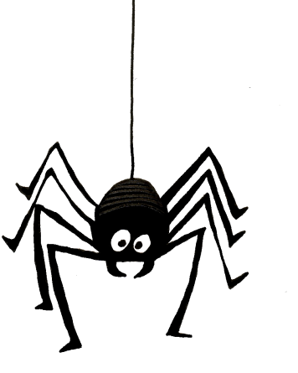
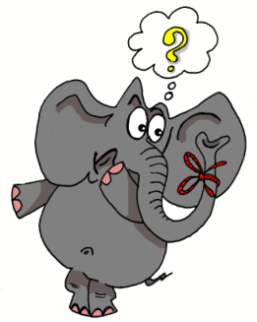
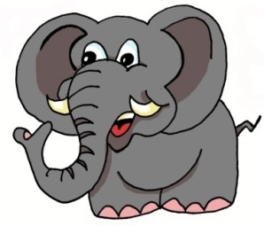

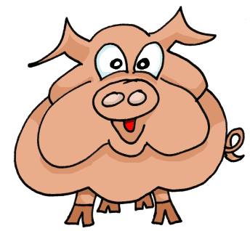
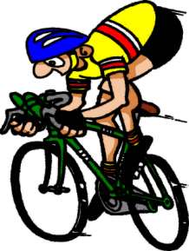
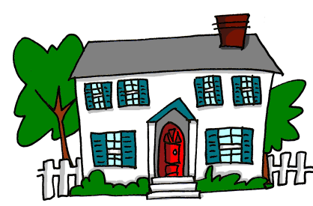
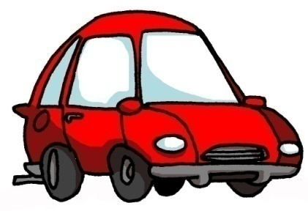
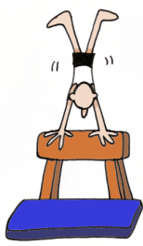
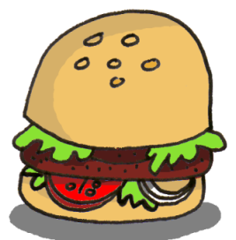
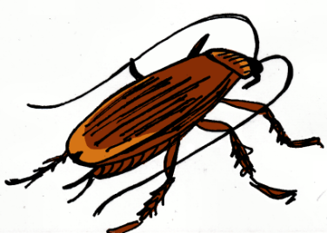
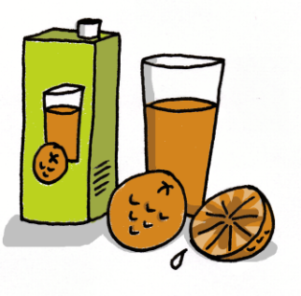

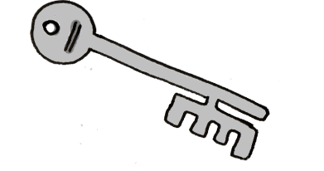

1 | 2 | 3 | 4
5 | 6 | 7 | 8
9 | 10 | 11 | 12
13 | 14 | 15 | 16
idea
araña
elefante
olvidar
universo
cerdo
ciclista
casa
coche
cucaracha
gimnasia
hamburguesa
España
zumo
gusano
llave
Notes:
8
Layering memory of the key phonics sounds – iconic word, image, gesture to represent each key sound, chosen for its difference to English pronunciation.

Slide 9
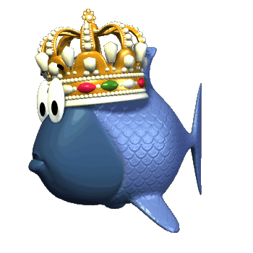
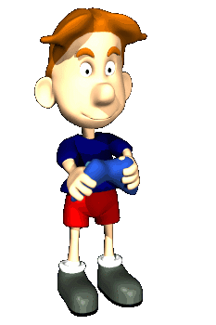
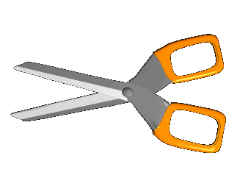

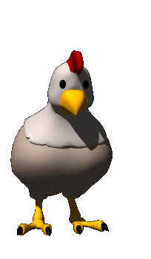


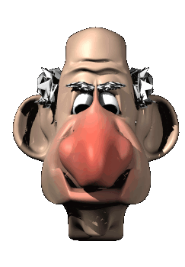



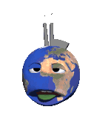
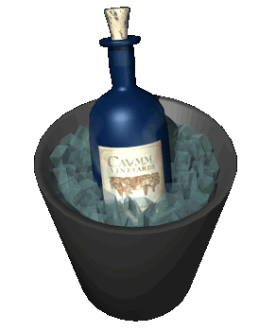
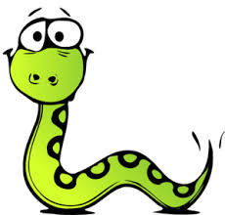

oi
ui
eu
au
le poisson
Oui!
le jeu-vidéo
les ciseaux
ou
i
u
é
la poule
le midi
les lunettes
le bébé
ez
er
qu
gn
le nez
danser
la question
la montagne
in
en
on
tion
le vin
le serpent
le pont
la pollution
Notes:
New version of Francophoniques – reduced to 16 key sounds.

Slide 10
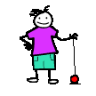
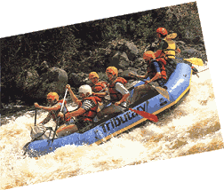
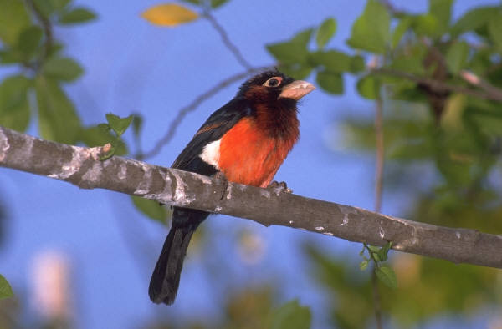
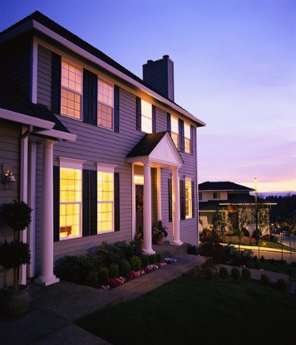
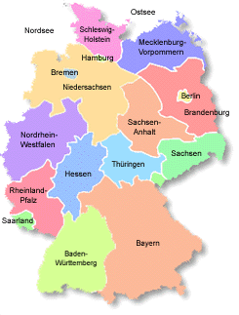
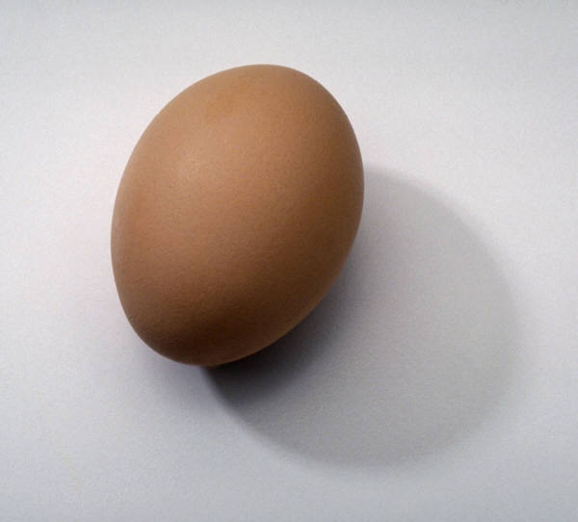
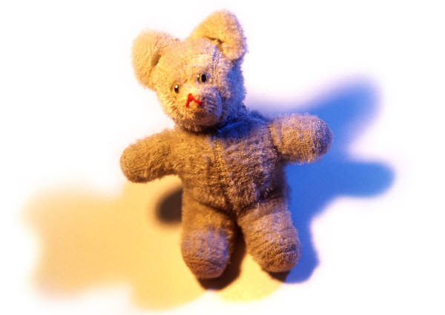
j
w
ch
z
v
ei
ai
ie
au
eu
äu
ö
ü
ä
Notes:
Jollyphonics – our German phonics written by Leigh McClelland, AST at Comberton Village College

Slide 11

Progression
1 I have learnt the phonics key words and remember them.
2 I can recognise and match key sounds and words that rhyme.
3 I can repeat new words accurately and make the link to key phonics.
4 I can read individual new words (including cognates) aloud, applying phonics knowledge.
4 I can write individual words accurately, building them from written syllables.
5 I can remember how to pronounce known words correctly over time.
6 I can read short phrases accurately that contain mostly familiar language.
7 I can write short phrases accurately that contain familiar language.
8 I can write individual new words with some accuracy, relating their spelling to key phonics words.
9 I can read a short text quite accurately that has familiar and new language in it.
10 I can write words and short phrases that I hear with some accuracy, predicting the spelling of new words.

Slide 12
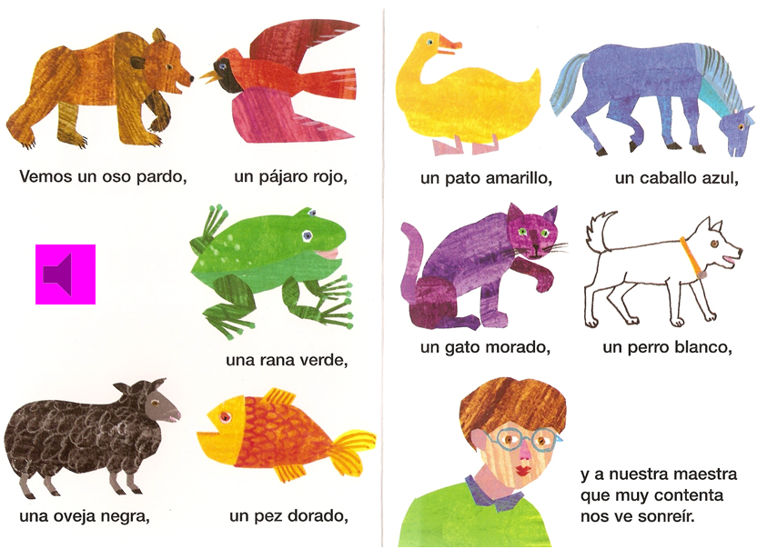
1 Vemos un oso pardo, un pájaro rojo,
2 un pato amarillo, un caballo azul
3 una rana verde, un gato morado,
4 un perro blanco, una oveja negra,
5 un pez dorado y a nuestra maestra que muy contenta nos ve sonreír.
Notes:
Let’s start with an example of a straightforward story text.
It is really helpful to have the lines of text numbered as we shall see.

Slide 13
Listening and responding
- to key sounds / phonics | ¿Estas palabras están en el texto? ¿Sí o no? Líneas uno a tres, ¿un caballo? (Are these words in the text? Yes or no? Lines one to three, a horse?) En líneas dos a cuatro encuentra una palabra que rima con ‘gato’ Encuentra 3 palabras con el sonido ‘j’, ‘v’.
- to individual words | Levanta la mano cuando oigas un color / un animal.
- to meaning | Un oso pardo ¿es posible? ¿Sí o no? (go through all of the animals)
- to mood / emotions
Reading and responding
- read aloud for pronunciation / fluency | Choral reading. Teacher drops out and pupils carry on.
- de-coding of words / idiom / meaning behind the word | ¿Cómo se dice ‘teacher’ en español? (How do you say ‘…’ in Spanish?)
- grammatical focus | In this text you could look at masculine / femenine nouns, adjective placement.
- comparison of two texts – sounds / words / imagery / rhymes / rhythm / style

Slide 14
Speaking and Writing - responses
Memory – individual words / phrases | Cover the text. Which words can they remember? Gap fill. Cover words up. Can students tell you which are missing?
Memory – whole text | Choral reading. Cover all / most / some of the text. Teacher begins to read – pupils join in and supply the missing words when the teacher pauses.
Memory → spoken performance | Work in pairs. Fui a la tienda de animales y compré…trying to list all the items in order.
Re-writing – individual words / substitution | ¿Cómo se dice ‘a red cat’ en español? Change the animal / colour details
Re-writing – different ending / different point of view / similar piece in the style of | Pupils tell a different story. In this case it would be one with different animal/colour combinations.
Creating in a new genre – a dialogue / a letter / a diary entry / narrative / rap | ¿Tienes un animal? Sí, tengo un… Y¿cómo es? Es …

Slide 15



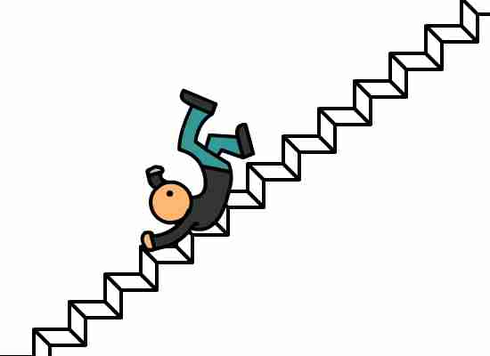

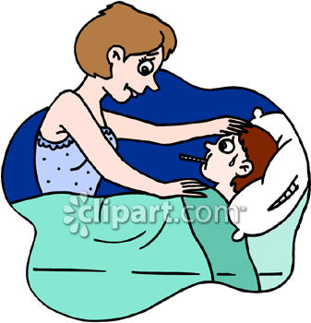
1 Mon ami Olivier
2 a un peu mal au pied.
3 Hier, il est tombé
4 en bas de l’escalier.
5 Il a beaucoup pleuré,
6 sa maman l’a soigné :
7 - Pauvre, pauvre Olivier,
8 et pauvre petit pied.
http://www.petitestetes.com/comptines/paroles-de-comptines-en-francais/

Slide 16
Task ideas
Read aloud tasks
Transcription tasks
Word card games
Rhyming poems
Tongue twisters
Categorising
Reading comic strips
Song / story (with or without gap-fills)
Cognate recognition
Syllable squares
Transcription
Integrated transcription

Slide 17
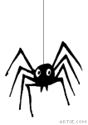
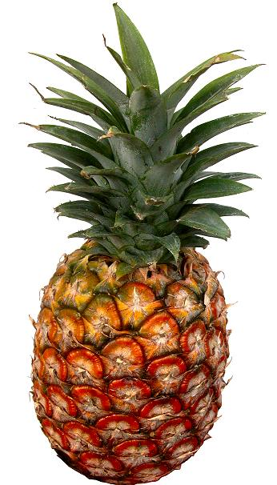

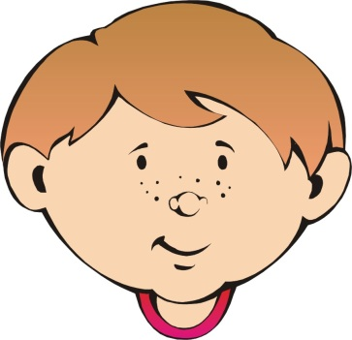

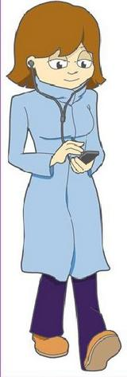


niño
niña
araña
piña
señor
señora
España
cumpleaños
Notes:
You can project these slides on the board and run through pronunciation & meaning first if you feel this will benefit the pupils & give them more confidence.
These slides are designed as cards which will (when photocopied double-sided and cut up) have the phonic on one side and a corresponding word & picture on the other.
Pupils should pronounce the phonic first and then incorporate it into their pronunciation of the word on the other side, recognising the meaning in English at the same time.
Pupils could play snap/happy families etc. by using the cards picture-side up, recognising when the phonic is the same and checking on the other side of the card.
The vocabulary translates as: Young boy, young girl, spider, pineapple
Man, woman, Spain, birthday

Slide 18
ñ | ñ | ñ | ñ
ñ | ñ | ñ | ñ

Slide 19

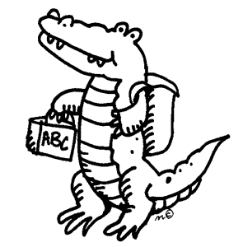

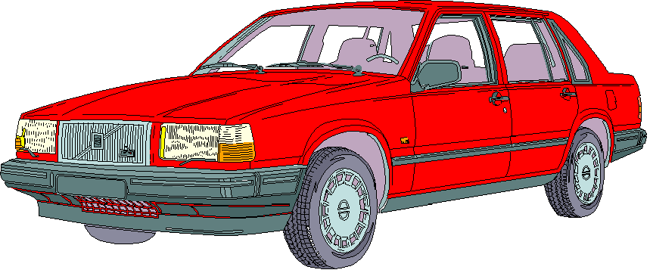


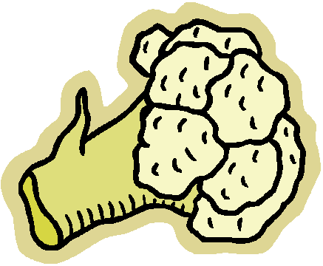
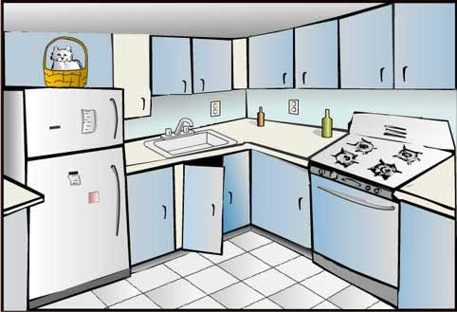
coche
colegio
cocodrilo
conejo
cobra
cohete
coliflor
cocina
Notes:
The vocabulary translates as: car, school, crocodile, rabbit
Cobra, rocket, cauliflower, kitchen

Slide 20
co | co | co | co
co | co | co | co

Slide 21
Welches Tier ist das?
1. Ich schlafe auf einer Matratze,
Ich bin eine kleine ……………………..
2. Hier ist mein neues Haus,
Hier wohnt meine liebe ………………….
3. Wie heißt du?
Und wie heißt deine schöne …………..?
4. Was ist unter dem Tisch?
Ach, nein, das ist mein …………….

Slide 22

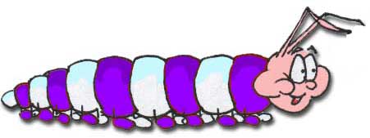


Una cacatrepa que trepa tiene tres cacatrepitos
(A caterpillar that climbs has three baby caterpillars)
Tres tristes tigres tragaban trigo en un trigal
(Three sad tigers were swallowing wheat in a wheat field )
Notes:
Starter – two trabalenguas

Slide 23
A
Clasifica estas palabras según el número de sílabas.
mal | delicado | grande | muy
robusto | pequeño | yo | feo
deportista | tan | elegante | alto
bronceado | rizado | moreno | bajo

Slide 24
B
Clasifica estas palabras según el sonido - /ka/thé/ché
/ka/ | /thé/ | /ché/
una camisa | ducharse | hacer
una discoteca | un chiste | chulo
cero | una casa | cinco

Slide 25

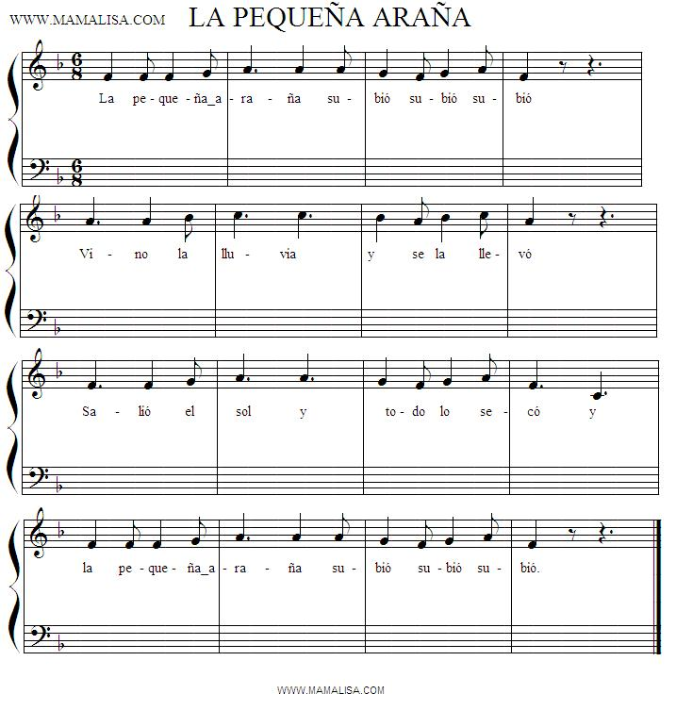
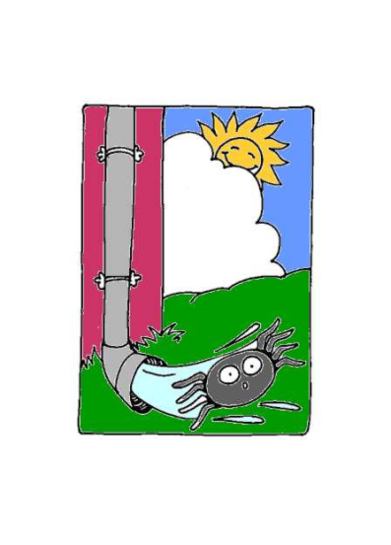
La pequeña araña
subió, subió, subió
vino la lluvia
y se la llevó.
Salió el sol
y todo lo secó
y la pequeña araña
subió, subió, subió.
Notes:
Songs embed language better than almost anything else.

Slide 26
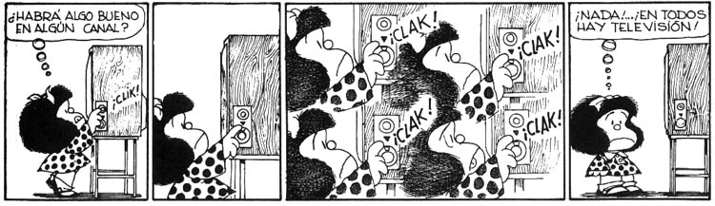
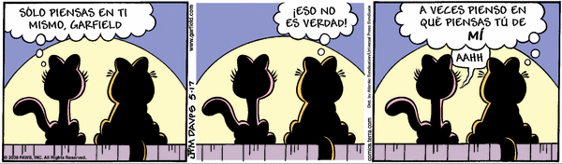

Slide 27






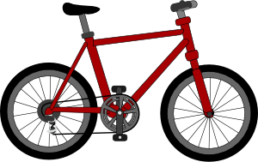


Escucha bien y elige el artículo apropiado.
1
A
B
C
2
A
B
C
3
A
B
C
4
A
B
C
Notes:
Teacher reads out 1 of the 3 items (cognates) and students choose the correct picture.
1. elefante, jirafa , leon,
2. chocolate, te, café
3. autobus, coche, bicicleta,
4. gris, blanco, rosa

Slide 28
¿Qué es un cognado?
un hospital
un adulto
un animal
celebrar
eléctrico
una familia
un círculo
un continente
enorme
Notes:
This is to enable you to elicit from them an understanding of what a cognado is. Give them some examples, pronounce them yourself to the class as you go through, establish what a cognate is and then reinforce pronunciation by getting them to quickly practise in pairs.

Slide 29
¿Qué son estas palabras?
pa | ón | par | fo | li | po
nes | cho | gru | plan | fá | mi
llón | to | sta | pla | mu | te
par | ta | so | le | que | ma
1. group | 2. lion | 3. map | 4. million
5. plant | 6. list | 7. park | 8. photo
9. much/a lot | 10. part | 11. plans | 12. sofa
Notes:
Tell them that these are all 2-syllable cognates and the English meanings are at the bottom. Each square is only used once. They can write their answers in their exercise books and then go through with you, pronouncing them obviously correctly thanks to their phonics knowledge!

Slide 30
garganta
1.
2.
3.
4.
5.
6.
7.
8.
9.
10.
11.
12.
ta | riz | ma | es | ma | lla
ca | ro | gar | re | de | pal
es | da | di | no | bra | o
na | pie | be | do | gan | to
jas | za | zo | na | go | pier
cabeza
espalda
mano
pierna
rodilla
nariz
orejas
estómago
brazo
dedo
pie
Notes:
Answers appear one by one. Click on yellow speakers to hear the words again if need be.

Slide 31
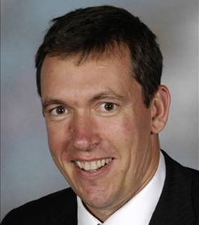
Wer ist das?
Er spielt gern Fußball.
Er macht viel Sport.
Er hat an der Uni in Cambridge studiert.
Er wohnt nicht in Comberton.
Er arbeitet an CVC.
Er ist älter als Frau Hawkes.
Er ist unser Schuldirektor.
Notes:
Listening task with ‘gradual reveal’. The last sentence makes it very obvious. The other sentences add information but do not get you closer.
Say it then reveal and repeat it.

Slide 32

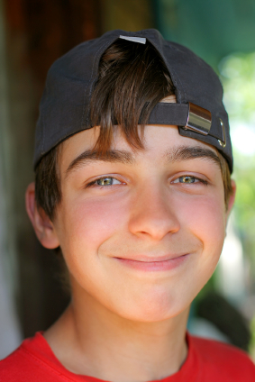


Me llamo Carlos Vicente. Soy de España pero mis padres son de Argentina así que soy medio argentino medio español. Hablo español, por supuesto, inglés y un poco de francés. Vivo ahora con mis padres; vivimos en Valencia, en el este del país. Mi hermana no vive allí. Ella y su amiga viven en Barcelona.
Notes:
Year 7 – Week 1. Start with a text and see what students know first.
1. Give them some time to interrogate each other’s knowledge and make some hypotheses about words they might know.
When they have finished talking they could record their group knowledge in a couple of different ways.
They could have a red / yellow / green post-it notes for unknown / think we know / know words
They could shade a large copy of the text with these colours.
Next steps depend on the knowledge of the class, but there are certain key activities that we can be sure will be beneficial for linguistic and skill development. So, for example:
2. Teacher reads the text several times through (3-4 times) at normal speed, but with a few differences. These could be differences in wording where the meaning is the same OR different words which change the meaning of the text, but I think it’s clearer to choose either one or the other and keep consistent throughout the text. So, with this text, I’ve chosen to do different wording where the meaning is the same. As below:
Mi nombre es Carlos Vicente. Soy de España pero mis padres son argentinos así que soy medio argentino medio español. Hablo español, claro, inglés y un poco de francés. Vivo ahora con mi familia; vivimos en Valencia en el este de España. Mi hermana no vive en Valencia. Ella y su amiga tienen un apartamento en Barcelona.
There are 6 x differences. First, students can be asked to underline where the text is different. On subsequent listenings, they can try to identify what the exact differences are and write down the words they hear. This is transcription! It reinforces phonic knowledge that they may have from primary school. If they find this hard, the teacher will know that they need some phonics reinforcement (may need to revise the key sounds with gestures from phonics words).
The teacher can take whole class feedback here and display the words that are different. The class can be asked whether the meaning is the same. Significa lo mismo? Algo diferente? The word ‘sinónimo’ is one they will be familiar with from KS2 literacy – this will make a useful link for them. It lays a bit of a foundation marker for the next 5 x years of language work too, as we will want them to use a variety of different language in their work.

Slide 33
Me llamo Carlos Vicente. Soy de España pero mis padres son de Argentina así que soy medio argentino medio español. Hablo español, por supuesto, inglés y un poco de francés. Vivo ahora con mis padres; vivimos en Valencia, en el este del país. Mi hermana no vive allí. Ella y su amiga viven en Barcelona.
Notes:
1. Teacher reads the text several times through (3-4 times) at normal speed, but with a few differences. These could be differences in wording where the meaning is the same OR different words which change the meaning of the text, but I think it’s clearer to choose either one or the other and keep consistent throughout the text. So, with this text, I’ve chosen to do different wording where the meaning is the same. As below:
Mi nombre es Carlos Vicente. Soy de España pero mis padres son argentinos así que soy argentino. Hablo español, claro, inglés y un poco de francés. Vivo ahora con mi familia; vivimos en Valencia en el este de España. Mi hermana no vive en Valencia. Ella y su amiga tienen un apartamento en Barcelona.
Students can be invited to compare their answers in their groups, or not, depending on time etc.
There are 6 x differences. First, students can be asked to underline where the text is different. On subsequent listenings, they can try to identify what the exact differences are and write down the words they hear. This is transcription! It reinforces phonic knowledge that they may have from primary school. If they find this hard, the teacher will know that they need some phonics reinforcement (may need to revise the key sounds with gestures from phonics words). The task has built-in differentiation.

Slide 34
Mi nombre es
___________ Carlos Vicente. Soy de España pero mis padres son __________ así que soy medio argentino medio español. . Hablo español, __________, inglés y un poco de francés. Vivo ahora con ___________; vivimos en Valencia, en el este __________. Mi hermana no vive allí. Ella y su amiga ________________ en Barcelona.
argentinos
claro
mi familia
de España
tienen un apartamento
Notes:
The teacher can take whole class feedback here and display the words that are different. The class can be asked whether the meaning is the same. Significa lo mismo? Algo diferente? The word ‘sinónimo’ is one they will be familiar with from KS2 literacy – this will make a useful link for them. It lays a bit of a foundation marker for the next 5 x years of language work too, as we will want them to use a variety of different language in their work.

Slide 35
The sounds of French
Almost all the French phonemes are contained in the French words for animals, colours and the numbers 1-20.
Par exemple: OU
douze les couleurs
rouge une souris

Slide 36

Songs are very useful
Il est né le divin enfant
Jouez hautbois, résonnez musettes
Il est né le divin enfant
Chantons tous son avènement

Slide 37
En France
En France on aime les bonbons!
On a des grands bonbons.
Nous aimons les bonbons!
Allons et trouvons des bonbons!
En France on porte des pantalons!
On porte des grands pantalons.
Nous aimons les pantalons .
Allons et trouvons les pantalons!

Slide 38
Next Steps
Think about a specific class you teach which is not as good at pronouncing from text or as confident when they speak as you would like
Decide what sort of intervention is needed (e.g phonics key words teaching? Just more practice with anticipating the spelling?)
Look at the key language you are teaching that class next week. Which key sounds can you usefully focus on?
Which activities can you build in to support and develop the sound-writing relationship for that class?

Slide 39
PHonics
http://www.rachelhawkes.com/PandT/2014_Curriculum/2014Curr.php
A sound foundation for language learning at Ks2 and ks3
http://www.rachelhawkes.com/Resources/Phonics/Phonics.php
Notes:
The new Programme of Study for languages at KS2 and KS3 charts a progressive development of phonics knowledge, that begins by exploring the patterns and sounds of language through songs and rhymes and linking the spelling, sound and meaning of words and leads to the ability to transcribe words and short sentences with increasing accuracy.
This session looks closely at how to teach, embed and extend phonics knowledge, and the ways in which it underpins the development of all four language skills at KS2 and KS3. We will focus on practical strategies and ideas today that can be put into practice tomorrow!

