Slide 1



Programme
Rachel Hawkes
Comberton Village College
MFL Neighbourhood INSET
Friday 1st March 2013
Darrick Wood School
Priorities | Timing
1 Strategies for Speaking | 9.10– 10.40
Strategies for Writing | 11.15 – 12.45

Slide 2

Rachel Hawkes
Comberton Village College
Manipulating language
Developing quality
(Variety & Range)
Manipulation, Quality & Accuracy
Accuracy
WRITING:
CLASSROOM STRATEGIES

Slide 3
Rachel Hawkes
Comberton Village College
Expectations and
shared purpose
Idea 1

Slide 4



Why do I mark your work?
What should your response be?
i.e. what should you do when you get your work back?

Slide 5

Targets for improvement
Feedback
Example
Scaffold
Reminder
Implicit ----------------------------------------------------------------→ Explicit
Rachel Hawkes
Notes:
According to Vygotsky, support should be contingent – i.e. dependent on and responsive to learner need. One way to individualise/differentiate support is to move from implicit to explicit support in terms of prompts for improvement. Here are 3 different types of prompt that could be used to structure formative feedback/target:
reminder
scaffold
Example
Here is an example of each. Reminders are clearly the most implicit and examples the most explicit and supportive.
‘Say more about how you feel about this person.’
‘Can you describe how this person is a ‘good friend’?’
‘Describe something that happened that showed they are a good friend.’
‘Choose one of these or your own: “He is a good friend because he never says unkind things about me”, “My friend is a friend because he never tells me lies.’” (Shirley Clarke)
Handout – Decide which of the prompts belongs to where on the spectrum.

Slide 6
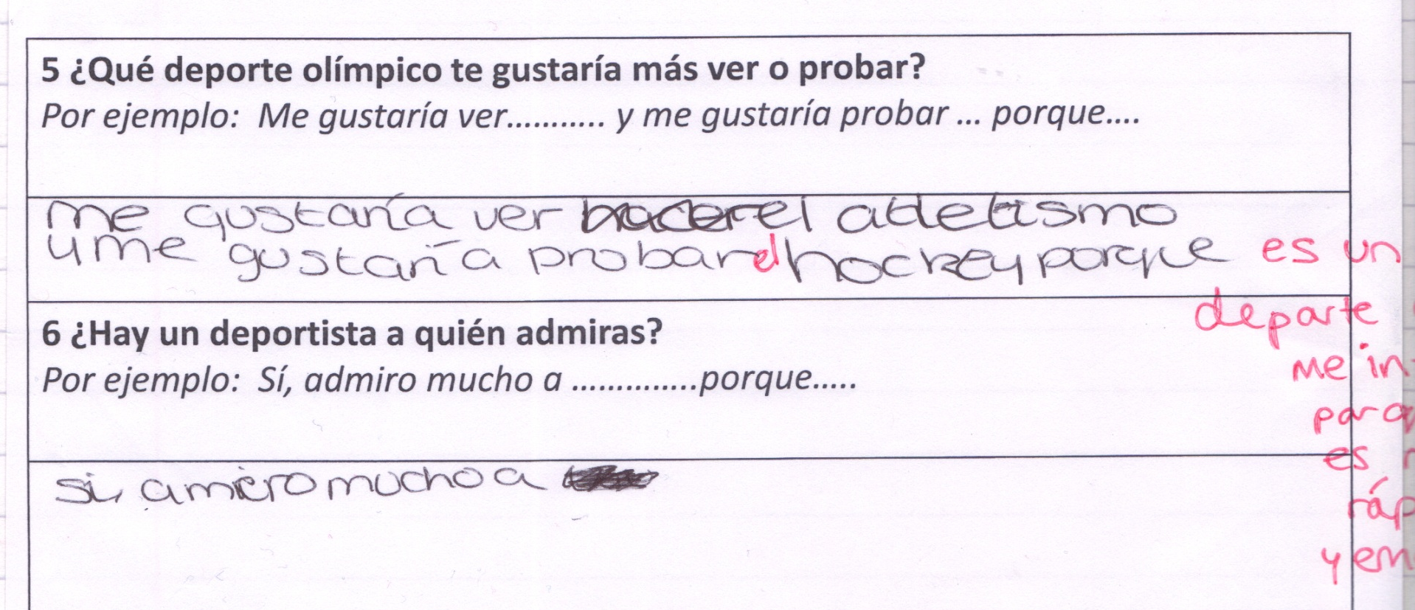
5. Me gustaría ver el atletismo y me gustaría probar el hockey porque es un deporte que me interesa porque es muy rápido y emocionante.
Why do I mark your work?
What should your response be? i.e. what should you do when you get your work back?
Notes:
Sometimes students need a whole example adding of the sort of length and interest that’s required. But I have been conscious in the past that students have managed to ignore my additions/corrections and reproduce their own original errors in subsequent work, so we have to be really sure that there is a ‘follow up’ and some action in response to our marking otherwise it is time wasted. Students need to really ‘get that’ and sometimes explicit examples are required.

Slide 7
Simple as 1, 2, 3!
1. Pimp my Spanish = better language = better grade!
2. Saco mágico = make improvements and collect all your ‘best stuff’ in one place where you can use it!
3. Snowball effect! = this stage is to move what’s in your book to what’s in your head so it can come out of your mouth/pen!

Slide 8
Rachel Hawkes
Comberton Village College
PIMP MY LANGUAGE
Idea 2

Slide 9
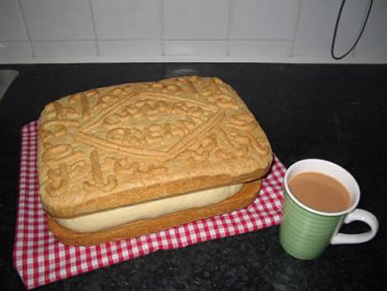
Pimp my Spanish!
Me gusta ir al cine…….
En el cole juego al fútbol…...
Mi programa favorito es….
Notes:
This really works in terms of getting students to understand ‘perfectly formed’ but ‘bigger and more’ notions and applying them to their writing. With a marked tendency to ‘under express’ many students don’t show what they can really do with the language they know. This flags this up in both writing and speaking.

Slide 10
Simple as 1, 2, 3!
1. Pimp my Spanish = better language = better grade!
2. Saco mágico = collect all your ‘best stuff’ in one place where you can use it!
3. Snowball effect! = this stage is to move what’s in your book to what’s in your head so it can come out of your mouth/pen!
Notes:
The ‘refer back to your book’ issue or lack of it. I have experienced students completely missing out this stage when it comes to producing new pieces of work, just turning to a new page and starting to write off the tops of their heads. Flagging up the stage of refining, improving, correcting and re-producing previous attempts is what the ‘saco mágico’ or swag bag idea is all about. Students periodically go back through their books harvesting all of the best bits.

Slide 11
Rachel Hawkes
Comberton Village College
SWAG BAG (SACO MáGICO)
Idea 3

Slide 12

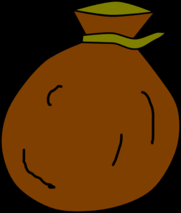
saco mágico
Notes:
This is a concept that students in my Y10 class have really gone for. Some called it my ‘saco mágico’ others say ‘my swag bag’ but they are clear what its purpose is and have ‘bought into’ the idea of revisiting work in their exercise books, synthesising my feedback with their initial work, improving it and then ‘banking it’ in the swag bag ( a purple wallet folder for each).

Slide 13
Simple as 1, 2, 3!
1. Pimp my Spanish = better language = better grade!
2. Saco mágico = collect all your ‘best stuff’ in one place where you can use it!
3. Snowball effect! = this stage is to move what’s in your book to what’s in your head so it can come out of your mouth/pen!

Slide 14
Rachel Hawkes
Comberton Village College
THE ‘SNOWBALL EFFECT’
Idea 4

Slide 15
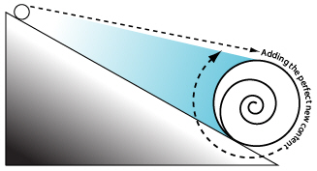
The ‘snowball’ effect
A ‘Vincent Everett’ phrase!
Notes:
This reinforces the idea that old words need to be retained with new words to ‘grow’ a vocabulary and also that action is needed to stop the ‘melt down’ – revisiting vocabulary, knowing well what is in your book from memory. I mostly to do this activity orally but have done it also with mini whiteboards and to practise writing/accuracy. It is much more engaging that teacher/whole class mini whiteboard work and students are on task throughout leaving the teacher time to circulate and assess how students are doing.

Slide 16
1 | I like comedies | me gustan las comedias
2 | because they make me laugh | porque me hacen reír
3 | I like horror films | me gustan las películas de terror
4 | because they make me scared | porque me dan miedo
5 | my mum loves soap operas | a mi madre le encantan las telenovelas
6 | like Eastenders for example | como Eastenders por ejemplo
7 | my dad likes sports programmes | a mi padre le gustan los programas de deportes
8 | my favourite programme is Educating Essex | mi programa favorito es Educating Essex
9 | it is a reality show | es un programa de tele-realidad
10 | it takes place in Essex in England | tiene lugar en Essex en Inglaterra
11 | it’s about life in a school | trata de la vida en un colegio
12 | it’s a programme for teenagers | es un programa para los jóvenes
13 | I prefer watching tv | prefiero ver la tele
14 | because it is cheaper than… | porque es más barato que
15 | going to the cinema | ir al cine
Notes:
Speed-dating style test. Assessors face the board, assessees face away. Can be done orally (I do it most often like that) but mini whiteboards work too.

Slide 17
Nombre: _________________________
Nombre: _________________________
1 | I like comedies
2 | because they make me laugh
3 | I like horror films
4 | because they make me scared
5 | my mum loves soap operas
6 | like Eastenders for example
7 | my dad likes sports programmes
8 | my favourite programme is Educating Essex
9 | it is a reality show
10 | it takes place in Essex in England
11 | it’s about life in a school
12 | it’s a programme for teenagers
13 | I prefer watching tv
14 | because it is cheaper than…
15 | going to the cinema
1 | I like comedies
2 | because they make me laugh
3 | I like horror films
4 | because they make me scared
5 | my mum loves soap operas
6 | like Eastenders for example
7 | my dad likes sports programmes
8 | my favourite programme is Educating Essex
9 | it is a reality show
10 | it takes place in Essex in England
11 | it’s about life in a school
12 | it’s a programme for teenagers
13 | I prefer watching tv
14 | because it is cheaper than…
15 | going to the cinema
Notes:
Marking grid for each round. Students move on when teacher gives the signal (Can play music at times too during this activity – makes it feel even more like a game). Those assessing mark with tick or cross each attempt made. Students see their own progress in one lesson and this is the motivation.

Slide 18
Manipulating language
Rachel Hawkes
Comberton Village College
TOOL BOX
Idea 5
Notes:
This is basically a way of ‘selling’ or presenting the notion that there are some ‘staple’ or essential components that every GCSE student needs to build sentences and text and that these are the structures that transfer from topic to topic, context to context. It’s helpful for students to be able to have a way of conceptualising and categorising this essential but non topic-specific language to highlight its importance, raise its profile. Obviously it’s not just enough to do that the once, so I think that the tool box also helps us as teachers in our planning as we can think of how students can use this language in combination with the new topic language to express themselves and build opportunities for this synthesis into every single lesson. That’s the only way this is going to stick ultimately is just frequency of exposure. I have found that to be true particularly this year with awkward constructs like ‘she and he likes’ and My brother likes in Spanish. We have put this into our ‘tool box’ and used it every single time new language has come up.

Slide 19

Il y a / Il y avait
Ne…..pas
C’est/ C’était
Je peux / on peut |  | I can / you/we can...
Je veux |  | I want to..
Je dois |  | I have to…
Je vais / on va | + verb | I’m going to/we’re going to…
J’aime /je n’aime pas |  | I like to / I don’t like to..
J’aime beaucoup |  | I love to…
Je voudrais |  | I would like to…
Notes:
What sorts of things will you have in your toolbox?
Key expressions like these
Starters + infinitives as these are easy on manipulation and rich in possibilities for self-expression.
Frequency expressions
Time expressions
What else?

Slide 20
To go to the cinema
I like to go/going …
I usually go…
I went...
I’m going to go…
presente
Normalmente ..
voy al cine
me gusta
ir al cine
futuro
pasado
El próximo fin de semana..
El fin de semana pasado..
voy a ir al cine
fui al cine
Notes:
I have found this year that our toolkit in Spanish needs to include a few essential verbs that we can conjugate in 3 tenses. Ultimately for my group this year it’s less important for them to learn a paradigm and manipulate accurately 100 AR reg verbs than it is for them to be completely happy and secure with the most useful verbs (invariably irregular). Consistency in presentation is helpful here.

Slide 21

Manipulating language
Rachel Hawkes
Comberton Village College
HARVESTING/CREATIVE TRANSFER
Idea 6
Notes:
This is an idea to get students to make links between language they learn and use in one topic in further topics. For example, when finishing the theme of holidays, students should be encouraged to do a mind map of key language, focusing on the verbs and sentences starters that they have practised and learnt during that topic. Then they should be given a new piece of paper and told the new theme. Their first task is to take all of the language they know from the context of holidays and adapt it to the new context. So, for example, I used to go on holiday to France can become I used to go to Milton Primary School. We went on holiday to Mallorca can become we went on an excursion to Alton Towers theme park with the school. It’s a very visual and practical way to get students to take stock of what they know already before starting a unit, so they never feel that they are beginning from scratch. If preferred, they could actually cross out the holidays related vocabulary and write the new possibilities (e.g. school/world of work) over the top.
This type of activity could also be done in different ways i.e the teacher could present them with a list of language from the holidays theme and they could highlight any language that they could use in the new theme.

Slide 22

Mes préférences
Mes vacances dernières
Je m’intéresse à …
Ce que m’intéresse le plus c’est..
Mes vacances idéales sont…
Ma destination préférée, c’est…
A mon avis
Je pense que
Je trouve que
Je suis allé(e) à ….
pour…semaines
Après être arrivé
Avant de partir
J’ai joué au golf
Je joue au golf depuis 3 ans Après avoir (fini)
Je me suis bien amusée
Je viens de lire ta lettre…..
J’allais à….
avec ma famille
Quand il faisait beau je sortais…
Quand il faisait mauvais je restais…
j’aimais beaucoup….
A l’avenir
J’ai envie de…
J’ai l’intention de..
Je voudrais..
J’amerais…
Ji’irai…..
Si j’avais le choix, j’irai…
mais = but
parce que = because
aussi = also/as well
par exemple = for example
pendant = during/whilst
peut-etre = perhaps
qui = who
si = if
quand = when
et = and
probablement = probably
seulement = only
Quand j’étais plus jeune..
L’année prochaine………..
Notes:
Re-do this mind map with the theme of school and world of work in mind. How could you re-use the language in the new context?
This can be simplified or extended, depending on the level of your students and the grades they are targeting.

Slide 23

Manipulating language
Rachel Hawkes
Comberton Village College
WORDLE
Idea 7
Notes:
Wordle can be used in all sorts of ways. A great starter for sentence-building practice for writing. At word level to start a new topic and sort out all the already known words from unfamiliar language etc..
It would even be good as part of the revising process that they made their own wordles by going through their books to produce a summary wordle of the topic.
Or they can paste in a piece of their writing to see if it is too repetitive (AS do this too)

Slide 24
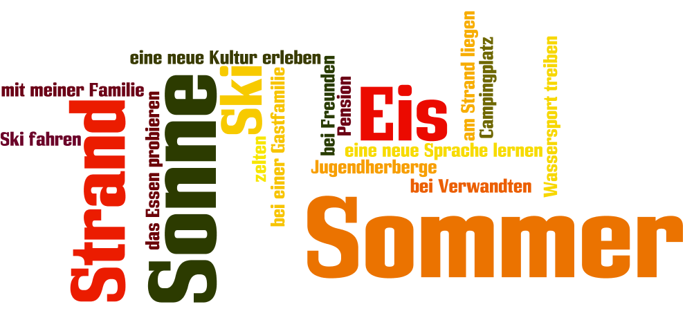
www.wordle.net
Rachel Hawkes

Slide 25
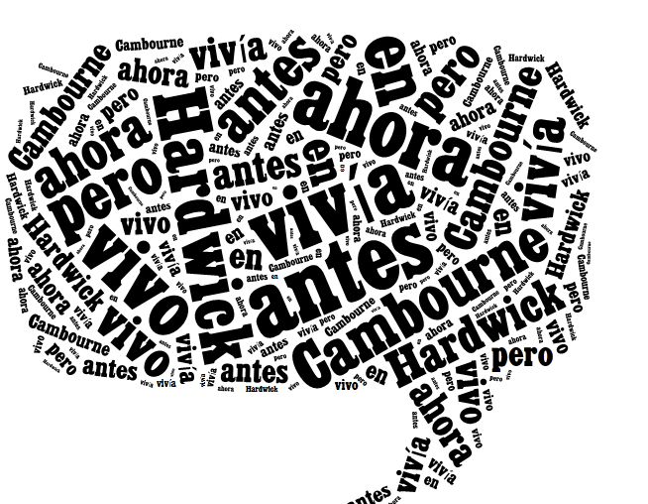
Before I used to live in Hardwick but now I live in Cambourne.
Antes vivía en Hardwick pero ahora vivo en Cambourne.
http://www.tagxedo.com/

Slide 26

The bad thing is that there’s not a lot going on.
Lo malo es que no hay mucha marcha.
Notes:
www.wordle.net

Slide 27

The good thing is that I have lots of friends there.
Lo bueno es que tengo muchos amigos allí.
Notes:
www.tagxedo.com

Slide 28
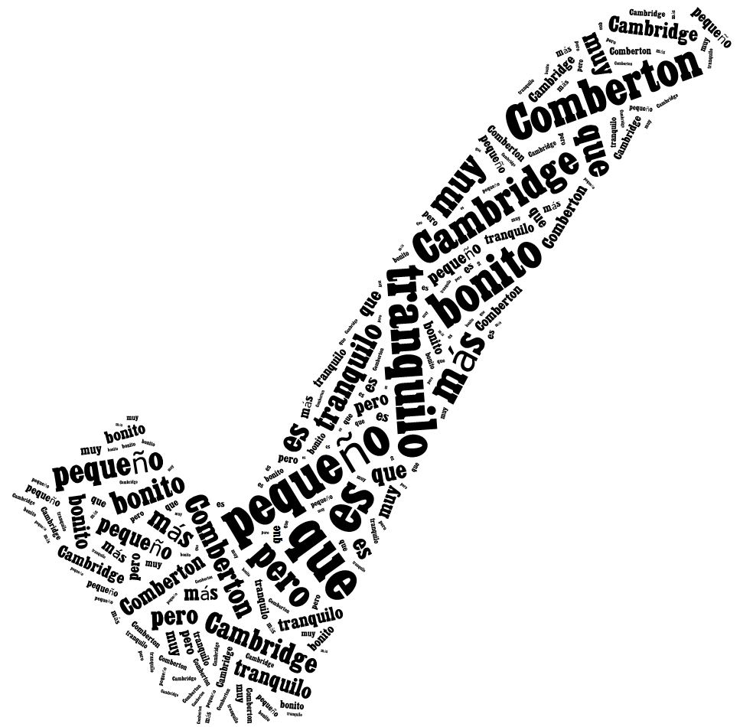
Comberton is smaller than Cambridge but it is quiet and very pretty.
Comberton es más pequeño que Cambridge pero es tranquilo y muy bonito.

Slide 29
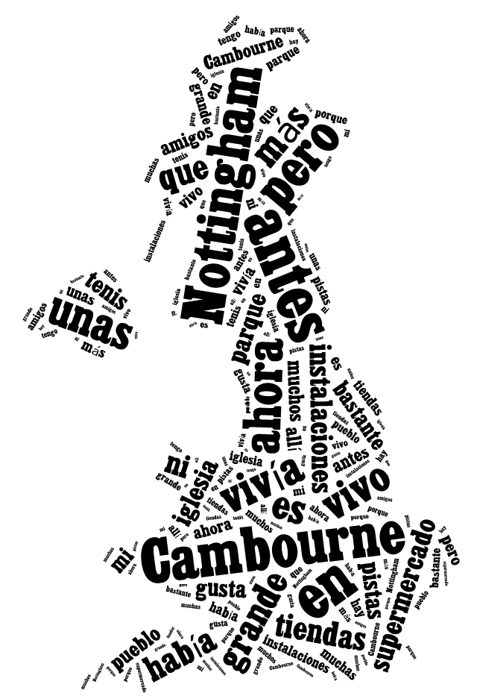
Before I used to live in Nottingham but now I live in Cambourne. Nottingham is bigger than Cambourne. Before in Cambourne there were not many shops nor facilities but now there is a supermarket, a church, a park and some tennis courts. I like my town quite a lot because I have lots of friends there.

Slide 30
Manipulating language
Rachel Hawkes
Comberton Village College
ONLINE REFERENCING
Idea 8
Notes:
At KS3 we embed an idea of ratio when we set written homework. The idea that 80% of what they produce should be recycled and adapted language from the lessons. i.e. As the teacher I can recognise where the language comes from. 20% can be ‘experimental’ and researched language, particularly we encourage them to use online referencing tools to help them to conjugate new verbs.
I think it is still a good ‘rule of thumb’ at KS4 to think in terms of 80:20 ratio, so some of the classroom or homework tasks involve using www.verbix.com to find out specific verbs forms.

Slide 31
Research & reference
1. www.wordreference.com
Online dictionary – use this and not an online translator
2. http://www.verbix.com/ (or http://www.conjugation.org/ )
Online verb conjugation tool – you type in the verb and it shows you all forms of all tenses
3. http://french.typeit.org/ (http://german.typeit.org/ http://spanish.typeit.org/)
Saves pupils having to ask how to type accents or leaving them out on homework completely!

Slide 32
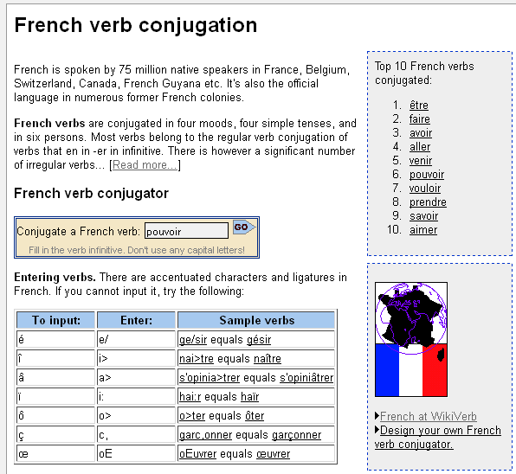
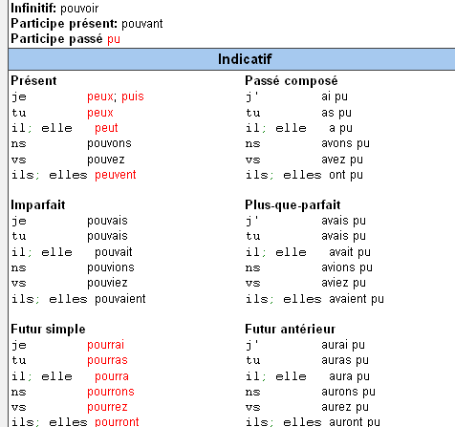
pouvoir – to be able to
http://www.verbix.com/

Slide 33
Manipulating language
Rachel Hawkes
Comberton Village College
LOOKING BACK
Idea 9

Slide 34
1. My school is a mixed comprehensive school.
2. The subject I most like is maths because I always get good marks.
3. My ideal teacher has a sense of humour and always wants to help us.
4. The school rules are important but too strict – for example you can’t wear coats inside the building.
5. The biggest problem at my school is the stress of exams.
6. After school there’s a lot to do. I usually do dance club on Tuesdays.
7. My primary school was much smaller than this school. I was able to walk there everyday.
8. Last year I did work experience for 2 weeks. I had a good time and learnt a lot.
9. Next year I plan to do A levels. I want to study English, Spanish and Maths.
Rachel Hawkes
Notes:
It is hard to get students to use what they have learnt already sometimes. To focus them back on what is in their books, maybe choose 9 questions in the TL OR 9 phrases in English that are the equivalent of essential target language on the topic and give them the task of finding them from their books.

Slide 35
NAME:__________________________________________________________
Translate into French and write your text in the lined space provided below:
Hello. My name is Claire and I live in Cambridge (3) with my family and my dog (3) who is called Schmitty (3).Cambridge is an old city (3). I don’t have any brothers or sisters (3). In Cambridge there is a market, two swimming pools and some museums (3). My mum likes to go to the museums (3) but I prefer to go bowling (3).There isn’t an ice rink in Cambridge (3) but you(‘one’) can go to Peterborough (3). I like Cambridge and in my opinion it’s pretty (3) but it isn’t big (3). Sometimes I go to the café in the village (3). My friends play table football (3) but I can’t play (3) because it’s too difficult (3).
____________________________________________________________________
____________________________________________________________________
____________________________________________________________________
____________________________________________________________________
____________________________________________________________________
____________________________________________________________________
____________________________________________________________________
____________________________________________________________________

Slide 36
Mark | Definition
3 | Fully communicated. Perfect translation – including spelling, grammar and punctuation.
2 | Fully communicated with only minor error(s). Minor errors include: understandable spelling, plurals & punctuation.
1 | Partially communicated/fully communicated but with major areas which have been taught and focussed on in class. Major errors include: possessive adjectives, negatives, verb conjugations & tense.
0 | Not communicated. Or whole sentence has been done using a translator.

Slide 37


Manipulating language
Rachel Hawkes
Comberton Village College
DICTIONARY SKILLS
http://www.tes.co.uk/article.aspx?storyCode=6067974
Idea 10
Notes:
Students need to be secure with dictionaries and this is clearly not just a KS4 thing that we want to surprise them with. We need to build in the dev of dictionary skills from the outset. I’ve drawn together a collection of resources from the TES and help here.

Slide 38
Variety and range
Rachel Hawkes
Comberton Village College
FUNCTIONS & THEMES
Idea 11

Slide 39
Functions |  | Themes
A | Questions | 1 | Future plans
B | Opinions | 2 | Work experience
C | Suggestions | 3 | Uniform
D | What others say | 4 | Primary school
E | Likes & dislikes (not ‘aimer’) | 5 | Subjects and teachers
F | Habits | 6 | Extra-curricular
G | Comparisons | 7 | Problems
H | Past events | 8 | School rules
Notes:
A bit of a wordy one to explain but essentially it’s about getting students to think outside the box and use their language creatively. On the right are the main sub-themes from a topic, school in this case. On the left are various language ‘functions’. By mixing up the combinations some creative sentences can be written that are not usually found within textbooks.
For example – comparisions are often drawn between subjects (G5) but not so often between future plans (G1) or school rules (G8) and yet, with a little bit of thinking, students can come up with content and language that fulfills on these new combinations and makes for more interesting work.
With one class I put them into groups and gave combinations. We collated all responses electronically and after oral feedback, all students got all of the work, not just theirs, sent out to them.

Slide 40
Funciones |  | Temas
A | Preguntas | 1 | Planes para el futuro
B | Opiniones | 2 | Las prácticas laborales
C | Sugerencias | 3 | El uniforme
D | Lo que otros dicen | 4 | La escuela primaria
E | Gustos y Preferencias (no se permite ‘gustar’) | 5 | Asignaturas y profesores
F | Costumbres | 6 | Actividades extraescolares y responsabilidades
G | Comparaciones | 7 | Problemas en el insti
H | Acontecimientos pasados | 8 | Las normas del insti

Slide 41


Variety and range
Rachel Hawkes
Comberton Village College
GROUP WRITING
Idea 12
Notes:
This type of task can be excellent to produce thinking and planning to write. Also it can highlight very well the need to link each paragraph.

Slide 42
Variety and range
Rachel Hawkes
Comberton Village College
ASL (Average Sentence Length)
Idea 13
Notes:
This is just a quick and easy strategy to get students to focus on the length of their sentences and to help them to notice and think about extending sentences. At the end of a piece of writing, they can total the words and divide between the number of sentences – this gives them their ASL. Obviously an ASL of 7-9 indicates that they are not often using subordination, connectives or other conjunctions. ASL of 11-15 would indicate that they are doing this. Clearly it doesn’t measure success with accuracy but it is just a useful measure that highlights this aspect of quality of language.

Slide 43
Variety and range
Rachel Hawkes
Comberton Village College
TICK GRID
Idea 14
Notes:
This is essentially a pre-writing and a post-writing set of tasks rolled into one. The pre-writing ‘scopes out’ the task with the students, inviting them to anticipate the task and what language they will need to address a given question and to think through how and when they will be able to use certain structures. Very consciousness-raising.
After they have written the task, they get formative feedback, i.e. a tick (5-bar gate) to note each correct example and in the sad face the incorrect attempts, still worth flagging up to them.
They then return to the work and re-draft. The 2nd time around they get a grade/mark.
There are lots of other ways to use the tick grid.

Slide 44

Johnny Depp est né le 9 juin 1963 à Owensboro dans le Kentucky, aux États-Unis. Il est acteur américain, qui est déjà très célèbre. Il est en couple avec la chanteuse et actrice française Vanessa Paradis et ils vivent en France. Ils ont deux enfants ensemble. En 2010, il a refusé le titre de l'homme le plus sexy de l'année pour servir d'exemple à ses deux enfants.
 |  | ☺ | ☹
Present |  | //// /
Past |  | //
Future
Imperfect
Negatives
Opinions
Reasons |  | /
Links |  | ///
Clauses |  | /
Detail/Extras

Slide 45
How to use the tick grid
GCSE German | ☺ | ☹
present
past
future
opinions
WO1 conjunctions
WO2
WO3 conjunctions
wann? wie? wo?
prepositions + R2/3
modal verbs
um…zu +INF
adjective endings
no communication
spelling/capitals
With text book listening tasks
With written text
When peer assessing
When completing speaking preparation for GCSE tasks
When listening to exam board sample material
When assessing model answer provided by the teacher

Slide 46
Variety and accuracy
Rachel Hawkes
Comberton Village College
PEER ASSESSMENT
Idea 15

Slide 47
1 | Subject variety (other than ‘ich’)
2 | Number of present tenses
3 | Number of past tenses
4 | Number of future tenses
5 | Number of opinions
6 | Number of different adjectives
7 | Number of reasons
8 | Number of ‘juicy’ moments
“In lessons, students are regularly required to check each other’s work, discuss it and spot errors before they look at the correct copy.”
paired assessment before handing in
whole class assessment of anonymous samples of student homework as starter
‘auction’ activities to spot errors/correct formulations
paired listenings
 | Number of errors spotted
Notes:
Peer assessment before handing in homework can be very useful – students can use the tick grid OR they can do a Quality of Language check only as in this tally sheet.

Slide 48
Accuracy
Rachel Hawkes
Comberton Village College
SENTENCE AUCTION
Idea 16

Slide 49


¿Qué apuestas?
 | Frase | / x | Apuesto | Gano | Pierdo
1 | Me gusta las comedias.
2 | los programas de deporte son divertido.
3 | Me gusta ir al cine porque son interesante.
4 | A mi madre le encantan las telenovelas.
5 | Prefiero los deportes de equipo porque es más emocionante.
subtotal
Marca con / o x las frases correctas y las frases con errores
Apuesta entre 1 y 10 puntos
Escucha al profesor para ver si las frases son correctas o no
Si has escrito / o x en el lugar correcto ganas los puntos. Si no, pierdes los puntos
Escribe tu total en la casilla

Slide 50
¿Qué apuestas?
Marca con / o x las frases correctas y las frases con errores
Apuesta entre 1 y 10 puntos
Escucha al profesor para ver si las frases son correctas o no
Si has escrito / o x en el lugar correcto ganas los puntos. Si no, pierdes los puntos
Escribe tu total en la casilla
 | Frase | / x | Apuesto | Gano | Pierdo
1 | Ayer jugé al fútbol
2 | Juan es una persona contenta
3 | No salí porque tenía muchos deberes
4 | Yo amor el español
5 | Las matemáticas es difícil
6 | ¿Como te llamas?
7 | No les gusta la política
8 | Me duele los pies
9 | ¿Cuándo es tu cumpleaños?
10 | Dónde está mi libro?
11 | Hablaremos más tarde
12 | Haceré mis deberes esta noche
13 | No me gusta chocolate
14 | Le encanta las películas de acción
15 | Pasó mis vacaciones en Francia
16 | Saqué muchas fotos
17 | Fútbol es aburrido
18 | Mi padre es un médico
19 | Mi hermana es muy alto
20 | Pedro soy español
subtotal
Gano - pierdo = Total

Slide 51
Accuracy
Rachel Hawkes
Comberton Village College
TXT SPK
Idea 17

Slide 52
¿Cómo mandar un SMS en español?
a2
¿Estás bien?
saludos
adiós
hasta luego
besos
por favor
hl
xfa
salu2
tas OK?
bs
Notes:
Match the txtspk to the ‘proper’ Spanish.

Slide 53
¿Cómo mandar un SMS en español?
1. ‘e’, ‘es’ y la ‘d’ entre vocales desaparecen
Por ejemplo: estoy → toy/toi / espera → pera / todo → too
2. Unas letras cambian: ‘c’ y ‘q’ → ‘k’ / ‘y’ → ‘I’ / ‘ch’ → ‘x’
Por ejemplo: quiero → kiero, quién → kien, escucha → kuxa
3. Siglas (initials)
Por ejemplo: tkm → te quiero mucho / tki → tengo que irme
nph → no puedo hablar / npn → no pasa nada
4. Letras que hablan
Por ejemplo: bb → bébé / rs → eres /
Notes:
A couple of slides giving the ‘rules’ or patterns of txtspk in Spanish. Similar to what we do in English – leave out vowels, use numbers that ‘sound’ like the word or part of the word e.g. l8r etc..
http://matadornetwork.com/abroad/global-netspeak-20-words-and-phrases-to-get-started-texting-in-spanish/

Slide 54
5. Los números y los símbolos
Por ejemplo: x = por, + = mas, and – = menos
saludos → salu2, recién → re100, besitos → b7s, porque → xq, al menos → al-, demasiado → de+sia2
6. La ‘u’: ‘bu’ y ‘gu’ pierden ‘b’ y ‘g’. El sonido ‘u’ se escribe como ‘w’
Por ejemplo: bueno → weno, guapo → wapo
7. La inclusividad
Por ej.: amigos/amigas → amig@s, todos/todas → tod@s
8. El uso del fonético español para comunicar palabras inglesas
Por ejemplo: jelou, japibirdei, sorri, plis.

Slide 55

s3
estrés
Notes:
‘Say what you see’ ess-tres → estrés (stress)

Slide 56
Salu2. Mym Alicia i tng 16 añs.
Saludos. Me llamo Alicia y tengo 16 años.
Soy tdnt n l nsti CVC n CB.
Soy estudiante en el instituto Comberton Village College en Cambridgeshire.
Tudio mtcs, pñl, ngls, cncs, grf, hst i rt.
Estudio matemáticas, español, inglés, ciencias, geografía, historia y arte.
Notes:
Students start with 100 points and take one away for each mistake, including accents!

Slide 57
Tng 1 mpl ls findes n WHSmth.
Tengo un empleo los fines de semana en WHSmith
Ksra hcr prctcs n Marshalls.
Quisiera hacer prácticas en Marshalls.
M gstra tnr xprnca n 1 gn mprsa
Me gustaría tener experiencia en una gran empresa.
Notes:
To finish…….

Slide 58
Me llamo Carlos Roberto. Tengo dieciocho años y soy estudiante en el Instituto Pablo Picasso en Málaga. Estudio las ciencias y las matemáticas. Tengo facilidad en las matemáticas.
Tengo un pequeño empleo el fin de semana en un restaurante de mi pueblo.
Quisiera hacer prácticas en Iberia por que me gustaría tener experiencia en una línea aérea. En el futuro quisiera ser piloto.
Escribe este párrafo como un SMS. Luego dáselo a tu compañero para que lo vuelva a ‘traducir’ al español.
……………………………………………………………………………………………………………………………………………………………………………………………………………………………………………………………………………………………………………………………………………………………………………………………………………………………………………………………………………………………………………………………………………………………………………………………………………………………………...........
Notes:
This is a similar reading text. This time the idea is to work memory AND attention to detail, first by re-writing the text as textspeak and then by trying to re-construct the text again and then comparing with the original version.

Slide 59
Manipulation, Variety & Accuracy
Rachel Hawkes
Comberton Village College
NARRATION
Idea 18

Slide 60
El sábado pasado estaba en casa con mi hermano y veía la televisión … | cuando él dijo, “No hay nada en la televisión. Prefiero ir al cine.” | Entonces dije, “Sí. ¿Qué tipo de película quieres ver?” “Una comedia” dijo. | Entonces fuimos al cine y vimos la película. Lo pasamos bomba. Cuando salimos del cine, hacía sol.
Entonces dije, “Quiero un helado. ¿Vamos a comprar un helado de chocolate en el café? | Pero cuando fuimos al café la señora dijo, “Lo siento, no tenemos helados de chocolate”. | Dije, “¿Tiene helados de fresa? Y mi hermano dijo, “dos, por favor!” | ¡Qué día más perfecto! ¡Cine, helado y sol!
Draw the parts of the story
Colour all the imperfect verbs in green
Underline all the preterite verbs
Thank you to Vincent Everett for this idea.
Notes:
Model the first box and then ask students to complete the task. Go through the verbs with them, making sure they have identified correctly and also know what each means.
Give them a choice of HW task

Slide 61
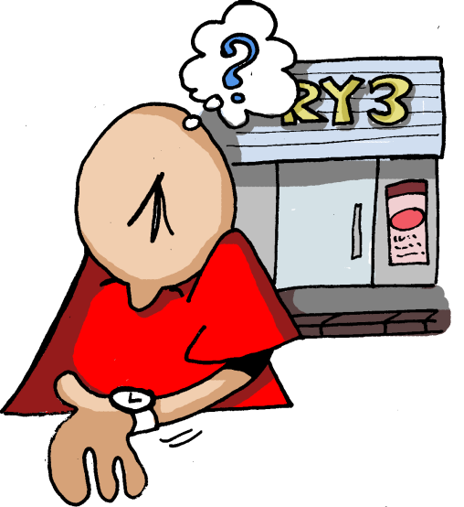
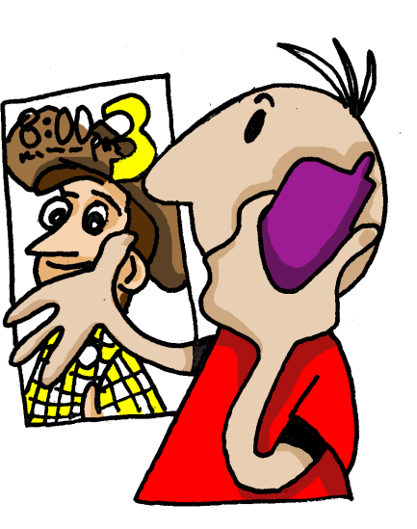

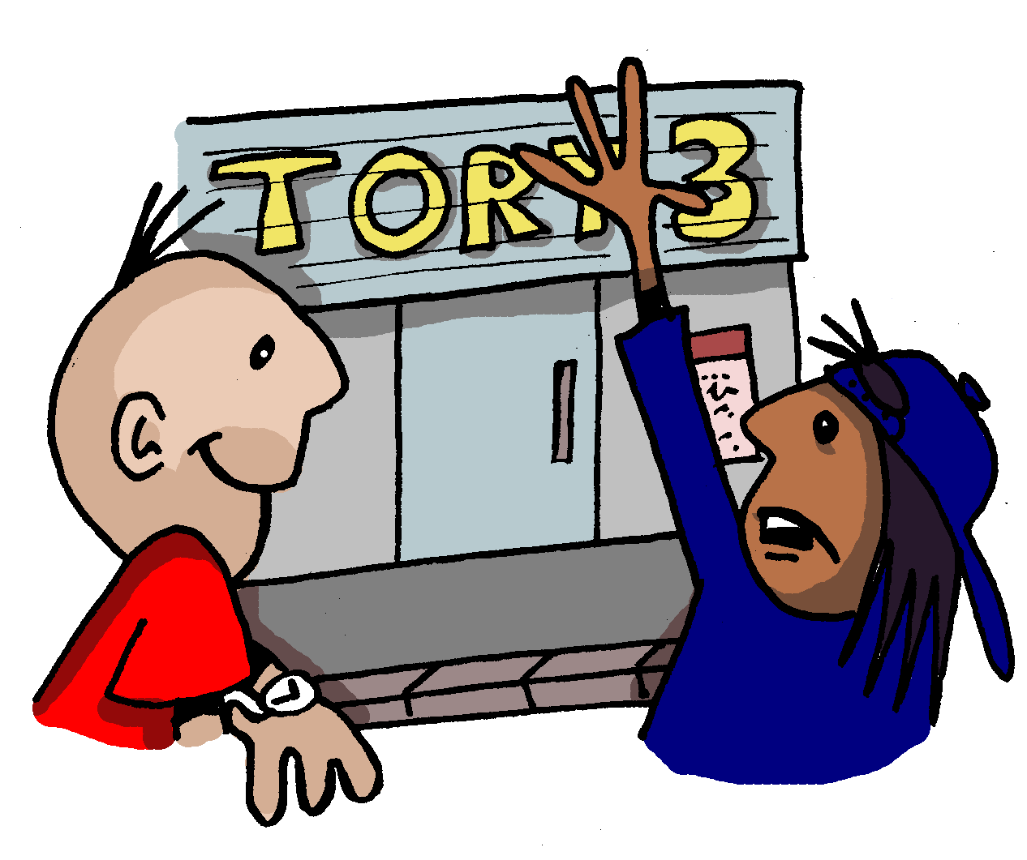
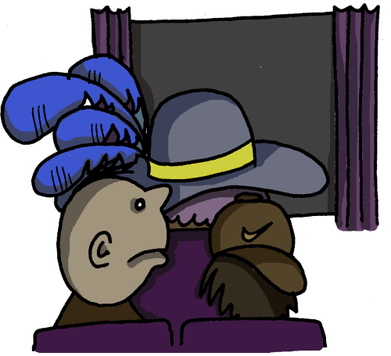
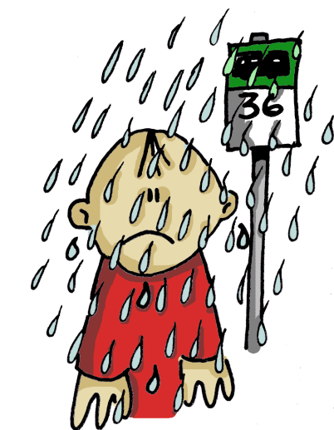
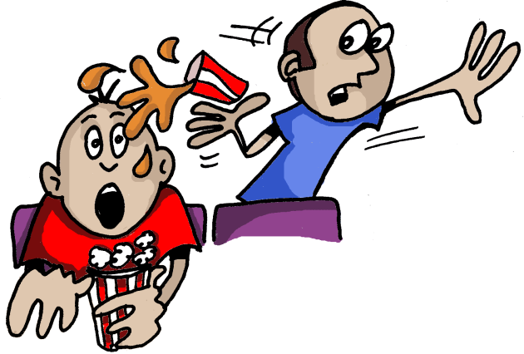
1 | 2 | 3 | 4
5 | 6 | 7
Notes:
Easier NOT to cut this one and just cut the text cards I think

Slide 62





1 | 2 | 3 | 4
1
2
3
4
5
6
7
5 | 6 | 7
Empareja las imágenes con el texto.
Había muchísima gente en el cine, incluso una mujer con un sombrero enorme, que estaba delante de nosotros.
a | b | c
Al final empezó a llover cuando estaba en la parada de autobuses. ¡Estaba ya harto de esa excursión!
Todavía peor, un chico que estaba detrás de nosotros ¡nos echó encima su coca cola!
d | e | f | g
Un día llamé a mi amiga Teresa. La invité al cine y quedamos a las 7.
Una media hora después Teresa llegó. Dijo que había mucho tráfico en la ciudad.
En seguida entramos en el cine y sacamos las entradas. Luego compramos palomitas.
A las 7 estaba en la puerta del cine pero Teresa no llegó.
Notes:
Depending on the class, this task might be approached as a reading strategy development task, asking students how they could look for clues to sort out the sequence of the story, looking for a likely beginning phrase. Looking for links between one phrase at the next. Looking also at the pictures to help understand the story and thinking of key Spanish words they know that might help them to match the pictures to text.
Quite often groups enjoy moving cards around to do this sort of task so at the end of this lesson are A4 size sheets to print and cut. As the text is already jumbled. Students could do their own cutting!

Slide 63
1 | 2 | 3 | 4
1
2
3
4
5
6
7
d
g
5 | 6 | 7
e
Empareja las imágenes con el texto.
f
Había muchísima gente en el cine, incluso una mujer con un sombrero enorme, que estaba delante de nosotros.
a | b | c
Al final empezó a llover cuando estaba en la parada de autobuses. ¡Estaba ya harto de esa excursión!
Todavía peor, un chico que estaba detrás de nosotros ¡nos echó encima su coca cola!
a
c
d | e | f | g
Un día llamé a mi amiga Teresa. La invité al cine y quedamos a las 7.
Una media hora después Teresa llegó. Dijo que había mucho tráfico en la ciudad.
En seguida entramos en el cine y sacamos las entradas. Luego compramos palomitas.
A las 7 estaba en la puerta del cine pero Teresa no llegó.
b
Notes:
Depending on the class, this task might be approached as a reading strategy development task, asking students how they could look for clues to sort out the sequence of the story, looking for a likely beginning phrase. Looking for links between one phrase at the next. Looking also at the pictures to help understand the story and thinking of key Spanish words they know that might help them to match the pictures to text.
Quite often groups enjoy moving cards around to do this sort of task so at the end of this lesson are A4 size sheets to print and cut. As the text is already jumbled. Students could do their own cutting!

Slide 64
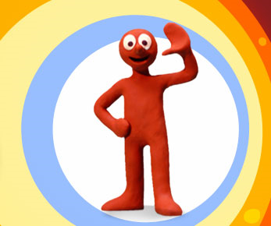

Slide 65

Notes:
Most people will want to download these to use them in class. Here are the links to each one:
Red = episode 3 - http://www.youtube.com/watch?v=8i9juY3ezrg&feature=related
Yellow = episode 6 - http://www.youtube.com/watch?v=w0cpY4lrevY&feature=related
Green = episode 13 - http://www.youtube.com/watch?v=UxjYJZC4j0c&feature=fvsr
Blue = episode 14 - http://www.youtube.com/watch?v=11HZt2JCj7g&feature=related
It will be helpful to provide some useful verbs for each one, plus a reminder of some key narrative links. These are on the next slide.

Slide 66
sentarse – to sit down
pulsar – to press
desaparecer – to disappear
aparecer – to appear
reírse – to laugh
leer – to read
explotar – to explode
(el control remoto, el botón, el periódico)
cruzar – to cross
pagar – to pay
decir – to say
decidir – to decide
rodear – to go around
desaparecer – to disappear
transformarse en – to turn into
(el puente, un peaje, un monstruo acuático)
jugar a las cartas
apostar (bollos) – to bet (buns)
descubrir – to discover
hacer trampas – to cheat
comer – to eat
estar lleno – to be full
pesar (mucho) – to weigh ( a lot)
romperse – to break
caerse – to fall
ser orgulloso de – to be proud of
ponerse en marcha – to start up
entrar (en) – to go (into)
salir (de) – to come out (of)
ser una broma – to be a joke
fingir – to pretend
(una máquina del tiempo, muy viejo, un bébé)

Slide 67
Morph – episodio ?
1.
2.
3.
4.
5.
6.
7.
8.
9.
Notes:
They should write their narration in the preterite (+ imperfect) and use a maximum of 9 stages as with episode 4. If on computers they should be encouraged to use an online verb conjugator to check the preterite forms. The next slide shows a screen shot of an example of this to model to students.

Slide 68
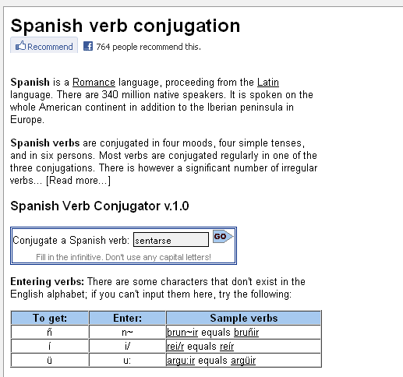
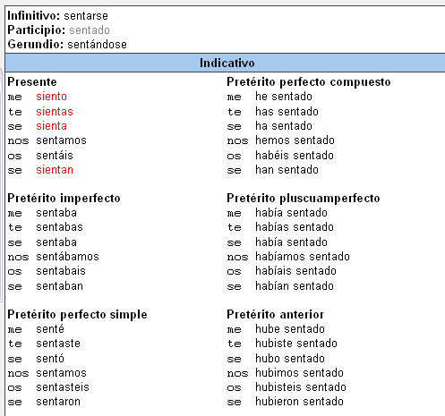
http://www.verbix.com/languages/spanish.shtml
Escribe el infinitivo en español aquí
el presente
el pretérito
Notes:
http://www.verbix.com/languages/spanish.shtml

Slide 69
Manipulation, Variety & Accuracy
Rachel Hawkes
Comberton Village College
MODELLING
Idea 19

Slide 70
Wie heisst deine Stadt oder dein Dorf?
Ich wohne in Toft.
Ich wohne in einem kleinen Dorf, das Toft heißt.
Ich wohne in einem kleinen Dorf, das Toft heißt. Früher habe ich in Bristol gewohnt.
Ich wohne in einem kleinen Dorf, das Toft heißt. Früher habe ich in Bristol gewohnt. Wenn ich älter bin, möchte ich in London wohnen.
Ich wohne in einem kleinen Dorf, dasToft heisst. Früher habe ich in Bristol gewohnt. Wenn ich älter bin, möchte ich in London wohnen.
Include present, past and future as often as you can!

Slide 71
Value added* - to the past
iba a + infinitive… - I was going to ….
pero decidí + infinitive – but I decided to …
mi padre me dijo, “….” – my Dad said…
¿por qué no + infinitive…? – why not…..?
dije, “…” – I said….
(aunque) me hubiera gustado + infinitivo – although I would have liked to…

Slide 72
Basic sentence:
Fui a España.
Enhanced by the ‘super’ structures:
Iba a ir a Francia, pero mi padre dijo, “Hablas español entonces ¿por qué no ir a España?”. Entonces decidimos ir a España aunque me hubiera gustado ir a Francia.

Slide 73
Question: ¿Te gusta jugar al fútbol?
Si hace sol, me encanta jugar al fútbol sobre todo con mis amigos en el parque, pero si llueve, prefiero ver el fútbol en la televisión. Por ejemplo, el fin de semana pasado iba a jugar al fútbol, pero Kevin dijo, “Está lloviendo” entonces decidimos ir a mi casa a ver el fútbol en la televisión, aunque me hubiera gustado ir a ver un partido de verdad.
(This answers contains: present, opinions, longer/extended sentences, imperfect, preterit, present continuous, preterit(plural form), pluperfect subjunctive).
Now try your own example!

Slide 74
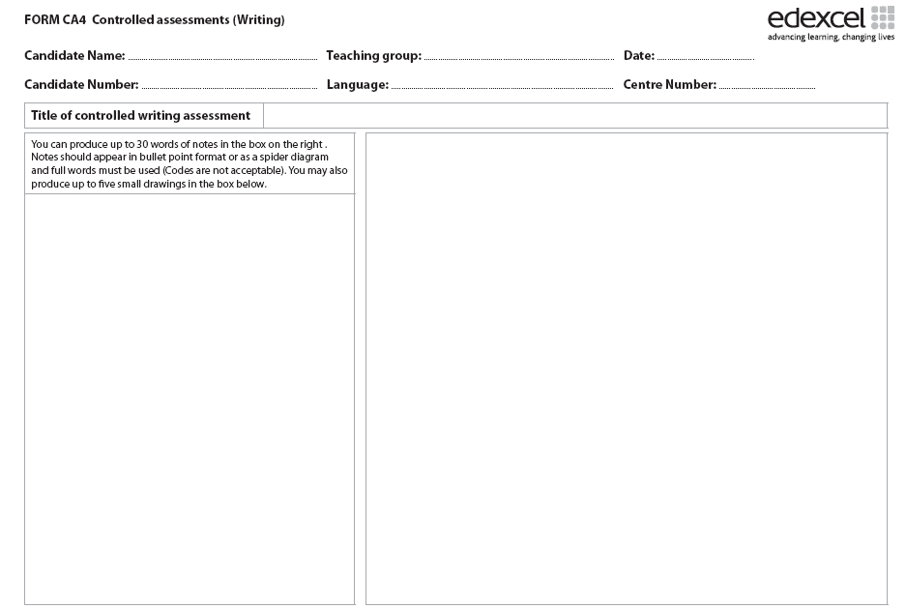
especializdo
me ayuda
suelo
demasiados deberes
no se permite
hay que
más informal
prácticas laborales
escuela
horas de trabajo
primer día
más me gustó
buena experiencia
bachillerato
tengo ganas
en el extranjero
1. Students can prepare a 30 word notes sheet from a ‘model answer’ given by the teacher/text book.
2. Students can write a piece from a 30 words notes sheet given by the teacher.

Slide 75
Comberton Village College
Reflection and planning
Take this opportunity to remind yourself of the strategies for writing that we have seen. Identify one or two that you would like to include in your planning for a particular KS4 class. Sketch out in rough the language you want to include, depending on the topic you are teaching.
Rachel Hawkes

