Slide 1



Comberton Village College
Achieving your best grade in GCSE languages
Independence in speaking Secure grasp of repertoire of key structures and reference skills in writing (Perseverance in listening and link-making in reading) (Vocabulary!)
Rachel Hawkes

Slide 2
Programme
Rachel Hawkes
Comberton Village College
MFL Neighbourhood INSET
Friday 1st March 2013
Darrick Wood School
Priorities | Timing
1 Strategies for Speaking | 9.10 – 10.40
Strategies for Writing | 11.15 – 12.45

Slide 3

Get the best grade you can in GCSE French speaking
Anglia Ruskin University
Monday 21 January 2013
Notes:
Describe the organisation, vision for and outcomes on the day.

Slide 4
Spot the difference
Are these true for speaking or writing or both?
1. You have time to plan before you produce the language
2. You communicate your opinions through words only
3. You have a lot of time to think
Communicating a lot of information is important
Accuracy is one factor, but others are equally important
Your performance depends largely on listening comprehension
Notes:
To introduce students to the objectives of the day.
Begin by pointing out that there are 2 x productive skills (i.e. when they are actually producing language themselves, rather than working to understand language that they are on the receiving end of, as in listening and reading). These are speaking and writing. They have similarites but they are also different from each other, especially when it comes to how they are assessed/graded at GCSE. How so?
Is this speaking or writing or both?
1. You have time to plan before you produce the language
2. You communicate your opinions through words only
3. You have a lot of time to think
Communicating a lot of information is important
Accuracy is one factor, but others are equally important
Your performance depends largely on listening comprehension
Give the students time to discuss this for a few minutes and take answers from the floor.
The statements are deliberately open with elements of ambiguity and the idea is to draw out some of the following thoughts:
1. In GCSE you have some time to plan for both speaking and writing. In the actual exam itself, the moment of production is more immediate/spontaneous in speaking whereas in writing, you can stop/start/revise/cross out/start again and it’s only at the end of the hour that you actually ‘produce’ the piece of language which is marked. in speaking, once you start speaking everything you say is part of the assessment. In real life, of course, there can be planned speaking e.g. presentations / talk / assembly etc.. but there is a lot more talking that is unplanned
In writing – this is more true, although we want to introduce the idea that using punctution helps convey mood as well. In speaking, the words are important of course, but we have many non-verbal aspects too, such as tone of voice / intonation, pronunciation, facial expression, hesitations/fillers for thinking time, body language / gesture
3. Relatively – this applies more to writing of course. in speaking, though, we should not forget that we can buy ourselves time with fillers to get a few seconds thinking time and that this is perfectly acceptable, normal, as it happens in usual conversations in the mother tongue too!
4. Yes, important to both. Ultimately, it the quantity of information that we communicate in both speaking and writing that counts.
5. Can apply to both, of course. In writing – accuracy is one factor but complexity is another important aspect. In speaking, accuracy is also important, but the other factors that are equally important are sounding confident, saying it like you mean it, responding readily to what is said to you, in short, being able to interact with others It is hard to quantify this exactly, but over the years as an examiner it has been proven to me time and time again that this counts for an awful lot, and certainly is more important than grammatical mistakes, even quite serious ones, as long as the meaning is clear.
6. This is of course only true of speaking, and underlies the most fundamental difference. Whatever exam board you do, your speaking performance starts with you understanding the questions / comments that are put to you by the other person, then knowing how to repsond readily to them. This is why this afternoon we will work on listening skills. The more quickly you can process / understand questions the more confidently you will be able to respond to them.

Slide 5



Pour commencer…
Personne 1: Un
Personne 2: Deux
Personne 1: Trois
1. Au lieu de dire le mot ‘deux’, il faut applaudir.
2. Au lieu de dire le mot ‘trois’, il fault sauter.
Notes:
At this point we have explored some of the similarities and differences between writing and speaking, the 2 ways you are learning to produce language. We’ve identified a couple of key differences. As our focus is on speaking today, it follows that we need to spend time on these.
1. Using tone of voice to express emotion
2. Responding readily
3. Sounding confident (saying it like you mean it!)
It’s often easiest to start doing this by beginning with the simplest language. Like in a scientific experiment, where, to focus on one element you keep everything else the same. So, we’re going to start with language you don’t even have to think too hard about producing! Numbers 1 – 2 – 3. Don’t be fooled into thinking this is going to be easy though. We’re working on tone of voice, ready responses, sounding confident.
In pairs, have this conversation. First, just get a rhythm going. I’ll give you 30 seconds to do that. When I call ‘trois – deux – un silence’ I want you to stop.
Now, I want you to try putting some mood/emotion into it. You may include questions – responses – exclamations. Don’t try to do this too fast or you won’t be really responding to what you hear. Try to think about the emotion you’re conveying and use an appropriate gesture or facial expression. You’ve all done drama at KS3 so use all your strategies from there.
(useful to have another teacher there to demo this with)
Off you go!

Slide 6
Grade changers
Vary your adjectives (don’t repeat ‘intéressant / ennuyeux’!)
Extend and justify opinions with ‘parce que’
Refer to others (s/he – we – they)
Compare then and now
Describe things with 5 details
Use 5 different verbs in the past (J’ai fait beaucoup de choses: par ejemple…)
Link and narrate (Tout d’abord….puis…ensuite…finalement)
Use ‘pour’ to extend (Je suis allée a Londres pour faire du shopping)
Use ‘I wanted but I couldn’t, so I…’ (Je voulais aller au cinéma mais je n’ai pu pas, alors j’ai regardé un film chez moi)
Refer to the future (Je vais…/Je veux…/Je voudrais…/J’ai l’intention de…/J’espère…)
Notes:
You will have heard your teachers talk about these already I’m imagining. They may not have displayed them in a list quite like this, but these are 10 essential things that, once you’ve learnt to do them with confidence, will make you a better speaker of the language and will also change your grade in speaking
Some core grade changers from D → C and C→ B. If students manage all of these with confidence, good pronunciation and intonation their performance will most likely be at B grade, if ½ to ¾ then a secure C. It is fine to tell them this.
Session 1 – we are going to work on the first 5 of these and Session 2 we will improve on the other 5.
To do these, it will be best to work in smaller groups, so we’re going to break out now into our groups.

Slide 7

Comberton Village College
QCDA Pilot CD: Sample Controlled Assessment
Rachel Hawkes
Notes:
Examiner comment: variety of structures, readily understood. Not initiate or develop the task, little explanation of ideas or extended replies. Most characteristic of Grade B.
Define initiate: not necessarily asking a question! It means extending the answers really, offering more information that was required for a minimal response to the question asked.
What could Pippa have done?
More factual information about the film itself and Jonny Depp too.
Narrate the story
More range of language to describe the type of film
Character Jonny plays in the film. Say why the film is amusant.
Other films Jonny has been in.
Other details about the actor – e.g. he speaks French, he’s been in a French film himself, he can’t see 3D films, not typical Hollywood star
More prepared to talk in depth about her own hobbies
Swimming – she swims for Oxfordshire! Since when? Family also into swimming? When/where does she train? Competitions? How often? Why does she like it? Take it further? Any other sports? Why prefer it to other sports?
Why does the question C’etait comment? Confuse her? Spontaneity is first and foremost about understanding – grasping the meaning of the question quickly.
What should classroom interaction look like? What can the teacher do?
More extended questioning with one student each lesson (aim to do this with 4-5 students per lesson). Deeper, sequential, unpredictable questioning. Perhaps this will need to be whilst others students are doing group work? So that it is not too much pressure in front of peers. However, research shows that other students benefit from the learning opportunities that are created from secondary participation in these spontaneous interactions. i.e. they have the time to attend to what is said and learn from it, when not fully involved themselves.

Slide 8
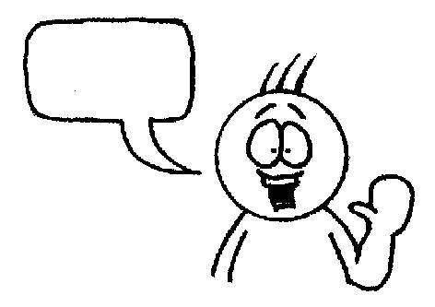
Comberton Village College
Session 1: Strategies for Speaking
Rachel Hawkes
Practising output
(fluency , pronunciation, automatization, memory)
Increasing interactivity
(spontaneity, sustaining the flow, filling pauses, intonation)
Manipulating language
(Sentence-building, creativity, improvisation)
Questioning
Developing quality
(Assessing, improving, enhancing, modelling)
Rewarding spontaneity

Slide 9
Comberton Village College
Practising output (fluency , pronunciation, automatization, memory)
Rachel Hawkes
Telepathy (trapdoor/bubbles)
Idea 1

Slide 10

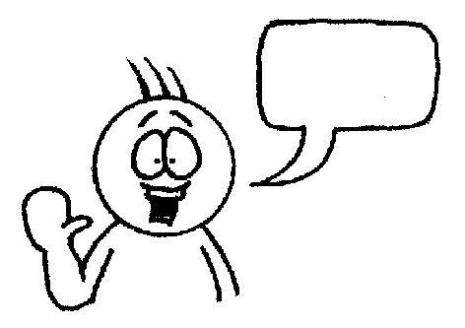
L’année dernière, je suis allé(e)
en Espagne.
aux Étas-unis
en France.
dans un hotel
dans un camping
dans une gîte
confortable.
bien equipé(e).
très moderne.
Je suis resté(e)
et c’était
des monuments
des musées
des galeries
j’ai fait du cyclisme.
j’ai nagé dans la mer.
j’ai fait des excursions.
J’ai visité
et
les plages
les boîtes de nuit
les restaurants
la chaleur.
les toilettes.
les embouteillages.
J’aimais bien
mais pas
Écosse
Autriche
Australie
faire de l’alpinisme.
faire du canoë-kayac.
visiter les attractions.
L’année prochaine, j’irai en
pour
Notes:
Anna’s TES resources reminded me of this one! She calls it Trapdoor and it’s brilliant for a) memory and b) speaking (repetition with a reason!) It’s a competitive game in pairs. Each chooses and option for each sentence in their head. One starts reading out loud, trying to anticipate the other’s choices. Each time they make a choice, the partner either nods or shakes his/her head. If the choice is wrong, play passes to the partner who starts the same process. If it is the right choice, the student gets to continue. The aim is to get to the end first. Answers don’t change, so this is also a great memory developer.

Slide 11
Comberton Village College
Practising output (fluency , pronunciation, automatization, memory)
Idea 2 Once more with feeling

Slide 12
Para empezar…
Persona 1: Uno
Persona 2: Dos
Persona 1: Tres
1. En vez de decir la palabra ‘dos’, da una palmada.
1. En vez de decir la palabra ‘tres’, salta.

Slide 13
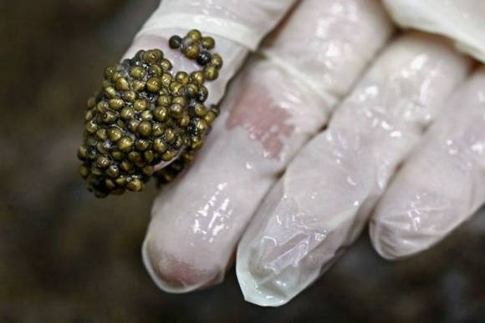

Slide 14





¡Un poco de teatro!
Persona 1: ¿Qué es esto?
Persona 2: No lo sé. Y tú, ¿qué piensas?
Persona 1: ¡No tengo ni idea!

Slide 16
¡Un poco de teatro!
Persona 1: ¿Qué es esto?
Persona 2: No lo sé. Y tú, ¿qué piensas?
Persona 1: ¡No tengo ni idea!

Slide 17
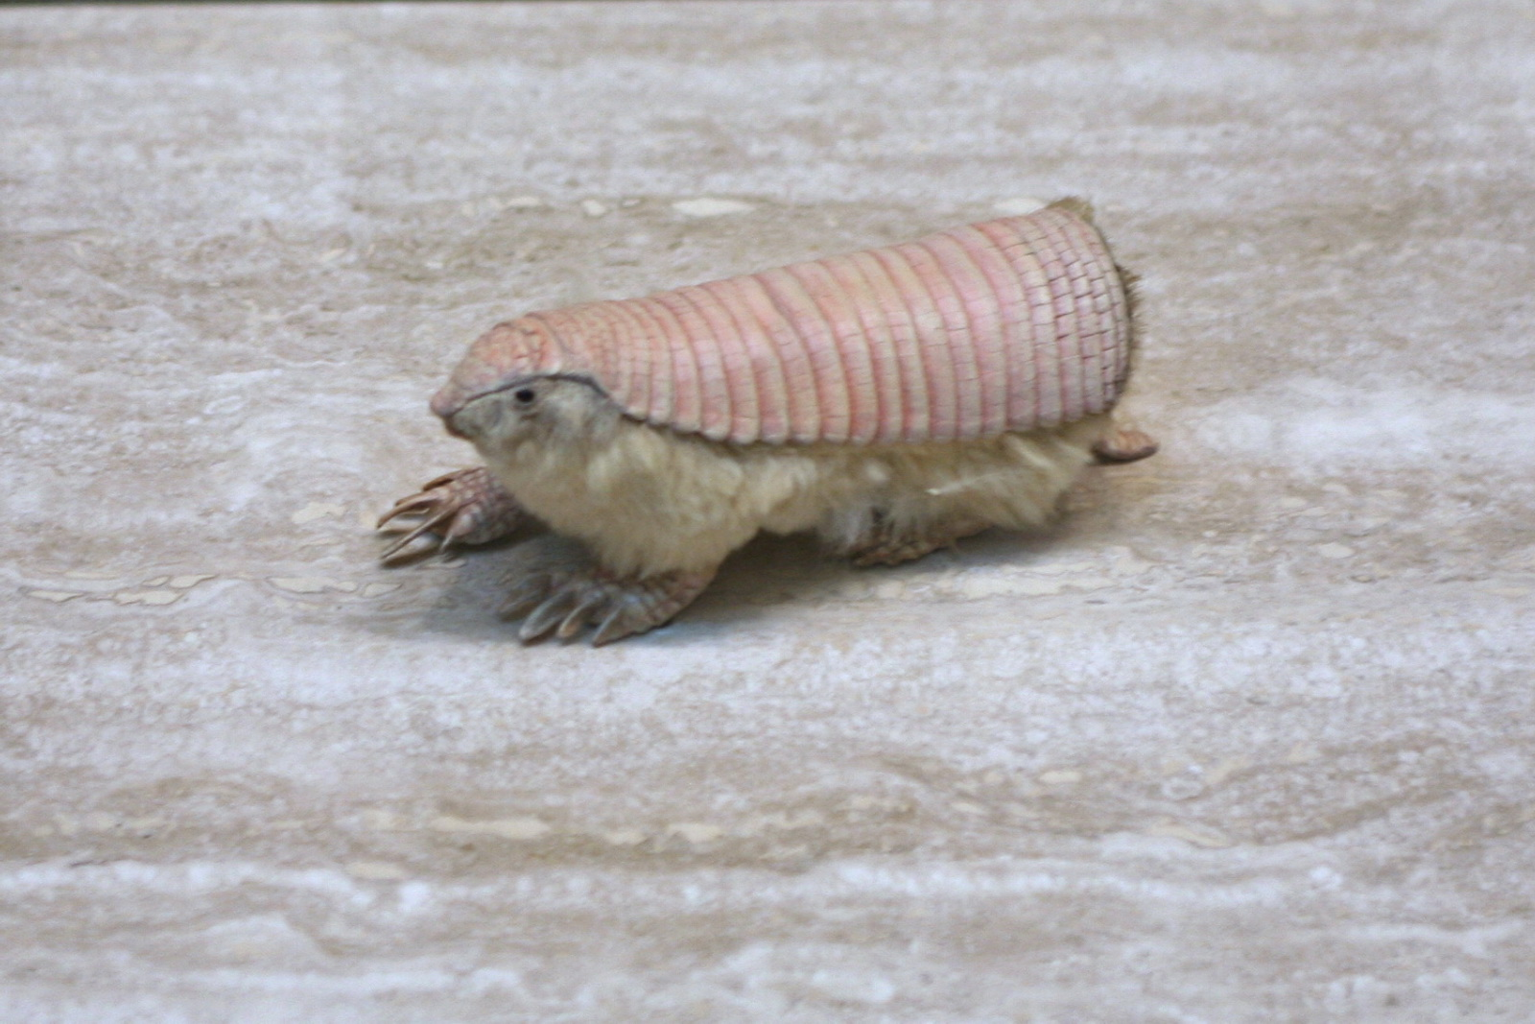

Slide 18
¡Un poco de teatro!
Persona 1: ¿Qué deportes te gustan?
Persona 2: Pues, me gustan mucho los deportes individuales.
Persona 1: ¡Los deportes individuales! ¡Yo prefiero los deportes de equipo!

Slide 19
¡Un poco de teatro!
Persona 1: ¿Qué deportes te gustan?
Persona 2: Pues, me gustan mucho los deportes individuales.
Persona 1: ¡Los deportes individuales! ¡Yo prefiero los deportes de equipo!
Persona 2: A mí me encanta el tenis.
Persona 1: ¿El tenis? Yo prefiero el hockey.

Slide 20
¡Un poco de teatro!
Persona 1: ¿Qué significa realmente la educación?
Persona 2: Pues hombre, son los estudios, no?
Persona 1: Sí, claro. Pero también se trata de los buenos modales.

Slide 21
Comberton Village College
Practising output (fluency , pronunciation, automatization, memory)
Idea 3: Choral gap-fills

Slide 22
En mi tiempo libre me gusta ___________al fútbol. Lo ________ normalmente los martes en el colegio. También _________los fines de semana con mis amigos en el parque. El fin de semana pasado, no ________ porque ________a Londres para ver un partido de Arsenal. ¡___________bomba! El próximo fin de semana_____________ al fútbol otra vez con mis amigos.
jugar
juego
juego
jugué
fui
Me lo pasé
voy a jugar

Slide 23

- ¿Qué más haces para llevar una vida sana?
- Bueno, hago ______________ ejercicio por lo menos ___________ veces a la semana. Generalmente ______________ footing. Ayer hice footing ____________ del colegio y luego a las cuatro ______________ en el equipo de fútbol. Normalmente _____________ hacer deporte en equipo porque es más interesante. Mañana voy a hacer natación con mi padre.

Slide 24
- ¿Qué más haces para llevar una vida sana?
- Bueno, hago ______________ ejercicio por lo menos ___________ veces a la semana. Generalmente ______________ footing. Ayer hice footing ____________ del colegio y luego a las cuatro ______________ en el equipo de fútbol. Normalmente _____________ hacer deporte en equipo porque es más interesante. Mañana voy a hacer natación con mi padre.
mucho
tres
hago
antes
jugué
prefiero

Slide 25
asatiempo
referido
1 | ¿Cuál es tu p_____________ p___________? (What is your favourite hobby?)
2 | ¿C____________ lo empezaste? (When did you start it?)
3 | ¿A____________ a alguien? (Do you admire anyone?)
4 | ¿Tienes una __________ preferida? (Do you have a favourite shop?)
5 | ¿Hay o_______ c____________ que te gustan hacer? (Are there other things you like doing?)
6 | ¿Qué h____________ el fin de semana p____________? (What did you do last weekend?
7 | ¿A____________ fuiste? (Where did you go?)
8 | ¿Qué p__________ tienes para el p__________ f__ de s________? (What are you planning to do next weekend?)
9 | Y tu programa favorito, ¿d__________ tiene l_________? (Your favourite programme, where is it set?)
10 | ¿De qué t___________? (What’s it about?)
11 | ¿Te g_____________ los medios s___________? (Do you like social media?)
12 | ¿Te gustaría p___________ algún deporte o_____________? (Would you like to try an olympic sport?)
uándo
dmiras
tienda
tras
osas
iciste
asado
dónde
lanes
róximo
in
emana
ónde
ugar
rata
ustan
ociales
robar
límpico

Slide 26
1 | ¿Cuál es tu p_____________ p___________? (What is your favourite hobby?)
2 | ¿C____________ lo empezaste? (When did you start it?)
3 | ¿A____________ a alguien? (Do you admire anyone?)
4 | ¿Tienes una __________ preferida? (Do you have a favourite shop?)
5 | ¿Hay o_______ c____________ que te gustan hacer? (Are there other things you like doing?)
6 | ¿Qué h____________ el fin de semana p____________? (What did you do last weekend?
7 | ¿A____________ fuiste? (Where did you go?)
8 | ¿Qué p__________ tienes para el p__________ f__ de s________? (What are you planning to do next weekend?)
9 | Y tu programa favorito, ¿d__________ tiene l_________? (Your favourite programme, where is it set?)
10 | ¿De qué t___________? (What’s it about?)
11 | ¿Te g_____________ los medios s___________? (Do you like social media?)
12 | ¿Te gustaría p___________ algún deporte o_____________? (Would you like to try an olympic sport?)

Slide 27
1 | (What is your favourite hobby?)
2 | (When did you start it?)
3 | (Do you admire anyone?)
4 | (Do you have a favourite shop?)
5 | (Are there other things you like doing?)
6 | (What did you do last weekend?
7 | (Where did you go?)
8 | (What are you planning to do next weekend?)
9 | (Your favourite programme, where is it set?)
10 | (What’s it about?)
11 | (Do you like social media?)
12 | (Would you like to try an olympic sport?)

Slide 28
Comberton Village College
Practising output (fluency , pronunciation, automatization, memory)
Rachel Hawkes
DICE/CHUNKING
Idea 4 Dice/Chunking

Slide 29
Role the dice each time and move left to right through the boxes. Say your phrase out loud. Your partner will use the whiteboard to translate what you are saying. Take it in turns to produce these level 5 speeches.
A
B
C
1 El año pasado 2 El verano pasado 3 Hace dos años 4 Durante las vacaciones 5 En 2007 6 El invierno pasado | 1 fui a España 2 fui a Francia 3 fui a Escocia 4 fui a Norfolk 5 fui a Grecia 6 fui a Italia | 1 con mis amigos. 2 con mi familia. 3 con mis padres. 4 para dos semanas. 5 para una semana. 6 para un mes.
Me gustó mucho porque…….. 1 nadé en el mar 2 visité monumentos 3 descansé 4 jugué al voleibol 5 fui a la playa 6 comí platos típicos | 1 y mandé mensajes. 2 y saqué fotos. 3 y tomé el sol. 4 y bailé en la discoteca. 5 y monté en bici. 6 y escuché música. | 1 ¡Fue genial! 2 ¡Fue guay! 3 ¡Fue fantástico! 4 ¡Fue estupendo! 5 ¡Fue maravilloso! 6 ¡Fue fenomenal!
El año que viene, cuando vaya a España….. 1 voy a ……. 2 me gustaría.. 3 quiero.. 4 tengo ganas de.. 5 tengo pensado.. 6 espero.. | 1 ir de compras 2 ir a la piscina 3 hablar español 4 jugar al tenis 5 montar a caballo 6 acampar | 1 en la playa. 2 con mis amigos. 3 todo el tiempo. 4 todos los días. 5 por la noche. 6 y tomar el sol.
Where you went
Time phrase
Who with?
D
E
F
A second activity
One activity
An opinion
G
H
I
Next year’s plans
What you will do
Extra detail
Notes:
Speaking & memory lesson – instructions for teacher
1 Explain and ‘sell’ the concept of the lesson – students are going to aim to memorise one level 5 speech as a minimum by the end of the lesson. They are going to improve their Spanish speaking AND their memory skills in this lesson. (5 mins)
2 Show the sheet – for most groups the first step will be to take them through the meanings. Allow students to writing in the English meanings by the side of the Spanish if desired. (8 mins)
3 Next model a speech using the dice – display the sheet on the whiteboard as you do so and underline each part as you roll, emphasising the Spanish and repeating the whole speech from the beginning each time you roll so that by the end of 9 boxes you have said the first box part 9 times! This is excellent repetition practice and they will do this without noticing if you model it clearly as you show them what to do. (5 mins)
4 Elicit the English meaning from the students of the speech you have given (either taking oral contributions or on whiteboards) – this is what the partner will do when they do this is pairs so is important to model this part too. (3 mins)
5 Make clear that this is just the first activity and that they have 6 minutes to make as many sentences as they can, taking it in turns each time. (6 mins)
Speaking & memory lesson – instructions for teacher
cont’d
Now explain that you want them to use the scaffolding sheet to write their own 30-second marathon sentence. All will write using a phrase from each of the 9 boxes. (5 mins)
Now the challenge is to use some memory strategies to learn it off by heart. Explain that the first 6 boxes are compulsory (will make about 20 seconds) and adding in the final 3 boxes will be exceptionally good and will be about 30 seconds.
Suggest that one strategy (chunking) is already provided by the sheet itself and that building up the speech ‘chunk by chunk’ repeating each bit that they learnt before should help them to memorise.
Suggest also that they might split their page into 9 boxes.
Write each bit out with just the first letter to prompt in each box
Draw a picture instead of the words in each box
Use look, cover, say, check
Work in pairs to test each other
(5 mins)
Give them 14 minutes to work on their speeches – circulate to support
Plenary – hopefully there will just be time to hear 2 or 3 students ‘perform’ their speeches – plenty of praise at this point.
For homework, set them to work their speech into their longer term memory by repeating some of the activities that have worked for them in the lesson. Say you will begin next lesson by hearing and recording their speeches.

Slide 30
Comberton Village College
Practising output (fluency , pronunciation, automatization, memory)
Rachel Hawkes
VOKIS (or other)
Idea 5 Vokis

Slide 31
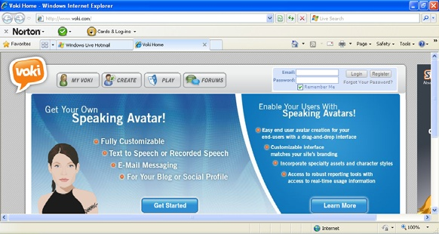
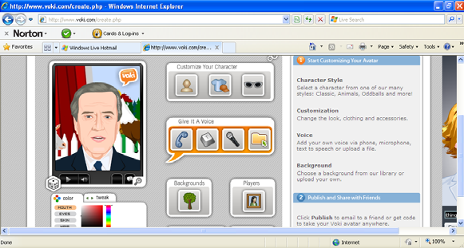

www.voki.com
http://text-to-speech.imtranslator.net/
http://www.cueprompter.com/
http://www.starwars.com/games/playnow/crawl_creator/
Notes:
Vokis are talking avatars. Using this free website you can either record and upload the mp3 audio file OR you can copy/paste corrected TL script and choose a voice to say your words.

Slide 32
Comberton Village College
Practising output (fluency , pronunciation, automatization, memory)
Rachel Hawkes
REVISION / MASTERY
Idea 6 Revision / Mastery

Slide 33
Last year I went on holiday to France with my family.
Notes:
It is hard to get students to use what they have learnt already sometimes. To focus them back on what is in their books, ask them to choose 9 sentences on the theme they have been covering and write them in English, making sure they know how they would be said in the TL (they will have this doubtless in their books). They then get up and go around the class, testing each other. When they find someone who can do a phrase correctly they write their name in one of the boxes next to that phrase. In this version each phrase needs 2 x different names. The plenary activity that follows is for the teacher to do a brief ‘spot check’ asking named individuals to do the phrase they have been signed up for. This gets students to think back to what they have covered and to fix it more deeply in their long term memories.

Slide 34
I am 15 years old
to do WE
to have experience
I would like..
I am called
Hello
m.., s…,E…,S…and a…
in the service industry
I am good at …
I study
at CVC
I am a student
in a hotel in..
because I would like
¿Cómo se dice en español?

Slide 35
Buenos días
8
Tengo facilidad en
1
Me llamo
9
Quisiera
2
10
hacer prácticas
3
Tengo..años
11
en un hotel en
4
Soy estudiante
porque me gustaría
12
5
en el instituto de Comberton
13
tener experiencia
6
Estudio
7
m..c..i..e..y a
14
en el sector servicios
Las respuestas

Slide 36
1 | hello | Buenos días
2 | I am called | Me llamo
3 | I am 15 years old | Tengo quince años
4 | I am a student | Soy estudiante
5 | at CVC | en el instituto de Comberton
6 | I study | Estudio
7 | I study maths, English, science, art and Spanish | Estudio las matemáticas, el inglés, las ciencias, el arte y el español
8 | I am good at Spanish! | Tengo facilidad en el español.
9 | I would like | Quisiera
10 | I would like to do work experience | Quisiera hacer prácticas
11 | in a hotel in Málaga | en un hotel en Málaga
12 | because I would like | porque me gustaría
13 | to have experience | tener experiencia
14 | in the service industry | en el sector servicios
15 | many thanks - bye | Muchas gracias – hasta luego

Slide 37
1 | hello | buenos días
2 | I am helpful | soy servicial
3 | I am hard-working | soy trabajador/a
4 | I am responsible | soy responsable
5 | Last year | El año pasado
6 | I did work experience | hice prácticas
7 | in a hotel in Cambridge | en un hotel en Cambridge
8 | I worked | Trabajé
9 | in the reception | en la recepción
10 | I helped | Ayudé
11 | in the kitchen | en la cocina
12 | I will be available | Estaré disponible
13 | from the 5th | del cinco
14 | al 31st August | al treinta y uno de agosto
15 | Can I stay in the hotel? | Puedo quedarme en el hotel?
Notes:
Speed-dating style test. Assessors face the board, assessees face away.

Slide 38
1 | hello
2 | I am helpful
3 | I am hard-working
4 | I am responsible
5 | Last year
6 | I did work experience
7 | in a hotel in Cambridge
8 | I worked
9 | in the reception
10 | I helped
11 | in the kitchen
12 | I will be available
13 | from the 5th
14 | al 31st August
15 | Can I stay in the hotel?
1 | hello
2 | I am helpful
3 | I am hard-working
4 | I am responsible
5 | Last year
6 | I did work experience
7 | in a hotel in Cambridge
8 | I worked
9 | in the reception
10 | I helped
11 | in the kitchen
12 | I will be available
13 | from the 5th
14 | al 31st August
15 | Can I stay in the hotel?

Slide 39
Comberton Village College
Practising output (fluency , pronunciation, automatization, memory)
Rachel Hawkes
3 – 2 - 1
Idea 7

Slide 40

Johnny Depp est né le 9 juin 1963 à Owensboro dans le Kentucky, aux États-Unis. Il est acteur américain, qui est déjà très célèbre. Il est en couple avec la chanteuse et actrice française Vanessa Paradis et ils vivent en France. Ils ont deux enfants ensemble. En 2010, il a refusé le titre de l'homme le plus sexy de l'année pour servir d'exemple à ses deux enfants.
Notes:
This is just an example. This activity works best when students have written their own paragraph and use it to play a talking game with their partner. This fulfils several purposes. Pronunciation practice with an added motivation. 2 x pairs of eyes concentrating on written work just produced – the chances are that spelling or other errors may be picked up this way. Students can learn from each others work – they may spot useful language that they can use in their own work.

Slide 41

Comberton Village College
Questions

Slide 42
Comberton Village College
Questioning
WHAT ARE THE QUESTIONS
Idea 8: What are the questions?

Slide 43

¿Cuáles son las preguntas?
7. Sí, pero es un poco aburrido.
1. Me llamo Adam.
2. Tengo 15 años.
6. Sí, por supuesto. ¿Y tú?
3. En Cambourne.
5. Sí, me gusta mucho.
4. Sí.
Notes:
43

Slide 44

Quelle est la question?

Slide 45


5 jours

Slide 46
le fromage

Slide 47
Non, merci

Slide 48
les maths

Slide 49
Seulement le lundi!

Slide 50
Harry Potter

Slide 51
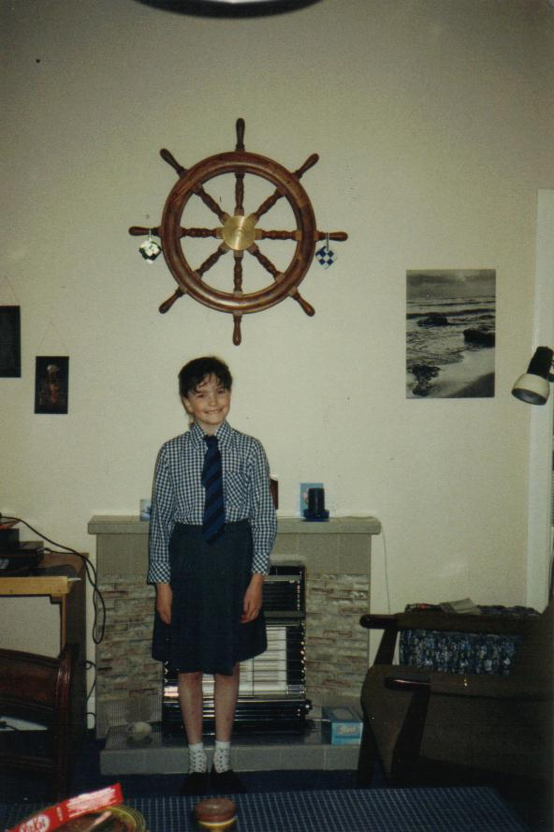
Mein Schultag beginnt um halb neun (1)
Nein. Deutsch ist natürlich mein Lieblingsfach. (2)
Das langweiligste Fach ist Englisch. (2)
Eine gute Frage. Ich finde Mathe nützlicher als Englisch. (2)
Ich habe Grammatik gelernt und ich habe gesungen (2)
Man darf niemanden hänseln oder ärgern (1)
Letztes Jahr war Geschichte sehr langweilig aber dieses Jahr ist es besser. (2)
Ja (5).
Manchmal ist es lustig aber leider ist Mathe oft nur langweilig. (2)
Ich werde immer pünktlich zur Deutschklasse kommen (1)
Nein. Ich muss Hausaufgaben machen (5)
Ich muss Hausaufgaben machen (2)

Slide 52
Deutsch ist schwierig, ja?
Hast du mein Goldfisch genommen?
Wie findest du Mathe?
Das langweiligste Fach ist Geschichte oder?
Magst du Pizzasaft?
Denkst du, dass Alex ist ein bisschen verrückt?
Was hast du in den Ferien gemacht?
Was ist das langweiligste Fach?
Was du in dein letztes Deutschfach gelernt?
Englisch ist interessant, oder?
Möchtest du ins Kino gehen?
Findest du Englisch langweilig, oder?
Später kannst du Schaflaufen ?
Was ist eine Schulregeln?
Warum kannst du nicht mit mir nach Cambridge gehen?
Magst du Geschichte?
Wie findest du Geschichte?
Frau Gillings, ist das du?
Was musst du nächstes Jahr gemachen?
Was musst du am Freitag machen?
Ist Mathe langweilig?
Variety of formulations
Mixture of tenses
Use of statements + oder?
Some more complex question structures
Some mistakes!
Message-oriented
Humour!
Like EFL sessions

Slide 53
Comberton Village College
Questioning
Rachel Hawkes
FIND SOMEONE WHO
Idea 9: Find someone who

Slide 54
Trouve quelqu’un qui………….
1. joue au foot les samedis
2. va souvent au cinéma
3. regarde la télé tous les jours
4. prépare le dîner une fois par semaine
5. adore faire les magasins

Slide 55
Busca a la persona que / a quién…
le gusta Come Dine with Me.
no le gusta Top Gear.
le gusta Factor X.
Notes:
Where we had to start!

Slide 56
Comberton Village College
Questioning
Rachel Hawkes
20 QUESTIONS
Idea 10: 20 questions

Slide 57
20 questions
Have you…?
Do you like…?
How…?
Where…?
Is…?

Slide 58
¿Piensas que …?
Do you think that………..?
Notes:
Could generate a whole variety of questions at any stage!

Slide 59
Comberton Village College
Questioning
Rachel Hawkes
HOT SEATING
Idea 11: Hot seating

Slide 60
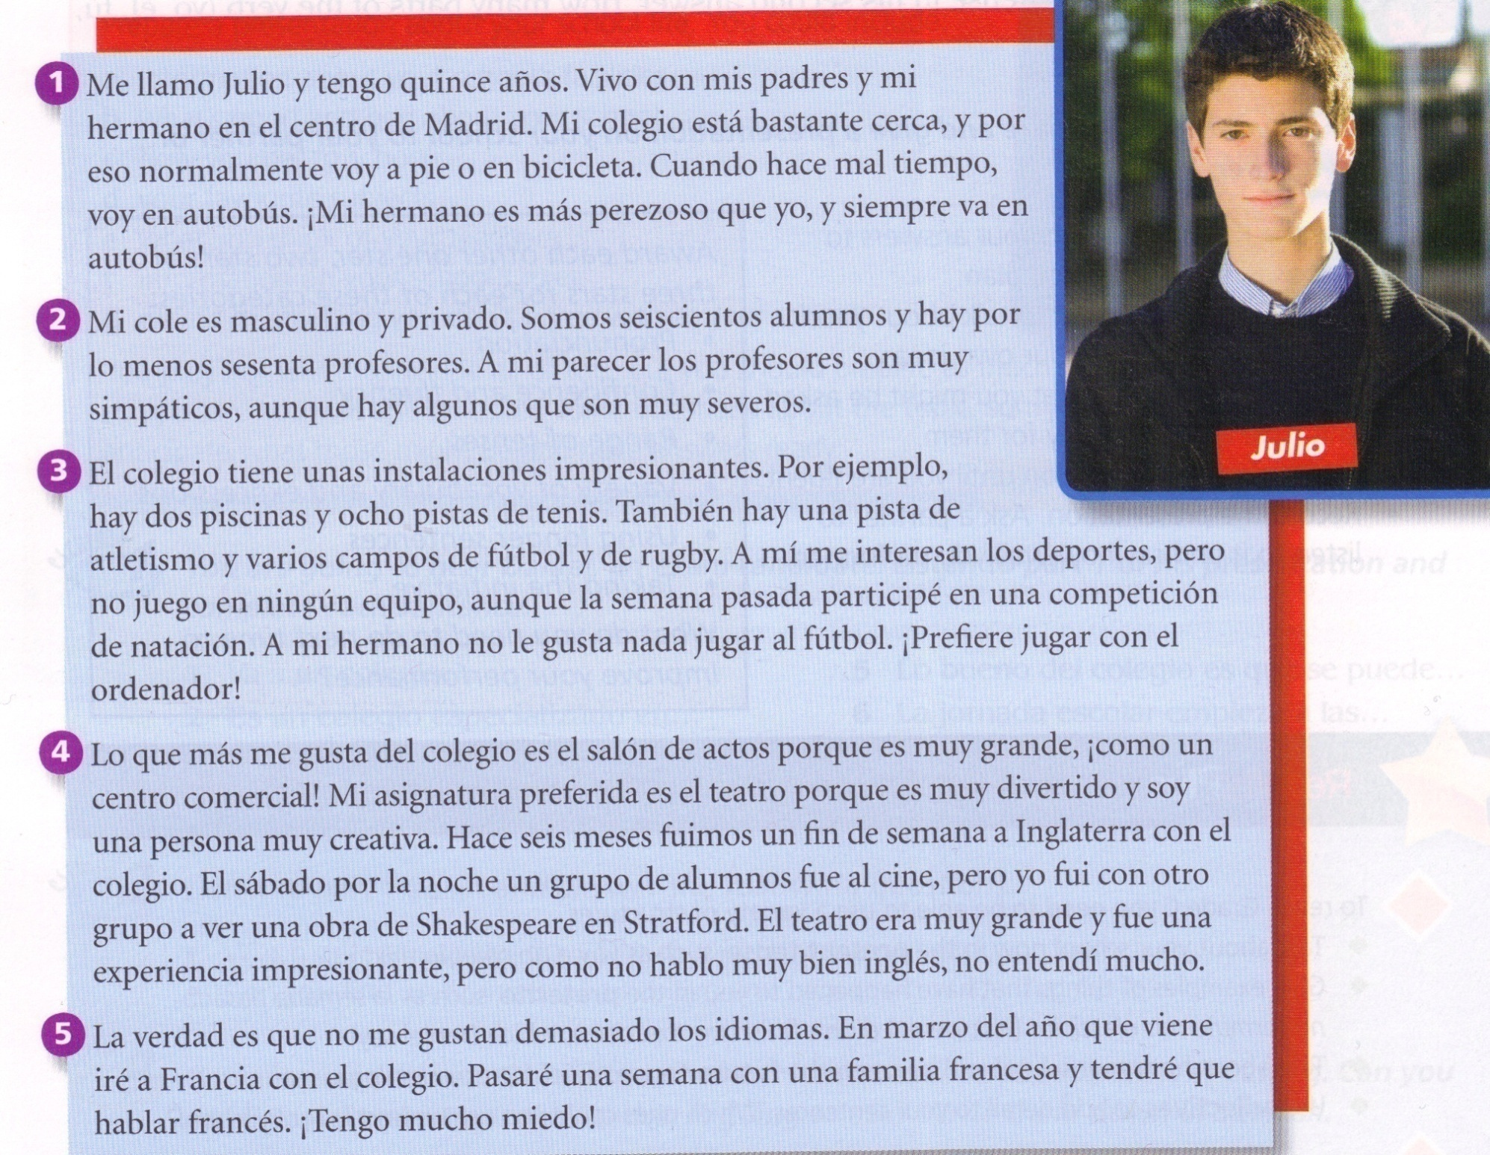
Notes:
Hotseating is for me one of the best ways to exploit some of the reading texts in any KS4 textbook. Here is one example of such a text from the School & Education theme. The idea is that the text, rather than being useful as reading comprehension – it is too straightforward for that really! – does provide some very useful language to be ‘harvested’ by students to help structure their own spoken responses. In this way it provides both the stimulus material for the class to generate questions and for one member of the class (or the group, if you can set this up as a group activity) to be ‘hotseated’ to answer the questions as if s/he were Julio. This particular text lends itself to 5 different ‘hotseats’ so that the role of answerer can be rotated around the group. The rest of the group have to generate questions on the content of the text. The idea is that the answers should ‘use up’ all of the information provided by the text.

Slide 61

Comberton Village College
Manipulating language (Sentence-building, creativity, improvisation)

Slide 62
Comberton Village College
Manipulating language (Sentence-building, creativity, improvisation)
Rachel Hawkes
MASTERMIND +
Idea 12: Mastermind +

Slide 63
El fin de semana pasado
al fútbol
jugué
juego
con los videojuegos
Normalmente
El próximo fin de semana
voy a jugar
al tenis
¿Cómo se dice en español?

Slide 64
juego
El fin de semana pasado
al tenis
voy a jugar
al fútbol
Normalmente
con los videojuegos
El próximo fin de semana
jugué
¿Cómo se dice en español?

Slide 65
juego
El fin de semana pasado
al tenis
voy a jugar
al fútbol
Normalmente
con los videojuegos
El próximo fin de semana
jugué
+ detalles / + opiniones / + razones

Slide 66
Comberton Village College
Manipulating language (Sentence-building, creativity, improvisation)
Rachel Hawkes
TARGET TALK
Idea 13: Target talk

Slide 67

¿Qu’est-ce que tu as fait le weekend dernier?
Your answer must contain EXACTLY 7 words!
¿Qu’est-ce que tu as voulu faire?
Your answer must contain more than 9 words!
Notes:
The conditions or ‘targets’ can be many and varied. It ALMOST doesn’t matter as the point of putting a condition there is to cause students to think their sentences through carefully as they build them. It makes them much more aware of what they’re saying. And making a sentence of exactly 8 words will involve usually a very short clause with ‘weil’ or two clauses linked with ‘und’ or additional details like when and where. So they focus on different ways to make their sentences longer. It also works well to set >9 words or <5 words at times too.
67

Slide 68

Comberton Village College
Manipulating language (Sentence-building, creativity, improvisation)
Rachel Hawkes
PIMP MY SENTENCE
Idea 14: Pimp my sentence

Slide 69
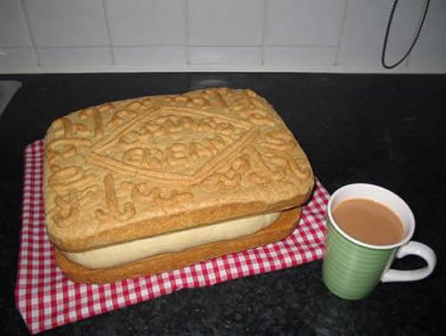
Pimp my sentence!
Je joue au tennis.
J’habite au nord de l’Angleterre.
Mon chien s’appelle Bob.

Slide 70
Comberton Village College
Manipulating language (Sentence-building, creativity, improvisation)
Rachel Hawkes
SAY SOMETHING ELSE
Idea 15: Say something else

Slide 71
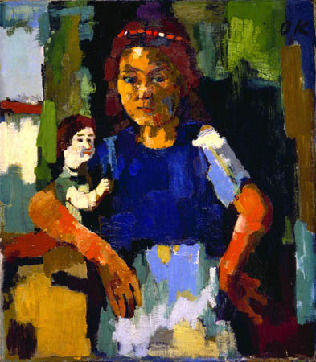
1. Das Mädchen ist zwanzig Jahre alt.
2. Es trägt ein schwarzes Kleid.
3. Es ist in der Küche.
4. Das Mädchen ist faul.
5. Es hat schwarze Haare.
6. Das Zimmer ist schwarz und weiβ.
7. Die Puppe ist glücklich und sehr groβ.
8. Ich finde das Bild fantastisch.
Sag etwas anders!
Notes:
Here learners need to change a detail or more in each sentence to say something different about the picture. The sentences give support to learners as they try to build sentences without writing preparation time.

Slide 72


HAVE I GOT NEWS
FOR YOU
Hinesh, 14ans, va
jouer pour…
Chloe admet: Je fume…cigarettes
par jour
Selon Adam, Alex a acheté des
chocolats...
Abir fait… tous les jours, dit James.

Slide 73
Comberton Village College
Manipulating language (Sentence-building, creativity, improvisation)
Rachel Hawkes
ODD ONE OUT
Idea 16 Odd one out

Slide 74



Slide 75
1908
1992
2012
1948
Notes:
Pilla al intruso. Students may say anything from ‘2012 porque es futuro y los otros son pasados’ or ‘2012’ porque son ‘dos mil’ y los otros son ‘mil novecientos’. My answer is ‘1992’ porque los juegos olimpicos tuvieron lugar en Barcelona y los otros en Londres.

Slide 76

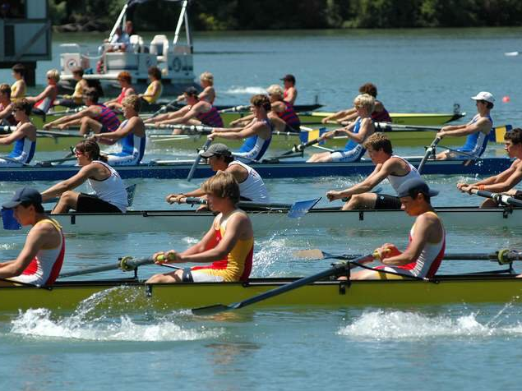
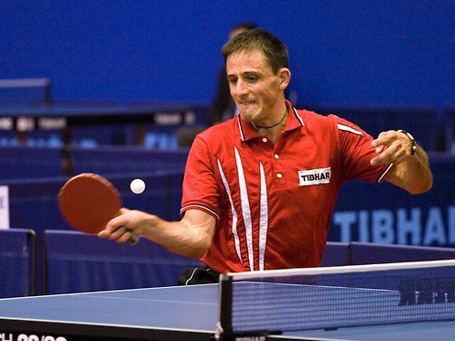
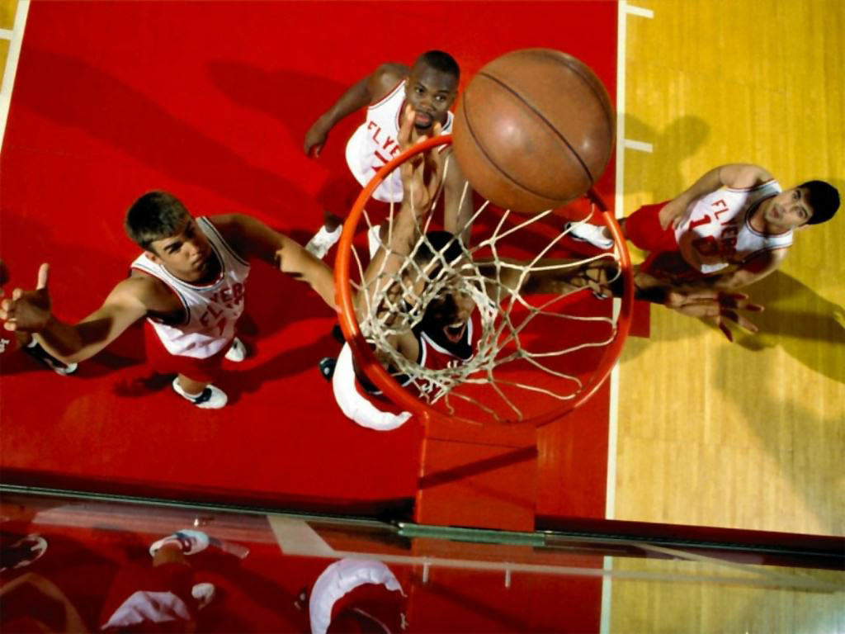
Notes:
Pilla al intruso. El hockey, el remo, el tenis de mesa o el baloncesto. El remo porque es el unico que necesita agua? El remo porque los otros tienen pelotas? El tenis de mesa porque es el unico deporte individual – los otros son deportes de equipo?

Slide 77
Comberton Village College
Manipulating language (Sentence-building, creativity, improvisation)
Rachel Hawkes
READING IMAGES
Idea 17 Reading images

Slide 78

Notes:
Reading images – a way to stimulate creative sentence-building, recycling of known languages in a new context and spontaneous responses. This can be a short or long a task as required, and the teacher can vary questions accordingly. A routine for this picture could be:
¿Cómo se llama esta chica? ¿Cuántos años tiene? ¿Es mayor o menor que vosotros (o la misma edad? ¿Qué tal está? ¿Tiene problemas? ¿Por qué? ¿Qué quiere hacer? ¿Qué tiene que hacer? ¿Qué le gustaría más hacer? ¿Qué planes tiene para el fin de semana?

Slide 79







Qu’est-ce que Laura va faire pendant les vacances?
Qu’est-ce qu’elle ne va pas faire?
Notes:
This is a simple set of picture prompts for future holiday plans narrative. However, it can be turned into a much more creative and interesting activity if you ask what Laura is not going to do, to see, to eat, to visit, who she’s not going to go with etc... Learners have all the language they know available to them with this question and there can always be more to say!

Slide 80

Cubo de basura
¿Qué vas a tirar?
¿Por qué?
Notes:
http://www.muchosgifs.com/1a1a1a/hogar/cubos/basura25.gif

Slide 81
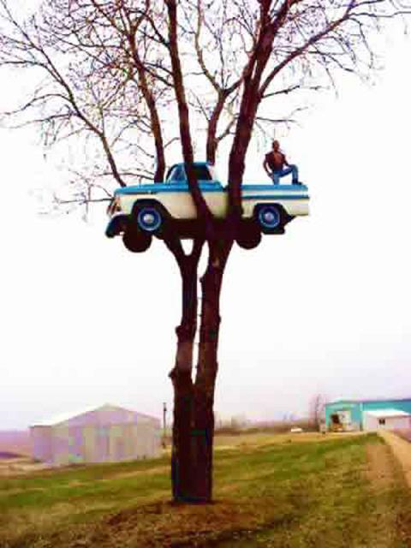
Qu’est-ce qu’il veut faire?
Qu’est-ce qu’il peut faire?
Was wird jetzt passieren?
Wo ist das?
Was ist gleich passiert?
Was sieht man im Foto?
Wer hat das Foto genommen?
Was sieht man nicht?

Slide 82

¡Atasco!
¿Adónde ibas?
¿A qué hora saliste de casa?
¿Cuánto tiempo llevas esperando?
¿Qué harás mientras sigues esperando?
Notes:
http://www.cosasdemotor.es/images/novedades_ley_de_trafico.jpg

Slide 83
Comberton Village College
Manipulating language (Sentence-building, creativity, improvisation)
Rachel Hawkes
DEFINITIONS
Idea 18: Definitions

Slide 84
el atletismo
la hípica
el tenis de mesa
el bádminton
el hockey
el tiro
el baloncesto
el judo
el tiro con arco
el balonmano
la lucha
el triatlón
el boxeo
la natación
la vela
el ciclismo
pentatlón moderno
el voleibol
la esgrima
el piragüismo
el fútbol
el remo
la gimnasia
el taekwondo
la halterofilia
el tenis
Notes:
If time allows, here are the other olympic sports to practise pronunciation of. Note that halterofilia is weightlifting, hípica is equestrian. Hockey is pronounced is a rather english fashion (with the ‘h’ and rhyming with okay) and judo is pronounced ‘you-do’

Slide 85

¿De qué deporte se habla aquí?
1. Es el deporte más popular en Inglaterra y en España.
2. Es un deporte individual que es popular en Inglaterra, que se hace cerca del agua.
3. Es un deporte de equipo que se juega con una pelota y se puede jugarlo en la playa.
4. Es un deporte acuático y olímpico en el cuál ganó medalla de oro Rebecca Adlington en Beijing.
5. Es un deporte que originó en Inglaterra en una ciudad que lleva el mismo nombre.
6. Es un deporte individual cuyo objetivo es subir.
7. Es un deporte que es como una mezcla entre el fútbol y el baloncesto.
Rachel Hawkes

Slide 86
Es un deporte ... | It’s a..........sport | que se juega/se hace.... | ...that you play/do...
de equipo/individual | team/individual | con una pelota | with a ball
de combate | combat | en una cancha | on a court
acuático | water | con ...jugadores | with....players
olímpico | Olympic | sobre/en el agua | on/in the water
popular (en/con) | popular (in/with) | Es un deporte que... | It’s a sport that...
muy caro/barato | very expensive/ cheap | (no) me guesta porque... | I (don’t) like because...
emocionante/aburrido | exciting/boring | Es como una mezcla entre........ y.. | It’s like a mixture between.... and....
Rachel Hawkes

Slide 87
Comberton Village College
Manipulating language (Sentence-building, creativity, improvisation)
Rachel Hawkes
THEN AND NOW
Idea 19 Then and now

Slide 88
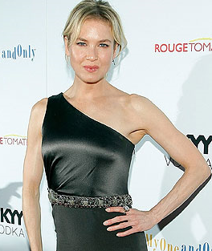
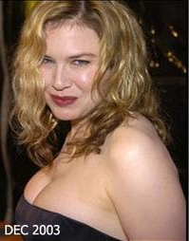
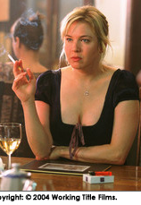
Antes…. | Ahora…
Cuando jugaba el papel de Bridget Jones… | Hoy en día …
Notes:
I used this after revising present and imperfect talking about healthy lifestyles so they could relate that
back to what they eat/drink.
I remember the girls being particularly enthusiastic, but the boys as well were quite quick to talk about era gorda porque comía muchas patatas fritas/comida rápida etc, no hacía deportes, era perezosa
Some also brought back in quite a lot that we had previously done on sports and related that in, so they started off with era gorda/es delgada but then extended into why - they just made it up obviously!
Using vocabulary they knew from talking about their own free time.

Slide 89
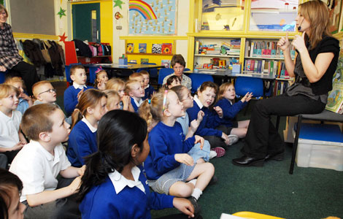

À mon école primaire, il y avait… | À mon école secondaire, il y a…

Slide 90
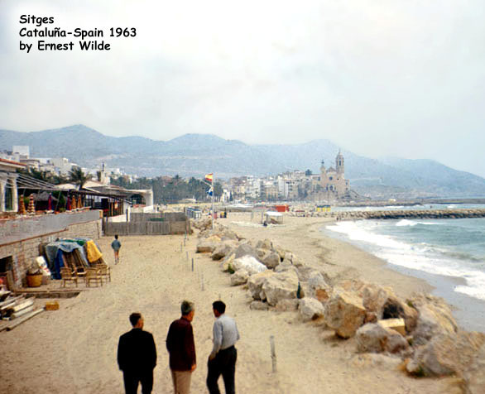
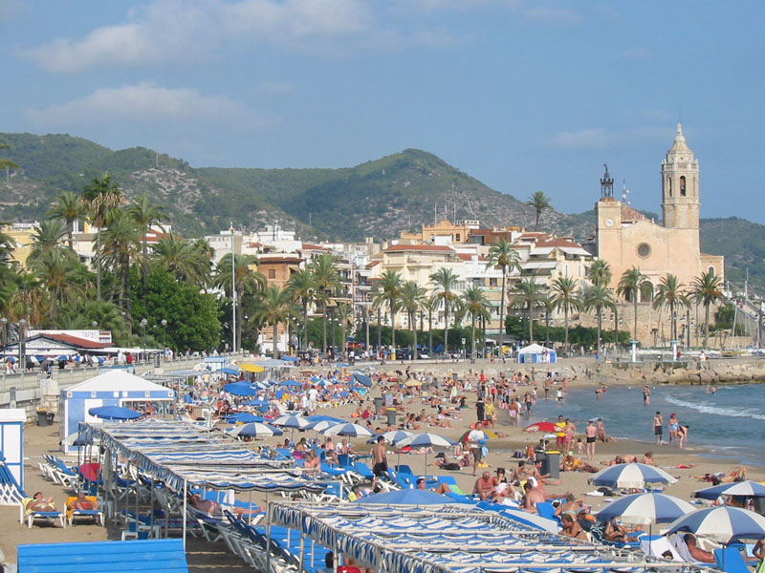
Sitges
Cataluña, Spain 2009
Hace 50 años, había más rocas en la playa. | Hoy no hay rocas en la playa.

Slide 91
Comberton Village College
Manipulating language (Sentence-building, creativity, improvisation)
Rachel Hawkes
MIND MAPPING
Idea 20 Mind mapping
Notes:
This is an idea to get students to make links between language they learn and use in one topic in further topics. For example, when finishing the theme of holidays, students should be encouraged to do a mind map of key language, focusing on the verbs and sentences starters that they have practised and learnt during that topic. Then they should be given a new piece of paper and told the new theme. Their first task is to take all of the language they know from the context of holidays and adapt it to the new context. So, for example, I used to go on holiday to France can become I used to go to Milton Primary School. We went on holiday to Mallorca can become we went on an excursion to Alton Towers theme park with the school. It’s a very visual and practical way to get students to take stock of what they know already before starting a unit, so they never feel that they are beginning from scratch. If preferred, they could actually cross out the holidays related vocabulary and write the new possibilities (e.g. school/world of work) over the top.
This type of activity could also be done in different ways i.e the teacher could present them with a list of language from the holidays theme and they could highlight any language that they could use in the new theme.

Slide 92
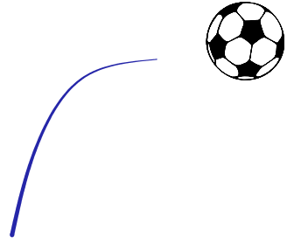


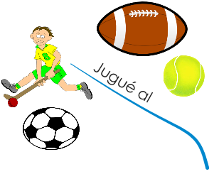


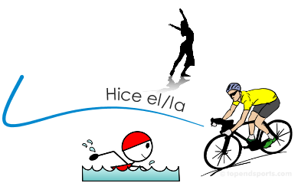

















Slide 93
Cada equipo tiene dos laterales, dos extremos, un centro, un pivote y un portero.
Se juega en una cancha del balonmano, que tiene 20 de 40 metros.
El objetivo es meter goles en la portería contraría, pero se necesita también defender la portería propia.
KS4
El Balonmano
Hay dos tiempos de 25-30 minutos cada uno durante un partido. Hay tambien un descanso de 10 minutos a mediados del partido.
Hay una área de 6 metros delante de cada portería que todos los jugardores sino el portero no deben pisar.
Tiene mucho en común con el baloncesto y el fútbol.
Danny McNamee 10T
Notes:
93

Slide 94

Comberton Village College
Increasing interactivity (spontaneity, sustaining the flow, intonation) Questioning
Rachel Hawkes
SPEAKING LINES/SPEED DATING
Idea 21 Speaking lines / Speed dating

Slide 95
Buenas vacaciones
KS4
A
Be prepared to answer questions about:
where you went on hoilday
how long you spent there
what the hotel was like
what the weather was like
B
Be prepared to answer questions about:
when you went on holiday
where you stayed
what there was in the hotel
what you did
Ask your partner these questions:
¿Cuándo fuiste de vacaciones?
¿Dónde te alojaste?
¿Qué había en el hotel?
¿Qué hiciste?
! ¿Adónde te gustaría ir en tus próximas vacaciones?
Ask your partner these questions:
¿Adónde fuiste de vacaciones?
¿Cuánto tiempo pasaste allí?
¿Cómo era el hotel?
¿Qué tiempo hizo?
! ¿Adónde vas a ir en tus próximas vacaciones?

Slide 96
Unplanned speaking strategies
Repeat back a couple of words of the question with raised intonation.
When you are beginning to run out of flow, ask a question!
Keep talking for as long as you can – it’s always easy to add in an example or an opinion.

Slide 97
Speaking spontaneously
Content and response (/18)
Detailed and relevant
Interacts (very) well
Speaks confidently (and with spontaneity)
(Frequently) takes initiative and develops elaborate responses
(very) little (/no) hesitation
Able to deal with unpredictable elements (without difficulty)
Range of language (/6)
Range of vocabulary and structures (some complex structures)
Unambiguous tenses (consistently competent)
Extended sentences
Accuracy (/6)
Generally accurate
Errors in more complex structures
(Consistently) good pronunciation and intonation
Notes:
Key points from Edexcel mark scheme for 2nd band marks (12-15;5;5)
Information in brackets is for top band marks (C&R: 16-18; RoL: 6; A: 6)

Slide 98
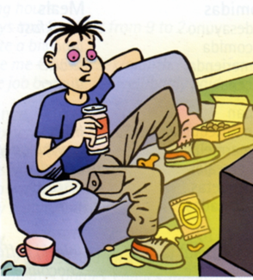
Est-ce que tu regardes la télé tous les
jours?
Quelle sorte d’émission préfères-tu?
Quel est ton émission préférée?
Qu’est-ce qur tu as regardé à la télé
hier soir?
Qu’est-ce que tu vas regarder ce soir?
Est-ce que tu lis une magazine
souvent? Quelle magazine préfères-
tu?
Est-ce qu tu vas au cinéma souvent?
Quel genres de film préfères-
tu?
Listen to the question VERY carefully
Buy yourself time with a ‘hesitation’ word
Think of something you know you can say quickly – e.g. Repeat back a couple of words of the question with raised intonation - Tous les jours?
Use what you know how to say
Keep talking for as long as you can – it’s always easy to add in a ‘par exemple’ or an opinion
When you are beginning to run out of flow, ask a question! (Et toi?)
Use other ‘help’ to get your message across well – i.e. Expression, emotion – sound like you mean it + facial expressions + body language + gestures
Don’t worry about any mistakes – keep talking!
Notes:
Here is the pair work task. This sheet is printed out and cut down the middle so that the respondent does NOT see the questions. S/he has to try to make this into a conversation though and is encouraged to ask questions back to their partner, who will therefore also need to be listening carefully and be ready to respond.

Slide 99
Education
1. Welche Fächer machst du? Was ist dein Lieblingsfach?
2. Beschreib deinen idealen Lehrer.
3. Wie lange studierst du jeden Tag?
4. Beschreib einen typischen Schultag.
5. Hast du Verantwortungen in der Schule?
6. Ist deine Schule gut?
7. Wann du mit deinem Studium hier fertig bist, was wirst du studieren? Wo? Warum?
8. Auf was wirst du dich spezialisieren?
9. Was für Arbeitserfahrung hast du?
10. Deiner Meinung nach,was sind die Unterschiede zwischen deiner Schule und einer deutschen Schule?
Notes:
I’ve put a whole range of discussion questions on this slide that would fit broadly into the theme of school and education – it might not be appropriate to have them all at once but it should be possible to build up to these, taking perhaps 3 per lesson to practise in a speaking line/speed-dating activity.

Slide 100
Comberton Village College
Increasing interactivity (spontaneity, sustaining the flow, intonation) Questioning
Rachel Hawkes
SPEND THE WORDS
Idea 22 Spend the words

Slide 101
hier | mais | À mon avis | Je pense que
le weekend dernier | Ce que je trouve intéressant, c’est.. | Par exemple | Avant de…
parce que | Je voudrais | Je préfère | Je suis allé(e)
Notes:
These words/phrases are on cards and they are divided up equally between the pair or small group. Then a topic is given and the students have to try to ‘spend’ their cards naturally in conversation on the given topic.

Slide 102

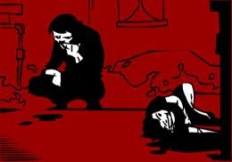
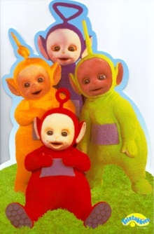



Me gustan mucho | tiene lugar en | Mi programa preferido
entretenido (a/os/as) | son | Prefiero
porque | trata de | No me gustan tanto
A mi madre | una telenovela | tonto (a/os/as)

Slide 103
Spend the Words
Take it in turns to ask and answer the same questions as before. This time, rather than speaking for as long as you can, you need to try and include the words below and ‘spend’ the words as you answer your 5 questions. Your partner will cross them off as you use them and you need to do the same for your partner. The first to use up all the words is the winner.
um...zu... | schwerer als | leicht | aufstehen | es würde...geben
man darf (nicht/kein(e)) | wir müssen | streng | nicht leiden | Mobbing
dreckig | meiner Meinung nach | AGs | ...fällt mir/fallen mir | gestern
letzte Woche | Deutschland | Schulregeln | weder…noch… | können
Mittagspause | gute Noten | vielleicht | Schuluniform | Gang

Slide 104
Comberton Village College
Increasing interactivity (spontaneity, sustaining the flow, intonation) Questioning
Rachel Hawkes
JUST A MINUTE! (GROUPS)
Idea 23

Slide 105

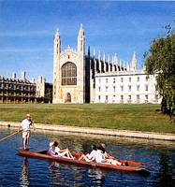


1
2
3
4
5
6
20
7
19
8
17
9
16
15
14
13
12
11
10
Notes:
A Keep Talking for 1 minute game. Can do this in groups but direct from the front. Click on ? To roll the dice. A player from each group then has to talk for 1 minute on that theme. 1 member of each group has a stop watch to time and others listen to make sure they keep talking. In this way, all engaged simultaneously.

Slide 106
1
2
3
opinión
normalmente..
pasado
futuro
porque
pregunta
4
5
6
Notes:
Although this could work as a whole class activity, this version where talking for one minute is the aim I think it works best in groups (up to 6 in one group). Each person chooses a category, tries to talk for one minute (one of group has stop watch) and they can colour in the coloured segment if they manage it. If the teacher chooses to display this on data project, each segment is triggered so if you click on it it turns the colour as indicated on the key in top left of the slide.

Slide 107
Comberton Village College
Developing quality (Assessing, improving, enhancing, modelling)
Rachel Hawkes
BINGO
Idea 24 Bingo

Slide 108
Opinion | Present | Future
Reason | Time expression | Comparison
Complexity | Past | Reference to others
Rachel Hawkes
Notes:
Given a specific topic to talk about (or a set of questions if appropriate), students have to try to include each thing from the Bingo grid. When they do, they cross off the box and in their pairs, it’s the first person to cross everything off who wins (full house).

Slide 109
Comberton Village College
Increasing interactivity (spontaneity, sustaining the flow, intonation) Questioning
Rachel Hawkes
GROUP TALK
Idea 25

Slide 110

Es ist toll!
¡Es ist schrecklich!
Ich mag das (nicht)!
Wie findest du das?

Ja, das stimmt!
¡Nein, das stimmt nicht!
Ich auch!
Ich nicht!
X
X
X
Du bist verrückt!
Ich denke...
Gracias @ Greg Horton
Notes:
Year 7 Talking frame
110

Slide 111




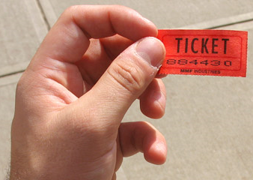
Comberton Village College
Increasing interactivity (spontaneity, sustaining the flow, intonation) Questioning
9Rachel Hawkes
REWARDING SPONTANEITY
Idea 26

Slide 112


Comberton Village College
Increasing interactivity (spontaneity, sustaining the flow, intonation) Questioning
Rachel Hawkes
DEBATE
Idea 27 Debate

Slide 113
Los debates
This term we will have 8 short debates. Each person will have one debate where s/he defends the motion and one where s/he attacks it. For the other 6 debates, s/he will have the role of either supporting or criticising the argument, through questions, discussion, and giving opinions. Everyone must have prepared enough to talk in every debate. Each person only has the major preparation role twice this term and will make a presentation of 2-3 minutes laying out their arguments for or against the motion. Then there will be some discussion (up to 10 minutes) and finally a vote.
Week/Date | Motion | Defending | Attacking
Wk 2 Thurs 12 Jan | “Un buen profesor es un profesor estricto”. | Maria (Martha, Eden, Sofie) | Freddie (Eddie, Kate, Molly)
Wk 3 Thurs 19 Jan | “No hace falta aprender los idiomas extranjeros porque todo el mundo habla inglés.” | Martha (Eddie, Freddie, Molly) | Kate (Maria, Eden, Sofie)
Wk 4 Thurs 26 Jan | “El sistema educativo español es mejor que el sistema inglés.” | Eddy (Kate, Eden, Maria) | Molly (Martha, Freddie, Sofie)
Wk 6 Thurs 9 Feb | “La educación separada no es una educación buena.” | Sofie (Eddie, Molly, Kate) | Eden (Freddie, Martha, Maria)
Wk 9 Thurs 8 Mar | “Más vale la pena trabajar que estudiar.” | Freddie (Molly, Martha, Eden) | Maria (Eddie, Kate, Sofie)
Wk 11 Thurs 22 Mar | “Hay que controlar la venta de ropa barata para proteger a los niños del tercer mundo.” | Molly (Martha, Kate, Sofie) | Eddy (Freddie, Eden, Maria)
Wk 12 Thurs 29 Mar | “Los que no trabajan no merecen ayuda del Estado.” | Eden (Maria, Freddie, Molly) | Sofie (Martha, Eddy, Kate)
Wk 1 Thurs 18 Apr | “La descriminación laboral ya no existe”. | Kate (Sofie, Eddy, Molly) | Martha (Eden, Maria, Freddie)

Slide 114
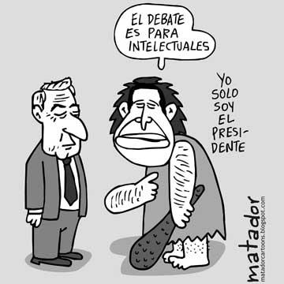
Un debate es una técnica, tradicionalmente de comunicación oral, que consiste en la discusión de opiniones antagónicas entre dos o más personas sobre un tema o problema.
Tema del debate:
“un buen profesor es un profesor estricto”

Slide 115
Si te entiendo bien, piensas que..
Tienes toda la razón
pero no es verdad..
Has dicho que ….pero
¡ni hablar!
En mi opinión
¡En absoluto!
Estoy totalmente de acuerdo
Bueno, depende
Notes:
To encourage students to respond to each other’s ranking suggestions

Slide 116
Comberton Village College
Developing quality (Assessing, improving, enhancing, modelling)
Rachel Hawkes
MODELLING
Idea 28

Slide 117
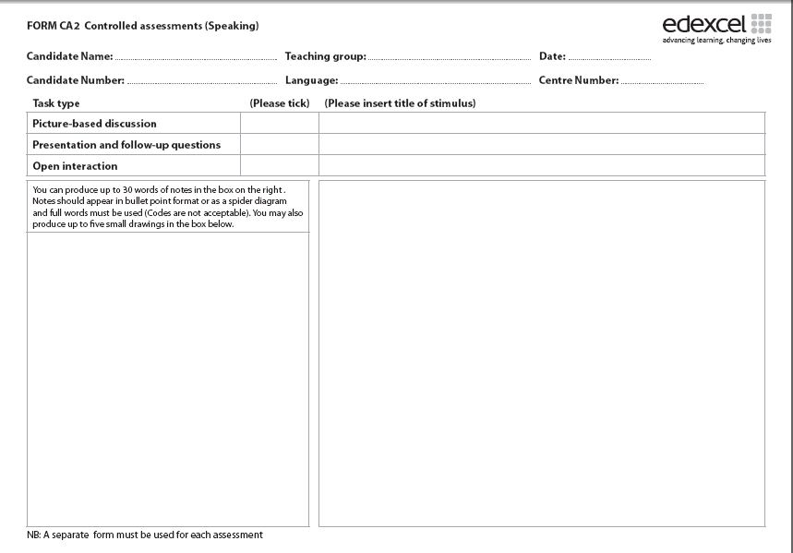
Prácticas laborales
escuela
horas de trabajo
primer día
no ganaba
ayudar a
jugaba
más me gustó
buena experiencia
trabajo a tiempo parcial
futuro
bachillerato
gente
al extranjero
no tengo ganas..
1. Students can generate possible questions to ask (if this is the prompt sheet).
2. They can answer the questions as if they were this person.
3. They can prepare a prompt sheet for a different topic.

Slide 118
Write a short presentation about one hobby. Use this one as a model.
Otra actividad que me gusta es hacer el footing. Me gusta porque es bueno para la salud y es relajante.
Me encanta cantar. Canto todos los días en casa y a veces en conciertos en el colegio o en la iglesia.
¿Cuándo?
¿Dónde?
cantar
¿Otra actividad?
Me encanta cantar porque es divertido y relajante y también porque me gusta la música.
¿Admiras a alguien?
¿Por qué te gusta?
Admiro mucho a Maria Callas que fue una cantante de opera muy famosa. También admiro a Adele porque tiene mucho talento y mucho éxito.
Empecé a cantar cuando tenía 5 años.
¿Cuándo empezaste? (When did you start?)

Slide 119
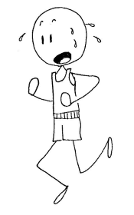



Otra actividad que
Todos los días
a veces
Admiro a
éxito
porque
también
me dan
el fin ..pasado
hice
el próximo …
voy a
entretenido
tiene lugar
trata de
Empecé
tenía

Slide 120
Grade changers
Vary your adjectives (don’t repeat ‘intéressant / ennuyeux’!)
Extend and justify opinions with ‘parce que’
Refer to others (s/he – we – they)
Compare then and now
Describe things with 5 details
Use 5 different verbs in the past (J’ai fait beaucoup de choses: par ejemple…)
Link and narrate (Tout d’abord….puis…ensuite…finalement)
Use ‘pour’ to extend (Je suis allée a Londres pour faire du shopping)
Use ‘I wanted but I couldn’t, so I…’ (Je voulais aller au cinéma mais je n’ai pu pas, alors j’ai regardé un film chez moi)
Refer to the future (Je vais…/Je veux…/Je voudrais…/J’ai l’intention de…/J’espère…)
Notes:
You will have heard your teachers talk about these already I’m imagining. They may not have displayed them in a list quite like this, but these are 10 essential things that, once you’ve learnt to do them with confidence, will make you a better speaker of the language and will also change your grade in speaking
Some core grade changers from D → C and C→ B. If students manage all of these with confidence, good pronunciation and intonation their performance will most likely be at B grade, if ½ to ¾ then a secure C. It is fine to tell them this.
Apart from on a ‘one-off revision day’ this list is of much more use to the teacher to aid planning over the long term (from Y7 as the first 3 start then…) – there should be no need for this to just become a focus of teaching in KS4 when we look at controlled assessment.
Certain things can just be routine from as early on as when they encounter the structures involved.
On the specific speaking days we looked at one particular activity to promote each of these, but the strategies shared in the session above can all be made to serve this purpose too, and there’s greater variety in the strategies presented in the session than you will see in the Speaking Day sessions, which were necessarily intense and compact.

Slide 121
Comberton Village College
Reflection
Think of perhaps 2 tasks or strategies for speaking that could be incorporated into your KS4 lessons over the next two weeks. Make a brief note of them and the topic you will need them to fit into.
Rachel Hawkes

