Slide 1
Comberton Village College
Wednesday 4 July Outstanding teaching and learning in GCSE Spanish Strategies for successful and motivating teaching at KS4
Rachel Hawkes

Slide 2
Comberton Village College
10.15am Developing speaking skills: motivation and success 11.30am Morning coffee 11.45am Writing skills: independence and achievement • Manipulating language • Variety and range • Accuracy 1.00pm Lunch 2.00pm Listening, reading and vocabulary Developing knowledge and skills using authentic materials 3.15pm Working tea-break 3.30pm Evaluation and close
Rachel Hawkes

Slide 3
Listening and Reading
Integrate the 4 skills as much as possible (L & S, R & W, but also R & S) Include authentic material for variety but also difficulty of language Allow for choice of task wherever possible Make opportunities for collaborative work in L & R
Rachel Hawkes
Comberton Village College
Key points
See handouts of Listening and Reading strategies

Slide 4
Comberton Village College
Listening
Causes most anxiety Always feels like a test Most challenging for lower ability But…certain top set students also fear it
Rachel Hawkes
Notes:
Listening is vital for language learning. It is a source of language input, the decoding of which is believed by most to account to a large extent for language acquisition. But for learners it is often the activity that causes most anxiety. You can often detect a powerful change in the atmosphere in a languages classroom when a listening activity is announced and then in progress. So often students ask ‘is it a test?’ when you start a listening activity, presumably because this is how it feels to them. I’ve never been asked that about a reading activity. It is true that it’s most often the lower ability that find it the most scary and demotivating but there are a significant number of students in top sets that struggle with listening.

Slide 5
Comberton Village College
Listening – whole class
Listening (with confidence and perseverance) 1. In pairs 2. Answers first 3. Ordering cards ‘Running listening comprehension’ 5. Visual listening (YouTube, BBC online clips, adverts) 6. Songs 7. Listening → speaking 8. Produce own listening assessment
Rachel Hawkes
9. All speaking (when spontaneous) is listening
10. Pre-teach key language
11. Repeat listening tasks
Notes:
In whole class teaching situations I think there are lots of things we can do to make listening more effective and more enjoyable. By more effective I really mean less scary, because fear is not positively correlated with either motivation or progress! Some favourite ideas for this involve a slight twist on the usual format of playing a CD, individual work answering questions. 1. Learners work in pairs and listen for alternate number answers and then share their answers before listening a second time. On feedback their approach is “we think that no. 1 is.....”
2. Give the answers first and ask learners to anticipate (written or orally) what language they will hear (even scripting a suggested dialogue/monologue). When they listen, they compare what they’ve anticipated with the audio material.
3. Learners respond to material heard by ordering cards. The focus can be the on structures, where learners sort the activity cards into columns to denote present, past or future or opinions, where the categorising is into positive and negatives or simply on the order in which the items on the cards are mentioned in the passage.
4. Learners are the source of listening themselves. A text is posted on the wall – learners read and memorise as much as they can and run back to their group and repeat it. Learners have to respond to the text by answering questions or filling in a grid or completing a multiple choice activity. (if learners write down what is said, this is called ‘running dictation’).
5. Move away from the ‘disembodied voices’ of CD by using video extracts for listening tasks (Youtube, foreign television channels, short tv adverts, bbc online clips)
6. Use songs. Gap fill and or responding using a simple proforma to identify key features, key language and elicit opinions.
7. Use listening as a stimulus for speaking as often as you can, rather than an end in its own right.
8. Learners make their own listening material in groups (as a revision activity at the end of a module) and the whole class completes the different activities. Can use video for this (webcam & effects)
9. Think of all speaking activities as listening activities too and let this influence your planning. For example, verbal tennis, speaking lines, role plays are as much about listening as they are about speaking.
10. Pre-teach some key language. Teacher selects some key language crucial to the listening passage and flags this up, defining it in the foreign language for learners before listening. This activity is a listening task in itself and can greatly enhance learners’ comprehension of the text when they come to listen to it.
11. Repeat listening exam papers a couple of lessons later or the following week (after you have gone through and marked it. This really improves confidence which in turn impacts on performance.

Slide 6
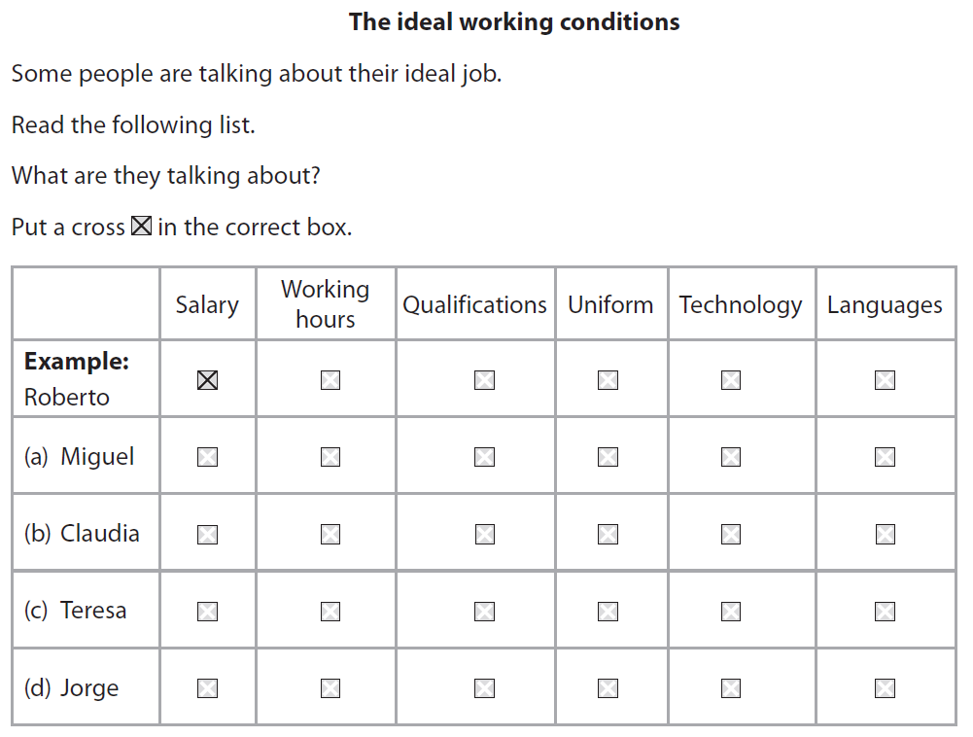
Notes:
2010 Edexcel Higher Q7

Slide 7
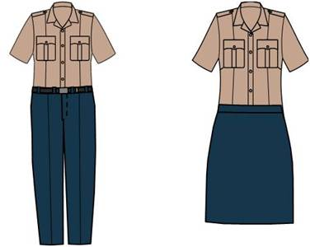

Slide 8
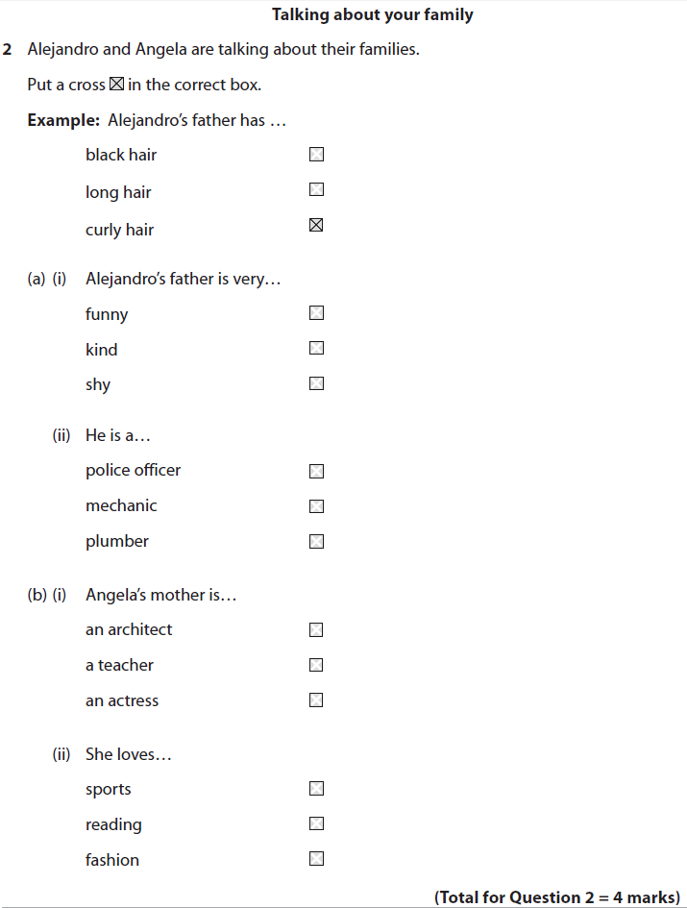
¿Y cómo es su carácter? Es una persona muy simpática. ¿Y en qué trabaja tu padre? Es agente de policía y trabaja muchas horas.
¿Y tu madre? Mi madre es actriz. Es muy famosa. ¡Qué interesante! Si, pero siempre está leyendo. Es un poco aburrida.
Notes:
2010 Edexcel Higher Q2 Various different models – could do running dictation (read text, run back, say it all and others choose correct answer) – if it’s a dialogue, could send two people (attempt to do intonation). OR they could run and listen (I have this on computers with just the part of the question they need, for them to click on ), then run back and try to say it from memory (better for intonation, pronunciation skills). Both are good for working memory, which is what listening relies on.
Or, you could also do ‘chinese whispers style’. Only 1 in each group has the questions to answer. One hears the text (or reads it) and has to whisper it to the next person, down the line.
¿Y cómo es su carácter? Es una persona muy simpática. ¿Y en qué trabaja tu padre? Es agente de policía y trabaja muchas horas.
¿Y tu madre? Mi madre es actriz. Es muy famosa. ¡Qué interesante! Si, pero siempre está leyendo. Es un poco aburrida.

Slide 9
Hoy no me puedo levantar el fin de semana me dejó fatal toda la noche sin dormir bebiendo, fumando y sin parar de reír Hoy no me puedo levantar nada me puede hacer andar no sé que es lo que voy a hacer. Me duelen las piernas, me duelen los brazos me duelen los ojos, me duelen las manos. Hoy no me puedo concentrar tengo la cabeza para reventar es la resaca del champán burbujas que suben y después se van Hoy no me levanto estoy que no ando hoy me quedo en casa guardando la cama hay que ir al trabajo, no me da la gana Me duelen las piernas, me duelen los brazos me duelen los ojos, me duelen las manos
Hoy no me puedo levantar nada me puede hacer andar Hoy no me puedo levantar el fin de semana me dejó fatal toda la noche sin dormir bebiendo, fumando y sin parar de reír Hoy no me puedo levantar Hoy no me puedo levantar Hoy no me puedo levantar

Slide 10
Escucha la canción
1 ¿Cuál será el título? _____________________________________________________ 2 En la letra, ¿cuántas partes del cuerpo oyes? Apúntalas. __________________________________________________________________________________________________________ 3 ¿Cómo se siente el cantante?
_____________________________________________________ 4 ¿Qué síntomas tiene? _____________________________________________________
5 ¿Qué tiene pensado hacer hoy? _____________________________________________________

Slide 11
today |  | I am going to do
the weekend |  | my legs hurt
wiped me out |  | my arms hurt
I can / I can’t |  | to burst
to get up |  | hangover
night |  | bubbles
to sleep |  | I’m staying at home
without |  | bed
to laugh |  | I have to go to work
I don’t know |  | I don’t feel like it

Slide 12
Comberton Village College
Listening: at own pace
Reduces anxiety Student controls playback – ‘test’ feeling removed Facilitates ‘listen again’ according to need Increases the range and complexity of material you can use for listening
Rachel Hawkes
Notes:
It’s not always possible to get computer access (hence the need for developing whole class listening strategies!) but when you can it is brilliant to enable students to do listening activities at their own pace. This does several things. First, it reduces the sense of anxiety and second, with the student in control of playback the activity does not feel like a test.
The fact that students can, and will, listen to the same stretch several times but according to their own individual need, differentiates and personalises the activity of listening This in turn means that you can increase the interest and complexity of material that you give learners, firstly because they can stop, start, pause, rewind at will and this reduces frustration when understanding is not immediate and secondly, because they can progress from more straightforward tasks to more challenging ones and listening becomes a differentiation by outcome activity. With a class I will quite often choose to do several short, discrete tasks so that slower learners in the group will still feel that they have ‘finished’ the work, whilst others, who tell me that they’ve finished can be put into ‘new groups’ using Sanako and given more challenging tasks. Here’s one example of this. Go to player and show. (Example 1: Listening Practice 1 & 2 Numeros – Practicar los numeros – through to Transformers trailer)

Slide 13
La semana
Voy corriendo, la poli va detrás Voy corriendo, a mí me quieren pillar el alquiler, no voy a pagar que vengan a buscarme, no me encontrarán. Yo voy corriendo lunes, martes, miércoles jueves, viernes, sábado y domingo (x2) ¿Qué malo he hecho yo? (x4) Voy corriendo, la poli siempre detrás Voy corriendo, a mí me quieren pillar Mis hijos no van a hacer el servicio militar que vengan a buscarme, no me encontrarán. Yo voy corriendo lunes.......... (ad lib)
Artista - Amparanoia (CD – El poder de Machín)

Slide 14
La semana
Voy__________, la poli va ________ Voy corriendo, me quieren ________ el alquiler, yo no ______ a pagar que vengan a buscarme, no me encontrarán. Voy corriendo lunes, ________, miércoles jueves, ________, sábado y domingo (x2) ¿Qué _______ he hecho yo? (x4) Yo voy corriendo, la poli _______ detrás Voy corriendo, me __________ pillar Mis _______ no van a hacer el servicio militar que vengan a buscarme, no me encontrarán. Yo voy corriendo lunes.......... (ad lib)
Artista - Amparanoia (CD – El poder de Machín)
martes
detrás
hijos
corriendo
quieren
siempre
viernes
malo
pillar
voy
Notes:
Obviously there is a wealth of video material on the internet that you can set tasks to. You can include songs, adverts, video clips, tv programmes, film trailers – all available from YouTube. I download using RealPlayer.
An example of a song I like using: Amparanoia – La semana Task can be very structured like a gap fill or simply ‘listen and write down any words you can’ They group these into words they know (and therefore probably know how to spell) and those they can write down but don’t yet know the meaning of. This supports their phonics knowledge, that we work really hard on in Year 7. Although the song has lots on unknown, fairly complex language for Y7, they are completely capable of learning it – example of Spanglovision. Listening repeatedly reinforces memory and pronunciation skills. Learning language through song is very powerful and effective.
Just show one more example of a video that makes excellent listening practice – just found on the internet. This is now in our Y9 SOW.

Slide 15
Best sources of video
Comberton Village College
http://www.bbc.co.uk/learningzone/clips/
www.youtube.com
www.dailymotion.com Just using Google works for finding most things!
Bookmarking
http://www.youtube.com/rachelhawkes60
http://www.delicious.com/rachelhawkes/videos
Rachel Hawkes

Slide 16
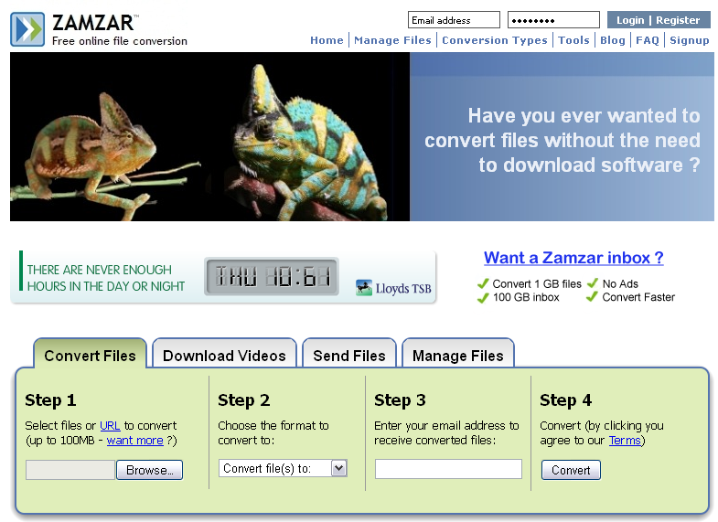
Downloading video clips
Comberton Village College
RealPlayer
(Zamzar)
www.zamzar.com
http://uk.real.com/realplayer/
Rachel Hawkes

Slide 17
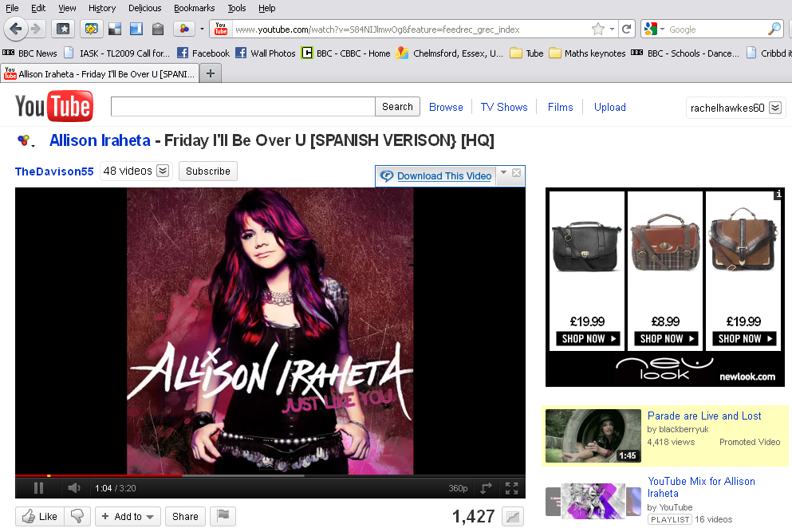
RealPlayer
1. Find your clip. Hover mouse over the clip and the RealPlayer download prompt appears. Just click this!

Slide 18
RealPlayer
2. This RP Downloader window appears and shows the download.
3. The files save by default to ‘My videos’ within ‘My documents’.
4. They are .flv format.
5. To download RealPlayer to your computer, go to: http://uk.real.com/realplayer/

Slide 19
YouTube 1. If you create your own account (channel) on YouTube you can keep the video clips you like in one place and organise them into categories. 2. You can also share them more easily with others this way.
3. Appropriately enough, here’s a link to a YouTube clip taking you through how to do this.
http://www.youtube.com/watch?v=p_IZ6CAlxG8
4. If you Google almost anything, it will bring up a YouTube link to a clip showing you how to do it.

Slide 20
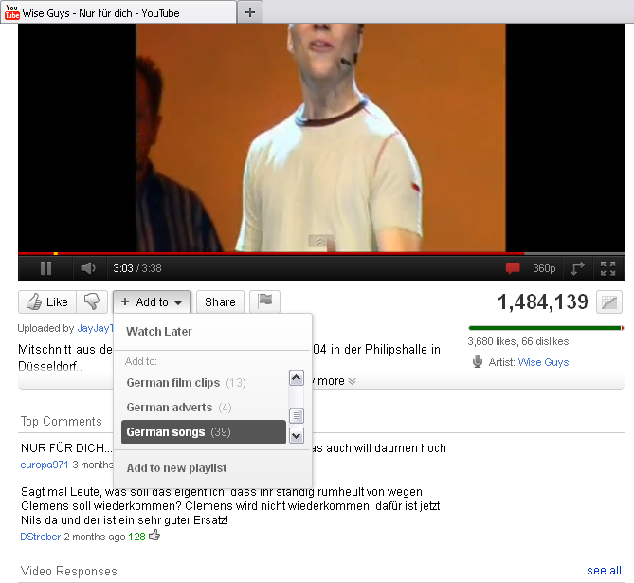
5. Then when you find clips you like, just do ‘Add to’ and put them into a category (or playlist). 6. It’s easy to create a new playlist for a new category whenever you need to.

Slide 21
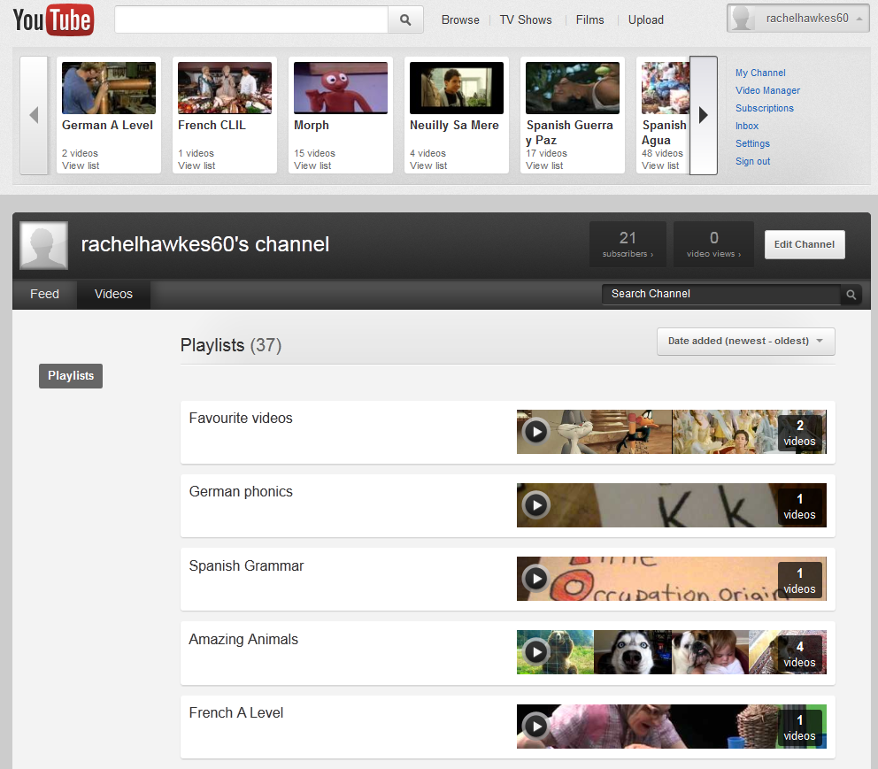
http://www.youtube.com/user/rachelhawkes60

Slide 22
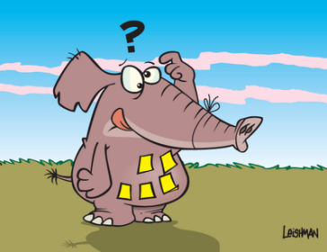
Comberton Village College
Things we know about vocabulary learning
It is essential for progress and motivation It is hard for most / all learners It is not exciting
Rachel Hawkes
Notes:
All of us would I think agree that we need to know words, vocabulary in the language to make progress. Some would say, with good reason, I think, that success, particularly at GCSE, is to a large extent defined by the number of words we know, although also I think that it is also about the choice of words that we learn – some have a higher currency for me than others. But we will certainly not argue too long about the role vocabulary knowledge plays in making progress in the foreign language. Perhaps more importantly and less often considered is the interplay between the words students know in their heads and can produce without reference to notes and their motivation. Surveying around 300 students from different secondary schools in Years 7-10 revealed a remarkable consistency in the belief that what they know in their heads and can produce confidently by heart is the true representation of what they know/can do/ their level of the language at any particular time. It is not therefore much of a leap to say that if they don’t know many words they won’t feel very confident in the language – the link between confidence and motivation is clear in language learning (most other learning too, come to that).
Secondly, vocabulary learning is hard. Even for higher ability learners, considerable work is required to fix words in memory and keep them there over the medium- longer term. For learners with auditory and / or kinaesthetic learning preferences, it can be particularly hard, particularly to retain spellings (auditory learners) or pronunciation (kinaesthetic learners) over time. A lot of traditional vocabulary learning methods do play to the visual learning preference.
Finally (although we could talk at length about all of these points!) it is not exciting. Learners know it is important, but the combination of difficulty + lack of excitement do make a set vocabulary learning homework the least popular and most often ‘left until last’ homework.
So, what can help? Well, there are no universally right answers to this, or at least no completely easy solutions that just make the whole thing effortless and painless. If I could present that, perhaps I would not be long for the working world and might soon be sunning myself on a beach in the Bahamas! However, there are some strategies, types of activity, ways of learning, even ways to engage 3rd parties that can be of benefit and it’s just a few of those that I’m going to mention here. Please note that I have had to strip down my initial brainstorming for this session, knowing how important it is to keep to time, so there are lots more ideas, many that I’m sure you all use already, but I’m just confining this to a sharing of a few key ideas. I’m drawing most particularly on the experience of teaching lowest GCSE groups and NVQ level 2 groups.

Slide 23
Comberton Village College
Variety of strategies
Contextualisation and repetition Choice of method (and language) Uses of music Online possibilities
Rachel Hawkes

Slide 24
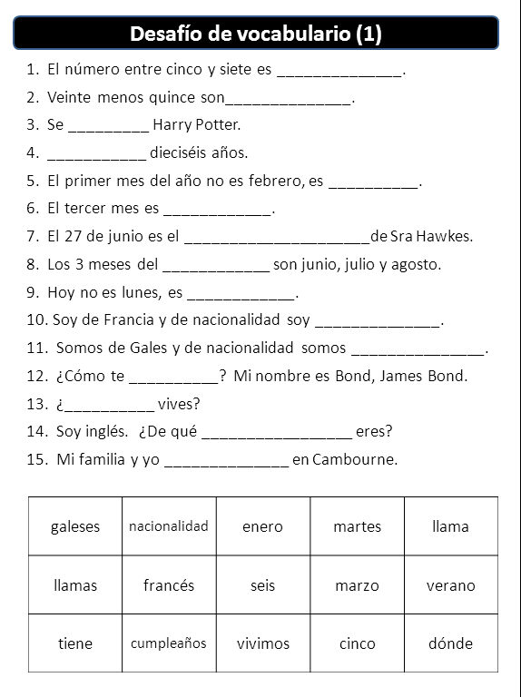
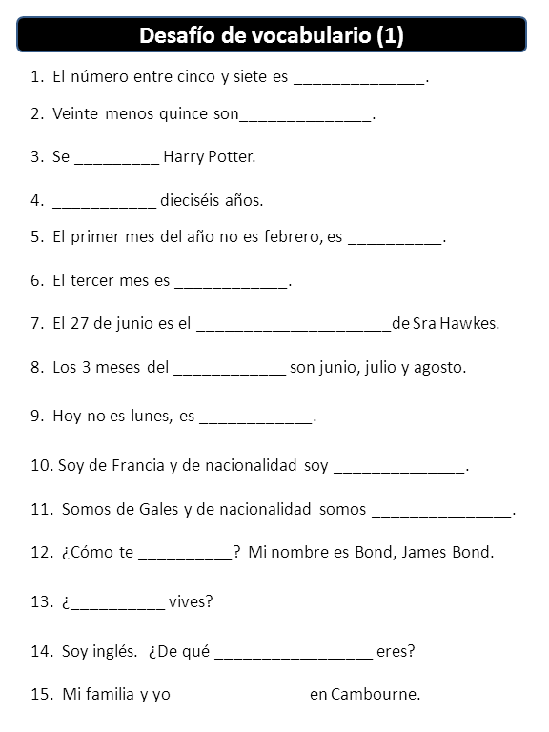
Comberton Village College
Contextualisation and repetition
Rachel Hawkes
Notes:
At all levels, but particularly at KS4 where the first step is often to find out what students already know/can do in the language based on their vocabulary from previous years, it’s often useful to give vocabulary activities as embedded items at sentence level. The example on the left is clearly a first stage, where it is receptive knowledge and the ability to decode meaning at sentence level and use the language in context which is assessed here. Assuming that they have managed this first stage fairly confidently, a subsequent stage (several lessons every weeks later) would be to give the same sentences again but without the words listed below. Alternative answers that fit do need to be accepted, but either way, we are still consolidating on vocabulary. I have made the start of a bank of these using the Edexcel Spanish vocabulary list. They are on the TES website but also on mine – links on the final slide.
I like the fact that with these I am able to test vocabulary but also develop reading skills. I find that students of all abilities (you can vary the difficulty obviously) find this challenging but engaging and you can hear from their verbalisations that they are really thinking actively about the meaning of the words. It is also something very active you can give students to do for homework, rather than just set ‘learn 20 words’.

Slide 25
seis
1. El número entre cinco y siete es ______________.
2. Veinte menos quince son______________.
3. Se _________ Harry Potter.
4. ___________ dieciséis años.
5. El primer mes del año no es febrero, es __________.
6. El tercer mes es ____________.
7. El 27 de junio es el _____________________de Sra Hawkes.
8. Los 3 meses del ____________ son junio, julio y agosto.
9. Hoy no es lunes, es ____________.
10. Soy de Francia y de nacionalidad soy ______________.
11. Somos de Gales y de nacionalidad somos _______________.
12. ¿Cómo te __________? Mi nombre es Bond, James Bond.
13. ¿__________ vives?
14. Soy inglés. ¿De qué _________________ eres?
15. Mi familia y yo ______________ en Cambourne.
llama | verano | dónde
martes | marzo | cinco
enero | seis | vivimos
nacionalidad | francés | cumpleaños
galeses | llamas | tiene

Slide 26
Números | Países
Actividades | Expresiones temporales
siempre | cuatro | España | a menudo | Argentina
quince | todos los días | salgo | descargo | nunca
juego | Perú | a veces | catorce | voy
Gran Bretaña | leo | doce | Alemania | veinte

Slide 27
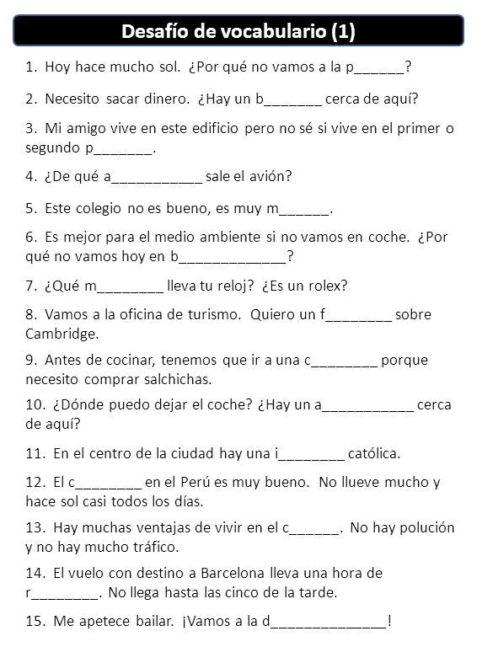
Example of Reading strategy 10.

Slide 28
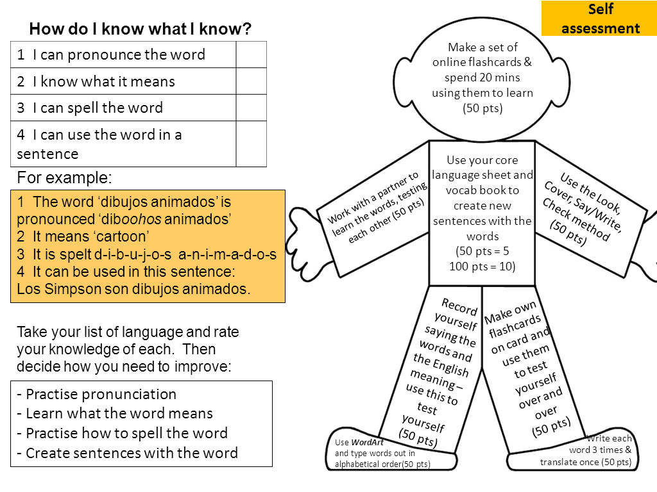
Comberton Village College
Choice of method and language
Rachel Hawkes
VocabMan adapted from MFL resrouces
Notes:
Go through with students how they learn their vocabulary and keep the conversation going with them about this during the year so that they don’t forget at any point that they need to be very active when doing vocabulary hw. There should be evidence that you can see that they have done the hw, rather than just having to spend class time doing a test to see that.
In terms of choice of language, I do think it can be very useful to get students to select their own list of 10, 15, 20 words to learn on a given topic. This personalisation not only leads to the student learning the words that they are most likely to want to use (paragliding need not be learnt actively by all!) but it also neatly injects the elements of autonomy and active learning into a learning homework.
Showing them how to use www.wordreference.com rather than google translate is a helpful first step here – to avoid blunders!

Slide 29
Comberton Village College
Uses of music
Y7 song competition highlights value of music for memory Using music in lessons for creative language use supports vocabulary learning
Rachel Hawkes
Notes:
Links to ideas on this on final slide. Just explain super-briefly!

Slide 30
Comberton Village College
Online possibilities
Vocab Express Quizlet
Rachel Hawkes
http://quizlet.com/6985620/gcse-free-time-2-flash-cards/
Notes:
Describe briefly how I have used both of these and spell out the typical differences between the free possibilities and vocab express i.e. the ads of the latter are the monitoring, tracking, homework setting, competition possibilities as well as the lack of making and preparation of course.

Slide 31
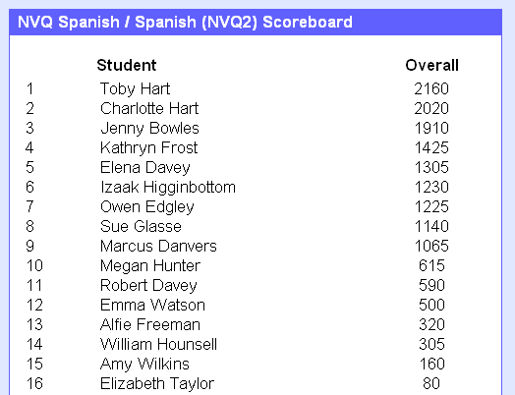
Comberton Village College
Collaboration and competition
Rachel Hawkes
Vocab Express Leader Board – Mixed Age Learning project
Notes:
Talk about the Mother and son partnership / competition.

Slide 32
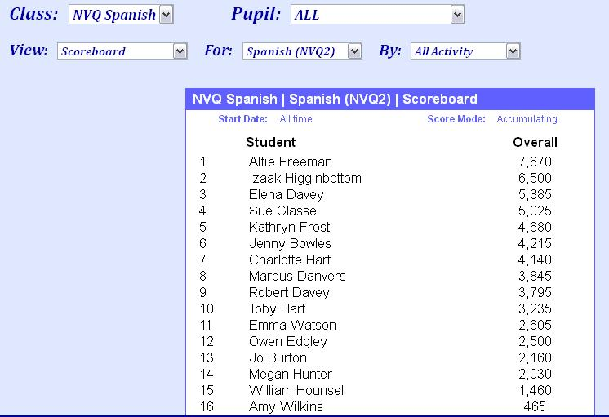
Comberton Village College
Collaboration and competition
Rachel Hawkes
Vocab Express Leader Board – Mixed Age Learning project June 2011
Notes:
Not always the same ones who shine. Student who is a school refuser tops the board in June. Particularly attractive to boys but girls love competition too – as we will see! Mention Megan here.

Slide 33
Comberton Village College
Vocab Express EDL Championships
Rachel Hawkes
Notes:
3.07p.m. 20,000 points approx ahead Last minute steal from Tunbridge Well Girls’ Grammar School Relate the excitement – the use of IT rooms at lunchtimes, breaks, before school!
Comberton answered 236,669 questions during the course of the competition (an average of almost 30,000 per day).

Slide 34
Comberton Village College
Reading: authentic contexts
Rachel Hawkes
Las vacaciones de Lionel Messi
Notes:
3.07p.m. 20,000 points approx ahead Last minute steal from Tunbridge Well Girls’ Grammar School Relate the excitement – the use of IT rooms at lunchtimes, breaks, before school!
Comberton answered 236,669 questions during the course of the competition (an average of almost 30,000 per day).

Slide 35
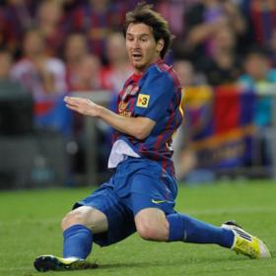
Leo va de vacaciones Messi se va de vacaciones después de la mejor temporada de toda su vida deportiva. El futbolista ha marcado 82 goles en 69 partidos oficiales, números que lo han convertido en el mejor goleador de la historia en una misma temporada, superando a ilustres futbolistas como Gerd Müller (67 tantos en la 72-73) o al mismísimo Pelé (66, en la 57-58). "Me voy de vacaciones tranquilo y muy feliz", dijo Leo.
Notes:
http://www.as.com/futbol/articulo/messi-va-vacaciones-82-goles/20120613dasdaiftb_5/Tes

Slide 36
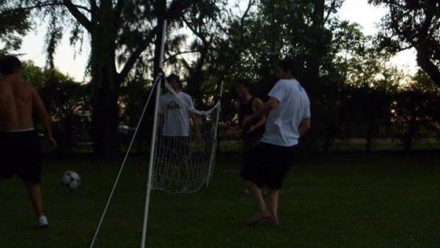
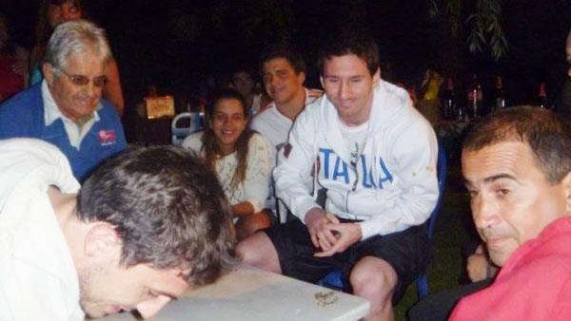
Messi disfruta de las vacaciones Diciembre 2011: Fue a pasar algunos días en Rosario, Argentina, con su familia y sus amigos. Jugó al fútbol-tenis en el jardín.
Fue a cenar con sus amigos en un restaurante.

Slide 37
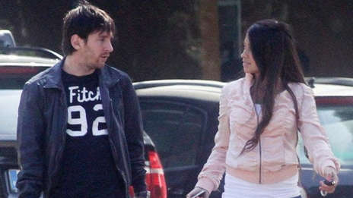
Fueron de paseo
Abril 2012: Messi fue de vacaciones con su pareja Antonella Roccuzzo en Río de Janeiro, Brasil.
Fueron de compras
Fueron a la playa para descansar y tomar el sol
Notes:
http://www.bekia.es/celebrities/fotos/leo-messi-antonella-roccuzzo-vacaciones-rio-janeiro/ http://www.diariofemenino.com/actualidad/famosos/articulos/escapada-romantica-leo-messi-antonella-roccuzzo-brasil/

Slide 38
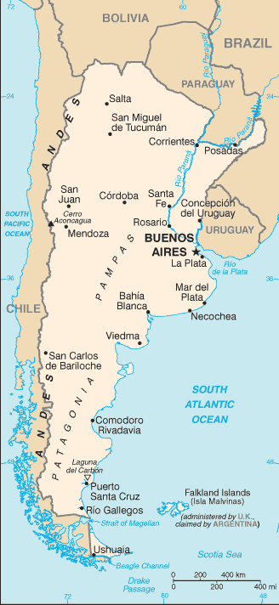
Mayo 2012: Fue de vacaciones con su pareja Antonella Roccuzzo a Ibiza.
Messi recarga las pilas
Messi dedica tiempo a su familia. Descansa en la playa con su novia / pareja Antonella.
Junio 2012: Messi está de vacaciones en Rosario, su ciudad natal.
Leo con su pareja Antonella Roccuzzo
en Rosario, Argentina.
El mejor futbolista mundial Lionel Messi ya disfruta de sus vacaciones en Rosario. El martes por la noche fue al bar Rock and Feller’s. En esta oportunidad no fue con su novia, Antonella Roccuzzo, sino fue de copas con dos amigos.

Slide 39
Octubre 2012
Será papá en octubre.
2012 es un gran año para Messi y será aún mejor. Su pareja de siempre, Antonella Roccuzzo, lo hará padre a finales del mes de octubre. Todavía no sabemos si tendrá un niño o una niña pero lo que es cierto es que será ¡Un nuevo reto para el mejor futbolista del mundo!

Slide 40
Imagínate que eres Messi o Antonella
De vacaciones 1 ¿Qué es lo más importante para tí? 2 ¿Adónde vas de vacaciones normalmente? 3 ¿Con quién vas de vacaciones normalmente? 4 ¿Qué te gusta hacer de vacaciones? 5 ¿Prefieres las vacaciones de invierno o las vacaciones de verano? ¿Por qué?
6 ¿Adónde quieres ir de vacaciones el año que viene? 7 ¿Te gusta ir a la playa? Por qué? 8 ¿Adónde fuiste de vacaciones el año pasado?
Haces una entrevista para la revista ‘Gente’.

Slide 41
www.tripadvisor.es/Hotel_Review-g664838-d518412-Reviews-Joyuda_Plaza_Hotel-Cabo_Rojo_Puerto_Rico.html

Slide 46
El hotel tiene tres piscinas.
El hotel tiene un restaurante.
El hotel no tiene un bar.
Hay televisores en el hotel.
El hotel no tiene página web.

Slide 47
F
El hotel tiene tres piscinas.
El hotel tiene un restaurante.
El hotel no tiene un bar.
Hay televisores en el hotel.
El hotel no tiene página web.
V
F
V
V

Slide 48
www.tripadvisor.es/Hotel_Review-g664838-d518412-Reviews-Joyuda_Plaza_Hotel-Cabo_Rojo_Puerto_Rico.html

Slide 49
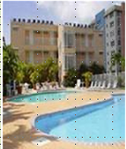
« Desagradable »
« Bueno, cuando yo entré a mi habitación, las sábanas estaban sucias, él piso del baño estába inundado. Además no había papel higiénico, y el televisor era de hace 30 años. No pude dormir porque había gente borracha gritando y hablando...
A
Joyuda Plaza Hotel, Puerto Rico
C
« ¡un lugar horrible! » De verdad, la limpieza es pésima, En la cama había incluso cucarachitas. No había agua caliente en el baño. El personal no era nada servicial.
« Nooooooooooooo! »
« La habitación era fea y la cama estaba fatal. Las habitaciones no tenían ventanas. La piscina estaba sucia. Los empleados no era agradables. En fin, ¡no lo recomiendo!
B
« ¡un lugar horrible! »
¡Este hotel es absolutamente horroroso! Las habitaciones eran muy pequeñas y mal diseñadas. Las sábanas estaban muy sucias e incluso tenían manchas. Las camas eran tan incómodas que no pudimos dormir....
D

Slide 50
 | A | B | C | D
1 The room was ugly.
2 This hotel is absolutely horrible.
3 The bathroom floor was flooded.
4 The pool was dirty.
5 The sheets were dirty.
6. The sheets were dirty and even had stains!
7 There was no hot water in the bathroom.
8. There was no toilet paper
9 The staff were not nice.
10 The rooms were very small and badly designed.
11 There were even little cockroaches in the bed.
12 The tv was 30 years old.
13 The beds were so uncomfortable that we couldn’t sleep.
14 The staff were not at all helpful.
15 I couldn’t sleep because there were drunk people shouting and talking…

Slide 51
 | A | B | C | D
1 The room was ugly.
2 This hotel is absolutely horrible.
3 The bathroom floor was flooded.
4 The pool was dirty.
5 The sheets were dirty.
6. The sheets were dirty and even had stains!
7 There was no hot water in the bathroom.
8. There was no toilet paper
9 The staff were not nice.
10 The rooms were very small and badly designed.
11 There were even little cockroaches in the bed.
12 The tv was 30 years old.
13 The beds were so uncomfortable that we couldn’t sleep.
14 The staff were not at all helpful.
15 I couldn’t sleep because there were drunk people shouting and talking…

Slide 52
vocabulario 7 (para el 18 de junio 2012)
Mi vocabulario – versión inglesa | Mi vocabulario - español
1 the bed
2 the sheets
3 the window
4 the staff
5 dirty
6 clean
7 helpful
8 nice
9 small
10 drunk
11 flooded
12 the cockroaches

Slide 53
vocabulario 7 (para el 18 de junio 2012)
Mi vocabulario – versión inglesa | Mi vocabulario - español
1 the bed | la cama
2 the sheets | las sábanas
3 the window | la ventana
4 the staff | el personal
5 dirty | sucio
6 clean | limpio
7 helpful | servicial
8 nice | agradable
9 small | pequeño
10 drunk | borracho
11 flooded | inundado
12 the cockroaches | las cucarachas

Slide 54
Comberton Village College
Discussion, reflection & planning
Take this opportunity to remind yourself of the strategies for listening, reading and vocabulary that we have seen. Identify one or two that you would like to include in your planning for a particular KS4 class.
Rachel Hawkes

Slide 55
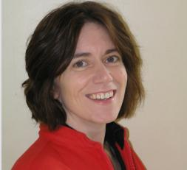
Comberton Village College
My contact details and links to resources
www.tes.co.uk (type ‘rhawkes’ into search to pull up all resources) www.rachelhawkes.com Spontaneous talk sessions Resources (Y7, 9,GCSE, AS Level Spanish) Using music http://www.rachelhawkes.com/RPP/Song/SongContests.php
Rachel Hawkes
www.rachelhawkes.com rhawkes@comberton.cambs.sch.uk 01223 262503 ext.222
Notes:
There are obviously a lot more ideas – limit is only time to explore them, create them, try them out! And today, the time is limited to share the ideas, but I hope that’s been a useful session and you’ve taken at least one thought away to explore in your own practice.

