Slide 1
ICT TeachMeet session

Slide 2
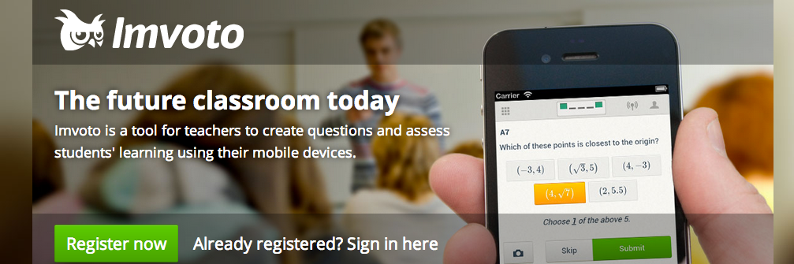
1) Imvoto
Link: www.imvoto.com Email: jfreeman@comberton.cambs.sch.uk (Jamie Freeman)

Slide 3
2) 4 links for learning
1 http://www.fodey.com/generators/newspaper/snippet.asp Very good to get the students to write a short article in the target language, very professional looking.
2 http://www.tagxedo.com/app.htm Good for vocabulary, if you hover over the word, it becomes bigger. It is similar to www.wordle.net
3 https://itunes.apple.com/gb/app/duolingo-learn-spanish-french/id570060128?mt=8 Duolingo app for iPads and iPhones (also exists for Android devices). This is a very good app for Spanish, German and French. It also has Italian and Portuguese. It has grammar, vocabulary, listening, dictation, speaking. Very easy to use and excellent for learning the language in a very interactive way. 4. http://www.discoveryeducation.com/free-puzzlemaker/ - to create vocabulary starters in a very easy manner
Email: mfoster@tbgs.torbay.sch.uk (Marisol Foster)

Slide 4
3) GCSE vocabulary revision
www.cramit.co.uk
There are apps for learning GCSE French, German and Spanish exam vocabulary.
Email: Hayley Bourne (The Polesworth School)

Slide 5
4) Speak! online drama
http://www.whystudylanguages.ac.uk/ks3/drama
Email: LEdwards997@st-josephs.bolton.sch.uk (Lisa Edwards)

Slide 6
5) Textivate
Link: www.textivate.com Email: CCroxall@woodrushhigh.worcs.sch.uk (Claire Croxall)

Slide 7
6) Using film in languages lessons
1) http://www.youtube.com/watch?v=sECzJY07oK4
2) http://www.youtube.com/watch?v=5ftLgbUXqNU
3) http://www.youtube.com/watch?v=4LjhfZB8XJE
4) http://www.youtube.com/watch?v=dDYRaSjRy9E
Email: drakeford.a@kings.peterborough.sch.uk (Alister Drakeford)

Slide 8
7) Online activity creator
Link: www.classtools.net Email: IDuffell@helsbyhigh.org.uk (Ian Duffell)

Slide 9
8) Skype
Link: www.skype.com Email: uccchabouzit@uctc.org.uk (Chantal Habouzit)

Slide 10
9) iPad apps
Dropbox | Box | Audioboo | Recorder Plus HD+ | SoundCloud | Songify
Wordreference | El conjugador | Leo | Dictionary - Ascendo Inc. | Spelling Bee | Mind snacks
Comic Life | Puppet pals 2 | Sock puppets | iMovie | Aurasma | I-nigma
20minutes.fr | 20minutos.es | Linguascope Newshound | Skitch | ClassDojo | Imvoto
Notes:
See accompanying list for free / costs of individual apps.

Slide 11
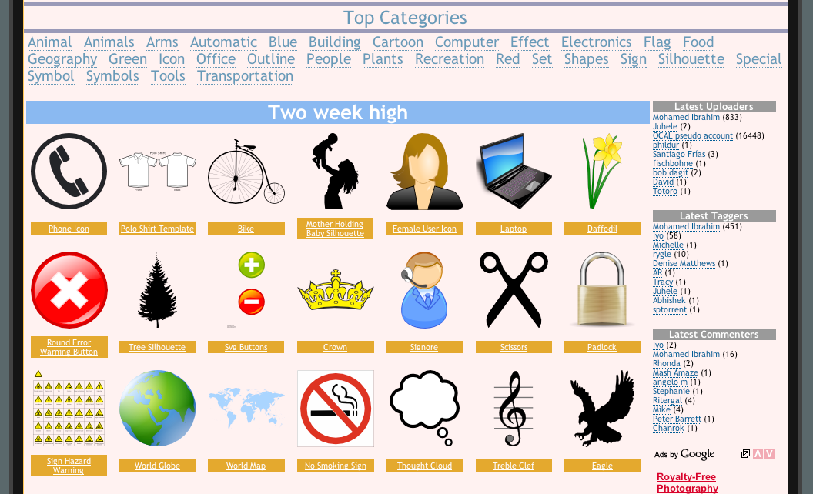
10) Copyright free images
Link: www.clker.com

