Slide 1



Rachel Hawkes
Comberton Village College
Priorities
1 Strategies for Speaking
Strategies for Writing
3 Strategies for Listening and Reading Further discussion and planning

Slide 2

WRITING: CLASSROOM STRATEGIES
Manipulating language
Developing quality (Variety & Range)
Accuracy
Manipulation, Quality & Accuracy

Slide 3
Comberton Village College
Manipulating language
Rachel Hawkes
TOOL BOX
Idea 1

Slide 4

Il y a / Il y avait
Ne…..pas
C’est/ C’était
Je peux / on peut |  | I can / you/we can...
Je veux |  | I want to..
Je dois |  | I have to…
Je vais / on va | + verb | I’m going to/we’re going to…
J’aime /je n’aime pas |  | I like to / I don’t like to..
J’aime beaucoup |  | I love to…
Je voudrais |  | I would like to…

Slide 5

Comberton Village College
Manipulating language
Rachel Hawkes
HARVESTING/CREATIVE TRANSFER
Idea 2
Notes:
This is an idea to get students to make links between language they learn and use in one topic in further topics. For example, when finishing the theme of holidays, students should be encouraged to do a mind map of key language, focusing on the verbs and sentences starters that they have practised and learnt during that topic. Then they should be given a new piece of paper and told the new theme. Their first task is to take all of the language they know from the context of holidays and adapt it to the new context. So, for example, I used to go on holiday to France can become I used to go to Milton Primary School. We went on holiday to Mallorca can become we went on an excursion to Alton Towers theme park with the school. It’s a very visual and practical way to get students to take stock of what they know already before starting a unit, so they never feel that they are beginning from scratch. If preferred, they could actually cross out the holidays related vocabulary and write the new possibilities (e.g. school/world of work) over the top.
This type of activity could also be done in different ways i.e the teacher could present them with a list of language from the holidays theme and they could highlight any language that they could use in the new theme.

Slide 6

Mes préférences
Mes vacances dernières
Je m’intéresse à … Ce que m’intéresse le plus c’est.. Mes vacances idéales sont… Ma destination préférée, c’est… A mon avis
Je pense que
Je trouve que
Je suis allé(e) à ….
pour…semaines
Après être arrivé
Avant de partir
J’ai joué au golf Je joue au golf depuis 3 ans Après avoir (fini)
Je me suis bien amusée
Je viens de lire ta lettre…..
J’allais à….
avec ma famille Quand il faisait beau je sortais… Quand il faisait mauvais je restais… j’aimais beaucoup….
A l’avenir J’ai envie de… J’ai l’intention de.. Je voudrais.. J’amerais… Ji’irai….. Si j’avais le choix, j’irai…
mais = but
parce que = because
aussi = also/as well
par exemple = for example
pendant = during/whilst
peut-etre = perhaps
qui = who
si = if
quand = when
et = and probablement = probably
seulement = only
Quand j’étais plus jeune..
L’année prochaine………..
Notes:
Re-do this mind map with the theme of school and world of work in mind. How could you re-use the language in the new context? This can be simplified or extended, depending on the level of your students and the grades they are targeting.

Slide 7
Comberton Village College
Manipulating language
Rachel Hawkes
WORDLE
Idea 3

Slide 8
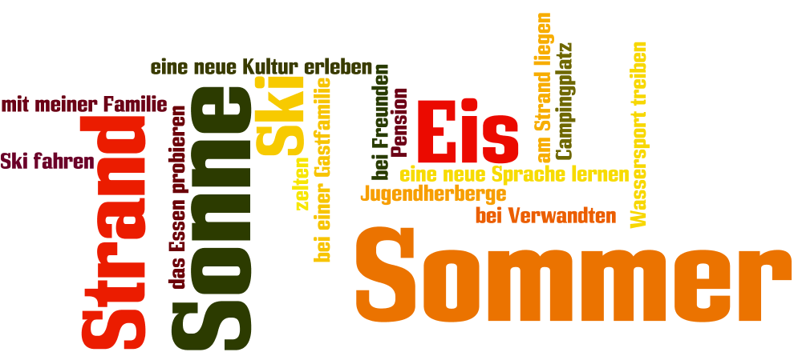

www.wordle.net
Rachel Hawkes

Slide 9
Comberton Village College
Manipulating language
Rachel Hawkes
ONLINE REFERENCING
Idea 4

Slide 10
Research & reference 1. www.wordreference.com Online dictionary – use this and not an online translator 2. http://www.verbix.com/ (or http://www.conjugation.org/ ) Online verb conjugation tool – you type in the verb and it shows you all forms of all tenses
3. http://french.typeit.org/ (http://german.typeit.org/ http://spanish.typeit.org/)
Saves pupils having to ask how to type accents or leaving them out on homework completely!

Slide 11
Comberton Village College
Manipulating language
Rachel Hawkes
LOOKING BACK
Idea 5

Slide 12
1. My school is a mixed comprehensive school.
2. The subject I most like is maths because I always get good marks.
3. My ideal teacher has a sense of humour and always wants to help us.
4. The school rules are important but too strict – for example you can’t wear coats inside the building.
5. The biggest problem at my school is the stress of exams.
6. After school there’s a lot to do. I usually do dance club on Tuesdays.
7. My primary school was much smaller than this school. I was able to walk there everyday.
8. Last year I did work experience for 2 weeks. I had a good time and learnt a lot.
9. Next year I plan to do A levels. I want to study English, Spanish and Maths.
Rachel Hawkes
Notes:
It is hard to get students to use what they have learnt already sometimes. To focus them back on what is in their books, maybe choose 9 questions in the TL OR 9 phrases in English that are the equivalent of essential target language on the topic and give them the task of finding them from their books.

Slide 13
Comberton Village College
Manipulating language
Rachel Hawkes
DICTIONARY SKILLS
See handout
Idea 6

Slide 14
Comberton Village College
Variety & Range
Rachel Hawkes
FUNCTIONS & THEMES
Idea 7

Slide 15
Functions |  | Themes
A | Questions | 1 | Future plans
B | Opinions | 2 | Work experience
C | Suggestions | 3 | Uniform
D | What others say | 4 | Primary school
E | Likes & dislikes (not ‘aimer’) | 5 | Subjects and teachers
F | Habits | 6 | Extra-curricular
G | Comparisons | 7 | Problems
H | Past events | 8 | School rules

Slide 16
Funciones |  | Temas
A | Preguntas | 1 | Planes para el futuro
B | Opiniones | 2 | Las prácticas laborales
C | Sugerencias | 3 | El uniforme
D | Lo que otros dicen | 4 | La escuela primaria
E | Gustos y Preferencias (no se permite ‘gustar’) | 5 | Asignaturas y profesores
F | Costumbres | 6 | Actividades extraescolares y responsabilidades
G | Comparaciones | 7 | Problemas en el insti
H | Acontecimientos pasados | 8 | Las normas del insti

Slide 17
Comberton Village College
Variety & Range
Rachel Hawkes
GROUP WRITING
Idea 8

Slide 18
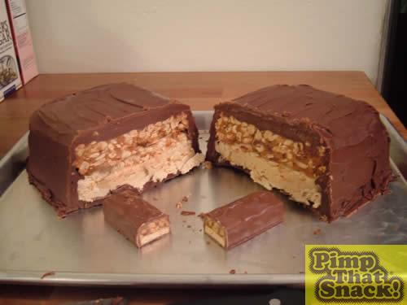
Comberton Village College
Variety & Range
Rachel Hawkes
‘PIMP’ MY LANGUAGE
Idea 9

Slide 19
Wie heisst deine Stadt oder dein Dorf?
Ich wohne in Toft.
Ich wohne in einem kleinen Dorf, das Toft heißt.
Ich wohne in einem kleinen Dorf, das Toft heißt. Früher habe ich in Bristol gewohnt.
Ich wohne in einem kleinen Dorf, das Toft heißt. Früher habe ich in Bristol gewohnt. Wenn ich älter bin, möchte ich in London wohnen.
Ich wohne in einem kleinen Dorf, dasToft heisst. Früher habe ich in Bristol gewohnt. Wenn ich älter bin, möchte ich in London wohnen.
Include present, past and future as often as you can!

Slide 20
Comberton Village College
Variety & Range
Rachel Hawkes
ASL (Average Sentence Length)
Idea 10
Notes:
This is just a quick and easy strategy to get students to focus on the length of their sentences and to help them to notice and think about extending sentences. At the end of a piece of writing, they can total the words and divide between the number of sentences – this gives them their ASL. Obviously an ASL of 7-9 indicates that they are not often using subordination, connectives or other conjunctions. ASL of 11-15 would indicate that they are doing this. Clearly it doesn’t measure success with accuracy but it is just a useful measure that highlights this aspect of quality of language.

Slide 21
Comberton Village College
Variety & Range
Rachel Hawkes
TICK GRID
Idea 11

Slide 22

Johnny Depp est né le 9 juin 1963 à Owensboro dans le Kentucky, aux États-Unis. Il est acteur américain, qui est déjà très célèbre. Il est en couple avec la chanteuse et actrice française Vanessa Paradis et ils vivent en France. Ils ont deux enfants ensemble. En 2010, il a refusé le titre de l'homme le plus sexy de l'année pour servir d'exemple à ses deux enfants.
 |  | ☺ | ☹
Present |  | //// /
Past |  | //
Future
Imperfect
Negatives
Opinions
Reasons |  | /
Links |  | ///
Clauses |  | /
Detail/Extras

Slide 23
How to use the tick grid
GCSE German | ☺ | ☹
present
past
future
opinions
WO1 conjunctions
WO2
WO3 conjunctions
wann? wie? wo?
prepositions + R2/3
modal verbs
um…zu +INF
adjective endings
no communication
spelling/capitals
With text book listening tasks
With written text
When peer assessing
When completing speaking preparation for GCSE tasks
When listening to exam board sample material
When assessing model answer provided by the teacher

Slide 24
Comberton Village College
Variety & Accuracy
Rachel Hawkes
PEER ASSESSMENT
Idea 12

Slide 25
1 | Subject variety (other than ‘ich’)
2 | Number of present tenses
3 | Number of past tenses
4 | Number of future tenses
5 | Number of opinions
6 | Number of different adjectives
7 | Number of adjective endings
8 | Number of appropriate R2/R3 articles
9 | Number of inversions
10 | Number of WO3 constructions
11 | Number of modal verbs
12 | Number of um … zu … clauses
13 | Number of idioms
“In lessons, students are regularly required to check each other’s work, discuss it and spot errors before they look at the correct copy.”
paired assessment before handing in
whole class assessment of anonymous samples of student homework as starter
‘auction’ activities to spot errors/correct formulations
paired listenings
Notes:
Peer assessment before handing in homework can be very useful – students can use the tick grid OR they can do a Quality of Language check only as in this tally sheet.

Slide 26
Comberton Village College
Accuracy
Rachel Hawkes
SENTENCE AUCTION
Idea 13

Slide 27
¿Qué apuestas?
Marca con / o x las frases correctas y las frases con errores
Apuesta entre 1 y 10 puntos
Escucha al profesor para ver si las frases son correctas o no
Si has escrito / o x en el lugar correcto ganas los puntos. Si no, pierdes los puntos
Escribe tu total en la casilla
 | Frase | / x | Apuesto | Gano | Pierdo
1 | Ayer jugé al fútbol
2 | Juan es una persona contenta
3 | No salí porque tenía muchos deberes
4 | Yo amor el español
5 | Las matemáticas es difícil
6 | ¿Como te llamas?
7 | No les gusta la política
8 | Me duele los pies
9 | ¿Cuándo es tu cumpleaños?
10 | Dónde está mi libro?
11 | Hablaremos más tarde
12 | Haceré mis deberes esta noche
13 | No me gusta chocolate
14 | Le encanta las películas de acción
15 | Pasó mis vacaciones en Francia
16 | Saqué muchas fotos
17 | Fútbol es aburrido
18 | Mi padre es un médico
19 | Mi hermana es muy alto
20 | Pedro soy español
subtotal
Gano - pierdo = Total

Slide 28
Comberton Village College
Manipulation, Variety & Accuracy
Rachel Hawkes
MODELLING
Idea 14

Slide 29
Value added* - to the past
iba a + infinitive… - I was going to ….
pero decidí + infinitive – but I decided to …
mi padre me dijo, “….” – my Dad said…
¿por qué no + infinitive…? – why not…..?
dije, “…” – I said….
(aunque) me hubiera gustado + infinitivo – although I would have liked to…

Slide 30
Basic sentence: Fui a España.
Enhanced by the ‘super’ structures: Iba a ir a Francia, pero mi padre dijo, “Hablas español entonces ¿por qué no ir a España?”. Entonces decidimos ir a España aunque me hubiera gustado ir a Francia.

Slide 31
Question: ¿Te gusta jugar al fútbol?
Si hace sol, me encanta jugar al fútbol sobre todo con mis amigos en el parque, pero si llueve, prefiero ver el fútbol en la televisión. Por ejemplo, el fin de semana pasado iba a jugar al fútbol, pero Kevin dijo, “Está lloviendo” entonces decidimos ir a mi casa a ver el fútbol en la televisión, aunque me hubiera gustado ir a ver un partido de verdad. (This answers contains: present, opinions, longer/extended sentences, imperfect, preterit, present continuous, preterit(plural form), pluperfect subjunctive). Now try your own example!

Slide 32
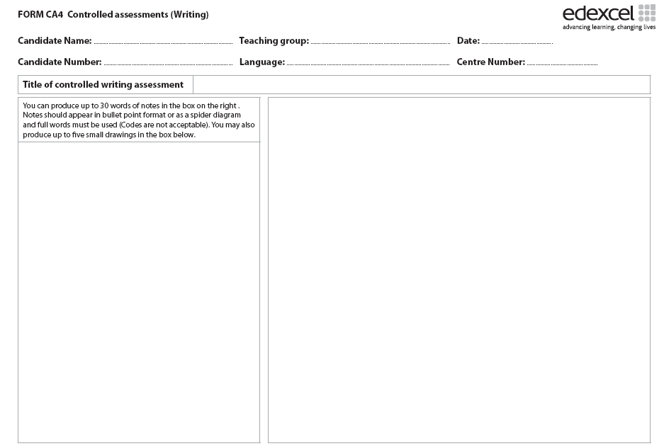
especializdo me ayuda suelo demasiados deberes no se permite hay que más informal prácticas laborales escuela horas de trabajo primer día más me gustó buena experiencia bachillerato tengo ganas en el extranjero
1. Students can prepare a 30 word notes sheet from a ‘model answer’ given by the teacher/text book. 2. Students can write a piece from a 30 words notes sheet given by the teacher.

Slide 33
Comberton Village College
Manipulation, Variety & Accuracy
Rachel Hawkes
NARRATION
Idea 15

Slide 34
El sábado pasado estaba en casa con mi hermano y veía la televisión … | cuando él dijo, “No hay nada en la televisión. Prefiero ir al cine.” | Entonces dije, “Sí. ¿Qué tipo de película quieres ver?” “Una comedia” dijo. | Entonces fuimos al cine y vimos la película. Lo pasamos bomba. Cuando salimos del cine, hacía sol.
Entonces dije, “Quiero un helado. ¿Vamos a comprar un helado de chocolate en el café? | Pero cuando fuimos al café la señora dijo, “Lo siento, no tenemos helados de chocolate”. | Dije, “¿Tiene helados de fresa? Y mi hermano dijo, “dos, por favor!” | ¡Qué día más perfecto! ¡Cine, helado y sol!
Draw the parts of the story
Colour all the imperfect verbs in green
Underline all the preterite verbs Thank you to Vincent Everett for this idea.
Notes:
Model the first box and then ask students to complete the task. Go through the verbs with them, making sure they have identified correctly and also know what each means. Give them a choice of HW task – either writing their own illustrated story or completing the verb gapfill on slide 10.

Slide 35
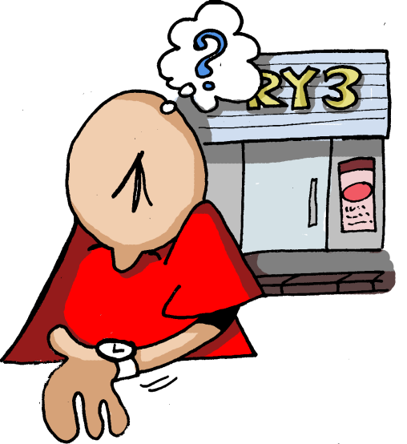
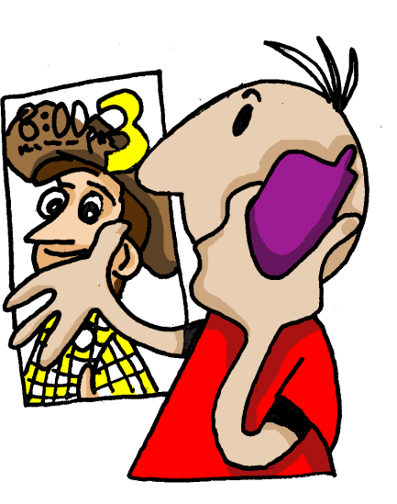

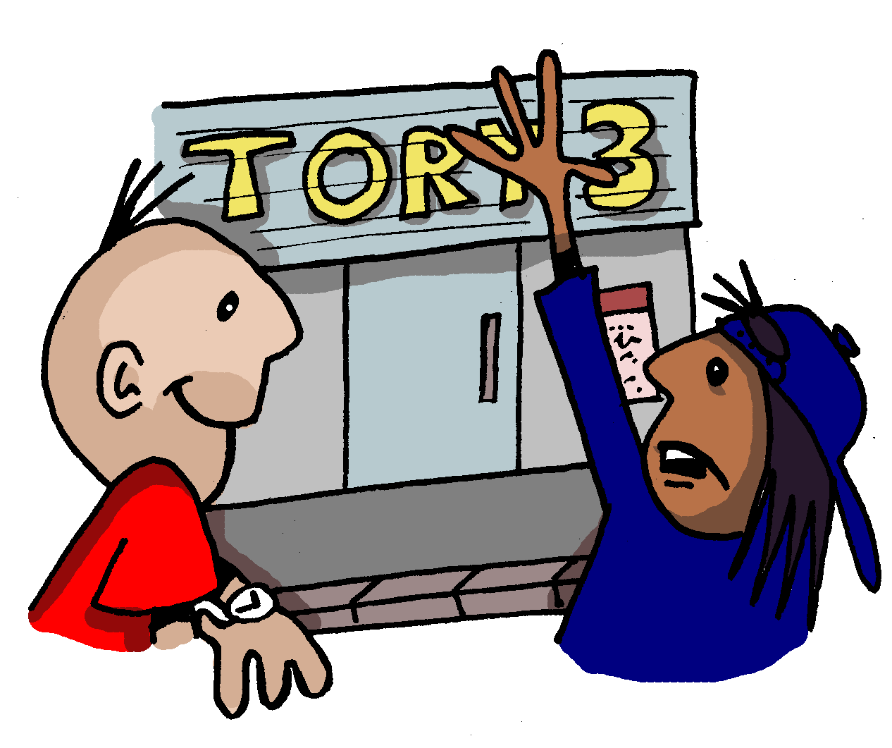
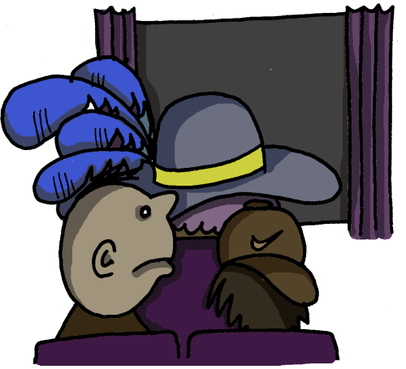
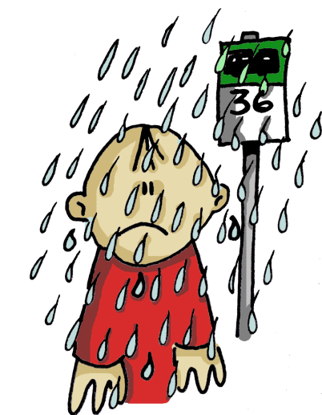
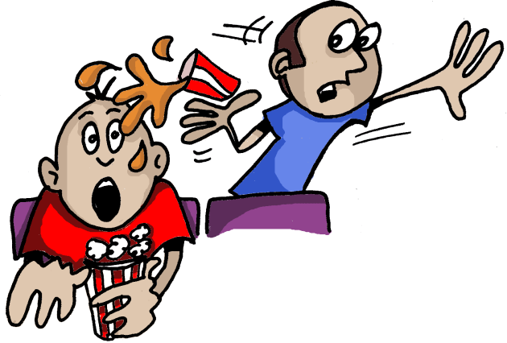
1 | 2 | 3 | 4
5 | 6 | 7
Notes:
Easier NOT to cut this one and just cut the text cards I think

Slide 36





1 | 2 | 3 | 4
1
2
3
4
5
6
7
5 | 6 | 7
Empareja las imágenes con el texto.
Había muchísima gente en el cine, incluso una mujer con un sombrero enorme, que estaba delante de nosotros.
a | b | c
Al final empezó a llover cuando estaba en la parada de autobuses. ¡Estaba ya harto de esa excursión!
Todavía peor, un chico que estaba detrás de nosotros ¡nos echó encima su coca cola!
d | e | f | g
Un día llamé a mi amiga Teresa. La invité al cine y quedamos a las 7.
Una media hora después Teresa llegó. Dijo que había mucho tráfico en la ciudad.
En seguida entramos en el cine y sacamos las entradas. Luego compramos palomitas.
A las 7 estaba en la puerta del cine pero Teresa no llegó.
Notes:
Depending on the class, this task might be approached as a reading strategy development task, asking students how they could look for clues to sort out the sequence of the story, looking for a likely beginning phrase. Looking for links between one phrase at the next. Looking also at the pictures to help understand the story and thinking of key Spanish words they know that might help them to match the pictures to text. Quite often groups enjoy moving cards around to do this sort of task so at the end of this lesson are A4 size sheets to print and cut. As the text is already jumbled. Students could do their own cutting!

Slide 37
1 | 2 | 3 | 4
1
2
3
4
5
6
7
d
g
5 | 6 | 7
e
Empareja las imágenes con el texto.
f
Había muchísima gente en el cine, incluso una mujer con un sombrero enorme, que estaba delante de nosotros.
a | b | c
Al final empezó a llover cuando estaba en la parada de autobuses. ¡Estaba ya harto de esa excursión!
Todavía peor, un chico que estaba detrás de nosotros ¡nos echó encima su coca cola!
a
c
d | e | f | g
Un día llamé a mi amiga Teresa. La invité al cine y quedamos a las 7.
Una media hora después Teresa llegó. Dijo que había mucho tráfico en la ciudad.
En seguida entramos en el cine y sacamos las entradas. Luego compramos palomitas.
A las 7 estaba en la puerta del cine pero Teresa no llegó.
b
Notes:
Depending on the class, this task might be approached as a reading strategy development task, asking students how they could look for clues to sort out the sequence of the story, looking for a likely beginning phrase. Looking for links between one phrase at the next. Looking also at the pictures to help understand the story and thinking of key Spanish words they know that might help them to match the pictures to text. Quite often groups enjoy moving cards around to do this sort of task so at the end of this lesson are A4 size sheets to print and cut. As the text is already jumbled. Students could do their own cutting!

Slide 38
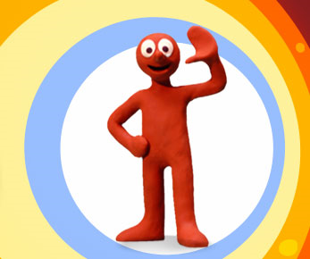

Slide 39

Notes:
Most people will want to download these to use them in class. Here are the links to each one:
Red = episode 3 - http://www.youtube.com/watch?v=8i9juY3ezrg&feature=related Yellow = episode 6 - http://www.youtube.com/watch?v=w0cpY4lrevY&feature=related Green = episode 13 - http://www.youtube.com/watch?v=UxjYJZC4j0c&feature=fvsr Blue = episode 14 - http://www.youtube.com/watch?v=11HZt2JCj7g&feature=related
It will be helpful to provide some useful verbs for each one, plus a reminder of some key narrative links. These are on the next slide.

Slide 40
sentarse – to sit down
pulsar – to press desaparecer – to disappear aparecer – to appear reírse – to laugh leer – to read explotar – to explode (el control remoto, el botón, el periódico)
cruzar – to cross
pagar – to pay
decir – to say
decidir – to decide
rodear – to go around
desaparecer – to disappear transformarse en – to turn into (el puente, un peaje, un monstruo acuático)
jugar a las cartas apostar (bollos) – to bet (buns) descubrir – to discover hacer trampas – to cheat comer – to eat estar lleno – to be full pesar (mucho) – to weigh ( a lot) romperse – to break caerse – to fall
ser orgulloso de – to be proud of ponerse en marcha – to start up
entrar (en) – to go (into)
salir (de) – to come out (of)
ser una broma – to be a joke
fingir – to pretend (una máquina del tiempo, muy viejo, un bébé)

Slide 41
Morph – episodio ?
1.
2.
3.
4.
5.
6.
7.
8.
9.
Notes:
They should write their narration in the preterite (+ imperfect) and use a maximum of 9 stages as with episode 4. If on computers they should be encouraged to use an online verb conjugator to check the preterite forms. The next slide shows a screen shot of an example of this to model to students.

Slide 42
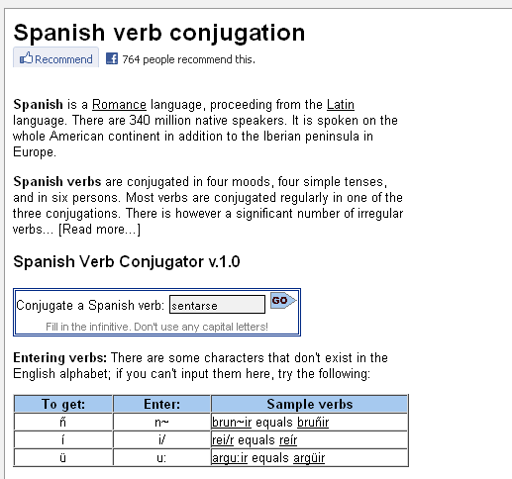
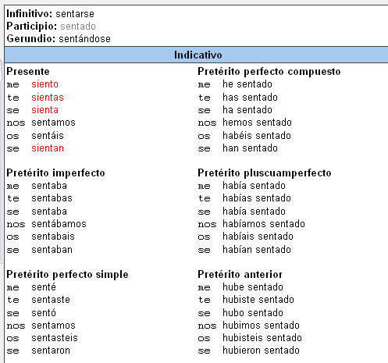
http://www.verbix.com/languages/spanish.shtml
Escribe el infinitivo en español aquí
el presente
el pretérito
Notes:
http://www.verbix.com/languages/spanish.shtml

Slide 43
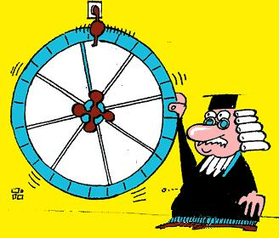
¡Conectar al azar!
especial
Escocia
tenis
lotería
Nueva York
queso
perro
paciente
Notes:
Choose a selection of words that students have to put into a 50 word max story.

Slide 44
Comberton Village College
Reflection and planning
Take this opportunity to remind yourself of the strategies for speaking and writing that we have seen. Identify one or two that you would like to include in your planning for a particular KS4 class. Sketch out in rough the language you want to include, depending on the topic you are teaching.
Rachel Hawkes

