Slide 1


Talk to me!
Session 3
Pair and Group Talk
Rachel Hawkes

Slide 2

Practising output (fluency , pronunciation, automatization, memory)
Idea 1: 1-2-1 dialogues

Slide 3


Warming up…
Person 1: One
Person 2: Two
Person 1: Three
1. Instead of saying ‘two’ clap.
2. Instead of saying ‘three’ jump.

Slide 4
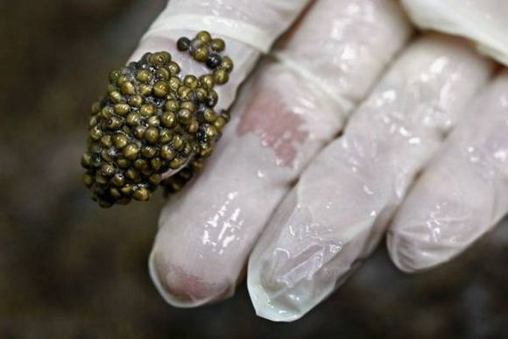

Slide 5


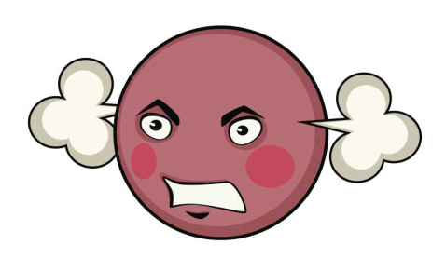


A bit of drama!
Person 1: What is that?
Person 2: I don’t know. What do you think?
Person 1: I’ve no idea!

Slide 7
A bit of drama!
Person 1: What is that?
Person 2: I don’t know. What do you think?
Person 1: I’ve no idea!

Slide 8
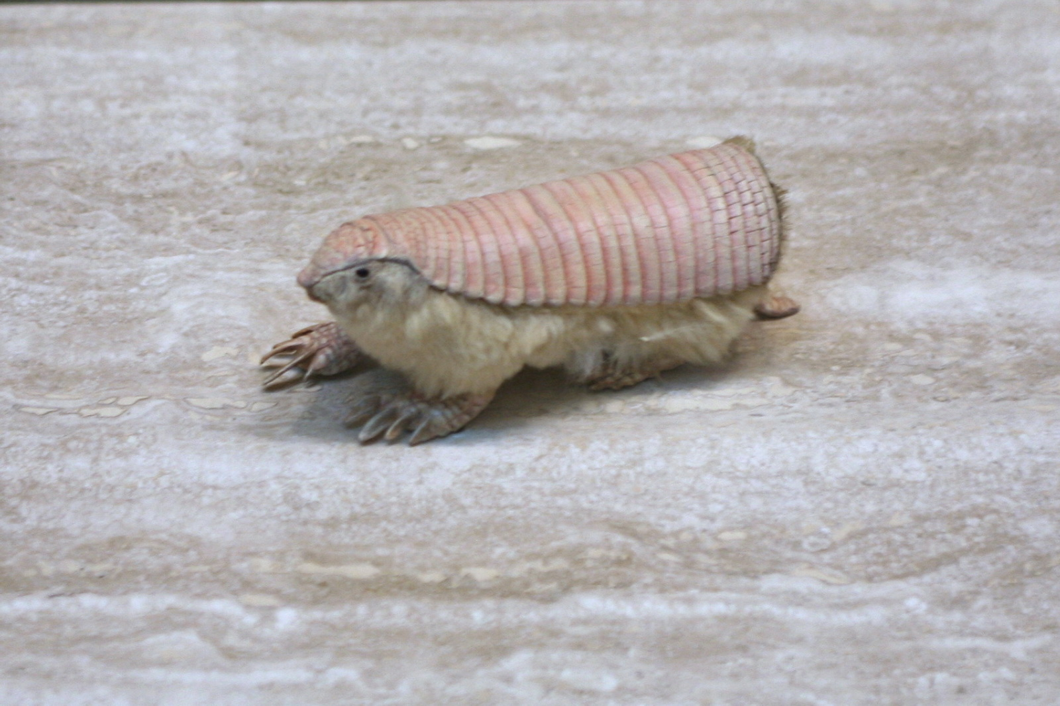

Slide 9
A bit of drama!
Person 1: What sports do you like?
Person 2: Erm…well I like water sports a lot.
Person 1: Water sports! I prefer team sports like football and hockey!

Slide 10
A bit of drama!
Person 1: What sports do you like?
Person 2: Erm…well I like water sports a lot.
Person 1: Water sports! I prefer team sports like football and hockey!
Person 2: I love tennis.
Person 1: Tennis? Why do you like tennis?.

Slide 11

Person 1: The most important thing for me is (the
beach)
Person 2: (The beach!) Well, for me it’s (the food).
Person 1: Yes, (the food) is also important to me.

Slide 12
A bit of drama!
Person 1: What does the word ‘education’ really mean?
Person 2: Well, it’s what you study at school isn’t it?
Person 1: Yes, of course. But it’s also about good manners and things like that.

Slide 13
Practising output (fluency , pronunciation, automatization, memory)
Idea 2
Telepathy (trapdoor/bubbles)

Slide 14
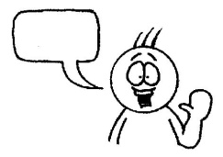
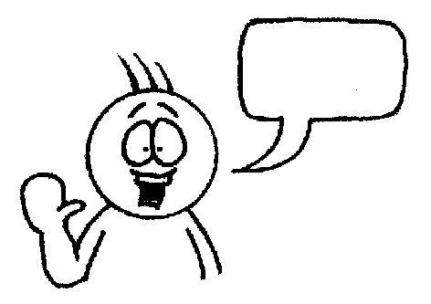



Last year
Last summer
Two years ago
to Greece
to America
to Spain
for two weeks
for one month
for 10 days
I went
my family.
my school.
my friends.
by coach
by car
by plane
and the journey was
boring.
exciting.
long.
with
We went
in a youth hostel.
in a four-star hotel.
on a campsite.
We stayed
the sights.
the beach.
the shopping centre.
It was tedious!
It was brilliant!
It was interesting!
We visited
a great
an amazing
an awful
I would like to go back.
I got really bored.
I loved the countryside.
I had
time
and/but
Notes:
This is a competitive game in pairs. Each chooses and option for each sentence in their head. One starts reading out loud, trying to anticipate the other’s choices. Each time they make a choice, the partner either nods or shakes his/her head. If the choice is wrong, play passes to the partner who starts the same process. If it is the right choice, the student gets to continue. The aim is to get to the end first. Answers don’t change, so this is also a great memory developer. Make sure they don’t write each other’s answers on their sheet, though, or else it won’t be a memory game!

Slide 15
Practising output (fluency , pronunciation, automatization, memory)
Idea 3: Speed-dating
SPEED-DATING

Slide 16
1 | Are you happy today?
2 | Are you a tidy person?
3 | Is your teacher strict?
4 | Are your friends fun?
5 | Is your birthday in January?
6 | Are you ok?
7 | Is homework annoying?
8 | Is English easy?
9 | Is school fun?
10 | Are you teachers nice?
11 | Is your grandma from France?
12 | Are … and … going out?
13 | Is …your boy/girlfriend?
14 | Are…your favourite fruit?
15 | Is…your favourite sport?
1 | Are you happy today?
2 | Are you a tidy person?
3 | Is your teacher strict?
4 | Are your friends fun?
5 | Is your birthday in January?
6 | Are you ok?
7 | Is homework annoying?
8 | Is English easy?
9 | Is school fun?
10 | Are you teachers nice?
11 | Is your grandma from France?
12 | Are … and … going out?
13 | Is …your boy/girlfriend?
14 | Are…your favourite fruit?
15 | Is…your favourite sport?
Notes:
to practise Yes, I am / No, I’m not / Yes, s/he is – No, s/he isn’t. Yes they are, no they’re not.

Slide 17
1 | What is your favourite hobby?
2 | How long have you been doing it for?
3 | Do you admire anyone who does this sport/activity?
4 | Are there other things you like doing?
5 | Do you have a favourite shop?
6 | What did you do last weekend
7 | Where did you go?
8 | What are you planning to do next weekend?
9 | What is your favourite TV programme?
10 | Where is it set? What’s it about?
11 | Do you like social media?
12 | Which Olympic sport would you most like to try?
Fillers
Oh, right
I see
OK
Well
erm…
Follow up questions
For example?
Anything else?
Oh, is it good?
Why (do you like it?)
When (do you do it?)
Where (do you do it?)

Slide 18
1 | ….favourite hobby?
2 | How long..?
3 | …admire anyone…?
4 | …other things…?
5 | …favourite shop?
6 | …last weekend?
7 | …go?
8 | …next weekend?
9 | …your favourite programme?
10 | …set? …about?
11 | …social media?
12 | …Olympic sport…?
Fillers
Oh, right
I see
OK
Well
erm…
Follow up questions
For example?
Anything else?
Oh, is it good?
Why (do you like it?)
When (do you do it?)
Where (do you do it?)

Slide 19
Practising output (fluency , pronunciation, automatization, memory)
Idea 4: Tandem
TANDEM

Slide 20
Tandem: Talk to your partner | Tandem: Talk to your partner
A | B
In English: Magst du Sport? | You should hear: Do you like sport? Answer the question.
You should hear: Do you like going to the cinema? Answer the question. | In English: Gehst du gern ins Kino?
In English: Spielst du gern Tennis? | You should hear: Do you like playing tennis? Answer the question.
You should hear: Do you like playing on the computer? Answer the question. | In English: Spielst du gern am Computer?
In English: Was ist dein Lieblingsfernsehprogramm? | You should hear: What is your favourite TV programme? Answer the question.

Slide 21
Practising output (fluency , pronunciation, automatization, memory)
Idea 5: Revise and revisit
REVISE and REVISIT

Slide 22
Letztes Jahr bin ich mit meiner Familie nach Spanien gefahren.
Notes:
It is hard to get students to use what they have learnt already sometimes. To focus them back on what is in their books, ask them to choose 9 sentences on the theme they have been covering and write them in English, making sure they know how they would be said in the TL (they will have this doubtless in their books). They then get up and go around the class, testing each other. When they find someone who can do a phrase correctly they write their name in one of the boxes next to that phrase. In this version each phrase needs 2 x different names. The plenary activity that follows is for the teacher to do a brief ‘spot check’ asking named individuals to do the phrase they have been signed up for. This gets students to think back to what they have covered and to fix it more deeply in their long term memories.

Slide 23




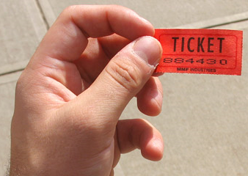
Spontaneity and interaction
REWARDING SPONTANEITY
Notes:
Lots of ways to do this. Try out a different way with different classes. The essential idea is to a. Make it clear that this is something you value extremely highly b. Raise the profile and keep it raised over time. C. provide simple, manageable incentives to do it.
Ideas
1. Raffle tickets
2. Cards with key words (same ones each lesson OR per half term have key topic words included too) – they spread them out on the desk at the start and have to try to use as many as they can by the end of the lesson
Chart on wall or in the backs of their books that they colour in when they have made spontaneous contributions
Have a spontaneous TL monitor each lesson who ticks a register list for each spontaneous contribution (not the same as answering Qs in class)
Annotated seating plan for each lesson for the teacher – record actual utterances against name → phone call home
I use these also to chart the longer exchanges that I plan to have with individuals in a lesson, so that I am not trying to have a longer interaction every lesson with every student but that over a month I would try to have had at least one with all students.
OK, so now if we look at how we plan and prepare for spontaneity with specific task types. This might sound like a paradox – prepare for spontaneity, but spontaneity for learners doesn’t mean spontaneity for the teacher necessarily. Also as I said before, certain tasks teach the specific skills needed for unplanned TL interaction better than others – it is strategy training at times, at other times it is aiming to open up the space for spontaneity and make room for learners to take the initiative, other activities may just help learners glimpse fluency – an aspirational moment where they do feel in command of the words sufficiently that they can ‘say to mean’ without inhibition. Although these activities are scripted and the opposite of spontaneous, in a way, ironically perhaps they have a role to play in this because of the way they build a confident platform from which learners will springboard to greater spontaneity.

Slide 24

Spontaneity and interaction
Idea 6: Character cards
CHARACTER CARDS

Slide 25
Character 1
silly, laughs a lot,
younger than the others
Character 2
self-confident,
speaks very loudly
Character 4
very energetic,
moves around a lot
Character 3
shy, speaks quietly
Character 5
likes being in charge,
interrupts continually
Character 6
in a very bad mood,
stamps his/her foot a lot
Character 7
enthusiastic, smiles a lot
and claps his/her hands
Character 8
thoughtful, stares into space, scratches his/her head

Slide 26
Spontaneity and interaction
Idea 7: Find someone who
FIND SOMEONE WHO

Slide 27
Find someone who…
has a birthday in June
has more than one sister
plays handball well
has the favourite colour green
doesn’t have any pets
Rachel Hawkes

Slide 28
Spontaneity and interaction
Idea 8: Group talk (opinions)
GROUP TALK (OPINIONS)

Slide 29


Me too!
Me neither!
I like / don’t like..
What do you think?
X
Why?
Why?

Yes, that’s true
No, that’s wrong!
X
Because...
Because...
I think that... because
I prefer…because…
..it’s better than..
..it’s worse than..
..it’s more… than..
..it’s less…than...

Yes, you’re right.
I agree.
No, that’s rubbish!
I don’t agree!
X
What do you think?
Rachel Hawkes
Notes:
Group talking frame for younger learners

Slide 30
Number | Example | Type of music
1
2
3
4
5
6
7
8
reggae
hip hop
classical
folk
rock
jazz
pop
traditional
hip hop | reggae | classical | folk
jazz | rock | traditional | pop
Notes:
There are 30 secs of each type of music to play to the students. Use the talking frames on the next 3 slides (Year 7,8,9) to get students to discuss the types of music after you have played the first 3 examples. If this routine works well you might want to repeat it after you’ve played the next 5 excerpts.

Slide 31
 |  | Type of music | Instruments | ¿Male or female vocalist?
1
2
3
4
5
6
7
8
reggae
hip hop
classical
folk
rock
jazz
pop
traditional
Notes:
Play them the extracts again and this time, ask them to identify some of the instruments that they hear and the gender of the singer if appropriate. I haven’t done the answers for these – it is to give a context for further discussion, answers not so important!

Slide 32

I (don’t) like because ...

Yes, you’re right
No, you’re wrong
X
I think that...
Yes, me too
No, me neither

X
On the one hand...but on the other hand…
You said that… but I think that...
No way! I don’t agree
What do you think?
Rachel Hawkes
Notes:
A more advanced talking frame - there is less supporting structure and more freedom, which increases the difficulty.

Slide 33
Spontaneity and interaction
Idea 9: Taboo
TABOO

Slide 34
Which sport is it?
1. It’s the most popular sport in England.
2. It’s an individual sport, which is very popular in England. You do it near the water. I think it’s slow and boring.
3. It’s a team sport that is played with a ball. It can be played on the beach. It’s a summer sport and also an Olympic sport.
4. It’s both an Olympic and a water sport. Rebecca Adlington won a gold medal in this sport in Beijing in 2008.
5. It’s a team sport that began in England. It’s fairly aggressive and it’s not an Olympic sport.
6. It’s a sport which is like a mixture of football and basketball.
rugby | volleyball | swimming
fishing | football | handball

Slide 35
It’s a..........sport | It’s a sport that you play/do...
team/individual | with a ball
combat | on a court
water | with....players
Olympic | on/in the water
popular (in/with) | It’s something that...
very expensive/ cheap | I (don’t) like because...
exciting/boring aggressive/brutal | It’s like a mixture between.... and....
Notes:
Students in pairs are going to describe 16 different sports as quickly as they can, without saying the sport name on the card.
To help students prepare for their taboo game. They can spend a few minutes looking through the cards and consulting the definitions prompts and practising, but need to speak spontaneously without notes when playing the game. They are working with a partner with half the cards each trying to get through the whole set of 16 cards in the quickest amount of time. They should practise several times and then can try against the clock, perhaps put them into groups of 6 ( 3 x pairs) with a stop watch for each group.
Time allowing, the winners from each group could go forward into the next round and so on until we get to winners?
Or to speed things up the 2nd and subsequent rounds could be done using 1 minute as the time allowed and seeing how many are successfully defined.

Slide 36
football | boxing | swimming | hockey
gymnastics | cycling | athletics | triathlon
rugby | sailing | fishing | decathlon
Formula 1 | skiing | snowboarding | judo
Notes:
This is the template for the taboo cards.
Cut up into cards and students take one and have to describe it not using the word.

Slide 37
Spontaneity and interaction
Idea 10: Cheat
CHEAT

Slide 38
CHEAT
A way to revise key language from each topic
A way to increase spontaneity and fluency in oral responses
How it works
Share out the cards (the object is to get rid of all your cards).
In turns, pick up a card (no-one must see each other’s cards!)
If it has a statement, read it out as if it were your opinion (with conviction, good intonation) and place the card in the centre face down
If it says ‘¡Estás haciendo trampa! you have to invent your own statement on the topic, deliver it convincingly as if it were just a regular card and place it in the centre face down.
If someone suspects you are ‘cheating’ s/he will say ‘trampa’. If you were, you have to pick up all the cards from the centre. If no, the accuser has to pick them all up.
The winner is the one to get rid of all his/her cards first.

Slide 39
In my view parents protect the child’s self-esteem. | Families today are more independent of each other. | As far as I’m concerned, the concept of family is still very important. | The traditional model of the family still exists but today there are many different models. | It’s important for young people to be able to talk about their problems with their parents.
One difference is that young people in England tend to leave home earlier. | I think that parents teach their children essential values. | I think that society is changing and the role of the family is changing too. | Sometimes my parents get angry with me, but they always support me in the important things. | In general I’d say that I get on well with my parents.
Family can be the only stable environment that the child knows. | The most important thing is for a family to share love and communication. | In my opinion, to be a parent you need a lot of patience and understanding. | I think it’s ideal to have mother and father figures in a family, but the most important is for the child to feel loved. | I think my parents are fair – they’re only strict when they need to be.
I believe that children need to know that their parents are always there for them to rely on. | We don’t row a lot in my family – only sometimes if I want to go out late on a school night. | Family is, and always has been, the central pillar of society. | Parents should respect their children and viceversa. | The role of parents brings a lot of responsibility with it.

Slide 40
For me the most important thing in a family is love. | Your parents help you to develop your personality. | The family creates the citizens of tomorrow. | I don’t think that there is an insurmountable generation gap. | People need to get to know each other better and break down the stereotypes.
You are cheating! | You are cheating! | You are cheating! | You are cheating! | You are cheating!
You are cheating! | You are cheating! | You are cheating! | You are cheating! | You are cheating!
You are cheating! | You are cheating! | You are cheating! | You are cheating! | You are cheating!

Slide 41
Make your own…
Youth culture and concerns
Lifestyle, health & fitness
Young people
Technology
Drink, drugs and sex
Music and fashion
Sport
Adventure sports and fashionable sports
Food and diet
Health

Slide 42


Idea 11: Debate
Spontaneity and interaction
DEBATE

Slide 43
Los debates
This term we will have 8 short debates. Each person will have one debate where s/he defends the motion and one where s/he attacks it. For the other 6 debates, s/he will have the role of either supporting or criticising the argument, through questions, discussion, and giving opinions. Everyone must have prepared enough to talk in every debate. Each person only has the major preparation role twice this term and will make a presentation of 2-3 minutes laying out their arguments for or against the motion. Then there will be some discussion (up to 10 minutes) and finally a vote.
Week/Date | Motion | Defending | Attacking
Wk 2 Thurs 12 Jan | “Un buen profesor es un profesor estricto”. | Maria (Martha, Eden, Sofie) | Freddie (Eddie, Kate, Molly)
Wk 3 Thurs 19 Jan | “No hace falta aprender los idiomas extranjeros porque todo el mundo habla inglés.” | Martha (Eddie, Freddie, Molly) | Kate (Maria, Eden, Sofie)
Wk 4 Thurs 26 Jan | “El sistema educativo español es mejor que el sistema inglés.” | Eddy (Kate, Eden, Maria) | Molly (Martha, Freddie, Sofie)
Wk 6 Thurs 9 Feb | “La educación separada no es una educación buena.” | Sofie (Eddie, Molly, Kate) | Eden (Freddie, Martha, Maria)
Wk 9 Thurs 8 Mar | “Más vale la pena trabajar que estudiar.” | Freddie (Molly, Martha, Eden) | Maria (Eddie, Kate, Sofie)
Wk 11 Thurs 22 Mar | “Hay que controlar la venta de ropa barata para proteger a los niños del tercer mundo.” | Molly (Martha, Kate, Sofie) | Eddy (Freddie, Eden, Maria)
Wk 12 Thurs 29 Mar | “Los que no trabajan no merecen ayuda del Estado.” | Eden (Maria, Freddie, Molly) | Sofie (Martha, Eddy, Kate)
Wk 1 Thurs 18 Apr | “La descriminación laboral ya no existe”. | Kate (Sofie, Eddy, Molly) | Martha (Eden, Maria, Freddie)

Slide 44
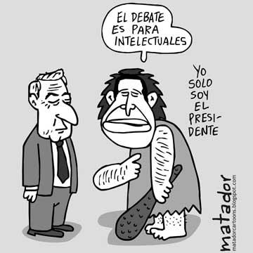
A debate is a formal discussion on a particular topic, in which opposing arguments are put forward.
Theme of the debate:
“A good teacher is a strict teacher”

Slide 45
If I understand you correctly, you think that..
You are 100% correct in saying…
but it’s not true to say..
You’ve said…but…
Not at all!
In my view…
Absolutely not!
I agree completely that…
Well, it depends
Notes:
To encourage students to respond to each other’s ideas

Slide 46

Idea 12: Spend the words
Range and content
SPEND THE WORDS

Slide 47
yesterday | but | in my view | I think that
last weekend | I most like | For example | I used to like
because | I would like | I prefer | I went
Notes:
These words/phrases are on cards and they are divided up equally between the pair or small group. Then a topic is given and the students have to try to ‘spend’ their cards naturally in conversation on the given topic.

Slide 48

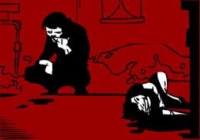
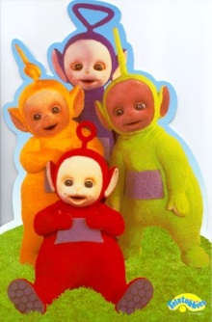


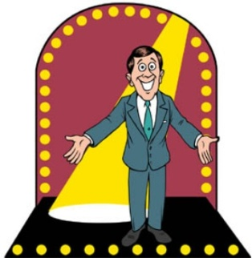
I like it/them a lot | it is set in | My favourite programme
entertaining | are | I prefer
because | it’s about | I don’t like it/them so much
My mum | a soap opera | stupid

Slide 49
Spend the Words
Take it in turns to ask and answer the same questions as before. This time, rather than speaking for as long as you can, you need to try and include the words below and ‘spend’ the words as you answer your 5 questions. Your partner will cross them off as you use them and you need to do the same for your partner. The first to use up all the words is the winner.
Tell me about your morning routine
What is good about your school?
What is not so good?
What is the most important thing about school for you?
Tell me about your future plans
for | harder than | easy | I usually get up | there will be
you can’t | you should | strict | I can’t stand | bullying
dirty | in my view | clubs | I don’t like | yesterday
last week | England | the rules | neither...nor | I want
break | good grades | maybe | uniform | in the playground

Slide 50
Idea 13: Bingo
Range and content
BINGO

Slide 51
Opinion | Present | Future
Reason | Time expression | Comparison
Complexity | Past | Reference to others
Notes:
Given a specific topic to talk about (or a set of questions if appropriate), students have to try to include each thing from the Bingo grid. When they do, they cross off the box and in their pairs, it’s the first person to cross everything off who wins (full house).

Slide 52
Idea 14: Just a minute!
Range and content
JUST A MINUTE! (GROUPS)

Slide 53

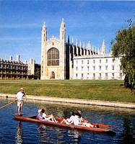


1
2
3
4
5
6
20
7
19
8
17
9
16
15
14
13
12
11
10
Notes:
A Keep Talking for 1 minute game. Can do this in groups but direct from the front. Click on ? To roll the dice. A player from each group then has to talk for 1 minute on that theme. 1 member of each group has a stop watch to time and others listen to make sure they keep talking. In this way, all engaged simultaneously.

Slide 54
1
2
3
opinion
usually
past
future
because
question
4
5
6
Notes:
Although this could work as a whole class activity, this version where talking for one minute is the aim I think it works best in groups (up to 6 in one group). Each person chooses a category, tries to talk for one minute (one of group has stop watch) and they can colour in the coloured segment if they manage it. If the teacher chooses to display this on data project, each segment is triggered so if you click on it it turns the colour as indicated on the key in top left of the slide.

Slide 55
Adjective – Opinion – Reason – Reference to someone else –
Then and now
Describe your school. | Describe your town/village.
Describe a famous person. | Describe your school.
Notes:
Model the first one with the class. Take suggestions and write them up. Then give them a few moments to prepare and practise. They will need to speak without notes when they report back, but they can refer back to the work done in this session and make brief notes.

Slide 56
Reflection
Think of perhaps 2 tasks or strategies for pair/group speaking that could be incorporated into your lessons over the next two weeks. Make a brief note of them and the topic you will need them to fit into.

