Slide 1


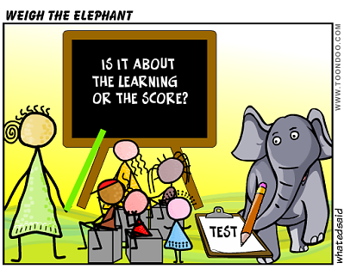
Life after levels:
the new face of assessment
Notes:
Life after levels: the new face of assessment
Session 1 : 10.00am -10.45am - Keynote
Life after levels: the new face of assessment
Starting from the key government messages about assessment, and outlining the range of possible approaches to life after levels, this keynote focuses on one specific example for languages, which measures progression from KS2 to KS4, whilst maintaining an emphasis on assessment for learning.

Slide 2
No more levels…
In May 2013, the Secretary of State announced: ‘as part of our reforms to the national curriculum, the current system of ‘levels’ used to report children’s attainment and progress will be removed. It will not be replaced.’

Slide 3
KS3: Assessment without NC Levels
All change…!
KS2: Languages statutory Y3 to Y6
KS4: New GCSE- new grading system / new level challenge
Notes:
When everything changes at once, it’s fairly interesting!
What is the constant that we can cling to in the face of this uncertainty?
We need some sort of anchor….

Slide 4
Expected Progress and Guided Learning Hours
Year | Hours of tuition | Cumulative hours | CEFR Level
3 | 19* | 19
4 | 19* | 38
5 | 38* | 76
6 | 38* | 114 | A1
7 | 95 | 209 | A2
8 | 95 | 304 | A2+
9 | 95 | 399
10 | 95 | 494 | B1
11 | 95 | 589
12 | 190 | 779 | B2
13 | 190 | 969 | C1
*Figures based on 30 minutes per week at Y3 and Y4, 60 minutes at Y5 and Y6
Notes:
The first thing I looked at was the Common European Framework. All other European countries use to measure language learning over time.
There are some stable guided learning hours which are useful in terms of setting out what is reasonable and likely from school-based language learning.
I set these hours up against the language learning allocations in two of the schools I work in, to get an idea.
We’ll come back to how I used this later, but one thing I want us to take from this slide: We are going to find it much easier to get students to the new GCSE if the statutory learning is in place at KS2…
The GLH were helpful in deciding the approximate progress we can expect during each key stage. All primary and secondary schools vary in their allocation of curriculum time for language learning, but here I have taken as a starting point 30 minutes per week in Years 3 and 4, 60 minutes in Years 5 & 6, and 150 minutes per week across KS3 and KS4. (This equates to 3 x 50 minute lessons across KS3 and KS4. This is a rough average. In fact, our dual linguists have less and our single linguist classes have slightly more than this.)
We can see from the table that, with this number of GLH, we might reasonably expect learners to achieve at least A1 competence by the end of KS2, and at least A2 by the end of Y8 (assuming the curriculum allocation hours given), making significant progress towards B1 but not reaching it by the end of Y9. I used this information to peg the key progression points A1 and A2 within the new framework.
A1 = Step 4 on my framework

Slide 5
Listening listen attentively to spoken language and show understanding by joining in and responding explore the patterns and sounds of language through songs and rhymes and link the spelling, sound and meaning of words Speaking engage in conversations; ask and answer questions; express opinions and respond to those of others; seek clarification and help* speak in sentences, using familiar vocabulary, phrases and basic language structures develop accurate pronunciation and intonation so that others understand when they are reading aloud or using familiar words and phrases* present ideas and information orally to a range of audiences* Reading read carefully and show understanding of words, phrases and simple writing appreciate stories, songs, poems and rhymes in the language broaden their vocabulary and develop their ability to understand new words that are introduced into familiar written material, including through using a dictionary Writing write phrases from memory, and adapt these to create new sentences, to express ideas clearly describe people, places, things and actions orally* and in writing Grammar understand basic grammar appropriate to the language being studied, such as (where relevant): feminine, masculine and neuter forms and the conjugation of high-frequency verbs; key features and patterns of the language; how to apply these, for instance, to build sentences; and how these differ from or are similar to English. | Listening listen to a variety of forms of spoken language to obtain information and respond appropriately transcribe words and short sentences that they hear with increasing accuracy Speaking initiate and develop conversations, coping with unfamiliar language and unexpected responses, making use of important social conventions such as formal modes of address express and develop ideas clearly and with increasing accuracy, both orally and in writing speak coherently and confidently, with increasingly accurate pronunciation and intonation Reading read and show comprehension of original and adapted materials from a range of different sources, understanding the purpose, important ideas and details, and provide an accurate English translation of short, suitable material read literary texts in the language, such as stories, songs, poems and letters, to stimulate ideas, develop creative expression and expand understanding of the language and culture Writing write prose using an increasingly wide range of grammar and vocabulary, write creatively to express their own ideas and opinions, and translate short written text accurately into the foreign language. Grammar identify and use tenses or other structures which convey the present, past, and future as appropriate to the language being studied use and manipulate a variety of key grammatical structures and patterns, including voices and moods, as appropriate develop and use a wide-ranging and deepening vocabulary that goes beyond their immediate needs and interests, allowing them to give and justify opinions and take part in discussion about wider issues use accurate grammar, spelling and punctuation.
KS2
KS3
Notes:
Handout 1: The new Programme of Study
KS2 on the left and KS3 on the right
Adapted to show more clearly the continuity between KS2 and KS3
Joining up KS2 and KS3 – arguably the most important piece of work we will do in our careers over the next 5 x years. The level of responsibility for this will differ, Heads of languages in secondary schools will have an obligation to grapple with it – otherwise their learners will not reach the levels required at the end of KS4 (even though we have not see what those are, we can guess from Curriculum 14 that the standards will be tough). But classroom teachers have the responsibility similarly to respond to what the learners in front of them know – to build on it, to notice the words, skills they already have, and not to assume a ‘from zero’ approach in Y7.
There are things we can do to make this explicit, too.
Group learners strategically and give them the theme for the lesson and a piece of sugar paper to write down any TL words at all that they think they might be able to make use of in that topic area. Get them to share all of the words in the group – including teaching each other the words.
Welcome their previous knowledge, and make it clear that it all counts.
This new NC document may be minimal, but sometimes there is strength in that. I found that this has been the first document that I’ve been able to share with heads of primary schools to get the message across about the need for sharing a common 7-year purpose and framework. It really hasn’t been clear enough before now. For the first time, there is a sense of pulling together – and a championing of the languages cause in the same way that primary and secondary have come together over literacy and numeracy – in terms of transition – ie. recognising the need for regular meetings and for sharing practice. This all on one A4 page doc has been a helpful catalyst here.
Let’s just take the sound-spelling link statement at KS2.

Slide 6
Listening
1) Listen and show understanding by joining in and responding
2) Link the sound, spelling and meaning of words
Speaking
1) Ask and answer questions
2) Express opinions
3) Ask for clarification and help
4) Speak in sentences
5) Describe people, places, things
Grammar
1) Gender of nouns
2) Singular and plural forms
3) Adjectives (place and agreement)
4) Conjugation of key verbs
Reading
1) Read and show understanding of phrases and simple texts
2) Read aloud with accurate pronunciation
3) Use a dictionary
Writing
1) Write phrases from memory
2) Adapt phrases to create new sentences.
3) Describe people, places, things
Notes:
Despite (or actually because of) its brevity, the PoS document is very dense. Here I’ve extracted the key elements further and categorised to achieve greater clarity.
Let’s imagine that students actually arrived with this knowledge for a moment…

Slide 7
Transition
“the introduction of compulsory language learning has not yet stimulated increased contact between language teachers in state primary and secondary schools.”
p.69, Language Trends Survey 2015

Slide 8

It’s good to talk!
It’s bad not to talk!
Notes:
Just rephrasing ‘It ‘s good to talk’ to ‘It’s bad not to talk’ can subtly alter the way we think about this.
There’s no doubt that there are both elements of carrot (reward) and stick (negative consequences) to the issue of KS2 – KS3 languages transition.
It seems clear that, at the moment, the factors compelling us to focus our energies on transition in a concerted and consistent way are not sufficient.
So, perhaps we need to consider a little more carefully what happens if we don’t talk…

Slide 9
Transition
How do we (best) assess on transition going forward?
A piece of writing produced in the summer term sent up to the Y7 teacher
A language specific baseline assessment in September of Y7
A non-language specific assessment in September of Y7

Slide 10
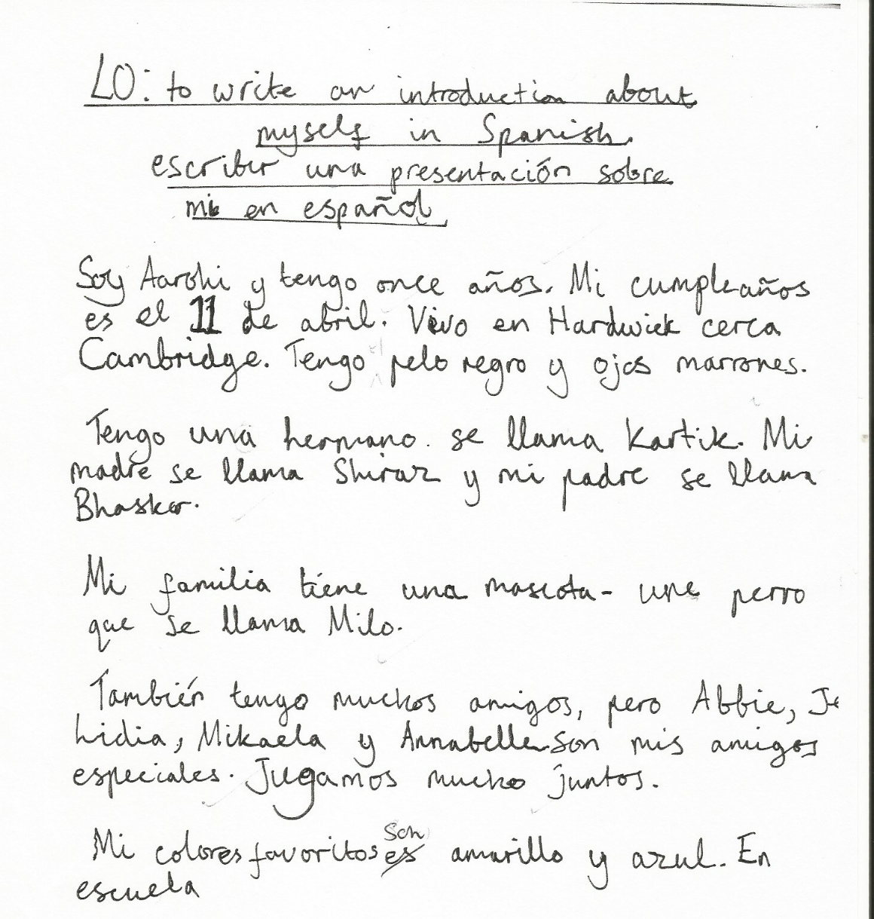
Y6 writing

Slide 11
GCSE Grades
1 | 2 | 3 | 4 | 5 | 6 | 7 | 8 | 9
G | F | E | D | C | B | A | A*

Slide 12
New GCSE:
new grading system / new challenge

Slide 13
KS3 Assessment
Life after levels …..
Challenges for languages assessment:
Accurate description of progression within the subject
Joined up approach across KS2,3 and 4
Assess knowledge (conceptual / content) and skills
Consistent with whole school approach

Slide 14
Whole school approach
schools are free to determine their own approach to assessment, data collection, achievement monitoring and reporting to parents
AND:
must publish their assessment policy for KS3 on their own school websites by September 2015?
individual subject specialists to describe progression within our own subjects

Slide 15



Slide 16
A new assessment framework
based on the requirements of the new Programmes of Study at KS2 and KS3
drawing also on
the CEFR and the Languages Ladder
the KS2 and KS3 Frameworks
attempting to avoid some of the pitfalls of the old NC Levels

Slide 17
A new assessment framework
provides descriptors of emerging linguistic competence, as evidenced through
performance in each of the 4 skills
applied use of grammatical structures
supporting vocabulary strand which describes a repertoire of knowledge

Slide 18
One thing I have tried to avoid is providing descriptors that can be reduced to a list of ‘things to do to reach the next level’.
There is a fine line between description and prescription.
That is not to say that teachers and learners should not look at the descriptors for the next step to help inform their target-setting, but that the descriptors do not provide an itemised checklist of things learners need to ‘do’ to move up to the next level.

Slide 19
Framework structure
10 language learning steps
Spaced out over the 7 years of KS2 and KS3
Year | 3 | 4 | 5 | 6 | 7 | 8 | 9
Steps range KS2 & KS3 | 1-2 | 1-3 | 2-4 | 2-4(+) | 3-6 | 5-8 | 6-10

Slide 20
Expected Grades at GCSE
Predicted range of future performance in the new GCSE exams (first teaching September 2016 to current Y9).
Year 9 Step | 6 | 7 | 8 | 9 | 10
new GCSE predicted grade range | 1-4 | 4-6 | 6-8 | 7-9 | 8-9

Slide 21
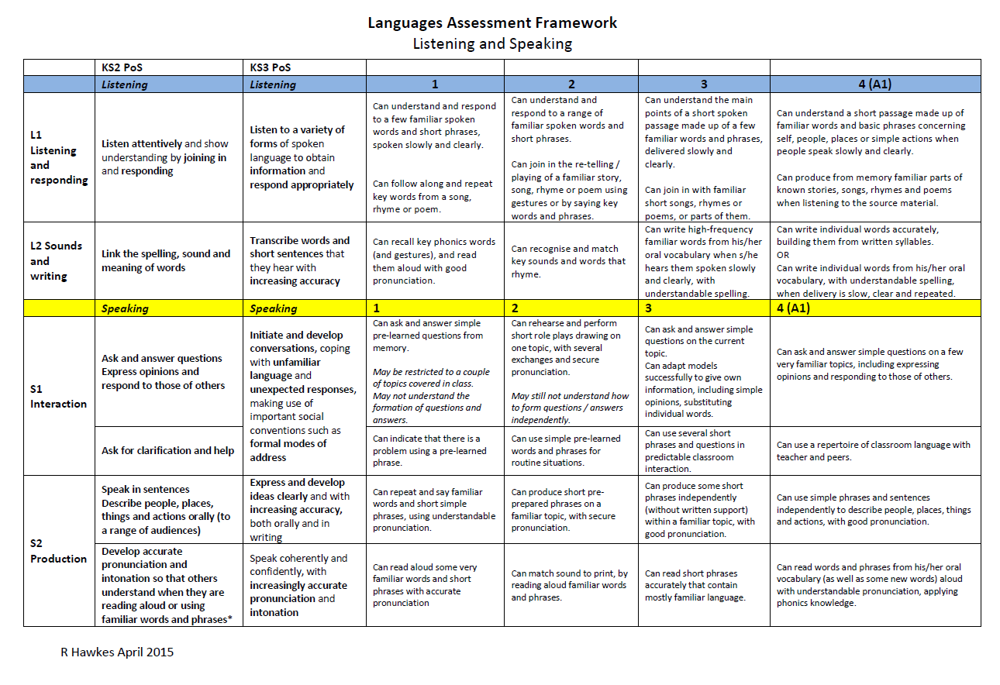
Notes:
Direct people to Handout 2

Slide 22

Year 7
Speaking
STEP 6
STEP 5
interact across three-four topics and in classroom talk, adapting and re-combining pre-learnt language to produce spontaneous exchanges, including forming some questions, with some pauses for thinking.
I can:
STEP 4
ask and answer an increasing range of questions in topic-based and classroom interaction, adapting familiar questions, and can give information confidently from two-three recent topics.
STEP 3
ask and answer simple questions on a few familiar topics and in classroom talk, giving opinions, using simple phrases and sentences independently, with good pronunciation, expressing opinions and responding to those of others.
ask and answer simple questions on the current topic and for classroom talk, producing short phrases, including opinions, from memory, with good pronunciation.

Slide 23
Year 8
Speaking
STEP 8
take part in multi-exchange conversations on familiar topics, including those covered in previous years, constructing questions independently and using a variety of structures, with more frequent pauses with less predictable interactions.
STEP 7
I can:
interact confidently within familiar topics and in classroom talk, asking questions independently, and can express information in more than one time frame, without reference to notes, with some hesitation and/or inaccuracy.
STEP 6
STEP 5
interact across three-four topics and in classroom talk, adapting and re-combining pre-learnt language to produce spontaneous exchanges, including forming some questions, with some pauses for thinking.
ask and answer an increasing range of questions in topic-based and classroom interaction, adapting familiar questions, and can give information confidently from two-three recent topics.

Slide 24
Year 9
Speaking
STEP 10
STEP 9
STEP 8
engage in longer stretches of unplanned conversation on the full range of KS3 topics, showing the ability to cope with unexpected questions or responses, whilst still pausing and/or making errors when trying out more ambitious language.
I can:
initiate and ask a range of questions confidently and appropriately to extend conversations (2-3 minutes) and can give more developed responses on a range of topics, which go beyond personal, everyday issues.
STEP 7
take part in multi-exchange conversations on familiar topics, including those covered in previous years, constructing questions independently and using a variety of structures, with more frequent pauses with less predictable interactions.
STEP 6
interact confidently within familiar topics and in classroom talk, asking questions independently, and can express information in more than one time frame, without reference to notes, with some hesitation and/or inaccuracy.
interact across three-four topics and in classroom talk, adapting and re-combining pre-learnt language to produce spontaneous exchanges, including forming some questions, with some pauses for thinking.

Slide 25
Customising the framework
From the SOW:
1) a list of 200 non-cognate words for each language taught
2) an overview list of the main topics and sub-topics to be learnt throughout the key stage
3) a list of the types of text to be included in listening and reading tasks

Slide 26
Customising the framework
From the SOW:
4) a list of the grammatical structures to be learnt, including when they are first introduced, subsequently re-used, and when independent use is expected.
(grammar strand included within the framework itself is not as generic as it might at first sight appear, being informed by the KS2 and KS3 Spanish schemes of work in use in our schools).

Slide 27
KS3 Assessment
Life after levels …..
Challenges for languages assessment:
Accurate description of progression within the subject
Joined up approach across KS2,3 and 4
Assess knowledge (conceptual / content) and skills
Consistent with whole school approach

Slide 28
Checklist
Described progression in my subject (from KS2 – KS4)
Cross-referenced with a recognised progression framework that has guided learning hours
Integrated that progression map into the new whole school assessment framework, which might have involved:
Breaking down overall progression into equal ‘steps’ with a notion of progress expected for the ‘more able, average and less able’ student over each year
Designing regular assessments that ‘test’ whether students have made (more / less than) expected progress
Setting assessments that rank students by percentiles that in turn generate an assessment of + = - (or verbal equivalent)
Generating targets and flight paths??!!

Slide 29
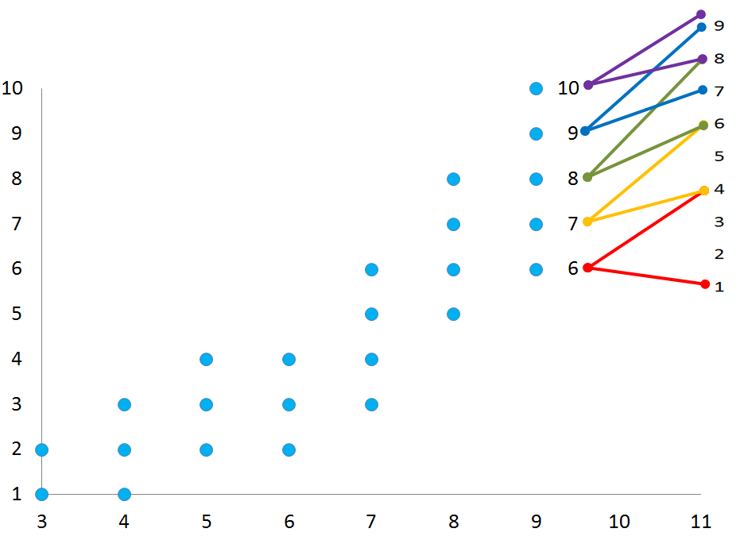
A realistic flightpath…
GCSE grades
STEPS
Academic year

Slide 30
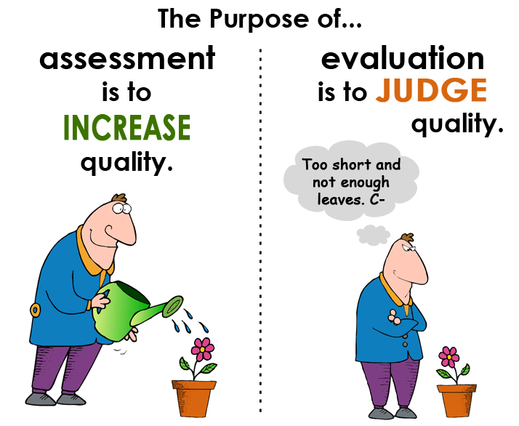
Let’s not forget…
http://www.rachelhawkes.com/PandT/Assessment_2015/Assess2015.php

Slide 31


Year 7
Listening & Reading
STEP 6
passages of approx. 50 words, containing predictable information drawn from several familiar topics, and can infer meaning of some unfamiliar language, translating individual words and short phrases into English.
STEP 5
I can understand:
the details in a short passage on a few familiar topics with predictable information contained in simple sentences with mostly familiar language, and can pick out and translate from written text individual words into English.
STEP 4
a short passage made up of familiar words and basic phrases concerning self, people, places or simple actions.
STEP 3
the main points of a short passage made up of a few familiar words and phrases.

Slide 32
Year 8
Listening & Reading
STEP 8
longer passages of approx. 100 words, which may contain a few unpredictable elements, including a range of structures, and drawn from several topics including those less recently studied, and can cope with some unfamiliar language in a variety of text types.
STEP 7
I can understand:
passages of approx. 80 words, containing predictable information from four-five topics including a range of structures, and can infer meaning in some authentic and/or adapted texts, translating short phrases into English.
STEP 6
STEP 5
passages of approx. 50 words, containing predictable information drawn from several familiar topics, and can infer meaning of some unfamiliar language, translating individual words and short phrases into English.
the details in a short passage on a few familiar topics with predictable information contained in simple sentences with mostly familiar language, and can pick out and translate from written text individual words into English.

Slide 33
Year 9
STEP 10
Listening & Reading
STEP 9
STEP 8
extended, varied passages of approx. 200 words, which contain unpredictable elements, time frames, a range of structures, and drawn from any topics previously studied, and can translate short passages into English.
I can understand:
longer, varied texts of approx. 150 words, which may contain some unpredictable elements, different time frames and a range of structures, and can translate shorts extracts into English.
STEP 7
longer passages of approx. 100 words, which may contain a few unpredictable elements, including a range of structures, and drawn from several topics including those less recently studied, and can cope with some unfamiliar language in a variety of text types.
STEP 6
passages of approx. 80 words, containing predictable information from four-five topics including a range of structures, and can infer meaning in some authentic and/or adapted texts, translating short phrases into English.
passages of approx. 50 words, containing predictable information drawn from several familiar topics, and can infer meaning of some unfamiliar language, translating individual words and short phrases into English.

Slide 34

Year 7
Writing
STEP 6
STEP 5
write short paragraphs from memory on two-three topics with good accuracy, and adapt known structures (with some inaccuracy) and add new, researched language with some success, as well as translate short sentences from English across two-three topics.
I can:
STEP 4
write a paragraph from memory made up of short sentences using taught language on a few topics, (which may have some mistakes), and can translate short phrases from English containing all familiar language from the most recent topic.
STEP 3
write a short, simple text from memory, using simple sentences from one familiar topic with reasonable spelling, and can write sentences on a few topics using a model, e.g. a writing frame.
write words, phrases and short, simple sentences from memory with understandable spelling, and change some elements in sentences to create new ones.

Slide 35
Year 8
Writing
STEP 8
write text of several paragraphs from memory, using a variety of structures, manipulating known structures and combining with new elements to produce new meanings, which are almost always clear, and translate a short paragraph from English, drawing on language from four-five topic areas.
STEP 7
I can:
write from memory at greater length (e.g. 60-75 words) on one topic, using more than one time frame and a logical structure, recycling learnt language and combining with new elements to express own ideas, as well as translate a short paragraph from English.
STEP 6
STEP 5
write short paragraphs from memory on two-three topics with good accuracy, and adapt known structures (with some inaccuracy) and add new, researched language with some success, as well as translate short sentences from English across two-three topics.
write a paragraph from memory made up of short sentences using taught language on a few topics, (which may have some mistakes), and can translate short phrases from English containing all familiar language from the most recent topic.

Slide 36
Year 9
Writing
STEP 10
STEP 9
STEP 8
write a coherent piece of prose of several paragraphs from memory, using appropriate links between paragraphs, using a range of vocabulary and structures, showing a growing awareness of FL syntax, and how this differs to English, and can translate a paragraph from English drawn from all KS3 topics covered.
I can:
write extended pieces of several paragraphs from memory, drawn from a variety of current and previous topics, using a range of more complex structures (with some errors), and accurate straightforward language, and can translate a paragraph from English from previous and current topics.
STEP 7
STEP 6
write text of several paragraphs from memory, using a variety of structures, manipulating known structures and combining with new elements to produce new meanings, which are almost always clear, and and translate a short paragraph from English, drawing on language from four-five topic areas.
write from memory at greater length (e.g. 60-75 words) on one topic, using more than one time frame and a logical structure, recycling learnt language and combining with new elements to express own ideas, as well as translate a short paragraph from English.
write short paragraphs from memory on two-three topics with good accuracy, and adapt known structures (with some inaccuracy) and add new, researched language with some success, as well as translate short sentences from English across two-three topics.

Slide 37
Year 7
Grammar & Vocabulary
STEP 6
STEP 5
recall and use 30 verbs in the present tense and the simple future, use question words with more confidence to frame spontaneous questions, and use the relative pronoun ‘which’ in a variety of contexts to extend sentences, and use 80 cognate and 50 non-cognate words.
I can:
STEP 4
use nouns and adjectives, subject pronouns and present tense verbs (regular and key irregular) to generate positive and simple negative sentences independently, recalling at least 20 verbs, and use 50 cognate and 30 non-cognate words.
STEP 3
use high-frequency verb forms, nouns, articles and adjectives to form simple sentences independently, and has a basic repertoire of words and phrases related to people, places, things and simple actions.
use definite and indefinite articles, agree adjectives for number and gender, use all persons of several regular verbs in the present tense (with a writing frame) and use days of the week in simple sentence formation.

Slide 38
Year 8
Grammar & Vocabulary
STEP 8
recall and use 50 verbs, selecting and forming the correct time frame, albeit with some errors, and can use several modal verb + infinitive constructions, a variety of negative forms, and superlatives, and use 100 cognate and 100 non-cognate words.
STEP 7
I can:
recall and use 40 verbs, form the past tense with regular and key irregular verbs, use some modal verbs in combination with infinitives, use reflexive verbs in limited contexts and use comparative forms, and use 100 cognate and 80 non-cognate words.
STEP 6
STEP 5
recall and use 30 verbs in the present tense and the simple future, use question words with more confidence to frame spontaneous questions, and use the relative pronoun ‘which’ in a variety of contexts to extend sentences, and use 80 cognate and 50 non-cognate words.
use nouns and adjectives, subject pronouns and present tense verbs (regular and key irregular) to generate positive and simple negative sentences independently, recalling at least 20 verbs, and use 50 cognate and 30 non-cognate words.

Slide 39
Year 9
Grammar & Vocabulary
STEP 10
STEP 9
STEP 8
recall and use 75 verbs with reasonable accuracy in all tenses covered, can use direct object pronouns, a range of conjunctions, demonstrative adjectives and pronouns, and relative pronouns, and use 200 cognate and 150 non-cognate words.
I can:
recall and use 60 verbs, selecting and forming the correct tense with familiar and researched language, with some errors, and can form the imperative, use direct object pronouns and some conjunctions, and use 150 cognate and 125 non-cognate words.
STEP 7
STEP 6
recall and use 50 verbs, selecting and forming the correct time frame, albeit with some errors, and can use several modal verb + infinitive constructions, a variety of negative forms, and superlatives, and use 100 cognate and 100 non-cognate words.
recall and use 40 verbs, form the past tense with regular and key irregular verbs, use some modal verbs in combination with infinitives, use reflexive verbs in limited contexts and use comparative forms, and use 100 cognate and 80 non-cognate words.
recall and use 30 verbs in the present tense and the simple future, use question words with more confidence to frame spontaneous questions, and use the relative pronoun ‘which’ in a variety of contexts to extend sentences, , and use 80 cognate and 50 non-cognate words.

