Slide 1
Notes:
Students have revised SEIN and HABEN for homework. Start the lesson by narrating the story. Tell it twice through. Then give students the worksheet for them to complete. This is a full lesson’s activity, but if there is any time at the end, students can complete any suitable SEIN / HABEN plenary e.g. chanting the songs, mini whiteboard translations etc…

Slide 2
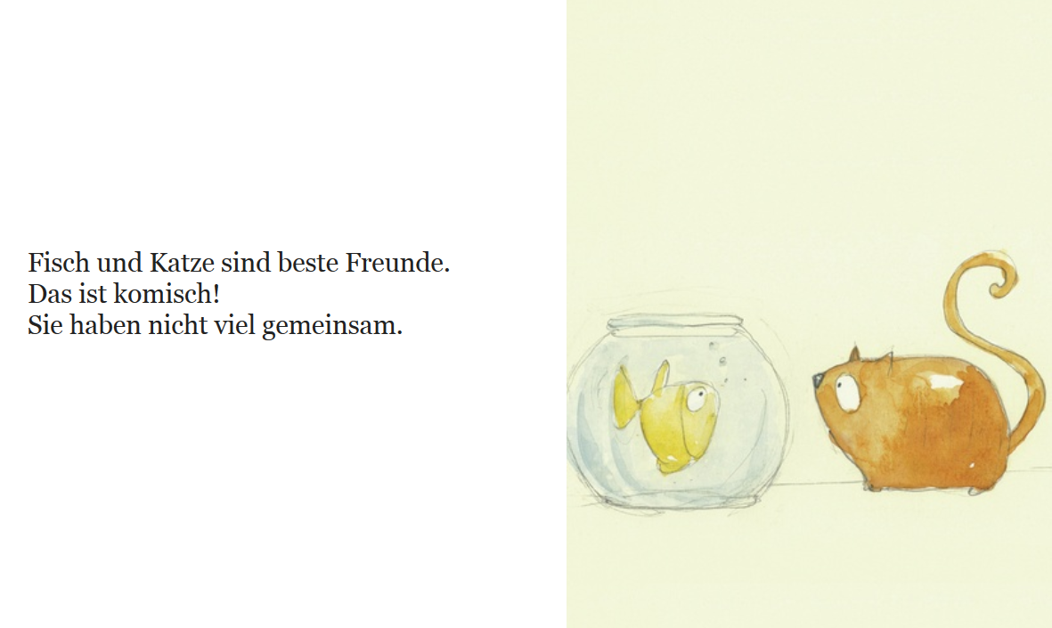

Slide 3
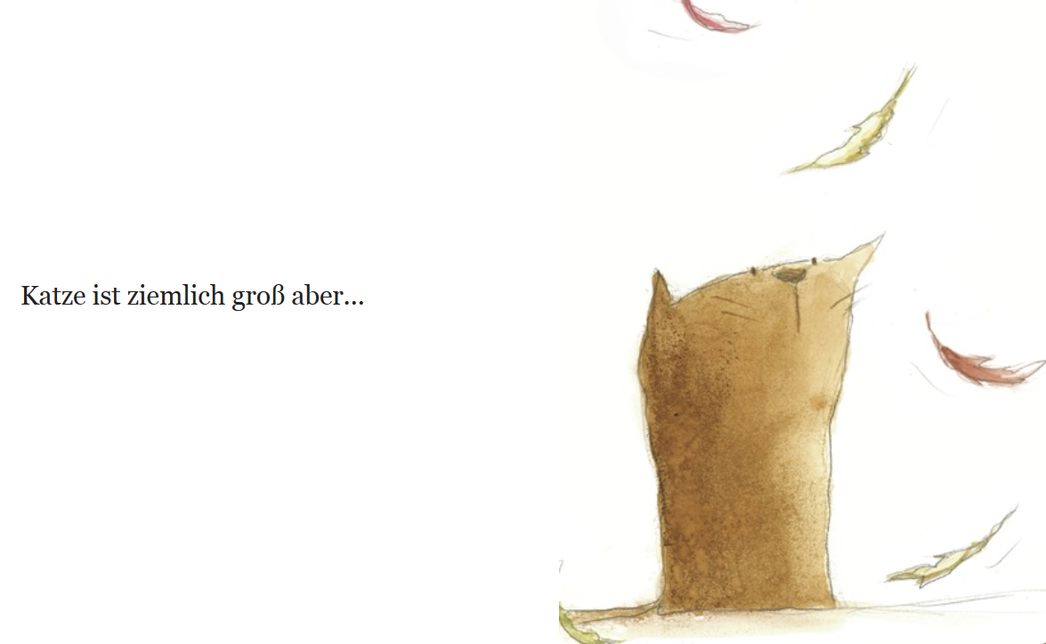

Slide 4
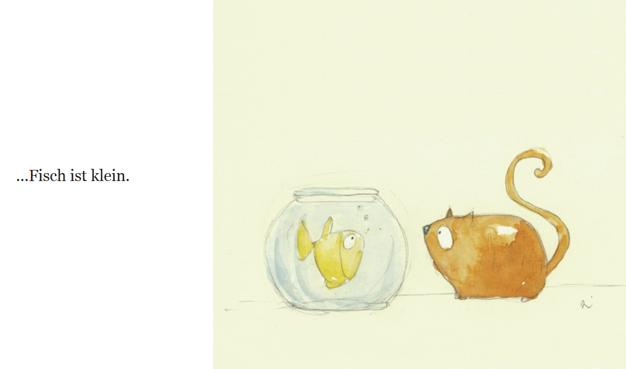

Slide 5
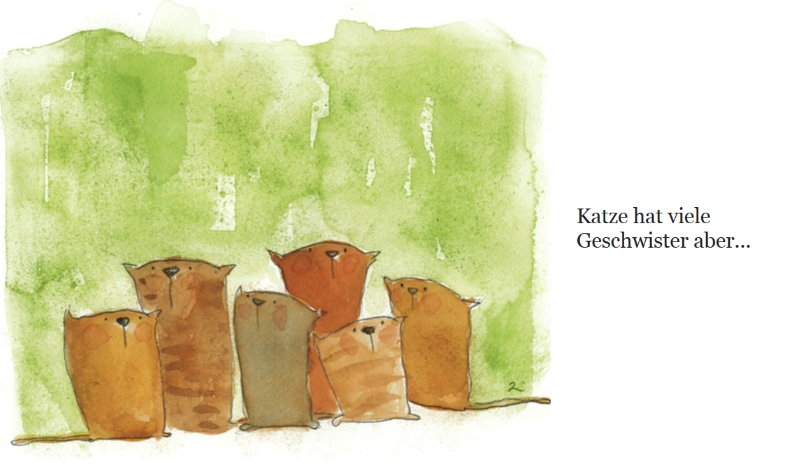

Slide 6
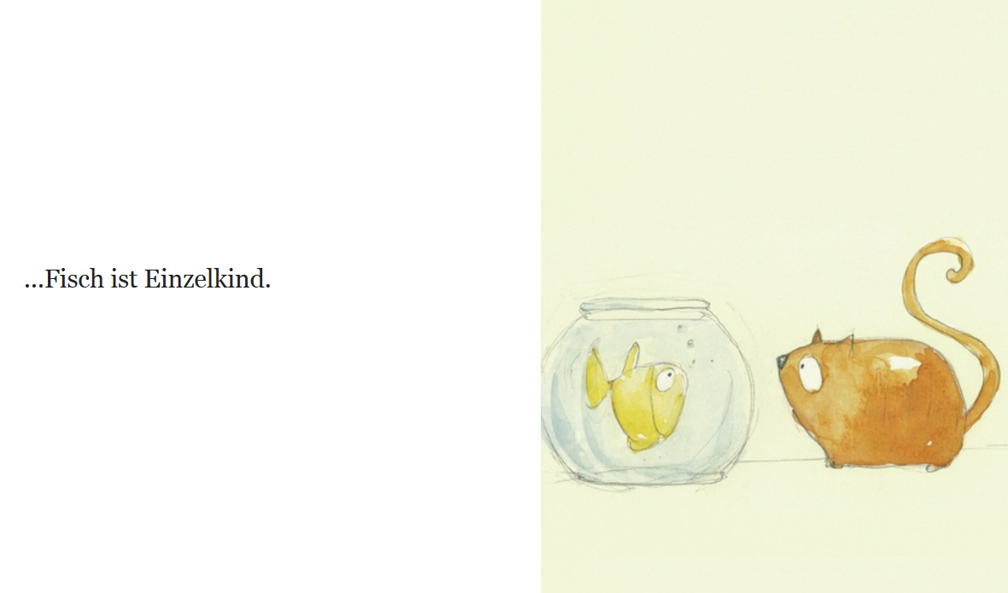

Slide 7
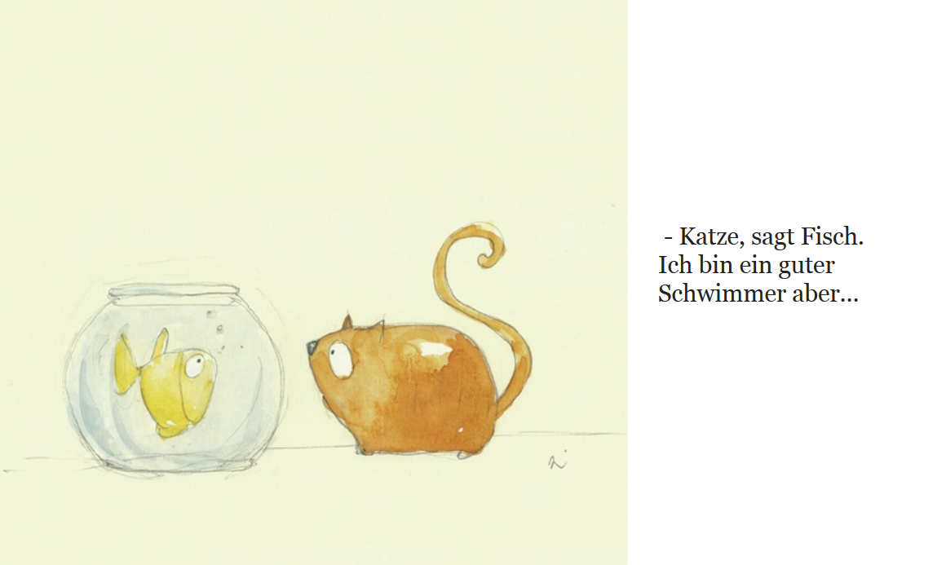

Slide 8
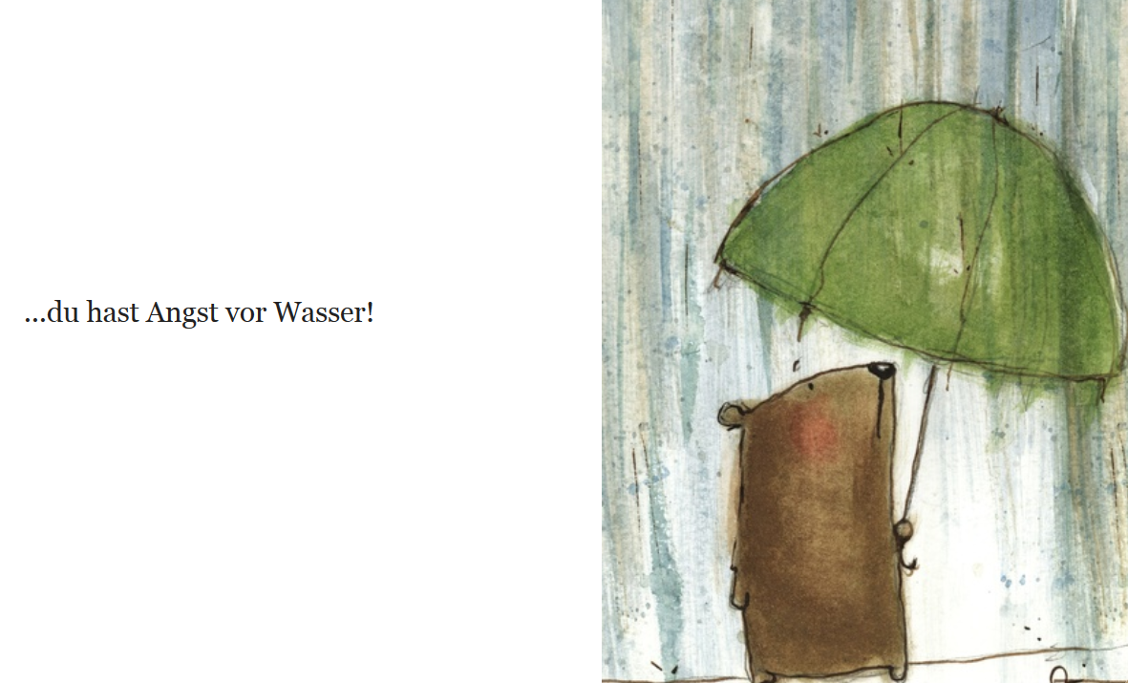

Slide 9
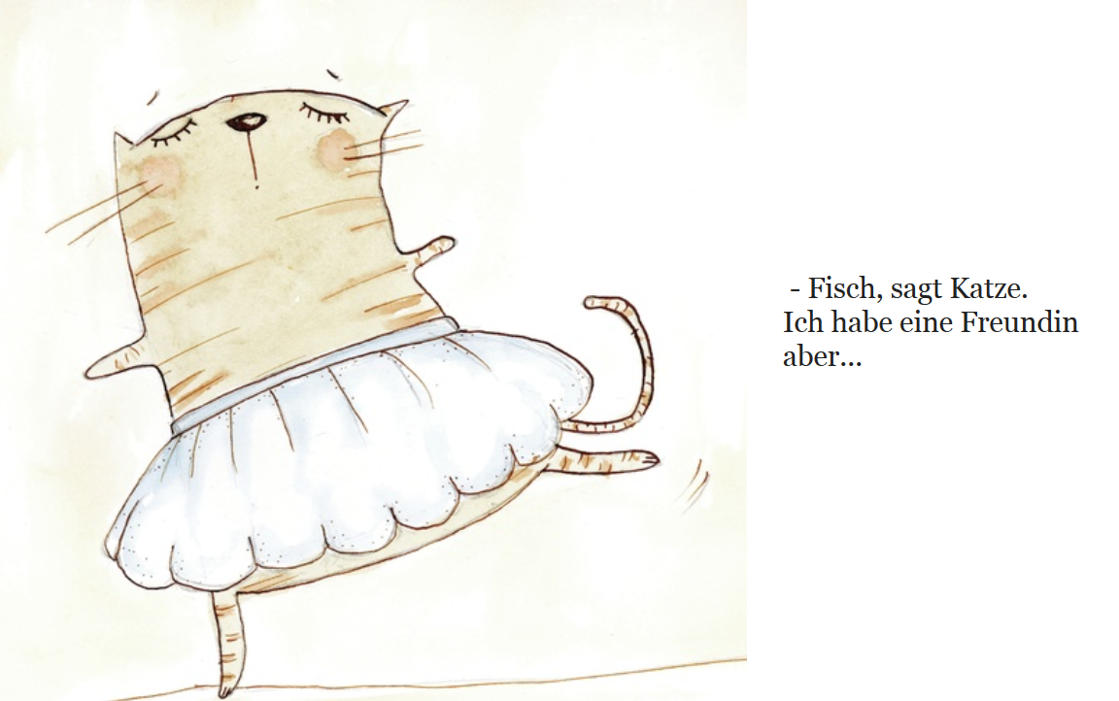

Slide 10
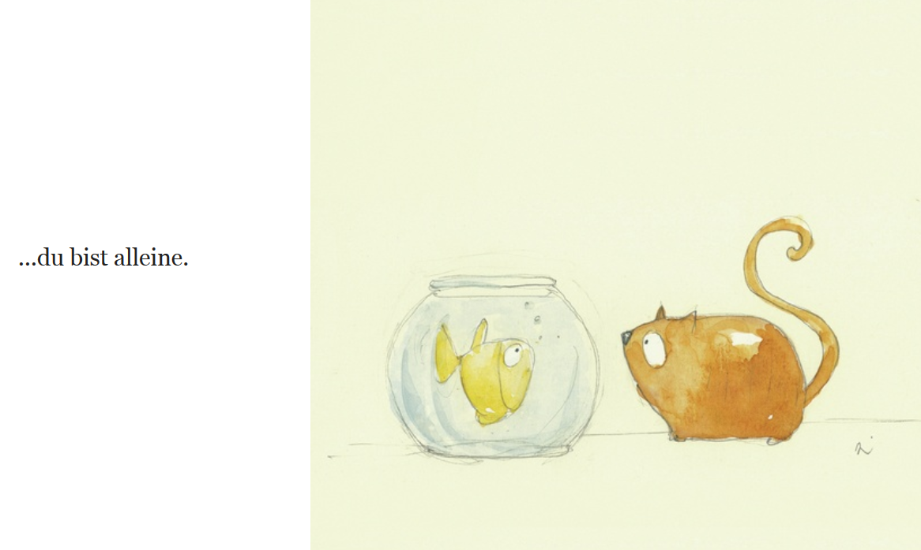

Slide 11
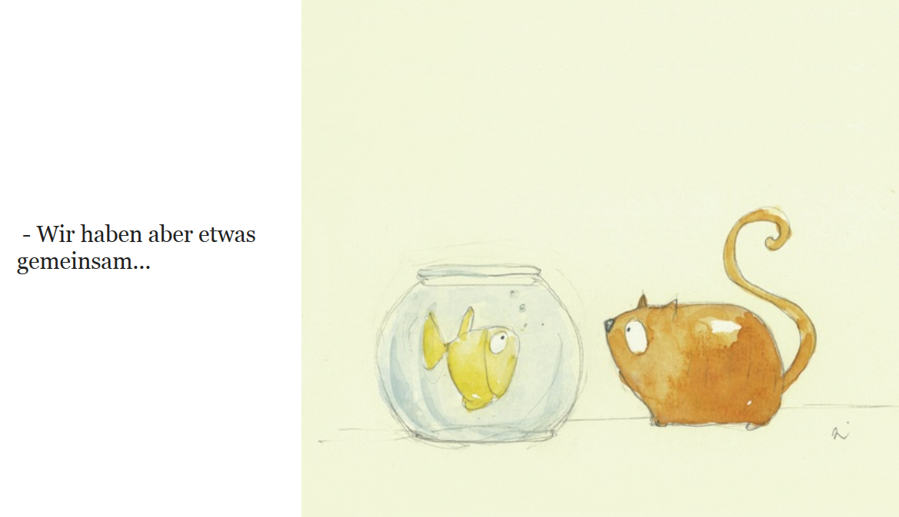

Slide 12
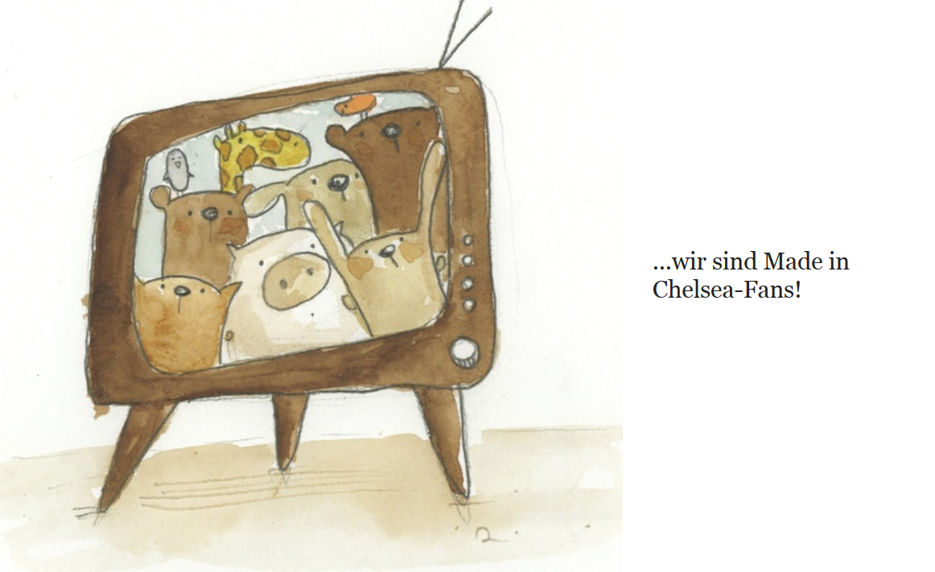

Slide 13
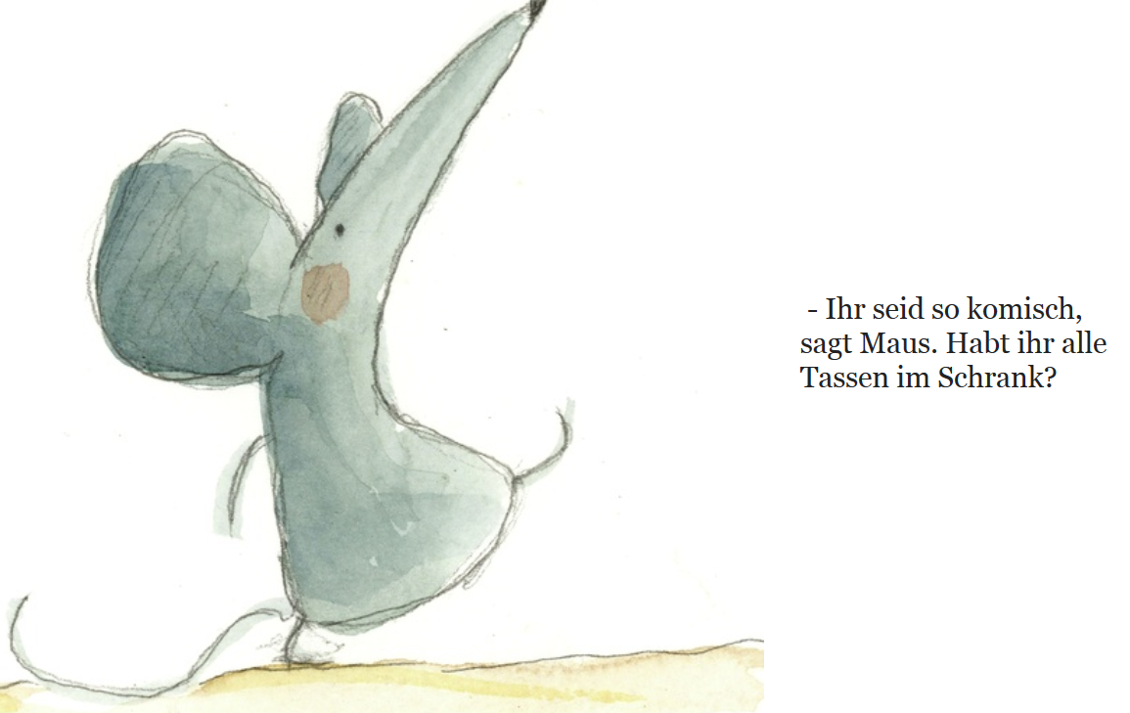

Slide 14
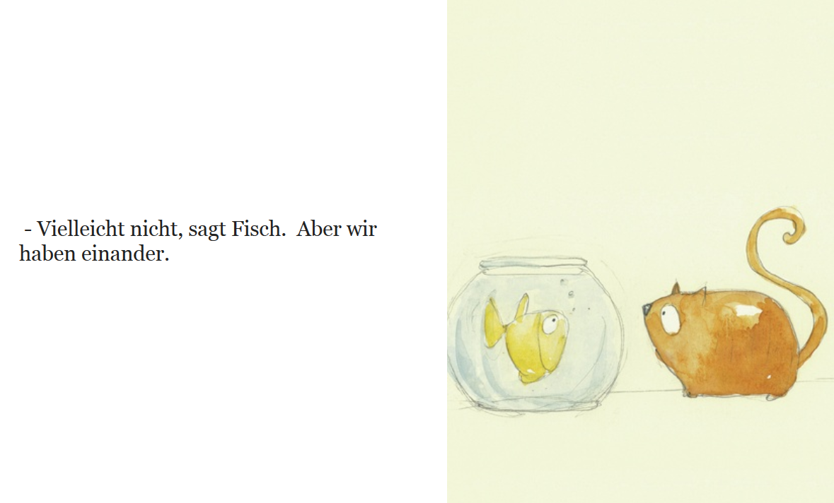

Slide 15
Jetzt seid ihr dran!

Slide 16
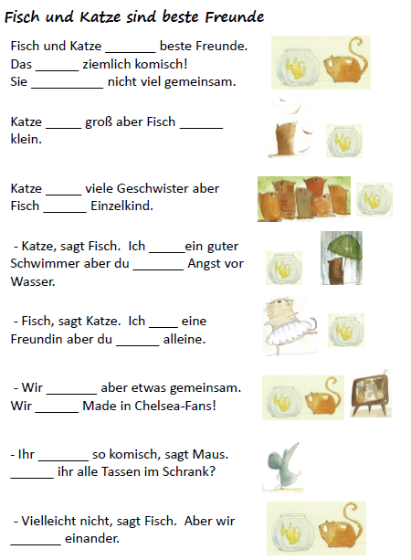
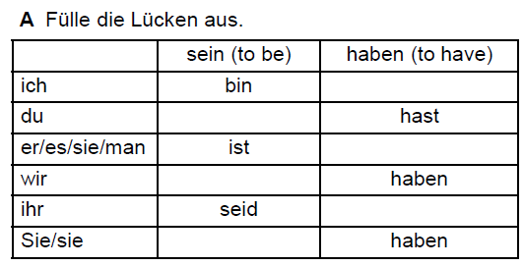
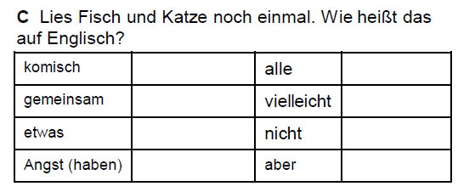
 | to be | to have
I
you
he/she
we
you (plural)
they
sind
am
have
ist
haben
are
have
is
has
ist
ist
are
have
are
have
hat
are
have
ist
bin
hast
habe
bist
habe
hat
bist
sind
habt
sind
haben
sind
seid
Habt
funny
all
in common
maybe
something
not
haben
fear (have)
but
Notes:
Worksheet answers

Slide 17
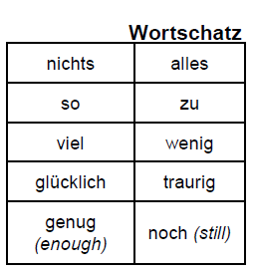
Being familiar with the most common 500 words of any language generally assures that 70-80% of basic, non-specialised texts can be understood.
nothing
everything
so
too
a lot / much
little
happy
sad

