Slide 1


Writing skills for GCSE:
Building a transferable repertoire from KS3
Making the most of memory
Developing translation skills
Notes:
Writing skills for GCSE (RH)
Building a transferable repertoire from KS3
Making the most of memory
Developing translation skills

Slide 2
Writing: ideas for teaching
Students need to:
know how to form simple, compound and complex sentences
have a bank of structures and core language that they can manipulate well across a the range of contexts at GCSE
have language stored in long-term memory
be attentive to detail, able to spot and correct errors
vary vocabulary and structures
write for different purposes, showing an awareness of style and register

Slide 3
1 Core Structures (and meaningful contexts)
Text
Deduce
Elicit
Use
Create
Evaluate
Sentence
Word
Being familiar with the most common 500 words of any language generally assures that 70-80% of basic, non-specialised texts can be understood.
Notes:
1 Core structures
Students need to have a bank of structures and core language that they can manipulate well across the range of contexts at GCSE. This learning begins at KS3 (or earlier if the language is studied at KS2). Once identified this key language, made up of high-frequency verbs, adverbs, adjectives, nouns and pronouns, is introduced systematically, built up over time and then repeatedly recycled across topics so that students combine and re-combine the elements to develop what they can write (and say). It is essential that teachers keep this core language uppermost in their planning.
One of the difficulties is mastery of the essentials. Knowing things really really well needs a lot of encounters, and opportunities for recycling across different topic / context areas, and so as not to be boring, in different formats and task types.
To ensure progression towards independence within such recycling, it can be helpful to think in terms of DEUCE – Deduce, Elicit, use, Create, Evaluate. Deduction as a point in our planning inclines us to start with the language in context, in a text, and move from text to sentence and then to word level, only to build back up again, more independently and creatively.
Let’s have a go at a task in German. This was designed to help German learners revise SEIN and HABEN before being introduced to the Perfect Tense. We often assume that they know these two verbs inside out by this point, but no matter how many vocab test we might have done, many still struggle with the bottom half of the verbs, can’t remember all of the pronoun meanings, confuse sie (they) with ihr (you plural) etc..
Stories (or other texts) can work really well for making the familiar but not 100% known just a little bit better known.
The use of stories fulfils on the essential paradigm of memory – that we remember best the things we things about, and the more deeply we think the better we remember, so our job is to get students to think as much as possible about what the language means as many times and in as many different ways as we can.
This story has very deliberately chosen words almost exclusively in the top 500 (many in the top 100) German words.

Slide 4

2 Sentence-building
Simple sentence (one main verb, one main idea)
Compound sentence (two simple sentences and two equal ideas joined together by ‘and’, ‘but’, ‘or’ etc.)
Complex sentence (two joined clauses, but only one is a simple sentence. The other is a dependent clause, which can’t stand on its own.)
NB: Awarding bodies define ‘complexity’ as the use of elements from the Higher Grammar list.
Notes:
It is important for us to plan for opportunities to lead students to producing these and knowingly, too. This is knowledge that lies within KS2 literacy, so we can add TL terminology (oración simple, compuesta y compleja) and then devise tasks to help students create them, in whatever topic we are working on.
Clearly – we can also use reading activities to sensitise students to the sorts of sentences we are after, but it also works well to ask them to generate sentences where they need to think about meaning.
The 13 word sentence they produce grows from simple – compound – complex.
There are lots more variations on the essential idea of starting with a simple sentence and growing it, here in this list. We don’t need to look at an example of each one, (we haven’t got time, in any case!) but it might be helpful to share a couple of activities that I adapt often and which word well with KS3 and KS4 classes.
Change one detail plenaries – give learners a statement and, using whiteboards for written version or orally, learners respond by changing a detail. Make this more interesting by focusing the statements on a visual stimulus.
Grow the sentence – instead of changing a statement, add something to it. There could be a list of options, or the task could be cumulative. This can be done as a ‘consequences’ style activity, folding over and passing writing on.
Target text – (the written equivalent of target talk) – pose a question and insist that answers have a set number of words (start with 7, 8 or 9). In subsequent rounds, set a minimum limit of 10,11,12.
Picture description - provide a visual stimulus and ask for three statements describing the picture: two should be true and one false.
Provide two pictures with some sentences / text describing one of them. Students adapt these to describe the second picture.
Adaptation tasks – for example, give students this sentence: Je joue au football avec mon frère and the following instructions:
change the subject (je)
change the sport
put “mon frère” in the plural
add one adjective
add one time expression
add 5 words or more to the sentence, making sure that it still makes sense at the end!
Now think of one sentence yourself and give it to your partner for them to do the same exercise!
Pyramids – visual way to model and practise creating longer sentences for both speaking and writing.
Mastermind – essential idea is for teacher or student to create a sentence and write it down (from the grid of options you’ve designed). Learners create sentences in turn orally, trying to match the mastermind sentence. Each time feedback is given, indicating how many of the 3 sentence segments are right.
Wordle, Tagxedo etc. – use these tools to display words jumbled. Students sort into categories and then use them to form sentences.

Slide 5
¡Con poco alcanza! (a little goes a long way!)
es | muy | al tenis | no | aburrido | pero | lo
juego | jugar | mucho | a menudo | porque | me gusta
1. no es aburrido | it is not boring
2.
3.
4.
5.
6.
7.
8.
9.
10.
A. Escribe tantas frases cortas como puedas en 6 minutos.
B. Haz una frase larga que usa todas las 13 palabras/frases.
Me gusta jugar al tenis pero no lo juego muy a menudo porque es aburrido.
Notes:
If students are struggling with this, give them some ideas to start them off.

Slide 6
De vacaciones…
dije = I said / dijo = s/he said
me gusta… | ir a la playa | con mi familia
prefiero… | ir a Francia / España… | con mis amigos
puedo… | tomar el sol | en el mar
quiero… | nadar | en la playa
tengo que… | descansar | en una discoteca
lo más importante (para mí) es | bailar | en un club
me encanta… | jugar al tenis / al fútbol… | en la piscina
lo mejor es… | viajar… | en un hotel / una granja…
lo peor es… | alojarme… | en tren / en avión
 | ir de compras
decidí… | visitar monumentos
iba a… | sacar fotos
 | alquilar (una bici/un barco)
voy a… | hacer surf /el esquí
me gustaría… | comer
espero… | beber
present
normalmente
siempre
a veces
a menudo
todos los años / días
ayer
el año pasado
el año que viene
past
future
y | pero | porque | también | entonces | cuando | aunque | por ejemplo | sobre todo si
fui = I went / fuimos = we went
hace sol / frío / calor = it’s sunny / cold / hot
Notes:
Here is a more elaborate, full way of doing the same sort of thing.

Slide 7
¿Cómo se dice en español?
1 I like going on holiday with my family.
2 The best thing is sunbathing on the beach.
3 Last year we went to Greece.
4 I like Greece although it is very hot there.
5 Everyday I used to go to the beach or the pool.
6 One day I decided to visit the monuments and take photos.
7 My mum said that it was fantastic.
8 Next year I want to go to America, for example, to New York.
9 I hope to stay in a luxury hotel there.
Notes:
Translation sentence-building orally with Spanish FLA, referring to core language sheet if/when necessary.

Slide 8
Respuestas
1 I like going on holiday with my family.
2 The best thing is sunbathing on the beach.
3 Last year we went to Greece.
4 I like Greece although it is very hot there.
5 Everyday I used to go to the beach or the pool.
Me gusta ir de vacaciones con mi familia.
Lo mejor es tomar el sol en la playa.
El año pasado fuimos a Grecia.
Me gusta Grecia aunque hace mucho calor allí.
Cada día iba a la playa o a la piscina.
Notes:
Translation sentence-building orally with Spanish FLA, referring to core language sheet if/when necessary.

Slide 9
Respuestas
6 One day we decided to visit the monuments and take photos.
7 My mum said that it was fantastic.
8 Next year I want to go to America, for example, to New York.
9 I hope to stay in a luxury hotel there. Cool!
Un día decidimos visitar los monuments y sacar fotos.
Mi madre dijo que era fantástico.
El año que viene quiero ir a América, a Nueva York,
por ejemplo..
Espero alojarme en un hotel de lujo allí. ¡Qué guay!
Notes:
Translation sentence-building orally with Spanish FLA, referring to core language sheet if/when necessary.

Slide 10

Il y a / Il y avait
Ne…..pas
C’est/ C’était
Je peux / on peut |  | I can / you/we can...
Je veux |  | I want to..
Je dois |  | I have to…
Je vais / on va | + verb | I’m going to/we’re going to…
J’aime /je n’aime pas |  | I like to / I don’t like to..
J’aime beaucoup |  | I love to…
Je voudrais |  | I would like to…
Notes:
What sorts of things will you have in your toolbox?
Key expressions like these
Starters + infinitives as these are easy on manipulation and rich in possibilities for self-expression.
Frequency expressions
Time expressions
What else?

Slide 11
To go to the cinema
I like to go/going …
I usually go…
I went...
I’m going to go…
presente
Normalmente ..
voy al cine
me gusta
ir al cine
futuro
pasado
El próximo fin de semana..
El fin de semana pasado..
voy a ir al cine
fui al cine
Notes:
I have found this year that our toolkit in Spanish needs to include a few essential verbs that we can conjugate in 3 tenses. Ultimately for my group this year it’s less important for them to learn a paradigm and manipulate accurately 100 AR reg verbs than it is for them to be completely happy and secure with the most useful verbs (invariably irregular). Consistency in presentation is helpful here.

Slide 12
3 Fixing language in long-term memory
Make pupils think
Repetition must link to meaning
Use different triggers or cues: visual, gesture, music
Keep cues distinct
Give students the skills to ‘know what they know’
Over learn
With tricky to fix language, use mnemonics, word association, chunking, other elaboration techniques
Test students as they will be tested (and encourage them to revise in the same way)
Notes:
Direct people to Handout 4 – SOTB Memory
No time to look in detail or discuss a lot, so just mention idea 5.

Slide 13
Look at the following list of words and give each one a number rating 1-5 based on how well you know the word.
Look at the VKS (Vocabulary Knowledge Scale) below:
1. I don’t remember having seen this word before.
2. I have seen this word before but I don’t know what it means.
3. I have seen this word before and I think it means….
4. I know this word: it means…….
5. I can use this word in a sentence, e.g……….
(ref: Wesche M & Paribakht T.S. (1996) “Assessing second language vocabulary knowledge: depth versus breadth”, The Canadian Modern Language Review 53, 1:28)

Slide 14
1 | I like comedies | me gustan las comedias
2 | because they make me laugh | porque me hacen reír
3 | I like horror films | me gustan las películas de terror
4 | because they make me scared | porque me dan miedo
5 | my mum loves soap operas | a mi madre le encantan las telenovelas
6 | like Eastenders for example | como Eastenders por ejemplo
7 | my dad likes sports programmes | a mi padre le gustan los programas de deportes
8 | my favourite programme is Educating Essex | mi programa favorito es Educating Essex
9 | it is a reality show | es un programa de tele-realidad
10 | it takes place in Essex in England | tiene lugar en Essex en Inglaterra
11 | it’s about life in a school | trata de la vida en un colegio
12 | it’s a programme for teenagers | es un programa para los jóvenes
13 | I prefer watching tv | prefiero ver la tele
14 | because it is cheaper than… | porque es más barato que
15 | going to the cinema | ir al cine
Notes:
Speed-dating style test. Assessors face the board, assessees face away. Can be done orally (I do it most often like that) but mini whiteboards work too.

Slide 15
Nombre: _________________________
Nombre: _________________________
1 | I like comedies
2 | because they make me laugh
3 | I like horror films
4 | because they make me scared
5 | my mum loves soap operas
6 | like Eastenders for example
7 | my dad likes sports programmes
8 | my favourite programme is Educating Essex
9 | it is a reality show
10 | it takes place in Essex in England
11 | it’s about life in a school
12 | it’s a programme for teenagers
13 | I prefer watching tv
14 | because it is cheaper than…
15 | going to the cinema
1 | I like comedies
2 | because they make me laugh
3 | I like horror films
4 | because they make me scared
5 | my mum loves soap operas
6 | like Eastenders for example
7 | my dad likes sports programmes
8 | my favourite programme is Educating Essex
9 | it is a reality show
10 | it takes place in Essex in England
11 | it’s about life in a school
12 | it’s a programme for teenagers
13 | I prefer watching tv
14 | because it is cheaper than…
15 | going to the cinema
Notes:
Marking grid for each round. Students move on when teacher gives the signal (Can play music at times too during this activity – makes it feel even more like a game). Those assessing mark with tick or cross each attempt made. Students see their own progress in one lesson and this is the motivation.

Slide 16

1. My school is a mixed comprehensive school.
2. The subject I most like is maths because I always get good marks.
3. My ideal teacher has a sense of humour and always wants to help us.
4. The school rules are important but too strict – for example you can’t wear coats inside the building.
5. The biggest problem at my school is the stress of exams.
6. After school there’s a lot to do. I usually do dance club on Tuesdays.
7. My primary school was much smaller than this school. I was able to walk there everyday.
8. Last year I did work experience for 2 weeks. I had a good time and learnt a lot.
9. Next year I plan to do A levels. I want to study English, Spanish and Maths.
Rachel Hawkes
Notes:
It is hard to get students to use what they have learnt already sometimes. To focus them back on what is in their books, maybe choose 9 questions in the TL OR 9 phrases in English that are the equivalent of essential target language on the topic and give them the task of finding them from their books.

Slide 17


flipped
classroom
http://quizlet.com/30143628/vacaciones-infinitivos-flash-cards/

Slide 18
Last summer…
El verano pasado…
I visited Spain. | Visité España.
First, I swam in the sea.
Then I listened to music on the beach.
One day, I went for a cycle ride.
I sunbathed everyday.
In the evening, I danced in the disco.
I played with new friends.
I took lots of photos.
I relaxed.
de vacaciones on holiday

Slide 19
4 Develop accuracy
Cues and prompts
Txt Spk
Sentence auction
Tick grids and peer assessment
Reference resources
Notes:
Lots of ideas again for this on the Handout. These work at KS3 and KS4.
We will look more in detail at Translation later and at Feedback / Bookback tasks
Here are just a few examples of some of the others.
Prompt retrieval of written language by providing the words in a variety of different ways:
1) vowels missing
2) upside down
3) back to front
4) mirror image
5) first letter of each word
6) pictures only
Txt Spk – provide text in a version of text speak (most usually involving the most well-known abbreviations plus omission of vowels
Sentence auction activity (or other variations on the theme of ‘spot the mistake’)
Gap-fill paragraphs with verbs missing (or given in the infinitive only)
Online vocabulary learning (Vocab Express, Quizlet etc..)
Translation from English into the target language (see the Translation handout)
Use checklists / tick grids - essentially a list of the expected features in the text. Students apply them either to their own, a peer’s work or a text provided
Peer testing – using mini whiteboards or similar
Reference resources – teach students to use dictionaries and online reference sites to check for gender, spelling, conjugations etc..
Ensure that students look back at previous work before starting every new piece
Give lesson time over to ‘book back’ tasks, where students are directed to respond to previous work with further activity / learning

Slide 20


A
B
¿C……. t… l……………?
¿D.. d…….. e……..?
¿C…. e.. t. n………………?
¿Q… i………. h……….?
1
2
Notes:
This is similar to a role play learners did 2 lessons ago, with just the 4th question added. It is useful reinforcement and practice.

Slide 21
¿Adónde fuiste de vacaciones?
Fui a…………….con….
¿Cuándo fuiste?
Fui en…
¿Cómo fuiste?
Fui ……………..

Slide 22
Lo pasé bomba…
Lo pasé bomba…
Lo que más me gusto fue…
Lo que más me gustó fue…
Sin embargo, un inconveniente fue…
Sin embargo, un inconveniente fue…
Al fin y al cabo fue una experiencia inolvidable.
Al fin y al cabo fue una experiencia inolvidable.

Slide 23
¿Cómo mandar un SMS en español?
a2
¿Estás bien?
saludos
adiós
hasta luego
besos
por favor
hl
xfa
salu2
tas OK?
bs
Notes:
Match the txtspk to the ‘proper’ Spanish.

Slide 24
¿Cómo mandar un SMS en español?
1. ‘e’, ‘es’ y la ‘d’ entre vocales desaparecen
Por ejemplo: estoy → toy/toi / espera → pera / todo → too
2. Unas letras cambian: ‘c’ y ‘q’ → ‘k’ / ‘y’ → ‘I’ / ‘ch’ → ‘x’
Por ejemplo: quiero → kiero, quién → kien, escucha → kuxa
3. Siglas (initials)
Por ejemplo: tkm → te quiero mucho / tki → tengo que irme
nph → no puedo hablar / npn → no pasa nada
4. Letras que hablan
Por ejemplo: bb → bébé / rs → eres /
Notes:
A couple of slides giving the ‘rules’ or patterns of txtspk in Spanish. Similar to what we do in English – leave out vowels, use numbers that ‘sound’ like the word or part of the word e.g. l8r etc..
http://matadornetwork.com/abroad/global-netspeak-20-words-and-phrases-to-get-started-texting-in-spanish/

Slide 25
5. Los números y los símbolos
Por ejemplo: x = por, + = mas, and – = menos
saludos → salu2, recién → re100, besitos → b7s, porque → xq, al menos → al-, demasiado → de+sia2
6. La ‘u’: ‘bu’ y ‘gu’ pierden ‘b’ y ‘g’. El sonido ‘u’ se escribe como ‘w’
Por ejemplo: bueno → weno, guapo → wapo
7. La inclusividad
Por ej.: amigos/amigas → amig@s, todos/todas → tod@s
8. El uso del fonético español para comunicar palabras inglesas
Por ejemplo: jelou, japibirdei, sorri, plis.

Slide 26

s3
estrés
Notes:
‘Say what you see’ ess-tres → estrés (stress)

Slide 27
Salu2. Mym Alicia i tng 16 añs.
Saludos. Me llamo Alicia y tengo 16 años.
Soy tdnt n l nsti CVC n CB.
Soy estudiante en el instituto Comberton Village College en Cambridgeshire.
Tudio mtcs, pñl, ngls, cncs, grf, hst i rt.
Estudio matemáticas, español, inglés, ciencias, geografía, historia y arte.
Notes:
Students start with 100 points and take one away for each mistake, including accents!

Slide 28
Tng 1 mpl ls findes n WHSmth.
Tengo un empleo los fines de semana en WHSmith
Ksra hcr prctcs n Marshalls.
Quisiera hacer prácticas en Marshalls.
M gstra tnr xprnca n 1 gn mprsa
Me gustaría tener experiencia en una gran empresa.
Notes:
To finish…….

Slide 29
Me llamo Carlos Roberto. Tengo dieciocho años y soy estudiante en el Instituto Pablo Picasso en Málaga. Estudio las ciencias y las matemáticas. Tengo facilidad en las matemáticas.
Tengo un pequeño empleo el fin de semana en un restaurante de mi pueblo.
Quisiera hacer prácticas en Iberia por que me gustaría tener experiencia en una línea aérea. En el futuro quisiera ser piloto.
Escribe este párrafo como un SMS. Luego dáselo a tu compañero para que lo vuelva a ‘traducir’ al español.
……………………………………………………………………………………………………………………………………………………………………………………………………………………………………………………………………………………………………………………………………………………………………………………………………………………………………………………………………………………………………………………………………………………………………………………………………………………………………...........
Notes:
This is a similar reading text. This time the idea is to work memory AND attention to detail, first by re-writing the text as textspeak and then by trying to re-construct the text again and then comparing with the original version.

Slide 30


¿Qué apuestas?
 | Frase | / x | Apuesto | Gano | Pierdo
1 | Me gusta las comedias.
2 | los programas de deporte son divertido.
3 | Me gusta ir al cine porque son interesante.
4 | A mi madre le encantan las telenovelas.
5 | Prefiero los deportes de equipo porque es más emocionante.
subtotal
Marca con / o x las frases correctas y las frases con errores
Apuesta entre 1 y 10 puntos
Escucha al profesor para ver si las frases son correctas o no
Si has escrito / o x en el lugar correcto ganas los puntos. Si no, pierdes los puntos
Escribe tu total en la casilla

Slide 31
¿Qué apuestas?
Marca con / o x las frases correctas y las frases con errores
Apuesta entre 1 y 10 puntos
Escucha al profesor para ver si las frases son correctas o no
Si has escrito / o x en el lugar correcto ganas los puntos. Si no, pierdes los puntos
Escribe tu total en la casilla
 | Frase | / x | Apuesto | Gano | Pierdo
1 | Ayer jugé al fútbol
2 | Juan es una persona contenta
3 | No salí porque tenía muchos deberes
4 | Yo amor el español
5 | Las matemáticas es difícil
6 | ¿Como te llamas?
7 | No les gusta la política
8 | Me duele los pies
9 | ¿Cuándo es tu cumpleaños?
10 | Dónde está mi libro?
11 | Hablaremos más tarde
12 | Haceré mis deberes esta noche
13 | No me gusta chocolate
14 | Le encanta las películas de acción
15 | Pasó mis vacaciones en Francia
16 | Saqué muchas fotos
17 | Fútbol es aburrido
18 | Mi padre es un médico
19 | Mi hermana es muy alto
20 | Pedro soy español
subtotal
Gano - pierdo = Total

Slide 32

Johnny Depp est né le 9 juin 1963 à Owensboro dans le Kentucky, aux États-Unis. Il est acteur américain, qui est déjà très célèbre. Il est en couple avec la chanteuse et actrice française Vanessa Paradis et ils vivent en France. Ils ont deux enfants ensemble. En 2010, il a refusé le titre de l'homme le plus sexy de l'année pour servir d'exemple à ses deux enfants.
 |  | ☺ | ☹
Present |  | //// /
Past |  | //
Future
Imperfect
Negatives
Opinions
Reasons |  | /
Links |  | ///
Clauses |  | /
Detail/Extras

Slide 33
How to use the tick grid
GCSE German | ☺ | ☹
present
past
future
opinions
WO1 conjunctions
WO2
WO3 conjunctions
wann? wie? wo?
prepositions + R2/3
modal verbs
um…zu +INF
adjective endings
no communication
spelling/capitals
With text book listening tasks
With written text
When peer assessing
When completing speaking preparation for GCSE tasks
When listening to exam board sample material
When assessing model answer provided by the teacher

Slide 34
1 | Subject variety (other than ‘ich’)
2 | Number of present tenses
3 | Number of past tenses
4 | Number of future tenses
5 | Number of opinions
6 | Number of different adjectives
7 | Number of reasons
8 | Number of ‘juicy’ moments
“In lessons, students are regularly required to check each other’s work, discuss it and spot errors before they look at the correct copy.”
paired assessment before handing in
whole class assessment of anonymous samples of student homework as starter
‘auction’ activities to spot errors/correct formulations
paired listenings
 | Number of errors spotted
Notes:
Peer assessment before handing in homework can be very useful – students can use the tick grid OR they can do a Quality of Language check only as in this tally sheet.

Slide 35
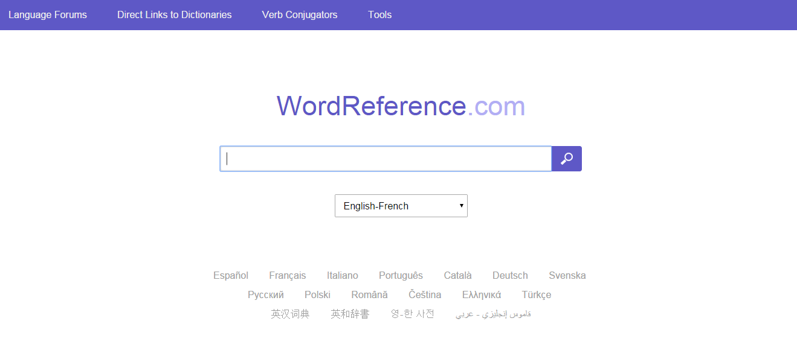
No dictionary at home, no problem!

Slide 36
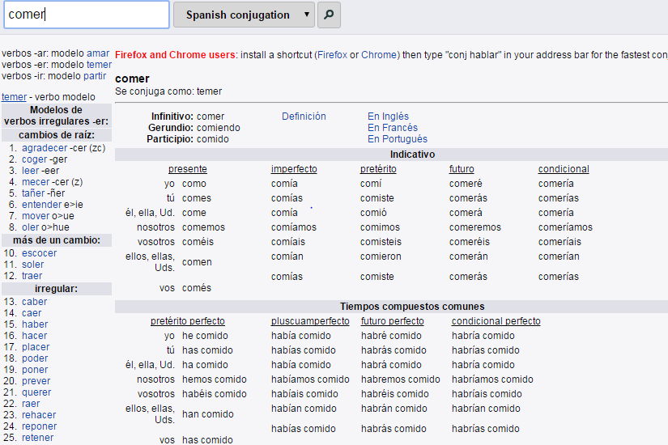
Remember these are the 2 tenses you should be looking for:

Slide 37
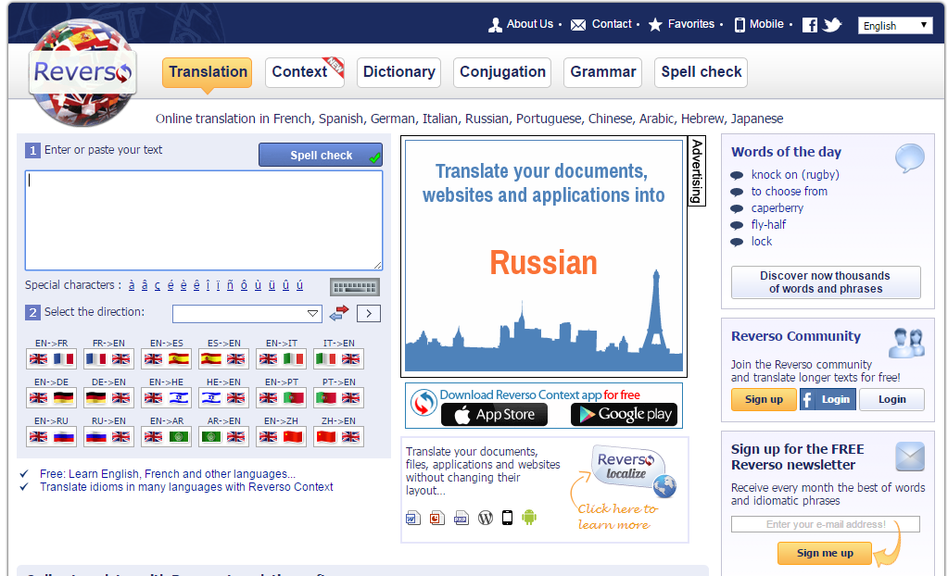
Even better!

Slide 38
This option will let you see the words in context! Very handy

Slide 39
This option will let you see the words in context! Very handy

Slide 40
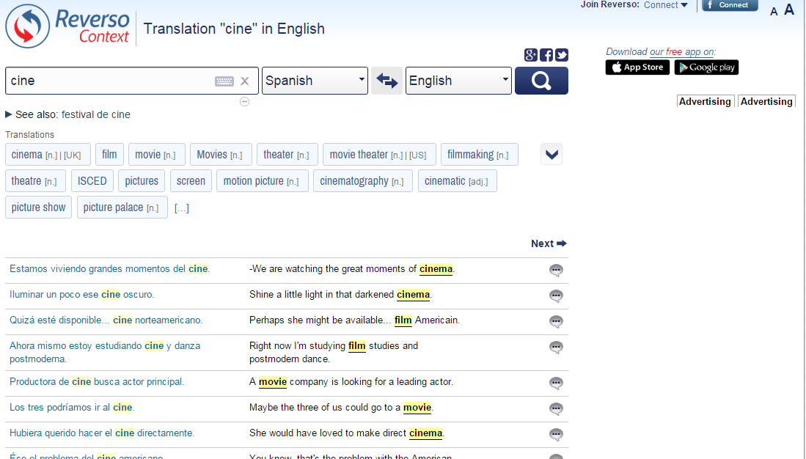
Just remember to avoid using the translation section!

Slide 41
Develop variety
ASL (Average Sentence Length)
Antonyms / synonyms
Harvesting
Function and themes
Modelling
Using reading as a springboard
Notes:
Again, there are more on Handout 1. A real mixture of strategies here, that I have found helpful to use with students.
Let’s just look at a couple of them to show an example:
Synonyms and Antonyms
Harvesting
Functions and Themes
Use authentic texts, and particularly literary texts to expand students’ vocabulary
Give students a choice in their vocabulary learning (e.g. 10 core words + 10 words of choice)
Use the 80:20 ratio in all written tasks – i.e. 80% of the writing produced should be recycled language from the classroom learning, 20% should be new, researched language of choice
Push students to produce synonyms and antonyms frequently in classroom work
Insist that students use the ASL (Average Sentence Length) measure on their own written work to ensure that they are including longer, more developed sentences.
Use group writing in the classroom, allocating different roles to each person, as well as different parts of the task
Use harvesting / creative transfer – when moving on to a new topic, students first brainstorm all the language from the previous topic that could be recycled in the new one
Functions and themes – teacher prepares a grid with all the sub-themes from one overall topics and a list of the functions (question, opinion, reason, suggestion, reported speech, likes and preferences, customs, comparison, future plans, past experiences) and allocates each student a pair (one function + one sub-theme) to generate language for. There are a lot of possible combinations and a lot of rich language is produced and then shared.

Slide 42
1 Soy bastante pesimista pero mi hermano es siempre _______________.
2 Mi profesora de español es _________ pero mi profe de historia es muy serio.
3 Por lo general, mi mejor amigo Santi es generoso, aunque de vez en cuando es ________.
4 Un buen amigo es _________; nunca es infiel.
5 Mi perro es muy travieso, pero a veces también puede ser ________.
6 Normalmente mi padre es ___________ pero los fines de semana es un poco perezoso.
simpático | hablador | bueno
divertido | optimista | tacaño
trabajador | inteligente | fiel

Slide 43
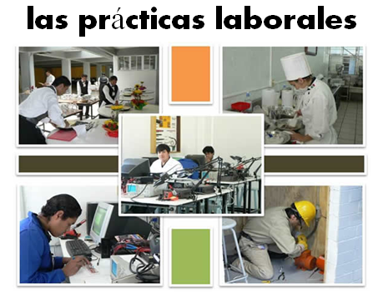
En el presente…
Opiniones y preferencias
Voy (a menudo a Francia)
Lo más importante para mí es (la playa) porque
Suelo ir (con mi familia)
Prefiero (las vacaciones del verano )porque…
Es (un sitio bonito y turístico)
Me gusta(n) (tomar el sol)
Está (en el sur del país)
Tiene (unos 8.000 habitantes)
No me gusta(n) (visitar monumentos)
El hotel tiene
(muy buenas instalaciones)
A mi madre le encanta(n) (los museos) Dice siempre.. “Vamos al museo”
En el futuro…
El año pasado …
En el pasado
Fui a…… con…
El año que viene…
Voy a ir a…
El hotel estaba (cerca del mar)
(el hotel) era… (la gente) era…
Quiero ver…
Hice muchas cosas, por ejemplo…
Tengo pensado …
Cada día iba (a la playa)
Cuando sea mayor…
Me lo pasé bomba / fatal/ bien
Tengo la intención de
Lo que más me gustó fue….
Me gustaría…
Fue una experiencia (inolvidable)

Slide 44
Functions |  | Themes
A | Questions | 1 | Future plans
B | Opinions | 2 | Work experience
C | Suggestions | 3 | Uniform
D | What others say | 4 | Primary school
E | Likes & dislikes (not ‘aimer’) | 5 | Subjects and teachers
F | Habits | 6 | Extra-curricular
G | Comparisons | 7 | Problems
H | Past events | 8 | School rules
Notes:
A bit of a wordy one to explain but essentially it’s about getting students to think outside the box and use their language creatively. On the right are the main sub-themes from a topic, school in this case. On the left are various language ‘functions’. By mixing up the combinations some creative sentences can be written that are not usually found within textbooks.
For example – comparisions are often drawn between subjects (G5) but not so often between future plans (G1) or school rules (G8) and yet, with a little bit of thinking, students can come up with content and language that fulfills on these new combinations and makes for more interesting work.
With one class I put them into groups and gave combinations. We collated all responses electronically and after oral feedback, all students got all of the work, not just theirs, sent out to them.

Slide 45
Wie heisst deine Stadt oder dein Dorf?
Ich wohne in Toft.
Ich wohne in einem kleinen Dorf, das Toft heißt.
Ich wohne in einem kleinen Dorf, das Toft heißt. Früher habe ich in Bristol gewohnt.
Ich wohne in einem kleinen Dorf, das Toft heißt. Früher habe ich in Bristol gewohnt. Wenn ich älter bin, möchte ich in London wohnen.
Ich wohne in einem kleinen Dorf, dasToft heisst. Früher habe ich in Bristol gewohnt. Wenn ich älter bin, möchte ich in London wohnen.
Include present, past and future as often as you can!

Slide 46
Value added* - to the past
iba a + infinitive… - I was going to ….
pero decidí + infinitive – but I decided to …
mi padre me dijo, “….” – my Dad said…
¿por qué no + infinitive…? – why not…..?
dije, “…” – I said….
(aunque) me hubiera gustado + infinitivo – although I would have liked to…

Slide 47
Basic sentence:
Fui a España.
Enhanced by the ‘super’ structures:
Iba a ir a Francia, pero mi padre dijo, “Hablas español entonces ¿por qué no ir a España?”. Entonces decidimos ir a España aunque me hubiera gustado ir a Francia.

Slide 48
Question: ¿Te gusta jugar al fútbol?
Si hace sol, me encanta jugar al fútbol sobre todo con mis amigos en el parque, pero si llueve, prefiero ver el fútbol en la televisión. Por ejemplo, el fin de semana pasado iba a jugar al fútbol, pero Kevin dijo, “Está lloviendo” entonces decidimos ir a mi casa a ver el fútbol en la televisión, aunque me hubiera gustado ir a ver un partido de verdad.
(This answers contains: present, opinions, longer/extended sentences, imperfect, preterit, present continuous, preterit(plural form), pluperfect subjunctive).
Now try your own example!

Slide 49
El sábado pasado estaba en casa con mi hermano y veía la televisión … | cuando él dijo, “No hay nada en la televisión. Prefiero ir al cine.” | Entonces dije, “Sí. ¿Qué tipo de película quieres ver?” “Una comedia” dijo. | Entonces fuimos al cine y vimos la película. Lo pasamos bomba. Cuando salimos del cine, hacía sol.
Entonces dije, “Quiero un helado. ¿Vamos a comprar un helado de chocolate en el café? | Pero cuando fuimos al café la señora dijo, “Lo siento, no tenemos helados de chocolate”. | Dije, “¿Tiene helados de fresa? Y mi hermano dijo, “dos, por favor!” | ¡Qué día más perfecto! ¡Cine, helado y sol!
Draw the parts of the story
Colour all the imperfect verbs in green
Underline all the preterite verbs
Thank you to Vincent Everett for this idea.
Notes:
Model the first box and then ask students to complete the task. Go through the verbs with them, making sure they have identified correctly and also know what each means.
Give them a choice of HW task

Slide 50
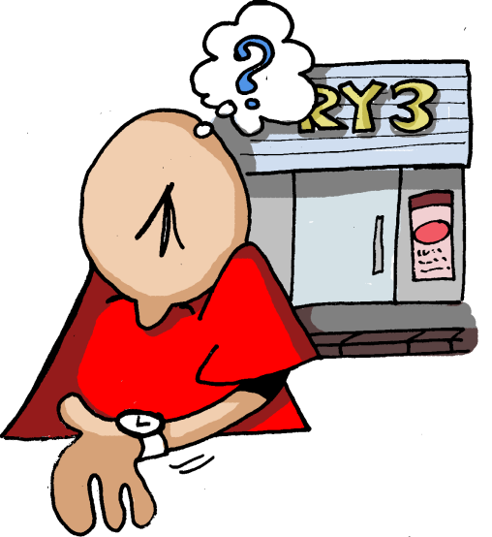
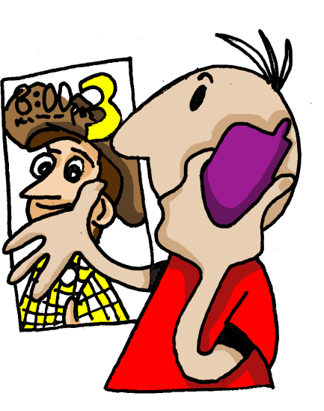

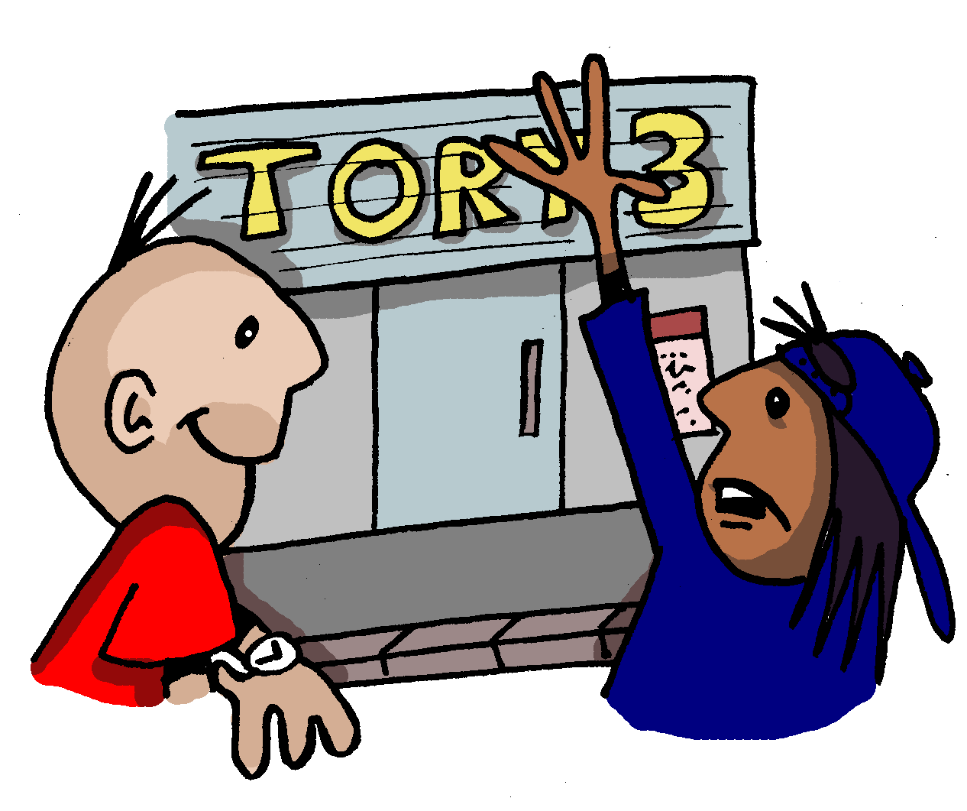
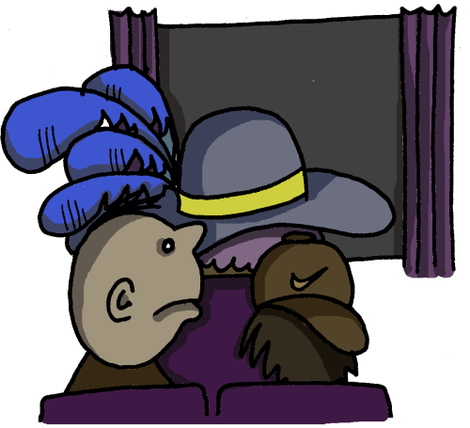
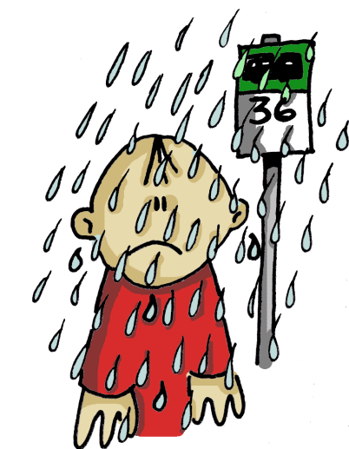
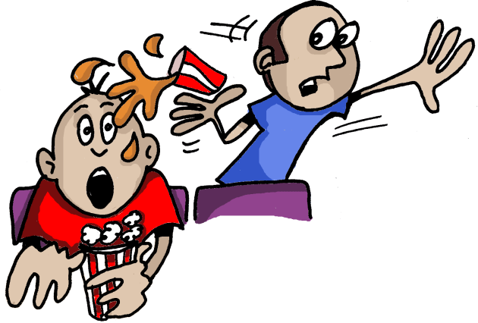
1 | 2 | 3 | 4
5 | 6 | 7
Notes:
Easier NOT to cut this one and just cut the text cards I think

Slide 51





1 | 2 | 3 | 4
1
2
3
4
5
6
7
5 | 6 | 7
Empareja las imágenes con el texto.
Había muchísima gente en el cine, incluso una mujer con un sombrero enorme, que estaba delante de nosotros.
a | b | c
Al final empezó a llover cuando estaba en la parada de autobuses. ¡Estaba ya harto de esa excursión!
Todavía peor, un chico que estaba detrás de nosotros ¡nos echó encima su coca cola!
d | e | f | g
Un día llamé a mi amiga Teresa. La invité al cine y quedamos a las 7.
Una media hora después Teresa llegó. Dijo que había mucho tráfico en la ciudad.
En seguida entramos en el cine y sacamos las entradas. Luego compramos palomitas.
A las 7 estaba en la puerta del cine pero Teresa no llegó.
Notes:
Depending on the class, this task might be approached as a reading strategy development task, asking students how they could look for clues to sort out the sequence of the story, looking for a likely beginning phrase. Looking for links between one phrase at the next. Looking also at the pictures to help understand the story and thinking of key Spanish words they know that might help them to match the pictures to text.
Quite often groups enjoy moving cards around to do this sort of task so at the end of this lesson are A4 size sheets to print and cut. As the text is already jumbled. Students could do their own cutting!

Slide 52
1 | 2 | 3 | 4
1
2
3
4
5
6
7
d
g
5 | 6 | 7
e
Empareja las imágenes con el texto.
f
Había muchísima gente en el cine, incluso una mujer con un sombrero enorme, que estaba delante de nosotros.
a | b | c
Al final empezó a llover cuando estaba en la parada de autobuses. ¡Estaba ya harto de esa excursión!
Todavía peor, un chico que estaba detrás de nosotros ¡nos echó encima su coca cola!
a
c
d | e | f | g
Un día llamé a mi amiga Teresa. La invité al cine y quedamos a las 7.
Una media hora después Teresa llegó. Dijo que había mucho tráfico en la ciudad.
En seguida entramos en el cine y sacamos las entradas. Luego compramos palomitas.
A las 7 estaba en la puerta del cine pero Teresa no llegó.
b
Notes:
Depending on the class, this task might be approached as a reading strategy development task, asking students how they could look for clues to sort out the sequence of the story, looking for a likely beginning phrase. Looking for links between one phrase at the next. Looking also at the pictures to help understand the story and thinking of key Spanish words they know that might help them to match the pictures to text.
Quite often groups enjoy moving cards around to do this sort of task so at the end of this lesson are A4 size sheets to print and cut. As the text is already jumbled. Students could do their own cutting!

Slide 53
6 Translation into the FL
Word level translation is about vocabulary knowledge, long-term memory, speed of recall, accuracy and spelling.
Sentence and short text translation are about vocabulary and grammar knowledge in use.
At its best it can be integrated into a learning cycle which includes formative assessment, individual analysis, target-setting, and follow-up tasks.
‘Mind the gap’ activities develop a sensitivity to the limitations for word-for-word translation.

Slide 54
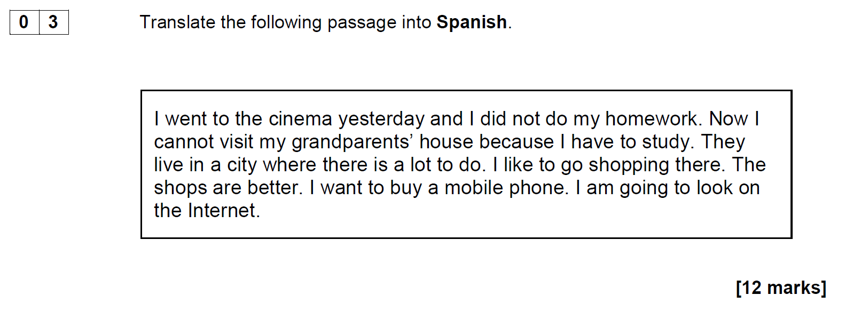
AQA Spanish Higher Writing SAMS April 2015

Slide 55
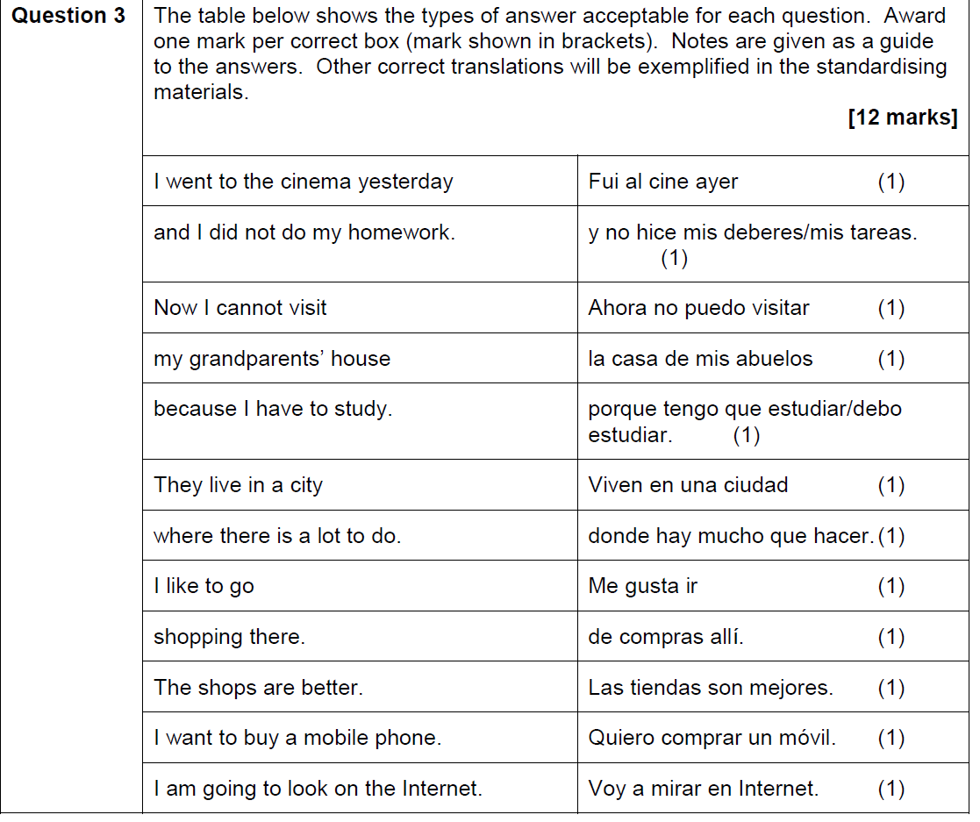

Slide 56
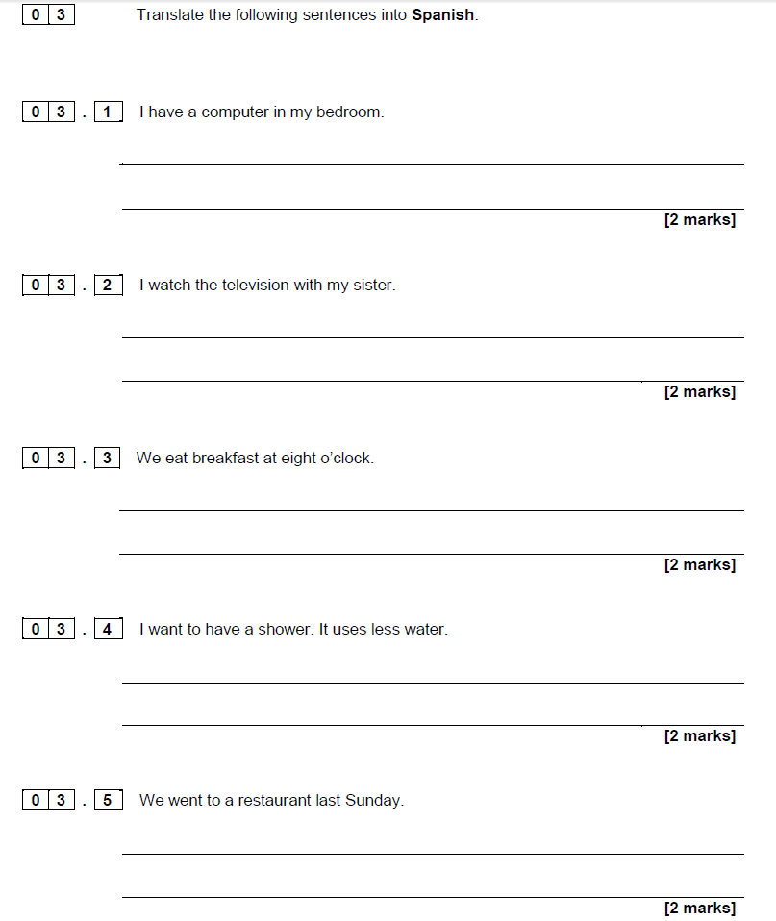
AQA Spanish Foundation Writing SAMS April 2015

Slide 57
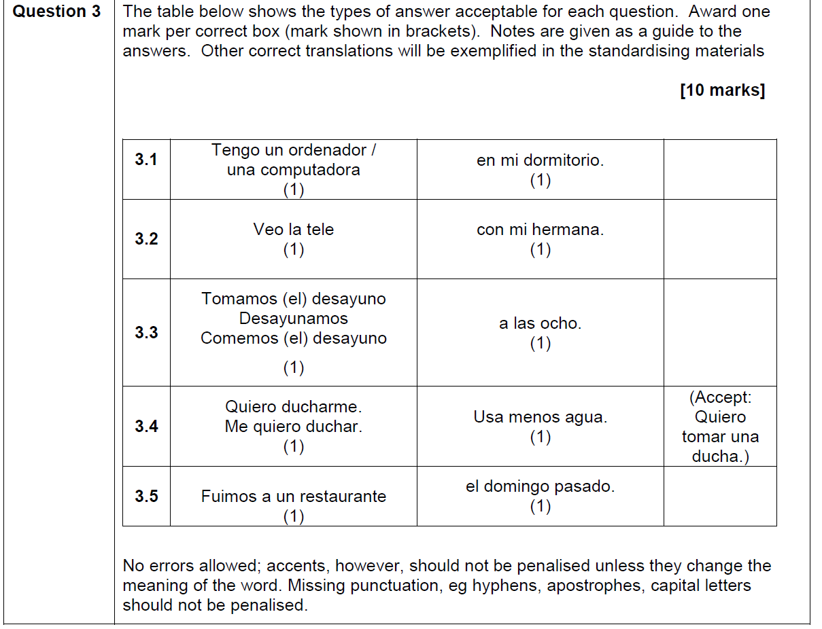

Slide 58

1a C’est un _________ de science-fiction.[film]
1b Je vais _________una conversation avec Johnny Depp.[film]
2a On doit __________ souvent de l’eau.[drink]
2b La lemonade c’est ma _____________ préfèrée. [drink]
3a Je fais mes devoirs dans le __________ .[study]
3b Je dois __________ beaucoup au collège. [study]
4a On va réduire la _______ de l’éléctricité. [use]
4b Il faut ________ les transports en commun. [use]
5a On va _________ la télé. [watch]
5b Quelle heure est-il? Tu as une _________? [watch]
6a Je vais__________demain. [phone]
6b Je peux utilizer ton __________ ? [phone]

Slide 59

The good thing is that I have lots of friends there.
Lo bueno es que tengo muchos amigos allí.
Notes:
www.tagxedo.com

Slide 60
Me presento [A]
Completa las frases en español con las palabras apropiadas.
1 ¡Hola! ¿_____ _________? [How are you?]
2 Me llamo Cara y ________ en Murcia. [I live]
3 Soy ________ seria pero muy _____________. [quite, nice]
4 ______ cuatro personas ____ mi familia; mis padres, mi abuela y yo. [there are, in]
5 ___ _________ hermanos _____ tengo tres ___________; [I don’t have, but, pets]
6 tengo dos _______ y ___ tortuga. [dogs, a]
7 Mi pasión _______ el fútbol. [is]
8 __ héroe es Cristiano Ronaldo. ¡Es genial! [my]
Notes:
Gap-fill

Slide 61
Me presento [B]
Completa la traducción en español y en inglés.
1 ¡Hola! ¿_____ _________? | 1 _________ ! How are you?
2 Me llamo Cara y ________ en Murcia. | 2 ________________________ I live ________________.
3 Soy ________ seria pero muy _____________. | 3 _____ quite ______________ nice.
4 ______ cuatro personas ____ mi familia; mis padres, mi abuela y yo. | 4 There are ____________ in _______________;__________.
5 ___ _________ hermanos _____ tengo tres ___________; | 5 I don’t have _____________ but _____________ pets.
6 tengo dos _______ y __ tortuga. | 6 ____________ dogs ____ a ________.
7 Mi pasión _______ el fútbol. | 7 __________ is ____________.
8 __ héroe es Cristiano Ronaldo. ¡Es genial! | 8 My ___________________. _______________!
Notes:
Parallel translation format

Slide 62
Me presento [C]
Completa el texto en español con las palabras apropiadas.
¡Hola! ¿_____ _________? Me llamo Maya y ________ en Mallorca. Soy ________ pero _____ simpática. ______ tres personas ____ mi familia. ___ _________ hermanos _____ tengo tres ___________; tengo dos _______ y __ gato. Mi pasión _______ el fútbol. __ héroe es Lionel Messi. ¡Es fenomenal!
Hello! How are you? I am called Maya and I live in Mallorca. I am serious but very nice. There are three people in my family. I don’t have brothers and sisters but I have three pets; I have two dogs and a cat. My passion is football. My hero is Lionel Messi. He’s amazing!

Slide 63
Me presento [D]
Traduce las frases al español.
1 Hello! How are you?
2 I am called Maya and I live in Mallorca.
3 I am serious but very nice.
4 There are three people in my family.
5 I don’t have brothers and sisters but I have three pets;
6 I have two dogs and a cat.
7 My passion is football.
8 My hero is Lionel Messi. He’s amazing!
Notes:
It can be extremely valuable for students to repeat tasks, after a time interval, and at a different level. With four different task formats, students can see their progression over time, if they attempt a more challenging version of the task the second time around.
Markscheme – 3 – 2 – 1 – 0

Slide 64
NAME:____________________________________________________________
Translate into German and write your text in the lined space provided below:
Hello. What is your name? (3) My name is Tina. (3) I live in France (3) but I learn German in school (3). Where do you live? (3)
I am 12 years old (3) and my birthday is on the 3rd March. (3) How old are you? (3)
My favourite subjects are German and History (3). What is your favourite subject? (3) I don’t like Science. (3) It is boring. (3)
________________________________________________________________________________________________________________________________________________________________________________________________________________________________________________________________________________________________________________________________________________________________________________________________________________________________________________________________________________________________________________________________________________________________________________________________________

Slide 65
Y8 German vocabulary test
1 | I eat chocolate.
2 | At break time I eat an apple.
3 | I drink coke at 10 o’clock..
4 | At 10 o’clock I drink coke.
5 | She eats a sandwich.
6 | They drink water at break time and they eat biscuits.
7 | We eat crisps.
8 | They drink orange juice.
9 | I eat a piece of cake.
10 | At break time you eat a piece of cake.

Slide 66
Target / Problem area | Action | Action 2
1 Word Order 2 | Do ex A | Do I & J
2 Capital letters | Do ex B | Do I & J
3 Spelling | Do ex C and H | Do I & J
4 Pronouns | Do ex D and E | Do I & J
5 Verb endings | Do ex D and E | Do I & J
6 Irregular verb ‘essen’ | Do ex E and F | Do I & J
7 Articles (‘a’ and ‘the’) – choice and spelling | Do ex G & H | Do I & J
8 Vocabulary not known | Do ex H | Do I & J

Slide 67

Y8 Zielübungen
C Wie heißt das auf Deutsch? Schreib jedes Wort dreimal. Ist es M, F oder N?
B Korrigiere den Text. Welche Wörter schreibt man groß?
hallo john! Ich schreibe über meine schule. sie heißt comberton village college und hier lerne ich viele fächer. mein lieblingsfach ist deutsch –natürlich. um zehn uhr zwanzig ist die erste pause. in der pause esse ich eine banane und ich trinke orangensaft. in der schule trage ich ein graues polohemd, eine schwarze hose und schwarze schuhe. ich finde die uniform langweilig. ich mache gern sport hier. ich spiele fußball im winter und tennis im sommer. tschüs!
A Was ist die richtige Ordnung? Schreib die Sätze auf. Beginn mit den unterstrichenen Wörtern.
1 ich / ein / esse / Butterbrot / in der Pause.
2 Ich / um / Cola / trinke / Uhr / zehn
3 wir / Montags / Stück / ein / essen / Kuchen
4 lerne / viele / in der Schule / ich / Fächer
5 isst / Chips / er / Orangensaft / wir / aber / trinken /
1 chocolate | Schokolade, Schokolade, Schokolade (F)
2 sandwich
3 biscuits
4 a piece of cake
5 orange juice
G Schreib diese Sätze auf Deutsch.
1 She eats a sandwich.
2 I have a brother.
3 The polo shirt is grey.
4 The shoes are black.
5 He drinks a bottle of water.
6 I eat an apple.
7 The uniform is awful.
8 I read a book.
D Wie heißt das auf Englisch. Dann schreib die deutschen Pronomen dreimal.
F Schreib diese Verbtabelle ab und füll sie aus.
ich
du
er
sie
wir
ihr
Sie
sie
I
E Vervollständige das Verb ‘wohnen’ mit den richtigen Endungen. Wie heißt das auf Englisch?
ich esse | I eat
 | you (singular) eat
 | s/he/it eats
 | we eat
 | you (plural) eat
 | you (polite) / they eat
ich wohn__ | I live
du wohn__
er / sie / es wohn__
wir wohn___
ihr wohn___
Sie / sie wohn___
H Wie heißt das auf Deutsch? Schreib der / die / das (ein / eine / ein).
1 2 3
4 5 6
J Schreib Fragen zu den Sätzen in I. Zum Beispiel: 1 = Magst du Rugby?
I Schreib diese Sätze auf Deutsch.
1 No, I don’t like rugby. | 4 ICT is really boring. | 7 In my school bag I have a pencil case.
2 My favourite subjects are English and art. | 5 In school I wear a uniform. | 8 My birthday is on the 14th March.
3 Sciences are great. | 6 I live in Cambourne. | 9 At break time I eat a sandwich.

Slide 68
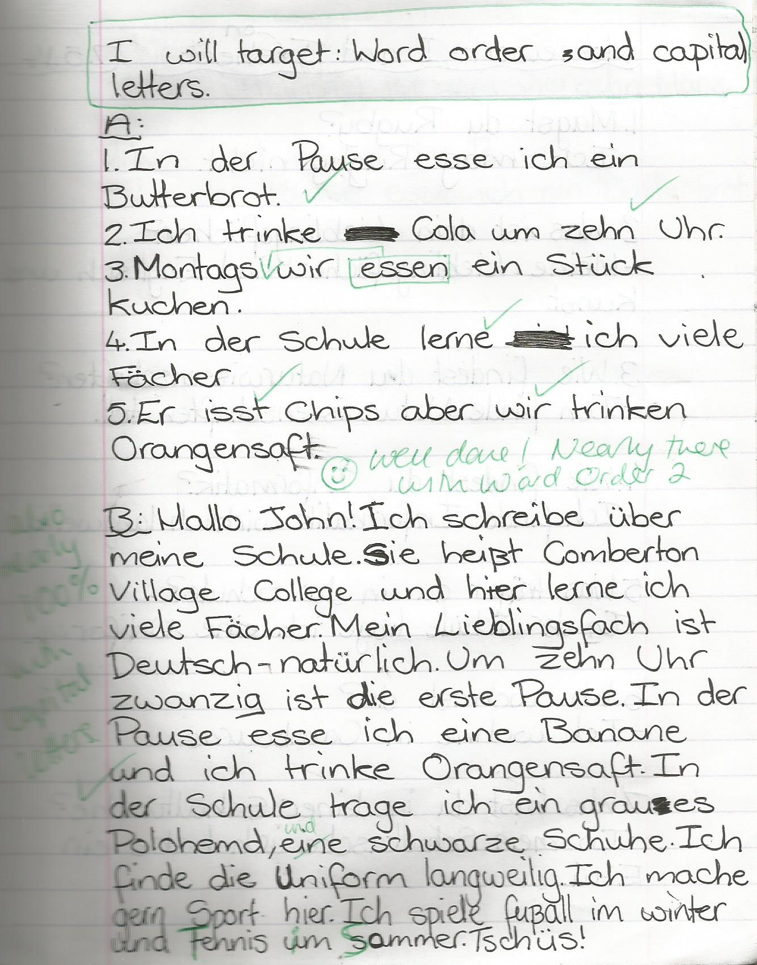
1 Students complete prose translation task.
2 Teacher marks it.
3 Students respond by:
i) selecting their own target(s)
ii) completing relevant follow-up activities to address their target(s)
4 Teacher responds by:
i) commenting on progress
and/or
ii) setting new target

Slide 69
Inglés | Español | Alemán
Do you have a pet? | ¿Tienes un animal? | Hast du ein Haustier?
Does he play tennis? | ¿Juega al tenis? | Spielt er Tennis?
Do they live in Italy? | ¿Viven en Italia? | Wohnen sie in Deutschland?
Does he write letters? | ¿Escribe cartas? | Schreibt er Briefe?

Slide 70

Bridging the gap - adapted
When?
Where?
How long?
What did you do?
¿Qué experiencia tienes del mundo laboral?
¿Dónde hiciste tus prácticas?
¿Cuánto tiempo duraron las prácticas?
¿Cómo ibas a tu lugar de trabajo?
¿Te gustaron las prácticas?
How get there?
Start / finish?
Good / bad?
People?
Notes:
Writing about work experience (whilst it’s still fresh in their minds!)
Explain the task:
Stage 1: Brainstorm in Spanish anything from your head that you could use to write a short piece of 100 words about your work experience (5-10 minutes) Teacher to correct the TL whilst students to stage 2.
Stage 2: Write in English a piece of 100 words about your work experience. Bear in mind that the end goal is to write a similar piece in Spanish so try to have that in mind i.e. don’t make the sentences too long or complicated (15 minutes)
Stage 3: Get some feedback from your teacher on what you have produced. S/he will help you ‘notice the gap’ between what you have produced in English and your current level of knowledge in Spanish. S/he will help you to focus on some strategies to bridge the gap. See next slide.

Slide 71
Simplifying ideas to fit own repertoire
Re-combining set phrases
Writing / Composition strategies
Avoiding
(say something different)
Re-structuring set phrases
Generating via translation
word for word
Notes:
Remind students what the strategies were and point out how well they used them – give specific examples
1) restructuring set phrase – Phoebe used ‘me hacían reír’ – they made me laugh, which was from media unit – me hacen reír from films
2) avoidance – instead of ‘I got lifts every day’ Ellis used ‘ Iba en coche todos los días’.
3) using set phrases – Lo pasé bomba used by lots of people
4) simplifying ideas – I was welcomed by the people → la gente era muy simpática
5) translation word for word – Ben I assisted in evaluating and developing software – era asistente de pruebas de desarrollo de software
Bridging the gap strategies – display this while students are writing first TL draft.
Use what you have in front of you – i.e. corrected TL brainstorm + English draft + Work Experience booklet + dictionary to write your first draft of 100 words in TL.
Teacher to correct this overnight for Tuesday morning. On fresh piece of A4 lined paper.

Slide 72
More on translation at KS4
Modelling (Create two similar translations. Provide a worked model answer for the first. Students complete the second.
Gap-fill (Gap the first example. Students complete the second independently)
Provide support for the ‘tricky’ moments in the form of highlighted prompts
Develop students’ use of the VAN checklist, to prompt them to be aware of accuracy as they translate.

Slide 73
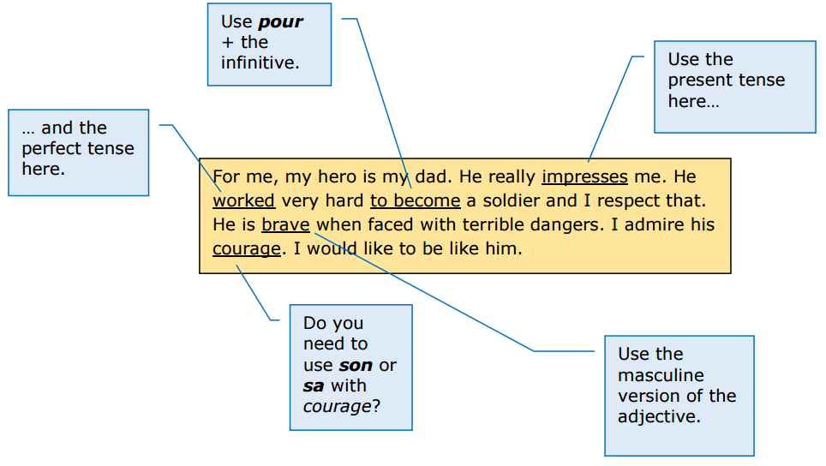
French
http://qualifications.pearson.com/content/dam/pdf/GCSE/French/2016/teaching-and-learning/Approaches_to_translation.pdf

Slide 74
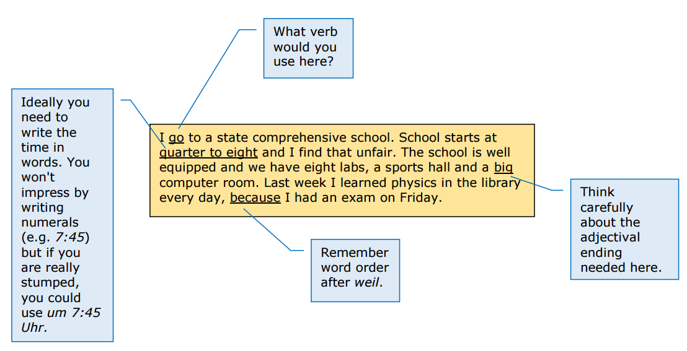
German

Slide 75
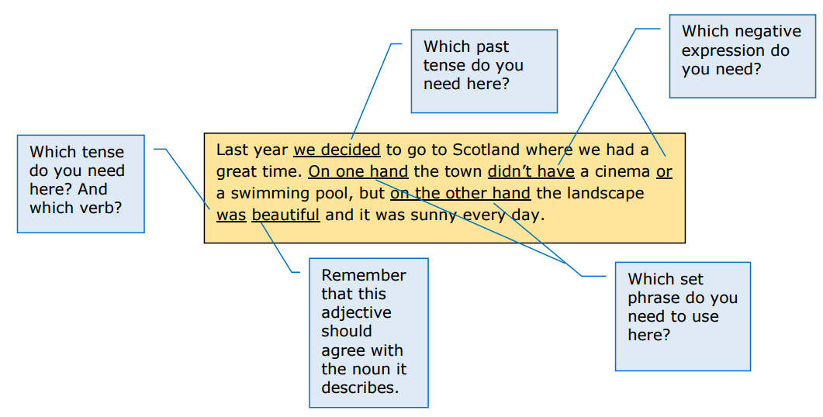
Spanish

Slide 76
VAN checklist
Verbs
Subject – Verb agreement (Who is doing what?)
Tense (When?)
Position in the sentence
Adjectives
Noun – Adjective agreement
Position
Nouns
Masculine / Feminine
Singular / Plural
Definite / Indefinite article

Slide 77
Writing skills for GCSE:
Building a transferable repertoire from KS3
Making the most of memory
Developing translation skills
http://www.rachelhawkes.com/PandT/2018_GCSE/2018GCSE.php
Notes:
Writing skills for GCSE (RH)
Building a transferable repertoire from KS3
Making the most of memory
Developing translation skills

