Slide 1
The 3Ps at KS4: Presentation, practice and production.
Usar para comunicarse Producir de memoria Producir con ayuda Pronunciar Comprender Reconocer
multi-modal
varied
meaning-focused
la escalera del saber
Notes:
Rachel Hawkes
The 3Ps at KS4: Presentation, practice, and production. Ideas to make each of these multi-modal, varied and meaning-focused.
Salter’s (1989) observation that language ‘practice’ should lead to language ‘use’ but doesn’t, sums up neatly the typical picture in most secondary language classrooms.
We have to be very careful therefore that the practice stage is optimum – it needs to progress from supported to unsupported, and to lead towards automatization without severing the link with meaning. It must not allow repetition / rote learning which loses track of the meaning of the language.

Slide 2
Presentation
Phonics
Elicitation of prior knowledge
Gestures
Songs and rhythm
Audio / video clips (→ Give one, get one)
Wordles
Text → Sentence → Word
Flipped learning
multi-modal
varied
meaning-focused

Slide 3
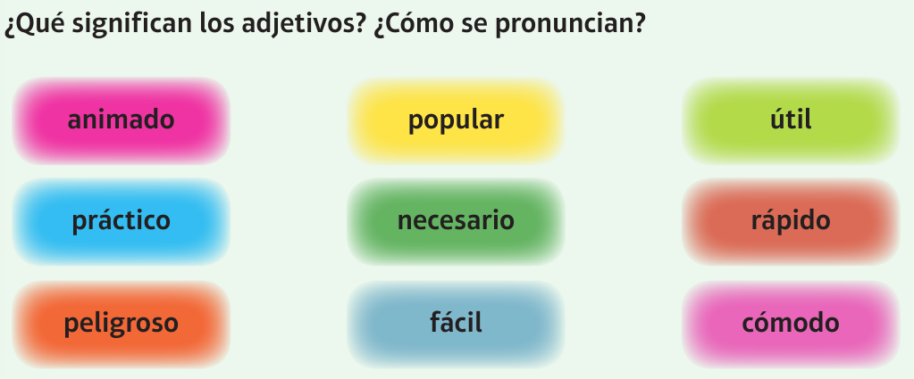
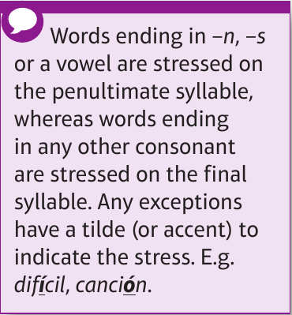
Inicio
60 segundos
60
45
30
15
0
Notes:
Phonics and reinforcing key pronunciation rules. Getting students using the language and working in pairs straightaway, rather than presenting, particularly with words that are cognates or semi-familiar from previous topics. Make sure students know what all these mean as well as how to pronounce them.

Slide 4
Presentation
Phonics
Elicitation of prior knowledge
New language in (familiar) context
Gestures
Songs and rhythm
Audio / video clips (→ Give one, get one)
Wordles
Text → Sentence → Word
Flipped learning
multi-modal
varied
meaning-focused

Slide 5
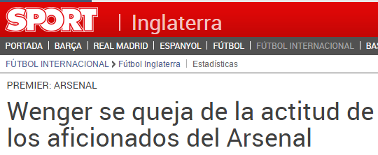
Hoy vamos a…
explicar problemas en un hotel
quejarnos

Slide 6
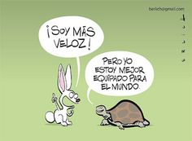
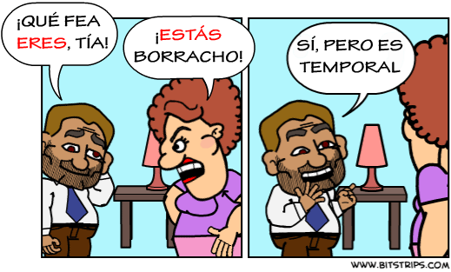
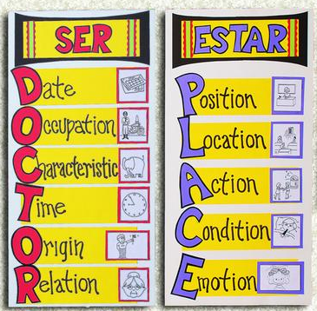
ESTAR
SER

Slide 7
Presentation
Phonics
Elicitation of prior knowledge
New language in (familiar) context
Gestures
Songs and rhythm
Audio / video clips (→ Give one, get one)
Wordles
Text → Sentence → Word
Flipped learning
multi-modal
varied
meaning-focused

Slide 8
¿Quién?
¿Con quién?
¿Cómo?
¿Por qué?
¿Qué?
¿Cuánto?
¿Dónde?
¿Cuántos?
¿Cuándo?
¿Cuál?
http://www.youtube.com/watch?v=iqCvE258vY0
Notes:
Teach the key question words with gestures. See this video for suggested gestures.
http://www.youtube.com/watch?v=iqCvE258vY0

Slide 9
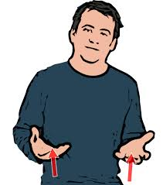
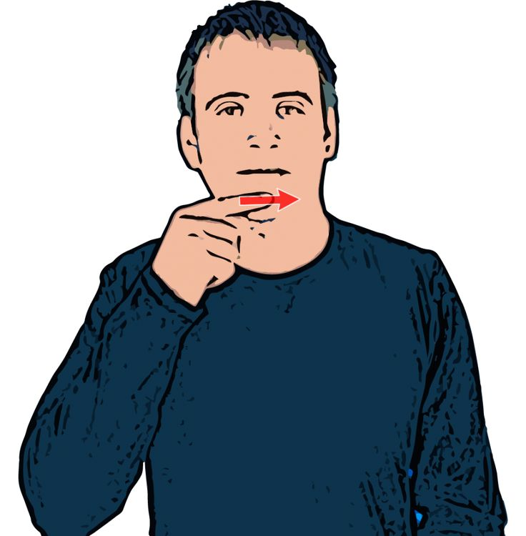
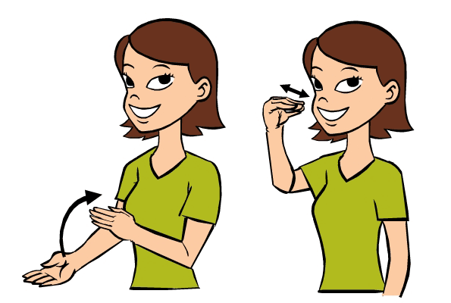
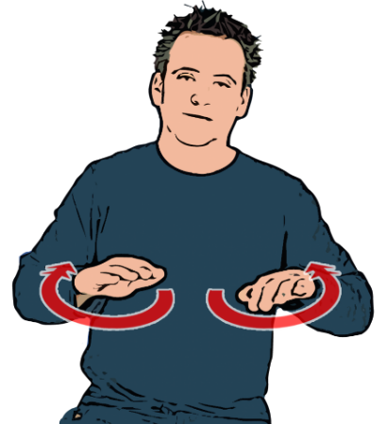
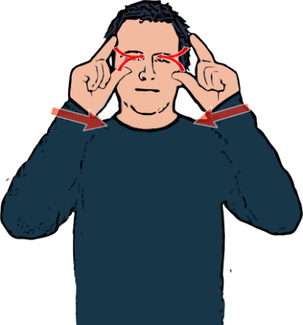
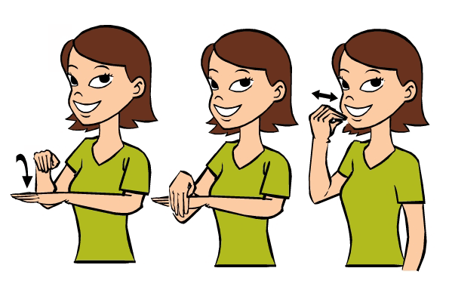
A | B | C
D | E | F
G | H | I

Slide 10
siempre
todos los días
…………………………………………………………
normalmente
a menudo
a veces
nunca

Slide 11
Presentation
Phonics
Elicitation of prior knowledge
New language in (familiar) context
Gestures
Songs and rhythm
Audio / video clips (→ Give one, get one)
Wordles
Text → Sentence → Word
Flipped learning
multi-modal
varied
meaning-focused

Slide 12
haben – to have
ich | habe
du | hast
er | hat
sie | hat
wir | haben
ihr | habt
Sie/sie | haben
Notes:
Practising this verb to the rhythm of music (click on picture to activate) will reinforce it before pupils need to use it in next two slides. Check that pupils know what ‘ihr’ means in English. They always seem to think that it means ‘they’ for some reason.

Slide 13
sein – to be
ich | bin
du | bist
er | ist
sie | ist
wir | sind
ihr | seid
Sie | sind
sie | sind
Notes:
Practising this verb to music (click on picture to activate) will reinforce it before pupils need to use it in next two slides.

Slide 14
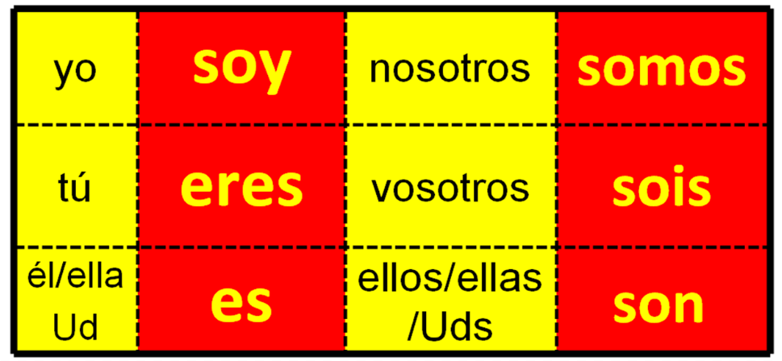
SER (to be)
Thanks to Leigh McClelland for this gem ☺

Slide 15
Estribillo: Cuidemos nuestro planeta. Cuidemos nuestro planeta. ¡Este planeta está en peligro! ¡Este planeta está en peligro! Cuidemos nuestro planeta. Cuidemos nuestro planeta. ¡Este planeta está en peligro! ¡Este planeta está en peligro! La contaminación del aire, de los ríos y de los mares es uno de los problemas más graves del mundo. Hasta que tomemos medidas para reducirla, ¡este hermoso planeta estará en peligro!
Algunas compañías van a contaminar los ríos hasta que el gobierno las castigue. Mientras la gente eche desperdicios en lugares públicos, los problemas continuarán.
Estribillo
http://www.phschool.com/atschool/realidades/hiphop/level3/pdfs/L3_9A_lyrics_text.pdf

Slide 16
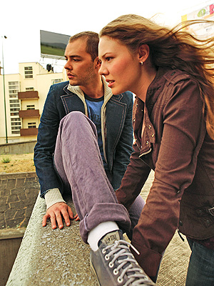
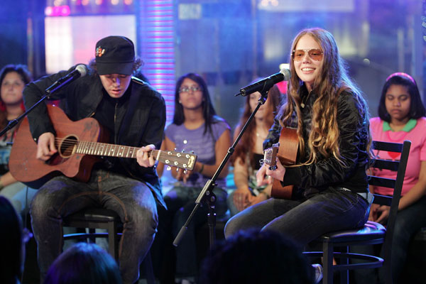
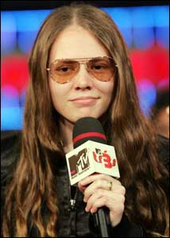
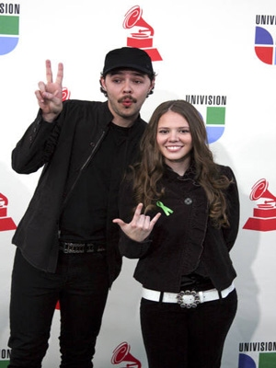
Ser o Estar No puedo esperar más sin tenerte junto a mí Desesperación es que no estés aquí Que no estés para verme caer Ni me pueda tu voz levantar Que difícil se vuelve lograr respirar No quiero ser No quiero hablar No quiero estar Si tu no estás aquí

Slide 17
Presentation
Phonics
Elicitation of prior knowledge
New language in (familiar) context
Gestures
Songs and rhythm
Audio / video clips (→ Give one, get one)
Wordles
Text → Sentence → Word
Flipped learning
multi-modal
varied
meaning-focused

Slide 18
Sé feliz

Slide 19
Be happy!
Follow your instinct!
Love your work!
Set goals!
Help others!
Dance!
Face up to your fears!
Do exercise!
Try to sleep well!
Live (in) the moment!
Accept that life has good and bad moments!
Believe in yourself!
Be honest with yourself!
Thank those who teach, support and encourage you…
Don’t forget that you can’t buy happiness!
Look after the love of your life!
Never stop learning!

Slide 20
Presentation
Phonics
Elicitation of prior knowledge
New language in (familiar) context
Gestures
Songs and rhythm
Audio / video clips (→ Give one, get one)
Wordles
Text → Sentence → Word
Flipped learning
multi-modal
varied
meaning-focused

Slide 21
www.wordle.net

Slide 22
Before I used to live in Hardwick but now I live in Cambourne.
Antes vivía en Hardwick pero ahora vivo en Cambourne.
http://www.tagxedo.com/

Slide 23
The bad thing is that there’s not a lot going on.
Lo malo es que no hay mucha marcha.
Notes:
www.wordle.net

Slide 24
The good thing is that I have lots of friends there.
Lo bueno es que tengo muchos amigos allí.
Notes:
www.tagxedo.com

Slide 25
Comberton is smaller than Cambridge but it is quiet and very pretty.
Comberton es más pequeño que Cambridge pero es tranquilo y muy bonito.

Slide 26
Before I used to live in Nottingham but now I live in Cambourne. Nottingham is bigger than Cambourne. Before in Cambourne there were not many shops or facilities but now there is a supermarket, a church, a park and some tennis courts. I like my town quite a lot because I have lots of friends there.

Slide 27
Presentation
Phonics
Elicitation of prior knowledge
New language in (familiar) context
Gestures
Songs and rhythm
Audio / video clips (→ Give one, get one)
Wordles
Text → Sentence → Word
Flipped learning
multi-modal
varied
meaning-focused

Slide 29
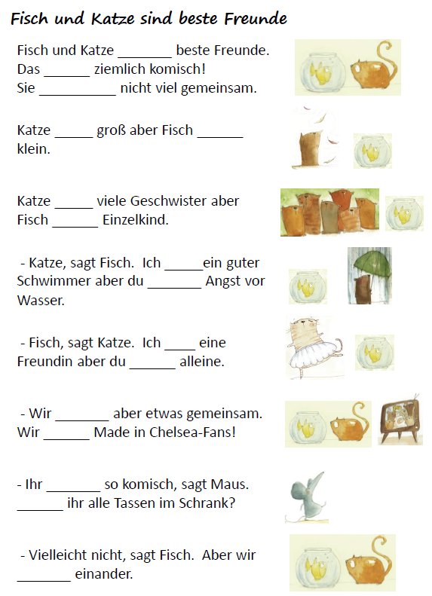
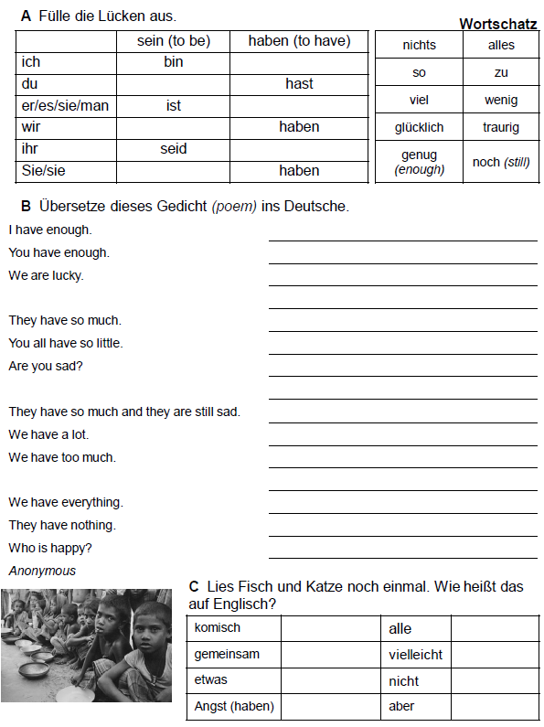

Slide 30
Presentation
Phonics
Elicitation of prior knowledge
New language in (familiar) context
Gestures
Songs and rhythm
Audio / video clips (→ Give one, get one)
Wordles
Text → Sentence → Word
Flipped learning
multi-modal
varied
meaning-focused

Slide 31
Deberes
Learn these 15 words/phrases.
https://quizlet.com/162716839/mi-vida-en-el-insti-week-3-vocabulario-1-flash-cards
un jersey (de punto) | a (knitted) jumper
un vestido | a dress
una camisa | a shirt
una camiseta | a t-shirt
una chaqueta | a jacket
una chaqueta de punto | a cardigan
una corbata | a tie
una falda | a skirt
unos pantalones | trousers
unos calcetines | socks
unos zapatos | shoes
unos vaqueros | jeans
unas medias | tights
a rayas | striped
a cuadros | checked
Vocabulary
- Minimum 15 words each week to learn
- Always on Quizlet (all vocabulary from each module is also there)
- Learn little and often
- Spend 30 – 60 minutes per week on vocabulary learning

Slide 32
Deberes
Learn these 15 words/phrases.
https://quizlet.com/162716839/mi-vida-en-el-insti-week-3-vocabulario-1-flash-cards
un jersey (de punto) | a (knitted) jumper
un vestido | a dress
una camisa | a shirt
una camiseta | a t-shirt
una chaqueta | a jacket
una chaqueta de punto | a cardigan
una corbata | a tie
una falda | a skirt
unos pantalones | trousers
unos calcetines | socks
unos zapatos | shoes
unos vaqueros | jeans
unas medias | tights
a rayas | striped
a cuadros | checked
Inicio
60 segundos
60
45
30
15
0
Notes:
Spanish into English first, then English into Spanish.
Timer to ensure that this activity is brisk!

Slide 33
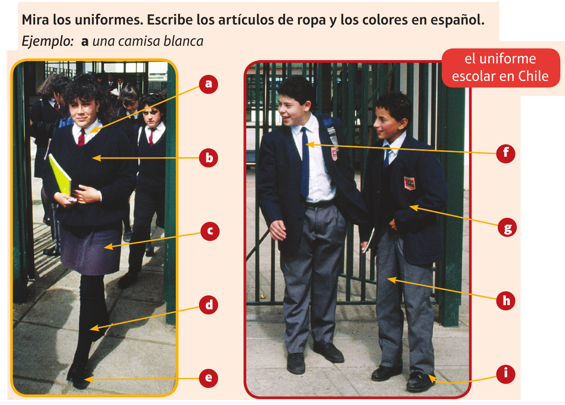
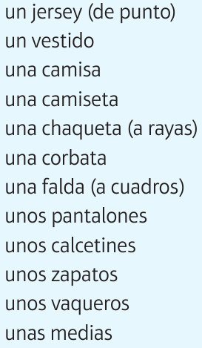
unas medias negras
a. una camisa blanca | d. | g.
b. | e. | h.
c. | f. | i.
una chaqueta azul (oscuro)
un jersey negro
unos zapatos negros
unos pantalones grises
una falda gris
una corbata azul (oscuro)
unos calcetines..?
Notes:
The aim of this task is a revision of clothes and reminder of the need to agree and position adjectives. If it has been a long time since students did clothes vocabulary, it would be a good idea to set this as flipped learning ahead of the lesson. See the link within the SOW for this vocabulary.
b. This could be dark blue or black – accept azul oscuro…

Slide 34
Practice
with support → from memory
effective, engaging and enjoyable
meaning-focused
Notes:
Salter’s (1989) observation that language ‘practice’ should lead to language ‘use’ but doesn’t, sums up neatly the typical picture in most secondary language classrooms.
We have to be very careful therefore that the practice stage is optimum – it needs to progress from supported to unsupported, and to lead towards automatization without severing the link with meaning. It must not allow repetition / rote learning which loses track of the meaning of the language.

Slide 35
A few principles
To retain knowledge it must be made meaningful
Proficiency requires practice
Where ‘rote learning’ (automatization) is necessary, connect it to meaning as much as possible
Ensure practice is engaging and purposeful
Adapted from Daniel Willingham’s book, Why Don’t Students Like School?

Slide 36
¿Adónde fuiste de vacaciones?
Fui a…………….con….
¿Cuándo fuiste?
Fui en…
¿Cómo fuiste?
Fui ……………..

Slide 37
Lo pasé bomba…
Lo pasé bomba…
Lo que más me gusto fue…
Lo que más me gustó fue…
Sin embargo, un inconveniente fue…
Sin embargo, un inconveniente fue…
Al fin y al cabo fue una experiencia inolvidable.
Al fin y al cabo fue una experiencia inolvidable.

Slide 38
Inicio
60 segundos
1 | ¿C_____ t_ l________ ?
2 | ¿C____ e_____?
3 | ¿C______ a____ t______?
4 | ¿C_______ e_ t_ c__________?
5 | ¿T________ a________?
6 | ¿D_______ v_______?
7 | ¿C__ q_______ v_______?
8 | ¿C____ e__ t__ n______________?
9 | ¿Q__ i_______ h______?
10 | ¿D____ t_ g_______ v_____ e_ e_ f______?
60
45
30
15
0

Slide 39
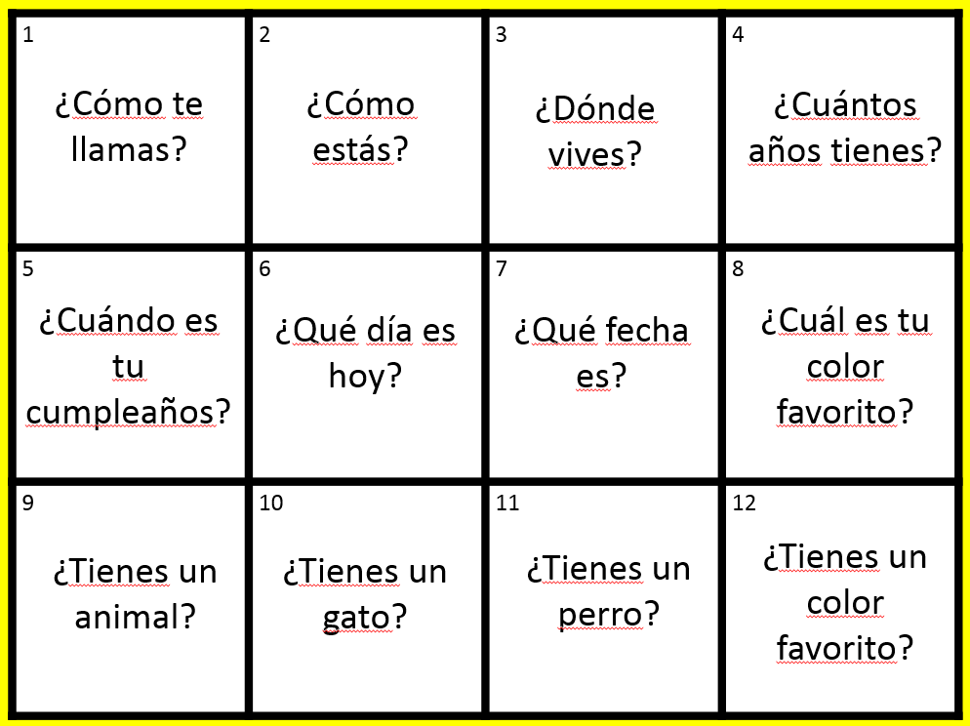
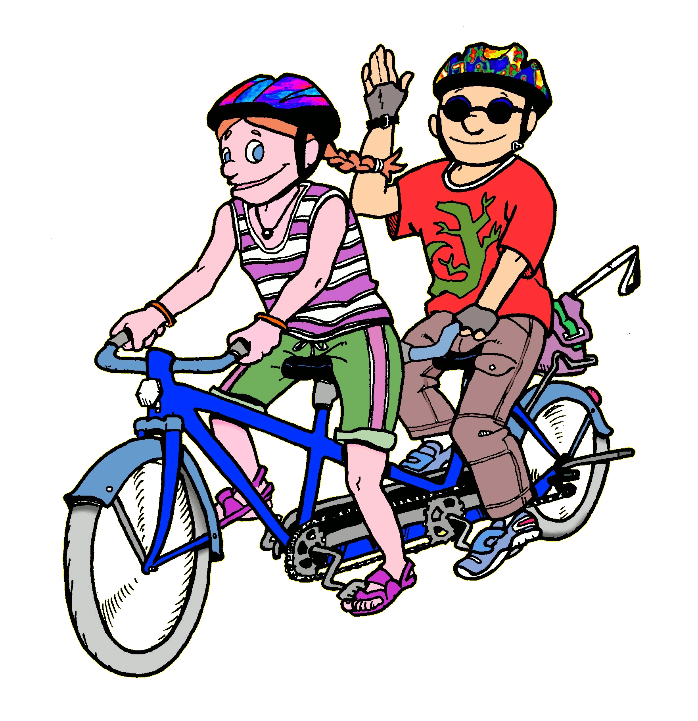
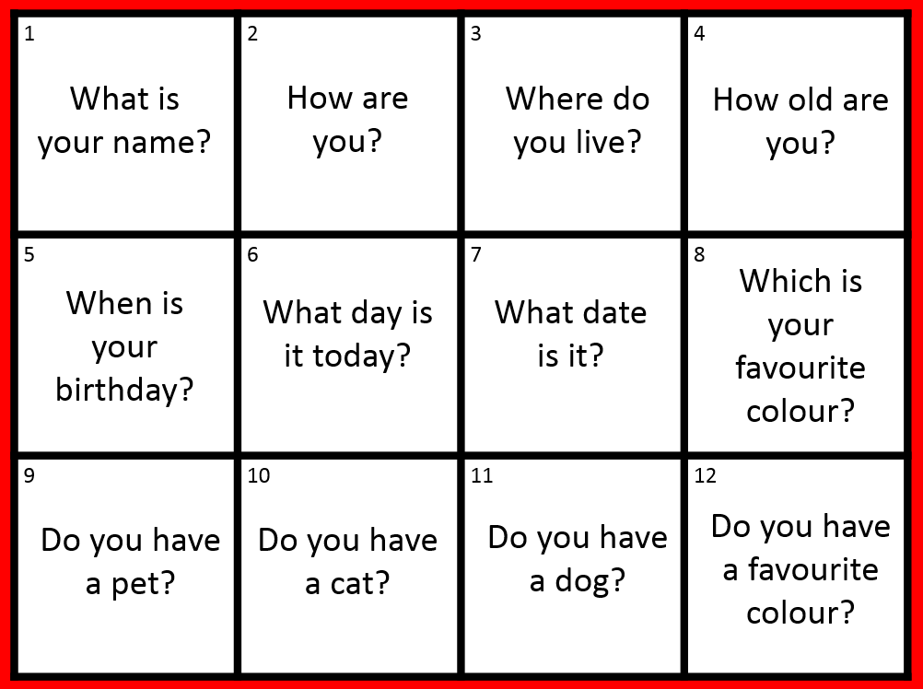
Trabaja en tándem

Slide 40
¡Pregunta!
¡Pregunta!
¡Intercambia!
¡Genial!
¡Qué guay!
¡Fenomenal!
¡Buen acento!
¡Bien hecho!
Quiz – Quiz - Trade

Slide 41
Encuentra a la persona que…
1. vive en Hardwick
2. tiene su cumpleaños en marzo 3. habla otro idioma (aparte del inglés) en casa
4. tiene segundo nombre que empieza con la letra ‘S’
Notes:
The Find Someone Who task If you want to simplify this, just leave out question 4, which is the most different/new of them all.

Slide 42
SAY SOMETHING DIFFERENT
J’habite dans un village.
Chez nous il y a beaucoup de pollution.
À Cambridge on peut faire les magasins.
Le weekend on va souvent au centre de loisirs.
Mon frère va normalement au stade.
Mes copains vont à la piscine.
Notes:
Students have to change something in the sentence – it could be one detail, it could be the whole thing, it could be adding an additional detail to ‘grow’ the sentence.
Do this one as an activity with the delegates.
42

Slide 43
1
2
3
Rosa.
David.
Felipe.
regular.
fatal.
bien.
11 años.
13 años.
12 años.
Hola, me llamo
Estoy
Tengo
4
5
20 de diciembre.
3 de enero.
31 de julio.
un gato
tres peces
un perro
Mi cumpleaños es el
Tengo
y
6
7
dos conejillos de Indias.
una serpiente.
nada más.
Francia
Jamaica
México
mi familia.
mis padres.
mis animales.
Vivo en
con
8
9
francés/francesa.
inglés/ inglesa.
mexicano/a.
francés y alemán.
inglés y español.
solo español.
Soy
y hablo
10
los Estados Unidos.
Escocia.
el Perú.
En el futuro me gustaría vivir en

Slide 44
1
2
3
Hola, me llamo…
Estoy…
Tengo…
4
5
Mi cumpleaños es el…
Tengo…
y…
6
7
Vivo en…
con…
8
9
Soy…
y hablo…
10
En el futuro me gustaría vivir en…

Slide 45
Production
use in real communication
combine and re-combine with other elements
long-term retention

Slide 46
speaking lines
speed dating
reading races
create class assessments

Slide 47
Play
Slap the board
0s and Xs
Kim’s game
Mastermind
Battleships
Connect 4
Treasure hunt / Points
Inverse bingo / strip bingo
Gap-fill relay
Telepathy
Wipe out

Slide 48
pude
pudimos
pude
pudimos
pudisteis
pudisteis
pudieron
pudiste
pudieron
pudieron
pudiste
pudo
pudo

Slide 49
Gap-fill relay Good for: plenary, focus on key words/verb forms, understanding at sentence level
Take
Preparation and Instructions:
Create two different texts with key language from the lesson, which fit side by side onto one PPT slide – divide the slide with a line down the middle to make it clear that there are two teams.
Create the same number of gaps in each text.
Give the first member of each team a pen. Each person has to fill in one word and pass the pen to someone else in their team.
The winning team is the one that fills in all the gaps correctly, first.
Variations:
Use a jigsaw translation text (i.e. some English / some TL gaps).
Use a verb table with key verbs in different tenses.
Use either an English text for translation into the TL, or a TL text that pupils have to translate into English.
Use a text in one tense that pupils have to translate into another.
Consider:
Involve all pupils in using the TL during the task by prompting them to encourage their teams (see prompts on sample slide).
The teacher keeps track of both texts and wipes off any incorrect answers to ensure that students re-consider their answers if they have got it wrong.

Slide 50
¡Hola! Soy Manuel y soy de España.
¿Qué tipo de ______ te gusta? ¿Te ______ la música pop?
Me gusta mucho _______ es alegre.
¿Sabes ________ el piano? Yo no, pero sé tocar la _________. ¿Qué __________ tocas? ¿Prefieres Justin Bieber o _____________? Yo __________ Katie Perry. ¡Adiós!
Manuel
¡Hola! ¿Cómo estás? Soy Elena y soy del Perú.
¿Te gusta la música ______?
No me ______ la música rap porque es __________.
¿Qué tipo de ______ te gusta? Toco la zampoña y el ________, que es un tipo de tambor.
Y tú, ¿Tocas un ________ ? ¿Prefieres _____________ o Little Mix? Yo __________ One Direction. ¡Hasta luego!
Elena
¡Bien!
¡Genial!
¡No! Es falso.
¡Perfecto!
¡Fenomenal!
¡Rápido!

