Slide 1





HoDs Derbyshire
Monday 19 June 2017
Preparing students for the new GCSE
What are we doing differently?

Slide 2


1
What are you doing differently?
2:00
2:00
1:59
1:58
1:57
1:56
1:55
1:54
1:53
1:52
1:51
1:50
1:49
1:48
1:47
1:46
1:45
1:44
1:43
1:42
1:41
1:40
1:39
1:38
1:37
1:36
1:35
1:34
1:33
1:32
1:31
1:30
1:29
1:28
1:27
1:26
1:25
1:24
1:23
1:22
1:21
1:20
1:19
1:18
1:17
1:16
1:15
1:14
1:13
1:12
1:11
1:10
1:09
1:08
1:07
1:06
1:05
1:04
1:03
1:02
1:01
1:00
0:59
0:58
0:57
0:56
0:55
0:54
0:53
0:52
0:51
0:50
0:49
0:48
0:47
0:46
0:45
0:44
0:43
0:42
0:41
0:40
0:39
0:38
0:37
0:36
0:35
0:34
0:33
0:32
0:31
0:30
0:29
0:28
0:27
0:26
0:25
0:24
0:23
0:22
0:21
0:20
0:19
0:18
0:17
0:16
0:15
0:14
0:13
0:12
0:11
0:10
0:09
0:08
0:07
0:06
0:05
0:04
0:03
0:02
0:01
End

Slide 3
Key approaches
Joining up KS2-KS3-KS4 - clarity about progression
Long-term memory (vocabulary learning and testing)
Verbs (infinitive lexicon and application)
Accuracy (attention to detail in understanding and use)
Reading and listening skills (more explicit from Y7)
Speaking and writing (without support)
Links with the English department ☺

Slide 4
☺ T
I can… I need to…
spell key topic words accurately.
use adjectives correctly (agreement and position).
use correct determiners (definite and indefinite article).
agree verb and subject.

Slide 5
☺
I can…
T
I need to…
Y7 Targets: Autumn 1 Mi vida
 | Au 1 | Au 2 | Au 3 | Booklet page number
1. spell key topic words accurately. |  |  |  | pp.19 – 31
2. use adjectives correctly (agreement and position). |  |  |  | p.48
3. use correct determiners (definite and indefinite article). |  |  |  | p.40
4. agree verb and subject. |  |  |  | p.42
5. use different forms of the irregular verbs ser and tener. |  |  |  | p.44
6. use conjunctions to structure my writing (y, también, pero). |  |  |  | p.16
7. use a range of key regular verbs in the 3rd person singular. |  |  |  | p.42-3
8. give my opinion and extend it with a reason. |  |  |  | p.16 / p.50
9. form yes/no questions in the present tense. |  |  |  | p.42-44
10. form key WH- questions (open questions). |  |  |  | p.2 and p.7
11. use adverbs (intensifiers) in my writing (muy, un poco, bastante). |  |  |  | p.16
*1 use a greater range of conjunctions. |  |  |  | p.16
*2 use more varied opinions and reasons. |  |  |  | p.16 / p.27
*3 refer to others. |  |  |  | p.42
*4 include additional tenses. |  |  |  | p.51-52
*5 use adjectives / adverbs for extra detail. |  |  |  | p.20
*6 use a dictionary/vocab guide to find “new” language not yet taught (80/20). |  |  |  | pp.19 - 31

Slide 6
GCSE non-negotiables
Present tense (irregular) – SER, ESTAR, TENER, IR
Present tense (regular)
Near future tense
Preterite tense
Opinion verbs + nouns / + infinitives
Adjective endings and position
Comparative
Modal verbs/constructions
SER vs ESTAR
Por vs Para

Slide 7
Summary
Joining up KS2-KS3-KS4 - clarity about progression
Long-term memory (vocabulary learning and testing)
Verbs (infinitive lexicon and application)
Accuracy (attention to detail in understanding and use)
Reading and listening skills (more explicit from Y7)
Speaking and writing (without support)
Links with the English department ☺

Slide 8
Vocabulary testing at KS3
Vocabulary learning homework & testing every two weeks.
15 words set, 10 words tested (10 words set for SL/lower sets).
Common Quizlet lists for all groups to facilitate smooth transfers.
Possibility of additional lists with extra vocabulary for keen beans.
All tests marked out of 20 and 14/20 is pass mark.
Marking may be by teacher or peer, perhaps alternating depending on marking load.
Pupils should maintain a vocabulary test average of 14 or above.
Tests may incorporate sentence structure or grammar points but only the vocabulary set is officially marked – the rest might inform a starter, for example.
If pupils are absent for a test then they should expect to do it in the next lesson.
Swift communication with parents if average falls below 14 and pupils must attend homework club – this will start after half-term.
Other vocabulary may be learnt & tested in lessons. Other homework tasks may be set as usual between the vocabulary learning tasks.
Notes:
Vocabulary tests (in sentences) are a good way to see whether students have mastered specific structures and grammar.
But they are not the same as free production, where we will expect more errors to be produced.

Slide 9
Prueba de vocabulario [4] Y7 Summer Term
1. What is there in your city?
2. In my neighbourhood there is a shopping centre…
3. with lots of shops and some restaurants.
4. However, the stadium is very small.
5. In the square there is often a market, which is pretty.
6. There is also a very big university.
7. The university is very famous.
8. In my village there is nothing.
9. There are no shops. (There aren’t any shops).
10. There isn’t a pool.
Notes:
What are the advantages of testing vocabulary in sentences like this?

Slide 10

Prueba de vocabulario [3] Y9 Summer Term (F)
1 Normally I go on holiday to France
2 We go by plane (because it’s cheap)
3 I like going to France
4 because it’s hot and sunny
5 Last summer we went to Italy
6 We stayed in a hotel/apartment
7 Every day I sunbathed on the beach.
8 Next year I am going to go to Spain.
9 We are going to travel by boat.
10 We are going to go sightseeing.
66 words

Slide 11
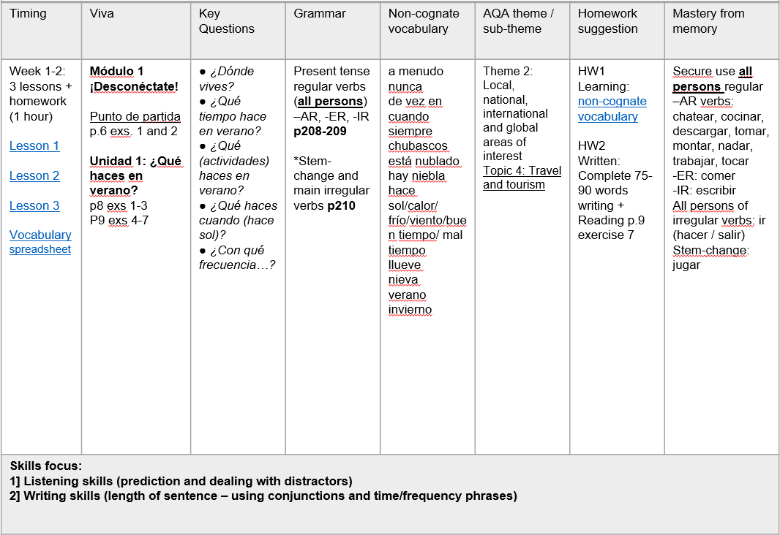

Slide 12

Deberes
Learn these 15 words/phrases.
I love (1)
I love (2)
since
given that
magazines
an ice rink
to dive
to use the computer
to be in the open air
to go cycling
to go shopping
to read
to watch films
a questionnaire
to spend the summer
https://quizlet.com/141649339/desconectate-week-2-3-vocabulario-flash-cards/
Vocabulary
- Minimum 15 words each week to learn
- Always on Quizlet (all vocabulary from each module is also there)
- Learn little and often
- Spend 30 – 60 minutes per week on vocabulary learning

Slide 13
2
What are the advantages of testing vocabulary in sentences?
2:00
2:00
1:59
1:58
1:57
1:56
1:55
1:54
1:53
1:52
1:51
1:50
1:49
1:48
1:47
1:46
1:45
1:44
1:43
1:42
1:41
1:40
1:39
1:38
1:37
1:36
1:35
1:34
1:33
1:32
1:31
1:30
1:29
1:28
1:27
1:26
1:25
1:24
1:23
1:22
1:21
1:20
1:19
1:18
1:17
1:16
1:15
1:14
1:13
1:12
1:11
1:10
1:09
1:08
1:07
1:06
1:05
1:04
1:03
1:02
1:01
1:00
0:59
0:58
0:57
0:56
0:55
0:54
0:53
0:52
0:51
0:50
0:49
0:48
0:47
0:46
0:45
0:44
0:43
0:42
0:41
0:40
0:39
0:38
0:37
0:36
0:35
0:34
0:33
0:32
0:31
0:30
0:29
0:28
0:27
0:26
0:25
0:24
0:23
0:22
0:21
0:20
0:19
0:18
0:17
0:16
0:15
0:14
0:13
0:12
0:11
0:10
0:09
0:08
0:07
0:06
0:05
0:04
0:03
0:02
0:01
End
Notes:
1. Focus on the small words as well (the, a, in, at, from, of)
2. You test a lot more verbs
3. It’s differentiated, so the more able can show you what they can do, but the lower attainers can still score very high marks if they’ve learnt the individual words
4. You can recycle a lot of key structures to refresh them in learners’ minds.
5. It’s low stakes testing of material that you hope will be in their long-term memory – pupils are not stressed by it as they know only the ‘purple’ text is point-scoring.
6. It gives you a lot of diagnostic information as the teacher to base future planning on.
7. Indepedent sentence building is tested in both speaking and writing in the new GCSE.

Slide 14
2
What are the advantages of testing vocabulary in sentences?
1. You can focus on the small words as well (the, a, in, at, from, of)
2. You test a lot more verbs
3. It’s differentiated, so the more able can show you what they can do, but the lower attainers can still score very high marks if they’ve learnt the individual words
4. You can recycle a lot of key structures to refresh them in learners’ minds.
5. It’s low stakes testing of material that you hope will be in their long-term memory – pupils are not stressed by it as they know only the ‘purple’ text is point-scoring.
6. It gives you a lot of diagnostic information as the teacher to base future planning on.
7. Independent sentence building is tested in both speaking and writing in the new GCSE.
Notes:
1. Focus on the small words as well (the, a, in, at, from, of)
2. You test a lot more verbs
3. It’s differentiated, so the more able can show you what they can do, but the lower attainers can still score very high marks if they’ve learnt the individual words
4. You can recycle a lot of key structures to refresh them in learners’ minds.
5. It’s low stakes testing of material that you hope will be in their long-term memory – pupils are not stressed by it as they know only the ‘purple’ text is point-scoring.
6. It gives you a lot of diagnostic information as the teacher to base future planning on.
7. Indepedent sentence building is tested in both speaking and writing in the new GCSE.

Slide 15
Summary
Joining up KS2-KS3-KS4 - clarity about progression
Long-term memory (vocabulary learning and testing)
Verbs (infinitive lexicon and application)
Accuracy (attention to detail in understanding and use)
Reading and listening skills (more explicit from Y7)
Speaking and writing (without support)
Links with the English department ☺

Slide 16
Verbs
In the early stages of a language course, particular attention should be paid to the planned building of pupils’ verb lexicon, focussing on the meaning of the stem or infinitive form of common verbs. A strong basic verb lexicon has been found to relate positively to pupils’ ability to learn to manipulate those verbs at later stages.
p.10 MFL Pedagogy Review Report November 2016

Slide 17
3
Note down the infinitive verbs that Y7 (or 8 or 9 or 10) have learnt this year.
How aware are the pupils of their verb lexicon?
Do they have opportunities to revisit, recycle, and reuse these verbs often (and in different tenses?)
2:00
2:00
1:59
1:58
1:57
1:56
1:55
1:54
1:53
1:52
1:51
1:50
1:49
1:48
1:47
1:46
1:45
1:44
1:43
1:42
1:41
1:40
1:39
1:38
1:37
1:36
1:35
1:34
1:33
1:32
1:31
1:30
1:29
1:28
1:27
1:26
1:25
1:24
1:23
1:22
1:21
1:20
1:19
1:18
1:17
1:16
1:15
1:14
1:13
1:12
1:11
1:10
1:09
1:08
1:07
1:06
1:05
1:04
1:03
1:02
1:01
1:00
0:59
0:58
0:57
0:56
0:55
0:54
0:53
0:52
0:51
0:50
0:49
0:48
0:47
0:46
0:45
0:44
0:43
0:42
0:41
0:40
0:39
0:38
0:37
0:36
0:35
0:34
0:33
0:32
0:31
0:30
0:29
0:28
0:27
0:26
0:25
0:24
0:23
0:22
0:21
0:20
0:19
0:18
0:17
0:16
0:15
0:14
0:13
0:12
0:11
0:10
0:09
0:08
0:07
0:06
0:05
0:04
0:03
0:02
0:01
End

Slide 18
ayudar | llevar
bailar | mandar
cantar | montar
chatear | navegar
dibujar | odiar
escuchar | olvidar
encontrar | osar
hablar | pensar*
jugar* | preguntar
llamarse | sacar
terminar
tocar
trabajar
visitar
aprender
beber
comer
leer
ver
escribir
salir
vivir
estar
ir
hacer
querer
ser
tener
encantar
gustar
Notes:
https://www.youtube.com/watch?v=qpSatdroK8o&feature=em-subs_digest
There are 40 verbs here, which I think Y7 meet in the first year of our KS3 curriculum.

Slide 19
Year 7
Grammar & Vocabulary
STEP 6
STEP 5
recall and use 30 verbs in the present tense and the simple future, use question words with more confidence to frame spontaneous questions, and use the relative pronoun ‘which’ in a variety of contexts to extend sentences, and use 80 cognate and 50 non-cognate words.
I can:
STEP 4
use nouns and adjectives, subject pronouns and present tense verbs (regular and key irregular) to generate positive and simple negative sentences independently, recalling at least 20 verbs, and use 50 cognate and 30 non-cognate words.
STEP 3
use high-frequency verb forms, nouns, articles and adjectives to form simple sentences independently, and has a basic repertoire of words and phrases related to people, places, things and simple actions.
use definite and indefinite articles, agree adjectives for number and gender, use all persons of several regular verbs in the present tense (with a writing frame) and use days of the week in simple sentence formation.

Slide 20
Year 8
Grammar & Vocabulary
STEP 8
recall and use 50 verbs, selecting and forming the correct time frame, albeit with some errors, and can use several modal verb + infinitive constructions, a variety of negative forms, and superlatives, and use 100 cognate and 100 non-cognate words.
STEP 7
I can:
recall and use 40 verbs, form the past tense with regular and key irregular verbs, use some modal verbs in combination with infinitives, use reflexive verbs in limited contexts and use comparative forms, and use 100 cognate and 80 non-cognate words.
STEP 6
STEP 5
recall and use 30 verbs in the present tense and the simple future, use question words with more confidence to frame spontaneous questions, and use the relative pronoun ‘which’ in a variety of contexts to extend sentences, and use 80 cognate and 50 non-cognate words.
use nouns and adjectives, subject pronouns and present tense verbs (regular and key irregular) to generate positive and simple negative sentences independently, recalling at least 20 verbs, and use 50 cognate and 30 non-cognate words.

Slide 21
Year 9
Grammar & Vocabulary
STEP 10
STEP 9
STEP 8
recall and use 75 verbs with reasonable accuracy in all tenses covered, can use direct object pronouns, a range of conjunctions, demonstrative adjectives and pronouns, and relative pronouns, and use 200 cognate and 150 non-cognate words.
I can:
recall and use 60 verbs, selecting and forming the correct tense with familiar and researched language, with some errors, and can form the imperative, use direct object pronouns and some conjunctions, and use 150 cognate and 125 non-cognate words.
STEP 7
STEP 6
recall and use 50 verbs, selecting and forming the correct time frame, albeit with some errors, and can use several modal verb + infinitive constructions, a variety of negative forms, and superlatives, and use 100 cognate and 100 non-cognate words.
recall and use 40 verbs, form the past tense with regular and key irregular verbs, use some modal verbs in combination with infinitives, use reflexive verbs in limited contexts and use comparative forms, and use 100 cognate and 80 non-cognate words.
recall and use 30 verbs in the present tense and the simple future, use question words with more confidence to frame spontaneous questions, and use the relative pronoun ‘which’ in a variety of contexts to extend sentences, , and use 80 cognate and 50 non-cognate words.

Slide 22


to go = ir
infinitivo
I went
I go
I’m going to go
Did you go?
Do you go?
Are you going to go?
S/he went
S/he goes
S/he is going to go
pasado
presente
futuro
we went
we go
We are going to go
they went
they go
They are going to go
I like going

Slide 23
to go = ir
infinitivo
fui
I go
I’m going to go
I went
voy
voy a ir
¿fuiste?
¿vas?
Did you go?
Do you go?
¿vas a ir?
Are you going to go?
S/he went
fue
va
S/he goes
va a ir
S/he is going to go
pasado
presente
futuro
fuimos
vamos
vamos a ir
we went
we go
We are going to go
they went
van
fueron
they go
van a ir
They are going to go
me gusta ir
I like going

Slide 24
To go to the cinema
I like to go/going …
I usually go…
I went...
I’m going to go…
presente
Normalmente ..
voy al cine
me gusta
ir al cine
futuro
pasado
El próximo fin de semana..
El fin de semana pasado..
voy a ir al cine
fui al cine
Notes:
I have found this year that our toolkit in Spanish needs to include a few essential verbs that we can conjugate in 3 tenses. Ultimately for my group this year it’s less important for them to learn a paradigm and manipulate accurately 100 AR reg verbs than it is for them to be completely happy and secure with the most useful verbs (invariably irregular). Consistency in presentation is helpful here.

Slide 25
pude
pudimos
pude
pudimos
pudisteis
pudisteis
pudieron
pudiste
pudieron
pudieron
pudiste
pudo
pudo

Slide 26

Play
Slap the board
0s and Xs
Kim’s game
Mastermind
Battleships
Connect 4
Treasure hunt / Points
Inverse bingo / strip bingo
Gap-fill relay
Telepathy
Wipe out

Slide 27
Summary
Joining up KS2-KS3-KS4 - clarity about progression
Long-term memory (vocabulary learning and testing)
Verbs (infinitive lexicon and application)
Accuracy (attention to detail in understanding and use)
Reading and listening skills (more explicit from Y7)
Speaking and writing (without support)
Links with the English department ☺

Slide 28


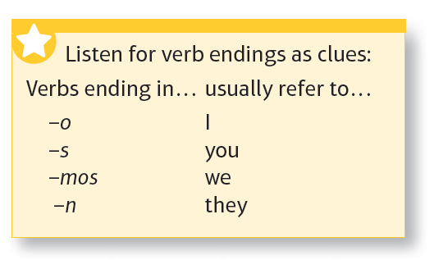
nadan
1 | Todos los días __________ en el mar.
2 | A veces _________ esquí en invierno.
3 | ¿____________ al voleibol en verano?
4 | José siempre ______ a la playa los sábados.
5 | Casi nunca ____________ en Internet porque _____ aburrido.
6 | ¿Dónde __________ tus padres, Almudena? ¿________ con ellos a menudo?
7 | ¿Qué __________ por la tarde después del insti?
8 | Normalmente ______ películas cuando mis padres ___________.
Notes:
[3 minutes only]
1. Elicit answers (resist the urge to translate into English at the moment!). Students correct (in green!)
2. Elicit the meanings of the time phrases by teacher using English.
Como se dice – From time to time, never, almost never, every day, two or three times a year, often
(this way round put the onus on the students to pronounce in Spanish).

Slide 29

Para empezar…
Traduce las frases 1-6 al inglés.
hice
Somos una familia muy activa. El año pasado mi familia y yo fuimos a Grecia e 1) hice muchas cosas. A mí me encanta hacer deportes acuáticos así que 2) hice windsurf todos los días. Mi madre y mi hermano 3) hicieron ciclismo en las montañas pero mi padre prefiere ir a pie, y por eso 4) hizo alpinismo. 5) Hizo mucho calor y sol. ¡Qué guay! Y tú y tu familia, 6) ¿qué hicisteis de vacaciones el verano pasado?
hiciste
hizo
hizo
hicimos
hicisteis
hicieron
Notes:
[3 minutes + 2 minutes feedback]
Translate from Spanish into English the numbered phrases in pink.

Slide 30

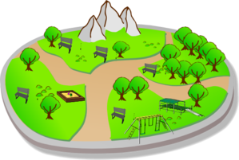


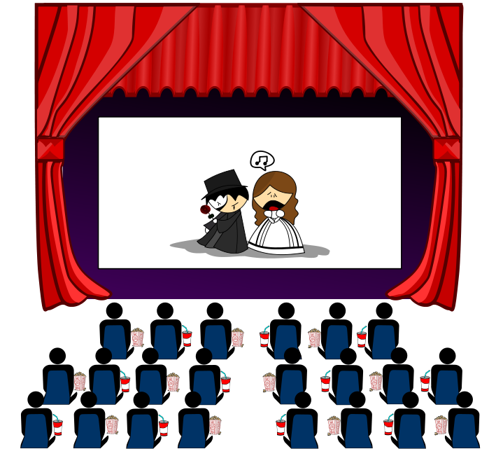

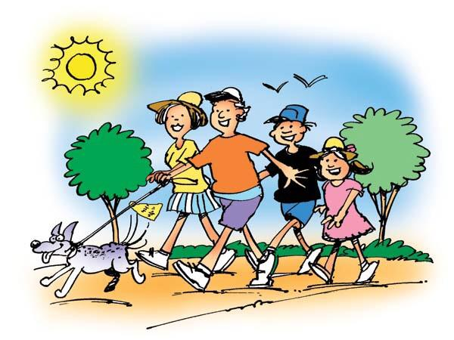


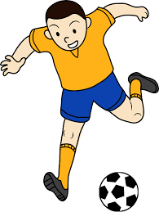

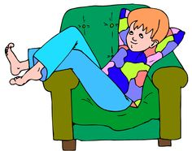

Slide 31
Normalmente
Este fin de semana

Slide 32
Normalmente
Este fin de semana

Slide 33
Voy
Vamos
Voy
No voy
☺
☹

Slide 34
4
What other ways can we think of to promote a focus on processing verb endings for meaning?
2:00
2:00
1:59
1:58
1:57
1:56
1:55
1:54
1:53
1:52
1:51
1:50
1:49
1:48
1:47
1:46
1:45
1:44
1:43
1:42
1:41
1:40
1:39
1:38
1:37
1:36
1:35
1:34
1:33
1:32
1:31
1:30
1:29
1:28
1:27
1:26
1:25
1:24
1:23
1:22
1:21
1:20
1:19
1:18
1:17
1:16
1:15
1:14
1:13
1:12
1:11
1:10
1:09
1:08
1:07
1:06
1:05
1:04
1:03
1:02
1:01
1:00
0:59
0:58
0:57
0:56
0:55
0:54
0:53
0:52
0:51
0:50
0:49
0:48
0:47
0:46
0:45
0:44
0:43
0:42
0:41
0:40
0:39
0:38
0:37
0:36
0:35
0:34
0:33
0:32
0:31
0:30
0:29
0:28
0:27
0:26
0:25
0:24
0:23
0:22
0:21
0:20
0:19
0:18
0:17
0:16
0:15
0:14
0:13
0:12
0:11
0:10
0:09
0:08
0:07
0:06
0:05
0:04
0:03
0:02
0:01
End

Slide 35
Summary
Joining up KS2-KS3-KS4 - clarity about progression
Long-term memory (vocabulary learning and testing)
Verbs (infinitive lexicon and application)
Accuracy (attention to detail in understanding and use)
Reading and listening skills (more explicit from Y7)
Speaking and writing (without support)
Links with the English department ☺

Slide 36

Listening strategies and skills
A good knowledge of vocabulary, high frequency words and synonyms
Prediction
Ability to spot opinions and changes of opinion
Avoidance of distractors and sustained concentration
Infer and make associations from synonymous phrases
Ability to cope with unfamiliar language / manage the panic!
Ability to recognise and decode cognates
Notes:
Listening and reading skills can be developed from the very beginning of the course.
Rather than seeing listening and reading solely as first steps in accessing new language content, we can see them also as ways to develop these essential comprehension skills.
It has often been the case that we become really explicit about listening and reading skills when revising / preparing for the GCSE exams.
However, we can do a lot with these skills over time, building them into our normal lesson planning.

Slide 37







Reading strategies and skills
Recognise high frequency and other key language
Use cognates and near cognates to work out meaning
Use context to work out meaning
Use skimming to get the overall idea
Use scanning to find specific details
Deduce and infer meaning from clues
Use grammatical clues to work out meaning and especially tenses.

Slide 38
Summary
Joining up KS2-KS3-KS4 - clarity about progression
Long-term memory (vocabulary learning and testing)
Verbs (infinitive lexicon and application)
Accuracy (attention to detail in understanding and use)
Reading and listening skills (more explicit from Y7)
Speaking and writing (with/without support)
Links with the English department ☺

Slide 39
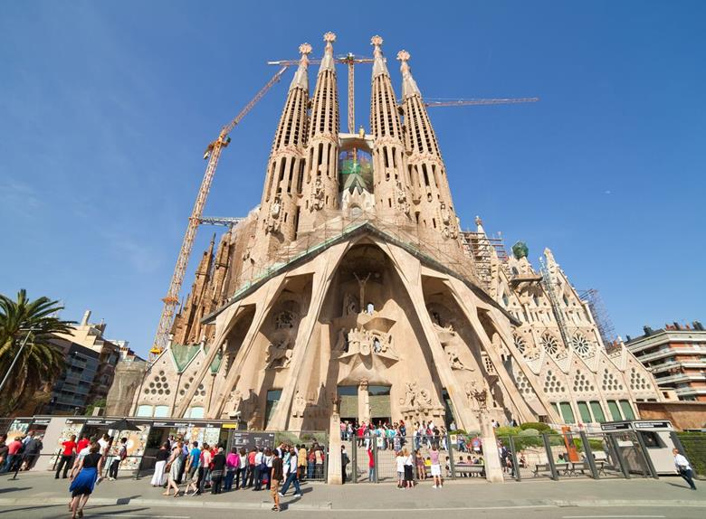

¿Qué hay en la foto?
¿Cómo es …?
¿Dónde está…?
¿Qué hacen?
Physical description
Action
Location
Mood
Notes:
Aiming to elicit:
En la foto hay un edificio / un monumento / una iglesia (not exactly a catedral, it’s a basilica)
El edificio / la catedral es grande, enorme, bonito/a, histórico/a, antiguo/a – (started 1882 - ?? possible completion date - 2026?), impresionante, importante, alto/a
También hay unas personas (que visitan el monumento).
Las personas son turistas.
En mi opinión / Pienso que está en España.
También hay unos edificios modernos y una palmera, una grúa (crane).
NB: the greyed out questions are extension – additional for higher attaining students.

Slide 40
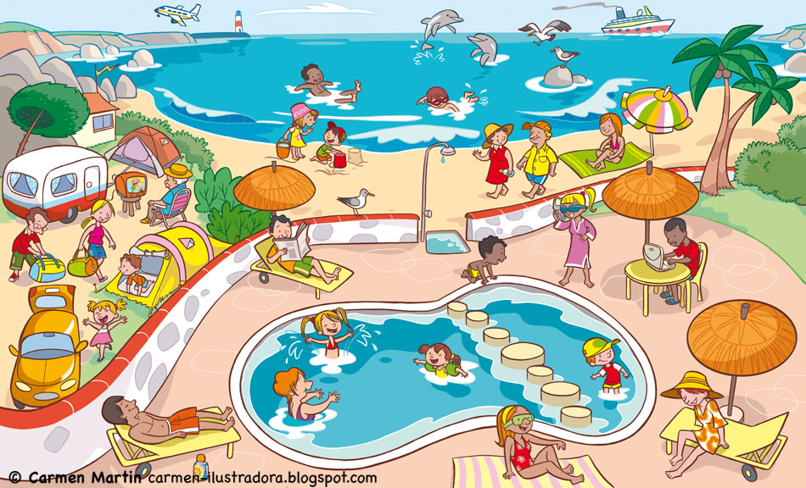
¿Qué hay en la foto?
¿Cómo es …?
¿Dónde está…?
¿Qué hacen?
Physical description
Action
Location
Mood

Slide 41
¿Qué hay en la foto?
To say who is doing what, change the infinitive.
Remove –ar/-er/-ir and add:
I = -o
you = -as / -es
s/he = -a / -e
we = -amos / -emos / -imos
they = -an /-en
infinitivo
En la foto hay…
muchas personas / mucha gente
un camping / una playa / una piscina etc…
nadar
tomar el sol
escuchar
montar
tocar
descansar
comprar
bailar
usar
estar
jugar* (juego)
hacer* (hago)
ver
leer
salir* (salgo)
ir*
¿Qué tiempo hace?
Hace…
(No) llueve / nieva.
Más vocabulario:
en el mar / en la piscina
a caballo / en bici
la guitarra
un helado
el ordenador
al aire libre / de vacaciones
a los videojuegos / al voleibol / a la pelota
deportes acuáticos
submarinismo
la tele / una película
un libro / un periódico / una revista
con mis amigos
de compras / de excursión (en barco) / de paseo
¿Qué hace la gente?
Todas las personas…
Unas persons…
Otras personas…
Una persona … (un hombre / una mujer un chico / una chica)
Y tú, ¿Qué haces normalmente en verano / en invierno?

Slide 42
¿Qué hay en la foto?
To say who is doing what, change the infinitive.
Remove –ar/-er/-ir and add:
I = -o
you = -as / -es
s/he = -a / -e
we = -amos / -emos / -imos
they = -an /-en
infinitivo
En la foto hay…
muchas personas / mucha gente
un camping / una playa / una piscina etc…
nadar
tomar el sol
escuchar
montar
tocar
descansar
comprar
bailar
usar
estar
jugar* (juego)
hacer* (hago)
ver
leer
salir* (salgo)
ir*
¿Qué tiempo hace?
Hace…
(No) llueve / nieva.
Más vocabulario:
¿Qué hace la gente?
Todas las personas…
Unas persons…
Otras personas…
Una persona … (un hombre / una mujer un chico / una chica)
Y tú, ¿Qué haces normalmente en verano/ en invierno?

Slide 43
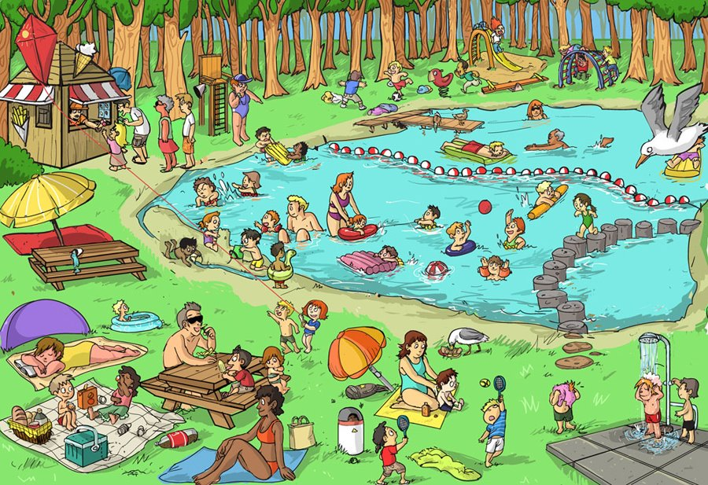
¿Qué hay en la foto?
¿Cómo es …?
¿Qué hacen?
¿Dónde está…?
Physical description
Action
Location
Mood

Slide 44
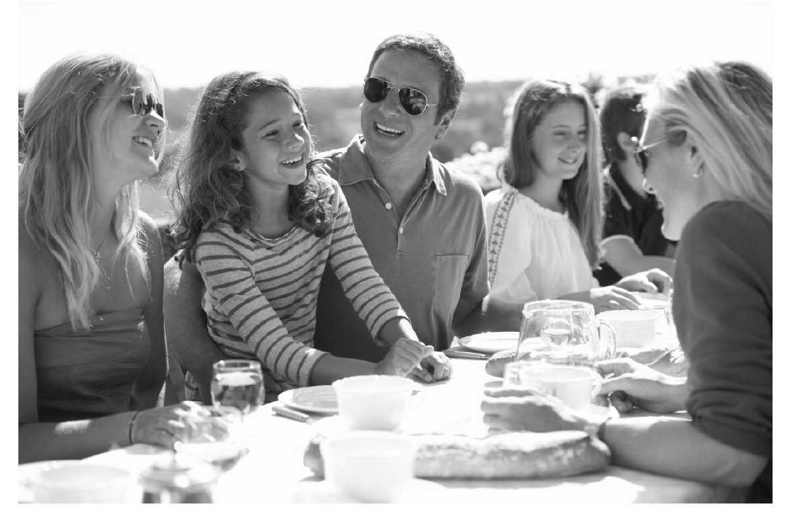
Physical description
Action
Location
Mood
(Weather)
Qu’est-ce qu’il y a sur la photo?
¿Qué hay en la foto?
Was gibt es auf dem Foto?

Slide 45
En la foto hay un grupo de personas. A lo mejor es una familia porque hay personas de varias edades.
En el centro podría ser el padre, y a la derecha quizás la madre. Al lado del padre hay una chica. Tiene el pelo largo y marrón, y a mi parecer tiene diez u once años.
Están sentados en una mesa fuera y están comiendo y charlando. En mi opinión podrían estar en el jardín pero no se puede ver mucho en el fondo. Pienso que es un evento especial porque no es un picnic. Parece una celebración más formal, posiblemente un cumpleaños aunque no hay regalos ni tarta de cumpleaños en la foto. Por lo visto están muy contentos porque todos están sonriendo y parecen muy relajados. Creo que hace mucho sol y calor porque llevan gafas de sol y ropa de verano.

Slide 46
Language functions and structures | Examples from the model answer
Physical description
Action
Location
Mood
Weather
Speculation / Hypothesis
Reasons / Justifications
Negation – i.e. Saying what isn’t there
General → specific vocabulary

Slide 47
Language functions/structures | Examples from the model answer
Physical description | tiene el pelo largo y marrón
Action | están comiendo y charlando, todos están sonriendo
Location | en la foto hay…, en el centro, a la derecha, al lado del (padre), en el fondo, están sentados, en una mesa, fuera,
Mood | están contentos, están sonriendo
Weather | hace mucho sol y calor
Speculation / Hypothesis | A lo mejor, podría ser, quizás, a mi parecer, en mi opinión, podrían estar, pienso que, parece, posiblemente, por lo visto, parecen, creo que
Reasons / Justifications | porque, pero, aunque, porque
Negation – i.e. Saying what isn’t there | no es un picnic, no se puede ver mucho en el fondo, no hay regalos ni tarta
General → specific vocabulary | un grupo de personas → una familia → el padre, la madre, una chica un event especial / una celebración → un cumpleaños

Slide 48
Summary
Joining up KS2-KS3-KS4 - clarity about progression
Long-term memory (vocabulary learning and testing)
Verbs (infinitive lexicon and application)
Accuracy (attention to detail in understanding and use)
Reading and listening skills (more explicit from Y7)
Speaking and writing (with/without support)
Links with the English department ☺

Slide 49
Grammar: Key terms
Noun Nombre, Sustantivo | A noun is a word which can be used after a determiner. They are words for a person, place, thing or idea. In Spanish they are classified as masculine or feminine, and singular or plural. | un gato, una hermana, unos perros, unas tías | acat, a sister, some dogs, some aunties
Adjective Adjetivo | An adjective is used to describe a noun, or after the verb “be”, to add detail. They are often called “describing” words. | alto, inteligente, enorme, | tall, intelligent, enormous
Preposition Preposición | A preposition links a following noun or pronoun to some other word in the sentence. | a, con, de | to, with, of
Verb Verbo | A verb is a word which can be described as having a tense (present/past/future) and an infinitive form. They are often called “doing words” | vivo, bebe, comen, pensamos | I live, he/she drinks, they eat, we think
Tense Tiempo verbal | Tense is the choice between present, past and future verbs. | hablo, voy a hablar | I speak, I am going to speak
Infinitive Infinitivo | The ‘dictionary form’ of the verb, equivalent to “…ing” or “to …” n English. There are 3 types of infinitive in Spanish: -AR, -ER, -IR. | hablar, comer, vivir | to speak, to eat, to live
Subject Sujeto | The subject of a verb is the person or thing that is doing (or being) the verb. The form of the verb depends on its subject. | yo, tú, él, ella | I, you, he, she
Object Objeto | An object is used with a verb, and shows what the verb is acting on. | como chocolate, lee un libro | I eat chocolate, she reads a book
Adverb Adverbio | An adverb is used to modify (add detail to) a verb, an adjective or another adverb. | rápidamente, bien, fácilmente | quickly, well, easily
Pronoun Pronombre | A pronoun is a word which can be used instead of a noun. It is used like a noun. | lo/la, él, nos | it, him, to us
Conjunction Conjunción | A conjunction links two words or phrases together. | y, pero, porque | and, but, because

Slide 50
-id at the end of the word changes to -ido
The boy is timid
El chico es tímido
Can you translate the following sentences?
El ácido es rojo.
The acid is a liquid.
What would the following words be in Spanish?
solid
rapid
vivid
Can you write a sentence in English using each and translate it into Spanish?

Slide 51
English department skills lessons Y7 – half-term 1
Skills lesson 1 | Key terminology: noun, noun phrase, adjective, determiner
Starter | Introduction | Development | Plenary | Homework
What is a noun? Define concrete, abstract and proper nouns. Group English nouns. Translate Spanish nouns and group. Identify 3 nouns in the classroom and categorise. Identify 1 noun in Spanish in the classroom. | Show 4 images and 2 adjectives in Spanish. Translate the adjectives and apply to the images. Write a descriptive sentence for each image using the adjective plus one other. Show a further image – students brainstorm adjectives to describe the nouns in the image. | Show students short piece of writing. Identify adjectives. Define noun phrases. Identify noun phrases in the passage. Short piece of writing in Spanish – translate underline noun phrases into English. | A further sentence. Identify nouns, adjectives, noun phrases and determiners. Write own short paragraph describing an image. Swap books over and label each other’s using key terminology.

Slide 52
Skills lesson 2 | Key terminology: Verb, adverb, simple sentence, auxiliary verb, adverbial, infinitive
Starter | Introduction | Development | Plenary | Homework
Show students a Where’s Wally cartoon. Identify as many verbs from the image as they can (infinitive form) Translate 3 verbs into Spanish (infinitive form) | What changes the form of the verb? (Who is doing the action and when the action is happening). Take the verb working and complete table of past and present forms for the pronouns I, He, We, They, You Sometimes verbs work with have/be (auxiliary verbs) which are used to show tense. Complete tale for past and present tense with auxiliary verbs (He…working/I…working/ We…working/ They…working/ You…working) | Students to translate Spanish verbs and to identify adverbs to add detail. Students to put these into full simple sentences. Show students an image – identify verbs and then adverbs. Students to translate adverbs into Spanish. | Define adverbial. Students to identify adverbs and adverbials in a piece of writing. Students to construct a sentence using given adverbs and adverbials.

Slide 53
Skills lesson 3 | Key terminology: sentence, subject, object, pronoun, main clause, conjunction, compound sentence
Starter | Introduction | Development | Plenary | Homework
Show students a sentence. Identify the key components. Students to rewrite including adjectives, adverbs, adverbials. Introduce terms subject and object. Students to identify subject and object in both English and Spanish sentences. | Define pronoun (replaces the noun). Students to replace pronouns in example sentences. Students to attach correct pronouns to images. | Recap simple sentence. Students to identify features in 2 simple sentences (ensure that one subject is a pronoun). Join sentence together – introduce conjunction and compound sentence. Show a short piece of Spanish. Students to translate into English and label grammatical features and sentence structures. | Students to write a short fairy tale. Students to highlight 4 sentences in their fairy tale. Partners to label the features.

Slide 54
5
What other ideas can we share for building links between English and languages departments?
2:00
2:00
1:59
1:58
1:57
1:56
1:55
1:54
1:53
1:52
1:51
1:50
1:49
1:48
1:47
1:46
1:45
1:44
1:43
1:42
1:41
1:40
1:39
1:38
1:37
1:36
1:35
1:34
1:33
1:32
1:31
1:30
1:29
1:28
1:27
1:26
1:25
1:24
1:23
1:22
1:21
1:20
1:19
1:18
1:17
1:16
1:15
1:14
1:13
1:12
1:11
1:10
1:09
1:08
1:07
1:06
1:05
1:04
1:03
1:02
1:01
1:00
0:59
0:58
0:57
0:56
0:55
0:54
0:53
0:52
0:51
0:50
0:49
0:48
0:47
0:46
0:45
0:44
0:43
0:42
0:41
0:40
0:39
0:38
0:37
0:36
0:35
0:34
0:33
0:32
0:31
0:30
0:29
0:28
0:27
0:26
0:25
0:24
0:23
0:22
0:21
0:20
0:19
0:18
0:17
0:16
0:15
0:14
0:13
0:12
0:11
0:10
0:09
0:08
0:07
0:06
0:05
0:04
0:03
0:02
0:01
End

Slide 55

HoDs Derbyshire
Monday 19 June 2017
BREAK
Preparing students for the new GCSE
What are we doing differently?

