Slide 1




Motivation matters!
With the introduction of the new, more challenging GCSE, it is clear to us as teachers that learner motivation is key. This session sets out strategies to create a motivational climate for learning and offers tasks that really motivate.
www.rachelhawkes.com

Slide 2
This session will…
review (briefly!) the evidence for language learning motivation in England
identify key motivational drivers for students in language learning
look at how we make the weather and create the right climate in our classrooms
explore strategies for harnessing key motivational drivers
tease out how to build long-lasting engagement in language learning at KS3 and KS4

Slide 3
With a long-term learning process such as the mastery of a second language, learners' ultimate success will depend heavily on their level of motivation. (Dörnyei, 2014)

Slide 4
What is the level of motivation for language learning of pupils in England?
(as expressed by the participation rates at KS4 and beyond)

Slide 5
Participation in language learning at KS4 and beyond
Fewer than 50% Year 11 pupils takes a language at GCSE (and of those, the pass rate is approx. 70%).
Less than a third of all pupils achieved a good GCSE in a language in 2017, (4.4% in more than one language - 2016).
There is regional disparity (65% in London, 43% in the North East, 28% in Middlesborough).
The number of pupils taking an A level language is down by 1/3 since 1996; entries are heavily skewed towards girls (64%) and the independent sector.
Board, K., & Tinsley, T. (2017). Language Trends Survey
Modern Foreign Language Pedagogy Review (2016)

Slide 6
When does motivation for language learning decline?

Slide 7
Meta-analysis L2 motivation studies of language learning (Lanvers, 2017)
Motivation and enjoyment of foreign language learning are high in the primary phase (Courtney, 2014, Martin, 2012)
Transition from primary to secondary is a more complex picture – reports of ‘increased boredom’ (Courtney, 2014, Graham et al., 2016) and of ‘learning properly’ (Chamber, 2016)
Motivation dips by the end of Y7 but it is not clear why (Deckner, 2017)
Overall students are poorly motivated at secondary level (Evans and Fisher, 2009; Lanvers, 2016; Taylor and Marsden, 2014) and students have lower self-efficacy in languages than other curriculum subjects (Graham, Macfayden and Richards, 2012)

Slide 8
Why does motivation for language learning decline?

Slide 9
Reasons for low motivation
Sociocultural / environmental factors
- English is global lingua franca - which language do English-speaking students need?
- England’s insularity and rejection of ‘European-ness’
- Disinterest → xenophobia of the press (Coleman, 2009)
- Negative reputation of British as language learners (Graham and Santos, 2015; Lanvers and Coleman, 2013)
Education policy
- Languages for All, 100% optional, Ebacc…
Pedagogy and classroom factors
- teacher, grouping, curriculum, assessment, methods, lack of challenge/meaningful communication (Wingate, 2016)
Individual learner differences
- gender(lots on this!), ability, personality, anxiety, learner ‘selves’ (Dörnyei, 2005, 2009, 2014)

Slide 10
What makes a positive impact on motivation?
What are the key motivational drivers for students in language learning?

Slide 11
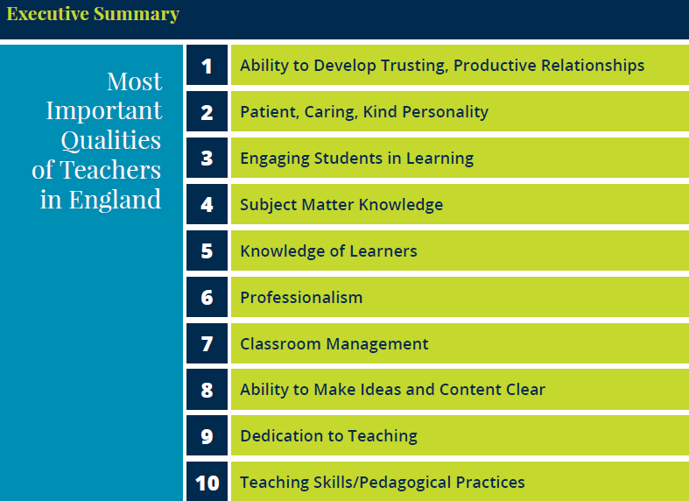
England: What makes an effective teacher?
Inicio
60 segundos
60
45
30
15
0
Katherine McKnight, PhD, Pearson
Lacey Graybeal, Jessica Yarbro, & John Graybeal, George Mason University
Notes:
Let’s just take a moment and come at this from the angle of a different piece of research, a more general study looking at What makes an effective teacher
It’s a study that was replicated in 50 countries. Unsurprisingly, there was unanimity about the top 3 responses in all/most of the countries.
Let’s see if you can predict what they are… Talk to the person next to you.

Slide 12
MFL Pedagogy Review Report November 2016
Research supports the Ofsted finding that factors other than a subject’s ‘usefulness’ or importance for future life or work influence pupil choice. Intrinsic motivation, which comes from a sense of progress, growing knowledge and understanding, and achievement, is a prime factor for pupils when they are asked to exercise choice about subjects to be pursued. That sense of real progress in inextricably linked to the way in which the subject matter of the course is planned, sequenced and taught. (p.7)

Slide 13
A lot of thinking and feeling!
Cognitive
Engagement & Motivation
Affective
Notes:
Synthesising both of these general findings might lead us to summarise that motivational language learning is essentially about doing a lot of thinking and feeling….!
And that where the cognitive and the affective overlap, that is where you find engagement / motivation.

Slide 14
Purpose of study
Learning a foreign language is a liberation from insularity and provides an opening to other cultures. A high-quality languages education should foster pupils’ curiosity and deepen their understanding of the world. The teaching should enable pupils to express their ideas and thoughts in another language and to understand and respond to its speakers, both in speech and in writing. It should also provide opportunities for them to communicate for practical purposes, learn new ways of thinking and read great literature in the original language. Language teaching should provide the foundation for learning further languages, equipping pupils to study and work in other countries.
Notes:
Both cognitive and affective dimensions are in here…

Slide 15
Summary of key theoretical model
Motivation concerns the fundamental question of why people behave as they do, that is, the choice of a particular action, the persistence with it, and the effort expended on it.
Because motivation always manifests itself in a dynamic interplay with other personal and contextual factors, a particularly fruitful approach to conceptualizing motivation is by focusing on motivational conglomerates of various motivational, cognitive, and emotional variables that form coherent patterns and, as such, act as wholes.
One motivational conglomerate that offers a particularly useful framework for language educators is the learners' future vision of themselves.
Language-specific vision is operationalized within the broader construct of the L2 motivational self system, which highlights three primary sources of L2 motivation: the learners' vision of themselves as effective L2 speakers (ideal L2 self); the social pressure coming from the learner's environment (ought-to L2 self); and the learners’ positive learning experiences.
Skills in motivating learners are central to effective teaching; relevant motivational strategies can be divided into three main clusters. focusing on: (I) the learner's future vision; (2) the individual's learning experience; and (3) the group's learning experience.
Taken from: Dörnyei, Z. (2014). Motivation in second language learning. In M. Celce-Murcia, D. M. Brinton & M. A. Snow (Eds.), Teaching English as a second or foreign language (4th ed., pp. 518-531). Boston, MA: National Geographic Learning/Cengage Learning.
Notes:
Let’s hold on to that vision and those two key elements – cognitive and affective, and turn to the work of someone whose work in the field of language learning motivation is hugely significant and far-reaching, Zoltan Dornyei.

Slide 16
Ideal self, ought-to self and positive learner experiences
‘I need a good GCSE grade in French’
‘I think I’m someone who will have friends in lots of different countries’
‘I’ve got much better at speaking since last year – we do lots of practice in class and I can have conversations without looking at my book, now’
‘I love that Spanish people have so many festivals’
‘I have to learn these words for a vocab test next week’
‘I just find that what we learn makes sense to me – I don’t struggle to get it’
‘I like coming up with strange questions for my teacher in German – she loves it when we ask things and it’s like banter but in German!’
‘We have to think a lot and it’s hard, but good because I can tell I’m getting better’
‘I don’t know if I’m going to need Spanish in later life but I think I could learn any language now because I know how to do it’
Notes:
It can be tricky at times to relate theoretical principles to what we actually see and experience in the classroom, so let’s have a look at a few statements (I’ve created these but these are the sorts of things we could hear students say’)
Can we identify them as relating to the three elements of Dornyei’s L2 motivational system?
Which are most prevalent, do you think?
Which of these three elements is the easiest to impact?
Over what do we as teachers have most direct control?

Slide 17
Key motivational drivers
(that we as teachers can impact)
Learners’ views of themselves as future language users
The social expectations that learners experience in relation to language learning
Individual learner experiences in the classroom
Group learning experiences in the classroom

Slide 18
What is the current situation / problem?
ACTION RESEARCH ENQUIRY
Establish the starting point
What does this tell me and what should I do next?
I think I should use X strategy in this situation.
Reflection, evaluation, analysis, review of problem in relation to data
Design an intervention and implement it
What happened and how do I know?
Data collection and analysis

Slide 19
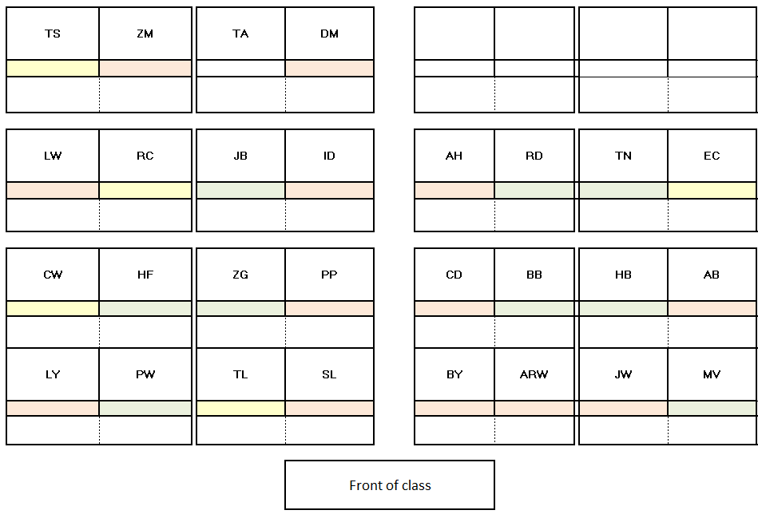



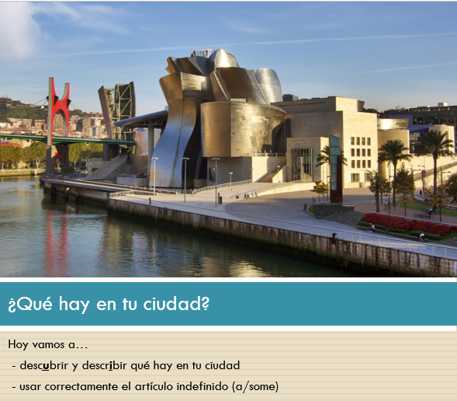
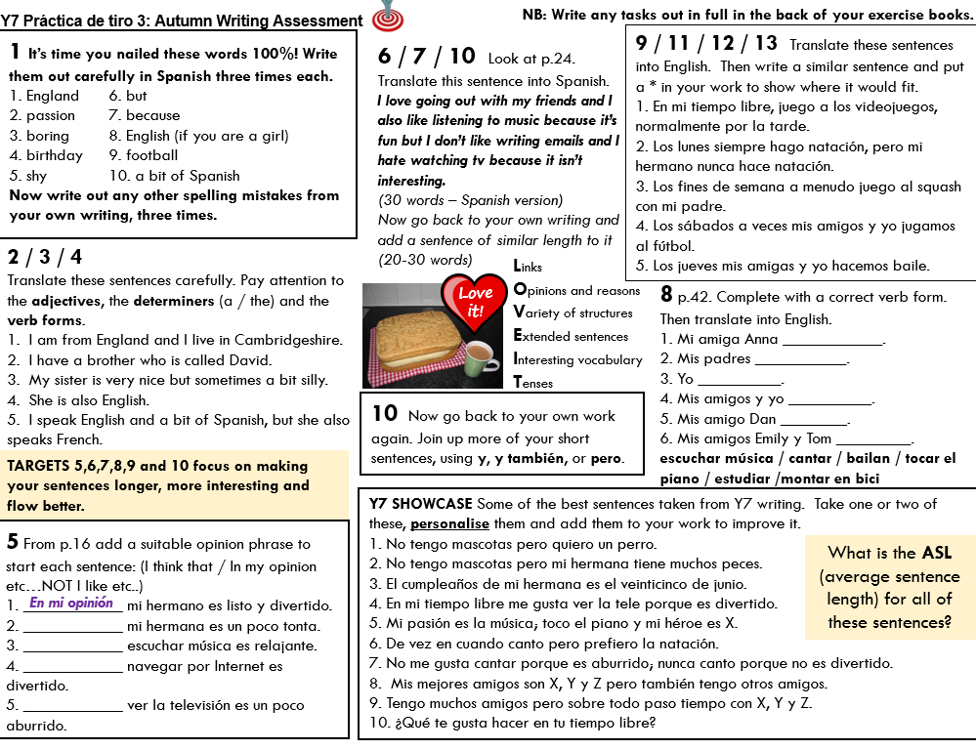
Intervention
Motivation strategies
Mixed ability teaching for longer
Mixed ability seating plans
Reward participation effort
Ethos of ‘osar’ / creating the climate
Choice and open-ended tasks
Sense of real progress
Personal repertoire
Challenge (Hard is good! ☺)
Teach skills explicitly
Usar para comunicarse
Producir de memoria
Producir con ayuda
Pronunciar
Comprender
Reconocer
Notes:
Combination of affective and cognitive strategies
I didn’t want to isolate individual strategies and try them out one by one.
I felt I had enough from the literature on motivation and my previous teaching experience to go straight in with a range of approaches that I thought would be successful.
In many cases they were tweaks on strategies I have developed over many years, just a question of emphasis or drawing out more explicitly the key components of each strategy.
So I taught using all of these strategies from September – February and then I gave students a ‘lesson experience survey’ and some further questions to ascertain how they felt about their own progress.

Slide 20
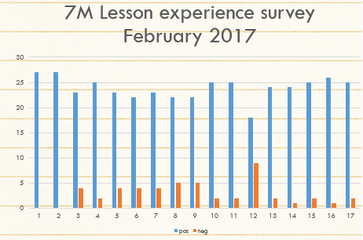
Data collection & analysis
1 | Lessons are well planned.
2 | Lessons have a clear learning purpose.
3 | Lessons are interesting.
4 | Lessons involve different activities.
5 | Lessons make me think.
6 | The whole class is actively involved in lessons.
7 | Lessons have a good pace.
8 | Lessons have a relaxed and positive, but purposeful atmosphere.
9 | Class behaviour is generally very good.
10 | The teacher explains things clearly.
11 | I feel I learn something new each lessons.
12 | I look forward to language lessons.
13 | The teacher has high expectations of me.
14 | The teacher has high expectations of the class.
15 | The teacher uses the target language for classroom instructions.
16 | The teacher uses the target language to praise us.
17 | I feel my books are always clearly marked and I know what to do to improve my work.
1 | Strongly agree
2 | Agree
3 | Disagree
4 | Strongly disagree

Slide 21
From February into ability groups but named by Spanish cities…
I got 7 BILBAO (set 3 of 5)
11 of the 29 pupils were also in 7M
I taught 7 BILBAO using the same strategies as previously
In mid-June students from 7M (now taught by 5 different teachers) re-did the two surveys from February

Slide 22
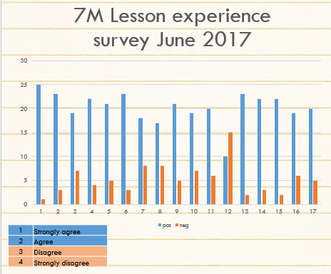
Data collection & analysis
1 | Lessons are well planned.
2 | Lessons have a clear learning purpose.
3 | Lessons are interesting.
4 | Lessons involve different activities.
5 | Lessons make me think.
6 | The whole class is actively involved in lessons.
7 | Lessons have a good pace.
8 | Lessons have a relaxed and positive, but purposeful atmosphere.
9 | Class behaviour is generally very good.
10 | The teacher explains things clearly.
11 | I feel I learn something new each lessons.
12 | I look forward to language lessons.
13 | The teacher has high expectations of me.
14 | The teacher has high expectations of the class.
15 | The teacher uses the target language for classroom instructions.
16 | The teacher uses the target language to praise us.
17 | I feel my books are always clearly marked and I know what to do to improve my work.

Slide 23
Attitudes to language learning
Learning Spanish is important.
Learning languages is fun.
Learning languages will help me get a good job.
Languages languages will help me if I want to travel abroad.
I am looking forward to carrying on learning languages in Year 8.
4 – Strongly agree 3 – Agree 2 – Disagree 1 – Strongly disagree

Slide 24
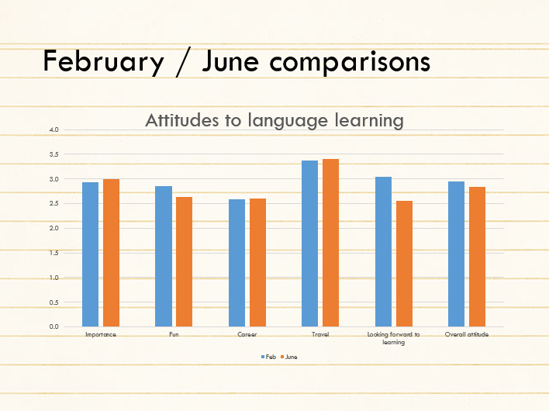

Slide 25
Reflection, evaluation,…
Despite slightly fewer positive responses about their classroom learning experiences in June compared to February, a significant majority of learners (in the sample) still feel their Spanish lessons are interesting, well-paced and involve variety. They think they learn something each lesson and feel their work is well-marked and that they can learn from the feedback. They recognise their own learning progress between February and June. They believe languages to be a little more important, both for their future career and for travel. However, a majority of the same learners reports not looking forward to language lessons (1/3 positive, 2/3 negative). This is a reversal from the February data (2/3 positive, 1/3 negative). They also believe it is less fun learning a language in June than they felt it to be in February.
More questions than answers…?!
Notes:
However, in comparison with national data on motivation, I can say that overall motivation for language learning had been sustained well with this class throughout Y7, despite the change of sets and teachers.
I am going to track the students through Y8 and 9, too, and take focus groups for interview to get further insights…
But back to the motivation strategies….

Slide 26
Intervention
Motivation strategies
Mixed ability teaching for longer
Mixed ability seating plans
Reward participation effort
Ethos of ‘osar’ / creating the climate
Choice and open-ended tasks
Sense of real progress
Personal repertoire
Challenge (Hard is good! ☺)
Teach skills explicitly
Usar para comunicarse
Producir de memoria
Producir con ayuda
Pronunciar
Comprender
Reconocer

Slide 27
Mixed ability seating plans
Lower attaining students to outer edges
(for easier support by the teacher)
Pair work first done with Higher / Lower attaining pairs (i.e. Left/Right)
Pair work task then repeated with more equal pairs (i.e. Front/Back)

Slide 28
Reward participation effort
Consistently high expectations
Frequent reminders
Recognition and rewards
Randomised selection

Slide 29




Ethos of ‘osar’/creating the climate
Hoy vamos a…
pensar
leer
cantar
conversar
osar

Slide 30



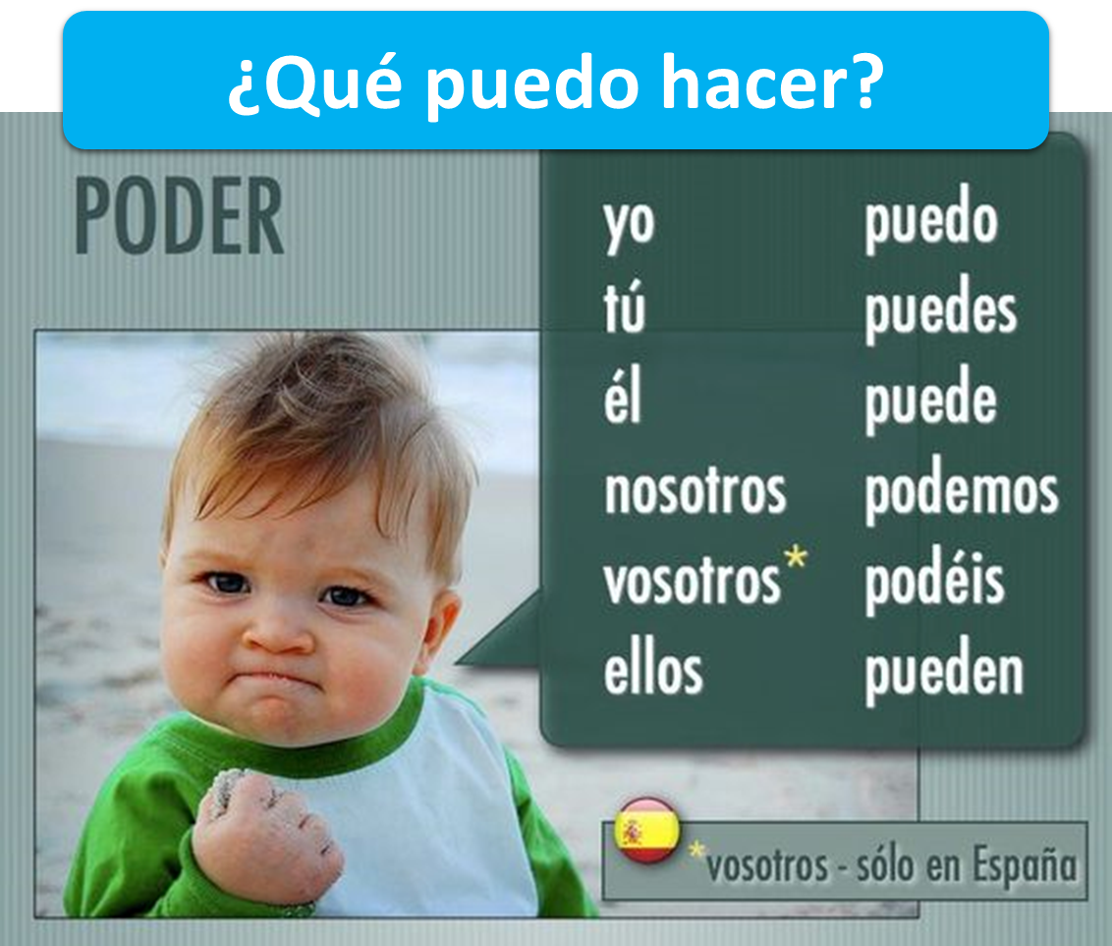

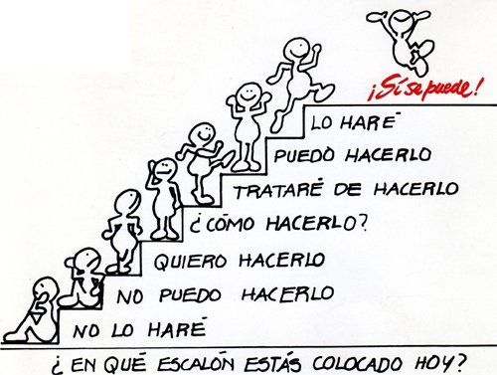

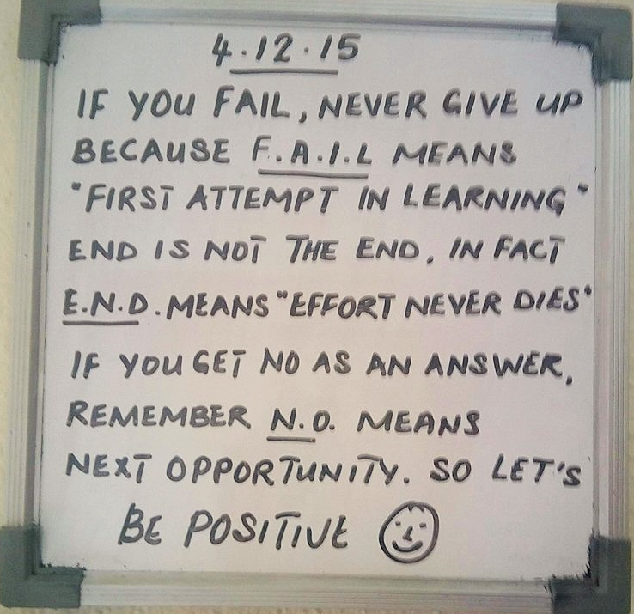


Slide 31





¿Tienes un problema??
Cerebro
Cuaderno
Compañero
Notes:
all images copyright free for non for profit use from www.clker.com

Slide 32


Creating the climate for learning
DOs
take risks
have a go
show good ‘audience’ skills
respond to others’ contributions
ask questions
make links
Co-teachers
Two rules for the classroom
1) Do everything to help yourself learn as much as you can
2) Do everything to help others learn
DONTs
think everyone else knows the answer
keep quiet when you’re not sure
get cross if you know the answer but don’t get to contribute

Slide 33
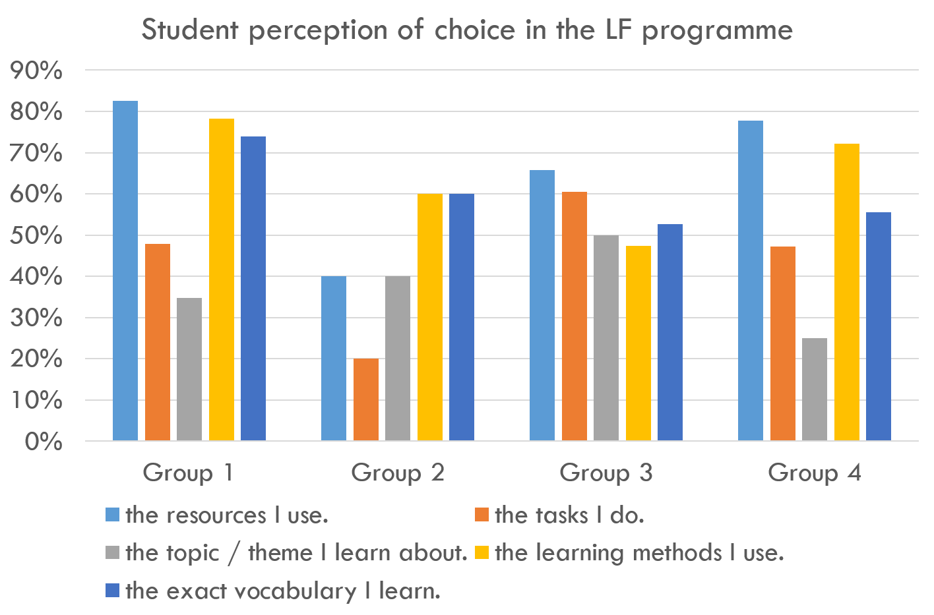
Choice and open-ended tasks
Many elements of choice within learning align positively with motivation (Language Futures Project)
Notes:
Direct teachers to the ALL stand downstairs to find out more about it
How can we give more choice within mainstream classroom teaching?
Even the illusion of choice can be very powerful…

Slide 34
Additions for authenticity
It is our core purpose to bring culture as well as language to our lessons.
Learning cultural knowledge is a gradual process of discovery, best integrated naturally into the content.
Cultural content is ‘new’ knowledge (in a way in which some of our topic knowledge is not, even though the language to clothe it, is!)
Cultural knowledge is intrinsically interesting – why would we not want to build it in?

Slide 35
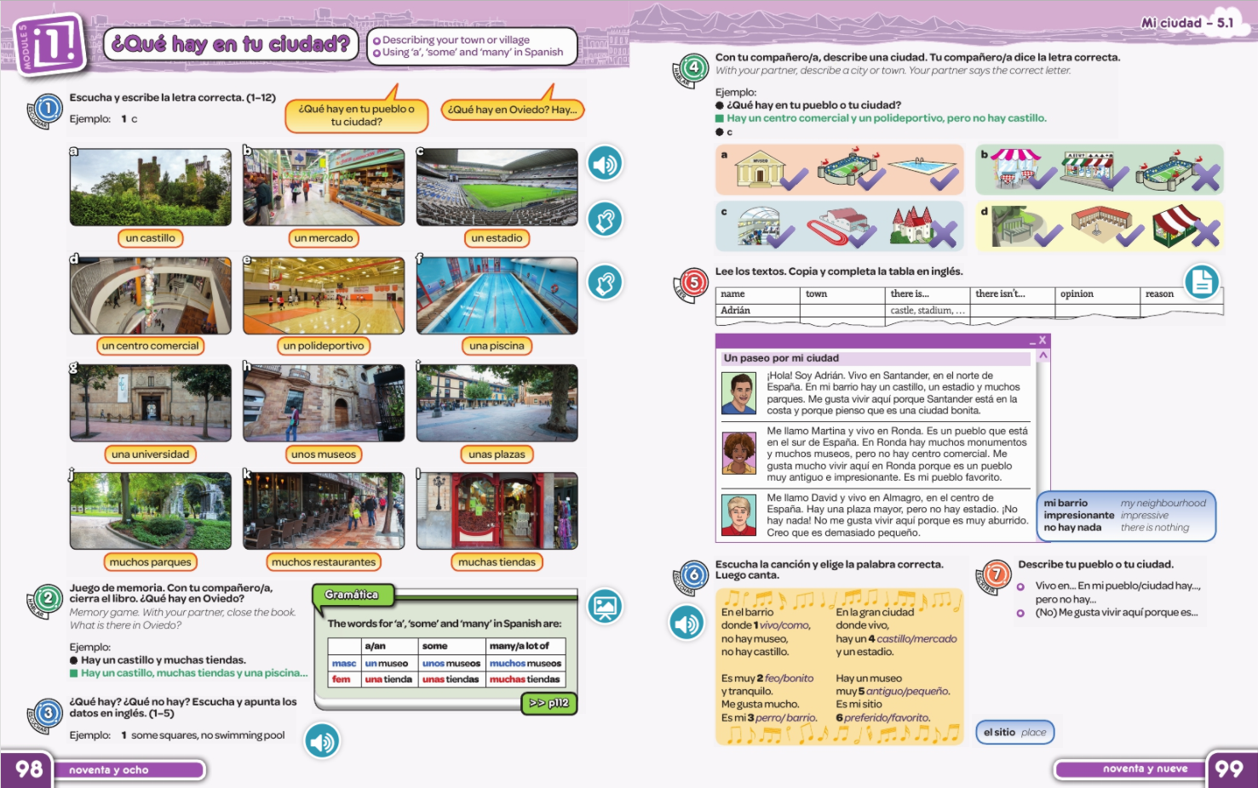
Year 7
Notes:
Core objective of this lesson:
learn some nouns for places you could see in a town
2. learn to use the indefinite articles ‘a’, ‘some’ and ‘many’
Which of these is more important?

Slide 36

¿Qué hay en tu ciudad?
Hoy vamos a…
- descubrir y describir qué hay en tu ciudad
- usar correctamente el artículo indefinido (a/some)

Slide 37



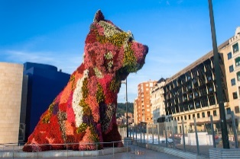


Bilbao
Bilbao está …
Tiene … que se llama …
Bilbao es … que tiene …
Bilbao está cerca de … y no es … es
Notes:
Explain the cities and group names!

Slide 38

¿Qué hay en Bilbao? Apunta en inglés.

Slide 39
¿Qué hay en el video?
singular (a)
plural (some)

Slide 40
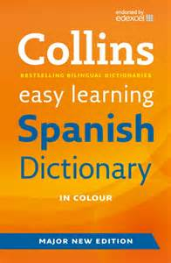
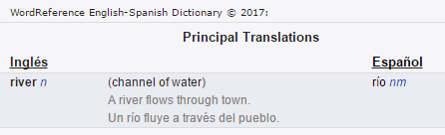
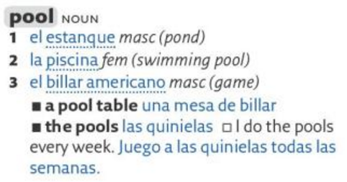

¡A los diccionarios!
jueves,19 de abril
 | singular (a) | plural (some)
masculino un / unos
femenino una / unas
¿Qué hay en Bilbao?
un río
masculino un / unos
femenino una / unas

Slide 41


Slide 42



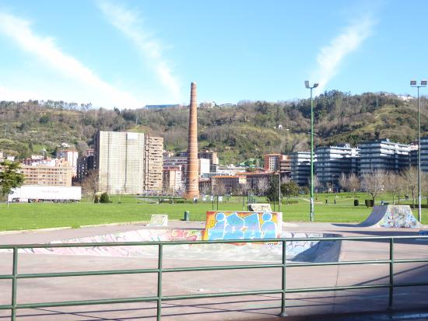
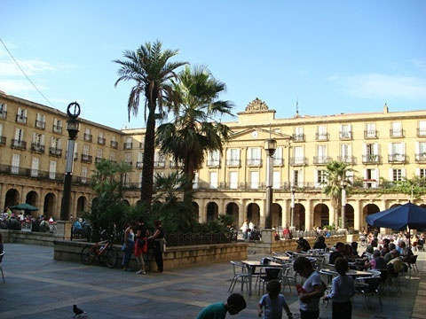
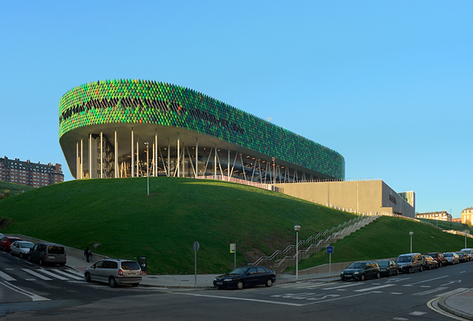



En Bilbao hay un museo famoso…
También hay un estadio de fútbol…
Bilbao Arena
En la parte antigua hay
una plaza. Aquí hay muchos restaurantes.
También hay muchos parques. El Parque Etxebarria tiene una pista de monopatín.
Hay un polideportivo que tiene unas piscinas y un gimnasio.
Hay un centro comercial que se llama Zubiarte y tiene muchas tiendas
En Bilbao hay un río que se llama Nervión.
También hay un puente moderno.

Slide 43



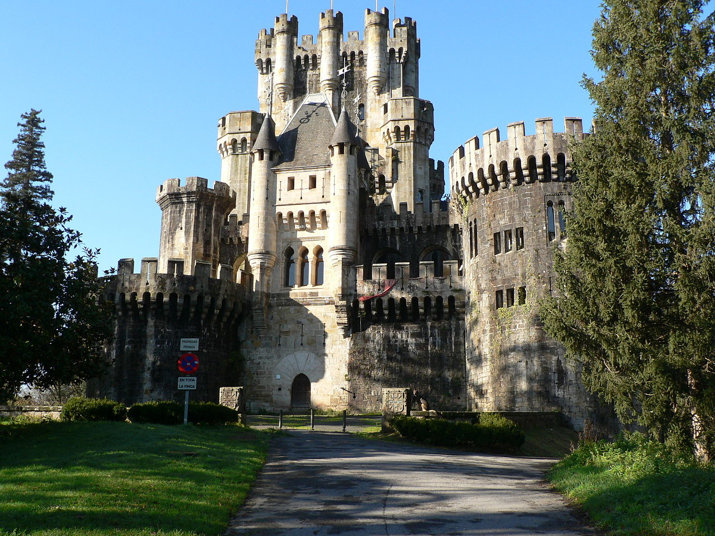

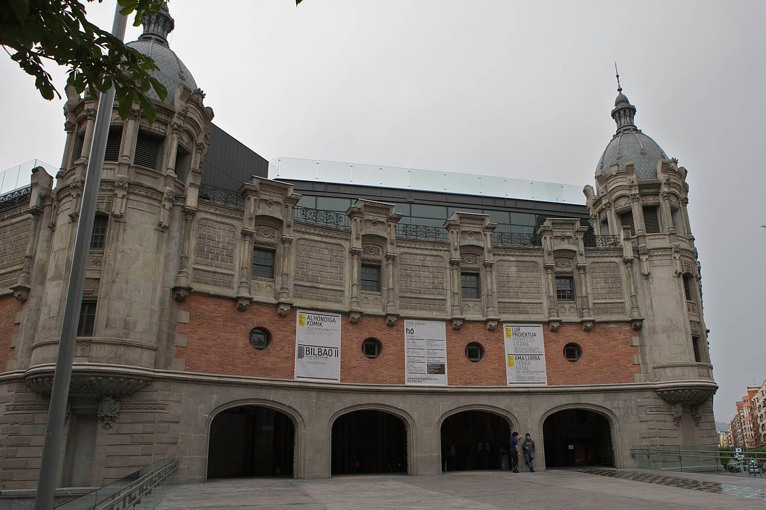
Hay una unversidad.
Hay un mercado muy grande y famoso que se llama Mercado de la Ribera.
Hay muchos edificios en Bilbao pero la Torre Iberdrola
es el edificio más alto de Bilbao.
Mide 165 metros de altura.
Tiene 41 plantas.
Hay un castillo, el Castillo de Butrón, que está a 15 minutos de Bilbao).
Azkuna Zentroa
Es un centro cultural con una biblioteca, muchas tiendas, un restaurante, un cine, un gimnasio y unas aulas.)

Slide 44
¿Qué hay en Bilbao? Hay…
un / una (singular)
unos/unas / muchos/muchas (plural)
a stadium
a museum
a swimming pool
a market
a shopping centre
a sports centre
a castle
a square
a university
lots of parks
lots of restaurants
lots of shops
some parks
some museums
some buildings
some shops
some rooms

Slide 45
Planning for progress
Use (in speech / writing) in free communication
Produce (in speech / writing) from memory
Produce (in speech / writing) with support
Pronounce (independently)
Understand (in sound / writing)
Recognise (in sound / writing)
The main curriculum content in language learning is grammar and vocabulary.
Apply these stages in your planning whether the learning focus is grammar or vocabulary, or both.

Slide 46
siempre
Usar para comunicarse
Producir de memoria
Producir con ayuda
Pronunciar
Comprender
Reconocer
todos los días
…………………………………………………………
normalmente
a menudo
a veces
nunca

Slide 47
siempre
Usar para comunicarse
Producir de memoria
Producir con ayuda
Pronunciar
Comprender
Reconocer
todos los días
…………………………………………………………
normalmente
a menudo
a veces
nunca

Slide 48
s_ _ m _ _ _
Usar para comunicarse
Producir de memoria
Producir con ayuda
Pronunciar
Comprender
Reconocer
t_ d_s l_ _ d_ _ _
…………………………………………………………
n_ _ _ _ _ m_ _ _ _
a m_ _ _ _ _
a v_ _ _ _
n_ _ _ _

Slide 49
Usar para comunicarse
Producir de memoria
Producir con ayuda
Pronunciar
Comprender
Reconocer
…………………………………………………………

Slide 50

Usar para comunicarse
Producir de memoria
Producir con ayuda
Pronunciar
Comprender
Reconocer
Notes:
Some students will automatically understand that this is what happens. They won’t even really think about it. They have a sense that learning is a good thing and they are happy to have more of it.
Those people are like those in this room!
Other students are helped by having the point of what they are doing made explicit (not every lesson!) but at the beginning when you are building the learning relationship with the class, and every now and then, when you feel you need to add to that relationship, steer it back on course, do mini interventions etc..
So I do show the ladder still, every now and then, and share examples like this, back with the class.
This is all very well, but if we teach 10+ classes of 30 students?
This is just a tiny specific example of progress from one student with one set of vocabulary.
What do we focus on that tell us if students are making progress?
We cannot focus on everything.
Teachers I work with, in this time of upheaval and uncertainty, are keen to have a few, key essential indicators so that they don’t lose sight of the picture.

Slide 51
Personal repertoire
Y7 SHOWCASE Some of the best sentences taken from Y7 writing.
Instruction to students: Take one or two of these, personalise them and add them to your work to improve it.
1. No tengo mascotas pero quiero un perro.
2. No tengo mascotas pero mi hermana tiene muchos peces.
3. El cumpleaños de mi hermana es el veinticinco de junio.
4. En mi tiempo libre me gusta ver la tele porque es divertido.
5. Mi pasión es la música; toco el piano y mi héroe es X.
6. De vez en cuando canto pero prefiero la natación.
7. No me gusta cantar porque es aburrido; nunca canto porque no es divertido.
8. Mis mejores amigos son X, Y y Z pero también tengo otros amigos.
9. Tengo muchos amigos pero sobre todo paso tiempo con X, Y y Z.
10. ¿Qué te gusta hacer en tu tiempo libre?
What is the ASL
(average sentence length) for all of these sentences?

Slide 52


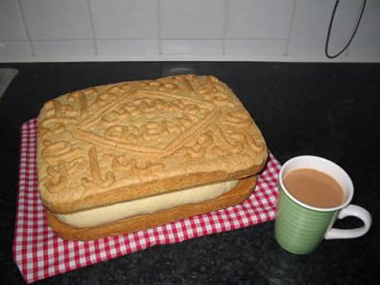
Y7 Práctica de tiro 3: Autumn Writing Assessment
NB: Write any tasks out in full in the back of your exercise books.
1 It’s time you nailed these words 100%! Write them out carefully in Spanish three times each.
1. England 6. but
2. passion 7. because
3. boring 8. English (if you are a girl)
4. birthday 9. football
5. shy 10. a bit of Spanish
Now write out any other spelling mistakes from your own writing, three times.
6 / 7 / 10 Look at p.24. Translate this sentence into Spanish.
I love going out with my friends and I also like listening to music because it’s fun but I don’t like writing emails and I hate watching tv because it isn’t interesting.
(30 words – Spanish version)
Now go back to your own writing and add a sentence of similar length to it (20-30 words)
9 / 11 / 12 / 13 Translate these sentences into English. Then write a similar sentence and put a * in your work to show where it would fit.
1. En mi tiempo libre, juego a los videojuegos, normalmente por la tarde.
2. Los lunes siempre hago natación, pero mi hermano nunca hace natación.
3. Los fines de semana a menudo juego al squash con mi padre.
4. Los sábados a veces mis amigos y yo jugamos al fútbol.
5. Los jueves mis amigas y yo hacemos baile.
2 / 3 / 4
Translate these sentences carefully. Pay attention to the adjectives, the determiners (a / the) and the verb forms.
1. I am from England and I live in Cambridgeshire.
2. I have a brother who is called David.
3. My sister is very nice but sometimes a bit silly.
4. She is also English.
5. I speak English and a bit of Spanish, but she also speaks French.
Links
Opinions and reasons
Variety of structures
Extended sentences
Interesting vocabulary
Tenses
Love it!
8 p.42. Complete with a correct verb form. Then translate into English.
1. Mi amiga Anna ____________.
2. Mis padres ___________.
3. Yo __________.
4. Mis amigos y yo __________.
5. Mis amigo Dan ________.
6. Mis amigos Emily y Tom _________.
escuchar música / cantar / bailan / tocar el piano / estudiar /montar en bici
10 Now go back to your own work again. Join up more of your short sentences, using y, y también, or pero.
TARGETS 5,6,7,8,9 and 10 focus on making your sentences longer, more interesting and flow better.
Y7 SHOWCASE Some of the best sentences taken from Y7 writing. Take one or two of these, personalise them and add them to your work to improve it.
1. No tengo mascotas pero quiero un perro.
2. No tengo mascotas pero mi hermana tiene muchos peces.
3. El cumpleaños de mi hermana es el veinticinco de junio.
4. En mi tiempo libre me gusta ver la tele porque es divertido.
5. Mi pasión es la música; toco el piano y mi héroe es X.
6. De vez en cuando canto pero prefiero la natación.
7. No me gusta cantar porque es aburrido; nunca canto porque no es divertido.
8. Mis mejores amigos son X, Y y Z pero también tengo otros amigos.
9. Tengo muchos amigos pero sobre todo paso tiempo con X, Y y Z.
10. ¿Qué te gusta hacer en tu tiempo libre?
5 From p.16 add a suitable opinion phrase to start each sentence: (I think that / In my opinion etc…NOT I like etc..)
1. ____________ mi hermano es listo y divertido.
2. ____________ mi hermana es un poco tonta.
3. ____________ escuchar música es relajante.
4. ____________ navegar por Internet es divertido.
5. ____________ ver la televisión es un poco aburrido.
What is the ASL
(average sentence length) for all of these sentences?
En mi opinión

Slide 53
Teach skills explicitly. How to…
predict when listening
make notes when listening
infer when reading
establish time frames when listening / reading
plan to write
buy yourself time when speaking
adapt an infinitive verb /verb phrase
memorise and retain vocabulary
spot patterns
check your own written work

Slide 54

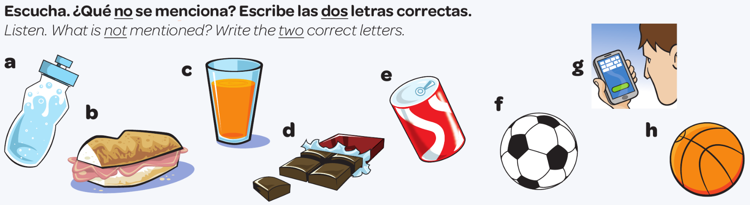

La predicción
un refresco
bocadillo
un zumo
agua
juego al fútbol
chocolate
leo mis SMS
una chocolatina
juego al baloncesto
Notes:
Slide to model and practise prediction as a listening skill
Students do this in pairs or fours.
Escucha. ¿Qué no se menciona? Escribe las dos letras correctas.
¿Qué haces durante el recreo, Juana?
Durante el recreo... a ver… primero como algo, un bocadillo o a veces una chocolatina.
Un momentito… primero comes un bocadillo, o a veces una chocolatina… muy bien. ¿Qué más?
Normalmente bebo agua.
…bebes agua… ¿Y luego? ¿Qué haces?
Luego juego al fútbol o al baloncesto en el patio con mis amigos.
Juegas al fútbol o al baloncesto… muy bien. ¿Algo más?
A veces leo mis SMS.

Slide 55

What it looks like in the classroom
thinking
making links
asking questions / enquiry / interest
supported risk-taking (in TL interaction and discussion about language)
hard work / challenge
strong relationships (humour)
shared class culture / history

Slide 56
What it looks like in books
care
individual / peer marking responsibility
teacher feedback
student follow up
recycling of ☺s and addressing of Ts
written work showing longer, more detailed and complex sentences with an increasing repertoire of vocabulary and structures (explicit ASL)
Notes:
What do we mark?
What do students mark?
What is the point of marking?

Slide 57
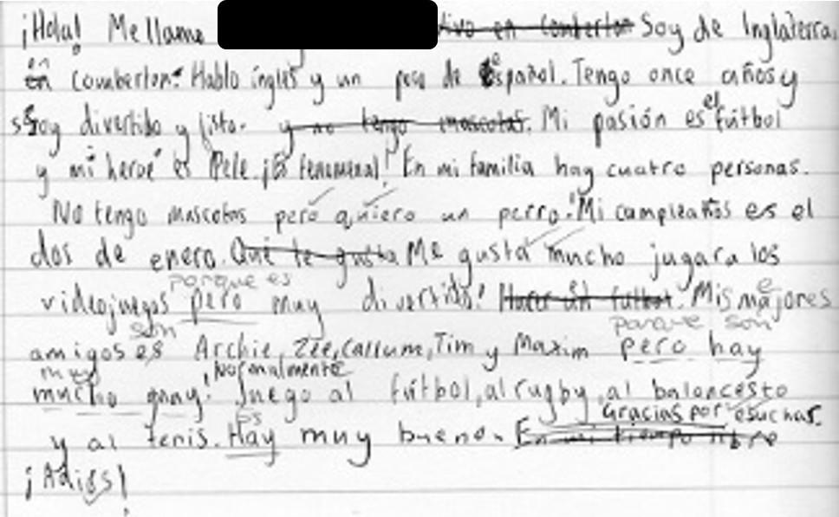
November 2016
Red = problem areas
¡Hola! Me llamo ……. Soy de Inglaterra en Comberton. Hablo inglés y un poco de español. Tengo once años y soy divertido y listo. Mis pasión es fútbol y mi heroé es Pele. ¡Es fenomenal! En mi familia hay cuatro personas. No tengo mascotas pero quiero un perro. Mi cumpleaños es el dos de enero. Me gusta mucho jugar a los videojuegos pero muy divertido. Mis majores amigos es Archie, Zee, Allum, Tim y Maxim pero hay mucho guay! Normalmente juego al fútbol, al rugby, al baloncesto y al tenis. Hay muy bueno. Gracias por escuchar. ¡Adiós!
95 words / 13 sentences = 7.3 words ASL (Average Sentence Length)
Notes:
We should see progress in books, too…

Slide 58

February 2017
Mi insti se llama Comberton VC. En mi insti hay unas clases, una biblioteca, un campo de fútbol grande y mucho más. No hay bonitos servicios, son malos!
Estudio español, inglés, historia y dibujo, por ejemplo. Me gusta la educación física, la música y el teatro porque es muy divertidos. No me gustan las matemáticas porque no son interesantes y el profesor es aburridísimo. Pienso que la profesora de teatro es muy raro y mi profesor favorito es Señor Gooch.
Durante el recreo como un bocadillo, una bolsa de patatas y fruta y bebo un agua o un zumo. A veces juego al fútbol en el recreo, pero en mi tiempo libre me gusta mucho jugar a los videojuegos. Me gusta mi insti porque es moderno, interesante y divertido.
Red = problem areas
Green = words that the learner was using incorrectly in November and here shows in correct use.
Purple = language re-used / recycled from the previous piece.
129 words / 10 sentences = 12.9 words ASL
Notes:
Progress can be very visible in writing – here it is clearly demonstrable as longer (more to say, greater vocabulary) and better (more compound and complex sentences, greater range of structures, wider variety of verbs).

Slide 59

Beyond the classroom strategies
Spanglovision
Spelling Bee
Translation Bee
Language Leaders
Linguamaths
Language Futures
Trips / Exchanges
Project days

Slide 60
How to build long-lasting engagement in language learning at KS3 and KS4
High attainment flows from high cognitive and affective engagement, which is generated by strong in-class and extra-curricular experiences, that are both enabling and challenging.
Not all aspects of learner motivation for language learning are within a teacher’s power to change. We cannot delay the rise of English as the global lingua franca, for example. However, most KS3/KS4 learners are, in my view, more influenced by their immediate individual and group classroom language learning experiences, than they are by wider sociocultural factors. That is good news for us as teachers!

Slide 61
The smallest changes can sometimes make the greatest of differences.
No puedo. → No, puedo.

Slide 62
This session will…
review (briefly!) the evidence for language learning motivation in England
identify key motivational drivers for students in language learning
look at how we make the weather and create the right climate in our classrooms
explore strategies for harnessing key motivational drivers
tease out how to build long-lasting engagement in language learning at KS3 and KS4

Slide 63
References
Board, K., & Tinsley, T. (2017). Language trends 2016/17
https://www.britishcouncil.org/sites/default/files/language_trends_survey_2017_0.pdf
Chambers, G. (2016). Pupils’ perceptions of Key Stage 2 to Key Stage 3 transition in modern foreign languages. The Language Learning Journal. Published Online 7 June 2016, https://doi.org/10.1080/09571736.2016.1172331.
Coleman, J.A. (2009) Why the British do not learn languages: myths and motivation in the United Kingdom, The Language Learning Journal, 37:1, 111-127, DOI:10.1080/09571730902749003
Courtney, L. M. (2014). Moving from primary to secondary education: An investigation into the effect of primary to secondary transition on motivation for language learning and foreign language proficiency. (Unpublished doctoral dissertation). University of Southampton, United Kingdom.
De Cecco, J., & Shaw, Margaret. (2008). Boys’ motivation towards the learning of modern foreign languages. Paper presented at the British Educational Research Association Annual Conference, Heriot-Watt University, Edinburgh, 3-6 September 2008. Accessed October 2017: http://www.leeds.ac.uk/educol/documents/174575.pdf
Deckner, S.E. (2017). Quantitative evidence of the occurrence of a motivational dip in language learning in year 7, The Language Learning Journal, DOI:10.1080/09571736.2017.1351482
Dörnyei, Z. (2005). The psychology of the language learner: Individual differences in second language acquisition. Mahwah, NJ: Lawrence Erlbaum.
Dörnyei, Z. (2009). The L2 Motivational Self System. In Z. Dörnyei & E. Ushioda (Eds.), Motivation, language identity and the L2 Self System (pp. 9–42). Bristol, UK: Multilingual Matters.
Dörnyei, Z. (2014). Motivation in second language learning. In M. Celce-Murcia, D. M. Brinton & M. A. Snow (Eds.), Teaching English as a second or foreign language (4th ed., pp. 518-531). Boston, MA: National Geographic Learning/Cengage Learning.
Evans, M., & Fisher, L. (2009). Language learning at Key Stage 3: The impact of the key stage 3 modern foreign languages framework and changes to the curriculum on provision and practice. Accessed at http://dera.ioe.ac.uk/11170/1/DCSFRR091.pdf
Graham, S., & Santos, D. (2015). Language learning in the public eye: An analysis of newspapers and official documents in England. Innovation in Language Learning and Teaching, 9, 72–85.
Graham, S., Macfadyen, T., & Richards, B. (2012). Learners’ perceptions of being identified as very able: Insights from modern foreign languages and physical education. Journal of Curriculum Studies, 44, 323–348.
Graham, S., Courtney, L., Tonkyn, A., & Marinis, T. (2016). Motivational trajectories for early language learning across the primary–secondary school transition. British Educational Research Journal. https://doi.org/10.1002/berj.3230.
Lanvers, U. (2016). Teaching languages ‘for the love of learning’? A 360 degree view of student, teacher and school management perspectives on language learning in England. In A. Hahn (Ed.), Proceedings of the 2015 Anglistentag (pp. 319–329). Trier, Germany: Wissenschaftlicher Verlag.
Lanvers, U. (2017). Language learning motivation, Global English and study modes: A comparative study. The Language Learning Journal, 45, 220–244.

Slide 64
Lanvers, U., & Coleman, J. A. (2013). The UK language learning crisis in the public media: A critical analysis. The Language Learning Journal 1–23. Published Online 11 Oct. 2013, https://doi.org/10.1080/09571736.2013.830639.
Martin, C. (2012). Pupils’ perceptions of foreign language learning in the primary school: Findings from the key stage 2 language learning pathfinder evaluation. Education 3–13, 40, 343–362.
McKnight, K. et al. (2016). England: What makes an effective teacher? Executive summary. Pearson. Published online at: https://www.pearson.com/content/dam/one-dot-com/one-dot-com/global/Files/efficacy-and-research/schools/global-survey/reports/RINVN9283_UK_July_ExecSum.pdf
Modern Foreign Languages Pedagogy Review (2016). Teaching Schools Council. https://www.tscouncil.org.uk/wp-content/uploads/2016/12/MFL-Pedagogy-Review-Report-2.pdf
Taylor, F., & Marsden, E. J. (2014). Perceptions, attitudes, and choosing to study foreign languages in England: An experimental intervention. Modern Language Journal, 98, 902–920.
TSC (Teaching Schools Council). (2016). Modern Foreign Languages Pedagogy Review. Published online November 2016, https://www.tscouncil.org.uk/wp-content/uploads/2016/12/MFL-Pedagogy-Review-Report-2.pdf
Wingate, U. (2016). Lots of games and little challenge: A snapshot of modern foreign language teaching in English secondary schools. The Language Learning Journal. Published Online 7 June 2016, https://doi.org/10.1080/09571736.2016.1161061

Slide 65
Motivation matters!
With the introduction of the new, more challenging GCSE, it is clear to us as teachers that learner motivation is key. This session sets out strategies to create a motivational climate for learning and offers tasks that really motivate.
www.rachelhawkes.com

